Slide 1
HCMI 4225: Health and Social Insurance
BUSN 203: Mon/Wed 11:00 AM – 12:15PM
Shane Murphy – shane@uconn.edu
Office Hours: Mon/Wed 12:30 PM – 2:00PM

Slide 2
Health Landscape and Health Costs
Key points:
  Expenditure is growing
  The United States is different
  Measurement of mortality and morbidity
    Importance of direct discussion of mortality and morbidity for health professionals
  Causes of mortality and morbidity vary
    By age, sex, and disease
  Entry points into the healthcare system vary
    By age, sex, and disease
  Drivers of health care expenditure vary
    By age, sex, and disease

Slide 3
Discussion Question
Health expenditure and GDP in the United States are rising. Is Health Expenditure as a share of GDP also rising? Should it be?

Slide 4
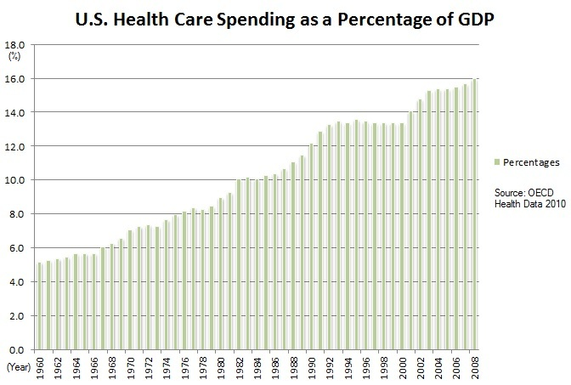
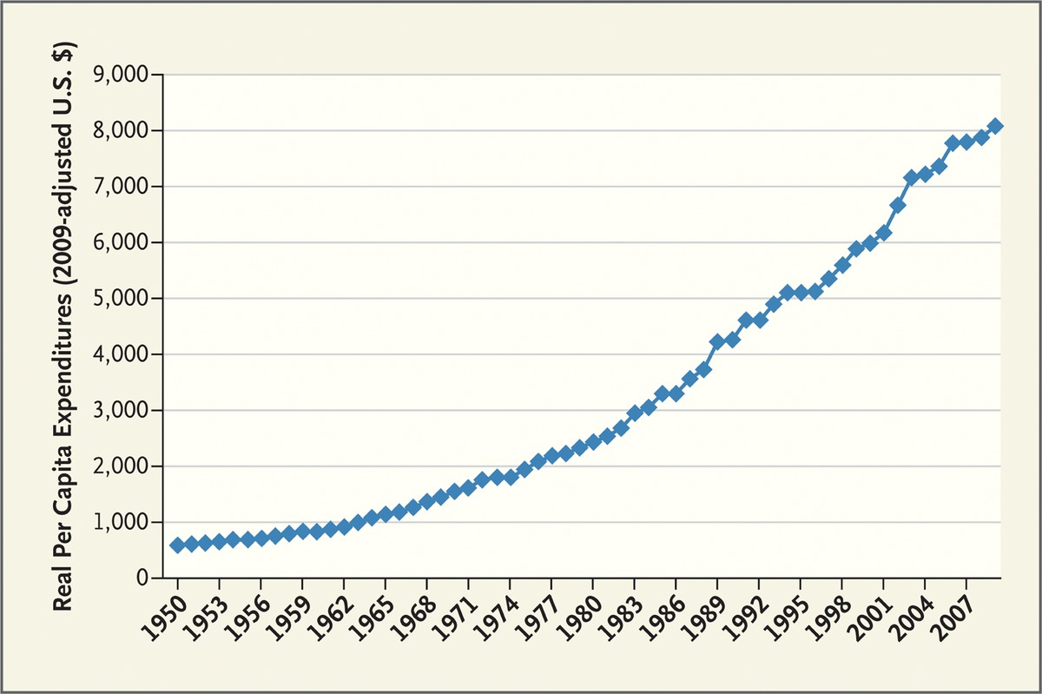
US Health Expenditure
Expenditure are increasing both in real terms and as a percentage of GDP
Fuchs 2012

Slide 5
Discussion Question
Is the United States and outlier?
How could we tell?

Slide 6
Comparing National Health Expenditures

Slide 7
Comparing National Health Expenditures

Slide 8
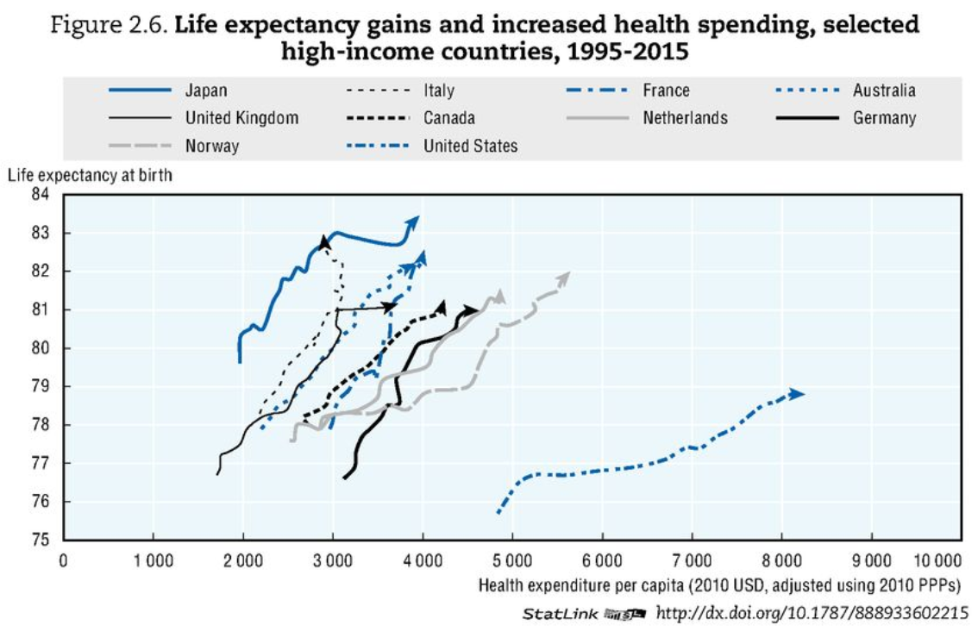
Comparing National Health Expenditures
OECD Health Data 2017

Slide 9
Unresolved Question
Is it bad that the United States is an outlier?
Is the United States wildly abnormal?
Is the income diversity (or other diversity) in the United States driving its outlier status?
Does Health Expenditure have a different meaning in the United States than elsewhere?

Slide 10
Measures of health
Mortality Rate: deaths per year per 100,000 people
YLL: years of life lost to a disease
DALY/QALY: sum of YLL and years of life lived with a disability

Slide 11
Disease Groups
Communicable Diseases
Neoplasms
Cardiovascular Diseases
Chronic Respiratory Diseases
Cirrhosis
Digestive Diseases
Neurological Diseases
Mental and Substance Abuse Diseases
DUBE
Musculoskeletal Disorders
Non-communicable Diseases
Injuries
Well Care
Risk Factors

Slide 12
Visualizing US Health and Health Expenditure
Health:
  https://vizhub.healthdata.org/gbd-compare/
Health Expenditure:
  https://vizhub.healthdata.org/dex/

Slide 13
Discussion Question
What causes the most disability?

Slide 14
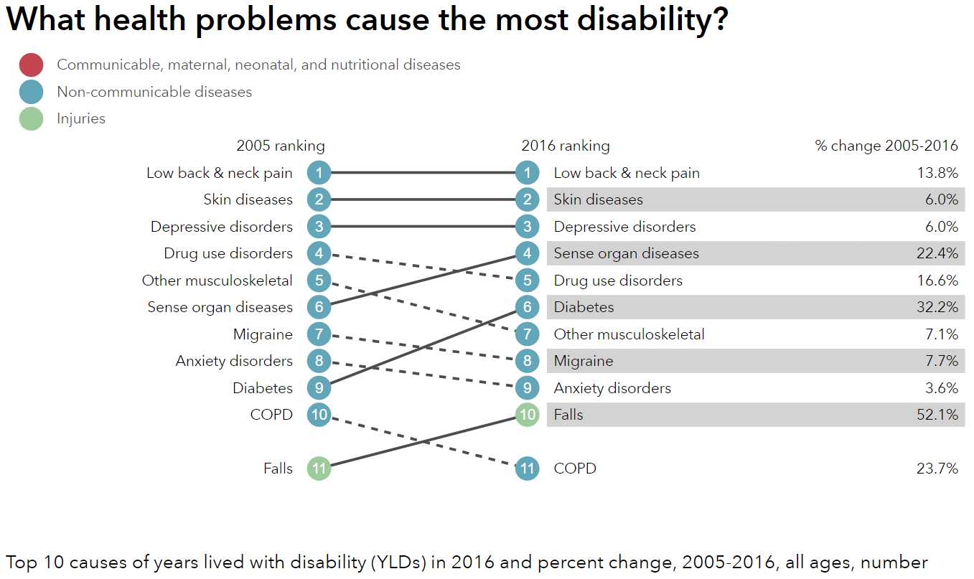
http://healthdata.org/us-health

Slide 15
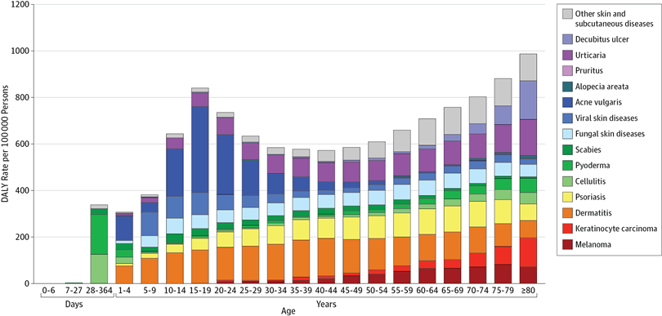
Unpacking DALY cost of skin diseases by age
Karimkhani et al 2017

Slide 16
Discussion Question
What causes the most deaths?

Slide 17
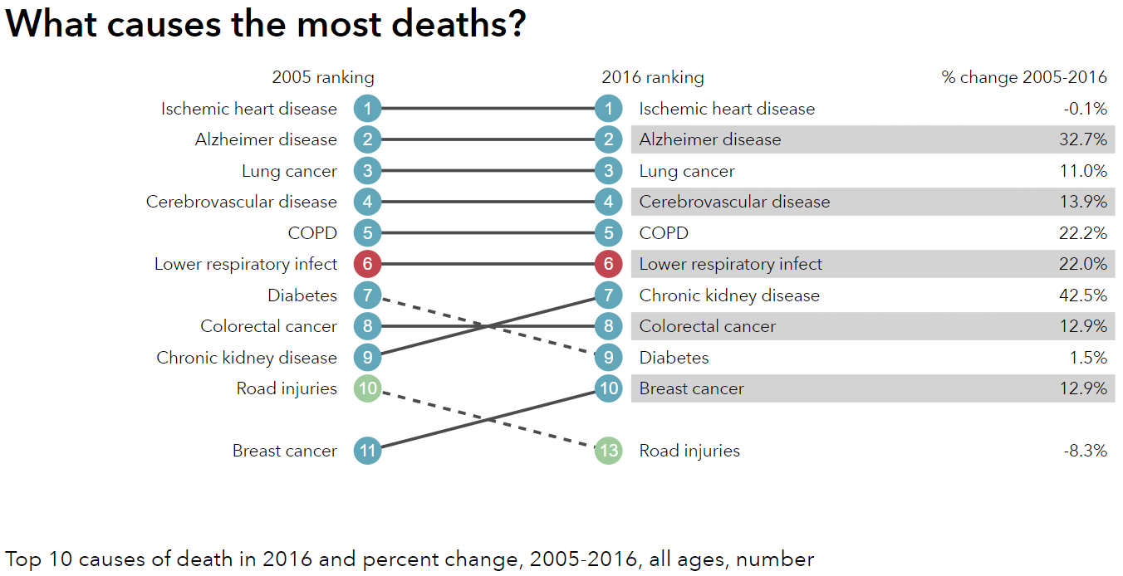
http://healthdata.org/us-health

Slide 18
Visualizing US Health and Health Expenditure
Health:
  https://vizhub.healthdata.org/gbd-compare/
Health Expenditure:
  https://vizhub.healthdata.org/dex/

Slide 19
Discussion Question
Is the problem Big Pharma? Is it too many hospital administrators? Is it predatory nursing facilities?

Slide 20
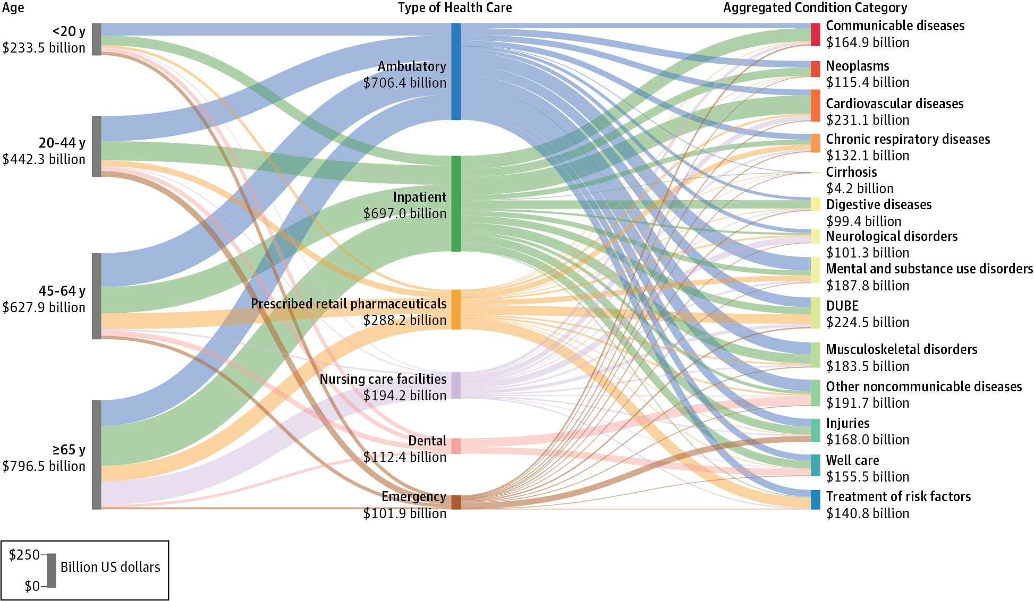
Health Care Cost by Type and Disease
Dielman et al 2016

Slide 21
Unresolved Question?
Is the problem Big Pharma? Is it too many hospital administrators? Is it predatory nursing facilities?

Slide 22
Discussion Question
In the broadest possible sense, who is driving health care costs?
How should insurance premiums be structured given the distribution of costs across age and sex?

Slide 23
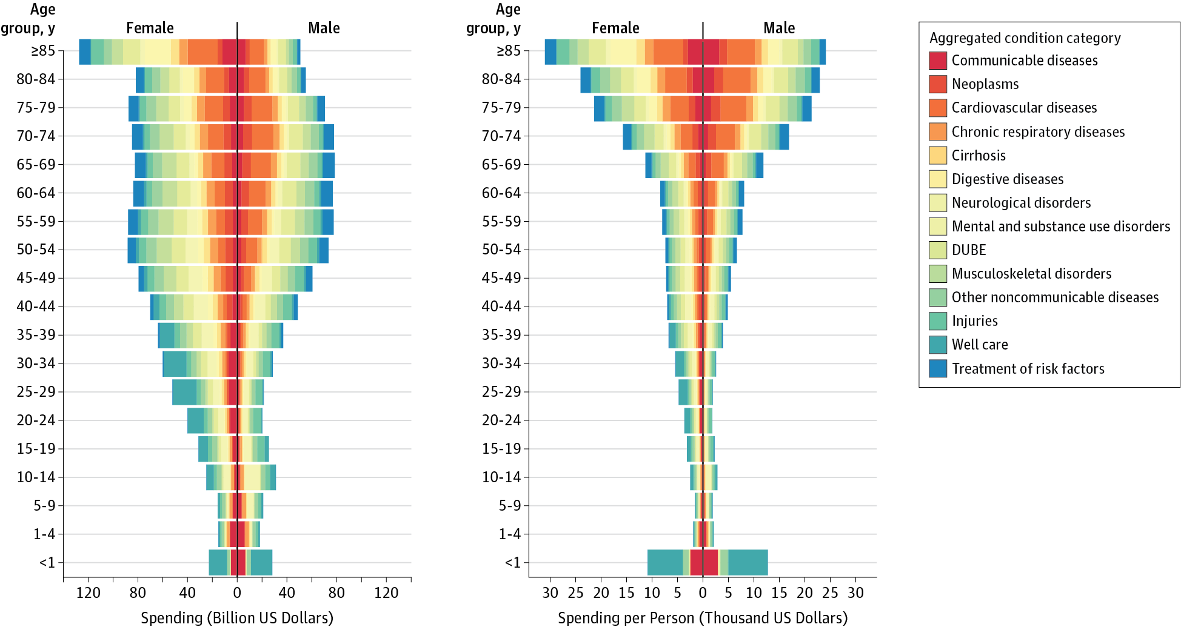
Health Care Costs by Age, Sex, and Disease
Dielman et al 2016

Slide 24
Unresolved Question
Does Medicare cause Health Care Costs to grow among people aged 65 and up or does increasing illness cause Health Care Costs to grow in this population?

Slide 25
Bonus Slide #1
How are expenditures for different diseases changing?

Slide 26
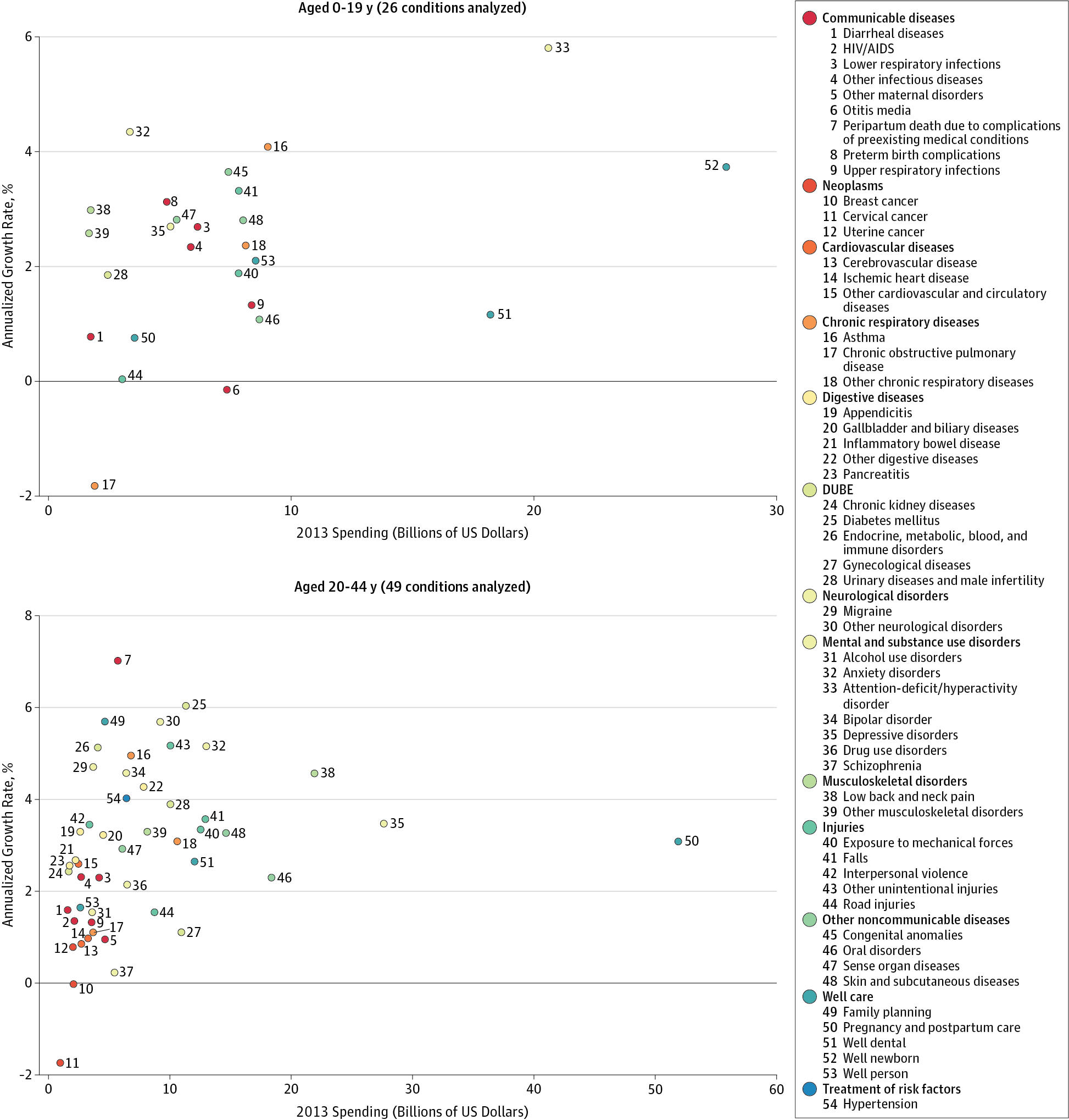
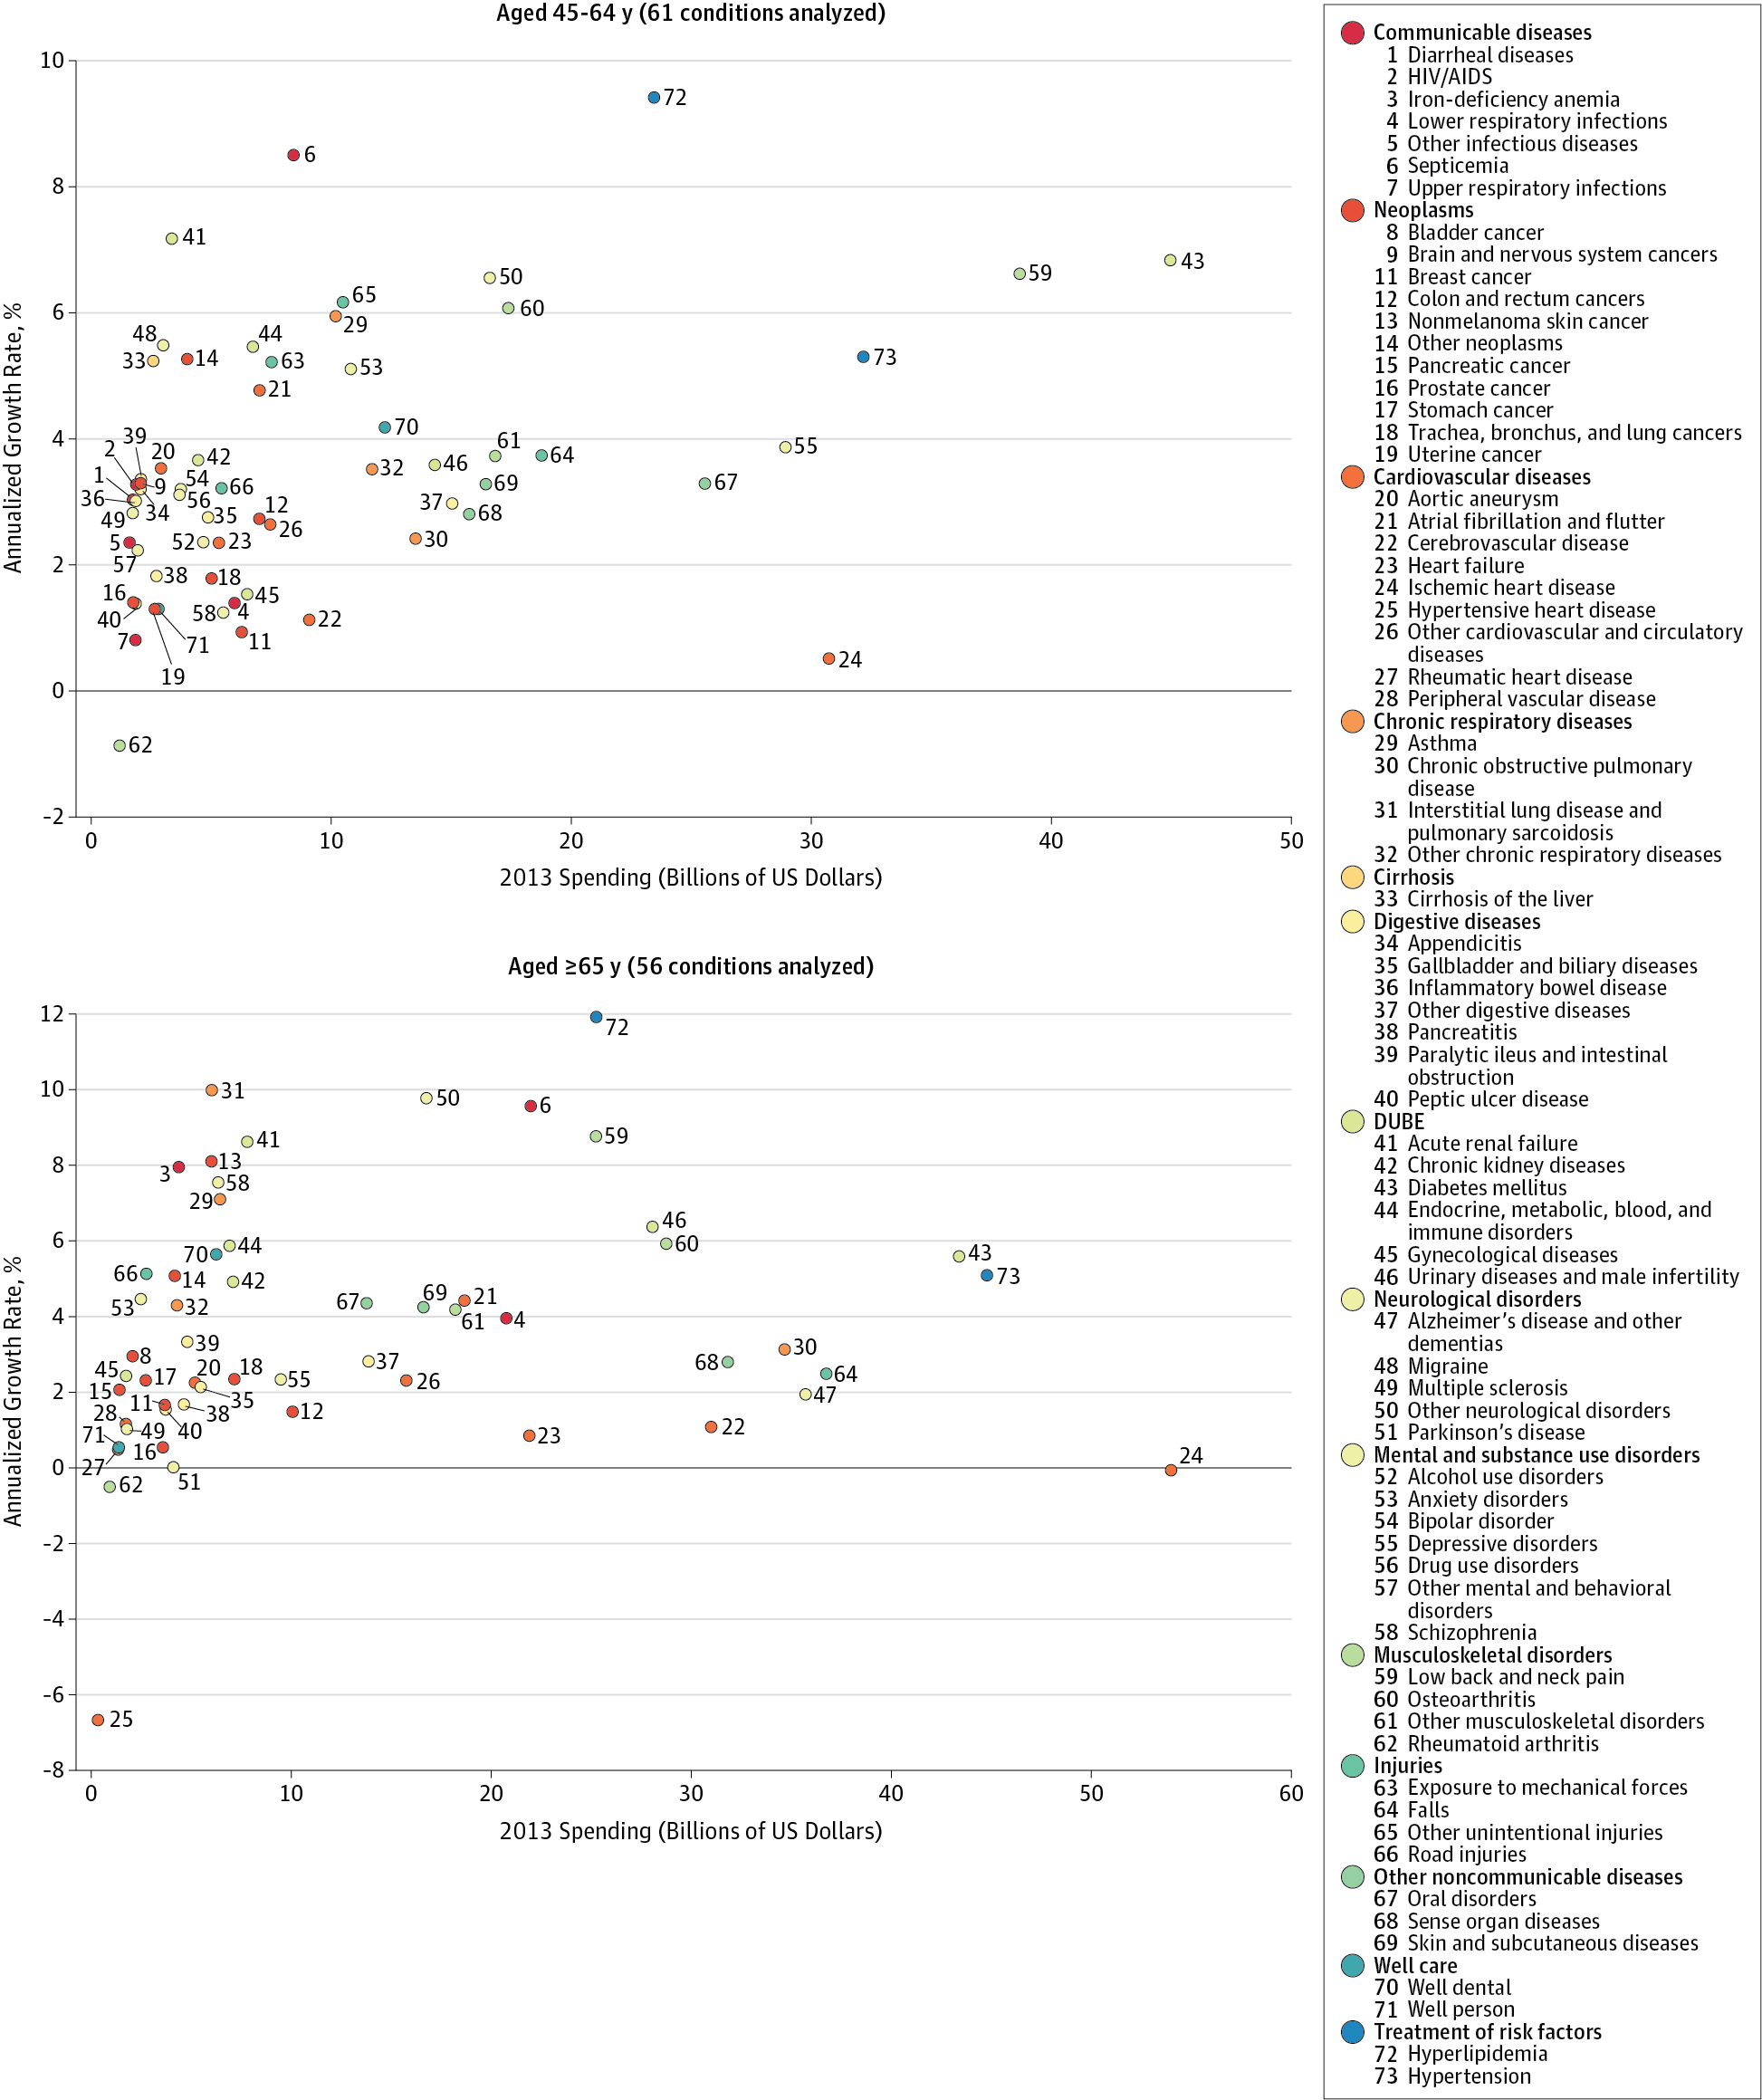
Dielman et al 2016

Slide 27
Bonus Slide #2:
How do we pay for this (more next week):

Slide 28
Fuchs 2012

Slide 29
Readings:
Fuchs, Victor R. "Major trends in the US health economy since 1950." New England Journal of Medicine 366, no. 11 (2012): 973-977.
Dieleman, Joseph L., et al. "US spending on personal health care and public health, 1996-2013." Jama 316.24 (2016): 2627-2646.
Bonus:
IHME Data Visualizations: https://vizhub.healthdata.org

Slide 30
Other Sources
Indicators, O. E. C. D. "Health at a Glance 2017." OECD Indicators, OECD Publishing, Paris. https://read.oecd-ilibrary.org/social-issues-migration-health/health-at-a-glance-2017_health_glance-2017-en#page1
Karimkhani, Chante, Robert P. Dellavalle, Luc E. Coffeng, Carsten Flohr, Roderick J. Hay, Sinéad M. Langan, Elaine O. Nsoesie et al. "Global skin disease morbidity and mortality: an update from the global burden of disease study 2013." JAMA dermatology 153, no. 5 (2017): 406-412.

