Slide 1
HCMI 4225: Financing Global Health
BUSN 203: Mon/Wed 11:00 AM – 12:15PM
Shane Murphy – shane@uconn.edu
Office Hours: Mon/Wed 12:30 PM – 2:00PM

Slide 2
Per capita health spending varies greatly
Annual spending in low income countries is less than $100
Remember, annual spending in the US is nearly $10000
Out of pocket (oop) spending dominates in Sub-Saharan Africa
Government spending plays a larger role in SE Asia, East Asia, and Oceana
Insurance and development assistance for health are more common in Sub-Saharan Africa

Slide 3
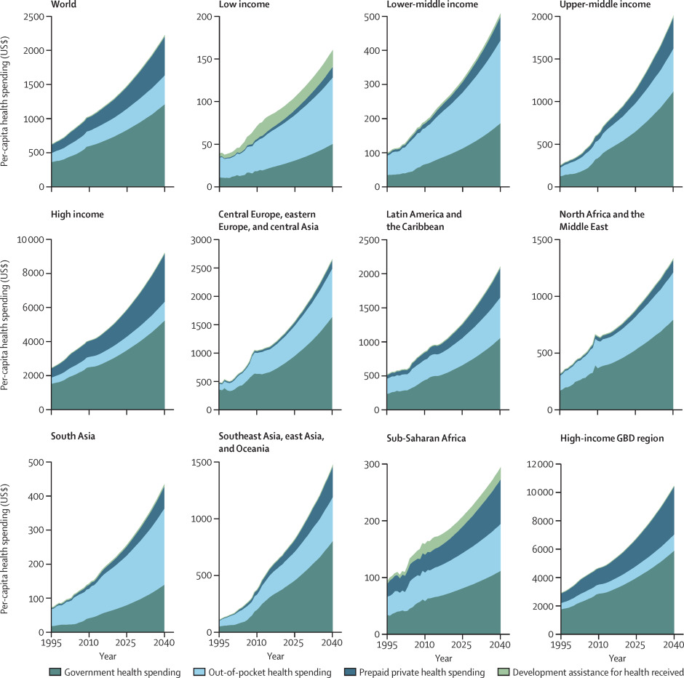
Notes:
Dieleman, Joseph L., Tara Templin, Nafis Sadat, Patrick Reidy, Abigail Chapin, Kyle Foreman, Annie Haakenstad, Tim Evans, Christopher JL Murray, and Christoph Kurowski. "National spending on health by source for 184 countries between 2013 and 2040." The Lancet 387, no. 10037 (2016): 2521-2535.

Slide 4
Source of health spending varies greatly
Notes:
http://www.healthdata.org/sites/default/files/files/policy_report/FGH/2017/IHME_FGH2016_Technical-Report.pdf

Slide 5
Government Health Expenditure per person is very low in developing countries
Notes:
Insurance spending in LICs is about half of government and oop is about double
Dieleman, Joseph L., Tara Templin, Nafis Sadat, Patrick Reidy, Abigail Chapin, Kyle Foreman, Annie Haakenstad, Tim Evans, Christopher JL Murray, and Christoph Kurowski. "National spending on health by source for 184 countries between 2013 and 2040." The Lancet 387, no. 10037 (2016): 2521-2535.

Slide 6
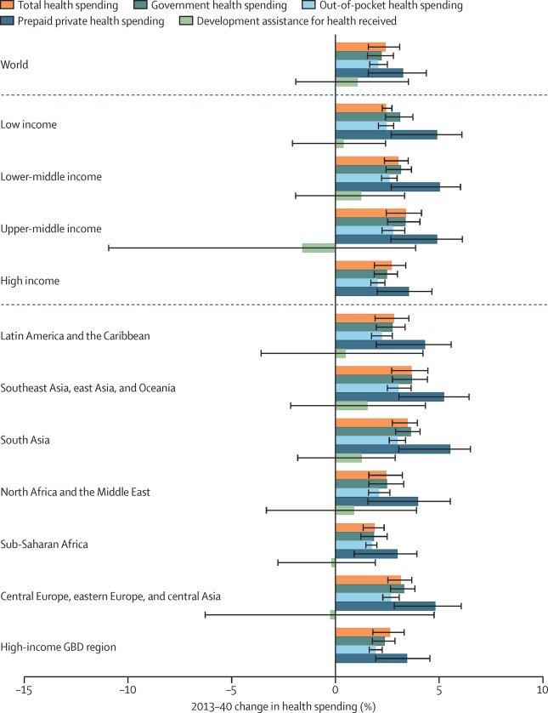
Insurance spending is growing faster than other sources
Especially in Asia and Central and Eastern Europe
Total health spending is growing relatively slowly in Africa and the middle east

Slide 7
Development assistance for health (DAH)
Financial and in-kind contributions
Funds aimed to improve health in developing countries
Water, sanitation, and other related areas are not always included in measures of DAH

Slide 8
Flows of Global Health Financing
http://vizhub.healthdata.org/fgh/
Notes:
In 2015, there was 38.4 billion dollars of DAH
Channels include US agencies, so the US is a source and a channel
A plurality of DAH is going to HIV/AIDS, although a significant proportion of that has implications outside of HIV/AIDS
Looking at flows, before 2000 DAH grew at a rate of about 5%. From 2000-2010, there was an increase of growth to about 10%. Since 2010, growth has slowed to 1%.
Over time, the proportion of DAH coming from bilateral agencies has decreased, while NGOs, including BMGF and the Global Fund has increased.
HIV/AIDS grew greatly as a focus between 2000 and 2010

Slide 9
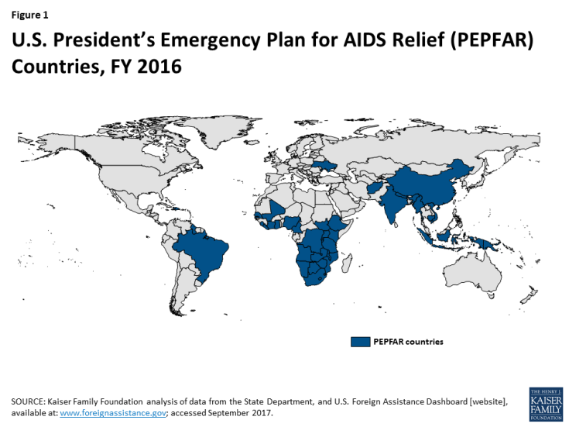
U.S. President's Emergency Plan for AIDS Relief (PEPFAR)
Notes:
https://www.kff.org/global-health-policy/fact-sheet/the-u-s-presidents-emergency-plan-for/

Slide 10
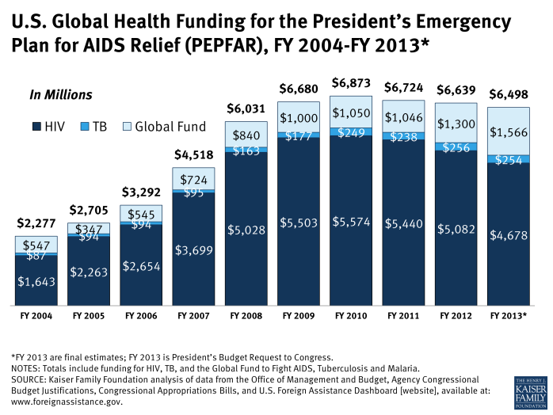
U.S. President's Emergency Plan for AIDS Relief (PEPFAR)
Notes:
https://www.kff.org/global-health-policy/fact-sheet/the-u-s-presidents-emergency-plan-for/

Slide 11
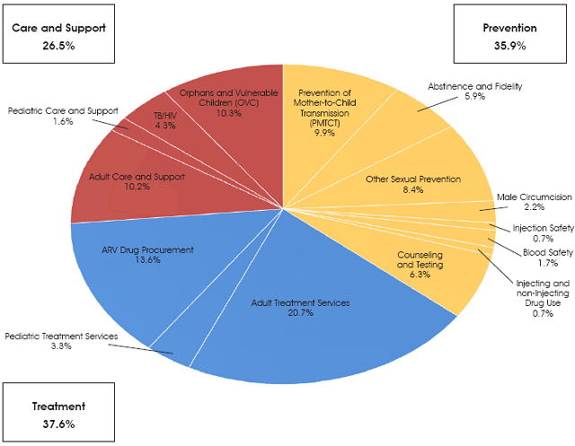
U.S. President's Emergency Plan for AIDS Relief (PEPFAR)
Notes:
https://www.pepfar.gov/press/seventhannualreport/166594.htm

Slide 12
Flows of Global Health Financing
http://vizhub.healthdata.org/fgh/
Notes:
In 2015, there was 38.4 billion dollars of DAH
In 2014 about 1.3 billion went to Ebola
In 2013, over 10 billion went to HIV/AIDS
In 2013, over 7 billion went to child health (much of this to vaccines)
In 2013, .6 billion went to NCDs
Channels include US agencies, so the US is a source and a channel
A plurality of DAH is going to HIV/AIDS, although a significant proportion of that has implications outside of HIV/AIDS
Looking at flows, before 2000 DAH grew at a rate of about 5%. From 2000-2010, there was an increase of growth to about 10%. Since 2010, growth has slowed to 1%.
Over time, the proportion of DAH coming from bilateral agencies has decreased, while NGOs, including BMGF and the Global Fund has increased.
HIV/AIDS grew greatly as a focus between 2000 and 2010
Map – Nigeria received the most

Slide 13
How well targeted is DAH?
Remember DALY is a measure of disease burden – it is the sum of the YLL and the years lived with a disability
So the ratio of DAH to DALY (DAH/DALY) is the amount of assistance per unit of burden
So now consider how the map looks focusing on this ratio

Slide 14
Flows of Global Health Financing
http://vizhub.healthdata.org/fgh/
Notes:
In 2015, there was 38.4 billion dollars of DAH
Channels include US agencies, so the US is a source and a channel
A plurality of DAH is going to HIV/AIDS, although a significant proportion of that has implications outside of HIV/AIDS
Looking at flows, before 2000 DAH grew at a rate of about 5%. From 2000-2010, there was an increase of growth to about 10%. Since 2010, growth has slowed to 1%.
Over time, the proportion of DAH coming from bilateral agencies has decreased, while NGOs, including BMGF and the Global Fund has increased.
HIV/AIDS grew greatly as a focus between 2000 and 2010
Map – Nigeria received the most
D

Slide 15
Development assistance for helth 2000-2010 and 2010-2015
Notes:
However HIV/AIDS was by far not the only area of growth during that period, and PEPFAR was by far not the only driver of growth

Slide 16
China: Public Health Insurance Goals
1.344 billion people
roughly equally split between rural (48%) and urban (52%)
Total health expenditure in 2010: ¥1998 billion (¥1490 per person)
New Rural Cooperative Medical Scheme (NRCMS) formed in 2003
Covers 95% of farmers (812 million) as of June, 2012.
Urban Resident Basic Health Insurance (URBHI) formed in 2007 and Urban Employee Basic Health Insurance (UEBHI)
UEBHI covers 30% of urban population and is jointly funded by employers and employees – URBHI attempts to cover rest of urban population.
Reimbursement rates for inpatient expenses is 75%
Medical Financial Assistance system (MFA) extends greater coverage for poorest citizens (68·76 million people)
Notes:
Marten, Robert, Diane McIntyre, Claudia Travassos, Sergey Shishkin, Wang Longde, Srinath Reddy, and Jeanette Vega. "An assessment of progress towards universal health coverage in Brazil, Russia, India, China, and South Africa (BRICS)." The Lancet 384, no. 9960 (2014): 2164-2171.

Slide 17
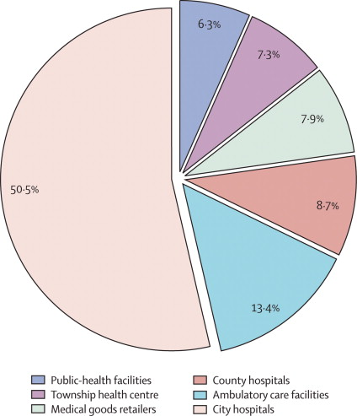
Distribution of Health Spending
Urban utilization dominates rural utilization
Notes:
Hu, Shanlian, Shenglan Tang, Yuanli Liu, Yuxin Zhao, Maria-Luisa Escobar, and David De Ferranti. "Reform of how health care is paid for in China: challenges and opportunities." The Lancet 372, no. 9652 (2008): 1846-1853.

Slide 18
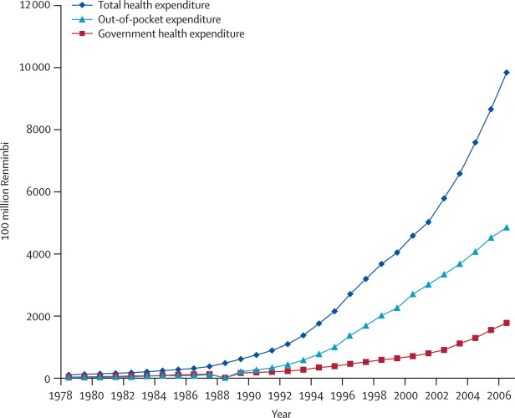
OOP spending dominated as of 2007
Notes:
Hu, Shanlian, Shenglan Tang, Yuanli Liu, Yuxin Zhao, Maria-Luisa Escobar, and David De Ferranti. "Reform of how health care is paid for in China: challenges and opportunities." The Lancet 372, no. 9652 (2008): 1846-1853.

Slide 19
But government spending has since overtaken OOP
https://vizhub.healthdata.org/fgh/
Notes:
Hu, Shanlian, Shenglan Tang, Yuanli Liu, Yuxin Zhao, Maria-Luisa Escobar, and David De Ferranti. "Reform of how health care is paid for in China: challenges and opportunities." The Lancet 372, no. 9652 (2008): 1846-1853.

Slide 20
Readings:
Chapter 3 of Institute for Health Metrics and Evaluation. Financing global health 2016 Funding Universal Health Coverage and the Unfinished HIV/AIDS Agenda, Institute for Health Metrics and Evaluation (2017): 69-84

