Slide 1
HCMI 4225: Social Insurance in the United States
BUSN 203: Mon/Wed 11:00 AM – 12:15PM
Shane Murphy – shane@uconn.edu
Office Hours: Mon/Wed 12:30 PM – 2:00PM

Slide 2
Something we missed last time: Workers’ Compensation
Workers’ Compensation
  Common law liabilities existed for employers and was used in the US in the early 1800s
  Employer liability laws increased between 1885 and 1920

Slide 3
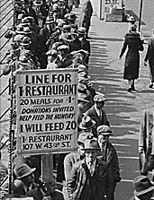
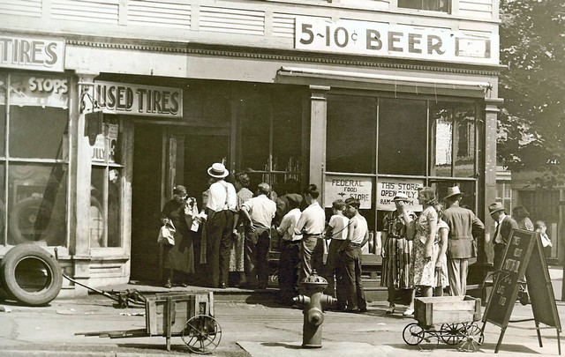
Great Depression (1929-1939)

Slide 4
1935 Social Security Act and the Welfare State in the US
Federal Old Age, Survivors, Disability and Hospital Insurance Program
  Originally entitled the Federal Old Age Benefits (I) program
  Program now also encompasses Medicare and is funded through FICA
Federal-state unemployment compensation program
  FUTA (1954)
9 other programs including aid to states for programs for the blind (X), needy dependent children (IV)
Avoided using the word “insurance” to provide some protection from conservative SC justices – but programs were called social insurance after SC ruling in support in 1939
American Medical Association opposed early efforts for state or national health insurance

Slide 5
Health Insurance programs in the Social Security Act
Four key programs
  Maternal and Child Health
  Crippled Children Services
  Vocational rehabilitation
  Public Health
Created as grants to states for state run programs
Initial plans included national health insurance, which AMA opposed and FDR thought was politically too risky, eventual AMA support of Act was reluctant

Slide 6
New Deal
First New Deal included banking reform and the Civil Works Administration
Second New Deal included labor union protections, establishmient of the Works Progress Administration, the creation of the US Housing Authority, the Fair Labor and Standards Act of 1938, and the Social Security Act
FDR (a New York Democrat) vs the conservative coalition of Republicans and Southern Democrats
  Harry F. Byrd Sr was a noted leader of the conservative coalition
  Opposed Federal control over standards for old age assistance and other programs

Slide 7
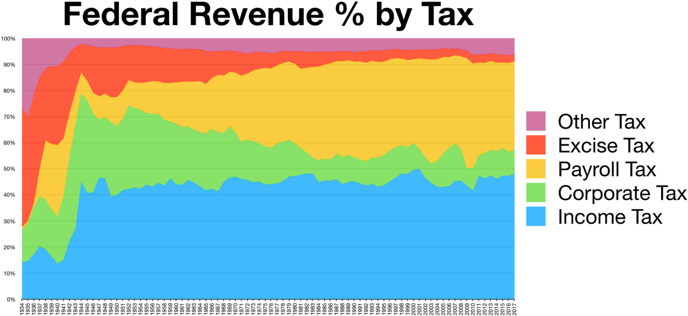
FICA - Federal Insurance Contributions Act &
FUTA - Federal Unemployment Tax Act
Payroll tax paid by both employers and employees
  Equal share between both, currently at 6.2% each for FICA and 1.45% each for Medicare
  6% for Employers for first $7,000 in wages for FUTA
  Tax is paid on a salary up to a maximum value – currently $128,400

Slide 8
Unemployment Insurance
Administered today by the Employment and Training Administration, Unemployment Insurance Service, US Department of Labor
Financed by Payroll tax (FUTA) into Unemployment Trust Fun, which is split into separate accounts for each state, territory, and DC
Federal FUTA payments can be offset by State SUTA/SUI payments

Slide 9
Social Security Administration today administers numerous programs
Federal Old-Age (Retirement), Survivors, and Disability Insurance (OASDI)
  This is what is usually meant by “Social Security check”
Temporary Assistance for Needy Families (TANF)
Health Insurance for Aged and Disabled (Medicare)
Grants to States for Medical Assistance Programs for low income citizens (Medicaid)
State Children's Health Insurance Program for low income citizens (SCHIP)
Supplemental Security Income (SSI)
  These are payments to the elderly or disabled indigent beyond OASDI

Slide 10
TANF and SSI
SSI signed in 1972, enacted in 1974
  Signed by Nixon
  Social Security reforms of the 1970s
  Federalized state run programs, creating uniform standards of disability
  Qualification for SSI generally implies qualification for a number of other programs:
    Medicaid, Food Stamps, Section 8 housing
TANF – commonly called welfare
  Replaced Aid to Families with Dependent Children in 1996
  Clinton welfare reform promise
  Offers only 24 months of support, pushing people back into employment

Slide 11
OASDI timeline
Created in 1935
Dependent survivors benefits introduced in 1939
  Few wives and widows over 65 and children under 18
  Extended to husbands and widowers over 65 in 1950
Early retirement for women at age 62 established in 1956
Benefits extended to disabled workers over 50 in 1956
Extended to all disabled workers in 1960
Early retirement extended to men in 1961
Increases tied to inflation (CPI) in 1972
  Before that date, increases required an act of congress
1970s stagflation led to a decrease in benefits in 1977 and 1983
Normal retirement age set to increase in 2022 based on legislation signed in 1983

Slide 12
OASDI qualifications and benefits
Qualification requires ten years of employment
Benefits are based on a percent of average annual income
  Between 50% and 24%
  “Equity vs Fairness”
Benefits are then reduced for early retirement
Spouses and dependent children receive half if they do not qualify for their own benefits
  In some situations, this can disincentivize spouses from working

Slide 13
OASDI’s primary insurance amount (PIA)
PIA formula: the sum of:
  90 percent of the first $895 of his/her average indexed monthly earnings
  32 percent of his/her average indexed monthly earnings over $895 and through $5,397
  15 percent of his/her average indexed monthly earnings over $5,397, up to $10,700
  Rounded to the next lower multiple of $.10 if it is not already a multiple of $.10.
For an individual who first becomes eligible for old-age insurance benefits or disability insurance benefits in 2018, or (relevant to the spouce) who dies in 2018 before becoming eligible for benefits

Slide 14
OASDI solvency
OASDI are funded through FICA, a payroll tax, paid into a trust fund
  FICA is currently greater than total payments
  But at current rates, there will be a deficit in the coming years and the Trust Fund may be drained in the 2040s or 2050s
Solutions?

Slide 15
OASDI solvency
OASDI are funded through FICA, a payroll tax, paid into a trust fund
  FICA is currently greater than total payments
  But at current rates, there will be a deficit in the coming years and the Trust Fund may be drained in the 2040s or 2050s
Solutions:
  Raise taxes and/or the max taxable income
  Raise the retirement age
    Logevity indexing
  Reduce benefits for all or for individuals with high incomes

Slide 16
Welfare or Insurance?
Social insurance is financed primarily by special contributions by employers and/or employees
  SSI and TANF are funded from the US Treasury General Funds (mostly income and capital gains taxes)
  OASDI are funded through FICA, a payroll tax, paid into a trust fund
  Unemployment is funded through ___
The right to benefit from social insurance is derived from past contributions
Most social insurance programs are compulsory
Benefits may be based on factors other than total contributions
  Need, number of dependents
Differs from private insurance in role of government
  Administered or supervised by government
  Does not solely cover government employees
  Determination of benefits by law

Slide 17
Means Testing
A means test is a determination of whether an individual or family is eligible for government assistance, based upon whether the individual or family possesses the means to do without that help.
  Used for Medicaid, TANF (welfare), Section 8, SNAP (food stamps), Pell Grants, and more
  Common proposal for OASDI reform

Slide 18
So What counts as Social Insurance
The American Risk and Insurance Association’s Committee on Social Insurance Terminology lists the following:
  OASDI
  Unemployment Insurance
  Workers’ Compensation
  Compulsory Temporary Disability Insurance
  Railroad Retirement System
  Railroad Unemployment and Temporary Disability Insurance
Does not include
  Civil Service Retirement System (only for government employees)
  National Service Life Insurance (not compulsory, only for government employees)
  Federal Crop Insurance (not compulsory)
  Public Assistance – TANF, SSI (cost not born directly by employers or employees)
  Veterans’ Benefits (cost not born directly by employers or employees, only for government employees)

Slide 19
Social Insurance is different from Private
Social Insurance | Private Insurance
Compulsory | Voluntary
Minimum floor of income protection | Benefits depend on individual desire and willingness to pay
Social Adequacy | Individual equity
Benefits prescribed by law that can be changed (statutory right) | Benefits established by legal contract (contractual right)
Government monopoly | Competition
Full funding unnecessary | Must be fully funded
No underwriting | Individual or group underwriting
Difference of opinion regarding objectives and results | Less differences
Investments generally in obligations of the government | Investiments mainly private
Taxing power can combat inflation | More vulnerable to inflation

Slide 20
But isn’t Social Security an Insurance Illusion?
Private insurance entails a legal right to benefits
  FICA is a compulsory almost universal tax, but not everyone who pays can get OASDI
    If you pay less than 10 years, you do not get a refund
    Inmates do not receive payments
  Laws about benefits can change
Old-age benefits are not based on a risk of loss
  Retirement is often voluntary and payments can begin for someone aged at lest 62
  Old-age does not necessarily entail risk of loss, and can be a marker of wealth

Slide 21
Ponzi Scheme
Full Funding
  Full funding can be defines as a program where the value of the accumulated assets under the plan is sufficient to discharge all liabilities for the benefit rights accrued to date under the plan.
    This definition is unclear when applied to OASDI
  Can also be defined using the closed group concept: The present value of assets must cover the present value of future benefits for present beneficiaries and present workers.
    Under this definition, the trust fund balance would need to be about 30 times greater than it currently is.
Instead, funding is based on transfers between current workers and current retirees
  Full funding not needed because contributions from new entrants is compulsory and the program is assumed to last indefinitely

Slide 22
Social Security Fiscal Transparency
Notes:
https://www.ssa.gov/policy/docs/chartbooks/fast_facts/2018/fast_facts18.pdf

Slide 23
Social Security’s Demographic Challenge
Notes:
https://www.ssa.gov/policy/docs/chartbooks/fast_facts/2018/fast_facts18.pdf

Slide 24
Social Security: Who benefits and how
Notes:
https://www.ssa.gov/policy/docs/chartbooks/fast_facts/2018/fast_facts18.pdf

Slide 25
Who is covered by OASDI?
Notes:
https://www.ssa.gov/policy/docs/chartbooks/fast_facts/2018/fast_facts18.pdf

Slide 26
Social Security
Primary source of income
  53% of beneficiary couples and 74% of unmarried beneficiaries received at least 50% of their income from Social Security in 2010
  Poverty rate among those 65 and older would be 35 percentage points higher without coverage
Income matters, Social Security payments:
  Increase the probability of early retirement
  Lower mortality
  Increase prescription drug use
  Increase nursing home use
  Improves health
Notes:
Tsai, Yuping. "Social security income and the utilization of home care: Evidence from the social security notch." Journal of health economics 43 (2015): 45-55.
Ayyagari, Padmaja. "Evaluating the impact of social security benefits on health outcomes among the elderly." (2015).

Slide 27
Major Reforms
Supplemental savings accounts
  Privatizes significant portion of OASDI
  Insurance replaced with savings
Guaranteed minimum income
  Either paid to all or paid after means test
  Removes regressive aspects of OASDI

Slide 28
8.2 Million SSI beneficiaries
16% receive state supplement as well and 2% only receive state supplement
Maximum monthly benefit in 2017 was $735/$1,103
Notes:
https://www.ssa.gov/policy/docs/chartbooks/fast_facts/2018/fast_facts18.pdf

Slide 29
Who is covered by SSI?
Notes:
https://www.ssa.gov/policy/docs/chartbooks/fast_facts/2018/fast_facts18.pdf

Slide 30
Readings:
Wilbur J.. Cohen, and Milton Friedman. Social Security: Universal or Selective?. American enterprise institute for public research, 1972.
  https://www.youtube.com/watch?time_continue=532&v=gr-_nRnMh2E
  https://www.aei.org/wp-content/uploads/2015/03/Social-Security-Universal-or-Selective-txt.pdf
  Also read the Wikipedia pages on Cohen and Friedman
DeWitt, Larry. “Research Note #25: Ponzi Schemes vs. Social Security.” Historians Office, Social Security Administration. https://web.archive.org/web/20120601193541/http://www.ssa.gov/history/ponzi.htm
Rejda, George E. Social insurance and economic security. Routledge, 2015.

