Slide 1
HCMI 4225: Health Insurance Financials
BUSN 203: Mon/Wed 11:00 AM – 12:15PM
Shane Murphy – shane@uconn.edu
Office Hours: Mon/Wed 12:30 PM – 2:00PM

Slide 2
How much do insurance companies make?
An average of 79.7 cents per premium dollar is spent by insurers on health care proper and 17.8 cents on the insurers’ operating costs, leaving only 2.7 cents per premium dollar as profits.
Medical loss ratio (MLR) – the portion of premiums collected health insurers “lose” to physicians, hospitals, and other entities who offer health care
Affordable Care Act (ACA) mandated an MLR of at least 85% for large insurance companies and of at least 80% for smaller carriers.
Pre-ACA MLRs were about 55%-65%
Profit margins for the larger US health insurers, for example, actually were much higher than just 3% in recent years, with 4.7% for Aetna, 7.0% for Cigna, and 4.6% for United Health Group in 2015 and 3.5% for Anthem in 2014.
These numbers include the Medicare Advantage program

Slide 3
Operating costs
18%
Include cost of marketing, determining eligibility, utilization controls (eg, prior authorization of particular procedures), claims processing, and negotiating fees with each and every physician, hospital, and other health care workers and facilities.
Twice as high as costs in other OECD countries with simpler systems
One study estimates this accounts for 39% of the difference in the cost of spending in Canada vs the US
31% is due to incomes, 14% due to spending intensity
For example, the Duke University's hospital system (with 3 hospitals) has 957 beds and about 1600 billing clerks.

Slide 4
Income Statement for WellPoint Inc.
Total Operating Revenue in 2008 - $X
X% from Premiums - $X
X% from fees for administering claims of employers who self-insure
X% Other revenue
Mostly on the “float” – money on hand from premium payments paid before outlays due
Can be significant when interest rates are high
Total health benefits in 2018 - $X
Health Benefits - $X
Cost of Drugs - $X
MLR: premium revenue divided by total Health Benefits – X%
S.G.&A. - Selling, General and Administrative Expenses – X% of total operating revenue
Marketing expenses - $X
Administrative expenses - $X
Net Income – $X
Profit Margin: Revenue vs expenses – X% in 2008, X% in 2007
Profit Margin: Revenue vs assets
Profit Margin: Revenue vs book value

Slide 5
Income Statement for WellPoint Inc.
Total Revenue in 2008 - $61,579.2 million
93.2% from Premiums - $57,101.0 million
6.3% from fees for administering claims of employers who self-insure
1% Other revenue
Mostly on the “float” – money on hand from premium payments paid before outlays due
Can be significant when interest rates are high
Total health benefits in 2018 - $48,210.9
Health Benefits - $47,742.4 million
Cost of Drugs - $468.5 million
MLR: premium revenue divided by total Health Benefits – 84.4%
S.G.&A. - Selling, General and Administrative Expenses – 14.7% of total revenue
Marketing expenses - $1,778.4 million
Administrative expenses - $7,242.1 million
Net Income – $2,490.7 million
Profit Margin: Revenue vs expenses – 4.07% in 2008, 5.47% in 2007
Profit Margin: Revenue vs assets – 5.14% in 2008, 6.42% in 2007
Profit Margin: Revenue vs book value – 11.62% in 2008, 14.55% in 2007

Slide 6
SG&A excesses as opportunity
Health Insurance Startups
Insurance Companies and Insurance Company Investors
Oscar, Zoom+, Clover Health, Melody Health Insurance, Beem Dental
Zenefits, Collective Health, Stride Health, GetInsured, SimplyInsured, Gravie, Picwell
Raised $1.2 billion in VC in 2015, $15 billion in VC in 2018

Slide 7
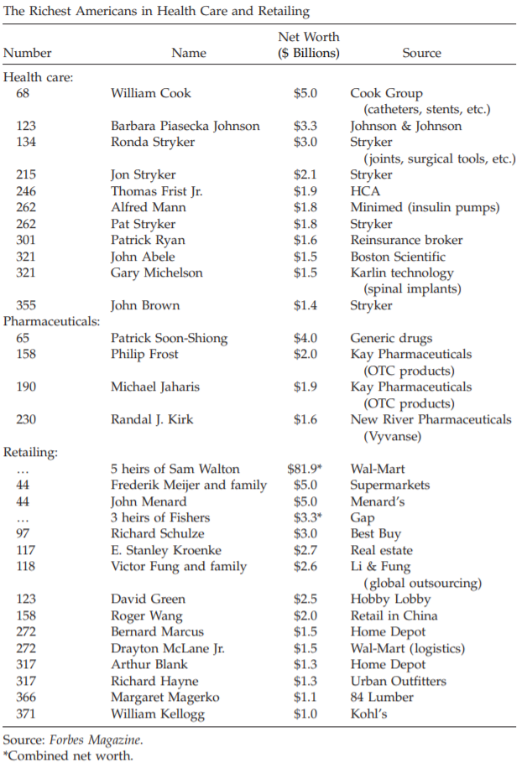
Pat Ryan
https://www.youtube.com/watch?v=1eg_MxV4dGQ

Slide 8
What’s left?
4 Classes Remain
Options:
Accountable Care Organizations
Pharmaceutical Prices and Reforms
CVS
Value Based Insurance Design
Employer-based insurance and the ACA
Health Insurance VCs
Health Insurance in LICs and MICs
Health Insurance in HICs
Single-payer systems
Mandate systems
Medicare for all?
Exam Review: December 3?, 5?
Final Exam: December 12

Slide 9
What’s left
4 Classes Remain
Options:
Accountable Care Organizations
Pharmaceutical Prices and Reforms + CVS - Aetna
Health Insurance in HICs
Single-payer systems
Mandate systems
Medicare for all?
Exam Review: December 3
Final Exam for those who wish to take it early: December 5?
Paper Due: December 8
Final Exam: December 12

Slide 10
Readings and sources:
Reinhardt, Uwe. "Where does the health insurance premium dollar go?." Jama 317, no. 22 (2017): 2269-2270.
Pozen, Alexis, and David M. Cutler. "Medical spending differences in the United States and Canada: the role of prices, procedures, and administrative expenses." INQUIRY: The Journal of Health Care Organization, Provision, and Financing 47, no. 2 (2010): 124-134.
Rosenthal, Elisabeth. "Those Indecipherable MedicalBills? They’re One Reason Health Care Costs So Much." New York Times Magazine(2017).
Cutler, David M. "Where are the health care entrepreneurs? The failure of organizational innovation in health care." Innovation Policy and the Economy 11, no. 1 (2011): 1-28.

