Slide 1
HCMI 4225: Accountable Care Organizations
BUSN 203: Mon/Wed 11:00 AM – 12:15PM
Shane Murphy – shane@uconn.edu
Office Hours: Mon/Wed 12:30 PM – 2:00PM

Slide 2
Accountable Care Organizations
Definition: A group of physicians (possibly including a hospital) that assumes responsibility for annual Medicare spending for a defined patient population. (defined by the Medicare Payment Advisory Commission – MedPAC)
MedPAC reimbursements to ACOs combines Fee-for-service and P4P.
The idea of ACOs existed prior to the ACA, but the ACA is now seen as creating ACOs through this reimbursement strategy
Idea originated with Pete Welch in 1989

Slide 3
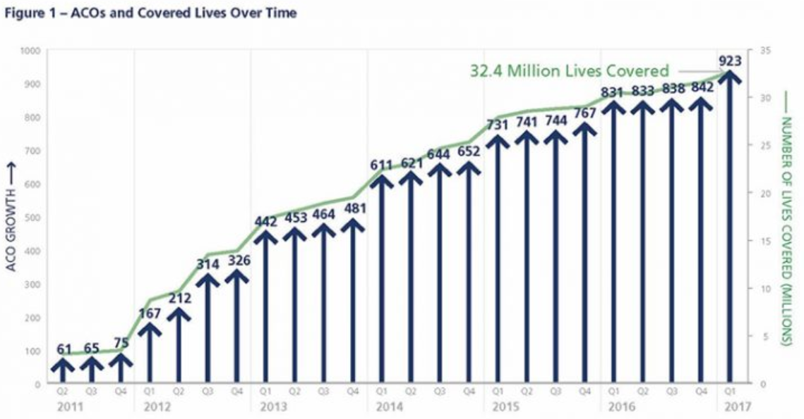
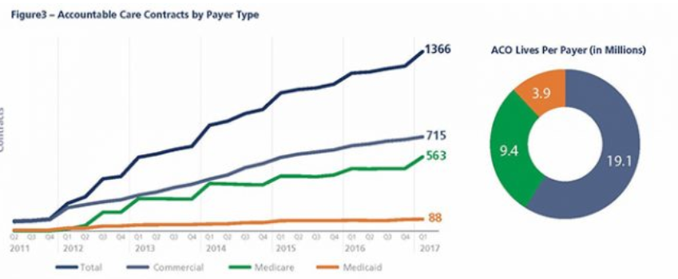
Growth in ACOs
As of 2017, 923 ACO contracts cover 32 million people (10% of the US population)
Commercial and Medicare contracts both significant

Slide 4
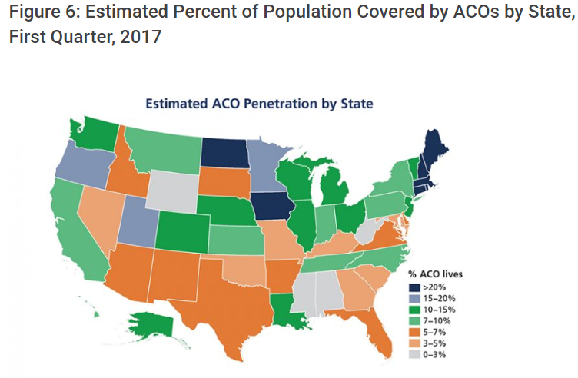
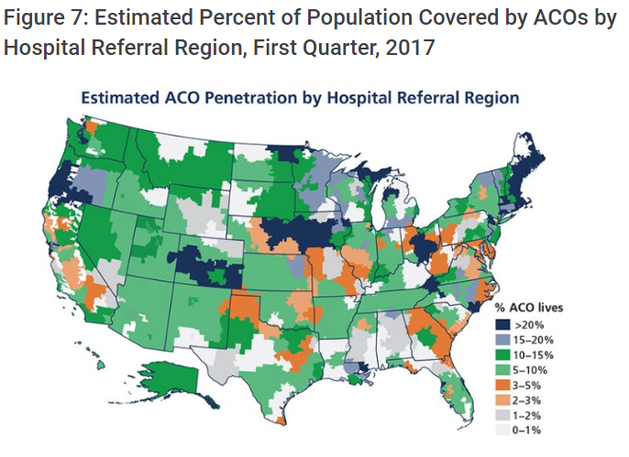
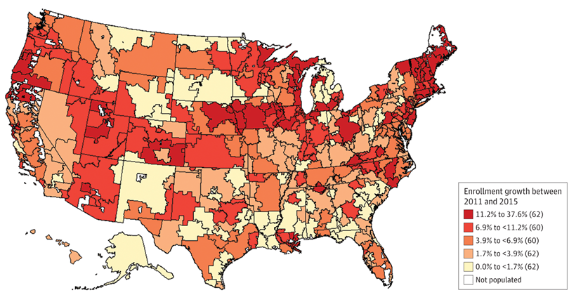
Growth in ACOs
Regional patterns:
ACOs strong in New England, Northern Prairie States, Western Great Lake States
Growing fast in the West
Lagging in the South

Slide 5
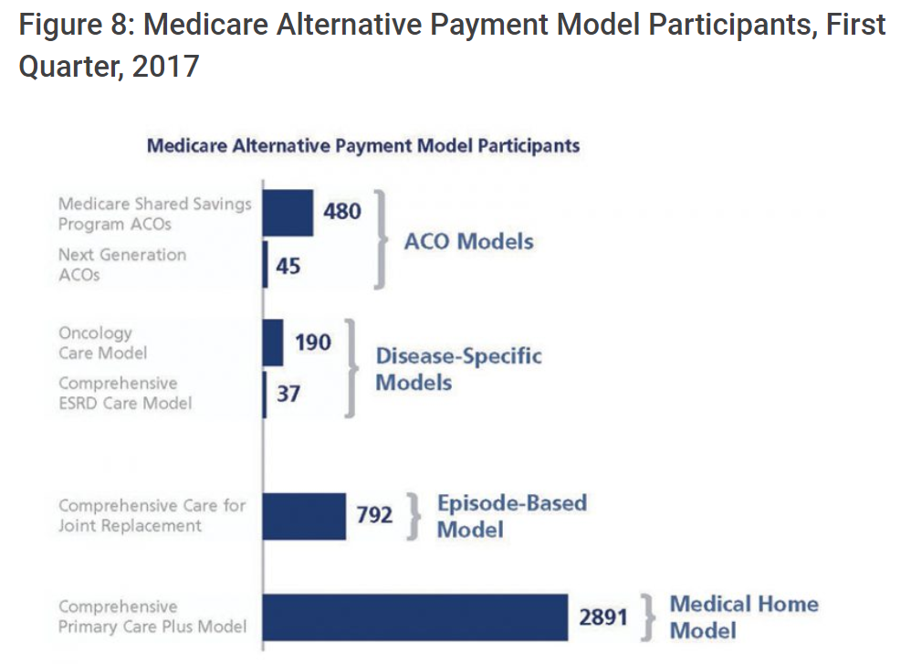
Extended Hospital Medical Staff
Most physicians are affiliated in some way with a local acute care hospital
Outpatient Care
Primary Care
Acute Care
Home Care
Inpatient Care
Pharmacy
Pros
Allow for definition of performance in P4P schemes
Allows for local organizational accountability
Centralizes and organizes efforts at quality improvement and cost containment
Cons
Alternative payment schemes reward high-tech and high volume services – leading to segregation in the market
Physicians prefer high degree of autonomy
Level of autonomy varies
Cost and revenue sharing legally and logistically difficult

Slide 6
Meta-analysis and systematic review
Estimate a weighted average from the results of the individual studies
Results can be generalized to a larger population
The precision and accuracy of estimates can be improved as more data is used.
May increase the statistical power to detect an effect
Inconsistency of results across studies can be quantified and analyzed
does inconsistency arise from sampling error, or are study results (partially) influenced by between-study heterogeneity
Hypothesis testing can be applied on summary estimates
Moderators can be included to explain variation between studies
The presence of publication bias can be investigated
Kaufman, Brystana G., B. Steven Spivack, Sally C. Stearns, Paula H. Song, and Emily C. O’Brien. "Impact of accountable care organizations on utilization, care, and outcomes: a systematic review." Medical Care Research and Review(2017): 1077558717745916.

Slide 7
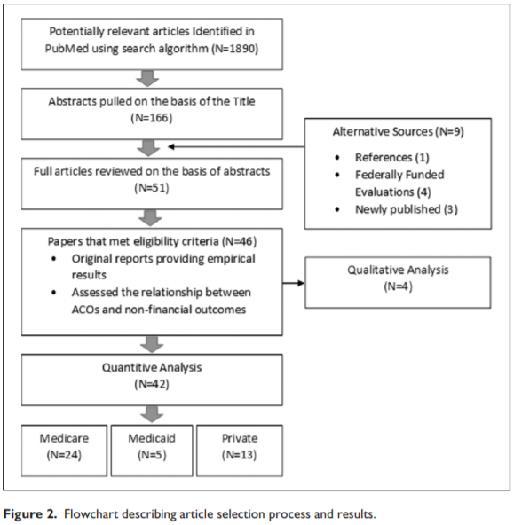
Meta-analysis and systematic review
Selection of studies
Selection/eligibility criteria
Search
N – sample size
Analysis
Qualitative
Quantitative

Slide 8
Quality research
Meta-analysis is only as good as the analysis it is based on (GIGO)
Quality research is based on three principles:
“The selection of the study groups”
Random vs observational
Large sample vs small
Sample representativeness and adaquacy
“The comparability of the groups”
Controls included in data or selection procedure
“The ascertainment of either the exposure or outcome of interest for case-control or cohort studies respectively”
Blind or not blind
Secure, detailed records
Non-response
Similarity of conditions for treatment and control
Length of follow-up

Slide 9
Sample of ACO Programs Evaluated
Read Table 2 as a group
MSSP
Shared Savings

Slide 10
Results
Utilization
Utilization decreased among ACO patients
Especially Inpatient and ED visits
Processes
Quality indicators generally saw improvement in some studies
Changes not large
Outcomes
Possible long-term improvements
Increased patient communication

Slide 11
What’s left?
3 Classes Remain
Issues:
CVS
Health Insurance in HICs
Single-payer systems
Mandate systems
Medicare for all
Exam Review: December 3
Final Exam: December 5 and/or 12

Slide 12
Readings and sources:
Kaufman, Brystana G., B. Steven Spivack, Sally C. Stearns, Paula H. Song, and Emily C. O’Brien. "Impact of accountable care organizations on utilization, care, and outcomes: a systematic review." Medical Care Research and Review(2017): 1077558717745916.
Muhlestein, David, Robert Saunders, and Mark McClellan. "Growth of ACOs and alternative payment models in 2017." Health Affairs Blog. https://www. healthaffairs. org/do/10.1377/hblog20170628 60719 (2017).

