Slide 1
HCMI 4225: CVS-Aetna
BUSN 203: Mon/Wed 11:00 AM – 12:15PM
Shane Murphy – shane@uconn.edu
Office Hours: Mon/Wed 12:30 PM – 2:00PM

Slide 2
Canada
Federal single payer system – health under provincial jurisdiction
Public administration, private provision
Providers required to be non-profit
Comprehensive coverage, Universal, Portable, Accessible

Slide 3
Canada: Issues
Financing crisis since the 1980s
Lead to cost controls – cost of care lower in 1997 than 1989
Some support for moving to a privatized single payer system

Slide 4
United Kingdom
National Health Services
Health care should be “free at the point of service,” a founding principle of the NHS.
Funded through income taxes
Focus on:
Primary care
Reducing inequalities
Incentivizing prevention
Uniform salary scale across subspecialists
Cost control, especially for drugs

Slide 5
UK: Managed Competition
Under Thatcher, the UK experimented with reducing regulations and cost controls, allowing providers to control funds, especially for elective services
Experiment failed, largely because providers did not build up the administrative structure to successfully bargaining between providers and provider groups called GP fundholers.
Ended in 1997

Slide 6
France
Fee-for-service private provision reimbursed by the NHI (liberalism)
Famously #1 in 2000 WHO ranking
Slightly over half funded by payroll taxes
Funding system is complex
Some care is paid out of pocket and then reimbursed
Some is fee-for-service
Some is based on estimated annual budgets

Slide 7
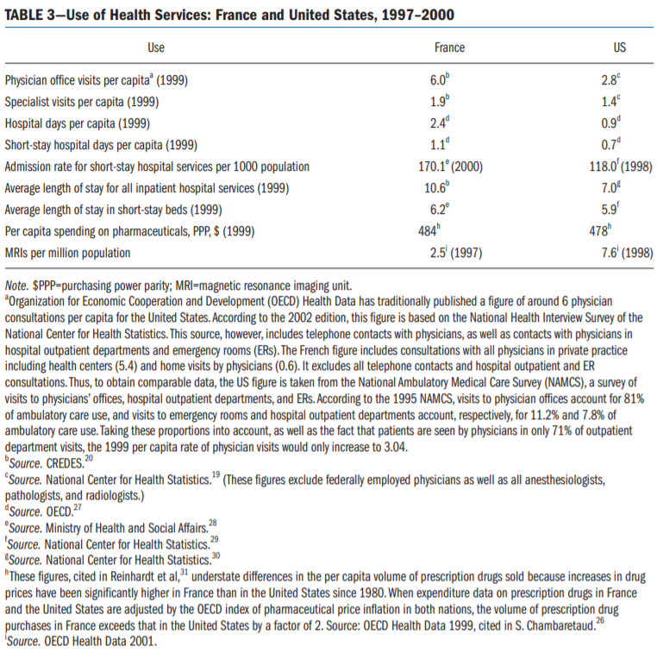

Slide 8
France: Issues
Significant inequalities of resources, outcomes, and quality
Relatively high spending

Slide 9
Germany
Statutory Health Insurance – 92% coverage, rest private or wealthy
Professional autonomy for providers with self-governing bodies
Financed with payroll taxes and regional or occupation based funds

Slide 10
Types of health care systems by provision and funding

Slide 11
Governance issues
Governance of Consumption
Extent of public access to care
Extent of public control of costs
Governance of provision
Extent of control of hospitals
Extent of constraints on private interests and doctors
Governance of Production
Extent of public constraints on medical innovation

Slide 12
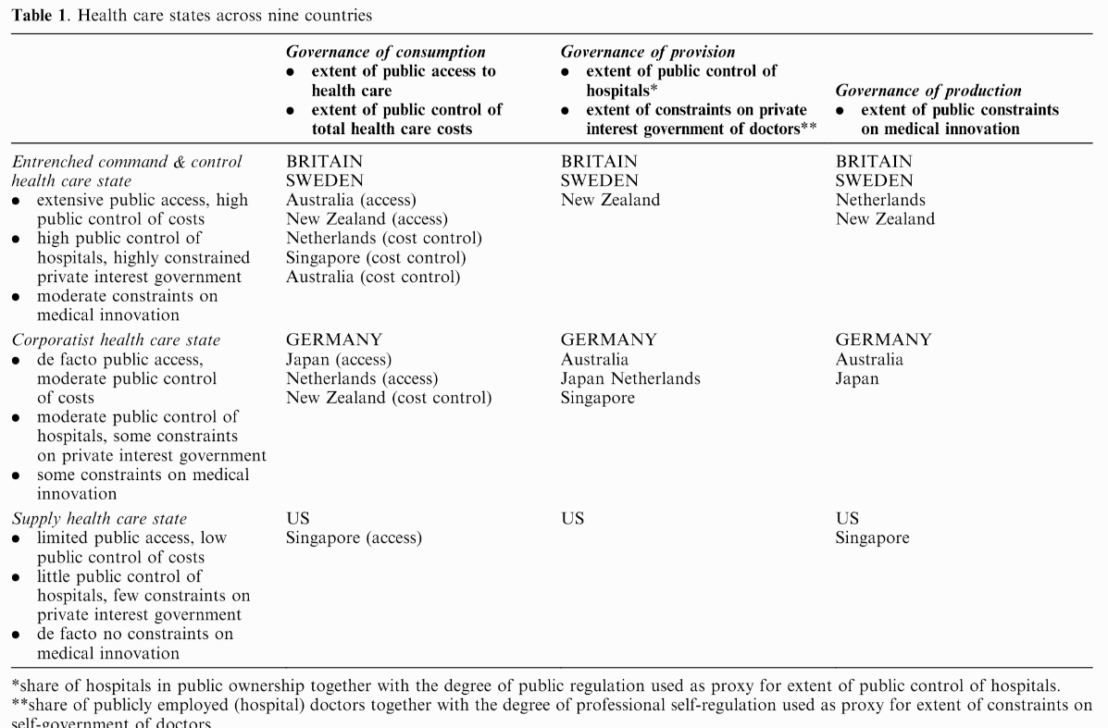

Slide 13
Problems facing any health care system
1. How does one reconcile the need for regional or national coordination with the ability to respond to local needs?
2. How does one reconcile urban with rural needs and the problems of maldistribution?
3. How does one devise a national health care system and yet honor and foster the energies, creativity, and resources of the voluntary sector?
4. How does one reconcile public accountability with professional autonomy and expertise?
5. How shall primary care be integrated with specialty and hospital care?
6. How shall individualistic principles and patterns of practice be reconciled with national standards and a national system?
7. How is a system to reconcile a focus on the patient with a focus on community and population health?

Slide 14
Answer: Master Price List?
https://www.youtube.com/watch?v=tNla9nyRMmQ

Slide 15
Readings and Sources
January 2003 edition of the American Journal of Public Health
Burau, Viola, and Robert H. Blank. "Comparing health policy: an assessment of typologies of health systems." Journal of comparative policy analysis 8, no. 01 (2006): 63-76.

