Slide 1
HCMI 4225: The Right to Health
BUSN 203: Mon/Wed 9:30 AM – 10:45PM
Shane Murphy – shane@uconn.edu
Office Hours: Mon/Wed 11:00 PM – 12:30PM

Slide 2
Quiz
To the nearest $1,000, what is the annual per capita health spending in the United States?

Slide 3
Discussion Questions:
What is a right? What is a human right?
Is health care a human right?
Should the government ensure provision of basic health needs to the entire population?
Should the government ensure provision of premium health care to the entire population?

Slide 4
Rights and Human Rights
https://www.youtube.com/watch?v=ew993Wdc0zo

Slide 5
Rights and Human Rights
1948 Universal Declaration of Human Rights
The preamble sets out the historical and social causes that led to the necessity of drafting the Declaration.
Articles 1–2 established the basic concepts of dignity, liberty, equality, and brotherhood.
Articles 3–5 established other individual rights, such as the right to life and the prohibition of slavery and torture.
Articles 6–11 refer to the fundamental legality of human rights with specific remedies cited for their defence when violated.
Articles 12–17 established the rights of the individual towards the community (including such things as freedom of movement).
Articles 18–21 sanctioned the so-called "constitutional liberties", and with spiritual, public, and political freedoms, such as freedom of thought, opinion, religion and conscience, word, and peaceful association of the individual.
Articles 22–27 sanctioned an individual's economic, social and cultural rights, including healthcare. Article 25 states: "Everyone has the right to a standard of living adequate for the health and well-being of himself and of his family, including food, clothing, housing and medical care and necessary social services." It also makes additional accommodations for security in case of physical debilitation or disability, and makes special mention of care given to those in motherhood or childhood.
Articles 28–30 established the general ways of using these rights, the areas in which these rights of the individual can not be applied, and that they can not be overcome against the individual.

Slide 6
Positive and Negative Rights
Negative Rights (first generation) are things which cannot be done to a person
Civil and political rights (including speech, religion, unlawful imprisonment)
Positive rights (second generation) are things which must be provided to a person
Include police protection, legal council, economic, social and cultural rights

Slide 7
Legal and natural rights
Natural rights are “universal” and “inalienable” (Locke, Paine, Hobbes)
Legal rights can be modified or repealed

Slide 8
Discussion Questions:
What is a right? What is a human right?
Is health care a human right?
Should the government ensure provision of basic health needs to the entire population?
Should the government ensure provision of premium health care to the entire population?

Slide 9
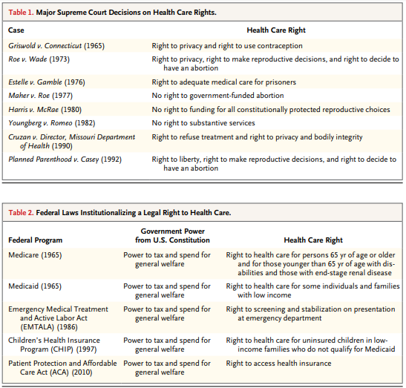
Federal Laws

Slide 10
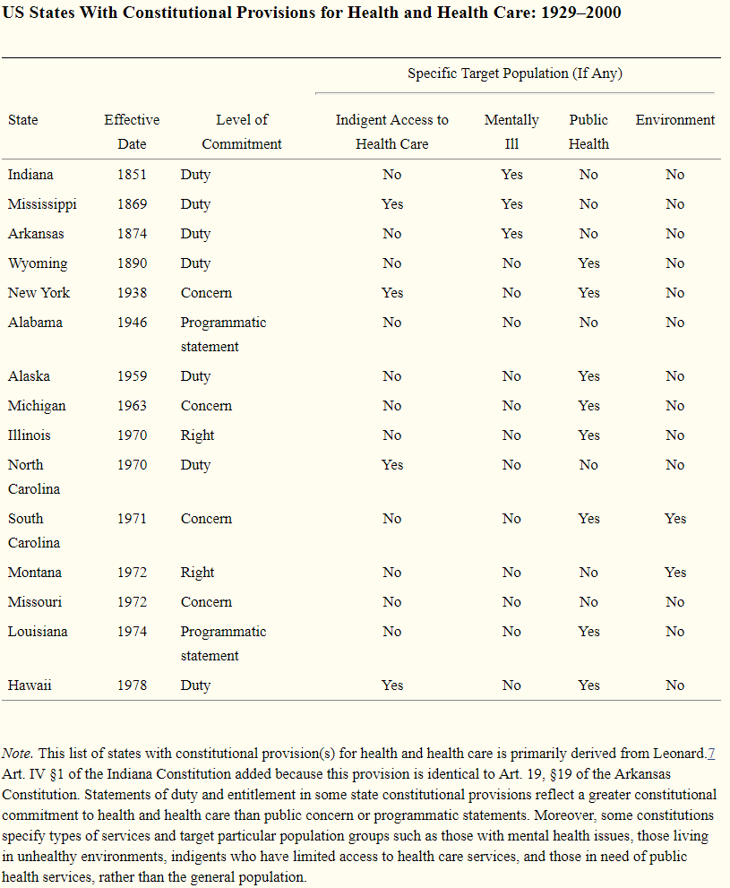
US State Constitutions
As of April 2014, 15 state constitutions specifically mention health and health care—either in the form of a programmatic statement, public concern, individual right, or government duty.

Slide 11
Discussion Questions:
What is a right? What is a human right?
Is health care a human right?
Should the government ensure provision of basic health needs to the entire population?
Should the government ensure provision of premium health care to the entire population?

Slide 13
Readings:
Health care as a public good
*Karsten, Siegfried G. "Health care: private good vs. public good." American Journal of Economics and Sociology 54, no. 2 (1995): 129-144.
*Galea, Sandro. “Public health as a public good.” Boston University School of Public Health, January 10, 2016, https://www.bu.edu/sph/2016/01/10/public-health-as-a-public-good/
Is health care a right? Is health insurance a right?
*Bauchner, Howard. "Health care in the United States: a right or a privilege." Jama 317, no. 1 (2017): 29-29.
*Lenchus, Joshua D. "The right to health care." JAMA 317, no. 13 (2017): 1377-1378.
*Hamel, Mary Beth, Jennifer Prah Ruger, Theodore W. Ruger, and George J. Annas. "The elusive right to health care under US Law." N Engl J Med 372, no. 26 (2015): 2558-63.
*Gawande, Atul. “Is health care a right?” New Yorker, October 2, 2017

