Slide 1
HCMI 4225: Adverse Selection and Moral Hazard in Demand for Insurance
BUSN 203: Mon/Wed 9:30 AM – 10:45 AM
Shane Murphy – shane@uconn.edu
Office Hours: Mon/Wed 11:00 AM – 12:30PM

Slide 2
Law of Large Numbers
Given a fair experiment, the average or mean value of the results obtained from a large number of trials should be close to the expected value. As more trials are performed, the mean will tend to become closer to the expected value.

Slide 3
Principles of micro
Elasticity of demand = percent change in quantity demanded
divided by percent change in price
Inelastic -> less responsive to a change in price
Elastic -> more responsive to a change in price
Goods that are more “necessary” are generally more inelastic

Slide 4
Elasticity of demand for insurance

Slide 5
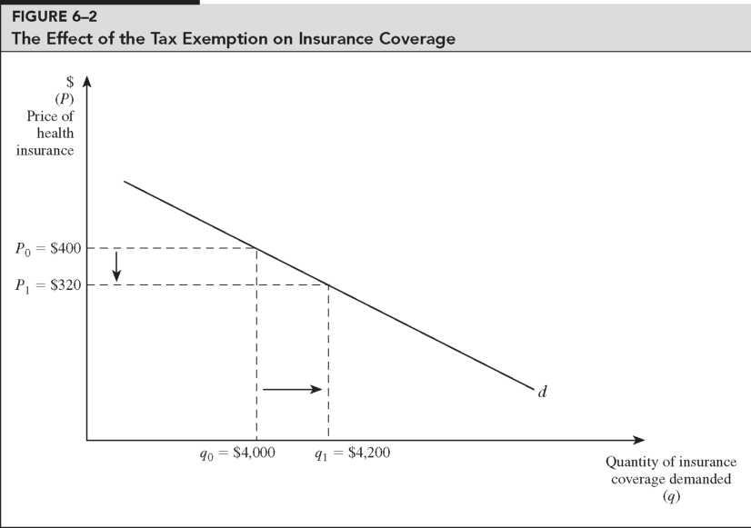
Calculate the elasticity of demand pictured here:

Slide 6
1965: Medicare and Medicaid debate
Kenneth Arrow (1963) – Actuarially fair health insurance for risk averse rational expected utility maximizers was “overwhelmingly” welfare improving
  It must be a market failure that so many people go uninsured
Mark Pauly (1968) – Health insurance lowers prices (for consumers) but not costs (for providers)
  Moral Hazard - Additional care purchased by insured consumers may be inefficient and lead to a welfare loss to society
  Further, this moral hazard leads to increase costs of coverage (insurance premiums), coverage beyond what an uninsured individual would buy at market price
  Thus explaining why insurance rates are so low
Most health economists agree, “The level and type of health insurance held by most U.S. families generate substantial welfare loss due to over-consumption of medical care service”!

Slide 7
Moral Hazard
Moral hazard can be reduced by a number of policies – and fear of moral hazard has lead to many such policies being widespread
  Higher deductibles and coinsurance
  Care management
  Prepayment
  Gatekeeping
  Utilization review
  Voluntary and mandatory second opinions
  Chronic disease management

Slide 8
Moral Hazard
Any change in behavior due to becoming insured
An insured person may take fewer precautions to avoid illness
Reduced prices increase consumption of health care
  Consuming health care that costs more than it is worth to the consumer
Pauly later (1983) clarified – his argument was intended to apply only or primarily to relatively inexpensive and predictable elements of medical care
  Routine visits, dental care, eye care, pharmaceuticals
Moral Hazard in the case of serious illness is a possible hole in this analysis to this day

Slide 9
Can you find and explain the deadweight loss in this graph?

Slide 10
Demand for insurance: Risk avoidance vs access
In the late 1990s, John Nyman made an argument against excessive concern for moral hazard
His argument is that risk avoidance and the demand for certainty is not the reason people buy insurance, especially health insurance
Instead, people demand health insurance in order to increase their access to health care in time of need (the access motive)

Slide 11
Demand for Insurance: Access effect
More importantly, consider an example:
  Elizabeth purchases an insurance policy (for $4,000) that directly writes a check for $40,000 upon a diagnosis with breast cancer
  Without the insurance, she would purchase a $20,000 mastectomy
  With the insurance, she also buys a $20,000 breast reconstruction procedure
Now consider a separate example:
  Elizabeth purchases an insurance policy (for $4,000) that pays up to $40,000 upon a diagnosis with breast cancer
  In this case, what would Elizabeth buy?
  What if the policy pays up to $80,000?

Slide 12
Demand for Insurance: Access effect
In the first example, Elizabeth’s purchases represent her demand for care when sick and provided with $40,000.
  Her spending represents the purchase which provides her with the most welfare
  So the moral hazard is, in a sense, efficient.
In the second and third cases, we don’t know how much of her purchases represent what she would do if she had a check or $40,000 and how much of her purchases represent the fact that medical care has an effective price of $0 for the first $40,000 of spending.

Slide 13
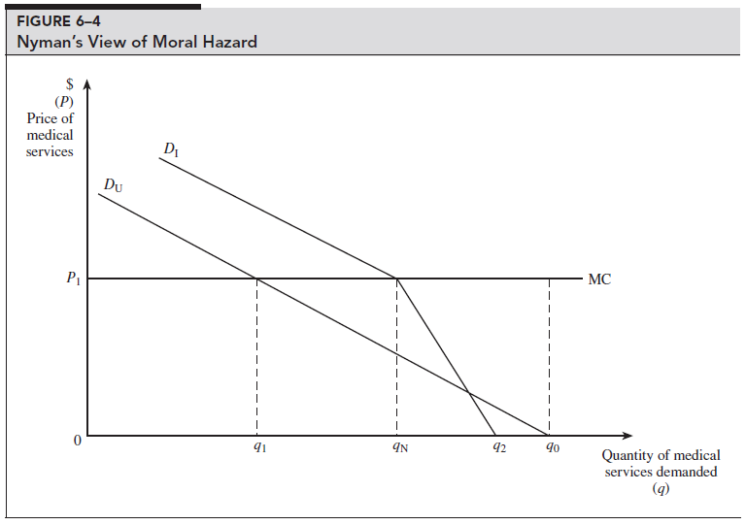
In fact, the uninsured may have less price elasticity for medical care than the insured
The uninsured
  Have higher rates of preventable and/or untreated illness
  Are less likely to receive care that they feel they need
  Have more preventable hospitalizations
  Have shorter hospital stays for the same conditions
  Are hospitalized sicker and have poorer health outcomes (including death)…
Can you find and explain the deadweight loss in this graph?

Slide 14
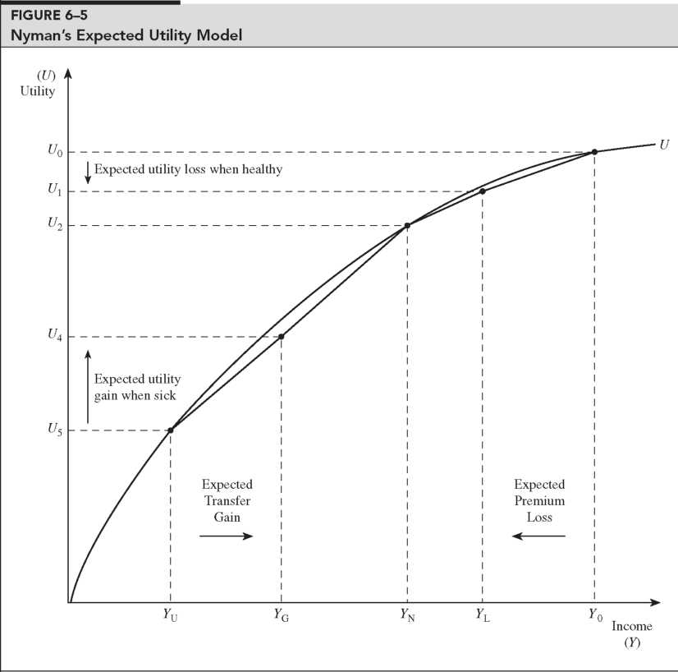
Transfer of wealth from the healthy to the sick has a different utility interpretation than a simple gamble

Slide 15
Implication for cost sharing
Remember our methods of mitigation moral hazard:
  Higher deductibles and coinsurance, Care management, Prepayment, Gatekeeping, Utilization review, Voluntary and mandatory second opinions, Chronic disease management
If the negative cost of moral hazard is overestimated, then mitigation will be overzealous
  “Cost sharing policies are directed at problems that largely do not exist”
  Insurance subsidies are socially optimal (providing access value to those who couldn’t afford it)

Slide 16
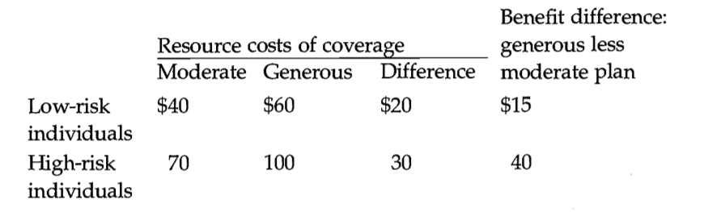
Adverse selection example
High risks are more expensive than low risks, and spending is greater under the generous plan for each risk type.
The last column shows the posited gain in benefits the different types of individuals receive from the generous as opposed to the moderate plan.
The efficient outcome in this example is for high-risk people to be in the more generous plan and low risk people to be in the moderate plan.
High risks should be in the generous plan because the incremental value of that plan to them ($40) is greater than its additional cost ($30).
For low risks, the opposite is true ($15 <$20).

Slide 17
Adverse selection example
We suppose that insurers charge the same premium for everyone enrolled in the plan
  possibly because individuals are indistinguishable to the insurer, equal premiums are required by law, or employers adopt this policy to help spread risks.
Starting at the efficient equilibrium, the premiums that would cover costs in this case are $40 for the moderate plan and $100 for the generous plan.
If these premiums were offered, however, all of the high-risk people would switch to the low-risk plan:
  the additional cost to high risks of the more generous plan ($60) is not worth the additional benefit ($40).
Thus, everyone would wind up in the moderate plan. The reason is simple: A person who switches from the generous to moderate plan benefits by mixing in with lower-risk individuals, and since premiums reflect risk mixes, this distorts choices towards the moderate plan.
This leads to higher costs for the low risk individuals or higher losses for the insurance provider

Slide 18
Adverse Selection
Adverse selection occurs when market participation is affected by asymmetric information
Adverse selection occurs when high-risk individuals are more likely to purchase insurance than low-risk individuals

Slide 19
Mitigating Adverse Selection
Individual Mandate in the ACA
Waiting Period before Coverage Takes Effect
Premiums Tied to Risk

Slide 20
Controversy: Moral Hazard is Welfare Decreasing
Moral Hazard implies excess utilization for the insured
The uninsured may receive less care than is socially optimal – lack of care can lead to higher long term costs
  Immunizations, women’s preventative care, non-fatal injuries
  We will revisit this issue when we look at the Oregon Medicaid Expansion experiment

Slide 21
Controversy: Insurance Payoffs have Income Effects
Traditional estimates of the welfare effects of insurance assume that insured individuals spending on health is equal to insurance payment
In practice, individuals with insurance buy more health care than only health care that is reimbursed by insurer

Slide 22
Controversy: Consumers prefer certain loses
Consider Prospect theory (Kahneman and Tversk 1979)
  People prefer a certain outcome over a gamble when it entails a gain but prefer a gamble over certainty when it entails a loss
So in theory, a choice between a small certain loss and an actuarially equivalent situation with a possibility of a larger loss, individuals should prefer the possibility of a larger loss – that is people might prefer not to insure
So the purchase of health insurance may need to be explained by factors other than risk preferences

Slide 23
Controversy: Risk preferences derive from diminishing marginal utility
In practice, using diminishing marginal utility of income to determine/derive risk aversion may be incorrec

Slide 24
Controversy: High coinsurance/copayment rates are welfare improving
Insurance companies should be better off with high coinsurance rates

Slide 25
Readings:
Nyman, John A. “Is ‘moral hazard’ inefficient? The policy implications of a new theory.” Health Affairs 23, no. 5 (2004): 194-199.
Cutler, David M., and Richard J. Zeckhauser. “Adverse selection in health insurance.” In Forum for Health Economics & Policy, vol. 1, no. 1. De Gruyter, 1998. (optional)

