Slide 1
HCMI 5243: Health Demand and Health Insurance Demand
GBLC 504: 6:00 PM – 9:00 PM
Shane Murphy – shane@uconn.edu
Office Hours: Mon/Wed 11:00 AM – 12:30PM

Slide 2
Outline
Health vs. Medical Care
Human Capital Model of Health (Grossman Model)
Determinants of Health (might not get to today)
Discussion of Cutler, Glaeser & Shapiro paper
Readings for this week:
  Pritchett & Summers. 1993. Wealthier is Healthier.
  Cutler, Glaeser, & Shapiro. 2003. Why have Americans become more obese?
  Optional: Grossman. 2000.

Slide 3
Health as a good
Health as a durable good, generates a flow of services over the lifetime
Consumption perspective: good health makes us feel better or provides “utility”
Investment perspective: relationship between health and use of time
  Good health – less time spent in sickness → more time for work/leisure
  Investments in health can be viewed as similar to investments in education
A note: Health is not the same as Medical Care
Notes:
In health economics, we view health as a durable good – one that generates a flow of services which provides satisfaction or “utility”.
As a good, health is desired for both consumption and investment purposes.
From a consumption perspective, people feel better or get utility when they have good health.
The investment perspective has to do with the relationship between health and use of time. If you are in a state of good health, you allocate less time to sickness and therefore have more time for other things like working to increase your income or pursuing leisure activities. This investment view of health is similar to how we view education when we are studying human capital. Just as one might invest in education in order to potentially earn a higher wage, people can invest in health to increase their likelihood of having more healthy days to work and generate income.

Slide 4
Health vs. Medical Care
Medical care refers to goods and services that maintain, improve, or restore one’s health.
  Examples: wheelchair, RX drugs, dentures, surgeries, PT visits, checkups
Services are different from goods in 4 ways:
  Intangibility – not a tangible thing you can assess by seeing, feeling, tasting, etc.
  Inseparability – production and consumption of a service happen simultaneously
  Inventory – providers can’t stockpile inventory of services (b/c of inseparability)
  Inconsistency – Composition and quality of services vary widely across medical events
Notes:
Medical care refers to the goods and services which are an input to one’s health.

Slide 5
Measuring Quality in Medical Care
Medical care is heterogenous – units are difficult to measure precisely
Quality of Medical care can be difficult to assess due to differences in:
  Structural quality – physical and human resources of the medical care organization. Examples: equipment (age and type), personnel (training and experience), administration (structure), etc.
  Process quality – actions healthcare providers take on behalf of patients to deliver and follow through with care. Examples: access (waiting time), data collection (background and testing), communication with patient, diagnosis & treatment, etc.
  Outcome quality – impact of care on patient’s health & welfare. Examples: patient satisfaction, work time lost to disability, etc.
We’ll come back to measurements of quality in in more detail later on..
Notes:
Quality of medical services can be more difficult to assess or measure than quality of medical goods, for these three reasons. Often researchers will measure medical care based on availability of medical care (i.e. number of doctors or hospital beds per 1,000 people) or the use of medical care (i.e. quantity of office visits or surgeries per capita can measure the use of physician services or the number of inpatient days can measure the amount of hospital services consumed).
We’ll look how we measure quantity and quality in a bit more detail later on. For now, it’s useful to know why it can be difficult to measure and these three broad ways of measuring quality in medical care.

Slide 6
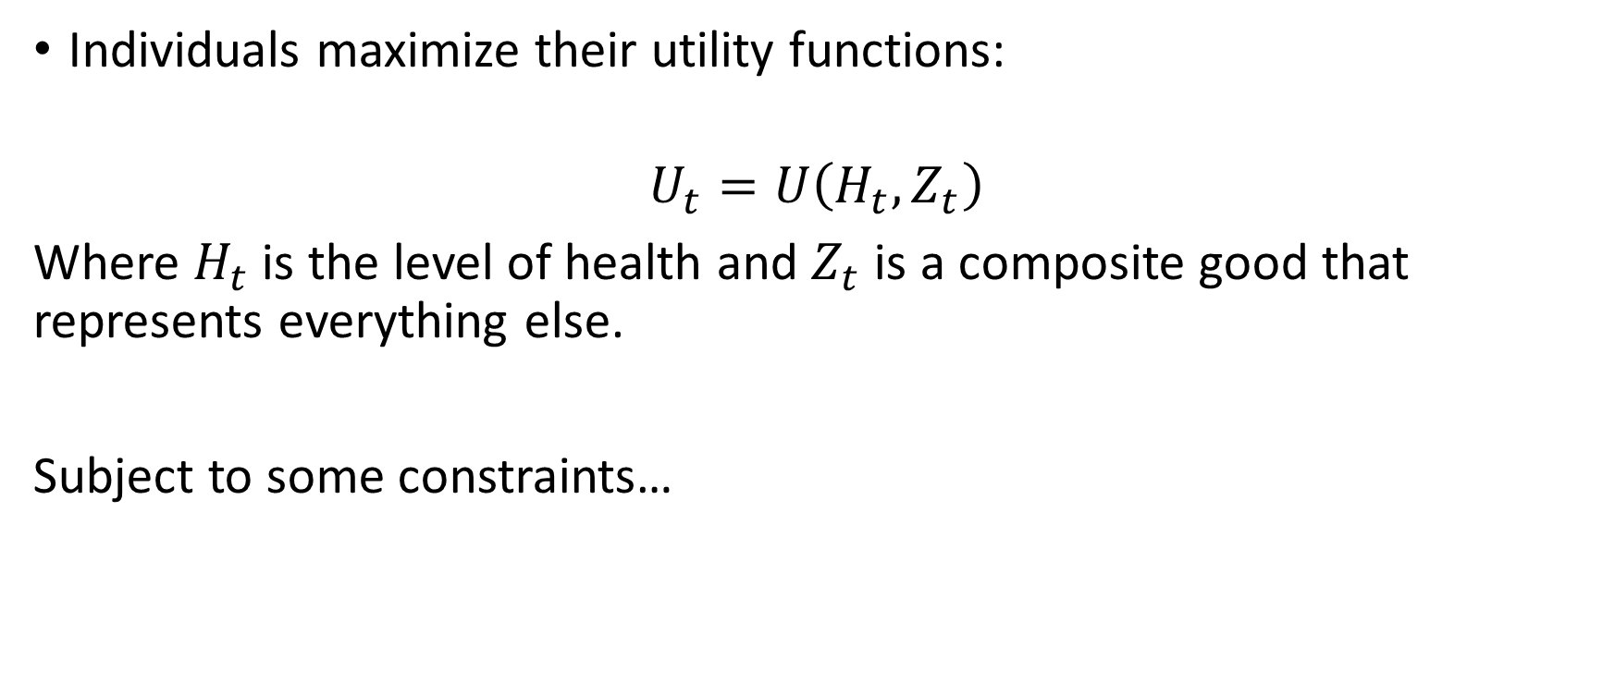
The Grossman Model of Demand for Health
Individuals maximize their utility functions:
$$U_{t}=U\left(H_{t},Z_{t}\right)$$
Where $H_{t}$ is the level of health and $Z_{t}$is a composite good that represents everything else.
Subject to some constraints…
Notes:
Grossman’s model integrates theory of human capital and household production to understand the demand for health.
The main ways health differs from the demand for other goods and services are described in the set-up of the model.

Slide 7
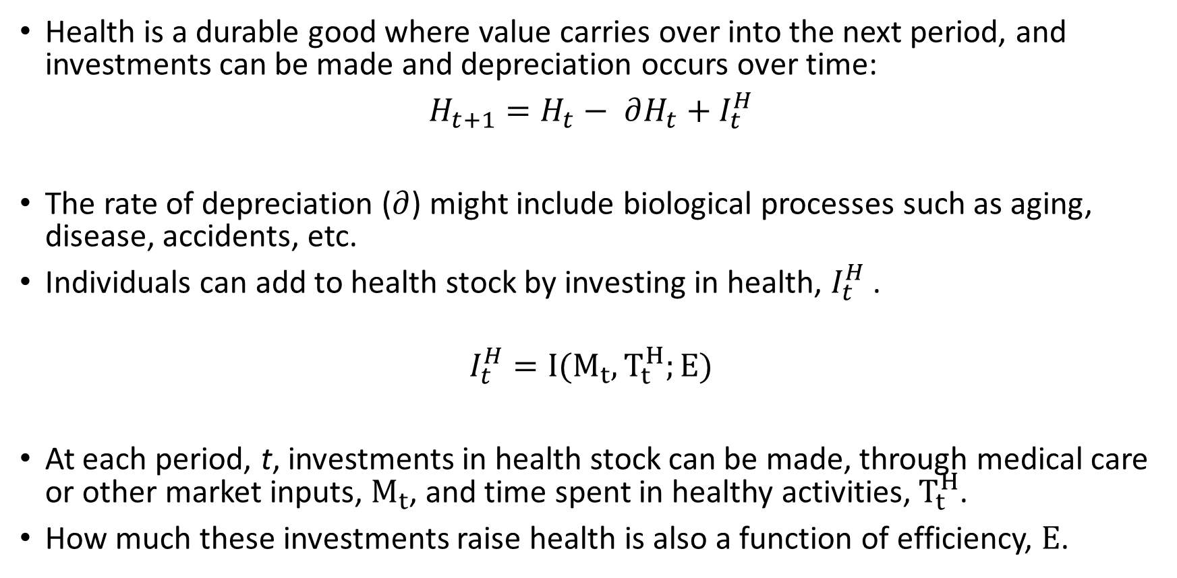
The Grossman Model: Production of Health
Health is a durable good where value carries over into the next period, and investments can be made and depreciation occurs over time:
$H_{t+1}=H_{t}− ∂H_{t}+I_{t}^{H}$
The rate of depreciation ($∂$) might include biological processes such as aging, disease, accidents, etc.
Individuals can add to health stock by investing in health, $I_{t}^{H}$ .
$$I_{t}^{H}=I(M_{t}, T_{t}^{H};E)$$
At each period, t, investments in health stock can be made, through medical care or other market inputs, $M_{t}$, and time spent in healthy activities, $T_{t}^{H}$.
How much these investments raise health is also a function of efficiency, $E$.
Notes:
The first two constraints are related to the production of health and from them we can get the health production function.
A person is born with initial endowment of H, which they add to by investment.
The rate of H production will depend on the efficiency of investment in H.
There will be δ in the value of the stock of H through age, accident, carelessness, sudden disease.

Slide 8
Investing in health
INPUTS
PRODUCTION PROCESS
OUTPUT
Health Care
Diet
HEALTH
STOCK
HEALTHY DAYS
Exercise
Environment
Income
Time

Slide 9
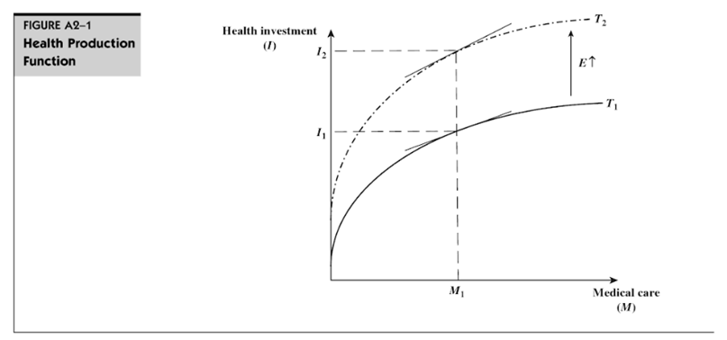
Health Production Function
The concave shape of the total product curve, T1, reflects the law of diminishing marginal productivity.
In other words, Higher levels of medical care or market inputs increase the level of health, but at a diminishing rate.
Efficiency is similar to technology in a firm’s production process. For the same levels of inputs (M1), a more efficient person can produce higher levels of health.
Notes:
Efficiency is kind of like technology in a firm’s production process. If a new technology comes in, it can shift the production function upward.

Slide 10
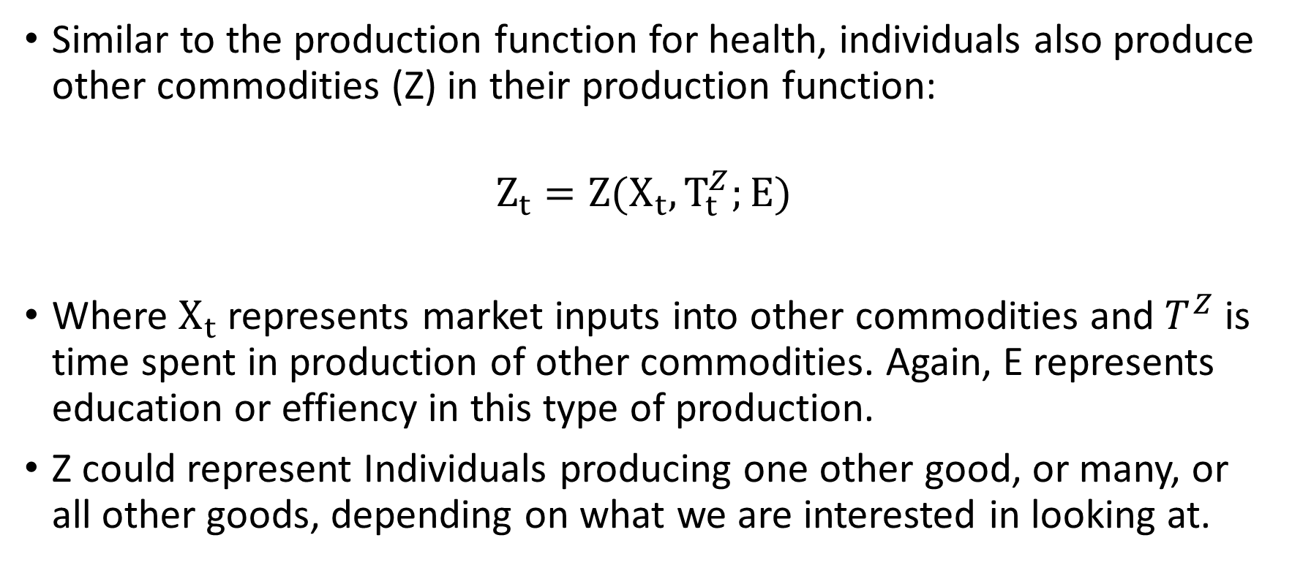
The Grossman Model: Production of All Else
Similar to the production function for health, individuals also produce other commodities (Z) in their production function:
$$Z_{t}=Z(X_{t}, T_{t}^{Z};E)$$
Where $X_{t}$ represents market inputs into other commodities and $T^{Z}$is time spent in production of other commodities. Again, E represents education or effiency in this type of production.
Z could represent Individuals producing one other good, or many, or all other goods, depending on what we are interested in looking at.
Notes:
These production functions for health and for other commodities capture the fact that individuals have some control over the production process, and that they can determine what quantity and mix of resources to use in producing their health, entertainment, transportation, meals, etc.
Individuals combine their time with inputs bought in the marketplace. Like all resources, these resources are scarce and are constrained by individuals total time and income.

Slide 11
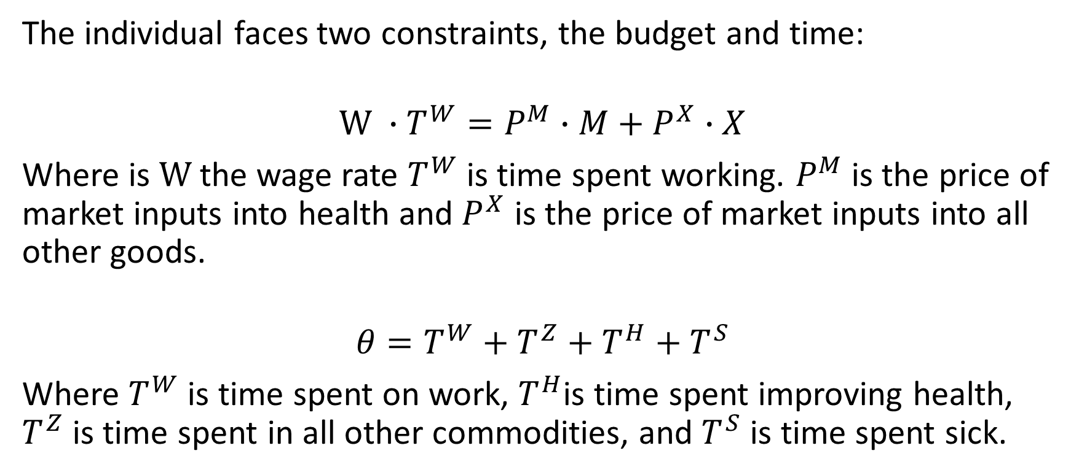
The Grossman Model: Budget & Time Constraints
The individual faces two constraints, the budget and time:
$$W ∙T^{W}=P^{M}∙M+P^{X}∙X$$
Where is $W$the wage rate $T^{W}$ is time spent working. $P^{M}$is the price of market inputs into health and $P^{X}$ is the price of market inputs into all other goods.
$$θ=T^{W}+T^{Z}+T^{H}+T^{S}$$
Where $T^{W}$ is time spent on work, $T^{H}$is time spent improving health, $T^{Z}$is time spent in all other commodities, and $T^{S}$is time spent sick.

Slide 12
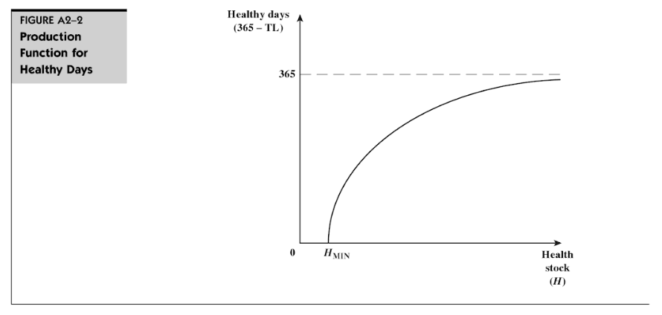


The Grossman Model: Production of Healthy Days
This final condition tells us that health capital provides some return over time:
$$Healthy Days=F\left(H\right)=(365 −T^{S})$$
An increase in health stock (H) reduces an individual’s time lost to sickness, $T^{S}$, and raises the individual’s total effective time.
The bowed shape indicates that the number of healthy days increases at a decreasing rate with improvements in health.
There is a minimum level of health stock, when health falls below it, death occurs.
Marginal product of health is positive, but diminishing.
Notes:
The final condition captures another important aspect of health capital. Any capital good exhibits two characteristics: it is durable and adjusts over time due to depreciation and investments (the second equation told us that), and that it provides some return over time.
This equation assumes that time is measured as days per year – so an individual’s total healthy days in a year equals 365 – time sick. This equation also tells us that the number of healthy productive days is a function of the underlying health stock (H). The more H, the more healthy & productive days in a year.

Slide 13
Implied choices
Inter-related time choices:
Labour time (income) vs. leisure time vs. ill time
Within leisure time choice:
  health producing time (gym) vs. non-health producing time
Resource choices:
Health care inputs vs. other consumption
  subject to budget constraint

Slide 14
Determining the Optimal Investment in Health
Suppose we just focus on the investment aspect of the model. We can assume that individuals consume and demand health purely for it’s investment features: Health produces Productive Days.
Focusing on this allows us to find the optimal investment in health.
  We know: Diminishing returns mean that healthy days occur at a decreasing rate.
  We need to learn to new concepts: MEC and Cost-of-Capital:

Slide 15
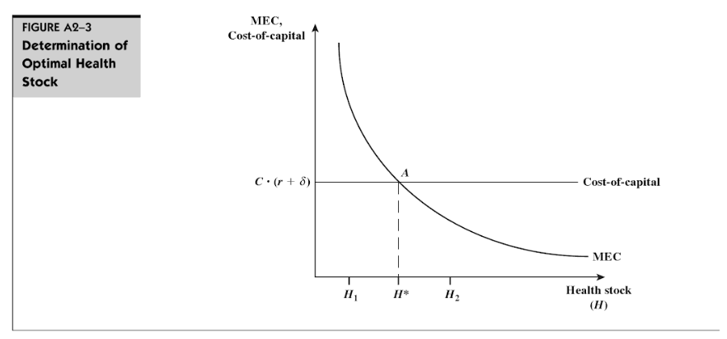

What is the MEC?
Marginal Efficiency of Capital, MEC, captures the value of an additional healthy day gained from a one-unit increase in the stock of health.
  We assume that wage is the opportunity cost of time and the marginal efficiency of capital is the marginal product of health multiplied by the wage rate:
$$MEC=MPH∙Wage$$
MEC is downward sloping because of the diminishing marginal product of health.
We can interpret the MEC as a demand curve for health capital.

Slide 16
What exactly is the Cost of Capital?
Cost-of-Capital = Cost of health investment (Opportunity cost + depreciation)
    Cost-of-Capital = C (r + δ)
The opportunity cost of a capital investment is the interest rate the investor would have received had they put the money into another investment (for example, stocks and bonds)
The problem is more complicated, however, because capital goods depreciate over time.
  For an investment to be worthwhile, it must not only earn a competitive return each year, but it also must provide enough return to cover depreciation.
  This suggests that the cost of holding this capital good for any one year, as well as over time, will equal the opportunity cost of the capital (interest foregone) plus the depreciation (deterioration of value).
Notes:
Note: There was an error in this slide that led to come confusion at the end of class – the correct equation should be:
C = Cost of a health investment multiplied by (Opportunity cost + rate at which capital good depreciates)
Where the Opportunity cost is cost of foregone alternatives i.e. interest rate.

Slide 17
Optimal Investment in Health
If rate of return on capital good is greater (less) than cost of capital, then the good will (not) be purchased. Capital good will be purchased only up to point where:
  Equilibrium condition:
  Rate of return = Cost of Capital
  MEC = r + δ

Slide 18
Practical questions
What effect on optimal health stock or demand for health inputs do the following have:
    Increases in life expectancy?
    Getting a higher salary?
    Going to college?
    Changes in Medical Prices?

Slide 19
Changes in Equilibrium - Age
The rate at which health stock may depreciate may increase during some periods of life and decline during others.
As an individual ages the δ rate of health stock is likely to increase (from δ₀ to δ₁ and finally to δ_{D}) i.e. the health of older individuals is likely to deteriorate faster than the health of younger individuals.
  Grossman allows the depreciation rate, δ, to increase with age. This directly raises the cost-of-capital and shifts the supply curve of health upwards.
Assume that wage and other factors determining MEC are not substantially altered by aging, ceteris paribus
Optimal health stock decreases with age (i.e. H_{O} > H₁)

Slide 20
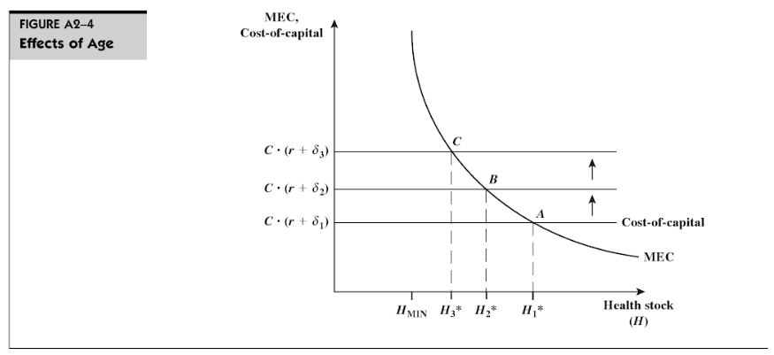

Slide 21
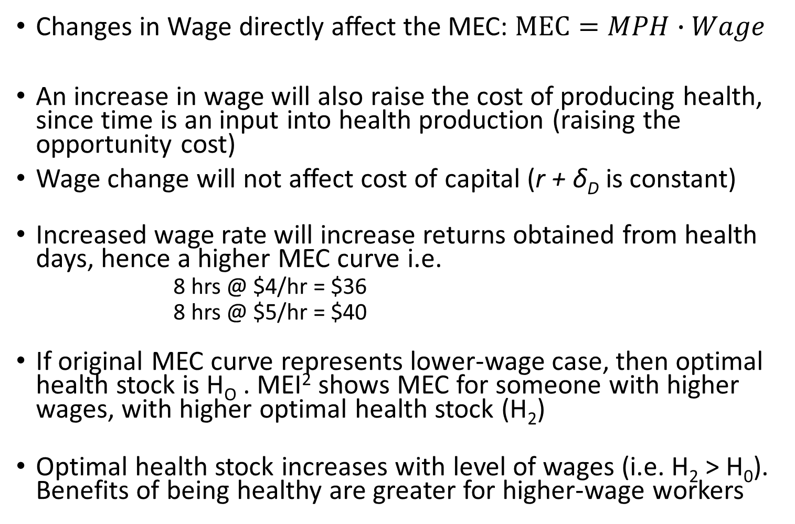
Changes in Equilibrium - Wage
Changes in Wage directly affect the MEC: $MEC=MPH∙Wage$
An increase in wage will also raise the cost of producing health, since time is an input into health production (raising the opportunity cost)
Wage change will not affect cost of capital (r + δ_{D} is constant)
Increased wage rate will increase returns obtained from health days, hence a higher MEC curve i.e.
        8 hrs @ $4/hr = $36
        8 hrs @ $5/hr = $40
If original MEC curve represents lower-wage case, then optimal health stock is H_{O} . MEI² shows MEC for someone with higher wages, with higher optimal health stock (H₂)
Optimal health stock increases with level of wages (i.e. H₂ > H₀). Benefits of being healthy are greater for higher-wage workers

Slide 22
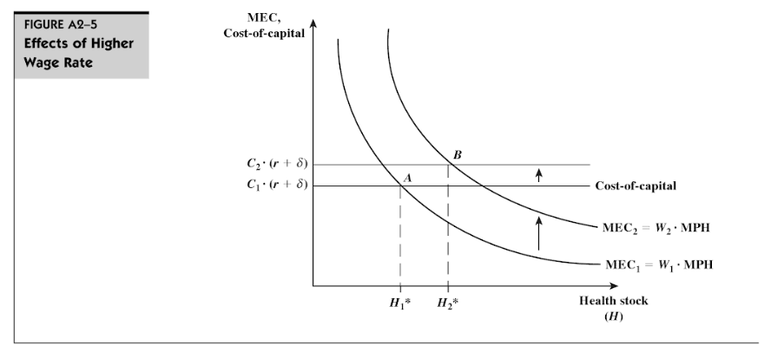
Note: In class we assumed ceteris paribus that the increase in wages would not include an increase in prices – and could not explain why cost-of-capital was increasing, with that assumption. However, In a general equilibrium model, an increase in wages may increase prices throughout the market, in particular, the price of an increase in H may be represented by an increase from C1 to C2.
Notes:
Note: In class we assumed ceteris paribus that the increase in wages would not include an increase in prices – and could not explain why cost-of-capital was increasing, with that assumption. However, In a general equilibrium model, an increase in wages may increase prices throughout the market, in particular, the price of an increase in H may be represented by an increase from C1 to C2.

Slide 23
Changes in Equilibrium – Education
Education improves efficiency in production
Higher education level raises marginal product of direct inputs i.e. less inputs are needed to produce a given amount of investment. A given investment can be generated at less cost for an educated person , hence higher rate of return to a given stock of health
Higher education level means a higher MEC curve (similar to effect of increased wage rate).
Optimal health stock increases with level of education (i.e. H₂ > H₀). A more educated person will choose a higher optimal stock of health than the less educated person.

Slide 24
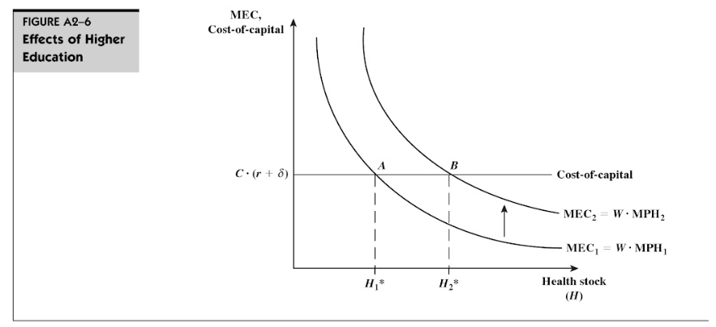

Slide 25
Change in the Price of Medical Care
A fall in the price of a unit of health inputs results in the budget line swivelling outwards from the intercept on the consumption axis
Assuming that the individual did not devote all of her income to consumption before the price change, she will employ more health inputs and consequently will be achieve better health.
This suggests that subsidising the price of health inputs (for example, milk and heating) will result in improved health for those receiving such subsidies.

Slide 26
Recap: What does the Grossman model tell us?
The individual is both the consumer and producer of health – in other words, individuals consume health for two reasons:
  Individuals get utility/enjoyment from being healthy
  Health raises individual productive capacity by raising available productive time
Health is both a consumption commodity as well as an investment commodity
Health is a capital stock, and has features of a durable good:
  It can depreciate over time
  We can make investments that carry value over time
Health belongs in an individual’s utility function, not medical care.
  We do not directly demand medical care, we demand it due to our underlying demand for health.
Notes:
The seven equations we looked at so far capture the main features of Grossman’s framework and also summarize why we view health as different from other commodities. These are the four essential takeaways from the Grossman model.

Slide 27
Policy implications
The model can be used to predict the likely (and opposite than intended) effects of policy changes
e.g the government may attempt to reduce queuing time in order to encourage greater utilisation of health care by the poor
This will increase the MEC of both rich and poor but since the value of extra time is greater for the rich, the MEC will shift up further for this group, thus increasing the inequality

Slide 28
Some Applications of the Grossman Model
Health Production Function
Risky Behaviors: Determinants of smoking, drinking, drug use, obesity
If other capital stocks are low an individual might choose to deplete her health stocks in order to replenish other stocks
  e.g a high wage occupation that causes the stock of health to decline may be chosen if the stock of wealth is low
A similar kind of argument might be applied to the type of recreation activities which are chosen
  e.g. an individual with low stocks of wealth relative to health may smoke since it is a relatively cheap in terms of wealth and expensive in terms of health

Slide 29
Some Criticisms of the Grossman Model
Assumes individuals are rational, forward-looking, have full information
  Rationality implies weighing all costs and benefits – do people do this?
  Forward-looking – Do people consider costs and benefits realized in the future? There is individual variation in rate-of-time preference.
  Full information – There are strong information asymmetries between consumers and providers, and uncertainty about decisions, outcomes, and costs. Do we really know the costs and benefits of our choices before we make them?
Assumes Health is a constant lifetime investment
Ignores insurance markets
It is deterministic – down the point of when we die

Slide 30
Summary
Health vs. Medical Care
Introduction to Grossman model of health as both a consumption and an investment good
Determining Optimal Health Investment and Changes in Age, Wage, Education and Price of Medical Care
Applications & Criticisms of the Grossman Model
Didn’t cover, but should read: Determinants of Health (p. 47-56)
Next week: Cost Benefit Analysis
  Chapter 3 S&N, Viscusi, 1993 – background reading
  Miguel & Kremer, 2004 – application & response paper (due Wed)

Slide 31
EMPIRICAL ANALYSES USING GROSSMAN’S MODEL
Results
Sickles and Yazbeck (1998) developed and estimated a structural model of health production that looks at the demand for leisure and the demand for consumption for elderly males. They find that both health care and leisure consumption tend to improve health.
Demand for health is estimated by Gerdtham and Johannesson (1999) and their results are consistent with the theoretical predictions and show that the demand for health increases with income and education and decreases with age, urbanization, being overweight, and being single.

Slide 32
Economic Effects of Obesity
Obesity is a bad health investment, leading to higher medical expenditures and lower earnings. Finkelstein and colleagues (2009) report that medical spending for the obese was about 42 percent higher per year when compared to someone of normal weight.
Cawley (2004) finds that heavier white females, black females, Hispanic females, and Hispanic males tend to earn less, and heavier black males tend to earn more, than their less heavy counterparts.

Slide 33
Schofield, Schofield and James, 1985; Whitney and Cataldo, 1983 estimate the 10- to 12-pound increase in median weight occurring in the past two decades requires a net caloric imbalance of about 100 to 150 calories per day
  One hundred and fifty calories per day is three Oreo cookies or one can of Pepsi.
  It is about a mile and a half of walking

Slide 34
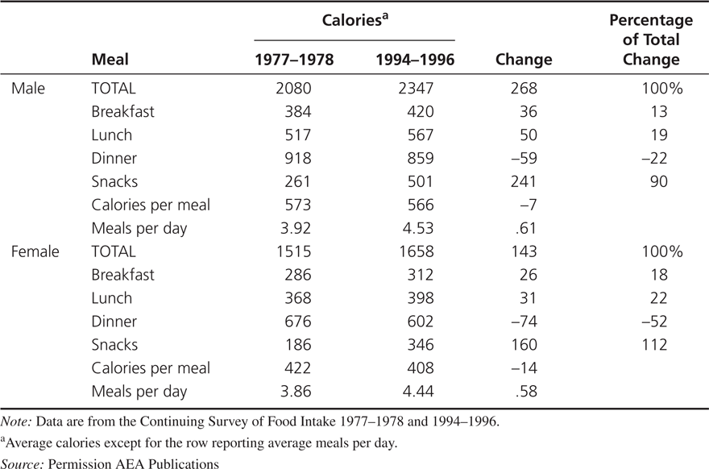
Why Has Obesity Increased?
Cutler, Glaser, and Shapiro (2003) show that there was increased caloric intake for men and women from the late 1970s to the late 1990s and no significant change in caloric expenditure.
Changes in
Food Consumption, 1977-1978 to 1994-1996

Slide 35
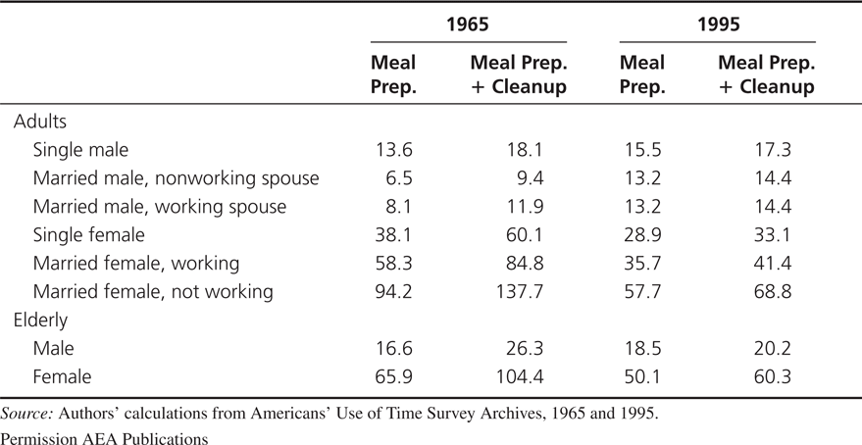
Why Has Obesity Increased?
A reduction in the cost of food increases consumption
The reductions in the time required to prepare food reduced the per-calorie cost of food by 29 percent from 1965 to 1995.
Time Costs by Demographic Group (minutes)

Slide 36
Implications of the time-cost theory of obesity
The lower costs of food preparation mean that individuals should consume a wider range of products at more times during the day.
The increase in food consumption should come mostly in foods that had an improvement in mass preparation technology (and complements to those foods).
Individuals who have taken the most advantage of the new technologies should have had the biggest increase in obesity.
Obesity rates should be higher in countries with greater access to technological changes in food consumption.

Slide 37
Hyperbolic discounting
People discount the future more at the moment of making a decision than they expect they will when planning a future decision making process.
People plan to invest more in their own health but when given a choice, they often choose less investment
Hyperbolic discounting discounts more in the near term than in the long term
  Exponential discounting discounts at a constant rate at all times
Decreasing time delay between deciding to eat and eating increases the perceived payoff to eating greater for hyperbolic discounters than for exponential discounters
Notes:
I think these bullet points need to be shortened.
The example is with the alarm clock, the night before people like to set their alarm clock early, comparing the discounted disutility of getting up early against the discounted utility of getting stuff done during that time. However in the morning, they discount the utility of getting the stuff done relatively more than they did the night before, and prefer to hit the snooze button. Thus their discounting is time inconsistent.

Slide 38
Time-cost and obesity
Yaniv, Rosin, and Tobol (2009) build on this model
  Assuming that healthy meals are cooked at home with purchased ingredients and time inputs
  For a non-weight conscious individual a fat tax will unambiguously reduce obesity, but a thin subsidy may increase obesity
    A thin subsidy may still subsidize eating more – even too much healthy food can cause obesity
  for a weight-conscious individual, particularly one who is physically active, even a fat tax may increase obesity, as it may reduce not just the consumption of junk-food, but also the time devoted to physical activity.

Slide 39
Discussion
Grossman:
  The Grossman model assumes a degree of rationality and full information that is unrealistic. What problems can this create in the model?
Cutler et al:
  Do you believe their conclusion that sedentary lifestyle is less important than food consumption in explaining obesity?
  They assume calories in equals calories out. If this assumption is not true, how might it change their conclusions? How could they have altered their approach to ask that question?
  Do you think people are hyperbolic in their discounting? What implications does this have for other health behaviors? When could hyperbolic discounters make decisions that are “better” than exponential discounters?

Slide 40
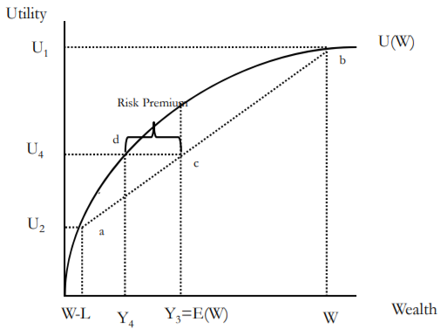
von Neuman-Morgenstern expected utility theory
We then used this version of utility to discuss individual demand for insurance

Slide 41
1965: Medicare and Medicaid debate
Kenneth Arrow (1963) – Actuarially fair health insurance for risk averse rational expected utility maximizers was “overwhelmingly” welfare improving
  It must be a market failure that so many people go uninsured
Mark Pauly (1968) – Health insurance lowers prices (for consumers) but not costs (for providers)
  Moral Hazard - Additional care purchased by insured consumers may be inefficient and lead to a welfare loss to society
  Further, this moral hazard leads to increase costs of coverage (insurance premiums), coverage beyond what an uninsured individual would buy at market price
  Thus explaining why insurance rates are so low
Most health economists agree, “The level and type of health insurance held by most U.S. families generate substantial welfare loss due to over-consumption of medical care service”!

Slide 42
Moral Hazard
Moral hazard can be reduced by a number of policies – and fear of moral hazard has lead to many such policies being widespread
  Higher deductibles and coinsurance
  Care management
  Prepayment
  Gatekeeping
  Utilization review
  Voluntary and mandatory second opinions
  Chronic disease management

Slide 43
Moral Hazard
Any change in behavior due to becoming insured
An insured person may take fewer precautions to avoid illness
Reduced prices increase consumption of health care
  Consuming health care that costs more than it is worth to the consumer
Pauly later (1983) clarified – his argument was intended to apply only or primarily to relatively inexpensive and predictable elements of medical care
  Routine visits, dental care, eye care, pharmaceuticals
Moral Hazard in the case of serious illness is a possible hole in this analysis to this day

Slide 44
Can you find and explain the deadweight loss in this graph?

Slide 45
Demand for insurance: Risk avoidance vs access
In the late 1990s, John Nyman made an argument against excessive concern for moral hazard
His argument is that risk avoidance and the demand for certainty is not the reason people buy insurance, especially health insurance
Instead, people demand health insurance in order to increase their access to health care in time of need (the access motive)

Slide 46
Demand for Insurance: Access effect
More importantly, consider an example:
  Elizabeth purchases an insurance policy (for $4,000) that directly writes a check for $40,000 upon a diagnosis with breast cancer
  Without the insurance, she would purchase a $20,000 mastectomy
  With the insurance, she also buys a $20,000 breast reconstruction procedure
Now consider a separate example:
  Elizabeth purchases an insurance policy (for $4,000) that pays up to $40,000 upon a diagnosis with breast cancer
  In this case, what would Elizabeth buy?
  What if the policy pays up to $80,000?

Slide 47
Demand for Insurance: Access effect
In the first example, Elizabeth’s purchases represent her demand for care when sick and provided with $40,000.
  Her spending represents the purchase which provides her with the most welfare
  So the moral hazard is, in a sense, efficient.
In the second and third cases, we don’t know how much of her purchases represent what she would do if she had a check or $40,000 and how much of her purchases represent the fact that medical care has an effective price of $0 for the first $40,000 of spending.

Slide 48
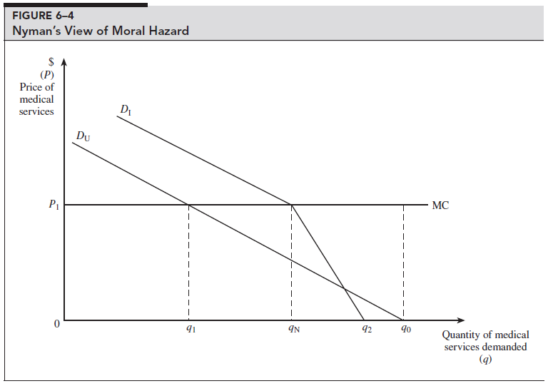
In fact, the uninsured may have less price elasticity for medical care than the insured
The uninsured
  Have higher rates of preventable and/or untreated illness
  Are less likely to receive care that they feel they need
  Have more preventable hospitalizations
  Have shorter hospital stays for the same conditions
  Are hospitalized sicker and have poorer health outcomes (including death)…
Can you find and explain the deadweight loss in this graph?

Slide 49
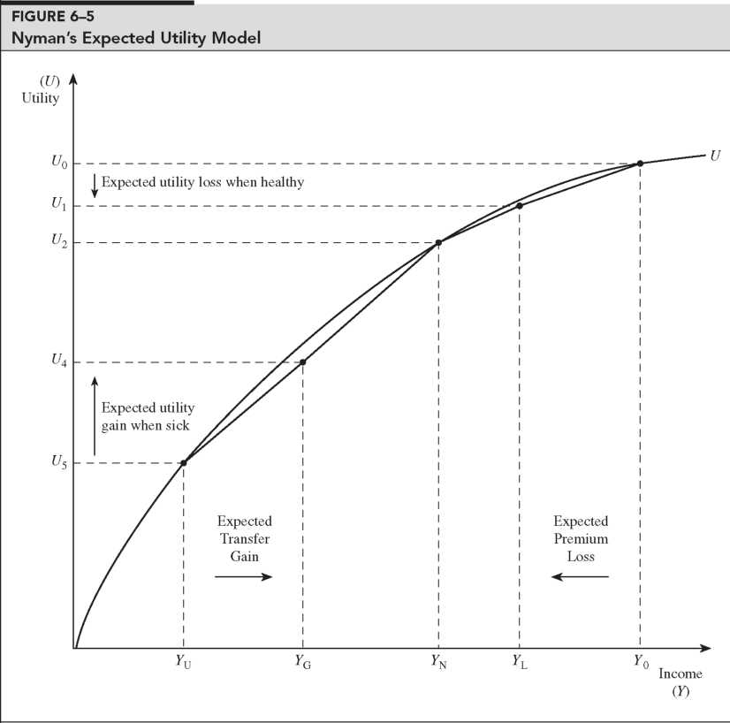
Transfer of wealth from the healthy to the sick has a different utility interpretation than a simple gamble

Slide 50
Implication for cost sharing
Remember our methods of mitigation moral hazard:
  Higher deductibles and coinsurance, Care management, Prepayment, Gatekeeping, Utilization review, Voluntary and mandatory second opinions, Chronic disease management
If the negative cost of moral hazard is overestimated, then mitigation will be overzealous
  “Cost sharing policies are directed at problems that largely do not exist”
  Insurance subsidies are socially optimal (providing access value to those who couldn’t afford it)

Slide 51
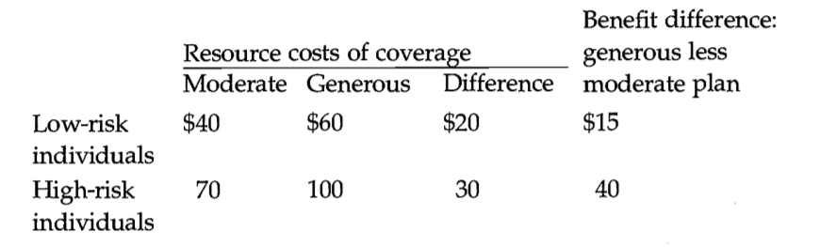
Adverse selection example
High risks are more expensive than low risks, and spending is greater under the generous plan for each risk type.
The last column shows the posited gain in benefits the different types of individuals receive from the generous as opposed to the moderate plan.
The efficient outcome in this example is for high-risk people to be in the more generous plan and low risk people to be in the moderate plan.
High risks should be in the generous plan because the incremental value of that plan to them ($40) is greater than its additional cost ($30).
For low risks, the opposite is true ($15 <$20).

Slide 52
Adverse selection example
We suppose that insurers charge the same premium for everyone enrolled in the plan
  possibly because individuals are indistinguishable to the insurer, equal premiums are required by law, or employers adopt this policy to help spread risks.
Starting at the efficient equilibrium, the premiums that would cover costs in this case are $40 for the moderate plan and $100 for the generous plan.
If these premiums were offered, however, all of the high-risk people would switch to the low-risk plan:
  the additional cost to high risks of the more generous plan ($60) is not worth the additional benefit ($40).
Thus, everyone would wind up in the moderate plan. The reason is simple: A person who switches from the generous to moderate plan benefits by mixing in with lower-risk individuals, and since premiums reflect risk mixes, this distorts choices towards the moderate plan.
This leads to higher costs for the low risk individuals or higher losses for the insurance provider

Slide 53
Adverse Selection
Adverse selection occurs when market participation is affected by asymmetric information
Adverse selection occurs when high-risk individuals are more likely to purchase insurance than low-risk individuals

Slide 54
Mitigating Adverse Selection
Individual Mandate in the ACA
Waiting Period before Coverage Takes Effect
Premiums Tied to Risk

