Slide 1
HCMI 4225: Title X
BUSN 203: Mon/Wed 9:30 AM – 10:45PM
Shane Murphy – shane@uconn.edu
Office Hours: Mon/Wed 11:00 AM – 12:30PM

Slide 2
War on Poverty (LBJ 1964)
Unintended childbearing and poverty
Adverse maternal and child health outcomes
Low income women were more than twice as likely as high income women to have an unintended pregnancy
Title X Established in 1970
Public Law 91-572 or "Population Research and Voluntary Family Planning Programs“
Subject to frequent modification
Hyde Amendment (1976) restricted the funding for abortions for Medicaid recipients.
Next slide is a timeline discussing trends in legislation related to the law

Slide 3
Extending Title X for future years and establishing global and national institutes (Nixon administration, 92nd–93rd Congress, January 20, 1969–August 9, 1974).
Stipulating that a broad array of family planning methods be offered and ensuring that economic status is not a deterrent to participation. Also, bills regarding abortion began to emerge (Ford administration, 94th Congress, August 9, 1974–January 20, 1977).
Implementing demonstration projects for infertility services, providing specific guidelines regarding the content of pregnancy information delivered, and stipulating that information and education be developed and disseminated through the community (Carter administration, 95th–96th Congress, January 20, 1977–January 20, 1981).
Stipulating that programs providing abortion referrals and services are not eligible for a Title X grant even if they provide these services with other funds (non–Title X funds) and that personnel cannot be terminated if they do not advise or provide specific methods of contraception. Proposals for repeals of Title X also appeared (Reagan administration, 97th–100th Congress, January 20, 1981–January 20, 1989).
Providing HIV counseling and testing, applying Title X restrictions to global family planning funding, and adhering to state parental notification laws (George H. W. Bush administration, 101st Congress, January 20, 1989–January 20, 1993).
Encouraging family participation among minors, stipulating that directing clinic staff be sensitive to a community's culture, and prohibiting funds supporting or opposing legislative proposals or candidates (Clinton administration, 103rd–106th Congress, January 20, 1993–January 20, 2001).
Reiterating that funds are prohibited from being used for abortion services and requiring counseling for minors on how to resist sexual activities, including sexual coercion (the combination of this language was found to be continually proposed in appropriation bills during this administration) (George W. Bush administration, 106th–110th Congress, January 20, 2001–January 20, 2009).

Slide 4
Title X
Administered by US Department of Health and Human Services (10 regional offices)
Award grants to health departments, university and community centers, Planned Parenthood clinics, and other public and nonprofit agencies.
Any public or nonprofit entity (located in a designated state) that offers a broad range of acceptable family planning methods and services is eligible to apply.
In 2008, there were 4522 Title X clinics serving more than 5 million individuals.

Slide 5
Services
Among female family planning users in 2008
44% received cervical cancer screening (Papanicolau tests)
46% received breast cancer screening (clinical breast examinations)
49% received chlamydia testing; 57% of male family planning users received chlamydia testing
Among every 10 family planning users, on average 4.7, 1.4, and 1.6 gonorrhea, syphilis, and HIV tests were provided, respectively.
90% of spending is on clinical family planning services
Commonly, Title X is their avenue of entry into the health care system

Slide 6
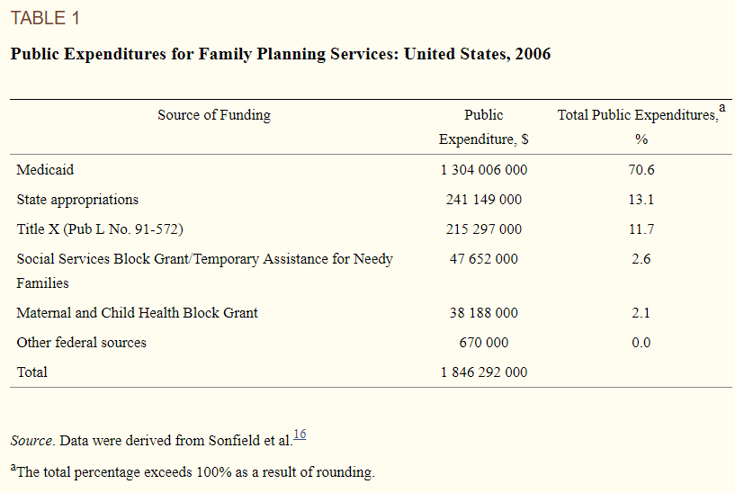

Slide 7
Restrictions
Federal regulations initiated in 1987 prohibiting clinics receiving Title X funding from disseminating abortion information or referrals (i.e., the “gag rule”). This legislation, although further supported by the Supreme Court as being constitutional in 1991, was later banned in 1993 by President Clinton.⁹
An attempt by the Reagan administration in 1982 to require minors to obtain written parental consent before receiving services (i.e., the “squeal rule”).This legislation was later reintroduced as the Parental Notification Act of 1998.
Legislation enacted in 1998 emphasizing abstinence-only education and ignoring the teaching of medically accurate and age-appropriate sexual information stressing health promotion and disease prevention.
Legislative proposals to repeal sections of Title X or the policy in its entirety.

Slide 8
Criticisms
"[Title X] was begun as family planning assistance for low-income families. It sounded commendable. Its stated purpose was to assist poor couples to plan their families. As with many other programs with humanitarian intent, Congress established Title X and left it in the hands of the federal bureaucracy. That is when things went haywire. .”
"Title X is welfare for affluent teenagers “
"The existence of [Title XI puts the United States government on record declaring that it is appropriate for government to decide who has children.”

Slide 9
Criticisms
"Planned Parenthood and its affiliates . . . constitute most of the Title X network. “
"Most Title X funds go to organizations which engage in abortion, pro- mote abortion, lobby for abortion, litigate about abortion. If the advocates of Title X want it to continue ... I need their support for legislation that will prohibit the use of Title X funds by any organization which in any way engages in abortion, abortion refer- ral, abortion counseling, abortion lobbying, abortion advertising.“
". . . no one can deny the fact that Title X does indeed subsidize teen- age sexual activity. “

Slide 10
Criticisms
“[In 1981, it was] demonstrated that the programs providing these teenage birth control services were not only totally ineffective in achieving their professed goals of reducing premarital pregnancy, illegitimate births, and abortion among teenagers, but had actually contributed significantly toward making these problems worse”

