Slide 1
HCMI 5243: CEA/CBA/VSL
GBLC 504: 6:00 PM – 9:00 PM
Shane Murphy – shane@uconn.edu
Office Hours: Mon/Wed 11:00 AM – 12:30PM

Slide 2
Outline
Cost & Benefit Evaluation Methods
Cost of Illness
Cost-Benefit Analysis
Discounting
The Value of Life – Human Capital approach & Willingness to Pay approach
Cost-Effectiveness Analysis
Cost-Utility Analysis
Viscusi, 1993 – The Value of Risks to Life and Health
Discussion
Notes:
Note: This week’s material is covered in Chapter 3 of the Santerre & Neun textbook.

Slide 3
Discussion
Here are a series of two brief videos that talk about cost-effectiveness analysis – they provide a good non-technical overview of CEA and how it works.
The first video presents two methods that we didn’t talk about in class/aren’t in the book: the standard gamble method and time trade-off calculations
https://www.youtube.com/watch?v=UeKQ7kBc33w
This second video talks about one way of calculating QALY’s as a discussion of why CEA has become a politicized issue in the US.
https://www.youtube.com/watch?v=RSBaEz10sQk

Slide 4
Cost of Illness (or Cost Identification)
Measures the total cost of a given medical condition or type of adverse health behavior.
Total cost on a society includes 3 components:
Direct medical care costs
Direct non-medical costs
Indirect costs
Examples: Cost of asthma or Alzheimer’s disease. Cost of cigarette smoking or excessive alcohol consumption.
Notes:
Direct Direct medical costs – all costs incurred by medical care providers when treating the condition.
Direct nonmedical costs – monetary costs imposed on any nonmedical care personnel, including patients and their relatives.
Indirect costs – opportunity cost of the time influenced by the illness or health behavior such as lost productivity because of sickness, injury, or loss of life.
Direct medical care costs encompass all costs incurred by medical care providers, such as hospitals, physicians, and nursing homes. They include such costs as the cost of all necessary medical tests and examinations, the cost of administering medical care, and the cost of any follow-up treatments
Direct nonmedical costs represent all monetary costs imposed on any nonmedical care personnel, including patients. For the patient, direct nonmedical costs include the cost of transportation to and from the medical care provider, in addition to any other costs borne directly by the patient. For example, the patient may require home care or have specific dietary restrictions. Others may also be influenced by the treatment. For example, the cost of instituting a substance abuse program in the workplace includes not only the direct medical costs of drug and alcohol rehabilitation but also any nonmedical costs the firm incurs while implementing and overseeing the program. Family members may be financially affected as well.
Indirect costs consist primarily of the time costs associated with implementation of the treatment. Indirect costs include the opportunity cost of the patient’s (or anyone else’s) time that the program affects, especially because many health behaviors and medical conditions result in lost productivity due to injury, disability, or loss of life. Consider the substance abuse program previously discussed. Costs should reflect the opportunity costs of the time needed to educate workers about the potential dangers of substance abuse. The time cost is borne by the employer and equals the value of forgone production.
Example: Cost of obesity

Slide 5
Value of Cost of Illness Studies
Pro: calculates the economic impact of illnesses and adverse health behaviors
Cons: does not provide information to identify the the best or most efficient way to treat a disease
Cost-Benefit Analysis and Cost-Effectiveness Analysis do offer this type of information.

Slide 6
Cost Effectiveness Analysis (CEA) Vs. CBA
Cost-benefit analysis asks the questions:
What is the dollar value of program costs and benefits?
Do the benefits exceed the costs by a sufficient amount, given the timing of these outcomes to justify undertaking the program?
In contrast, the question asked in CEA, “Given that some prespecified object is to be attained, what are the costs associated with the various alternative means for reaching that objective?”
Notes:
“What is the least cost way of achieving a given objective?”
CEA is an attempt to compare the cost of an intervention to DALYs averted
CEA focuses on health outcomes
But you could do a CA focusing on effectiveness of an intervention for non-health outcomes - for instance the CEA of an intervention to increase school attendance
CBA generally considers an even wider range of outcomes. The Worms paper gives a taste of the kinds of outcomes that a health intervention might lead to
These include spillovers for treated children (such as improved weight, not just relief from diarhhea), spillovers for non-treated children, and non health-related outcomes such as school attendance
So when thinking about total societal benefit of an intervention, we often might have a broad scope

Slide 7
Cost Effectiveness Analysis (CEA)
CEA: “What is the least cost way of achieving a given objective?”
Objective may be number of life years saved or reduced cholesterol levels or blood pressure, for example.
$$Cost of a life year saved= \frac{Cost of intervention}{Number of life years saved}$$
Costs would include both direct medical costs and direct nonmedical costs. The number of life years saved may also be multiplied by a quality of life index ranging from zero (death) to one (perfect health) to measure quality-adjusted live years saved.
Notes:
When the benefits that accrue from a particular policy are clearly defined and deemed desirable, cost-effectiveness analysis (CEA) is often employed.

Slide 8
How do
CEA: “What is the least cost way of achieving a given objective?”
Usually, we calculate an Incremental Cost Effectiveness Ratio (ICER)
$$ICER= \frac{Cost_{new}−Cost_{old}}{Effectiveness_{new}−Effectiveness_{old}}$$
Notes:
With CEA, the analyst estimates the costs associated with two or more medical treatment options or clinical strategies for a given health care objective, such as life-years saved, to determine the relative value of one medical treatment or technology over another. Other objectives, such as reducing cholesterol levels of blood pressure, may also be specified. In most cases, the comparison is done through the calculation of an incremental cost effectiveness ratio (ICER). For example, assume that a new medical treatment, new, is being compared to an existing treatment, old, and the cost and medical effectiveness of each treatment are C _{old}, C _{new} and E _{old}, E _{new} respectively. In this case:

Slide 9
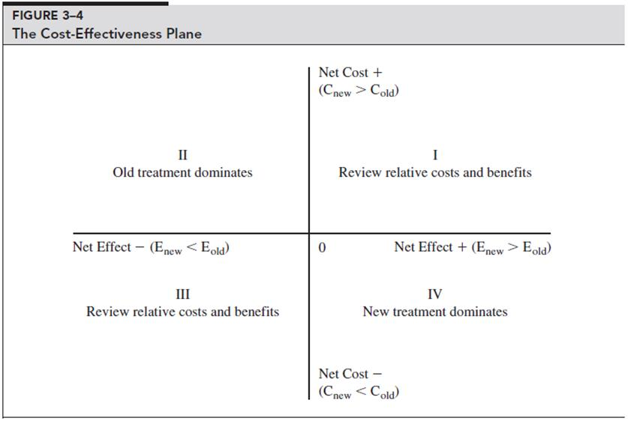
The Cost-Effectiveness Plane
Quadrant IV
C _{new}< C _{old and} E _{new} > E _{old}
_{Take on new treatment}
Quadrant II
C _{new}> C _{old and} E _{new} < E _{old}
_{Old treatment dominates}
Quadrant I
C _{new}> C _{old and} E _{new} > E _{old}
_{Use CEA to decide}
Is the increase in cost worth the improved health?
Quadrant III
C _{new}< C _{old and} E _{new} < E _{old}
Is the decrease in health worth the savings?
Notes:
If the new treatment is less costly than the old (C _{new} < C _{old}) and more effective ( E _{new} > E _{old}), then the new treatment is said to dominate the old and should be adopted. This situation is depicted in quadrant IV of Figure 3-4, where the net effect ( E _{new} – E _{old}) is measured on the horizontal axis and the net cost (C_{new} – C_{old}) is measured on the vertical axis.
On the other hand, if the new treatment is both more costly and less effective than the old, then the old is dominant (quadrant II in Figure 3-4). In this situation, the new treatment should not be adopted.
The most interesting case is when the new treatment is more effective than the old and at the same time more costly. This situation is captured in quadrant I of Figure 3-4. CEA becomes an important tool of analysis under this circumstance because a decision has to be made regarding whether the new treatment is worth adopting or not. The basic question becomes: Is the gain in improved health brought about by the new treatment worth the additional cost in dollars? For example, assume that the new treatment costs $5,000 per additional life-year saved. This seems like a rather small price to pay for a life-year and most would conclude that the new treatment should be adopted. But what happens if the cost is $150,000 per additional life-year saved? Is the cost of the new treatment worth the benefits in terms of life-years saved? Or, put in other terms, what is the threshold point at which a particular medical treatment or technology is simply too costly to adopt? Clearly, there is no straightforward answer. However, many agree that if the cost of a new medical treatment is less than $50,000 per additional year of life saved it is generally viewed favorably. Cutler (2004) places the threshold at double that amount, arguing that the value of a year of life is around $100,000.
Finally, we have the case where the new technology is less costly and less effective than the old. This situation is depicted in quadrant III of Figure 3-4 and the relevant question becomes whether the decrease in health is worth the cost savings. CEA is needed to provide the relative cost savings per life-year. Given that the major emphasis in medical care is on improving or extending life, very little attention is paid in literature regarding this possibility.

Slide 10
Drawbacks of Cost-Effectiveness?
Life-years are not homogenous
Trade-offs between life-years vs. quality of life
Some interventions provide one vs the other.
Notes:
Even cost effectiveness analysis is not without its critics. Some argue that life-years are not homogenous. Sometimes a medical intervention is associated with a significant number of life-years saved but a reduced quality of life. Conversely, a medical intervention may result in few life-years saved but an enhanced quality of life. For example, some analysts claim that coronary bypass operations do more to enhance the quality of life than they do to extend life.

Slide 11
Cost-Benefit Analysis (CBA)
Measures the total cost (direct medical care costs, direct non-medical costs, and indirect costs) against total benefits (health and non-health benefits) in money terms.
Assumes rationality:
People can rank their preferences from high to low
People don’t purposely choose to make themselves worse off
Assumes we optimize:
Expected Net Benefit of X = Exp. Benefit of X – Exp. Cost of X
$NB^{E}\left(X\right)=B^{E}\left(X\right)−C^{E}\left(X\right)$
Where X is a particular choice or activity under consideration.
Notes:
CBA allows the aggregation of health and non-health benefits because it values benefits, as well as costs, in money terms. In the United States, the Office of Management and Budget requires that a CBA be performed for all 'economically significant' regulations proposed by Federal agencies.
Formal cost-benefit analysis utilizes the same net benefit calculus to establish the monetary value of all the costs and benefits associated with a given health policy decision.
Here is a nicely-presented discussion of cost-benefit analysis and cost-effectiveness analysis: https://www.ahrq.gov/professionals/education/curriculum-tools/population-health/russell.html

Slide 12
How do we optimize Expected Net Benefit?
Max TNSB(Q) = TSB(Q) – TSC(Q)
Q identifies the decision variable – how many medical services to produce
TSB = Total Social Benefit assoc. with consuming and producing medical services
The money value of the satisfaction gained from consuming different amounts of medical services.
TSB increases at a decreasing rate reflecting the law of diminishing marginal utility.
TSC = Total Social Cost assoc. with consuming and producing medical services
The money value of resources used in the producing different amount of medical services.
TSB increasing at an increasing rate indicating the law of diminishing marginal productivity.
TNSB = Total Net Social Benefit
Notes:
This Equation allows for the fact that the levels of benefits, costs, and net social benefit depend on the quantity of medical services, Q. We maximize TNSB by choosing the quantity of medical services at which the difference between TSB and TSC reaches its greatest level.

Slide 13
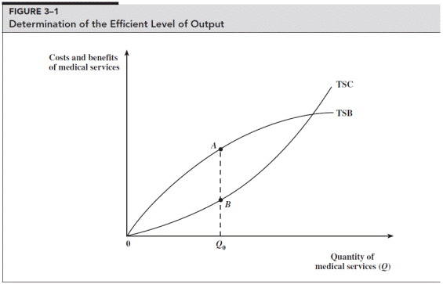
Optimization of Total Net Social Benefit
Marginal social benefit
(MSB) = ΔTSB/ΔQ or slope of TSB curve
Marginal social cost
(MSC) = ΔTSC/ΔQ or slope of TSC curve
Geometric principle – the distance between two curves is maximized when slopes are equal.
In other words, when
MSB = MSC
Notes:
Q₀ represents the efficient level of medical services because TNSB, the vertical difference between TCB and TSC, is the greatest.

Slide 14
A Marginal Perspective of the Efficient Level
$
A
MSC
E
G
C
F
H
B
MSB
Q_{L}
Q₀
Q_{R}
Quantity of Medical Services
Q
The amount of medical services at Q₀ is efficient because MSB = MSC. Q_{L} reflects underprovision
because MSB > MSC and Q_{R} indicates overprovision because MSC > MSB. Triangular areas
ECF and GCH reflect the deadweight losses associated with inefficient outcomes.

Slide 15
The Net Benefit Calculus - revisited
Our task of maximizing total net social benefit can be restated as setting the net marginal social benefit (NMSB) of each and every good equal to zero, or
NMSB(Q) = MSB(Q) – MSC(Q) = 0
If NMSB(Q) > 0 produce more
If NMSB(Q) < 0 produce less
Notes:
So, to summarize, we maximize social benefit and reduce net social cost – at the margins this means that we optimize where the net of the marginal social benefit equals zero.
The last two lines in this slide tell us something about what a policymaker might actually have to deal with. We aren’t necessarily going to have a point estimate of a Quantity such that NMSB = 0, but they may be able to estimate NMSB at the current level of Q, which would give them some idea of whether they should increase or decrease Q.
In practice, estimating the cost and benefit functions, or putting a dollar value on all of the costs and benefits of a health policy decision become the difficult part of this picture.

Slide 16
Practical Side of C/B Analysis
Several steps must be taken to implement C/B analysis in practice.
Enumerate and quantify the benefits of the program or intervention, this includes:
Medical costs diverted because an illness is prevented
Monetary value of any gains in productivity because death is postponed or illnesses prevented
The monetary value associated with the utility of being in a state of good health
Costs must be enumerated and quantified, e.g.,
Opportunity cost of each and every resource involved in the program or intervention.
Should capture both the money (explicit) and time (implicit) cost of resources.
Notes:
The first benefit is usually the easiest to calculate and involves estimating the medical costs that would have been incurred had the medical treatment not been implemented. The second benefit involves projecting the value of an individual’s income that would be lost due to illness or death.
The last benefit is the most subjective and therefore the most difficult to quantify, because it involves estimating the monetary value of the pleasure people receive from a longer life and good health. For example, how does one attach a dollar value to the decrease in pain and suffering an individual may experience after hip replacement surgery? Or what is the monetary value of the satisfaction a parent receives from watching a child grow up?
Given the difficulty involved in measuring the pleasure of life, many studies simply calculate the other three types of benefits. The resulting figure is considered to reflect a lower-bound estimate of total benefits.

Slide 17
Discounting
$100 today vs $100 one year from today
If we have a savings account with 4% APY, then the Present Value of $100 today = $104 and the PV of $100 one year from today = $100
Formally: $PV= \frac{F}{(1+r)}$ where F is a fixed sum of money and r is the annual interest rate, or rate at which the sum is discounted
Notes:
The costs and benefits of any medical decision are likely to accrue over time rather than at a single point in time. For example, the benefits of a polio vaccination are felt primarily in terms of allowing children who might otherwise have been afflicted with polio to lead normal, healthy, active lives. The benefits in this case accrue over many decades.
So, we make an adjustment to account for the fact that a benefit (or a cost) received today has more value than one received at a future date. To do this, the net benefit of an activity yielding a stream of future returns must be expressed in present value (PV) terms.
In simplest terms, PV means that an individual prefers $100 today rather than a year from now. Even if the individual wants to spend the money a year from now, he or she is still made better off by accepting the money today. For example, $100 deposited in a savings account offering a 4 percent annual return yields $104 a year later. We say that the PV of $104 to be received a year from now at a 4 percent rate of interest equals $100.
Stated in financial terms, a dollar received today is worth more than a dollar received tomorrow.

Slide 18
Discounting sums received over a number of periods
If different sums of money (or net benefits) are received over a number of years, n, our formula for calculating the Present Value is:
$$PV= \frac{F_{1}}{{\left(1+r\right)}^{1}}+\frac{F_{2}}{{\left(1+r\right)}^{2}}+\frac{F_{3}}{{\left(1+r\right)}^{3}}+ …+ \frac{F_{n}}{{\left(1+r\right)}^{n}}$$
For simplicity, we assume the discount rate is fixed over time.
We often re-write this equation in summation form, and in terms of costs and benefits (instead of in terms of a sum of money)
$$NB=\sum_{t=1}^{T}{\frac{(B_{t}−C_{t})}{{\left(1+r\right)}^{t}}}$$
Notes:
Each annual payment is expressed in today’s dollars by dividing it by the discounting factor. The discounting factor equals 1 plus the rate of interest raised to the appropriate power, which is the number of years in the future when the payment is to be received. The sum total, or PV, represents the present value of all annual payments to be received in the future.
Careful consideration must be given to the choice of the discount rate. The discount rate should reflect society’s time preference for goods and services.
If the chosen rate is higher than the true rate, short-term interventions will be chosen over long-term interventions.
The T-bill rate is often used and studies normally examine the sensitivity of the results to different discount rates.

Slide 19
The Value of Life
To properly estimate the total benefits of medical or policy intervention, we try to estimate the value of a human life.
Two ways we typically do this:
The Human Capital approach
The Willingness-to-Pay approach
Notes:
To properly estimate the total benefits of a medical intervention, we try to estimate the value of a human life. Because medical interventions (i.e. asthma treatment or heart disease treatment) and policy interventions (i.e. vaccine programs, diabetes screenings, etc.) usually extend life or improve the quality of life, we need to calculate some value of life in order to calculate the benefit of the intervention (for CBA).

Slide 20
The Human Capital Approach
Equates value of life to the market value of output produced by an individual during remaining years of their expected lifetime.
In other words, estimating a discounted PV of future earnings from an improvement or extension of life.
Most widely used method
Cons:
Gender and Racial discrimination in the labor market
Fails to consider non-market returns from other activities
Value of leisure time, value of pain/suffering averted
Estimates zero value for chronically unemployed individual

Slide 21
Willingness to Pay Approach
Assigns a value of life based upon someone’s willingness to pay for a small reduction in the probability of dying.
Often this kind of information is revealed when people purchase safety equipment or are compensated for working in risky jobs.
Advantage – measures the total value of life, both job market value and leisure time..
Disadvantage – difficult to develop precise, reliable data about how much people value safety.

Slide 22
Reconciling the Human Capital and Willingness to Pay Approaches
Keeler (2001) JHE
Points out that standard economic models of labor supply assume that the value of leisure time at the margin is equal to the marginal wage rate (i.e., marginal cost equals marginal benefit of working).
If we assume the value of all time is equal to the wage rate (no diminishing returns due to leisure – if so a lower bound estimate), we can calculate the value of life by multiplying the wage rate by total discounted hours of life time remaining.
“Neither the estimates of value of life in the literature nor these estimates of value of lifetime remaining are very precise, but it is amusing that they are so close to each other. Maybe people really do make these calculations implicitly in choosing a job, or answering a survey.”

Slide 23
Reconciliation - continued
Makes these assumptions
Workers stay employed for 5 years after we first observe them working.
After the initial period they revert to the 1990 participation rates: 92% of 25-54 year old mean remain employed; 70% of men 55-64; 16% of men 65 and over; 75% of 25-54 year old women; 46% of women 55-64; 9% of women 65 and older.
Hour wage rate given by the 1990 median weekly earnings for full-time wage and salary workers in their age-sex category divided by 40.
Workers work 2000 hours per week, if employed.
Workers live up to age 40 and then follow average US 1992 mortality rates.
Discount rate is 3%.

Slide 24
Value of life based on value of work and leisure time
Keeler, 2001, Makes these assumptions
Workers stay employed for 5 years after we first observe them working.
After the initial period they revert to the 1990 participation rates: 92% of 25-54 year old mean remain employed; 70% of men 55-64; 16% of men 65 and over; 75% of 25-54 year old women; 46% of women 55-64; 9% of women 65 and older.
Hour wage rate given by the 1990 median weekly earnings for full-time wage and salary workers in their age-sex category divided by 40.
Workers work 2000 hours per week, if employed.
Workers live up to age 40 and then follow average US 1992 mortality rates.
Discount rate is 3%.
Initial age of worker | Present Value of future working hours | Present Value of future hours | Value of future working hours/ value of all future hours
Male 20 | 532,000 | 2,771,000 | 19.2
Male 30 | 491,000 | 2,669,000 | 18.1
Male 40 | 418,000 | 2,438,000 | 16.3
Male 50 | 287,000 | 2,000,000 | 14.3
Female 20 | 354,000 | 2,238,000 | 15.8
Female 30 | 311,000 | 2,085,000 | 14.9
Female 40 Female 50 | 248,000 156,000 | 1,838,000 1,496,000 | 13.5 10.4
Keeler, 2001, JHE

Slide 25
Viscusi: The Value of Risks to Life and Health
Notes:
<<insert some slides about the Viscusi Paper here>>

Slide 26
Viscusi: The Value of Risks to Life and Health
Viscusi (1993) JEL found willingness to pay estimates to range between $3 million and $7million in 1990 based on labor market studies where workers must be compensated for undertaking risky jobs. Note the figure for wage premiums for dangerous factory jobs in Table 7-2.
Viscusi and others point out the willingness to pay numbers greatly exceed human capital estimates by a sizeable margin.
Notes:
<<insert some slides about the Viscusi Paper here>>

Slide 27
Calculating the Value of Statistical Life
Suppose 1/10,000 risk to 10,000 people so 1 expected death
Assume each would pay $800 to eliminate the risk
VSL = 10,000 people × $800/person = $8,000,000

Slide 28
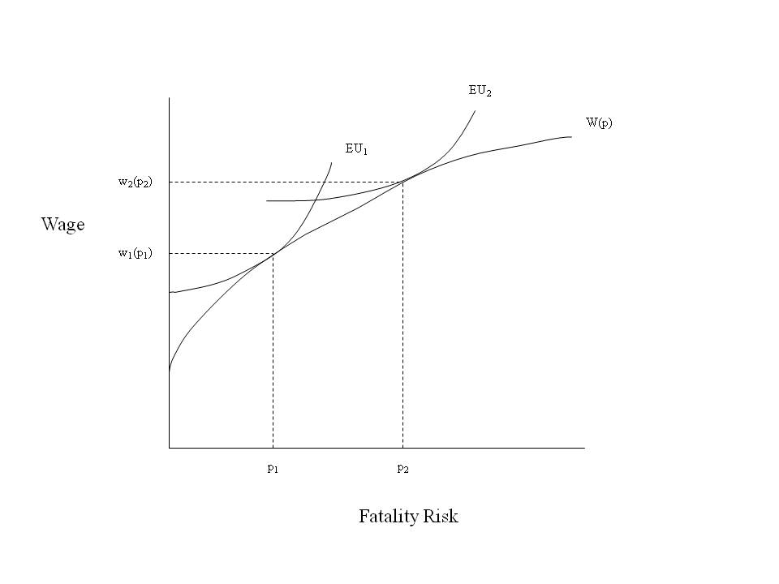
Heterogeneity Based on Risk Level, cont’d
Early studies found workers with fatality risk of 1/10,000 (Viscusi 1978, 1979) had VSL 5 times greater than study of workers facing risk of 1/1,000
That is, workers with lower VSL are more willing to take risky jobs relatively with less wage compensation for the additional risk.

Slide 29
Segmented Labor Markets
Workers may face different labor market offer curves
Settle into separate labor market equilibria (Viscusi and Hersch 2001)
Test: If workers face greater risk levels but receive less total wage compensation for risk, then cannot be on same market offer curve.
Smokers and Nonsmokers (Viscusi and Hersch 2001)
Black-white VSL differences (Viscusi 2003)
Mexican immigrants versus other immigrants or native Americans (Hersch and Viscusi 2010) .

Slide 30
Using VSL Saves Lives
VSL is used by policy makers interested in regulation
If benefits (calculated by VSL) exceeded costs, regulation is issued
Historical context is that VSL was more supportive of risk regulation than making lives “priceless”
VSL more recently under attack for pricing lives.

Slide 31
Should Income Levels Matter?
VSL increases with income
Provide policies poor don’t value?
Airline safety – should we regulate it more stringently than highway safety?
Planes versus guardrails
DOT adopted Viscusi-Aldy (2003) elasticity estimate of 0.55.
Rationale is stronger if beneficiaries of safety regulation pay for higher costs of safety.

Slide 32
Similarly, wealthier nations have a higher estimated VSL.
Is this reasonable?

Slide 33
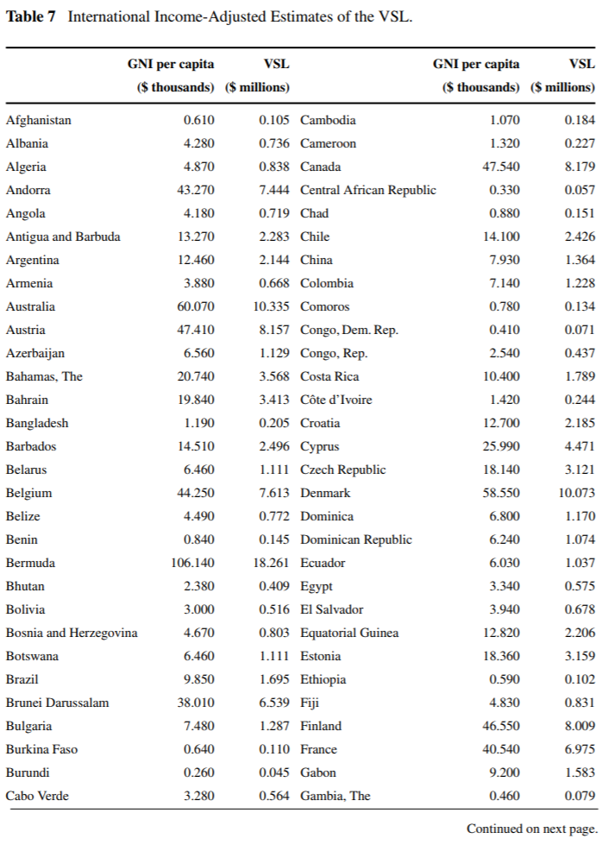
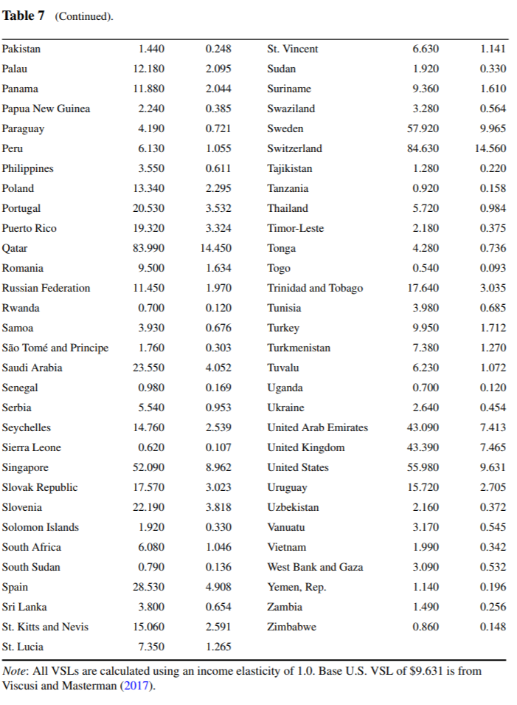
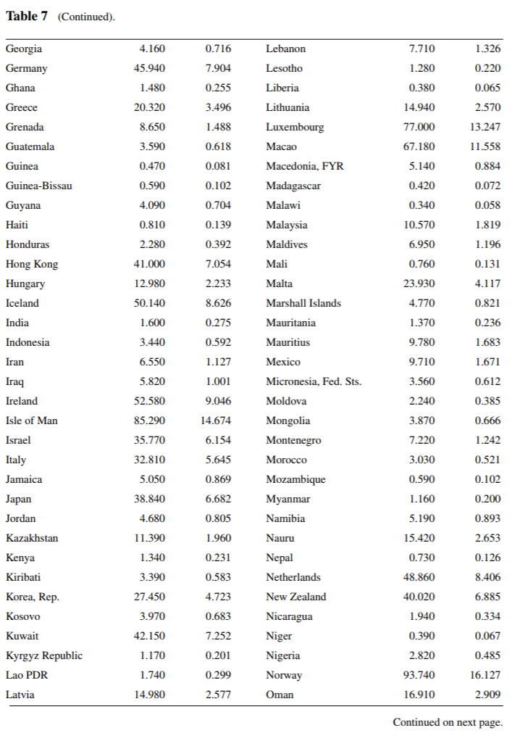

Slide 34
Other Sources of Variation in Valuing Life
How people die matters:
Victims of terrorism versus natural disasters differ by factor of 2 in society’s valuation of reducing their risks (Viscusi 2009)
Society is less willing to pay to prevent risks of “Irresponsible behavior by people who put themselves at risk” e.g., railway trespassers and suicides (Covey, Robinson, Jones-Lee, and Loomes 2010). .
Notes:
-- Wtp to avoid risk from terrorism is twice as high as wtp to avoid similar risk from natural disaster
-- we (society) are less willing to pay to prevent suicides (tall fences on bridges) than to prevent other riks, similarly, we are less willing to pay to prevent reckless behavior near rails/trains

Slide 35
Discussion
Here are a series of two brief videos that talk about cost-effectiveness analysis – they provide a good non-technical overview of CEA and how it works.
The first video presents two methods that we didn’t talk about in class/aren’t in the book: the standard gamble method and time trade-off calculations
https://www.youtube.com/watch?v=UeKQ7kBc33w
This second video talks about one way of calculating QALY’s as a discussion of why CEA has become a politicized issue in the US.
https://www.youtube.com/watch?v=RSBaEz10sQk

