Slide 1
HCMI 4225: Affordable Care Act
BUSN 203: Mon/Wed 9:30 AM – 10:45PM
Shane Murphy – shane@uconn.edu
Office Hours: Mon/Wed 11:00 AM – 12:30PM

Slide 2
Children's Health Insurance Program
Chip is a federally funded, state administered program that covers children from low income families who do not qualify for Medicaid. Chip covers up to between 175% FPL and 405% FPL (average 255% FPL), 9 million children
  Created by Ted Kennedy and Orrin Hatch in response to the failure of HillaryCare
  Part of the budget act in 1997
  Federal funds to state run programs
  Funded by tobacco taxes
Expired in 2017, but states kept it running, reauthorized and extended to 2027 in early 2018 as part of February budget (ending first shutdown during Trump administration)

Slide 3
Summary of the ACA
Require most U.S. citizens and legal residents to have health insurance.
Create state-based American Health Benefit Exchanges through which individuals can purchase coverage, with premium and cost-sharing credits available to individuals/families with income between 133-400% of the federal poverty level (the poverty level is $19,530 for a family of three in 2013) and create separate Exchanges through which small businesses can purchase coverage.
Require employers to pay penalties for employees who receive tax credits for health insurance through an Exchange, with exceptions for small employers.
Impose new regulations on health plans in the Exchanges and in the individual and small group markets.
Expand Medicaid to 133% of the federal poverty level.

Slide 4
Medicaid Expansion
https://www.healthinsurance.org/medicaid/
https://www.kff.org/uninsured/fact-sheet/key-facts-about-the-uninsured-population/

Slide 5
Questions
According to KFF Appendix A:
  What was the rate of uninsured in 2013 and 2016? What was the change in rate in percentage points? How many people was that?
According to healthinsurance.org:
  Who qualifies for Medicaid?
  What is the state Medicaid system called?
  How many additional people are covered or would be covered by an expansion?
  Are there any issues in the application system? Are there any interesting details about Medicaid in your state?

Slide 6
Expanding
State | 2013 Uninsurance Rate | 2017 Uninsurance rate | % point change | # change | Qualification (FPL) | # change in Medicaid/CHIP | Name of State Program | Other
Mass | 4.4% | 3.2% | 1.2% | 63,200 | 138% | 302,000 | MassHealth
Alaska | 20.5% | 15.5% | 5.0% | 32,900 | 138% | 81,157 | Alaska Medicaid
Maine | 13.4% | 9.8% | 3.6% | 41,500 | 100%? | 70,000 | MaineCare
New York | 12.5% | 6.7% | 5.8% | 961,800 | 138% | 812,875 | New York Medicaid
Pennsylvania | 11.5% | 7.0% | 4.5% | 508,400 | 138% | 584,465 | HealthPennsylvaniaCoverage | Seeking work requirement
Kentucky | 16.8% | 6.0% | 10.8% | 380,900 | 138% | 634,807 | Kentucky Medicaid
Not Expanding
State | 2013 Uninsurance Rate | 2017 Uninsurance rate | % point change | # change | Qualification (FPL) | Potential # change in Medicaid/CHIP if expanded | Name of State Program | Other
Wisconsin | 10.5% | 6.1% | 4.4% | 213,900 | 100% | 176,000 | BadgerCare | Subsidies exist for private purchases between 100% and 400% FPL
Oklahoma | 20.6% | 16.1% | 4.5% | 130,200 | 0% | 233,000 | Sooner Medicaid | state program to assist low income adult
Texas | 24.6% | 19.6% | 5.0% | 879,100 | 0% | 1,685,000 | StarMedicaid | Pay the most taxes towards Medicaid
South Dakota | 14.6% | 11.0% | 3.6% | 23,900 | 0% | 43,000.00 | Medicaid | Seeking work requirement
Wyoming | 14.7% | 14.5% | 0.2% | 3,100 | 0% | 27,000 | Medicaid

Slide 7
Expanding
State | 2013 Uninsurance Rate | 2017 Uninsurance rate | % point change | # change | Qualification (FPL) | Name of State Program | # change in Medicaid/CHIP | Other
Not Expanding
State | 2013 Uninsurance Rate | 2017 Uninsurance rate | % point change | # change | Qualification (FPL) | Name of State Program | Potential # change in Medicaid/CHIP if expanded | Other

Slide 8
Expanding
State | 2013 Uninsurance Rate | 2016 Uninsurance rate | % point change | %change | Qualification (FPL) | Name of State Program | Other
Connecticut | 11.8 | 7.2 | 4.6 | 0.3898305 | 138% | Husky | Early Expander
North Dakota | 12.1 | 8.9 | 3.2 | 0.2644628 | 138% | Medicaid | Lowest eligibility cap for CHIP
Colorado | 13.8 | 10.8 | 3 | 0.2173913 | 138% | Health first Colorado | Provided Coverage for children who have short residency
Massachusetts | 3.6 | 6.4 | -2.8 | -0.7777778 | 138% | MassHealth | Litigation
New York | 11.1 | 6.6 | 4.5 | 0.4054054 | 138% | Medicaid | Previous state funded support for individuals now heavilly dependent on ACA
New Jersey | 13.4 | 9 | 4.4 | 0.3283582 | 138% | New Jersey Medicaid | Early Expander
California | 16.4 | 8.7 | 7.7 | 0.4695122 | 138% | Medical | Undocumented children eligible
All States | 13.6 | 8.1 | 5.5 | 0.4044118
Not Expanding
State | 2013 Uninsurance Rate | 2016 Uninsurance rate | % point change | %change | Qualification (FPL) | Name of State Program | Other
Florida | 22 | 14.6 | 7.4 | 0.3363636 | 29% | Medicaid | Use SSI for qualifiction
South Dakota | 11.6 | 9.4 | 2.2 | 0.1896552 | 58% | Medicaid | Proposed work requirement
Maine | 11.3 | 8.7 | 2.6 | 0.2300885 | 100% | Maine Medicaid
Alabama | 17.8 | 10.1 | 7.7 | 0.4325843 | 13% | Medicaid | Low coverage for childless adults, State supported study suggested expansion
Georgia | 18.5 | 13.7 | 4.8 | 0.2594595 | 35% | Georgia Medicaid | One of the lowest income limits
Texas | 22.8 | 17.1 | 5.7 | 0.25 | 0% | Medicaid
All States | 18.1 | 13.3 | 4.8 | 0.2651934

Slide 9
Path to the ACA
Presidential Primaries
  CHOICE, Edwards, Hacker, and the medicare-based public option
Clinton and Obama
  Exchanges with public option
Joe Lieberman (I-CT)
  Senator from 1989-2013
Effects of the public option:
  Accountability, cost, market
  National vs federated pool

Slide 10
Veto Points vs Toll Booths
Public option
Cornhusker Kickback
  https://www.youtube.com/watch?v=w_Q_x3BaY6U

Slide 11
Individual Mandate
Require U.S. citizens and legal residents to have qualifying health coverage.
  Those without coverage pay a tax penalty of the greater of $695 per year up to a maximum of three times that amount ($2,085) per family or 2.5% of household income.
  The penalty was phased-in according to the following schedule: $95 in 2014, $325 in 2015, and $695 in 2016 for the flat fee or 1.0% of taxable income in 2014, 2.0% of taxable income in 2015, and 2.5% of taxable income in 2016.
Beginning after 2016, the penalty will be increased annually by the cost-of-living adjustment.
Exemptions will be granted for financial hardship, religious objections, American Indians, those without coverage for less than three months, undocumented immigrants, incarcerated individuals, those for whom the lowest cost plan option exceeds 8% of an individual’s income, and those with incomes below the tax filing threshold (in 2009 the threshold for taxpayers under age 65 was $9,350 for singles and $18,700 for couples).

Slide 12
Employer Requirements
For employers with 50 or more full-time employees
  Assess employers with 50 or more full-time employees that do not offer coverage and have at least one full-time employee who receives a premium tax credit a fee of $2,000 per full-time employee, excluding the first 30 employees from the assessment.
  Employers with 50 or more full-time employees that offer coverage but have at least one full-time employee receiving a premium tax credit, will pay the lesser of $3,000 for each employee receiving a premium credit or $2,000 for each full-time employee, excluding the first 30 employees from the assessment.
Exempt employers with up to 50 full-time employees from any of the above penalties.
Require employers with more than 200 employees to automatically enroll employees into health insurance plans offered by the employer. Employees may opt out of coverage.

Slide 13
Expansion of Public Programs: Medicaid
Expand Medicaid to all non-Medicare eligible individuals under age 65 (children, pregnant women, parents, and adults without dependent children) with incomes up to 133% FPL based on modified adjusted gross income (as under current law undocumented immigrants are not eligible for Medicaid).
  All newly eligible adults will be guaranteed a benchmark benefit package that meets the essential health benefits available through the Exchanges.
The Supreme Court ruling on the constitutionality of the ACA upheld the Medicaid expansion, but limited the ability of HHS to enforce it, thereby making the decision to expand Medicaid optional for states.
  To finance the coverage for the newly eligible (those who were not previously eligible for at least benchmark equivalent coverage, those who were eligible for a capped program but were not enrolled, or those who were enrolled in state-funded programs), states will receive 100% federal funding for 2014 through 2016, 95% federal financing in 2017, 94% federal financing in 2018, 93% federal financing in 2019, and 90% federal financing for 2020 and subsequent years.
  States that have already expanded eligibility to adults with incomes up to 100% FPL will receive a phased-in increase in the federal medical assistance percentage (FMAP) for non-pregnant childless adults so that by 2019 they receive the same federal financing as other states (93% in 2019 and 90% in 2020 and later).
  States have the option to expand Medicaid eligibility to childless adults beginning on April 1, 2010, but will receive their regular FMAP until 2014. In addition, increase Medicaid payments in fee-for-service and managed care for primary care services provided by primary care doctors (family medicine, general internal medicine or pediatric medicine) to 100% of the Medicare payment rates for 2013 and 2014.
  States will receive 100% federal financing for the increased payment rates.

Slide 14
Expansion of Public Programs: CHIP
Require states to maintain current income eligibility levels for children in Medicaid and the Children’s Health Insurance Program (CHIP) until 2019 and extend funding for CHIP through 2015.
  CHIP benefit package and cost-sharing rules will continue as under current law. Provide states with the option to provide CHIP coverage to children of state employees who are eligible for health benefits if certain conditions are met. Beginning in 2015, states will receive a 23 percentage point increase in the CHIP match rate up to a cap of 100%. CHIP-eligible children who are unable to enroll in the program due to enrollment caps will be eligible for tax credits in the state Exchanges.
Note: Chip is a federally funded, state administered program that covers children from low income families who do not qualify for Medicaid. Chip covers up to between 175% FPL and 405% FPL (average 255% FPL), 9 million children

Slide 15
Premium and Cost-Sharing Subsidies to Individuals
Provide refundable and advanceable premium credits to eligible individuals and families with incomes between 100-400% FPL to purchase insurance through the Exchanges. The premium credits will be tied to the second lowest cost silver plan in the area and will be set on a sliding scale such that the premium contributions are limited to percentages of income between 2% and 9.5%.
  Increase the premium contributions for those receiving subsidies annually to reflect the excess of the premium growth over the rate of income growth for 2014-2018. Beginning in 2019, further adjust the premium contributions to reflect the excess of premium growth over CPI if aggregate premiums and cost sharing subsidies exceed .504% of GDP.
Provide cost-sharing subsidies to eligible individuals and families. The cost-sharing credits reduce the cost-sharing amounts and annual cost-sharing limits
  Ensure that federal premium or cost-sharing subsidies are not used to purchase coverage for abortion if coverage extends beyond saving the life of the woman or cases of rape or incest (Hyde amendment). If an individual who receives federal assistance purchases coverage in a plan that chooses to cover abortion services beyond those for which federal funds are permitted, those federal subsidy funds (for premiums or cost-sharing) must not be used for the purchase of the abortion coverage and must be segregated from private premium payments or state funds.

Slide 16
Premium Subsidies to Employers
Provide small employers with no more than 25 employees and average annual wages of less than $50,000 that purchase health insurance for employees with a tax credit.
  For tax years 2014 and later, for eligible small businesses that purchase coverage through the state Exchange, provide a tax credit of up to 50% of the employer’s contribution toward the employee’s health insurance premium if the employer contributes at least 50% of the total premium cost. The credit will be available for two years. The full credit will be available to employers with 10 or fewer employees and average annual wages of less than $25,000. The credit phases-out as firm size and average wage increases. Tax-exempt small businesses meeting these requirements are eligible for tax credits of up to 35% of the employer’s contribution toward the employee’s health insurance premium
Create a temporary reinsurance program for employers providing health insurance coverage to retirees over age 55 who are not eligible for Medicare. Program will reimburse employers or insurers for 80% of retiree claims between $15,000 and $90,000. Payments from the reinsurance program will be used to lower the costs for enrollees in the employer plan. Appropriate $5 billion to finance the program. (Effective 90 days following enactment through January 1, 2014)

Slide 17
Tax changes related to health insurance: Credits
Refundable Tax Credit for purchasers of health insurance through state or federal exchanges who have incomes between 100% and 400% FPL
Tax credit for employers with fewer than 25 workers and average wages under $50,000

Slide 18
Tax changes related to health insurance: Excise taxes
Excise tax on individuals without adequate/qualifying health insurance coverage (exempting low income individuals and other groups)
Excise tax on employers of 50+ not offering adequate/qualifying health insurance coverage
Excise tax on employers offering “Caddilac” insurance plans
Excise tax on health insurance providers, pharmaceutical companies, and medical device companies

Slide 19
Tax changes related to health insurance: Excise taxes
Increase in payroll taxes of 0.9%
3.8% tax on net investment income for individuals with incomes exceeding $200,000 or couples with incomes exceeding $250,000
Additional limit on medical expense deduction
  Pre-ACA, taxpayers could deduct medical expenses exceeding 7.5 percent of income when calculating taxable income. Post-ACA, only medical expenses exceeding 10 percent of income can be deducted.

Slide 20
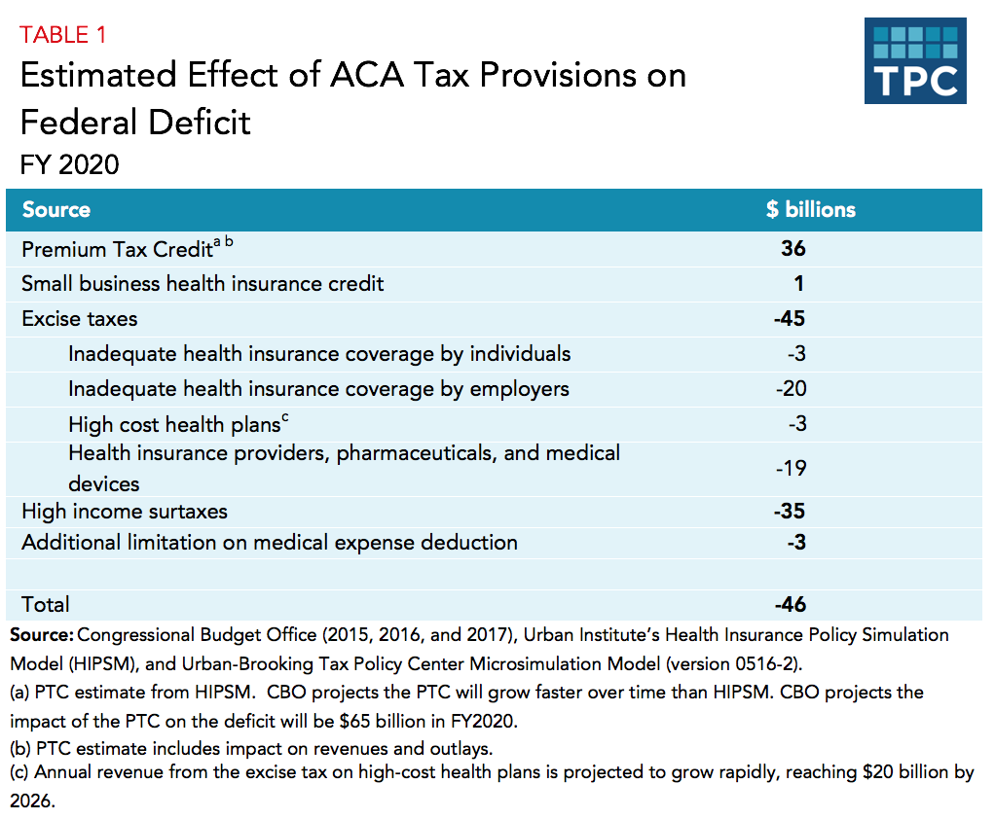

Slide 21
Additional Changes
Health Exchanges
Benefit Design
Cost Containment
Quality
  Pay-for-performance
Prevention, wellness, and long term care changes

Slide 22
National Federation of Independent Business v. Sebelius
(2012)
Consolidated suits by the NFIB and by the State of Florida
Other suits by the state of Virginia, Liberty University (Liberty University v. Geithner), a group of people with religious objections in DC (Mead V. Holder), a law group in Michigan (Thomas More Law Center v. Obama), and Seven-Sky v. Holder (as CoA judge, Kavanaugh dissented – see http://www.scotusblog.com/2018/07/kavanaugh-on-the-affordable-care-act-seven-sky-v-holder/)
Kathleen Sebelius
  Secretary of Health and Human Services (2009-2014)

Slide 23
National Federation of Independent Business v. Sebelius
(2012)
Constitutional:
  Anti-Injunction Act – individuals can’t sue to avoid paying taxes
    Court found that since the act is a penalty and not a tax, suits were allowed
  Congress taxing power
    The individual mandate was a valid exercise of taxing power
Medicaid Expansion
  Roberts, Breyer, and Kagan felt states should be allowed to opt out
  Scalia, Kennedy, Thomas, and Alito felt Medicaid expansion (and the entire ACA) was unconstitutional
  Ginsburg and Sotomayor dissented, would have upheld Medicaid expansion in all states
  Commerce Clause and the Necessary and Proper Clause
  “As for the Medicaid expansion, that portion of the Affordable Care Act violates the Constitution by threatening existing Medicaid funding. Congress has no authority to order the States to regulate according to its instructions. Congress may offer the States grants and require the States to comply with accompanying conditions, but the States must have a genuine choice whether to accept the offer.” – John Roberts

Slide 24
Tax Cuts and Jobs Act of 2017
Repeals the individual mandate, effective starting in 2019
  Reduces the penalty for going uncovered to zero
~13 million fewer persons would have health insurance by 2025
  8 million fewer on the Affordable Care Act exchanges and 5 million fewer on Medicaid
Lowers tax credits providing estimated over $300 billion in savings to government between 2020 and 2030

Slide 25
Readings and sources:
Obama, Barack. "United States health care reform: progress to date and next steps." Jama 316, no. 5 (2016): 525-532.
“Summary of the Affordable Care Act.” KFF, April 23, 2013: http://files.kff.org/attachment/fact-sheet-summary-of-the-affordable-care-act
“What tax changes did the Affordable Care Act make?” Tax Policy Center, https://www.taxpolicycenter.org/briefing-book/what-tax-changes-did-affordable-care-act-make

