Slide 1
HCMI 4225: Accountable Care Organizations
BUSN 203: Mon/Wed 11:00 AM – 12:15PM
Shane Murphy – shane@uconn.edu
Office Hours: Mon/Wed 12:30 PM – 2:00PM

Slide 2
Accountable Care Organizations
Definition: A group of physicians (possibly including a hospital) that assumes responsibility for annual Medicare spending for a defined patient population. (defined by the Medicare Payment Advisory Commission – MedPAC)
MedPAC reimbursements to ACOs combines Fee-for-service and P4P.
The idea of ACOs existed prior to the ACA, but the ACA is now seen as creating ACOs through this reimbursement strategy
Idea originated with Pete Welch in 1989

Slide 3
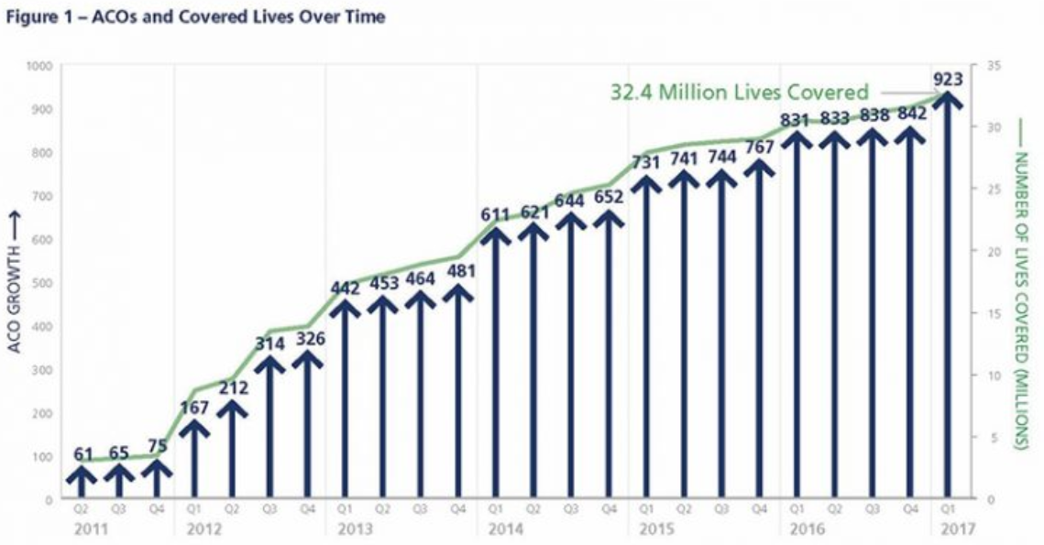
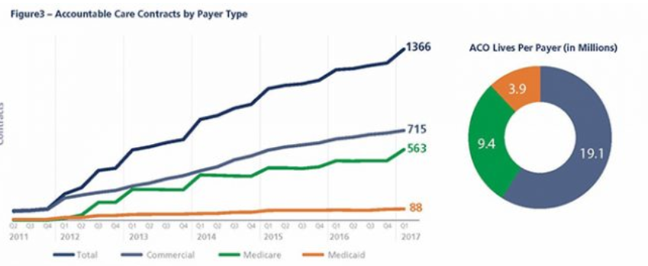
Growth in ACOs
As of 2017, 923 ACO contracts cover 32 million people (10% of the US population)
Commercial and Medicare contracts both significant

Slide 4
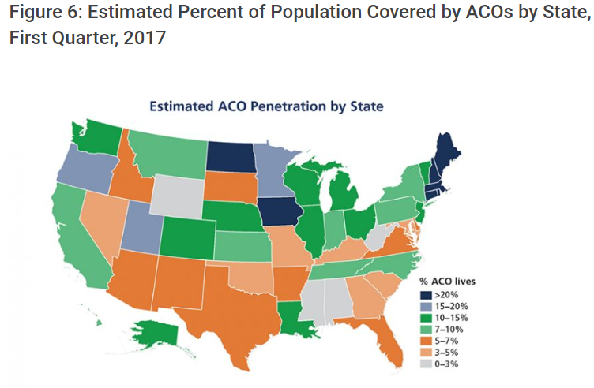
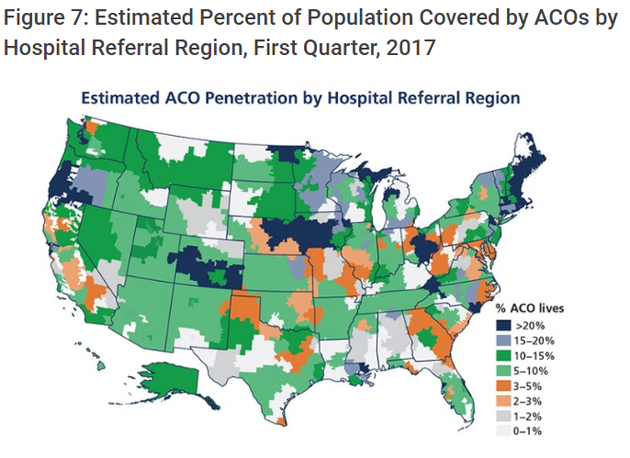
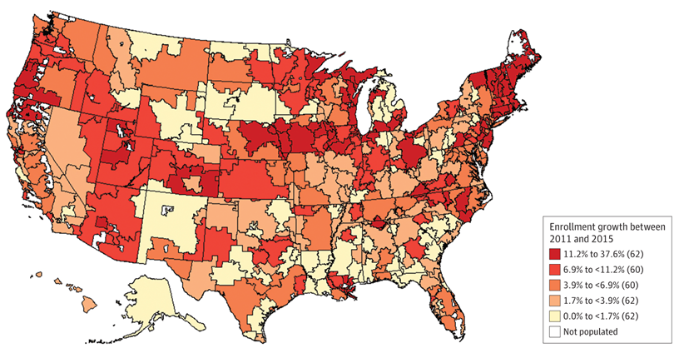
Growth in ACOs
Regional patterns:
ACOs strong in New England, Northern Prairie States, Western Great Lake States
Growing fast in the West
Lagging in the South

Slide 5
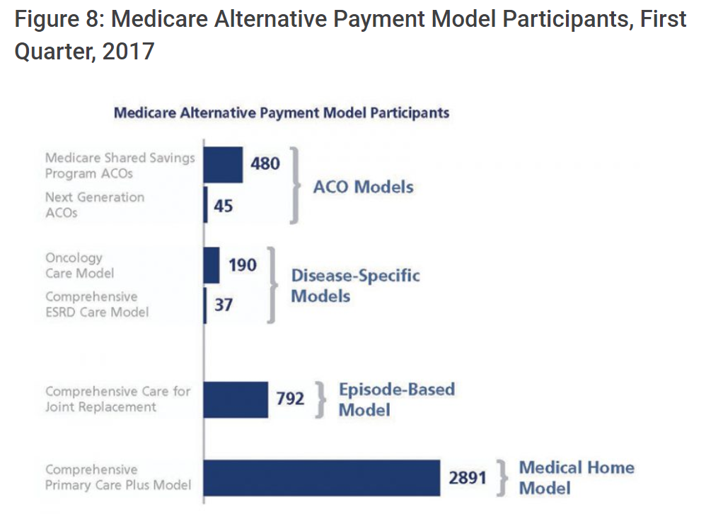
ACOs and APM
Majority of Medicare’s ACOs (561 of all 649 Medicare ACOs in 2018) are in the Medicare Shared Savings Program (MSSP)
Other ACO initiatives:
Next Generation ACO Model and Comprehensive ESRD Care Model

Slide 6
Extended Hospital Medical Staff
Most physicians are affiliated in some way with a local acute care hospital
Outpatient Care
Primary Care
Acute Care
Home Care
Inpatient Care
Pharmacy
Pros
Allow for definition of performance in P4P schemes
Allows for local organizational accountability
Centralizes and organizes efforts at quality improvement and cost containment
Cons
Alternative payment schemes reward high-tech and high volume services – leading to segregation in the market
Physicians prefer high degree of autonomy
Level of autonomy varies
Cost and revenue sharing legally and logistically difficult

Slide 7
Upside-Only Versus Two-Sided ACOs
The majority of Medicare’s ACOs – 460 of the 561 or 82% in 2018 – are in the upside-only “Track 1” of the Shared Savings Program.
Currently, ACOs are allowed to remain in the one-sided track for up to six years.
Notes:
Data from 2016

Slide 8
Upside-Only Versus Two-Sided ACOs
Savings has been less than 0.01% for upside-only ACOs and less than 0.1% for all ACOs.
Notes:
Data from 2016

Slide 9
Meta-analysis and systematic review
Estimate a weighted average from the results of the individual studies
Results can be generalized to a larger population
The precision and accuracy of estimates can be improved as more data is used.
May increase the statistical power to detect an effect
Inconsistency of results across studies can be quantified and analyzed
does inconsistency arise from sampling error, or are study results (partially) influenced by between-study heterogeneity
Hypothesis testing can be applied on summary estimates
Moderators can be included to explain variation between studies
The presence of publication bias can be investigated
Kaufman, Brystana G., B. Steven Spivack, Sally C. Stearns, Paula H. Song, and Emily C. O’Brien. "Impact of accountable care organizations on utilization, care, and outcomes: a systematic review." Medical Care Research and Review(2017): 1077558717745916.

Slide 10
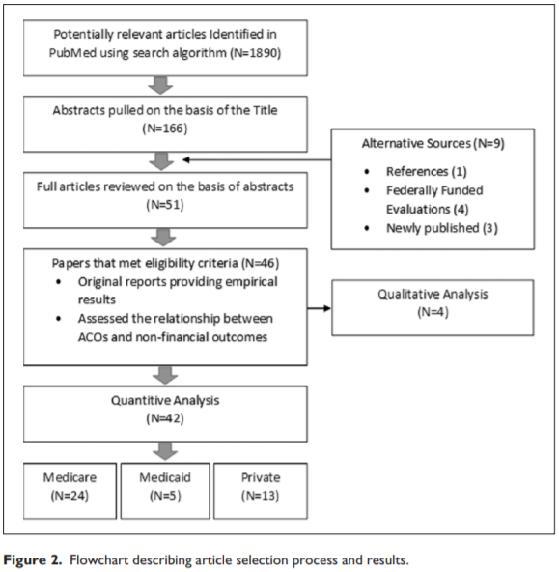
Meta-analysis and systematic review
Selection of studies
Selection/eligibility criteria
Search
N – sample size
Analysis
Qualitative
Quantitative

Slide 11
Quality research
Meta-analysis is only as good as the analysis it is based on (GIGO)
Quality research is based on three principles:
“The selection of the study groups”
Random vs observational
Large sample vs small
Sample representativeness and adaquacy
“The comparability of the groups”
Controls included in data or selection procedure
“The ascertainment of either the exposure or outcome of interest for case-control or cohort studies respectively”
Blind or not blind
Secure, detailed records
Non-response
Similarity of conditions for treatment and control
Length of follow-up

Slide 12
Sample of ACO Programs Evaluated
Read Table 2 as a group
MSSP
Shared Savings

Slide 13
Results
Utilization
Utilization decreased among ACO patients
Especially Inpatient and ED visits
Processes
Quality indicators generally saw improvement in some studies
Changes not large
Outcomes
Possible long-term improvements
Increased patient communication

Slide 14
Readings and sources:
Kaufman, Brystana G., B. Steven Spivack, Sally C. Stearns, Paula H. Song, and Emily C. O’Brien. "Impact of accountable care organizations on utilization, care, and outcomes: a systematic review." Medical Care Research and Review(2017): 1077558717745916.
Muhlestein, David, Robert Saunders, and Mark McClellan. "Growth of ACOs and alternative payment models in 2017." Health Affairs Blog. https://www. healthaffairs. org/do/10.1377/hblog20170628 60719 (2017).
Verma, Seema. “Pathways To Success: A New Start For Medicare’s Accountable Care Organizations.” Health Affairs Blog. https://www.healthaffairs.org/do/10.1377/hblog20180809.12285/full/

Slide 15
CVS
~9,700 retail locations - ~1,100 walk in clinics (MinuteClinics)
Minute Clinics currently can address a little less than half of the conditions seen in primary care – this is proposed to increase to 90%
76 percent of the population of the U.S. lives within five miles of a CVS pharmacy

Slide 16
CVS Caremark
CVS and Caremark merged in 2006/2007
80 percent of the PBM national market is controlled by three suppliers, including CVS
CVS Caremark, the PBM business for CVS Health, is the second largest PBM in the U.S., covering approximately 34% of covered lives

Slide 17
Aetna
Big 5: UnitedHealth Group, Anthem, Aetna, Cigna, Humana (ordered by market share)
Aetna’s market share is either the first or second largest in 57 of 389 Metropolitan Statistical Areas (MSA) studied
Aetna is the only of the big five insurance companies which does not have a significant in-house PBM
Merger with Humana proposed in late 2015, called off in February 2017 (after being blocked in courts)

Slide 18
Amazon
Early 2018 announced partnership with Berkshire Hathaway and JPMorgan Chase to create a health insurance company for their employees
Aquired online pharmacy PillPack in June/July 2018
Yet to see the total effect of these moves

Slide 19
CVS CEO Larry Merlo & Aetna CEO Mark Bertolini
PBS news hour: https://www.youtube.com/watch?v=vuBca96cUUw
CNBC: https://www.youtube.com/watch?v=-FzZN4v-LUI
Merger seen by some to be defensive – Amazon is considering entering the insurance or drug market
Thus there is a lot of focuse on the effect of the deal on mail order

Slide 20
Pros of a merger
COMPETITION IN THE PHARMACEUTICAL SUPPLY CHAIN: THE PROPOSED MERGER OF CVS HEALTH AND AETNA HEARING BEFORE THE SUBCOMMITTEE ON REGULATORY REFORM, COMMERCIAL AND ANTITRUST LAW OF THE COMMITTEE ON THE JUDICIARY HOUSE OF REPRESENTATIVES ONE HUNDRED FIFTEENTH CONGRESS SECOND SESSION FEBRUARY 27, 2018 - https://judiciary.house.gov/wp-content/uploads/2018/02/115-28.pdf
Increased efficiency and reduced health insurance premiums
PPBM/Health Insurance Market – Retail Pharmacy/Basic Urgent Care
Theory of the firm suggests in a competitive market, returns to scale from mergers can lower costs and prices
Theory of the firm suggests in a less competitive market, increased market power can lead to low levels of innovation and monopoly profits

Slide 21
Con: NCPA
Statement for the Record: The National Community Pharmacists Association (NCPA) United States House Subcommittee on Regulatory Reform, Commercial and Antitrust Law Hearing: “Competition in the Pharmaceutical Supply Chain: The Proposed Merger of CVS Health and Aetna” February 27, 2018 - https://docs.house.gov/meetings/JU/JU05/20180227/106898/HHRG-115-JU05-20180227-SD003.pdf
CVS Caremark is the second largest pharmacy benefit manager (PBM) in the US
Some PBMs exclude pharmacyies from their network
It can be difficult to identify in-network pharmacies, and CVS Caremark has been sanctioned for misleading information regarding this
PBMs direct or incentivize the use of certain pharmacies with benefit design (lower co-pay at certain providers)
CVS health sued in early 2018 over forcing HIV patients to use CVS pharmacies or CVS mail order
2012 merger of Express Scripts and Medco (two PBMs) may be a parallel
Evidence demonstrates that mail order pharmacies dispense costlier brand=name drugs and fewer generics than retail pharmacies

Slide 22
Con: NCPA
Statement for the Record: The National Community Pharmacists Association (NCPA) United States House Subcommittee on Regulatory Reform, Commercial and Antitrust Law Hearing: “Competition in the Pharmaceutical Supply Chain: The Proposed Merger of CVS Health and Aetna” February 27, 2018 - https://docs.house.gov/meetings/JU/JU05/20180227/106898/HHRG-115-JU05-20180227-SD003.pdf
Questions:
Will the merged entity use dominant position to increase payments to CVS pharmacies?
Will health plan competitors not want to use CVS pharmacies?
Will CVS Minute Clinics be exclusive to Aetna customers? Will Minute Clinics be privileged in Aetna plans? Will Aetna direct patients to use Minute Clinics? Will Minute Clinic patients be incented to use the CVS pharmacy?
Will mail order be incentivized more, reducing information for patients?
Will saving be passed along?
Will a combined CVS/Aetna limit selling its PBM services to certain health plans or conversely, will health insurance payers exclude CVS/Aetna from its pharmacy network or as its PBM?
Will the deal essentially “cut out” one of the big 3 PBMs therefore lessening bidding intensity by PBMs offering their services to health plans?
Will the deal create a potential horizontal issue by eliminating existing CVS Caremark/Aetna bidding competition in the market for provision of PBM services to non-health insurer plan sponsors, including employers and unions?

Slide 23
Con: AMA
STATEMENT of the American Medical Association to the U.S. House of Representatives Committee on the Judiciary Subcommittee on Regulatory Reform, Commercial and Antitrust Law Re: Competition in the Pharmaceutical Supply Chain: The Proposed Merger of CVS Health and Aetna February 27, 2018 - https://docs.house.gov/meetings/JU/JU05/20180227/106898/HHRG-115-JU05-20180227-SD003.pdf - https://www.youtube.com/watch?v=LKEIyQvsoLs
The PBM Market is performing poorly and needs inovation
CVS prevents Aetna from entering the PBM market
Aetna also will be less popular among potential new PBMs
CVS has been accused of using market power against independent pharmacies
Post-Merger, CVS may refuse either to supply PBM services to Aetna rivals or may provide services on disadvantageous terms – also CVS may refuse to supply pharmacy services to Aetna rivals or may provide services on disadvantageous terms
Merger will require more cooperation among other business, which may lead to anticompetitive behavior due to information sharing among competing health insurers
CVS provides PBM services to Anthem – the second larges health insurer

