Slide 1
HCMI 4225: Public Health Reform
BUSN 203: Mon/Wed 9:30 AM – 10:45PM
Shane Murphy – shane@uconn.edu
Office Hours: Mon/Wed 11:00 PM – 12:30PM

Slide 2
The problem in two graphs
Costs are growing, particularly administrative costs, prices, and overutilization
I prefer to focus on administrative costs
Health isn’t improving and for many it is getting worse
This may not be the fault of the medical health system, but rather the behavioral health system

Slide 3
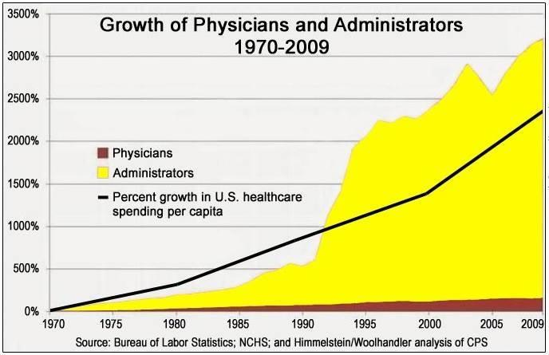

Slide 4
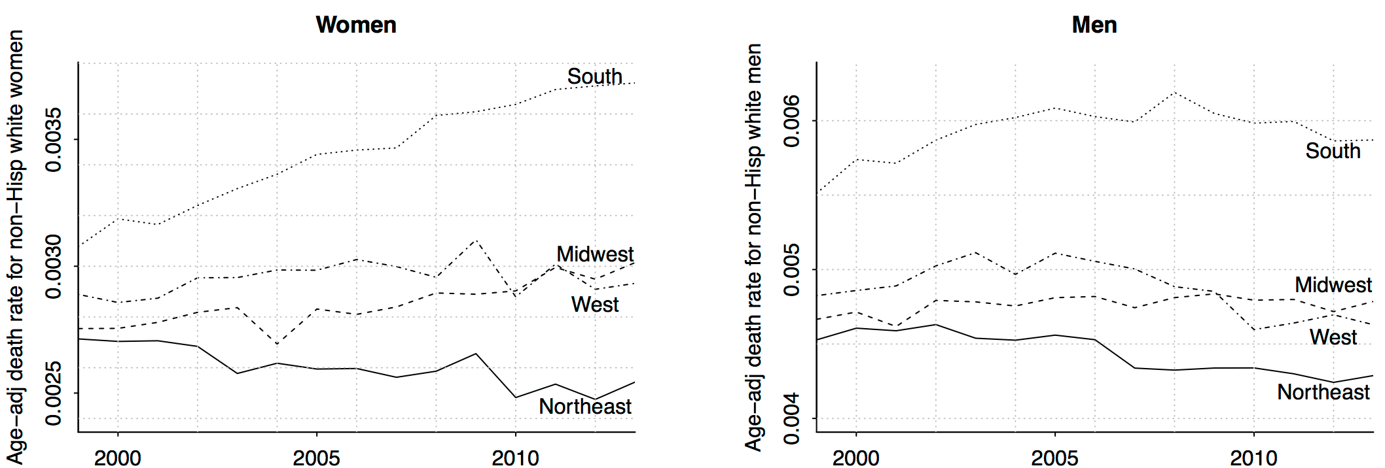
Deaton and Case 2015 (corrected by Gelman 2016)

Slide 5
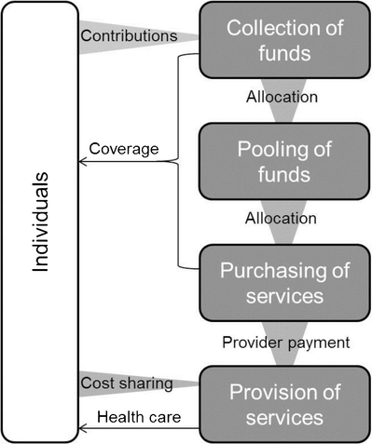
Health care financing reform proposals

Slide 6
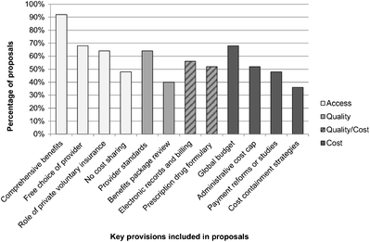
Single-payer proposals

Slide 7
Other single-payer questions
Prohibit private health plans?
Combine Medicare, CHIP, Medicaid, and possibly TriCARE and the IHS
Fully fund women’s health?
State or Federally run Programs?
Cost sharing?

Slide 8
ACA-repeal and replace proposals
Questions:
Reduce subsidies?
Encourage high-deductible plans?
Repeal Medicaid expansion?
Repeal ACA-excise taxes?
Block grants?
Popular ACA provisions:
Pre-existing conditions coverage?
Subsidized insurance for lower income Americans?

