Slide 1
HCMI 4225: Health and Social Insurance
BUSN 203: Mon/Wed 12:30 AM – 1:45PM
Shane Murphy – shane@uconn.edu
Office Hours: ?

Slide 2
Past Student Evaluations: What was the most positive aspect of the way in which this instructor taught this course?
HCMI 4225 Fall 2018 | HCMI 4225 Spring 2019 | HCMI 5243 Spring 2019
He explained the articles after we read them and did assignments on them, instead of just asking what we thought and leaving us confused. Shane was accessible to students and made lectures seem more like a conversation than him talking at us. He is very fun and entertaining, tries to make our very small lecture section fun and worthwhile | Classes were interesting and relevant to current events He had interactive segments throughout the semester which was good. Also, he would show videos to help us understand various concepts. He did a very good job keeping the class interacted with his teachings at all times. He really did a great job helping bolster our health insurance and social insurance knowledge and made sure everyone was on the same page at all times The activities were really helpful for engaging students and we got to choose some of the lecture topics. Also he was really engaged in supporting students learning and wanted us to succeed. | Shane is a nice guy, and very flexible on due dates. Professor brought in current topics and issues that were related to the material allowing for class discussion Professor Murphy has a very Socratic approach to teaching, in that he presents a few opposing perspectives and asks questions in attempt to break them down without letting his own biases guide the discussion toward a particular outcome. The best parts of the class were watching videos of other professionals and academics explaining the material in a concise and interesting manner. Instructor introduced some of world renowned economist/health economist work part of the course; I believe that made a huge impact in the learning process. Providing a lot of published articles as class material, which were really helpful. I think we read some interesting articles this semester.

Slide 3
Past Student Evaluations: What can this instructor do to improve teaching effectiveness in the classroom?
HCMI 4225 Fall 2018 | HCMI 4225 Spring 2019 | HCMI 5243 Spring 2019
Have more of a plan for each day; every day was kind of all over the place Try and find more class activities that can get the class involved. We had a couple, but not a lot. Reach out to other professors to see what information is taught in the lower level healthcare classes. A large amount of the information in this class is a repeat of information I’ve already learned, and the textbook used is the same textbook used for both HCMI 3240 and 3243. In addition, setting objectives a bit more clearly would help. I am not totally sure what the overall purpose of the course was. I definitely learned things, but I feel as though I just learned a wide variety of information without a solid main focus. | Break up the class a little more because sometimes it can very monotonous. I think the only big improvement that could be made is maybe have paper checkpoints for the final paper beginning even earlier in the semester The material was not related from week to week sometimes. It was hard to follow how some of the info was related. Also sometimes the slides were a little word | Use more recent articles for weekly readings. The articles assigned were extremely outdated. I don't feel as though I learned anything about the current economics of health care, but rather I learned more about the history of it. Also assign less reading/writing assignments! This is a part time MBA program and the amount of work given truly felt like a full-time course. The expectations to have each student read and write as much as we did is truly too high. More work assigned in this class, than a combination of classes! Article content was often boring and too outdated to promote functional learning. I would suggest focusing on current day health economics. Only one week is assigned to talk about the ACA and that is the final week of the semester which is extremely disappointing. At times, it was hard to grasp what was expected for the assignments and when assignments were due. He had a tendency to over-explain certain things to the point where it became a little unclear what the expectations were. The material needs to be organized better. Most of the readings were completely unnecessary. If the material is not going to be discussed in the subsequent classes, do not make students read 3 plus articles a week for no purpose. It was a complete waste of time and no value add. Class discussions also need more structure. Lectures lacked direction and cohesiveness. I think Shane should realize that his students are professionals and not academics and should structure his class to serve the interests of business professionals. People in the MBA program don't usually care about theory. I certainly don't and I can't imagine anyone does either. It doesn't factor into my everyday life.

Slide 4
Past Student Evaluations: Please write any comments you have about the course or course materials.
HCMI 4225 Fall 2018 | HCMI 4225 Spring 2019 | HCMI 5243 Spring 2019
good teacher! Cares about his students and you can tell he enjoys the subject The papers we had to read and the homework was all useful for me, a healthcare management major. I liked the supplemental readings more than the textbook (which wasn’t used much at all, anyways). Some of the assignments were a little long for homeworks, however. Especially the most recent homework assignment 8 which is in the same week as the final exam and paper. | Amazing course, amazing content, amazing teacher. | Get rid of the old articles assigned. Hardly any articles that were within the last 5 years. I feel like any health economist would capitalize on teaching this course, especially now, since there is so much going on in health care. However, this was not done this semester. Assign less work - unrealistic to expect full time dedicated to a part time program/class. I quite enjoyed this course and the way it examined a number of health topics from an economic perspective. My only criticism is that the reading materials were often quite dense and lengthy. I get the sense this might be typical of the economics field but some of the articles rambled considerably and were very poorly organized, to the point where their main thesis was muddled and lost. Examples include Deaton (2006), the Deaton youtube video, and Newhouse (1992) There were too many reading materials that had no value add to the course. The reading response papers felt like busy work. There should have be no response papers due towards the end of the course, or at least due every other since since there is both a research paper and a final exam for the course.

Slide 5
Health Landscape and Health Costs
Key points:
  Expenditure is growing
  The United States is different
  Measurement of mortality and morbidity
    Importance of direct discussion of mortality and morbidity for health professionals
  Causes of mortality and morbidity vary
    By age, sex, and disease
  Entry points into the healthcare system vary
    By age, sex, and disease
  Drivers of health care expenditure vary
    By age, sex, and disease

Slide 6
Discussion Question
Health expenditure and GDP in the United States are rising. Is Health Expenditure as a share of GDP also rising? Should it be?

Slide 7
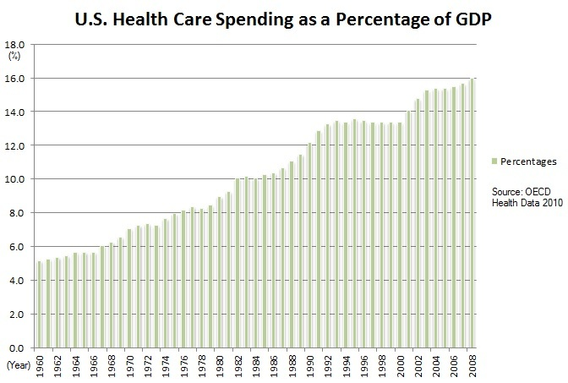
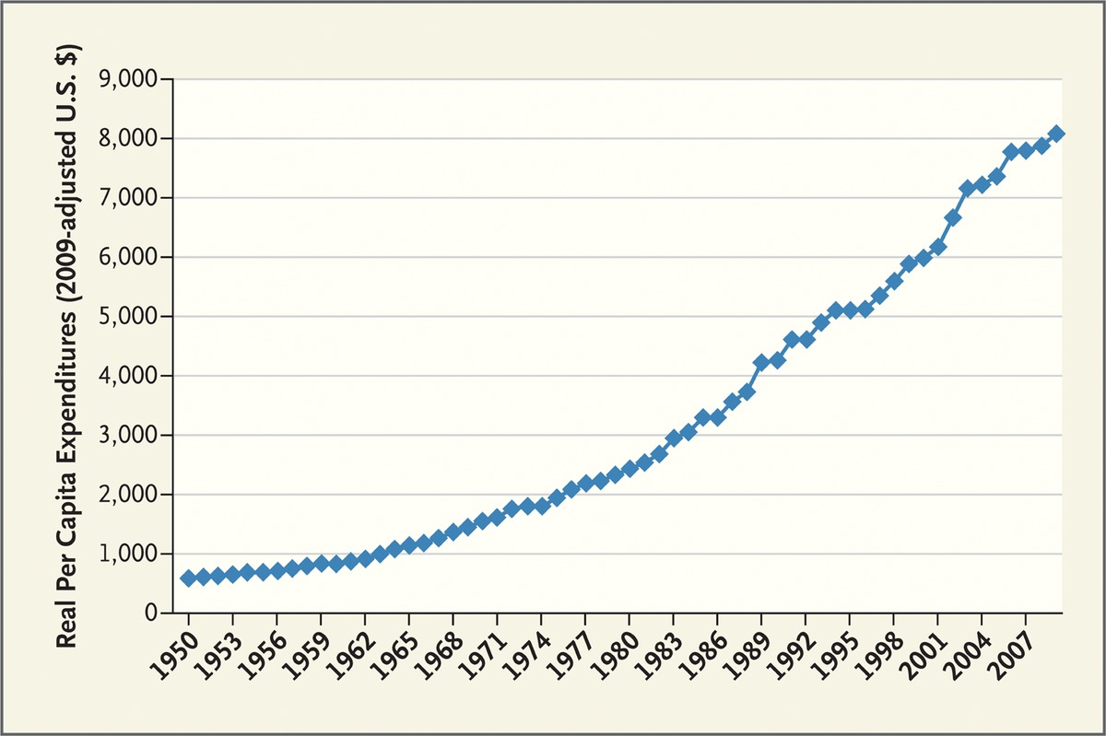
US Health Expenditure
Expenditure are increasing both in real terms and as a percentage of GDP
Fuchs 2012

Slide 8
Discussion Question
Is the United States and outlier?
How could we tell?

Slide 9
Comparing National Health Expenditures

Slide 10
Comparing National Health Expenditures

Slide 11
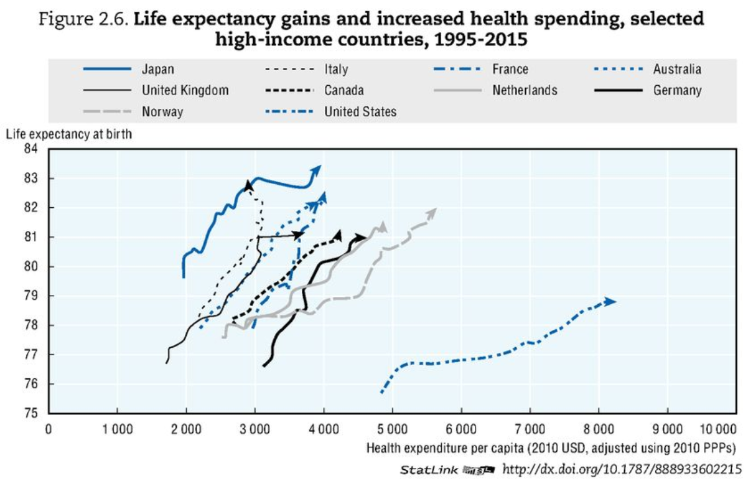
Comparing National Health Expenditures
OECD Health Data 2017

Slide 12
Unresolved Question
Is it bad that the United States is an outlier?
Is the United States wildly abnormal?
Is the income diversity (or other diversity) in the United States driving its outlier status?
Does Health Expenditure have a different meaning in the United States than elsewhere?

Slide 13
Measures of health
Mortality Rate: deaths per year per 100,000 people
YLL: years of life lost to a disease
DALY/QALY: sum of YLL and years of life lived with a disability

Slide 14
Disease Groups
Communicable Diseases
Neoplasms
Cardiovascular Diseases
Chronic Respiratory Diseases
Cirrhosis
Digestive Diseases
Neurological Diseases
Mental and Substance Abuse Diseases
DUBE
Musculoskeletal Disorders
Non-communicable Diseases
Injuries
Well Care
Risk Factors

Slide 15
Visualizing US Health and Health Expenditure
Health:
  https://vizhub.healthdata.org/gbd-compare/
Health Expenditure:
  https://vizhub.healthdata.org/dex/

Slide 16
Discussion Question
What causes the most disability?

Slide 17
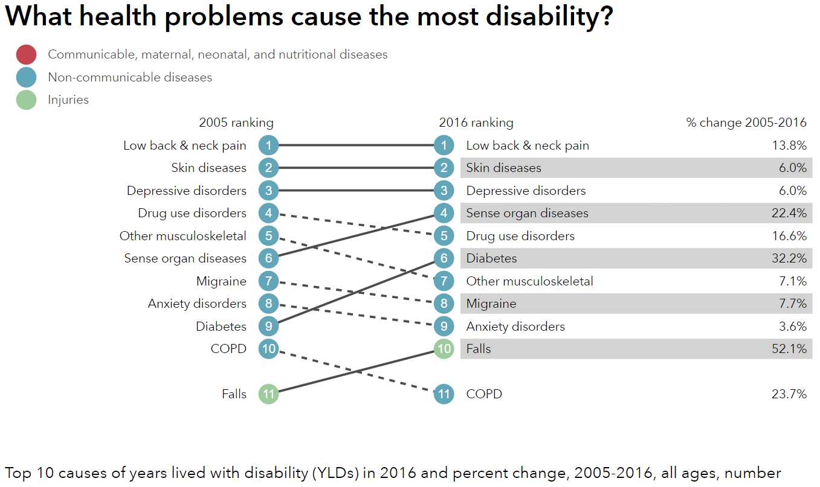
http://healthdata.org/us-health

Slide 18
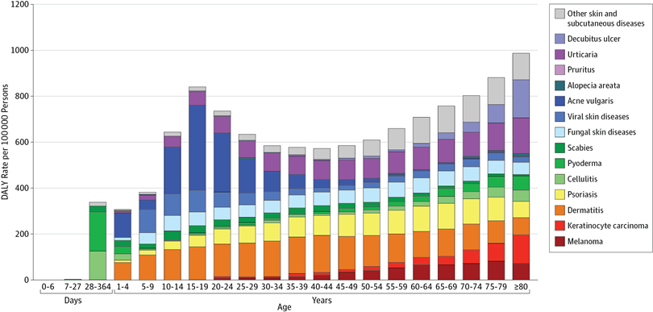
Unpacking DALY cost of skin diseases by age
Karimkhani et al 2017

Slide 19
Discussion Question
What causes the most deaths?

Slide 20
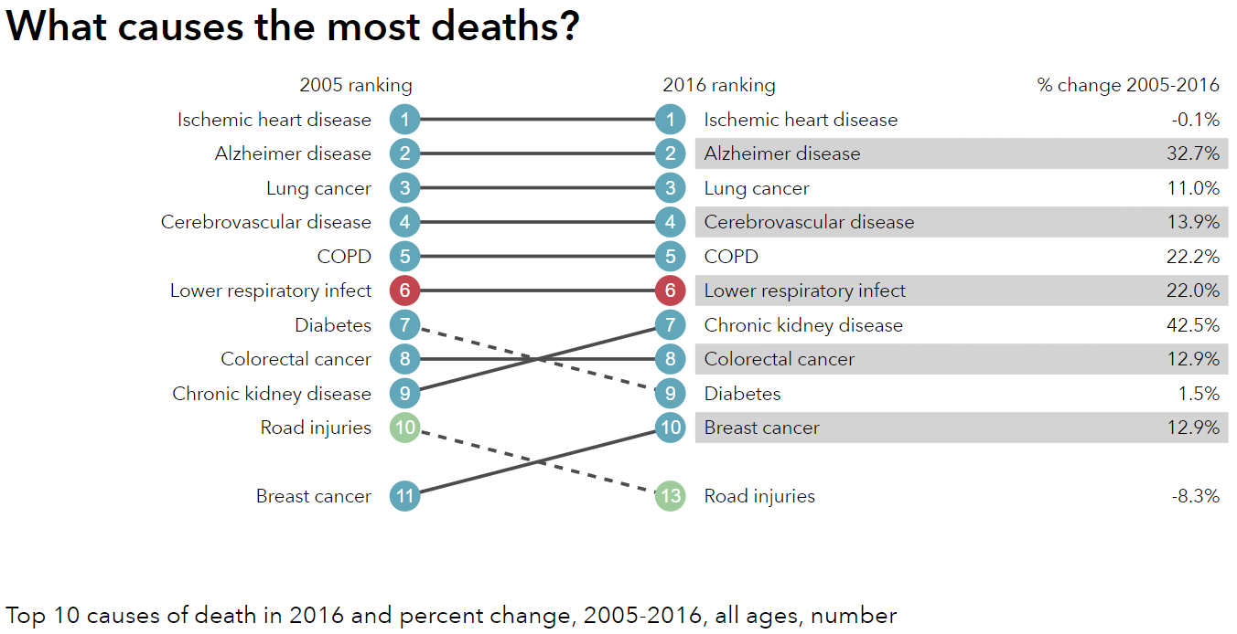
http://healthdata.org/us-health

Slide 21
Visualizing US Health and Health Expenditure
Health:
  https://vizhub.healthdata.org/gbd-compare/
Health Expenditure:
  https://vizhub.healthdata.org/dex/

Slide 22
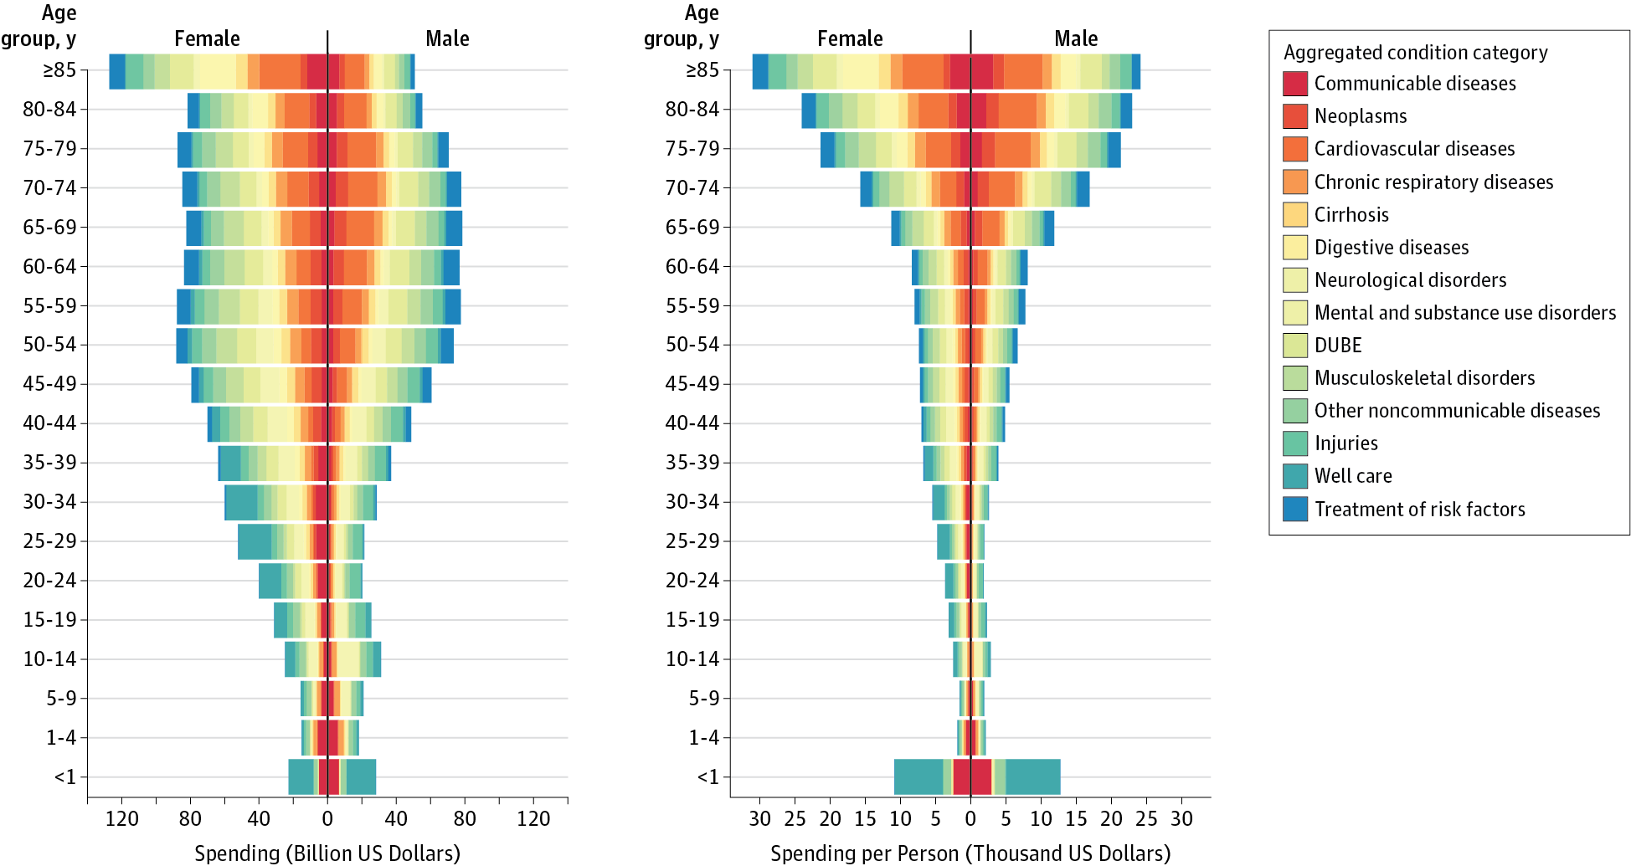
Health Care Costs by Age, Sex, and Disease
Dielman et al 2016

Slide 23
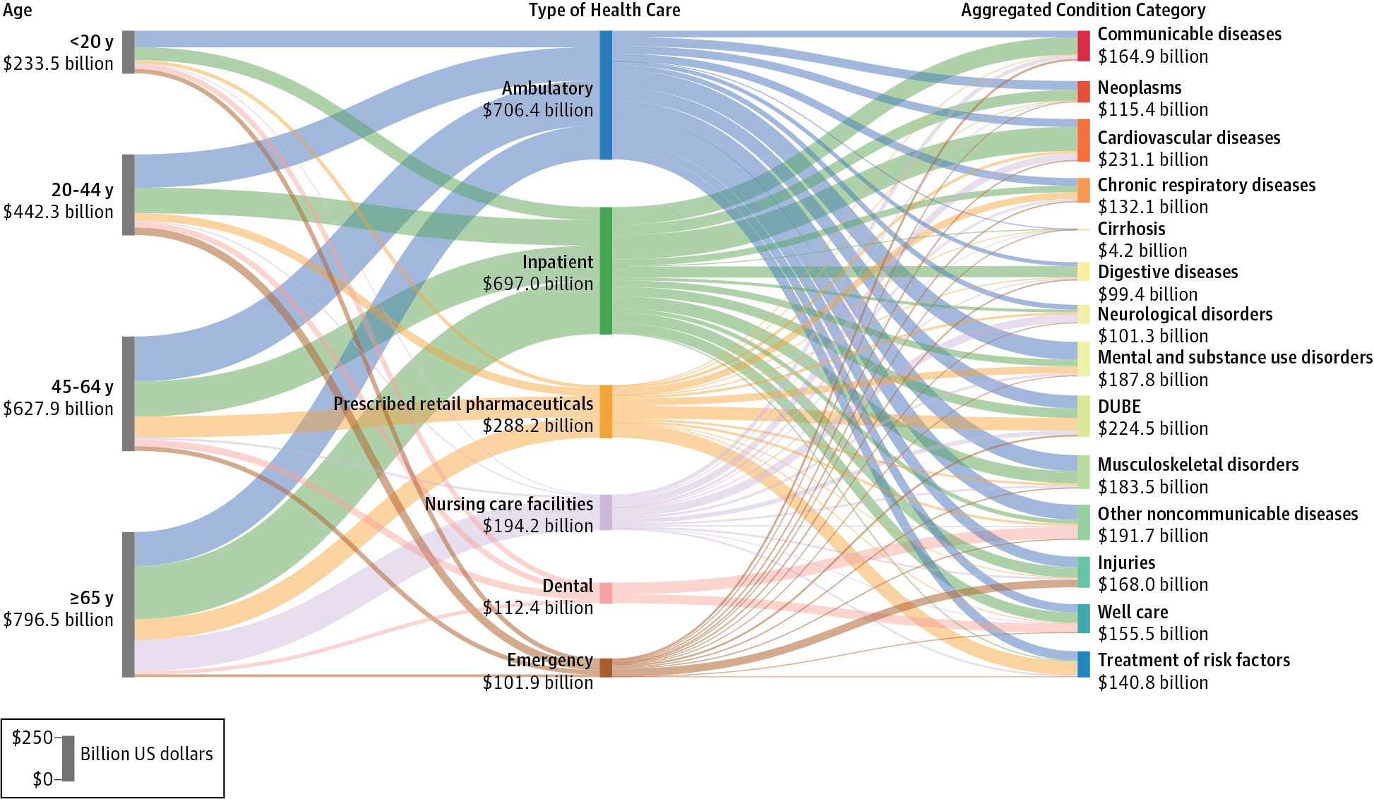
Health Care Cost by Type and Disease
Dielman et al 2016

Slide 24
Unresolved Question?
Is the problem Big Pharma? Is it too many hospital administrators? Is it predatory nursing facilities?
In a broad sense, who is driving health care costs?
How should insurance premiums be structured given the distribution of costs across age and sex?
Does Medicare cause Health Care Costs to grow among people aged 65 and up or does increasing illness cause Health Care Costs to grow in this population?

Slide 25
Discussion question
Why do some say that health care in the united states is the best in the world?

Slide 26
Discussion question
Why do some say that health care in the united states is the best in the world?
  For those who can afford care, quality is often very high
  US is leader in innovation and development
  Inequality in disease risk is higher in US than other wealthy countries
  US leads in some statistics such as cancer survival rates
  About 40 percent of the world’s medical travelers—people who go abroad to obtain acute elective care—come to the United States

Slide 27
Five-Year Survival Rates for Patients Diagnosed with Five Common Cancers in Seven Countries, 2005–2009
Country | Female Breast | Colon | Lung | Prostate | Childhood Leukemia
Canada* | 85.8 | 62.8 | 17.3 | 91.7 | 90.6
France** | 86.9 | 59.8 | 13.6 | 90.5 | 89.2
Germany | 85.3 | 64.6 | 16.2 | 91.2 | 91.8
Italy | 86.2 | 63.2 | 14.7 | 89.7 | 87.7
Japan | 84.7 | 64.4 | 30.1 | 86.8 | 81.1
United Kingdom* | 81.1 | 53.8 | 9.6 | 83.2 | 89.1
United States | 88.6 | 64.7 | 18.7 | 97.2 | 87.7

Slide 28
Readings:
Fuchs, Victor R. "Major trends in the US health economy since 1950." New England Journal of Medicine 366, no. 11 (2012): 973-977.
Dieleman, Joseph L., et al. "US spending on personal health care and public health, 1996-2013." Jama 316.24 (2016): 2627-2646.
Bonus:
IHME Data Visualizations: https://vizhub.healthdata.org

Slide 29
Other Sources
Indicators, O. E. C. D. "Health at a Glance 2017." OECD Indicators, OECD Publishing, Paris. https://read.oecd-ilibrary.org/social-issues-migration-health/health-at-a-glance-2017_health_glance-2017-en#page1
Karimkhani, Chante, Robert P. Dellavalle, Luc E. Coffeng, Carsten Flohr, Roderick J. Hay, Sinéad M. Langan, Elaine O. Nsoesie et al. "Global skin disease morbidity and mortality: an update from the global burden of disease study 2013." JAMA dermatology 153, no. 5 (2017): 406-412.

Slide 30
Next Time
Health care as a right and as a public good
Reading:
*Gawande, Atul. “Is health care a right?” New Yorker, October 2, 2017
* Section I (pages 5-10) of Ruger, Jennifer Prah. "Toward a theory of a right to health: capability and incompletely theorized agreements." Yale Journal of Law & the Humanities 18, no. 2 (2006): 3.
Optional Readings:
Hamel, Mary Beth, Jennifer Prah Ruger, Theodore W. Ruger, and George J. Annas. "The elusive right to health care under US Law." N Engl J Med 372, no. 26 (2015): 2558-63.
Ruger, Jennifer P. "The moral foundations of health insurance." Journal of the Association of Physicians 100, no. 1 (2007): 53-57.

