Slide 1
HCMI 4225: History of Insurance
BUSN 203: Mon/Wed 12:30-1:45
Shane Murphy – shane@uconn.edu
Office Hours: Mon/Wed 2:00 PM – 3:00PM

Slide 2
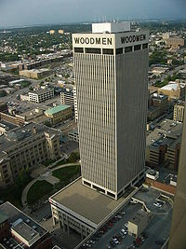
19th Century US Life Insurance
Life Insurance:
Legal Reserve Insurance
Stock companies
Owned by Investors
Mutual companies
Owned by policy holders
Fraternal orders
Notes:
https://www.youtube.com/watch?v=f7odiGPRBqc

Slide 3
Legal Reserve Insurance
Collects premiums in advance
Establishes reserves and holds assets
US regulation began in 1849 in New York
State regulation of insurance

Slide 4
Mutual Aid and Fraternal Insurance
Ancient Order of United Workmen (AOUW) formed in 1868
3 years after the end of the Civil War
Fraternal insurers grew from beginnings in 1860s to controlling half the market in the 1890s
Regulated after 1900
Generally required solvency
Disappeared thereafter, shrinking to 8% of the market by 1930s

Slide 5
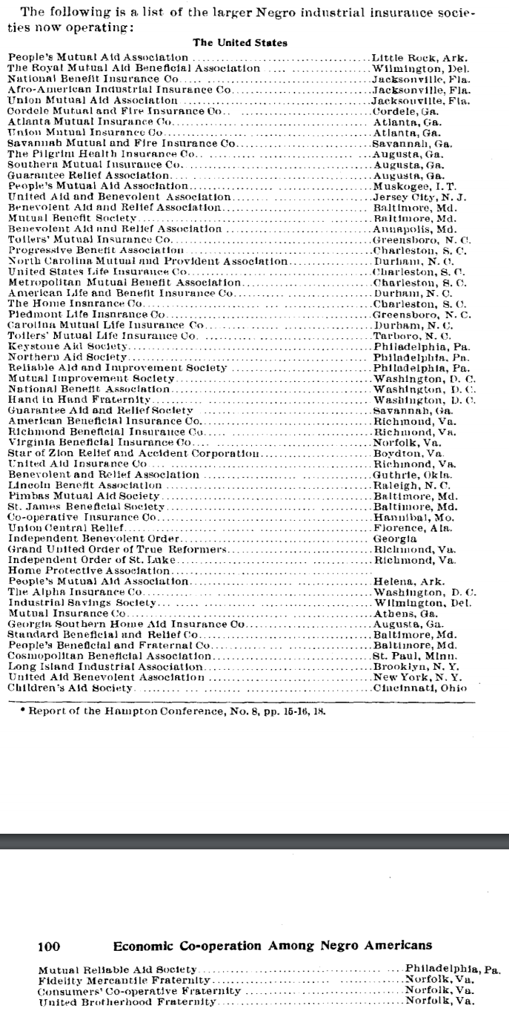
African American Insurance Societies
Mutual Aid Societies also played multiple important roles in African American Society
Insurance and social organization

Slide 6
Products of Fraternal Societies
Life Insurance
Sickness Insurance
Accident Insurance
Fixed-Fee Medical Care Provision
Other Charity
Social Organization

Slide 7
Causes of decline of Fraternal Insurance
Regulation
No regulation until 1888
Federal regulation began in 1893
Reserve requirement
Self regulating Mobile Bill of 1910
Growth of group insurance
Financial strain and dissolution
Workers compensation laws and assistance

Slide 8
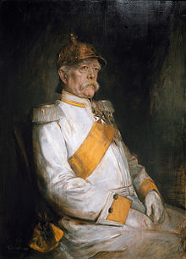
Otto van Bismarck
Minister President of Prussia from 1862-1890
Oversaw Prussian Military victories from 1863-1871
Oversaw Prussian led unified Germany in 1871
Then appointed Imperial Chancellor, serving from 1871-1890
“First” social insurance scheme in 1881, 1883, & 1884
Employer based: employers paying 2/3, employees 1/3
Responding to rising social movements and combat socialism

Slide 9
Why Germany?
Germany saw greatest level of industrial growth in late 1800s
German political philosophers (such as Fichte, Wagner, and Schaeffle) were less libertarian than Anglo counterparts (Smith, Mill, Franklin)
Note that in many ways, Marx was more pro-state than French Socialists
Well developed labor movement
1848 revolutions
Goals: Democracy (anti-monarchy and pro working class), social justice, and, in the case of Germany, unification
Bismark worked with German Socialists from 1848 revolutions such as Lasalle

Slide 10
Initial forms
First: Accident and sickness insurance
Sickness in 1883, accident in 1884
Base on no-fault principle, industrial accidents a fact of life
Later: Old age and invalidity
Even later:
Insurance for survivors of industrial accidents (widows and orphans)
Maternity insurance (First program created in 1911 in Italy)
Four Social Risks: injury, sickness, old age, and unemployment

Slide 11
Spread of accident insurance
Social insurance programs were initially slow to spread, with only Germany, Austria, and Hungary having programs by 1894
But by 1904, most of Western, Central, and Northern Europe had programs
United States was late, creating a program for federal employees only in 1908
Two years after the creation of a program in Mexico (then called Nuevo Leon)
Canadian provinces largely created programs between 1908-1910
Sickness insurance did not spread as quickly

Slide 12
Sick, old-age, and unemployment insurance
Spread was slower
Initial programs were largely subsidy based and voluntary
Unemployment insurance programs were more popular at local levels

Slide 13
Federal and State programs in the US
First state social insurance law was in Maryland in 1902
Accident insurance
For workers in mines, quarries, and steam and electric railroads
Granted $1,000 in case of fatal accident
Based on equal employee and employer contributions
Declared unconstitutional in 1904
Grounds that it deprived both parties right of trial by jury

Slide 14
Other early programs
Voluntary, equal contribution accident programs were set up in Massachusetts and Illinois in 1905 and 1908, but these were not popular among workers and unions
Connecticut state legislature investigation in 1907 found such programs would be good, but could not find a solution out of fear of interstate competition
However, Theodore Roosevelt succeeded in passing an accident insurance bill for US employees in 1908
He had supported a similar bill when he was governor of NY in the 1890s

Slide 15
State programs
Early programs by Maryland (1904), Montana (1910) and New York (1910) were later declared unconstitutional
Other 1910 programs by Massachusetts, Maryland, and New York were voluntary and failed
Starting in 1911, States began enacting effective programs

Slide 16
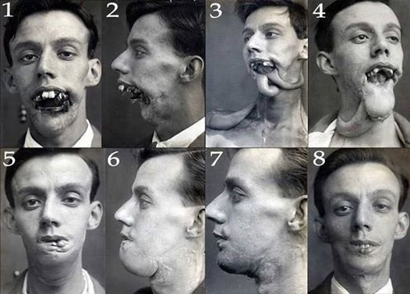
Phossy Jaw and the AALL
American Association for Labor
Legislation sough federal regulation
of yellow phosphorus used in match
manufacturing
Substitutes existed, the substance was banned in Europe, and it led to a painful, debilitating and sometimes deadly condition
Phosphorus necrosis
AALLs first movement was successful, and regulation began in 1912

Slide 17
Characteristics of initial state programs
Limited scope
Limited forms of industries
Iron and steel building erection, elevator operation, work on scaffolding, electricians, work with/near explosives, railworkers, construction of tunnels and subways, and compressed air work.
Dangerous operation with little interstate competition
Constitutional legality based on police power of state
Elective programs included changes to liability law
Non-electing companies no longer as able to waive liabilities
Electing employees reduced in ability to extract unlimited damages
But such progras generally were unsuccessful

Slide 18
Nudges
In most states, most employers did not elect to join scheme
Laborers were not in a strong position and were not generally able to take advantage of increased legal rights
Voluntary program in New Jersey was exception
In NJ, employers were assumed to have elected to join scheme unless they made a specific statement not to join
Many employers were uninterested or uninformed and joined by default
Voluntary program in Illinois was another exception
In both NJ and Illinois, insurance rates were lower so compensation was cheaper than liability

Slide 19
Workers compensation
State Employer Liability Acts passed between 1855 and 1907 allowed workers to sue for injury caused by employer negligence
Starting with Wisconsin in 1911, 36 states created workers’ compensation laws in the 1910s.
Mississippi was the last state to pass such legislation in 1948

Slide 20
Response of US labor
Organized labor initially fought against early programs
In 1909, the American Federation of Labor began to support social insurance
Private programs were created as well
US Steel and International Harvester
Values were placed on injuries
As the idea of public social insurance grew in popularity, state and federal jurists became less likely to make constitutional arguments against it

Slide 21
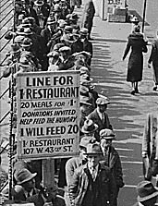
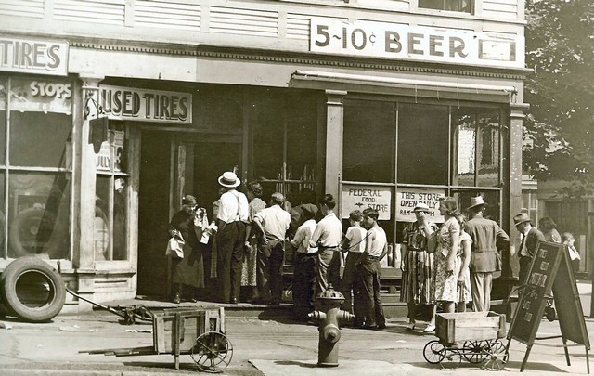
Great Depression (1929-1939)
Notes:
https://www.youtube.com/watch?v=IzjWk1DD6gE
https://www.youtube.com/watch?v=l4zfEkKs2ZM

Slide 22
1935 Social Security Act and the Welfare State in the US
Federal Old Age, Survivors, Disability and Hospital Insurance Program
Originally entitled the Federal Old Age Benefits (I) program
Program now also encompasses Medicare and is funded through FICA
Federal-state unemployment compensation program
FUTA (1954)
9 other programs including aid to states for programs for the blind (X), needy dependent children (IV)
Avoided using the word “insurance” to provide some protection from conservative SC justices – but programs were called social insurance after SC ruling in support in 1939
American Medical Association opposed early efforts for state or national health insurance

Slide 23
Health Insurance programs in the Social Security Act
Four key programs
Maternal and Child Health
Crippled Children Services
Vocational rehabilitation
Public Health
Created as grants to states for state run programs
Initial plans included national health insurance, which AMA opposed and FDR thought was politically too risky, eventual AMA support of Act was reluctant

Slide 24
New Deal
First New Deal included banking reform and the Civil Works Administration
Second New Deal included labor union protections, establishmient of the Works Progress Administration, the creation of the US Housing Authority, the Fair Labor and Standards Act of 1938, and the Social Security Act
FDR (a New York Democrat) vs the conservative coalition of Republicans and Southern Democrats
Harry F. Byrd Sr was a noted leader of the conservative coalition
Opposed Federal control over standards for old age assistance and other programs

Slide 25
World Wars
World War I (1914-1918) and World War II (1939-1945)
WWI: Allied Powers (France, Britain, Russia, Serbia, Belgium, Japan, Italy, US, Romania, Portugal, US, China, and others) vs Central Powers (Germany, Austria-Hungary, Ottoman Empire (Turkey), Bulgaria)
WWII: Allies (Russia [1941], US [1941], UK, China) vs Axis (Germany, Japan, Italy)
In 1919, as a part of the Treaty of Versailles, the International Labor Organization was created (now a part of the UN)
In 1927, the International Social Security Association was established affiliated with the ILO
In 1945, the UN was established

Slide 26
Communist programs
Leninist social insurance programs based on two 1912 principles
Cost solely responsibility of employers
Administration by employees
Program evolved greatly in 1930s
Centralized in 1931, expanded to include health care in 1936
Adopted by China in 1930s and other socialist countries after WWII

Slide 27
Spread of the German Model
Old age and sickness insurance in the German model spread through non-Communist states more quickly after 1919
US adopted old-age and unemployment insurance in 1935

Slide 28
Social Security development during WWII
1941 UK: Beveridge Plan
Led to the creation of social programs in the UK forming the Welfare State
Family Allowances Act 1945, National Insurance (Industrial Injuries) Act 1946, National Insurance Act 1946, National Health Service Act 1946, Pensions (Increase) Act 1947, Landlord and Tenant (Rent Control) Act 1949, National Insurance (Industrial Injuries) Act 1948, National Insurance Act 1949
1943 US: Wagner-Murray-Dingell Bill
Failed law for national medical and hospitalization coverage
1943 Canada: Marsh Plan
1944 India: India Beveridge Plan
1945 China, etc
By the 1950s, most industrial capitalist countries had comprehensive systems for all of the four social risks

Slide 29
Age of privatization
Neo-liberal ideology grew in influence since around 1980
Led by University of Chicago economists such as Milton Friedman
1981 privatization of the Chilean pension system
Under the Pinochet regime
Replace public pension with fully funded individual accounts system with contributions by individuals and administered privately
During debt crises in the 1980s (and carrying into the 1990s) in low and middle income countries (especially in Latin America) the World Bank and IMF pushed other countries with to privatize

Slide 30
Readings:
Cutler, David M., and Richard Johnson. "The birth and growth of the social insurance state: Explaining old age and medical insurance across countries." Public Choice 120, no. 1-2 (2004): 87-121.
Zanjani, George. "The Rise and Fall of the Fraternal Life Insurer: Law and Finance in US Life Insurance, 1870-1920." (2003).
Du Bois, William Edward Burghardt. "Economic co-operation among Negro Americans." In Conference for the Study of the Negro Problems 1907: Atlanta, Ga.). The Atlanta University Press, 1907. Section 11 p92-109
Rubinow, Isaac Max. Social insurance: With special reference to American conditions. H. Holt, 1913. (https://archive.org/details/socialinsurancew00rubiiala) Chapters 2, 10, 11, 12
Guyton, Gregory P. "A brief history of workers' compensation." The Iowa orthopaedic journal 19 (1999): 106.
Hu, Aiqun, and Patrick Manning. "The global social insurance movement since the 1880s." Journal of Global History 5, no. 1 (2010): 125-148.

