Slide 1
HCMI 4225: Legal and legislative challenges to the ACA
BUSN 203: Mon/Wed 9:30 AM – 10:45PM
Shane Murphy – shane@uconn.edu
Office Hours: Mon/Wed 11:00 AM – 12:30PM

Slide 2
Quiz
To people earning what percent of the FPL was medicaid expanded? Other than medicaid expansion, what was one way in which the ACA sought to reform insurance? What was one way in which the ACA sought to reform delivery?
Notes:
https://www.youtube.com/watch?v=KoTOzNRw8bg

Slide 3
Path to the ACA
Presidential Primaries
  CHOICE, Edwards, Hacker, and the medicare-based public option
Clinton and Obama
  Exchanges with public option
Joe Lieberman (I-CT)
  Senator from 1989-2013
Effects of the public option:
  Accountability, cost, market
  National vs federated pool
Notes:
https://www.youtube.com/watch?v=w_Q_x3BaY6U&t=41s

Slide 4
Edward Kennedy and Conference Committees
Kennedy died August 25, 2009
  Replaced by conservative Scott Brown in election in January and was seated in February
Senate passed the bill in November 2009 with Kennedy’s seat still vacant
If the house bill was not identical to the Senate bill, there would have needed to be a conference committee
  Pelosi and the house managed to pass an identical bill in December
  Avoiding conference led to a more liberal bill than otherwise may have existed
  For instance the Independent Payment Advisory Board would likely have been cut

Slide 5
Note about the IPAB
Rationing, death panels, etc?
https://www.youtube.com/watch?v=MQsaAuwYAfE

Slide 6
ACA, March 23, 2010
900 pages and 10 titles
Clarity v vagueness:
  Clarity: “Title 1: Quality Affordable Health Care for All Americans”
  Vagueness: 150 times “the secretary shall” and 50 times “the secretary may”
Shared federal and state responsibility
  State: insurance exchanges, premium stabilization, consumer protections…

Slide 7
Center for Medicare and Medicaid Innovation (CMMI), 2010
Tasked with designing, implementing, and testing new health care payment models to address growing concerns about rising costs, quality of care, and inefficient spending
  Medicare, Medicaid, and the Children’s Health Insurance Program (CHIP)
Organizes accountable care organizations (ACOs), bundled payment models, and medical homes models
Two CMMI models have met the statutory criteria to be eligible for expansion by reducing program spending while preserving or enhancing quality.
  Diabetes Prevention Program model and the Pioneer ACO model.

Slide 8
NFIB v Sibelius, 2012
John Roberts Biography: The Chief by Joan Biskupic
https://youtu.be/ESse04SnSU0?t=2038
Notes:
historic three days of oral arguments back in March of 2012 over President Obama's major domestic achievement this this law the Affordable Care Act that was signed in March of 2010 so they they have these arguments they go into their private conference and the initial vote led by the chief is five to four to strike down what we've all called the individual mandate and that was the requirement that everyone buy health insurance so that the the health insurance structure is supported by people who are healthy not just people who are ill you know it's the the idea that this cost should be borne by everyone and the the law established the new marketplaces and had many many other provisions another provision was the Medicaid expansion for people near the poverty line so there are two major planks of this thing and they vote 5-2 for that Congress lacked the power under its Commerce Clause power to to demand this individual insurance requirement and that's where everybody was paying attention all the attention at the time was on and there were the five conservatives led by the chief voted to strike it down and the four liberals said no but meanwhile they also took a vote on the Medicaid expansion and they voted to uphold it and the chief was with them to uphold it they don't vote in any way on this taxing power issue which again becomes relative becomes relevant in the very end because that's what the chief hangs on the question coming out of the conference conference as they call their private sessions is what's going to fall with the individual mandate because all these different parts were intertwined and Justice Kennedy who's normally in the middle on these things was adamant that the whole law had to fall this major you know nearly a thousand page law that had all sorts of other provisions that were popular with people would have to would have to be overturned because of how intertwined it was and Congress had not written in any kind of so-called severability clause and the Chief Justice starts having second thoughts about that the consequences of that and you remember this was an election year there's so much pressure on the court and there's a presumption among some commentators that the Republican controlled Supreme Court is going to invalidate the signature domestic achievement of President Barack Obama and the chief the chief is trying to figure out a middle ground on this and he's not getting any cooperation or assistance or you know help it all from Anthony Kennedy who he usually deals with who he was usually dealing with any kind of compromise meanwhile over to the far right our justices Alito Scalia and Clarence Thomas and they're they're not going to play they're not in play at all on the far left Justice Ginsburg and justice Sotomayor are not going to be in play either and they they are traditionally the ones who are always over to the far left and not working with the chief that much but justices Kagan and Breyer on the left but open to trying to take down the temperature try to find some compromise with the chief begin to work with him after he decides that he can find legitimate grounds for the individual mandate to be upheld on taxing power and what makes the conservative so angry is first of all even though the taxing power was completely briefed by the Obama administration it was even subject to arguments it was never voted on in conference they they never took an up or down vote on that so they were they felt you know in Scalia's word that it was you know fly-by-night briefing that was just was not a fair fair thing to suddenly turn to and the the liberal justices our want want this to unfold this way but they're also worried that the chief is going to you know possibly shift back again because you know they're they're feeling their original feeling coming out of that conference was complete de moron demoralisation because they're thinking it's gonna be five to four this big law is gonna go down and there's nothing we can do about it but all of a sudden the Chiefs show some flexibility but at the same time that he decides to find grounds to pull the mandate he decides that the Medicaid expansion should be killed and this is again and what didn't get a lot of attention at the time but this was really important for millions of Americans near the poverty line but the problem with it as the chief then decided was that the way Congress had written the expansion law it was it was essentially coercing the states into doing this program Medicaid is almost entirely funded by the federal government but it with that comes a lot of strings and the federal government was Congress said in the Medicaid expansion if you're if you don't expand the clientele the reach of the Medicaid all of your Medicaid funding is going to disappear and as the chief ends up writing this was essentially like holding a gun to the head of the state's the justices Breyer and Kagan decide to change their votes and go with the chief on that to show a certain amount of cooperation and feeling that the chief himself was making this big compromise that was going to get lots of criticism among his conservative brethren which it did so as a show of cooperation and sort of moving toward him that's why they changed their votes but they also figured that this was essentially free money for the state's weren't all the states going to adopt the expansion but lo and behold so many Republican governors did not want anything to do with the Obama expansion there and said no it that that has changed over the years but that turned out to be a bit of a surprise to the justices I'm left ok so I'm gonna make a strong statement just for the sake of it I'd like your reaction yeah John Roberts gets huge credit for this decision yes his hero is John Marshall Chief Justice John Marshall who he admires for committing acts of judicial jujitsu engaging in judicial statesmanship avoiding battles in the short term in order to shore up the courts power in the long term and by visibly struggling with the most polarized question of his age by pulling the court back from the point of really narrowing federal power in the most significant way since the New Deal he preserved the courts bipartisan legitimacy and proved that he meant when he said when he cared said that he would put legitimacy above politics discuss that's right no I think he should he people come up to him still and thank him and that decision has again you know going with that part of the decision that decision has really held in people's minds to define John Roberts as a moderate it's a one-of-a-kind decision but it was a hugely important decision and Charles freed a Reagan Solicitor General who succeeded Rex Lee who was seen as much more ideological actually gives him credit to says look it wasn't pretty the the ruling was shot through with uh with all sorts of problems people could rightly complain about the taxing rationale because it wasn't consistent with other parts of the ruling but it it got the job done it got the job done so I would say that yes this was an important ruling that he did and that the the grief he has gotten and continues to get from conservatives and and got at the time from then businessman Donald Trump and continues to get from President Donald Trump probably for the country was worth it but inside the way he went about it I think it still puzzles and confuses his colleagues but your point is well-taken for the country it's it made a big difference in people's lives and it still does and and the the Affordable Care Act is coming back to the court and I cannot imagine that John Roberts would now suddenly want to do what a judge down in Texas did invalidates the whole thing all over again

Slide 9
National Federation of Independent Business v. Sebelius
(2012)
Consolidated suits by the NFIB and by the State of Florida
Other suits by the state of Virginia, Liberty University (Liberty University v. Geithner), a group of people with religious objections in DC (Mead V. Holder), a law group in Michigan (Thomas More Law Center v. Obama), and Seven-Sky v. Holder (as CoA judge, Kavanaugh dissented – see http://www.scotusblog.com/2018/07/kavanaugh-on-the-affordable-care-act-seven-sky-v-holder/)
Kathleen Sebelius
  Secretary of Health and Human Services (2009-2014)

Slide 10
National Federation of Independent Business v. Sebelius
(2012)
Constitutional:
  Anti-Injunction Act – individuals can’t sue to avoid paying taxes
    Court found that since the act is a penalty and not a tax, suits were allowed
  Congress taxing power
    The individual mandate was a valid exercise of taxing power
Medicaid Expansion
  Roberts, Breyer, and Kagan felt states should be allowed to opt out
  Scalia, Kennedy, Thomas, and Alito felt Medicaid expansion (and the entire ACA) was unconstitutional
  Ginsburg and Sotomayor dissented, would have upheld Medicaid expansion in all states
  Commerce Clause and the Necessary and Proper Clause
  “As for the Medicaid expansion, that portion of the Affordable Care Act violates the Constitution by threatening existing Medicaid funding. Congress has no authority to order the States to regulate according to its instructions. Congress may offer the States grants and require the States to comply with accompanying conditions, but the States must have a genuine choice whether to accept the offer.” – John Roberts

Slide 11
Employer mandate delays, 2013-2016
Play or Pay
  Obama decision to delay mandate until 2016
Attempted further delays
  Authority for Mandate Delay Act of 2013
  Save American Workers Act of 2013, 2014, 2015, 2017, 2018
Additional compliance mandates delayed since 2014

Slide 12
Cadillac Tax delays
designed to disincentivize high-cost employer-sponsored coverage
Would have created a 40 percent excise tax on employer plans that exceed an estimated $10,800 in annual premiums for individuals and $29,050 for families
Protecting Americans from Tax Hikes (PATH) Act of 2015 delayed implementation from 2018 to 2020.
  Also made tax deductible
Further postponed to 2022 by The Tax Cut and Jobs Act of 2018

Slide 13
Burwell v. Hobby Lobby Stores, Inc. 2014
Allowing closely held for-profit corporations to be exempt from a regulation its owners religiously object to, if there is a less restrictive means of furthering the law's interest, according to the provisions of the Religious Freedom Restoration Act (RFRA) of 1993
Struck down the contraceptive mandate in the ACA
  May have broader implications for RFRA applications
Definition of “closely held” has possible liability implications

Slide 14
Compliance of employer-provided plans delays, 2014-present

Slide 15
Transitional Risk Corridor Program, 2014-2016
The Risk Corridors program set a target for exchange participating insurers to spend 80% of premium dollars on health care and quality improvement.
    Medical Loss Ratio
  Insurers with costs less than 3% of the target amount must pay into the risk corridors program;
  the funds collected were used to reimburse plans with costs that exceed 3% of the target amount.
No provision for excess high cost insurers
Moda Health Plan v. United States (2018) – Federal circuit court found:
  government does not have to pay health insurers that offered qualified health plans (QHPs) the full amount owed to them in risk corridors payments.

Slide 16
Medicare Access and CHIP Reauthorization Act of 2015
Repealed Sustainable Growth Rate model for controlling growth in physician payments
Significant effect on payment models
  Beginning July 1, 2015, clinicians will begin receiving a 0.5 percent payment increase to Medicare payments.
  This payment increase will continue annually until Dec. 31, 2018.
  Starting in 2019, clinicians will choose from one of two pathways: the Merit-based Incentive Payment System (MIPS) or Alternative Payment Models (APMs).

Slide 17
King v. Burwell, 2015
Challenged subsidies to plans purchased on national exchanges
  Theory that ACA meant only to subsidize state exchanges
Standing
  Plaintiffs argue that they have standing because, without the subsidies, they would be exempt from the individual mandate because the cost of the cheapest insurance plan exceeded 8% of their income, but, with the subsidies, the subsidized cost was low enough to require plaintiffs to purchase insurance or pay a penalty.
  Plaintiffs may have been eligible for free care or otherwise exempt
Plaintiffs won in circuit court, lost in supreme court (6-3)

Slide 18
Tax Cuts and Jobs Act of 2017
Zeroed the penalty of the individual mandate – left all other provisions in place
Massachusetts has had it own health coverage mandate since 2006
New Jersey passed a state-wide mandate that took effect in 2019
Vermont passed a health coverage mandate that will take effect in 2020

Slide 19
Cases challenging the ACA risk adjustment transfer formula
Minuteman Health, Inc v. U.S. Dept of HHS et al.
New Mexico Health Connections et al. v. U.S. Dept of HHS et al.
Evergreen Health Cooperative, Inc. v. U.S. Dep’t. of Health and Human Services et al.
Cases in progress
Challenges risk adjustment methods
Court rarely overturns administrative decisions of this nature

Slide 20
Trump inauguration day executive order, 2017
"It is the policy of my Administration to seek the prompt repeal“
"exercise all authority and discretion available to them to waive, defer, grant exemptions from, or delay“
"minimizing the economic burden [of Obamacare] pending repeal”

Slide 21
Trump policy overview
1 – Frequent overt criticism of ACA
2 – Enforcement of letter of law
Example: Refusal to let Idaho authorize plans in violation
3 – Improving parts of the law
Example: Political appointees not interfering with CMS civil services
4 – Prioritize individual options
Example: Supported short-term plans
5 – Undermined law where possible
Example: Terminating cost-sharing payments

Slide 22
Texas v Azar, 2018-present
Judge Reed O’Connor of the Northern District of Texas holds that the ACA is unconstitutional in its entirety
Removal of mandate invalidates the law
AG Willian Barr suggested the DOJ may not defend the ACA in appeal
  In a letter signed by assistant AG Joseph H. Hunt, the DOJ confirmed its decision to do just that
California Attorney General Xavier Becerra is now leading the defense of the ACA as the case moves to the circuit level.

Slide 23
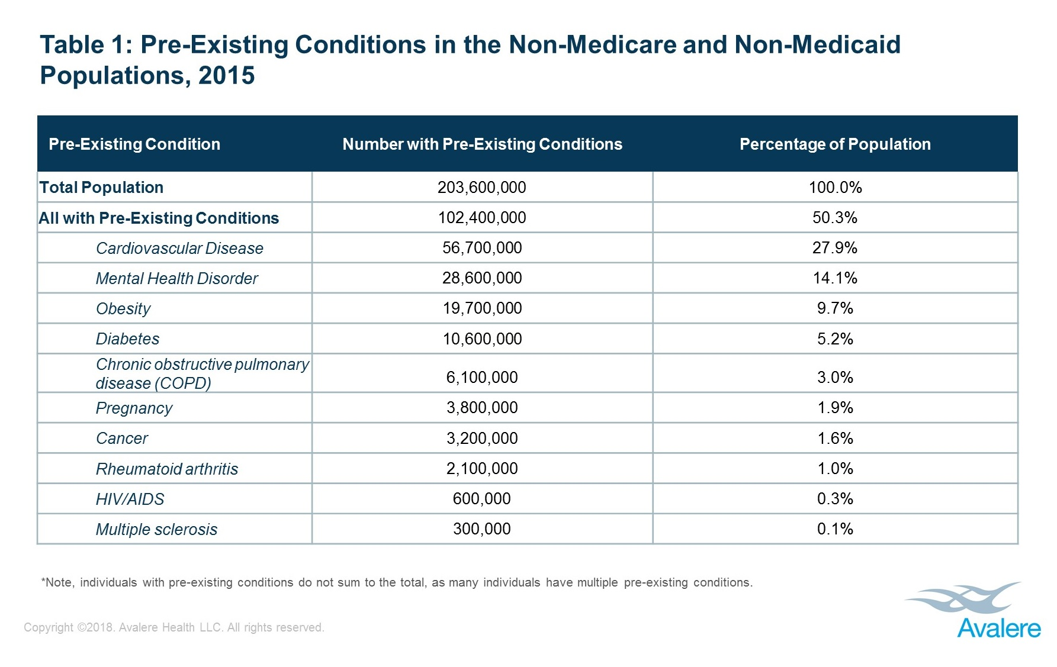
Bonus slide: Pre-existing conditions

Slide 24
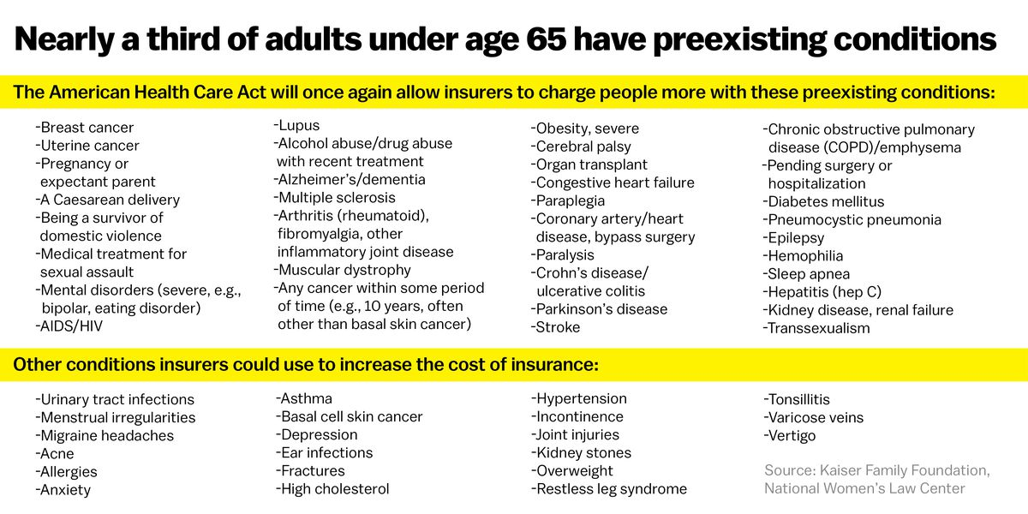
Bonus slide: Pre-existing conditions

Slide 25
Sources
Berkowitz, Edward. "Getting to the Affordable Care Act." Journal of Policy History 29, no. 4 (2017): 519-542.
Halpin, Helen A., and Peter Harbage. "The Origins And DemiseOf The Public Option." Health Affairs29, no. 6 (2010): 1117-1124.

