Slide 1
HCMI 4225: Effects of the Affordable Care Act
BUSN 203: Mon/Wed 9:30 AM – 10:45PM
Shane Murphy – shane@uconn.edu
Office Hours: Mon/Wed 11:00 PM – 12:30PM

Slide 2
Coverage: Medicaid expansion
All US citizens and legal residents with income up to 138% FPL qualify for coverage in participating states
Led to large growth in enrollment in participating states, smaller growth in non-participating states
Reduction in uninsured rates, especially among low-income individuals
Partial Woodwork effect/welcome mat effect
Growth among individuals who were previously eligible

Slide 3
Coverage: Medicaid expansion: criticism
Crowding out of private insurance
Mixed results, although there has been some decline in private coverage in participating states

Slide 4
Coverage: Medicaid expansion: subgroups
Coverage gains in expansion versus non-expansion states for specific vulnerable populations:
young adults, prescription drug users, people with HIV, veterans, parents, mothers, women of reproductive age (with and without children), children, lesbian, gay, and bisexual adults, newly diagnosed cancer patients, women diagnosed with a gynecologic malignancy, low-income workers, low-educated adults, early retirees, and childless adults with incomes under 100% FPL
Disproportionately positive impact in rural areas in expansion states
Gains can be found across racial/ethnic categories
Reduced disparities by income and age
Possibly reducing disparities by race/ethnicity

Slide 5
Coverage: Medicaid expansion: Alternative approaches
Section 1115 gave states the option of expanding Medicaid in alternative ways
These states (especially Arkansas, Michigan, and Indiana) have shown similar gains in coverage rates
Indiana instituted monthly contributions which have created enrollment and continuing coverage issues

Slide 6
Access, Utilization
Many studies find improvements in access to care
Increases in cancer diagnosis rates (especially early stage)
Earlier presentation for common surgical conditions – lowering complications
Increase listing for heart transplants among African Americans
Increased access for treatment of behavioral and mental health conditions
Increase in prescriptions for opioid use disorder and overdose
Increase in prescriptions for smoking cessation drugs

Slide 7
Access, Utilization
Many studies find improvements in access to care
Reduction in disparities by race, income, education, and employment status in access and affordability
Increased rates of optimal care for patients with common surgical conditions
Improved quality of care for common community health care treated conditions:
Asthma, Pap testing, BMI assessment, hypertension control
Declines in uninsured ED visits, but mixed evidence and no significant change in total ED volume
Reduced LOS for Medicaid patients
Improvements in care and quality in areas with primary care shortages

Slide 8
Access, Utilization: Criticism
Confusion in non-waiver states
Failures to follow up with new patients
Longer wait times

Slide 9
Affordability and Financial Security
Possible reduced patients with unmet medical need because of cost
Reduction in OOP
Average reduction in 2014 of about $205
Greater reductions among Medicaid expansion covered individuals than subsidized marketplace coverage individuals
Declines in unpaid bills and financial stress over future bills
In Ohio, percentage of expansion enrollees with medical debt fell by nearly half since enrolling in Medicaid (55.8% had debt prior to enrollment, 30.8% had debt at the time of the study)

Slide 10
Health Outcomes
Possible improvements in self-reported health
Improved outcomes for cardiac patients
Infant Mortality Rate Reductions for expansion states between 2014 and 2016, a period where the rate rose slightly for non-expansion states
Effect largest among African Americans
Limited of no effect on drug overdoses or alcohol poisonings

Slide 11
Economic effects
Federal matching for expansion population provided large spending savings for expansion states
No significant increase in state spending on Medicaid, including savings in some states
Possible reduction in overall spending due to spillovers
State costs related to behavioral health services, crime and the criminal justice system, and Supplemental Security Income program costs.
Lower Medicaid spending per enrollee
New enrollees generally less expensive than existing enrollees
First year of enrollment generally more expensive than subsequent years
Medicaid expansion lowers marketplace premiums
Marketplace enrollees younger and healthier in expansion states

Slide 12
Impacts on providers
Reduction in uninsured visits and uncompensated care costs
Decline in uninsured ED visits and increase in Medicaid-covered ED visits
Increase in Medicaid-covered substance use disorder treatment facility visits
Reduced disparity in uninsured visits between hospitals that treat a disproportionate share of low-income patients (DSH hospitals/safety net hospitals) and those that do not
Improved overall hospital financial performance, reduced probability of closure
Especially in rural areas

Slide 13
Labor Market Effects
Increased jobs
Did not reduce employment for low-income workers
Enrollees looking for work reported Medicaid enrollment made it easier to seek employment, those employed reported it made it easier to continue working
Increase volunteering

Slide 14
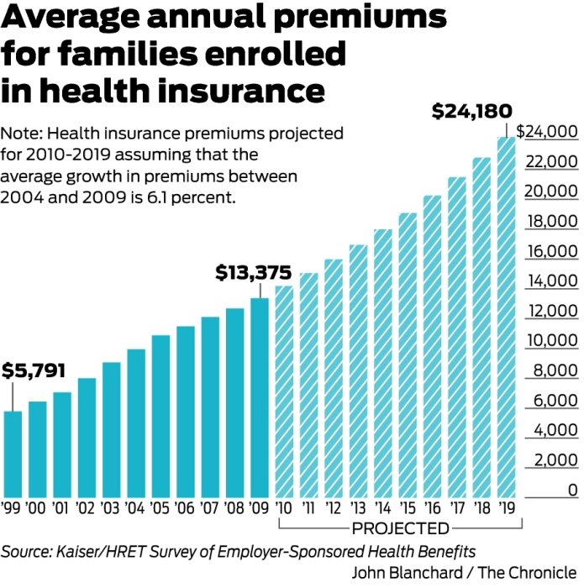
Health Insurance Premiums: Skyrocketing?
Premiums grew by over 6% between 2004 and 2009
If such growth continued, the cost for a family would grow to:
2010 | 14190.88
2011 | 15056.52
2012 | 15974.97
2013 | 16949.44
2014 | 17983.35
2015 | 19080.34
2016 | 20244.24
2017 | 21479.14
2018 | 22789.37
2019 | 24179.52

Slide 15
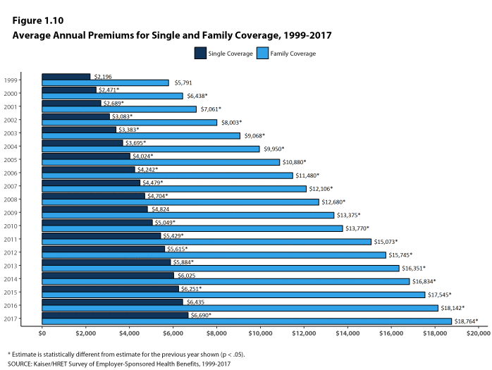
Health Insurance Premiums: Skyrocketing?
Actual growth rate has ben about 4.3%

Slide 16
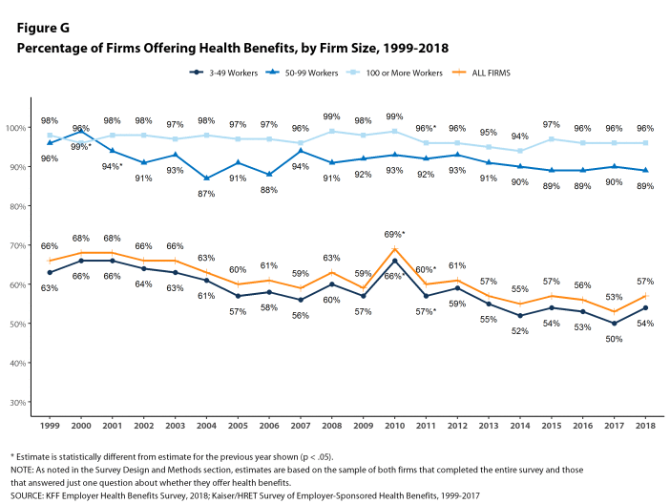

Slide 17
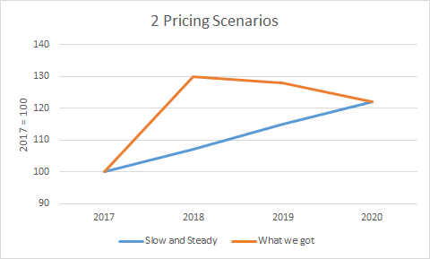
MLR and premiums
Increases in premiums will be tied to increases in healthcare spending by MLR regulations

Slide 18
Re-insurance pools
Two flavors
State run external money
External source of state based money is added to the pool of money collected by premiums.
Only adopted in few states
CMS run catastrophic reinsurance
Funded by premiums
High-cost risk pool
Reimburses issuers for 60 percent of an enrollee’s aggregated paid claims costs exceeding $1 million.
Reinsurance reduces overall preimums
Reduces high premiums more than low premiums
Reduces non-subsidized premiums and raises subsidized premiums

Slide 19
Advanced Premium Tax Credits (APTC) (and Gold gapping)
Advanced Premium Tax Credits (APTC) are how people get subsidized to buy Qualified Health Plans on Exchange.
Based on an individual’s income as determined by their family unit’s FPL percentage and the cost of the second least expensive Silver plan offered on Exchange in their area.
Second least expensive plan is called the benchmark plan
The subsidy arrangement means that individuals with the same exact financial situation will pay the same amount post-APTC subsidy for the second lowest Silver plan across the country.
Zero premium plans happen when a plan is priced below the silver benchmark and the relative premium spread is bigger than the individual’s expected personal contribution.
For the 100-138% cohort, the personal contribution for a single individual ranges from $22/month to about $55 per month for the benchmark silver plan.
The goal is for premiums of cheapest plans not to exceed 9.66% of income

Slide 20
Silvergapping (and Gold gapping)
Advanced Premium Tax Credits (APTC) are how people get subsidized to buy Qualified Health Plans on Exchange.
Based on an individual’s income as determined by their family unit’s FPL percentage and the cost of the second least expensive Silver plan offered on Exchange in their area.
Second least expensive plan is called the benchmark plan
The subsidy arrangement means that individuals with the same exact financial situation will pay the same amount post-APTC subsidy for the second lowest Silver plan across the country.
Zero premium plans happen when a plan is priced below the silver benchmark and the relative premium spread is bigger than the individual’s expected personal contribution. For the 100-138% cohort, the personal contribution for a single individual ranges from $22/month to about $55 per month for the benchmark silver plan. The benchmark plan is a silver plan with 94% AV CSR benefits. That translates into a deductible ranging from zero to a few hundred dollars and an out of pocket max of less than $2,000. Compared to a baseline silver, this is a great improvement in the quality of the benefit. It is still significantly worse than Medicaid if we assume appointments can be found.
Silvergapping is the measure of the spread between the least expensive Silver plan in a county and the benchmark Silver plan.
The bigger the spread, the better the deal that subsidized folks may be able to get.
The smaller the spread, the worse (comparative) deal subsidized buyers get.
Silver gapping is only about the relative differences in price and not about the absolute price levels.

Slide 21
Silver Gapping
Maximizing silver gap maximizes the relative value of the APTC subsidy
Carriers offer a low price Silver and then a higher priced Silver as the benchmark
Drive people to the #1 Silver plan as it will be comparatively cheaper than the #2 Silver. It will also have the ability to drive people to very low premium Bronze plans.
Example in CA:
Region 16 that Molina made its play and gained its share. Molina put up both the cheapest silver and the cheapest bronze plans in that region — massively undercutting the benchmark silver plan, and thus offering buyers a major discount on the Cost Sharing Reduction (CSR) subsidies available only with silver. For a 40 year-old earning $23,000, a shared under 200% of the Federal Poverty Level (FPL), Molina silver is just $74 per month in Region 16 in 2016, vs. the benchmark silver’s $119 (Health Net). Molina’s bronze plan at that age and income level is just $1 per month, vs. $55 for the nearest competitor.

Slide 22
Silver Spaming
The goal of an insurer in the Silver Spam strategy is to offer the #1 and #2 silver plans in the region with a very small gap between those two.
Furthermore if they can keep the price of the second Silver significantly lower than the price of the first Silver plan offered by a competitor, they’ll capture a large segment of the market.
The objective of the Silver Spam strategy is to take away choice.
The relative value of the APTC when applied to the purchase of the 1st Silver is not much higher than it is when applied to the #2 benchmark Silver.
If there is a large gap between the Silver Spammer’s Silver plans and the next best offer, the Silver Spammer will capture a large proportion of the market for Silver and should (all else being equal) capture a decent proportion of the Bronze market.
Example in Chicago:
For a 40 year old non-smoker, Celtic/Ambetter offers the 1st and 2nd Silver at $195 and $198, as well as the next four Silvers. The first non Celtic/Ambetter Silver is priced at $249.
The Celtic/Ambetter Silvers are all HMOs, and they all are sharing the same very narrow network. The benefit configuration (deductibles and co-insurance) change, but the out of pocket maximums are all tightly clustered. These six plans are functionally similar plans. The business decision to introduce these six plans, and more importantly the #2 Silver at just a few bucks more than #1 is a membership recruitment decision.
Both these “APTC hacking” strategies capitalize on regions with a small number of insurers

Slide 23
Changing Insurance Company or Status: Churn
Prior to implementation of the Affordable Care Act (ACA), nearly 60 percent of pregnant women experienced a month-to-month change in insurance type in the nine months leading to delivery, and half were uninsured at some point in the six months following birth
This has reduced to 14.5% pre-delivery and 16.9% post delivery
Greater improvement in expansion states
Auto-renewal is critical in reducing churn

Slide 24
Readings and sources:
Obama, Barack. "United States health care reform: progress to date and next steps." Jama 316, no. 5 (2016): 525-532.
Courtemanche, Charles, James Marton, Benjamin Ukert, Aaron Yelowitz, and Daniela Zapata. "Early Effects of the Affordable Care Act on Health Care Access, Risky Health Behaviors, and Self‐Assessed Health." Southern Economic Journal 84, no. 3 (2018): 660-691.
Antonisse, Larisa, Rachel Garfield, Robin Rudowitz, and Samantha Artiga. "The effects of Medicaid expansion under the ACA: Updated findings from a literature review." (2017). KFF https://www.kff.org/medicaid/issue-brief/the-effects-of-medicaid-expansion-under-the-aca-updated-findings-from-a-literature-review-march-2018/

