Slide 1
HCMI 4225: Health and Social Insurance
BUSN 202: Mon/Wed 9:30 AM – 11:45AM
Shane Murphy – shane@uconn.edu
Office Hours: ?

Slide 2
Health Landscape and Health Costs
Key points:
  Expenditure is growing
  The United States is different
  Measurement of mortality and morbidity
    Importance of direct discussion of mortality and morbidity for health professionals
  Causes of mortality and morbidity vary
    By age, sex, and disease
  Entry points into the healthcare system vary
    By age, sex, and disease
  Drivers of health care expenditure vary
    By age, sex, and disease

Slide 3
Discussion Question
Health expenditure and GDP in the United States are rising. Is Health Expenditure as a share of GDP also rising? Should it be?

Slide 4
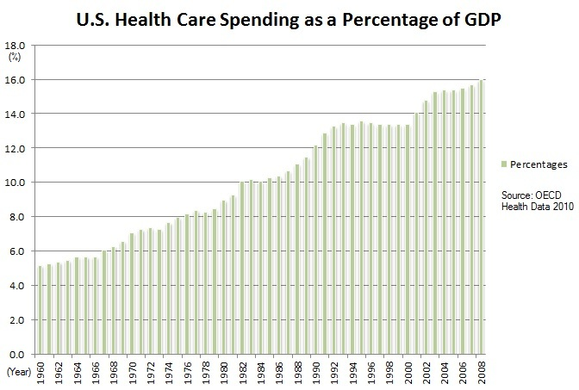
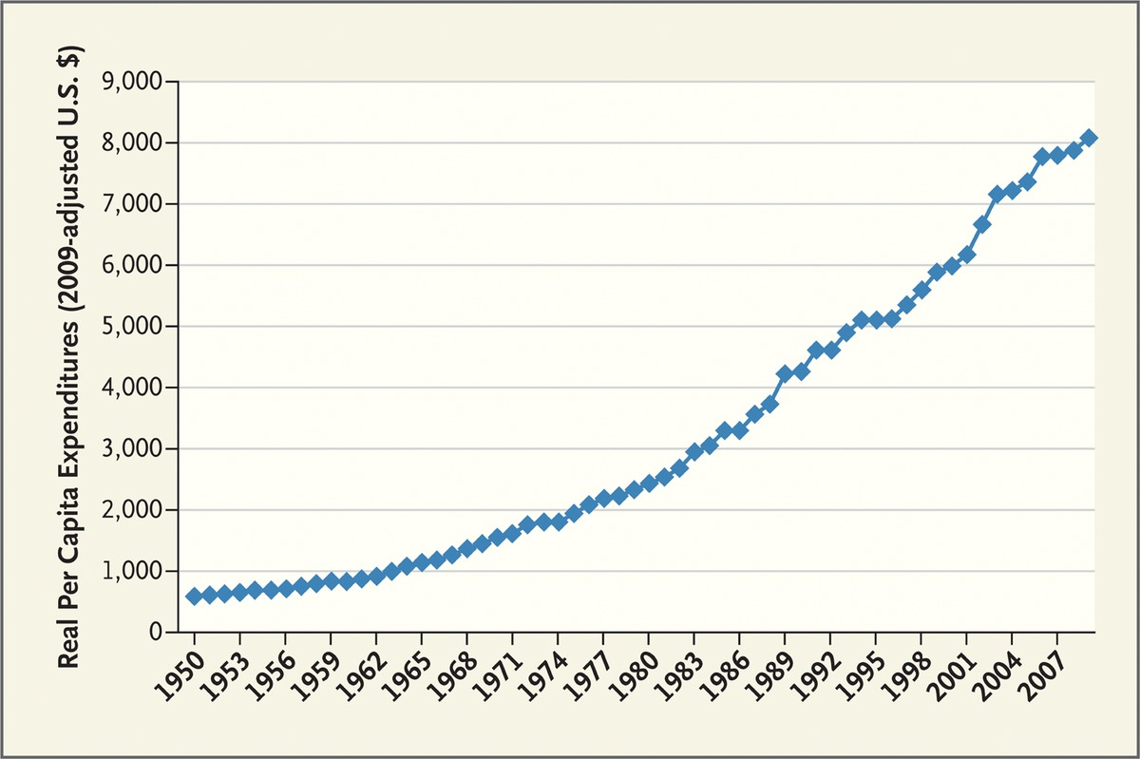
US Health Expenditure
Expenditure are increasing both in real terms and as a percentage of GDP
Fuchs 2012

Slide 5
Discussion Question
Is the United States and outlier?
How could we tell?

Slide 6
Comparing National Health Expenditures

Slide 7
Comparing National Health Expenditures

Slide 8
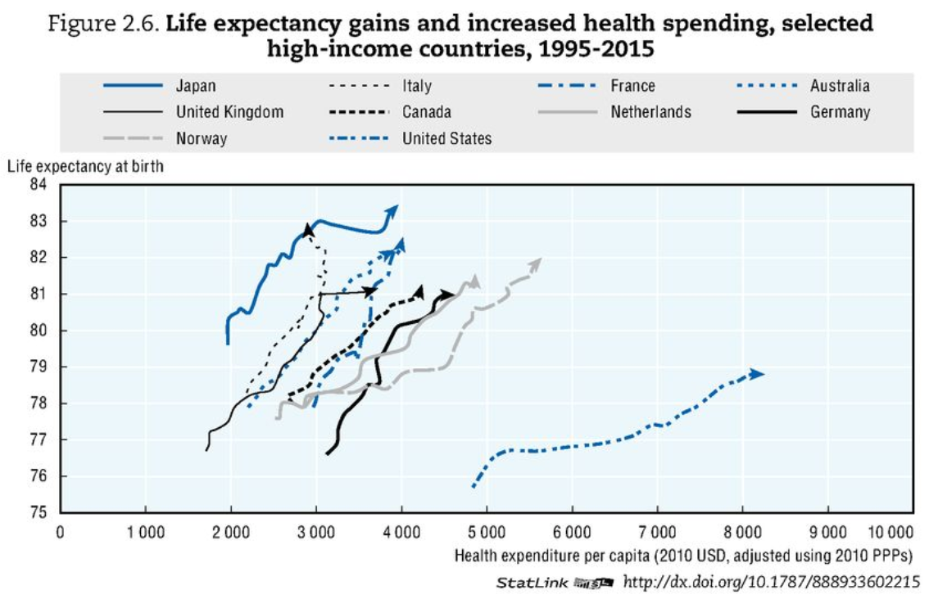
Comparing National Health Expenditures
OECD Health Data 2017

Slide 9
Unresolved Question
Is it bad that the United States is an outlier?
Is the United States wildly abnormal?
Is the income diversity (or other diversity) in the United States driving its outlier status?
Does Health Expenditure have a different meaning in the United States than elsewhere?

Slide 10
Measures of health
Mortality Rate: deaths per year per 100,000 people
YLL: years of life lost to a disease
DALY/QALY: sum of YLL and years of life lived with a disability

Slide 11
Disease Groups
Communicable Diseases
Neoplasms
Cardiovascular Diseases
Chronic Respiratory Diseases
Cirrhosis
Digestive Diseases
Neurological Diseases
Mental and Substance Abuse Diseases
DUBE
Musculoskeletal Disorders
Non-communicable Diseases
Injuries
Well Care
Risk Factors

Slide 12
Visualizing US Health and Health Expenditure
Health:
  https://vizhub.healthdata.org/gbd-compare/
Health Expenditure:
  https://vizhub.healthdata.org/dex/

Slide 13
Discussion Question
What causes the most disability?

Slide 14
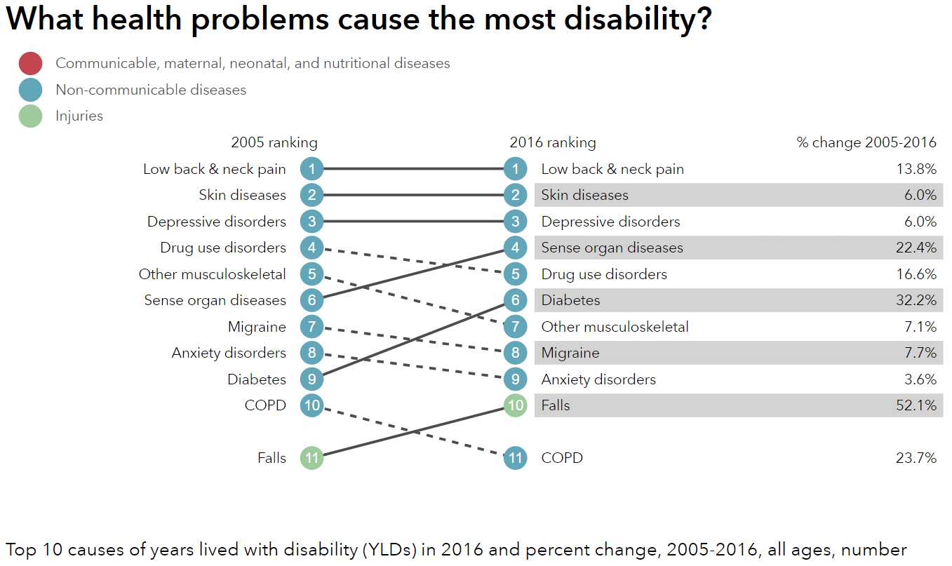
http://healthdata.org/us-health

Slide 15
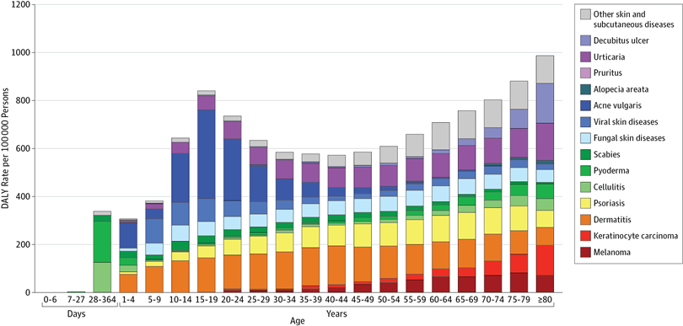
Unpacking DALY cost of skin diseases by age
Karimkhani et al 2017

Slide 16
Discussion Question
What causes the most deaths?

Slide 17
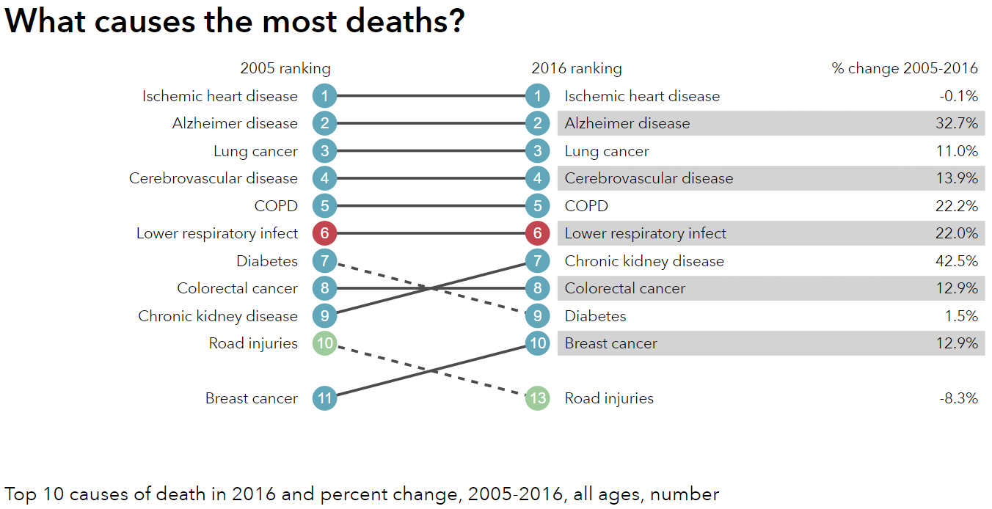
http://healthdata.org/us-health

Slide 18
Visualizing US Health and Health Expenditure
Health:
  https://vizhub.healthdata.org/gbd-compare/
Health Expenditure:
  https://vizhub.healthdata.org/dex/

Slide 19
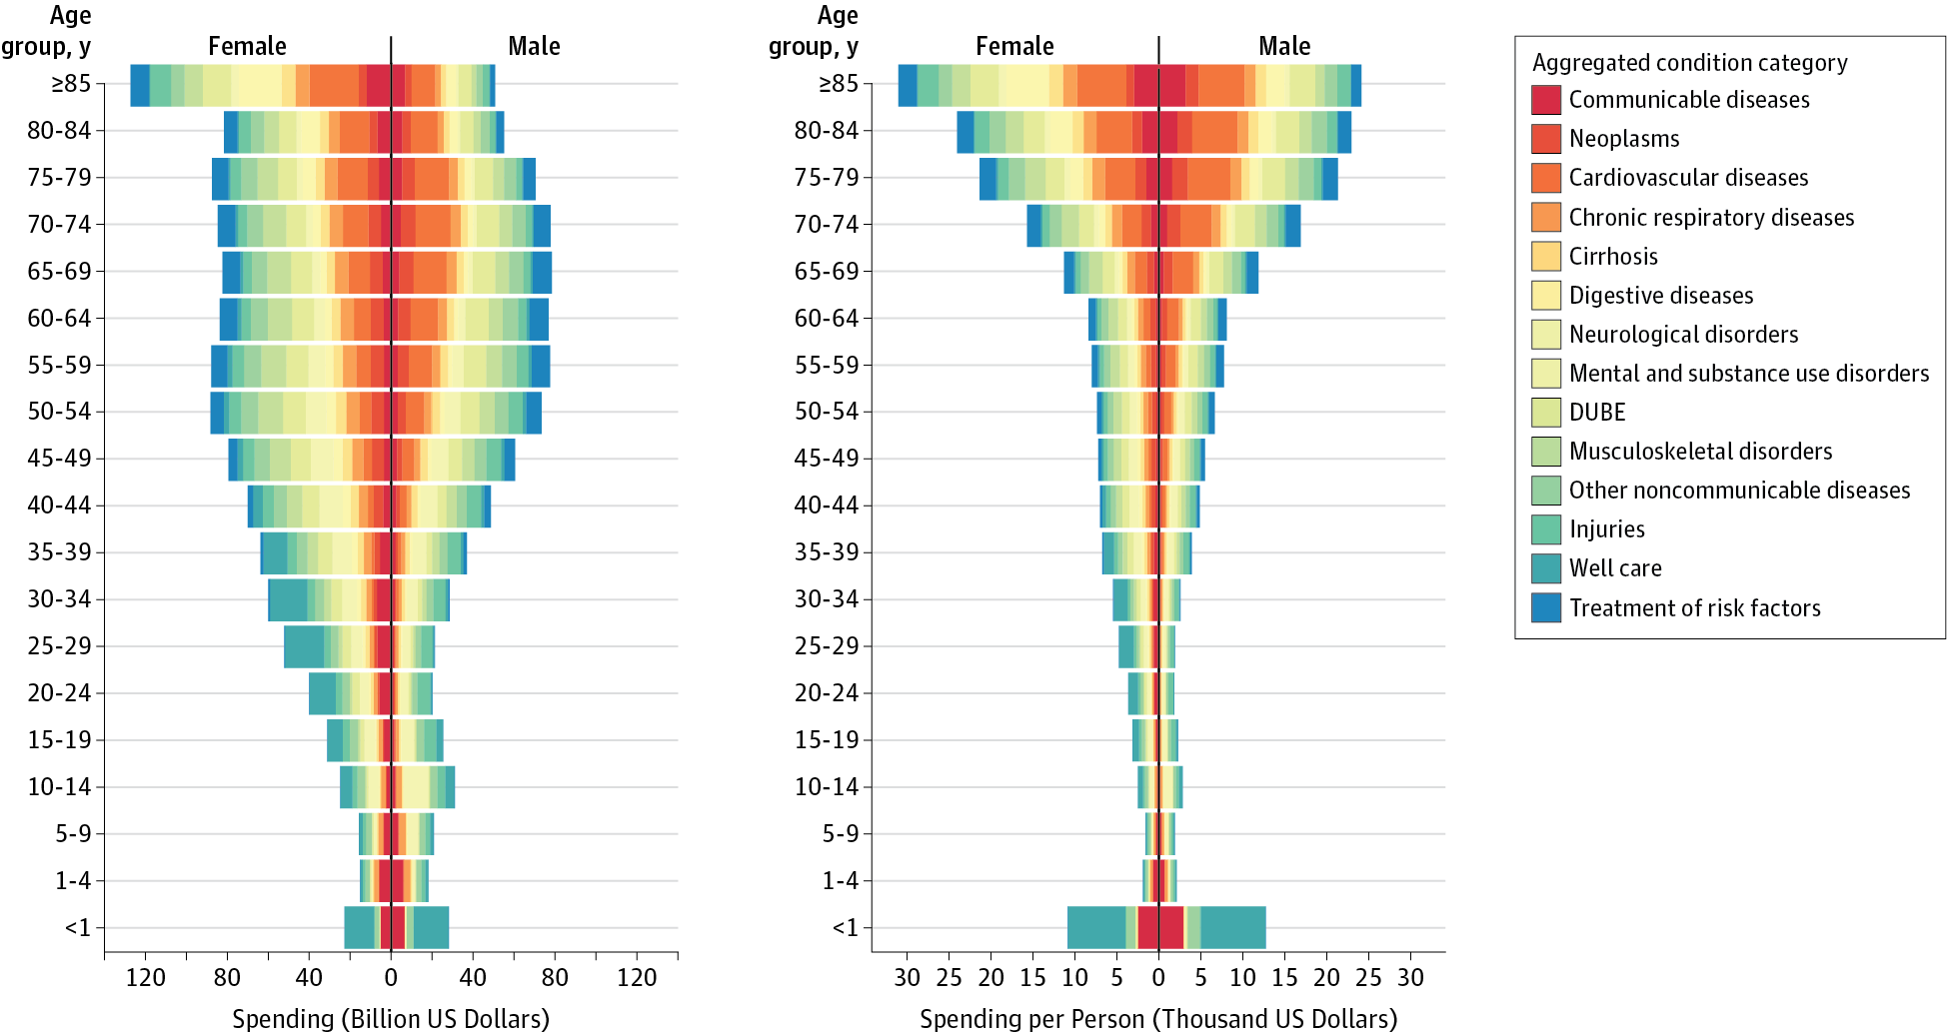
Health Care Costs by Age, Sex, and Disease
Dielman et al 2016

Slide 20
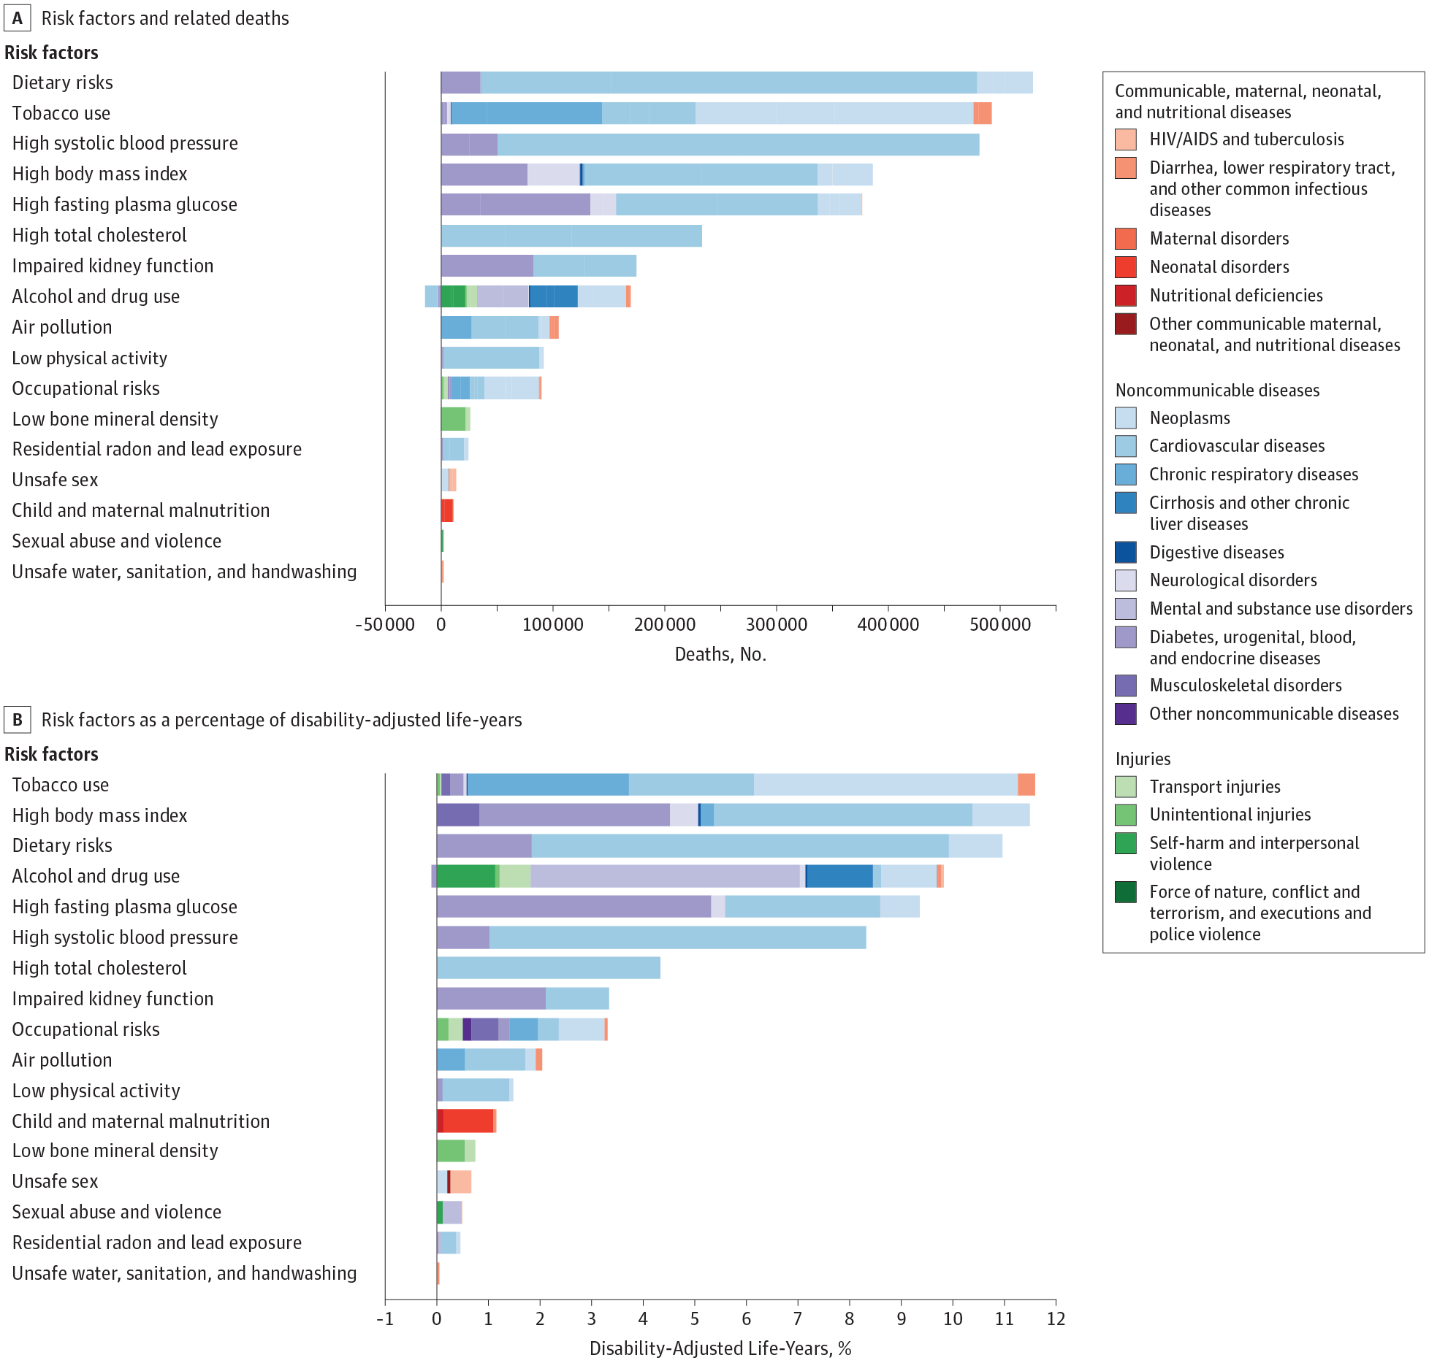
Risk Factors

Slide 21
Risk Factors

Slide 22
Unresolved Question?
Is the problem Big Pharma? Is it too many hospital administrators? Is it predatory nursing facilities?
In a broad sense, who is driving health care costs?
How should insurance premiums be structured given the distribution of costs across age and sex?
Does Medicare cause Health Care Costs to grow among people aged 65 and up or does increasing illness cause Health Care Costs to grow in this population?

Slide 23
Discussion question
Why do some say that health care in the united states is the best in the world?

Slide 24
Discussion question
Why do some say that health care in the united states is the best in the world?
  For those who can afford care, quality is often very high
  US is leader in innovation and development
  Inequality in disease risk is higher in US than other wealthy countries
  US leads in some statistics such as cancer survival rates
  About 40 percent of the world’s medical travelers—people who go abroad to obtain acute elective care—come to the United States

Slide 25
Five-Year Survival Rates for Patients Diagnosed with Five Common Cancers in Seven Countries, 2005–2009
Country | Female Breast | Colon | Lung | Prostate | Childhood Leukemia
Canada* | 85.8 | 62.8 | 17.3 | 91.7 | 90.6
France** | 86.9 | 59.8 | 13.6 | 90.5 | 89.2
Germany | 85.3 | 64.6 | 16.2 | 91.2 | 91.8
Italy | 86.2 | 63.2 | 14.7 | 89.7 | 87.7
Japan | 84.7 | 64.4 | 30.1 | 86.8 | 81.1
United Kingdom* | 81.1 | 53.8 | 9.6 | 83.2 | 89.1
United States | 88.6 | 64.7 | 18.7 | 97.2 | 87.7

Slide 26
Readings:
Fuchs, Victor R. "Major trends in the US health economy since 1950." New England Journal of Medicine 366, no. 11 (2012): 973-977.
Dieleman, Joseph L., et al. "US spending on personal health care and public health, 1996-2013." Jama 316.24 (2016): 2627-2646.
Bonus:
IHME Data Visualizations: https://vizhub.healthdata.org

Slide 27
Other Sources
Indicators, O. E. C. D. "Health at a Glance 2017." OECD Indicators, OECD Publishing, Paris. https://read.oecd-ilibrary.org/social-issues-migration-health/health-at-a-glance-2017_health_glance-2017-en#page1
Karimkhani, Chante, Robert P. Dellavalle, Luc E. Coffeng, Carsten Flohr, Roderick J. Hay, Sinéad M. Langan, Elaine O. Nsoesie et al. "Global skin disease morbidity and mortality: an update from the global burden of disease study 2013." JAMA dermatology 153, no. 5 (2017): 406-412.

Slide 28
Next Time
Health care as a right and as a public good
Reading:
*Gawande, Atul. “Is health care a right?” New Yorker, October 2, 2017
* Section I (pages 5-10) of Ruger, Jennifer Prah. "Toward a theory of a right to health: capability and incompletely theorized agreements." Yale Journal of Law & the Humanities 18, no. 2 (2006): 3.
Optional Readings:
Hamel, Mary Beth, Jennifer Prah Ruger, Theodore W. Ruger, and George J. Annas. "The elusive right to health care under US Law." N Engl J Med 372, no. 26 (2015): 2558-63.
Ruger, Jennifer P. "The moral foundations of health insurance." Journal of the Association of Physicians 100, no. 1 (2007): 53-57.

