Slide 1
HCMI 4225: Economics of Insurance
BUSN 202: Mon/Wed 9:30 AM – 10:45AM
Shane Murphy – shane@uconn.edu
Office Hours: Mon/Wed 11:00 AM – 12:30PM

Slide 2
Utility
y=U(x)
Utility is generally increasing in x
(So U’(x)>0)

Slide 3
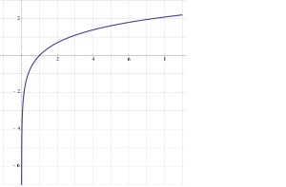
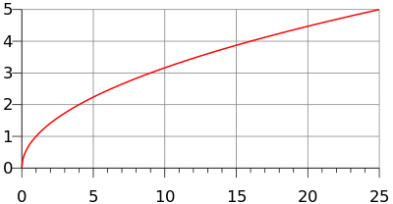
Diminishing Marginal Returns
Utility is generally concave
U(E(x))>E(U(x))
(also U’’(x)<0)
Examples
y=ln(x)
y=√x

Slide 4
Expected Value and Expected Utility
In a situation where there a multiple outcomes like a coin toss or a lottery, expected value is a weighted average of the outcomes where the weights are the probabilities of each outcome occuring

Slide 5
Expected value theory is based on gambling
In a lottery that has two possible outcomes, the expected value of the lottery is:
E(lottery) = probability of outcome 1 * payoff for outcome 1 +
probability of outcome 2 * payoff for outcome 2
This also works if there are more than two outcomes:
E(lottery) = probability of outcome 1 * payoff for outcome 1 +
probability of outcome 2 * payoff for outcome 2 +
probability of outcome 3 * payoff for outcome 3

Slide 6
Examples
What is the expected value of a lottery that pays $1,000 with probability 1% and $0 with probability 99%?
What is the expected value of a lottery that pays $1,000 with probability 25% and $100 with probability 75%?
What is the expected value of a lottery that pays $1,000 with probability 75% and -$1000 with probability 25%?

Slide 7
Expected Value and Expected Utility
Given multiple possible outcomes with associated probabilities the expected value of a lottery is the sum of the products of the outcomes and their associated probabilities
So if a lottery is called x and gives you A with probability p and B with probability Q, the expected value is E(x) = A*p + B*q
Given multiple possible outcomes with associated probabilities the expected utility of a lottery is the sum of the products of the utility of the outcomes and their associated probabilities
So if a lottery is called x and gives you A with probability p and B with probability Q, the expected value is E(U(x)) = u(A)*p + u(B)*q

Slide 8
Utility of expected value vs expected utility
The utility of the expected value is different from expected utility, how?
E(U(x)) is not equal to U(E(x))
What does this mean?
U(E(X)) is the utility of a risk free payoff of the expected value of the lottery
E(U(X)) is the utility of the lottery which includes any utility or isutility from playing the lottery
Would you rather play a lottery or be guaranteed the payoff of the lottery?
Would you rather invest in a risky asset or receive the expected return of that investment with no risk?

Slide 9
Expected Value and Expected Utility
What if the utility function is natural log
There are two events, it is equally likely that either will occur
The payoff of one event is 30 and the other is 10
Set up this problem for solving the expected value and expected utility

Slide 10
Expected Value and Expected Utility
Assume U(x) = ln (x), A = 30, p=1/2, B = 10, q=1/2
So E(x) = 30*1/2 + 10*1/2
= 15 + 5
= 20

Slide 11
Expected Value and Expected Utility
Assume U(x) = ln (x), A = 30, p=1/2, B = 10, q=1/2
So U(E(x)) = U(30*1/2 + 10*1/2)
= U(15 + 5)
= U(20)
= ln(20)
= 3

Slide 12
Expected Value and Expected Utility
Assume for Fred, U(x) = ln (x), A = 30, p=1/2, B = 10, q=1/2
So U(A) = ln (A)
= ln (30)
= 3.4
So U(b) = ln (b)
= ln (10)
= 2.3

Slide 13
Expected Value and Expected Utility
Assume U(x) = ln (x), A = 30, p=1/2, B = 10, q=1/2
So E(U(x)) = 3.4*1/2 + 2.3*1/2
= 1.7 + 1.15
= 2.85
Note: U(E(x)) > E(U(x))
3 > 2.85

Slide 14
Diminishing marginal utility
Utility functions generally show diminishing marginal returns
A millionaire gets less utility from an additional $100 than a poor person.
Graphical representation:
Most common functional forms:
U(x) = ln(x)
U(x) = $√x$

Slide 15
Risk Premium
Risk Premium is the maximum amount of money a risk-averse person would pay to avoid taking a risk
Risk Premium is the difference between the expected value of a gamble and the value of a sure outcome such that the utility of that outcome equals the expected utility of the gamble
In our previous problem,

Slide 16
Risk Premium
Risk Premium is the difference between the expected value of a gamble and the value of a sure outcome such that the utility of that outcome equals the expected utility of the gamble
Taking a risk means getting an expected utility of E(U(x))
What would Z need to be such that: U(Z) = E(U(X))?
Solve for Z in U(Z) = E(U(X))
Z = inverse U(E(U(X))
So in our previous problem, E(U(X)) = 2.85
so, Z = invers ln (2.85)
Z = e^(2.85)
Z = 17.3
Z is called the Certainty Equivalent

Slide 17
Risk Premium
Risk Premium is the difference between the expected value of a gamble and the value of a sure outcome such that the utility of that outcome equals the expected utility of the gamble
So the risk premium = E(U(x)) - inverse U(E(U(X))
= 20 – 17.3
= 2.7
So Fred would be willing to pay 2.7 in order to get 20 (that is, to get E(X)) with 100% certainty rather than be uncertain between 10 and 30.

Slide 18
Let’s do a problem:
40% chance of earning $2500/month
60% change of $1600/month
U(Y) = √Y
Expected utility: E(U(Y)) = P1*U(Y1) + P2*U(Y2)?
E(U(Y)) = 0.4(2500)0.5 + 0.6(1600)0.5 = 0.4(50) + 0.6(40) = 44
E(Y)?
E(Y) = 0.4(2500) + 0.6(1600) = 1960
Certainty Equivalent = inverse U(E(U(Y))?
44^2 = 1936
Risk Premium = E(U(Y)) - inverse U(E(U(Y))?
1960-44^2=1960-1936=24
Interpretation?

Slide 19
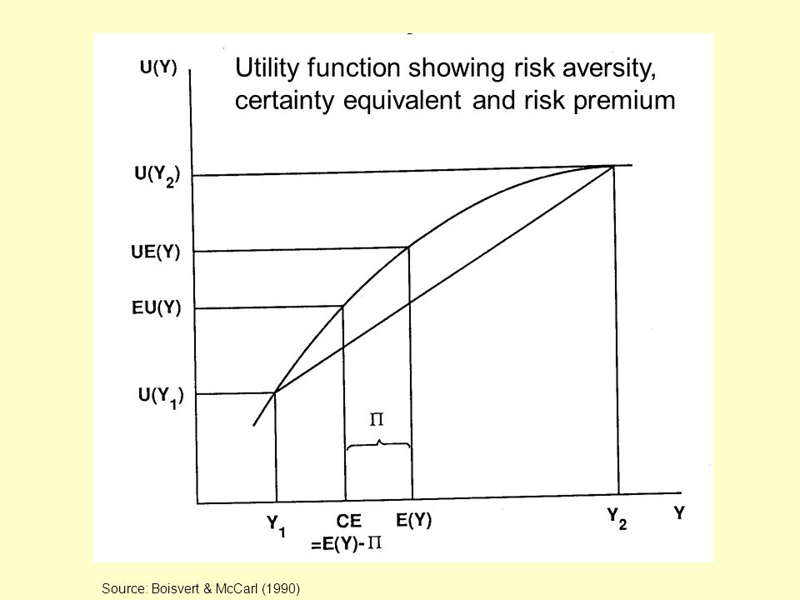
Graphical Representation

Slide 20
Another problem
Suppose have $200,000 home (wealth).
Small chance that a fire will damage you house. If does, will generate $75,000 in loss (L)
U(W) = ln(W)
Prob of a loss is 0.02 or 2%
Wealth in “good” state = W
Wealth in bad state = W-L
Fist Calculate E(Y) and E(U(Y))

Slide 21
E(Y) = (1-P)W + P(W-L)
E(Y) = 0.98(200,000) + 0.02(125,000) = $198,500
E(U(Y)) = (1-P) ln(W) + P ln(W-L)
E(U(Y)) = 0.98 ln(200K) + 0.02 ln(200K-75K) = 12.197

Slide 22
Continuing
Suppose you can add a fire detection/prevention system to your house.
This would reduce the chance of a bad event to 0 but it would cost you $C to install
What is the most you are willing to pay for the security system?
E(U(Y)) in the current situation is 12.197
Utility with the security system is U(W-C)
Set U(W-C) equal to 12.197 and solve for C

Slide 23
ln(W-C) =12.197
Recall that e^ln(x) = x
Raise both sides to the e
E^ln(W-C) = W-C = e^12.197 = 198,128
198,500 – 198,128 = $372
Expected loss is $1500
Would be willing to pay $372 to avoid that loss
Graph the situation

Slide 24
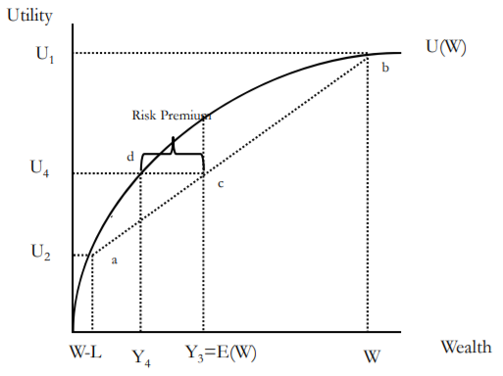
Will earn Y1 with probability p1 – Generates utility U1
Will earn Y2 with probability p2=1-p1 – Generates utility U2
E(I) =p1Y1 + (1-p1)Y2 = Y3
Line (ab) is a weighted average of U1 and U2
Note that expected utility is also a weighted average
A line from E(Y) to the line (ab) give E(U) for given E(Y)Take the expected income, E(Y). Draw a line to (ab). The height of this line is E(U).
E(U) at E(Y) is U4
Suppose income is know with certainty at I3. Notice that utility would be U3, which is greater that U4
Look at Y4. Note that the Y4
The line segment (cd) is the “Risk Premium.” It is the amount a person is willing to pay to avoid the risky situation.
If you offered a person the gamble of Y3 or income Y4, they would be indifferent.
Therefore, people are willing to sacrifice cash to ‘shed’ risk.

Slide 25
Can you spot the mistake?

Slide 26
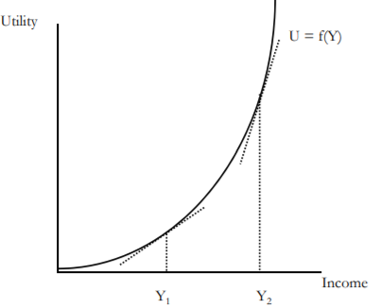
Risk averse vs Risk loving vs Risk neutral
What in the graph expresses an individual is risk averse?
If an individual is risk loving, their utility function is convex (like u(X)=x^2
What about Risk neutral?

Slide 27
Role of Insurance
Consider our Previous problem:
E(W) = $198,500
L = 75,000 with P=2%
E(U(W)) = 12.197
C = 198,128
Expected loss is $1500
Would be willing to pay (risk premium) $372 to avoid that loss
Another firm can capitalize on the risk aversion by providing insurance.

Slide 28
Role of Insurance
Consider our Previous problem:
E(W) = $198,500
L = 75,000 with P=2%
E(U(W)) = 12.197
C = 198,128
Expected loss is $1500
Would be willing to pay (risk premium) $372 to avoid that loss
How much can the firm charge?
What is the firms expected profit?
If the firm is required to keep capital on hand equal to the possible loss, if the insurance premium is paid each year, what is the firms return to capital on hand?

Slide 29
Role of Insurance
How much can the firm charge?
$1500 + $372 = $1872
What is the firms expected profit from this person if they charge this amount?
$372
If the firm is required to keep capital on hand equal to the possible loss, if the insurance premium is paid each year, what is the firms return to capital on hand?
Capital requirement is $75,000, so return is $372/$75,000 = .00496
If the firm is required to keep capital on hand equal to the 10% of the possible loss, if the insurance premium is paid each year, what is the firms return to capital on hand?
Capital requirement is $7,500, so return is $372/$7,500 = .0496

Slide 30
Role of Insurance
Suppose you can buy insurance that costs you PREM. The insurance pay you to compensate for the loss L.
In good state, income is
Y-Prem
In bad state; you paid PREM, lose L, and receive PAYMENT, therefore, income is
Y-Prem-L+PAYMENT
If PAYMENT=L, income in the bad state is
Y-Prem

Slide 31
Role of Insurance
Notice that insurance has made income certain. You will always have income of Y-PREM
What is the most this person will pay for insurance?
The expected loss is p*L
Expected income is E(Y)
The expected utility is U2
People would always be willing to pay a premium that equaled the expected loss
But they are also willing to pay a premium to shed risk (line cd)
The maximum amount they are willing to pay is expected loss + risk premium
Note: Y4 is the certainty equivalence

Slide 32
One final example
Suppose income is $50K, and there is a 5% chance of having a car accident that will generate $15,000 in loss
Expected loss is .05(15K) = $750
U = ln(y)
What is E(U)?
E(U)=10.8

Slide 33
One final example
What is the most someone will pay for insurance?
People would purchase insurance so long as utility with certainty is at least 10.8 (expected utility without insurance)
U* =U(Y – Prem) ≥ 10.8
Solve for Prem, CE, risk premium
979 ≥ PREM
CE = 49,021
Risk premium = E(Y) – CE = 49,250 – 49,021 = 229

Slide 34
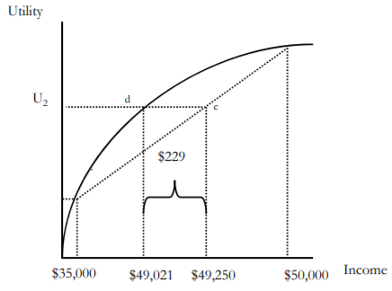
One final example
Recall that the expected loss is $750 but this person is willing to pay more than the expected loss to avoid the risk
Pay $750 (expected loss), plus the risk premium ($979- $750) = 229

Slide 35
Theory of the firm
What is the firms expected profit if the full risk premium is charged?
$229
If the firm must keep 100% of capital on hand, what is the return to this capital?
$229/$15,000 = 1.5%
If the market is perfectly competitive, profits will shrink – theoretically shrinking to zero. What would the premium be if markets were perfectly competitive?
E(Loss) = $750

Slide 36
Demand for Insurance
Factors of Demand:
Risk Aversion
Perception of Risk
Peer Behavior
Wealth and Income
Ability to Externalize Risk
Moral Hazard

Slide 37
Diversification and Pooling and the Role of the Standard Deviation
In a sense, Insurance is a mechanism by which the cost of risks are mediated through pooling
The insured are willing to pay a risk premium to cover administrative and transaction costs of the pool in return for the reduction in risk
Members of a pool do not necessarily make equal contributions
Contributions may be increasing in level of risk and exposure

Slide 38
Diversification and Pooling and the Role of the Standard Deviation
Risky Situation | No Risk Situation
E(Y)=49,250 SD(Y)=3.3 | E(Y)=49,021 SD(Y)=0
U(E(Y))=10.8 | U(E(Y))=10.8

Slide 39
Diversification and Pooling and the Role of the Standard Deviation
Why are there very few private flood insurance plans?

Slide 40
Law of Large Numbers
Given a fair experiment, the average or mean value of the results obtained from a large number of trials should be close to the expected value. As more trials are performed, the mean will tend to become closer to the expected value.

Slide 41
Pooling in Insurance
Efficiency (maximized social welfare) vs Equity (“fairness”)
How do you think Efficiency and Equity could be managed in designing an insurance program?
Pooling equilibrium – all risk types buy the same policy
High risk individuals pay lower rate, low risk individuals pay higher rate
Low risk individuals less likely to buy insurance
High risk individuals more likely to buy insurance
Separating equilibrium – Risk types buy different insurance policies
Low risk individuals pay lower rate, become more likely to buy policy
High risk individuals pay higher rate, become less likely to buy policy

Slide 42
Adverse Selection
Adverse selection occurs when market participation is affected by asymmetric information
Adverse selection occurs when high-risk individuals are more likely to purchase insurance than low-risk individuals

Slide 43
Mitigating Adverse Selection
Individual Mandate in the ACA
Waiting Period before Coverage Takes Effect
Premiums Tied to Risk

Slide 44
Moral Hazard
When there is a lack of incentive to guard against risks because an individual is protected from the consequences of those risks

Slide 45
Mitigating Moral Hazard
Co-payments and Deductibles

Slide 46
Readings:
Klein, Robert (2014) A Primer on The Economics of Insurance (https://www.researchgate.net/publication/270500085_A_Primer_on_The_Economics_of_Insurance)

