Slide 1
HCMI 4225: Economics of Insurance
BUSN 202: Mon/Wed 9:30 AM – 10:45AM
Shane Murphy – shane@uconn.edu
Office Hours: Mon/Wed 11:00 AM – 12:30PM

Slide 2
Theory of the firm
What is the firms expected profit if the full risk premium is charged?
$229
If the firm must keep 100% of capital on hand, what is the return to this capital?
$229/$15,000 = 1.5%
If the market is perfectly competitive, profits will shrink – theoretically shrinking to zero. What would the premium be if markets were perfectly competitive?
E(Loss) = $750

Slide 3
Diversification and Pooling and the Role of the Standard Deviation
In a sense, Insurance is a mechanism by which the cost of risks are mediated through pooling
The insured are willing to pay a risk premium to cover administrative and transaction costs of the pool in return for the reduction in risk
Members of a pool do not necessarily make equal contributions
Contributions may be increasing in level of risk and exposure

Slide 4
Diversification and Pooling and the Role of the Standard Deviation
Risky Situation | No Risk Situation
E(Y)=49,250 SD(Y)=3.3 | E(Y)=49,021 SD(Y)=0
U(E(Y))=10.8 | U(E(Y))=10.8

Slide 5
Diversification and Pooling and the Role of the Standard Deviation
Why are there very few private flood insurance plans?

Slide 6
Law of Large Numbers
Given a fair experiment, the average or mean value of the results obtained from a large number of trials should be close to the expected value. As more trials are performed, the mean will tend to become closer to the expected value.

Slide 7
Pooling in Insurance
Efficiency (maximized social welfare) vs Equity (“fairness”)
How do you think Efficiency and Equity could be managed in designing an insurance program?
Pooling equilibrium – all risk types buy the same policy
High risk individuals pay lower rate, low risk individuals pay higher rate
Low risk individuals less likely to buy insurance
High risk individuals more likely to buy insurance
Separating equilibrium – Risk types buy different insurance policies
Low risk individuals pay lower rate, become more likely to buy policy
High risk individuals pay higher rate, become less likely to buy policy

Slide 8
Adverse Selection
Adverse selection occurs when market participation is affected by asymmetric information
Adverse selection occurs when high-risk individuals are more likely to purchase insurance than low-risk individuals

Slide 9
Mitigating Adverse Selection
Individual Mandate in the ACA
Waiting Period before Coverage Takes Effect
Premiums Tied to Risk

Slide 10
Moral Hazard
When there is a lack of incentive to guard against risks because an individual is protected from the consequences of those risks

Slide 11
Mitigating Moral Hazard
Co-payments and Deductibles

Slide 12
Demand for Insurance
Factors of Demand:
Risk Aversion
Perception of Risk
Peer Behavior
Wealth and Income
Ability to Externalize Risk
Moral Hazard

Slide 13
Insurance Market Structure
Concentrated and becoming more concentrated
Hirschman-Herfindahl Index (HHI)
Average about 9.6 carriers per market in 2006 (down from 18.9 in 1998)
Increased concentration = less competition -> higher prices

Slide 14
Insurance Market Structure
Hospitals vs Insurance companies
Some evidence for cooperation rather than competition
Hospitals earn higher profits in markets where insurance companies earn higher profits
This may not be ideal and policies may seek to increase competition in these markets

Slide 15
Insurance Market Structure
Employers vs Insurance companies
In a perfectly competitive market, prices do not change with the income of the buyer
For insurance companies offering employee insurance plans, this would mean that premiums would not change with company profitability
However, There is evidence that insurers have market power
Premiums are higher for more profitable companies
This is not due to more profitable companies offering more coverage

Slide 16
How much do insurance companies make?
An average of 79.7 cents per premium dollar is spent by insurers on health care proper and 17.8 cents on the insurers’ operating costs, leaving only 2.7 cents per premium dollar as profits.
Medical loss ratio (MLR) – the portion of premiums collected health insurers “lose” to physicians, hospitals, and other entities who offer health care
Affordable Care Act (ACA) mandated an MLR of at least 85% for large insurance companies and of at least 80% for smaller carriers.
Pre-ACA MLRs were about 55%-65%
Profit margins for the larger US health insurers, for example, actually were much higher than just 3% in recent years, with 4.7% for Aetna, 7.0% for Cigna, and 4.6% for United Health Group in 2015 and 3.5% for Anthem in 2014.
These numbers include the Medicare Advantage program

Slide 17
Insurance Market Structure
Consumers vs Insurance companies
There is some evidence that individual market would be more efficient than group plans, and that this increase in efficiency may outweigh the benefit of risk pooling from group plans
However, when given choices, consumers don’t often use the information at hand rationally
When offered a better plan, few consumers switch
Perhaps consumers don’t even notice the better option?
Consumers generally care more about premiums than co-pays and other costs of different plans

Slide 18
Operating costs
18%
Include cost of marketing, determining eligibility, utilization controls (eg, prior authorization of particular procedures), claims processing, and negotiating fees with each and every physician, hospital, and other health care workers and facilities.
Twice as high as costs in other OECD countries with simpler systems
One study estimates this accounts for 39% of the difference in the cost of spending in Canada vs the US
31% is due to incomes, 14% due to spending intensity
For example, the Duke University's hospital system (with 3 hospitals) has 957 beds and about 1600 billing clerks.

Slide 19
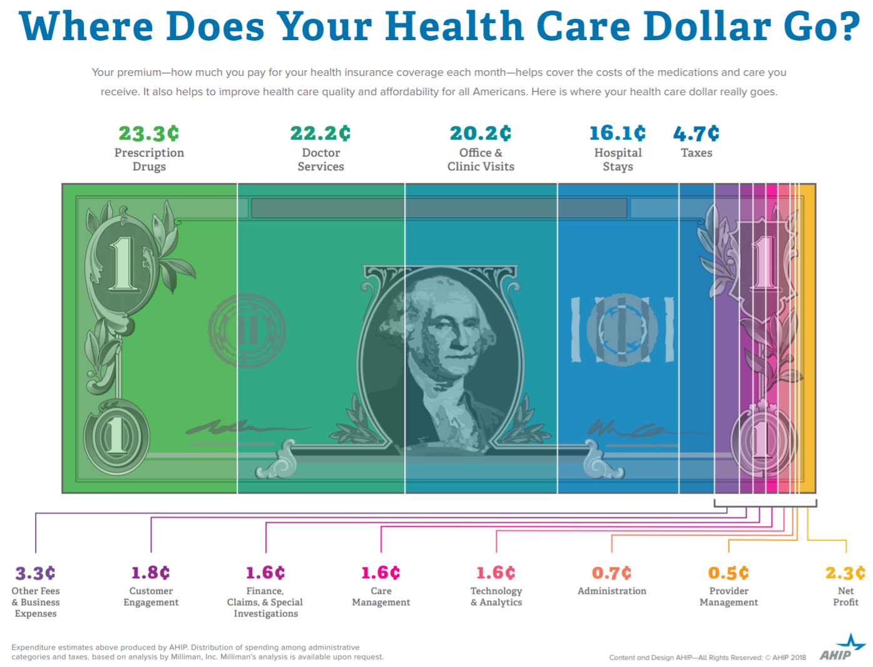
Notes:
https://www.ahip.org/wp-content/uploads/2017/03/HealthCareDollar_FINAL.pdf

Slide 20
Notes:
https://www.ahip.org/wp-content/uploads/2017/03/HealthCareDollar_FINAL.pdf

Slide 21
Notes:
https://www.ahip.org/wp-content/uploads/2017/03/HealthCareDollar_FINAL.pdf

Slide 22
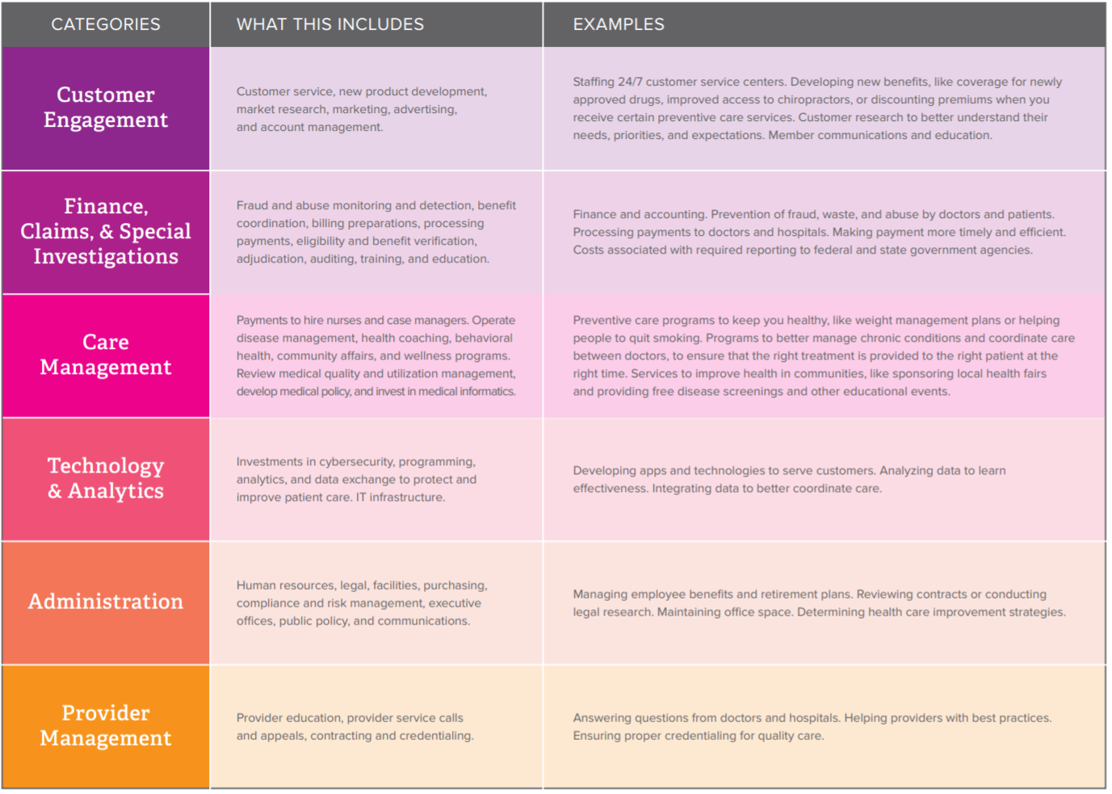
Notes:
https://www.ahip.org/wp-content/uploads/2017/03/HealthCareDollar_FINAL.pdf

Slide 23
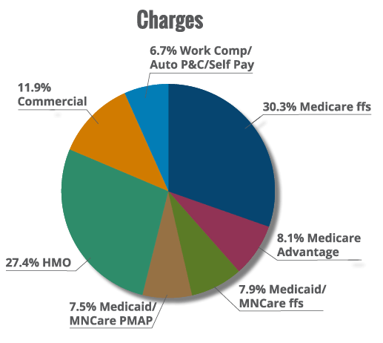
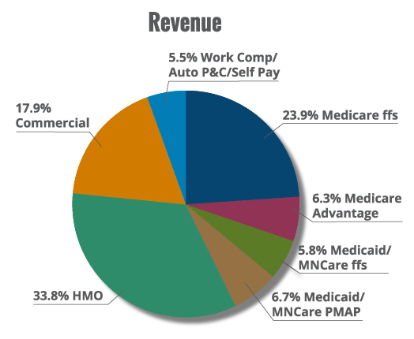
Compare to hospitals:
Notes:
https://www.mnhospitals.org/mn-hospitals/hospital-financing-101

Slide 24
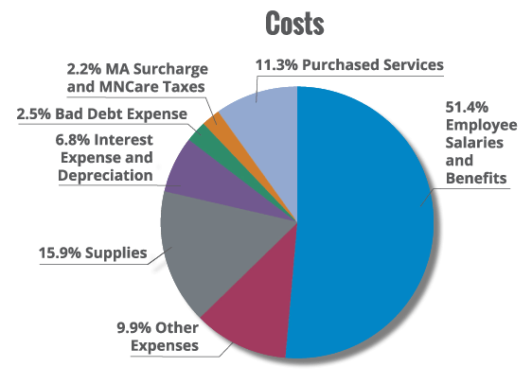
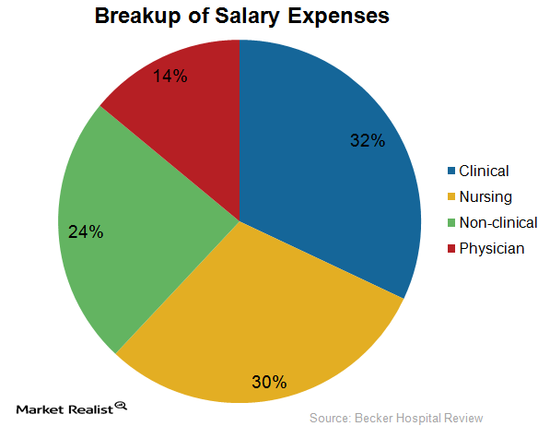
Compare to hospitals:
Notes:
https://articles.marketrealist.com/2014/11/analyzing-hospital-expenses/
Note that .222*.14*$3.5trillion/1million = $109,000

Slide 25
Readings:
Klein, Robert (2014) A Primer on The Economics of Insurance (https://www.researchgate.net/publication/270500085_A_Primer_on_The_Economics_of_Insurance)
Reinhardt, Uwe. “Where does the health insurance premium dollar go?.” Jama 317, no. 22 (2017): 2269-2270.
America’s Health Insurance Plans (AHIP), Where does the health insurance premium dollar go?.pdf May 22, 2018
Rosenthal, Elisabeth. “Those indecipherable medical bills? They’re one reason health care costs so much hospitals have learned to manipulate medical codes—Often resulting in mind-boggling bills.” New York Times Magazine (2017).

