Slide 1
HCMI 4225: New lessons from Covid-19
Shane Murphy – shane@uconn.edu

Slide 2
Information > Policy
People respond more to information than policy
Social distancing practice preceded social distancing policies
People respond more to local numbers of cases and deaths
People respond little if at all to stay at home orders

Slide 3
Enrollment periods in the healthcare marketplace
Hundreds of thousands or millions of people have lost employer sponsored insurance
CMS is not running a no strings attached Open Enrollment Period (OEP)
Special Enrollment Period (SEP)
Right now the Marketplace is not requiring consumers to upload supporting documentation to verify their eligibility to enroll in a Special Enrollment Period
Consumers may attest to that information that they provide
If a public benefit is easy to access, then lots of people will use the public benefit. If a public benefit is difficult to access, not many people will use that benefit.
SNAP/WIC, Voting, Medicaid, Student aid, ACA SEPs

Slide 4
IBNR - Incurred claims But Not Received claims
Clinical entities and organizations won’t provide services and bill the insurer on the same day.
slightly less than half of claims arrive at an insurer within a month.
By sixty days, close to 90% of all claims would have arrived at the insurer.
Larger, more administratively complex providers may bill every day.
Smaller practices might only bill on the 2nd Tuesday of the month or whenever the pile gets too high.
Insurers and actuaries will take a time period worth of received claims and then multiply that value by an IBNR multiplier.
Adjusted for day of the weak, season, type of claim, etc.

Slide 5
Hospitals are losing money, Insurers making money
From Credit Suisse Hospital Volume Tracker April Survey:
March Inpatient Volumes Down 10.9% year over year;
Outpatient Visits Down 13.5%
Inpatient surgeries down 11.7% in March (down 4.0% for the full first quarter)
Outpatient surgeries down 15.1% (down 2.5% for full Q1
April volumes will be down more
High margin elective procedures have been cancelled en masse
Hospitals and physician practices are in a massive hole if they are in primarily fee for service payment regimes because their marginal visits evaporated.
Insurers first quarter results will likely either be in line with to significantly more profitable than expectations
Lower hospital volumes mean lower claims

Slide 6
State premium submission period
Commercial insurers must submit premiums for 2021 to state regulators for review and approval in May and June
Insurers are not allowed to justify future premium increases based on any losses they expect this year.
Premium justifications must be based on assumptions about claims costs for next calendar year.
If claims costs are exceptionally high this year, though, insurers might need to replenish surplus in order to remain solvent.
In late summer, premiums are locked in and insurers will be unable to change those rates for the duration of the coming calendar year.
Uncertainty might reduce number of plans offered in some markets
Reinsurance and risk corridors

Slide 7
Temporary layoffs and APTC
Low income individuals may earn more income through unemployment and stimulus checks than they would have in their jobs
This may affect APTC if they get there health insurance through the ACA marketplaces
They may have received too large of an APTC
In this case, there could be a surcharge on their premium, so that they pay more than 9% of their income for insurance on the exchange once the layoff ends.

Slide 8
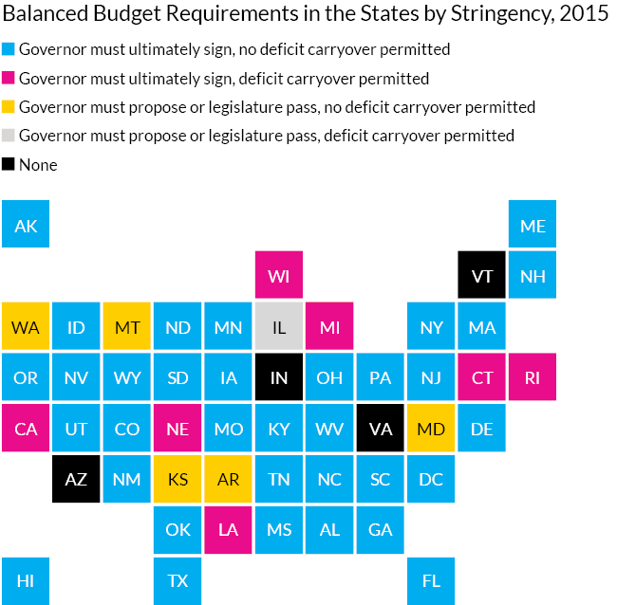
Starve the Beast
Reagan era anti-government slogan
Easier to cut taxes than cut government spending
Deficits and debt force policy makers to cut programs
46 states have balanced budget laws (36 in state constitutions)
So state budgets place even more stress on state policymakers
Federal support for states during financial crisis is necessary for states to continue to provide high levels of spending
Federal aid to states and local governments in the latest stimulus package failed in congressional negotiations

Slide 9
Unemployment
States vary in implementation
Some states purposely place administrative barriers on unemployment applications even for those who qualify
Long lines, high levels of paperwork, limited submission availability
States keep trust fund to fund unemployment
These have depleted in the face of the crisis, even in states with few cases.
Fear of exposure may not be allowed as an acceptable reason to refuse work and continue to receive unemployment benefits in some states

