Slide 1
HCMI 5243: Medicare and Medicaid
Shane Murphy – shane@uconn.edu

Slide 2
Does Medicare Save Lives? By David Card, Carlos Dobkin, Nicole Maestas
Medicare is the largest health insurance in US, one-fifth of total health care costs in the United States.; virtually free to those aged over 65
worked at least 10 years in covered employment.
Individuals can enroll on the first day of the month that they turn 65
Health insurance (including Medicare) increases utilization
Early evidence was unclear about health impacts

Slide 3
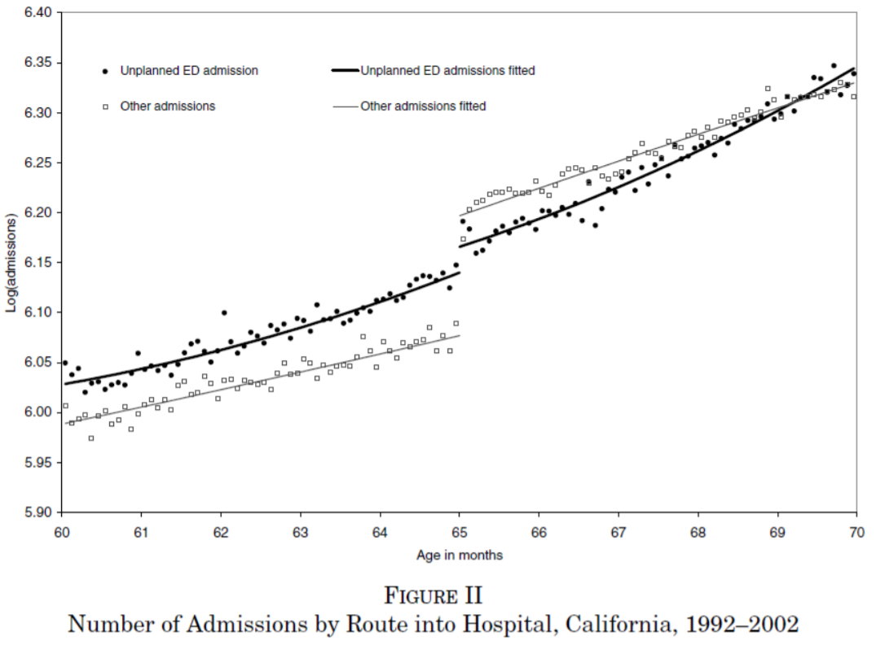
Regression Discontinuity
Mortality increases over time
Is there a jump when people turn 65 and enroll in medicare?
Let’s look at admissions:
Moral hazard
So we need to look at non-deferrable

Slide 4
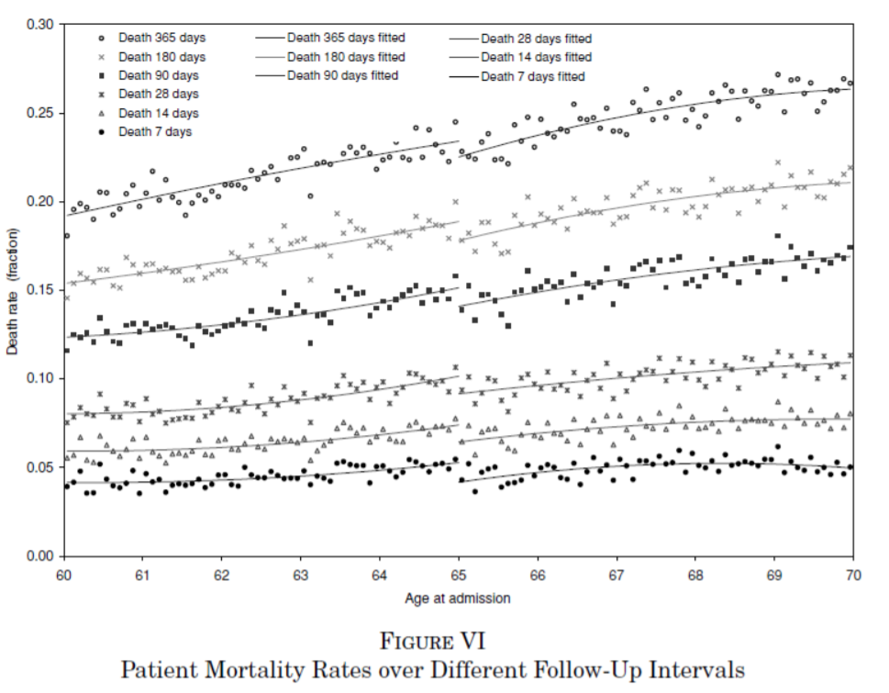
Result
Regardless of mortality measure

Slide 5
Result
The authors find that this change in coverage leads to a nearly 1 percentage point drop in 7-day mortality for patients at age 65 (20 percent reduction).
The mortality gap persists for at least two years following the initial hospital admission.
The magnitude is too large to be driven solely by changes in the 8% of the population that transition from no insurance to Medicare.

Slide 6
Does Medicaid Save Lives?
Famous 2012 paper says no
Finkelstein, Amy, Sarah Taubman, Bill Wright, Mira Bernstein, Jonathan Gruber, Joseph P. Newhouse, Heidi Allen, Katherine Baicker, and Oregon Health Study Group. "The Oregon health insurance experiment: evidence from the first year." The Quarterly journal of economics 127, no. 3 (2012): 1057-1106.
More recent results say yes
Antonisse, Larisa, Rachel Garfield, Robin Rudowitz, and Samantha Artiga. "The effects of Medicaid expansion under the ACA: updated findings from a literature review." (2018).
Updated here: https://www.kff.org/medicaid/report/the-effects-of-medicaid-expansion-under-the-aca-updated-findings-from-a-literature-review/

