Slide 1
HCMI 5243: Preston Curve – health, wealth, and other things
Shane Murphy – shane@uconn.edu
Office Hours: Mon/Wed 11:00 AM – 12:30PM

Slide 2
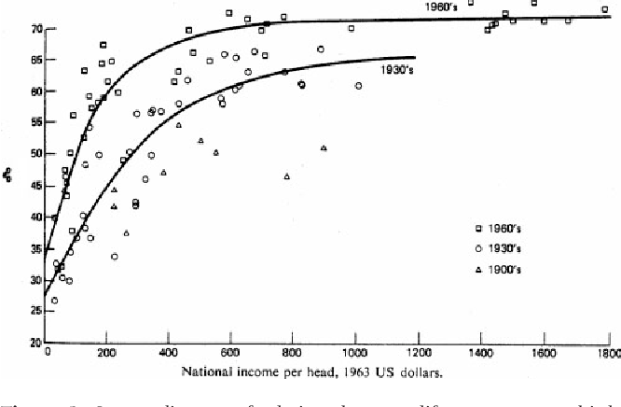
Preston 1975

Slide 3
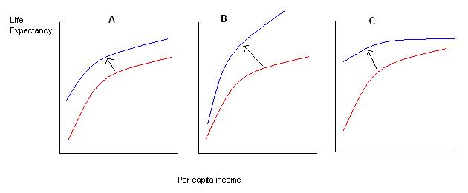

Slide 4
