Slide 1
HCMI 4225: History of Insurance
Online: Mon/Wed 12:30-1:45
Shane Murphy – shane@uconn.edu

Slide 2
Contents
Federal expenditure before 1900
Civil War
  Freedmen’s Bureau
  Pensions
Mutual Aid organizations

Slide 3
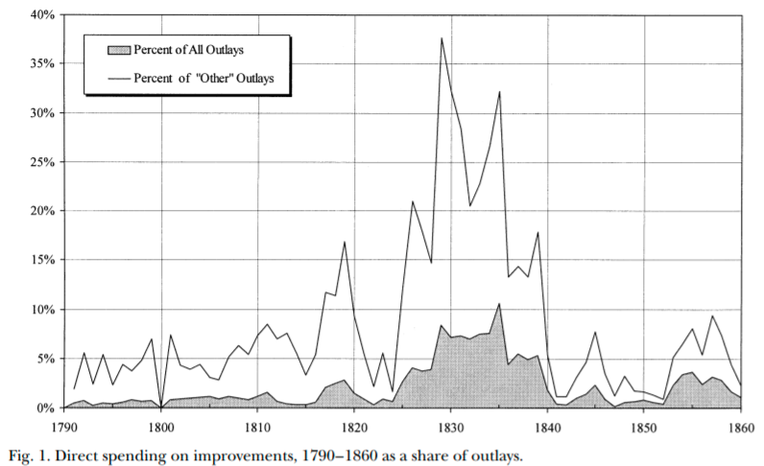
Federal expenditure before the Civil War (1861-1865)
Internal improvements, war, veterans pensions
  Defense (including pensions) made up about half of expenditure most years
Congressional structure made federal spending particularly hard
  Before 1820, non-defense spending was largely government employee salaries
  Ways and means controlled budget; Finance committee (1816), Appropriations committee (1867) came later
Increased Westward expansion and industrialization
  1820s until 1920s were an era of appropriations

Slide 4
Internal improvements
Building roads, canals, and railroads, river and harbor projects, and erecting lighthouses and other aids to navigation
Henry Clay and John Quincy Adam’s “American System”
  Seven Points of 1815
Era of internal improvements was 1825-1838
  Opposed by President Andrew Jackson (1829-1837)
  Ends with Panic of 1837
Land grants – distribution of land sale revenues to states – expanded greatly after 1841
Westward expansion and railroads
  Organization of Nebraska territory
    Slavery question
  Transcontinental railroad (1863-1869)

Slide 5
Civil war and emancipation
Secession starts in 1860 after Lincoln elected, before inauguration, war begins April 12, 1861
First Confiscation Act (August 6, 1861) legalizes giving escaped slaves right to remain across Union lines – called contraband
Emancipation proclamation (September 22, 1862)
  Went into effect on January 1, 1863
Reconstruction
  Bureau of Refugees, Freedmen and Abandoned Lands (March 3, 1865)

Slide 6
Freedmen’s Bureau
Impose a “free labor system” – northern labor ideology onto the South
  Give labor rights to workers, largely black
Less than 1000 agents, budget under $6 million per year
  Headed by Oliver O. Howard
Opposed by President Johnson, financing stripped in 1869, fully closed in 1872
  Black Codes (1865-1866)
  Federal troop occupation of the south continued until 1877 – reconstruction era is 1865-1877
Set up schools, hospitals, banks, orphanages, old-age homes, distribute food and clothes
  By September 1867, ran 45 hospitals, with 5,292 beds, budget about $250,000 per year (budget supplemented by donations and by exchange with garrisons)
  Pressure to move fiscal responsibility to local officials led to closures of most hospitals in 1869.

Slide 7
Civil War pensions
Competitive, patronage oriented political parties
Republican coalition was complex and cut across class and region
civil war pensions funded by precisely targeted tariffs could further electoral goals of the party
  Administered by the US Bureau of Pensions (merged into the VA in 1930)
  Pensions were advocated by the Grand Army of the Republic, a social group for veterans
  GAR became an important political group
  Disabled and elderly Veterans and their dependents were more generously aided than in fledgling welfare states of the day

Slide 8
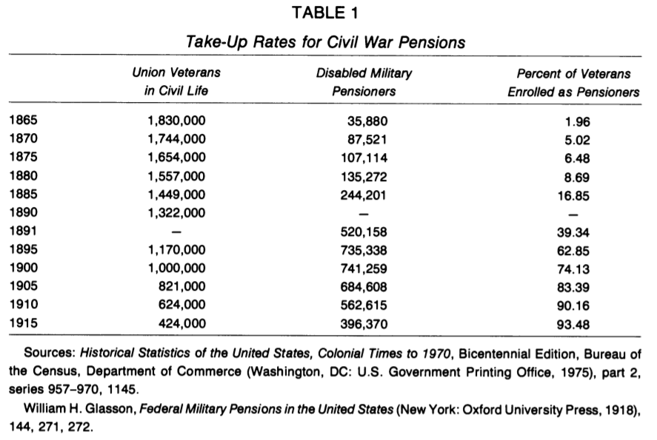
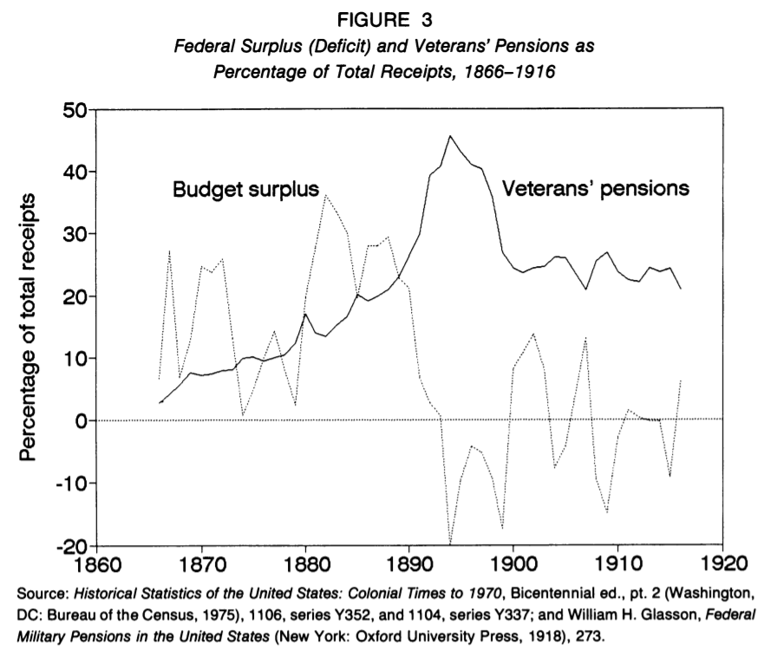
Civil War pensions

Slide 9
Extending benefits beyond veterans
Proposals to extend Civil War benefits used the language of "army of labor" to generalize from the Union Army
Proposals had some limited support from trade unions
Early 1900s proposals for old-age pensions, health and unemployment insurance, and labor regulations were rebuffed by the state
Popular support for these early programs floundered due to negative reactions to being seen as unfounded charity
Future programs would deal with this by becoming contributory
Failures at the federal level led to state level attempts
state level attempts had limited long-term success, but did develop ideas and expertise that would later be incorporated into the New Deal.
Wisconsin - social insurance rather than tax financed welfare

Slide 10
Maternalist movement
However, maternalist welfare state did begin to form
In the early 1900s, women's organizations grew in strength, pushing for women's rights as well as increased social protection for women
Both of these issues were cross-cutting, middle class women were aware of the possibility of destitution
Maternalist social organization was advocated especially by groups such as:
  National Child Labor Committee, National Consumers League, the General Federation of Women's Clubs, the National Congress of Mothers, and the Daughters of the American Revolution.

Slide 11
Comparing maternalist and fraternal social organization
Male dominated social groups cut across class and region
But middle class female dominated groups formed with religious, charitable, and welfare purposes
Task of shaping public opinion was key both in influencing legislatures to act and influencing courts to accept
This was in contrast with courts striking down laws intended to shield unions, regulate working conditions, and regulate the market

Slide 12
Local medical systems
Poorhouses/workhouses/pesthouses
Urban public hospitals systems
  Funded by cities
  Staffing supplemented by medical students
Limited willingness of counties and states to subsidize local systems before the Progressive Era (1890s-1916)

Slide 13
Children’s Bureau (1912)
The Children's Bureau was a key federal program that resulted from this effort
  Key leaders were Lillian Ward (Nurse, worked at juvenile wards, mental health advocate, co-founder of NAACP), Jane Addams (First US female Peace Prize winner, cofounder of ACLU, city-level activist, Hull settlement house), Florence Kelley (labor advocate, cofounder NAACP, congressional advocate), and Julia Lothrop (social worker training, supported AALL push for greater public health insurance, Juvenile courts, first head of the Children's Bureau)

Slide 14
Key federal programs
Children's Bureau:
  Birth registration
  Infant health campaigns
  commissioned studies
  Advocated for child labor protection - Keating Owen Act (1917-1918)
  Sheppard-Towner Act (1921-1929)
  New Deal
Sheppard-Towner Act
  Midwife training programs, licensing, and enforcement
  Parent education through traveling health demonstrations, health centers, home visits, correspondence courses, and classes
  Establishment of standards and licensing procedures for maternity homes
  Data collection on maternal and infant mortality
Lacked elite support:
Keating Owen Act (1917-1918) - Killed by the Supreme Court
Sheppard-Towner Act (1921-1929) - Sunsetted/failed to be renewed
  Opposed by AMA general congress – supported by Pedriatic section

Slide 15

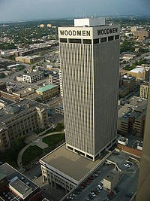
19th Century US Life Insurance
Life Insurance:
  Legal Reserve Insurance
    Stock companies
      Owned by Investors
    Mutual companies
      Owned by policy holders
  Fraternal orders
Notes:
https://www.youtube.com/watch?v=f7odiGPRBqc

Slide 16
Legal Reserve Insurance
Collects premiums in advance
Establishes reserves and holds assets
US regulation began in 1849 in New York
  State regulation of insurance

Slide 17
Mutual Aid and Fraternal Insurance
Ancient Order of United Workmen (AOUW) formed in 1868
  3 years after the end of the Civil War
Fraternal insurers grew from beginnings in 1860s to controlling half the market in the 1890s
Regulated after 1900
  Generally required solvency
Disappeared thereafter, shrinking to 8% of the market by 1930s

Slide 18
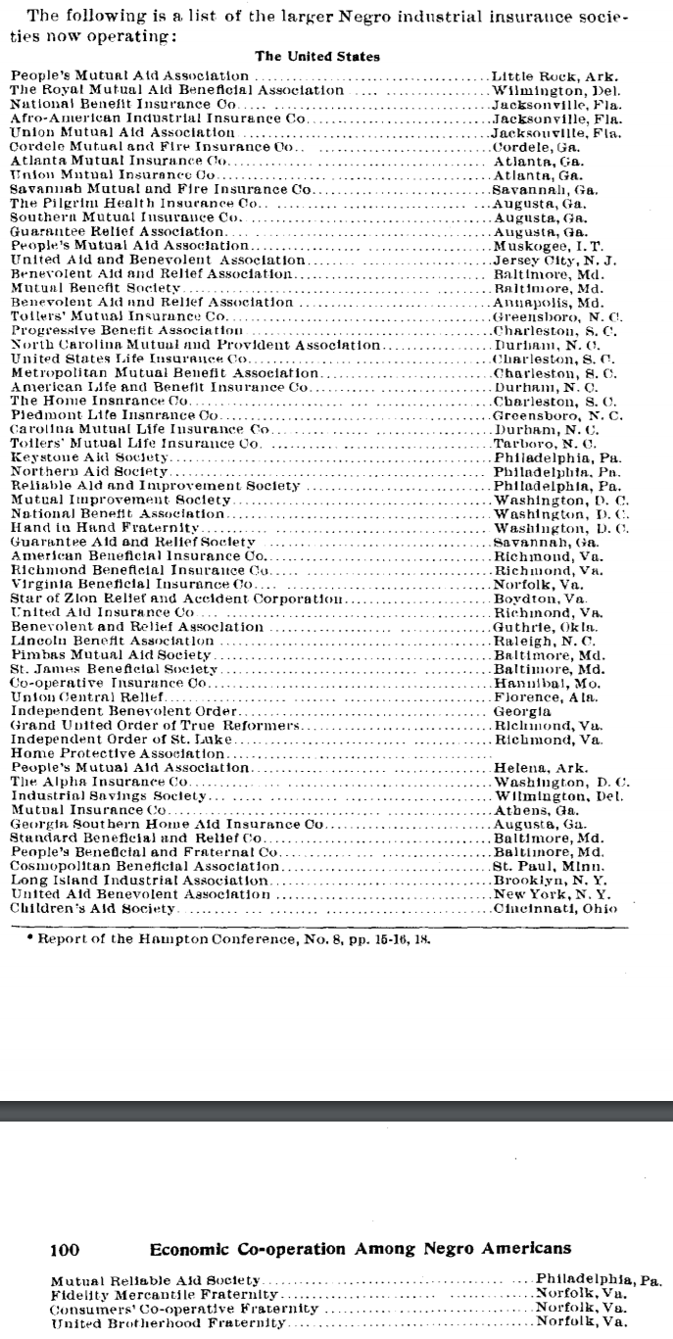
African American Insurance Societies
Mutual Aid Societies also played multiple important roles in African American Society
  Insurance and social organization

Slide 19
Products of Fraternal Societies
Life Insurance
Sickness Insurance
Accident Insurance
Fixed-Fee Medical Care Provision
Other Charity
Social Organization

Slide 20
Causes of decline of Fraternal Insurance
Regulation
  No regulation until 1888
  Federal regulation began in 1893
    Reserve requirement
  Self regulating Mobile Bill of 1910
Growth of group insurance
Financial strain and dissolution
Workers compensation laws and assistance

Slide 21
Next time
Early welfare states

Slide 22
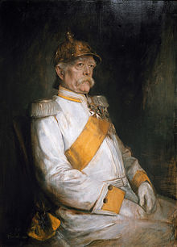
Otto van Bismarck
Minister President of Prussia from 1862-1890
Oversaw Prussian Military victories from 1863-1871
Oversaw Prussian led unified Germany in 1871
Then appointed Imperial Chancellor, serving from 1871-1890
“First” social insurance scheme in 1881, 1883, & 1884
  Employer based: employers paying 2/3, employees 1/3
  Responding to rising social movements and combat socialism

Slide 23
Why Germany?
Germany saw greatest level of industrial growth in late 1800s
German political philosophers (such as Fichte, Wagner, and Schaeffle) were less libertarian than Anglo counterparts (Smith, Mill, Franklin)
  Note that in many ways, Marx was more pro-state than French Socialists
Well developed labor movement
  1848 revolutions
    Goals: Democracy (anti-monarchy and pro working class), social justice, and, in the case of Germany, unification
  Bismark worked with German Socialists from 1848 revolutions such as Lasalle

Slide 24
Initial forms
First: Accident and sickness insurance
  Sickness in 1883, accident in 1884
  Base on no-fault principle, industrial accidents a fact of life
Later: Old age and invalidity
Even later:
  Insurance for survivors of industrial accidents (widows and orphans)
  Maternity insurance (First program created in 1911 in Italy)
Four Social Risks: injury, sickness, old age, and unemployment

Slide 25
Spread of accident insurance
Social insurance programs were initially slow to spread, with only Germany, Austria, and Hungary having programs by 1894
But by 1904, most of Western, Central, and Northern Europe had programs
United States was late, creating a program for federal employees only in 1908
  Two years after the creation of a program in Mexico (then called Nuevo Leon)
Canadian provinces largely created programs between 1908-1910
Sickness insurance did not spread as quickly

Slide 26
Sick, old-age, and unemployment insurance
Spread was slower
Initial programs were largely subsidy based and voluntary
Unemployment insurance programs were more popular at local levels

Slide 27
Federal and State programs in the US
First state social insurance law was in Maryland in 1902
  Accident insurance
  For workers in mines, quarries, and steam and electric railroads
  Granted $1,000 in case of fatal accident
  Based on equal employee and employer contributions
  Declared unconstitutional in 1904
    Grounds that it deprived both parties right of trial by jury

Slide 28
Other early programs
Voluntary, equal contribution accident programs were set up in Massachusetts and Illinois in 1905 and 1908, but these were not popular among workers and unions
Connecticut state legislature investigation in 1907 found such programs would be good, but could not find a solution out of fear of interstate competition
However, Theodore Roosevelt succeeded in passing an accident insurance bill for US employees in 1908
  He had supported a similar bill when he was governor of NY in the 1890s

Slide 29
State programs
Early programs by Maryland (1904), Montana (1910) and New York (1910) were later declared unconstitutional
Other 1910 programs by Massachusetts, Maryland, and New York were voluntary and failed
Starting in 1911, States began enacting effective programs

Slide 30
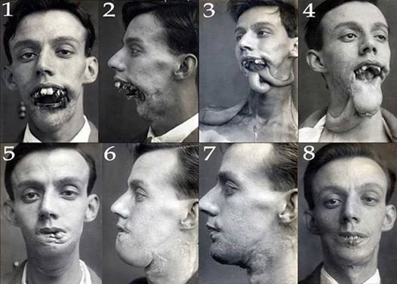
Phossy Jaw and the AALL
American Association for Labor
Legislation sough federal regulation
of yellow phosphorus used in match
manufacturing
Substitutes existed, the substance was banned in Europe, and it led to a painful, debilitating and sometimes deadly condition
  Phosphorus necrosis
AALLs first movement was successful, and regulation began in 1912

Slide 31
Characteristics of initial state programs
Limited scope
  Limited forms of industries
    Iron and steel building erection, elevator operation, work on scaffolding, electricians, work with/near explosives, railworkers, construction of tunnels and subways, and compressed air work.
    Dangerous operation with little interstate competition
    Constitutional legality based on police power of state
Elective programs included changes to liability law
  Non-electing companies no longer as able to waive liabilities
  Electing employees reduced in ability to extract unlimited damages
  But such progras generally were unsuccessful

Slide 32
Nudges
In most states, most employers did not elect to join scheme
  Laborers were not in a strong position and were not generally able to take advantage of increased legal rights
Voluntary program in New Jersey was exception
  In NJ, employers were assumed to have elected to join scheme unless they made a specific statement not to join
  Many employers were uninterested or uninformed and joined by default
Voluntary program in Illinois was another exception
  In both NJ and Illinois, insurance rates were lower so compensation was cheaper than liability

Slide 33
Workers compensation
State Employer Liability Acts passed between 1855 and 1907 allowed workers to sue for injury caused by employer negligence
Starting with Wisconsin in 1911, 36 states created workers’ compensation laws in the 1910s.
Mississippi was the last state to pass such legislation in 1948

Slide 34
Response of US labor
Organized labor initially fought against early programs
In 1909, the American Federation of Labor began to support social insurance
Private programs were created as well
  US Steel and International Harvester
  Values were placed on injuries
As the idea of public social insurance grew in popularity, state and federal jurists became less likely to make constitutional arguments against it

Slide 35
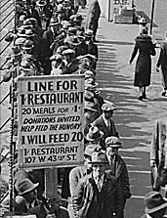
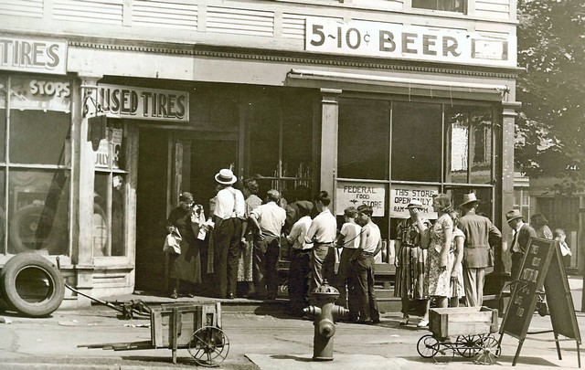
Great Depression (1929-1939)
Notes:
https://www.youtube.com/watch?v=IzjWk1DD6gE
https://www.youtube.com/watch?v=l4zfEkKs2ZM

Slide 36
1935 Social Security Act and the Welfare State in the US
Federal Old Age, Survivors, Disability and Hospital Insurance Program
  Originally entitled the Federal Old Age Benefits (I) program
  Program now also encompasses Medicare and is funded through FICA
Federal-state unemployment compensation program
  FUTA (1954)
9 other programs including aid to states for programs for the blind (X), needy dependent children (IV)
Avoided using the word “insurance” to provide some protection from conservative SC justices – but programs were called social insurance after SC ruling in support in 1939
American Medical Association opposed early efforts for state or national health insurance

Slide 37
Health Insurance programs in the Social Security Act
Four key programs
  Maternal and Child Health
  Crippled Children Services
  Vocational rehabilitation
  Public Health
Created as grants to states for state run programs
Initial plans included national health insurance, which AMA opposed and FDR thought was politically too risky, eventual AMA support of Act was reluctant

Slide 38
New Deal
First New Deal included banking reform and the Civil Works Administration
Second New Deal included labor union protections, establishmient of the Works Progress Administration, the creation of the US Housing Authority, the Fair Labor and Standards Act of 1938, and the Social Security Act
FDR (a New York Democrat) vs the conservative coalition of Republicans and Southern Democrats
  Harry F. Byrd Sr was a noted leader of the conservative coalition
  Opposed Federal control over standards for old age assistance and other programs

Slide 39
World Wars
World War I (1914-1918) and World War II (1939-1945)
  WWI: Allied Powers (France, Britain, Russia, Serbia, Belgium, Japan, Italy, US, Romania, Portugal, US, China, and others) vs Central Powers (Germany, Austria-Hungary, Ottoman Empire (Turkey), Bulgaria)
  WWII: Allies (Russia [1941], US [1941], UK, China) vs Axis (Germany, Japan, Italy)
In 1919, as a part of the Treaty of Versailles, the International Labor Organization was created (now a part of the UN)
In 1927, the International Social Security Association was established affiliated with the ILO
In 1945, the UN was established

Slide 40
Communist programs
Leninist social insurance programs based on two 1912 principles
  Cost solely responsibility of employers
  Administration by employees
Program evolved greatly in 1930s
  Centralized in 1931, expanded to include health care in 1936
  Adopted by China in 1930s and other socialist countries after WWII

Slide 41
Spread of the German Model
Old age and sickness insurance in the German model spread through non-Communist states more quickly after 1919
US adopted old-age and unemployment insurance in 1935

Slide 42
Social Security development during WWII
1941 UK: Beveridge Plan
  Led to the creation of social programs in the UK forming the Welfare State
  Family Allowances Act 1945, National Insurance (Industrial Injuries) Act 1946, National Insurance Act 1946, National Health Service Act 1946, Pensions (Increase) Act 1947, Landlord and Tenant (Rent Control) Act 1949, National Insurance (Industrial Injuries) Act 1948, National Insurance Act 1949
1943 US: Wagner-Murray-Dingell Bill
  Failed law for national medical and hospitalization coverage
1943 Canada: Marsh Plan
1944 India: India Beveridge Plan
1945 China, etc
By the 1950s, most industrial capitalist countries had comprehensive systems for all of the four social risks

Slide 43
Age of privatization
Neo-liberal ideology grew in influence since around 1980
  Led by University of Chicago economists such as Milton Friedman
1981 privatization of the Chilean pension system
  Under the Pinochet regime
  Replace public pension with fully funded individual accounts system with contributions by individuals and administered privately
During debt crises in the 1980s (and carrying into the 1990s) in low and middle income countries (especially in Latin America) the World Bank and IMF pushed other countries with to privatize

Slide 44
Readings:
Cutler, David M., and Richard Johnson. "The birth and growth of the social insurance state: Explaining old age and medical insurance across countries." Public Choice 120, no. 1-2 (2004): 87-121.
Zanjani, George. "The Rise and Fall of the Fraternal Life Insurer: Law and Finance in US Life Insurance, 1870-1920." (2003).
Du Bois, William Edward Burghardt. "Economic co-operation among Negro Americans." In Conference for the Study of the Negro Problems 1907: Atlanta, Ga.). The Atlanta University Press, 1907. Section 11 p92-109
Rubinow, Isaac Max. Social insurance: With special reference to American conditions. H. Holt, 1913. (https://archive.org/details/socialinsurancew00rubiiala) Chapters 2, 10, 11, 12
Guyton, Gregory P. "A brief history of workers' compensation." The Iowa orthopaedic journal 19 (1999): 106.
Hu, Aiqun, and Patrick Manning. "The global social insurance movement since the 1880s." Journal of Global History 5, no. 1 (2010): 125-148.
Minicucci, Stephen. "Internal Improvements and the Union, 1790–1860." Studies in American Political Development 18, no. 2 (2004): 160-185.
Olds, Victoria. "The Freedmen's Bureau: A nineteenth-century federal welfare agency." Social Casework 44, no. 5 (1963): 247-254.

