Slide 1
HCMI 4225: The ACA today
Online: Mon/Wed 12:30 PM – 1:45 PM
Shane Murphy – shane@uconn.edu

Slide 2
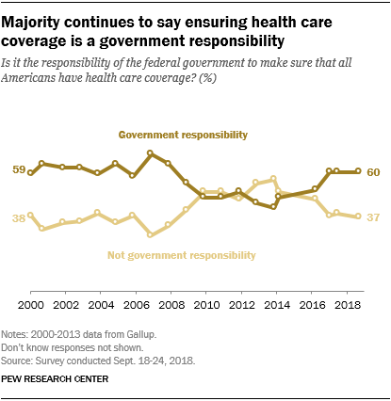
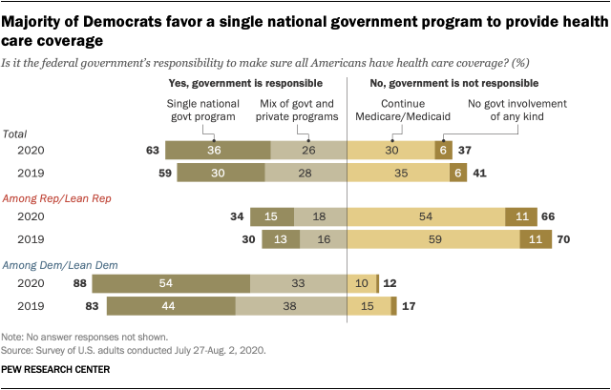
Opinion Polling
Pew and Kaiser are main health policy opinion pollsters
March 2017, ¼ of people thought ACA was repealed (Pew)
September 2017, ½ of people thought ACA marketplaces collapsing (Kaiser)

Slide 3
Coverage: Medicaid expansion
All US citizens and legal residents with income up to 138% FPL qualify for coverage in participating states
Led to large growth in enrollment in participating states, smaller growth in non-participating states
Reduction in uninsured rates, especially among low-income individuals
Partial Woodwork effect/welcome mat effect
Growth among individuals who were previously eligible

Slide 4
Coverage: Medicaid expansion: criticism
Crowding out of private insurance
Mixed results, although there has been some decline in private coverage in participating states

Slide 5
Coverage: Medicaid expansion: subgroups
Coverage gains in expansion versus non-expansion states for specific vulnerable populations:
young adults, prescription drug users, people with HIV, veterans, parents, mothers, women of reproductive age (with and without children), children, lesbian, gay, and bisexual adults, newly diagnosed cancer patients, women diagnosed with a gynecologic malignancy, low-income workers, low-educated adults, early retirees, and childless adults with incomes under 100% FPL
Disproportionately positive impact in rural areas in expansion states
Gains can be found across racial/ethnic categories
Reduced disparities by income and age
Possibly reducing disparities by race/ethnicity

Slide 6
Coverage: Medicaid expansion: Alternative approaches
Section 1115 gave states the option of expanding Medicaid in alternative ways
These states (especially Arkansas, Michigan, and Indiana) have shown similar gains in coverage rates
Indiana instituted monthly contributions which have created enrollment and continuing coverage issues

Slide 7
Access, Utilization
Many studies find improvements in access to care
Increases in cancer diagnosis rates (especially early stage)
Earlier presentation for common surgical conditions – lowering complications
Increase listing for heart transplants among African Americans
Increased access for treatment of behavioral and mental health conditions
Increase in prescriptions for opioid use disorder and overdose
Increase in prescriptions for smoking cessation drugs

Slide 8
Access, Utilization
Many studies find improvements in access to care
Reduction in disparities by race, income, education, and employment status in access and affordability
Increased rates of optimal care for patients with common surgical conditions
Improved quality of care for common community health care treated conditions:
Asthma, Pap testing, BMI assessment, hypertension control
Declines in uninsured ED visits, but mixed evidence and no significant change in total ED volume
Reduced LOS for Medicaid patients
Improvements in care and quality in areas with primary care shortages

Slide 9
Access, Utilization: Criticism
Confusion in non-waiver states
Failures to follow up with new patients
Longer wait times

Slide 10
Affordability and Financial Security
Possible reduced patients with unmet medical need because of cost
Reduction in OOP
Average reduction in 2014 of about $205
Greater reductions among Medicaid expansion covered individuals than subsidized marketplace coverage individuals
Declines in unpaid bills and financial stress over future bills
In Ohio, percentage of expansion enrollees with medical debt fell by nearly half since enrolling in Medicaid (55.8% had debt prior to enrollment, 30.8% had debt at the time of the study)

Slide 11
Health Outcomes
Possible improvements in self-reported health
Improved outcomes for cardiac patients
Infant Mortality Rate Reductions for expansion states between 2014 and 2016, a period where the rate rose slightly for non-expansion states
Effect largest among African Americans
Limited of no effect on drug overdoses or alcohol poisonings

Slide 12
Economic effects
Federal matching for expansion population provided large spending savings for expansion states
No significant increase in state spending on Medicaid, including savings in some states
Possible reduction in overall spending due to spillovers
State costs related to behavioral health services, crime and the criminal justice system, and Supplemental Security Income program costs.
Lower Medicaid spending per enrollee
New enrollees generally less expensive than existing enrollees
First year of enrollment generally more expensive than subsequent years
Medicaid expansion lowers marketplace premiums
Marketplace enrollees younger and healthier in expansion states

Slide 13
Impacts on providers
Reduction in uninsured visits and uncompensated care costs
Decline in uninsured ED visits and increase in Medicaid-covered ED visits
Increase in Medicaid-covered substance use disorder treatment facility visits
Reduced disparity in uninsured visits between hospitals that treat a disproportionate share of low-income patients (DSH hospitals/safety net hospitals) and those that do not
Improved overall hospital financial performance, reduced probability of closure
Especially in rural areas

Slide 14
Labor Market Effects
Increased jobs
Did not reduce employment for low-income workers
Enrollees looking for work reported Medicaid enrollment made it easier to seek employment, those employed reported it made it easier to continue working
Increase volunteering

Slide 15
Cost Sharing Reductions (CSR)
Another provision of the ACA is that consumers with incomes below 250% FPL are entitled to CSRs
Lower deductibles, copays, and other cost-sharing for low-income consumers
Increases the actuarial value of the plan
HHS was then required to reimburse insurance companies for the CSRs
Reimbursement was opposed by the conservative-majority House of Representatives
House v Burwell -> House v Azar
CSR reimbursement payments stopped
Drove up premiums on the marketplace

Slide 16
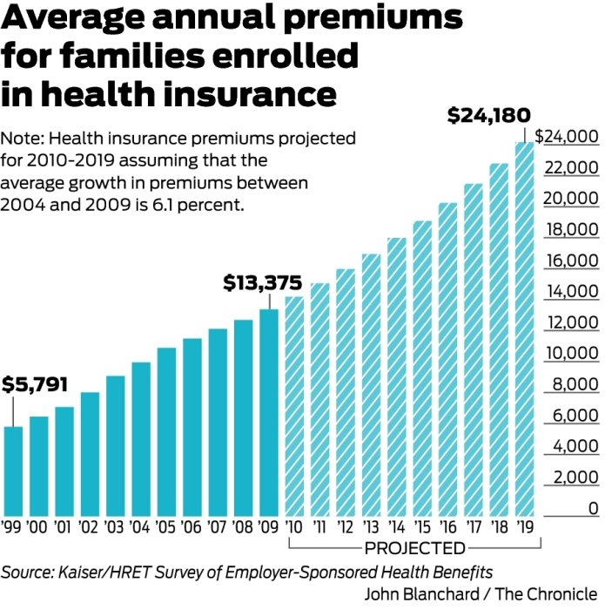
Health Insurance Premiums: Skyrocketing?
Premiums grew by over 6% between 2004 and 2009
If such growth continued, the cost for a family would grow to:
2010 | 14190.88
2011 | 15056.52
2012 | 15974.97
2013 | 16949.44
2014 | 17983.35
2015 | 19080.34
2016 | 20244.24
2017 | 21479.14
2018 | 22789.37
2019 | 24179.52

Slide 17
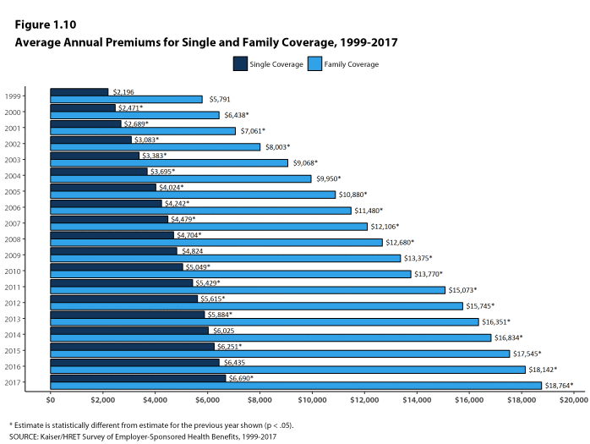
Health Insurance Premiums: Skyrocketing?
Actual growth rate has ben about 4.3%

Slide 18
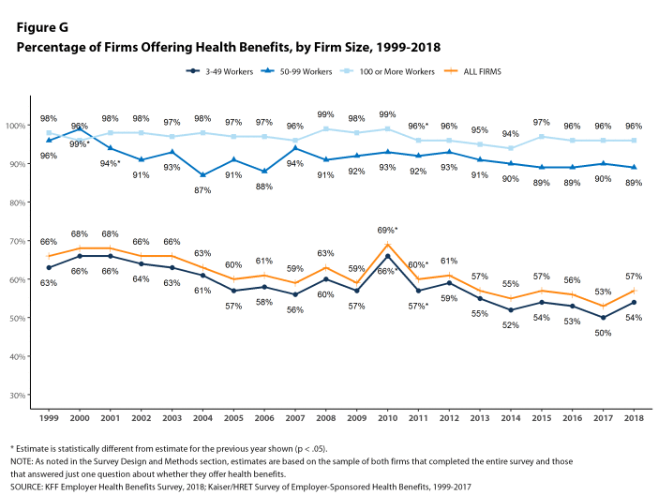

Slide 19
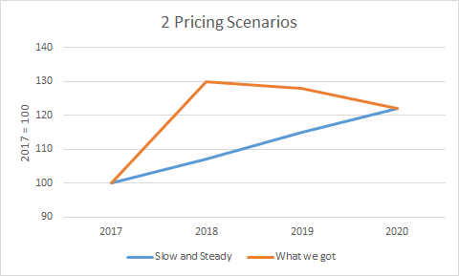
MLR and premiums
Increases in premiums will be tied to increases in healthcare spending by MLR regulations

Slide 20
Title 1: Quality, Affordable Health Care for All Americans.
The largest title of the ACA, measured in number of key provisions or in total spending and revenue
Title I focuses on the private health insurance sector.
Forty-nine provisions,
$509 billion in spending, $81 billion in revenue,
88 percent implemented.
High-profile provisions such as the creation of health insurance marketplaces, premium tax credits, employer and individual mandates, community rating requirements, and the ban on lifetime caps on coverage, among others.
As of 2019, 11.4 million Americans are covered by marketplace health insurance plans, down slightly from the peak of 12.7 million in 2016 (Kaiser Family Foundation 2019).

Slide 21
Title II: The Role of Public Programs
Medicaid expansion
Seventeen provisions, $459 billion in spending, $53 billion in revenue,
78 percent implemented
Meant to cover all adults ages nineteen through sixty-four living in families with income below 138 percent of the federal poverty level on January 1, 2014.
Instead, a Supreme Court ruling rendered this expansion effectively optional for states.
Twenty-four states plus the District of Columbia chose to expand Medicaid on or before January 2014;
about half of the target population of low-income nonelderly adults.
As of 2019, 64 percent of the adults in the expansion population live in states in which Medicaid expansion has been implemented or in which implementation is pending.

Slide 22
Title III: Improving the Quality and Efficiency of Health Care
Thirty-five key provisions, $54 billion in spending, $450 billion in revenue,
96 percent implemented.
Intended to improve the quality of care (or at least not degrade it) while reducing federal payments,
Aka delivery-system reform.
Cuts in Medicare payments to Medicare Advantage plans and to hospitals; together, CBO scored these cuts as achieving $290 billion in savings over the 2010 to 2019 scoring window.
Expanded quality measurement and value-based purchasing initiatives, and also created the Center for Medicare and Medicaid Innovation to facilitate the development and diffusion of innovations in Medicare policy
Introduced innovative payment models for Medicare such as the Shared Savings Program
spurred the growth of accountable care organizations, and expanded pilot projects of bundled payments.
Created (but not implemented) the Independent Payment Advisory Board

Slide 23
Title IV: Prevention of Chronic Disease and Improving Public Health.
$18 billion in spending and $1 billion in revenue, 19 provisions
85 percent implemented.
Creation of the Prevention and Public Health Fund.
Regulation expansions
Nutrition labeling for restaurant menus
Large firms provide break time and lactation space for employees who are nursing mothers

Slide 24
Title V: Health Care Workforce.
$18 billion in spending and zero revenue,
Eight of its nine key provisions— 94 percent—were implemented.
Grant programs and residency regulation
Unimplemented provision established a National Health Care Workforce Commission, and members were appointed in September 2010. Congress, however, never appropriated the money for the commission, which has therefore never met

Slide 25
Title VI: Transparency and Program Integrity.
$3 billion spending and $7 billion in revenue,
90 percent implemented
43 provisions
prevent fraud, including the creation of provider data banks for Medicare and Medicaid
Elder Justice Act, intended to prevent abuse, neglect, and exploitation of older Americans;
Physician Payments Sunshine Act, which requires pharmaceutical companies and drug manufacturers to report payments to physicians;
Creation of the Patient-Centered Outcomes Research Institute.
Could have been implemented separately, but included in part to provide revenue

Slide 26
Title VII: Improving Access to Innovative Medical Therapies.
zero spending and $7 billion in revenue
Seven key provisions, fully implemented
Adopted the Biologics Price Competition and Innovation Act of 2009 (BPCI Act), intended to create a simplified path for the approval of “biosimilar” therapies—essentially, generic versions of biological products approved by the Food and Drug Administration (FDA).
Only limited success
Expanded the 340B Drug Pricing Program in Medicaid, effectively increasing the number of hospitals that receive drug rebates from manufacturers.

Slide 27
Title VIII: Community Living Assistance Services and Supports.
The CLASS Act
zero spending and a stated $70 billion in forecast revenue
One provision, not implemented.
Intended to create an insurance-like program that would cover expenses for services required to help disabled individuals remain living in the community rather than having to move to a nursing home.

Slide 28
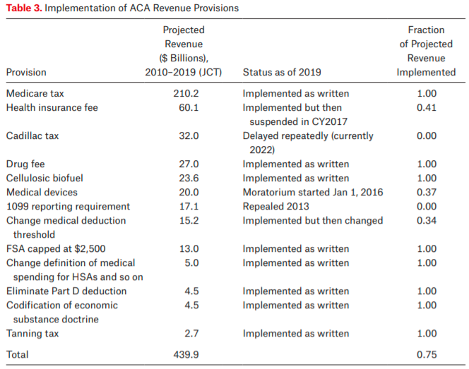
Title IX: Revenue Provisions.
Projected to raise $438 billion between 2010 and 2019, 19 provisions, 79% implemented
Medicare tax on high income individuals and on unearned income
property income, inheritance, pensions, and payments received from public welfare

Slide 29
Legal challenges
Medicaid expansion
National Federation of Independent Business v. Sebelius
Cost-sharing reductions
House v. Burwell
Payments meant to reimburse insurers for adhering to ACA rules that require them to limit the out-of-pocket costs of their low-income enrollees
Money never appropriated
Trump scrapped attempts to appropriate money
Lead to “silver loading”
Contraceptive coverage
Burwell v. Hobby Lobby

Slide 30
Born to fail
1099 reporting provision
Repealed by congress in April 2011
Community Living Assistance Services and Supports (CLASS) Act
Required to be self-sustaining
Capped premiums for low income and student enrollees
Premiums go into 10-year CBO window, outlays come later
Co-ops
Proposed loans to co-op insurance plans
23 programs initially took part, political failure to support and difficult market led to failure

Slide 31
Interest group pressure
Cadillac tax
Medical device tax
IPAB
DSH cuts
Free Choice vouchers
Allow low income employees to buy subsidized marketplace insurance rather than get employer based insurance
Menu labeling

Slide 32
Failure to thrive
Multistate compacts and multistate plans
Allows plans to be sold across state lines – no state has legalized such actions
Biosimilars
the generic drug industry works as well as it does because small-molecule compounds are easy to copy and cheap to manufacture. Biologics, in contrast, are large-molecule, protein based drugs that are much harder to copy
Antidiscrimination rules
Section 1557 of the ACA prohibits discrimination in “any health program or activity” that receives federal funds on the grounds of race, color, national origin, sex, age, or disability (see Grogan 2017, Rosenbaum and Schmucker 2017).
Ruled against by Reed O’Connor
Prevention and Public Health Fund
Funds chronically redirected by congress

Slide 33
Executive branch sabotage
Zeroing out the individual mandate
Back to Texas v Azar (aka Texs v US aka Texas v California)
Medicaid work requirements
Currently in courts
Short-term, limited duration insurance
Create 364 day plans to allow for a separating equilibrium
Increases chance that marketplace fails via death spiral
In courts
Association health plans
Also meant to divide pool
In courts

Slide 34
Reading
Grogan, Colleen M. "How the ACA addressed health equity and what repeal would mean." Journal of Health Politics, Policy and Law 42, no. 5 (2017): 985-993.
Levy, Helen, Andrew Ying, and Nicholas Bagley. "What’s Left of the Affordable Care Act? A Progress Report." RSF: The Russell Sage Foundation Journal of the Social Sciences 6, no. 2 (2020): 42-66.
Rosenbaum, Sara, and Sara Schmucker. "Viewing Health Equity through a Legal Lens: Title VI of the 1964 Civil Rights Act." Journal of Health Politics, Policy and Law 42, no. 5 (2017): 771-788.

