Slide 1
HCMI 4225: Gaming the Marketplace & Accountable Care Organizations
Online: Mon/Wed 12:30 PM – 1:45 PM
Shane Murphy – shane@uconn.edu

Slide 2
Challenges for Health Insurance Companies
Re-insurance
Providing low premiums in a changing regulatory environment
Cost Sharing Reductions for low income individuals
Lowers out of pocket maximums
Increases Actuarial Value (increasing coverage amounts)
Federal funding cut – Insurance companies have chosen to continue to provide
Advanced Premium Tax Credits
Gaming System
Silver Gapping
Silver Spamming
Churn
Accountable Care Organizations
Medical Home and Bundled Payment Models
Managed Care Organizations

Slide 3
Re-insurance pools
Two flavors
State run external money
External source of state based money is added to the pool of money collected by premiums.
Only adopted in few states
CMS run catastrophic reinsurance
Funded by premiums
High-cost risk pool
Reimburses issuers for 60 percent of an enrollee’s aggregated paid claims costs exceeding $1 million.
Reinsurance reduces overall premiums
Reduces high premiums more than low premiums
Reduces non-subsidized premiums and raises subsidized premiums

Slide 4
Advanced Premium Tax Credits (APTC) (and Gold gapping aka silver loading)
Advanced Premium Tax Credits (APTC) are how people get subsidized to buy Qualified Health Plans on Exchange.
Based on an individual’s income as determined by their family unit’s FPL percentage and the cost of the second least expensive Silver plan offered on Exchange in their area.
Second least expensive plan is called the benchmark plan
The subsidy arrangement means that individuals with the same exact financial situation will pay the same amount post-APTC subsidy for the second lowest cost Silver plan across the country.
Zero premium plans happen when a plan is priced below the silver benchmark and the relative premium spread is bigger than the individual’s expected personal contribution.
For the 100-138% cohort, the personal contribution for a single individual ranges from $22/month to about $55 per month for the benchmark silver plan.
The goal is for premiums of cheapest plans not to exceed 9.66% of income

Slide 5
Silver gapping (and Gold gapping)
Advanced Premium Tax Credits (APTC) are how people get subsidized to buy Qualified Health Plans on Exchange.
Based on an individual’s income as determined by their family unit’s FPL percentage and the cost of the second least expensive Silver plan offered on Exchange in their area.
Second least expensive plan is called the benchmark plan
The subsidy arrangement means that individuals with the same exact financial situation will pay the same amount post-APTC subsidy for the second lowest Silver plan across the country.
Zero premium plans happen when a plan is priced below the silver benchmark and the relative premium spread is bigger than the individual’s expected personal contribution. For the 100-138% cohort, the personal contribution for a single individual ranges from $22/month to about $55 per month for the benchmark silver plan. The benchmark plan is a silver plan with 94% AV CSR benefits. That translates into a deductible ranging from zero to a few hundred dollars and an out of pocket max of less than $2,000. Compared to a baseline silver, this is a great improvement in the quality of the benefit. It is still significantly worse than Medicaid if we assume appointments can be found.
Silver gapping is the measure of the spread between the least expensive Silver plan in a county and the benchmark Silver plan.
The bigger the spread, the better the deal that subsidized folks may be able to get.
The smaller the spread, the worse (comparative) deal subsidized buyers get.
Silver gapping is only about the relative differences in price and not about the absolute price levels.
Increase in premiums from cancelling CSR reimbursement is thus partially offset by increasing APTC to consumers
Although Insurance companies must be aware of an use this strategy
Total payments from the government and receipts by insurance companies are less affected by cancelling CSR reimbursement

Slide 6
Silver Gapping
Maximizing silver gap maximizes the relative value of the APTC subsidy
Carriers offer a low price Silver and then a higher priced Silver as the benchmark
Drive people to the #1 Silver plan as it will be comparatively cheaper than the #2 Silver. It will also have the ability to drive people to very low premium Bronze plans.
Example in CA:
Region 16 that Molina made its play and gained its share. Molina put up both the cheapest silver and the cheapest bronze plans in that region — massively undercutting the benchmark silver plan, and thus offering buyers a major discount on the Cost Sharing Reduction (CSR) subsidies available only with silver. For a 40 year-old earning $23,000, a shared under 200% of the Federal Poverty Level (FPL), Molina silver is just $74 per month in Region 16 in 2016, vs. the benchmark silver’s $119 (Health Net). Molina’s bronze plan at that age and income level is just $1 per month, vs. $55 for the nearest competitor.

Slide 7
Silver Spamming
The goal of an insurer in the Silver Spam strategy is to offer the #1 and #2 silver plans in the region with a very small gap between those two.
Furthermore if they can keep the price of the second Silver significantly lower than the price of the first Silver plan offered by a competitor, they’ll capture a large segment of the market.
The objective of the Silver Spam strategy is to take away choice.
The relative value of the APTC when applied to the purchase of the 1st Silver is not much higher than it is when applied to the #2 benchmark Silver.
If there is a large gap between the Silver Spammer’s Silver plans and the next best offer, the Silver Spammer will capture a large proportion of the market for Silver and should (all else being equal) capture a decent proportion of the Bronze market.
Example in Chicago:
For a 40 year old non-smoker, Celtic/Ambetter offers the 1st and 2nd Silver at $195 and $198, as well as the next four Silvers. The first non Celtic/Ambetter Silver is priced at $249.
The Celtic/Ambetter Silvers are all HMOs, and they all are sharing the same very narrow network. The benefit configuration (deductibles and co-insurance) change, but the out of pocket maximums are all tightly clustered. These six plans are functionally similar plans. The business decision to introduce these six plans, and more importantly the #2 Silver at just a few bucks more than #1 is a membership recruitment decision.
Both these “APTC hacking” strategies capitalize on regions with a small number of insurers

Slide 8
Changing Insurance Company or Status: Churn
Prior to implementation of the Affordable Care Act (ACA), nearly 60 percent of pregnant women experienced a month-to-month change in insurance type in the nine months leading to delivery, and half were uninsured at some point in the six months following birth
This has reduced to 14.5% pre-delivery and 16.9% post delivery
Greater improvement in expansion states
Auto-renewal is critical in reducing churn

Slide 9
Accountable Care Organizations
Definition: A group of physicians (possibly including a hospital) that assumes responsibility for annual Medicare spending for a defined patient population. (defined by the Medicare Payment Advisory Commission – MedPAC)
MedPAC reimbursements to ACOs combines Fee-for-service and P4P.
The idea of ACOs existed prior to the ACA, but the ACA is now seen as creating ACOs through this reimbursement strategy
Idea originated with Pete Welch in 1989

Slide 10
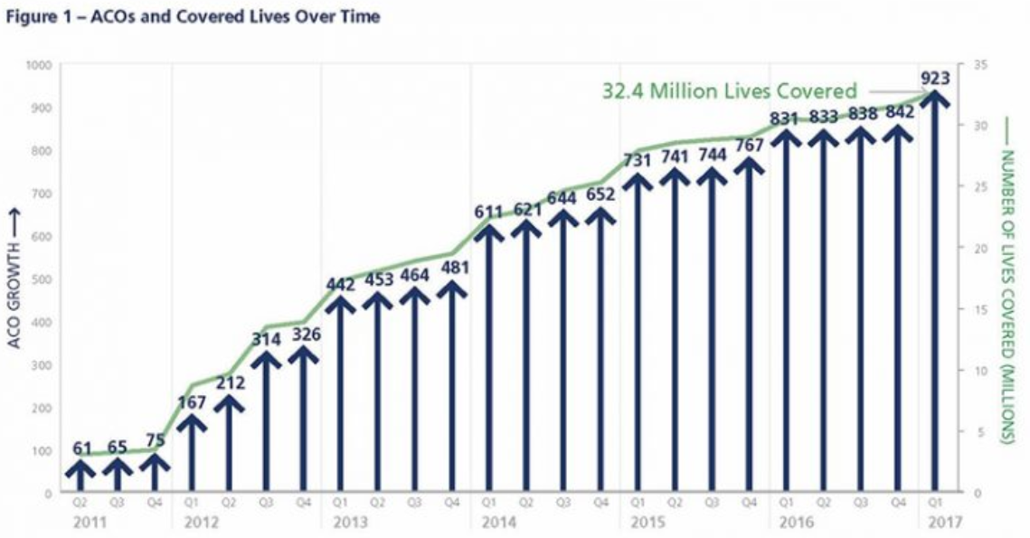
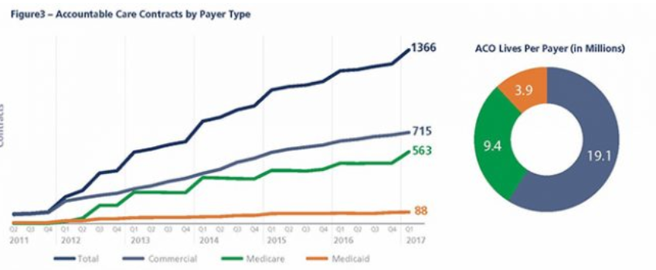
Growth in ACOs
As of 2017, 923 ACO contracts cover 32 million people (10% of the US population)
Commercial and Medicare contracts both significant

Slide 11
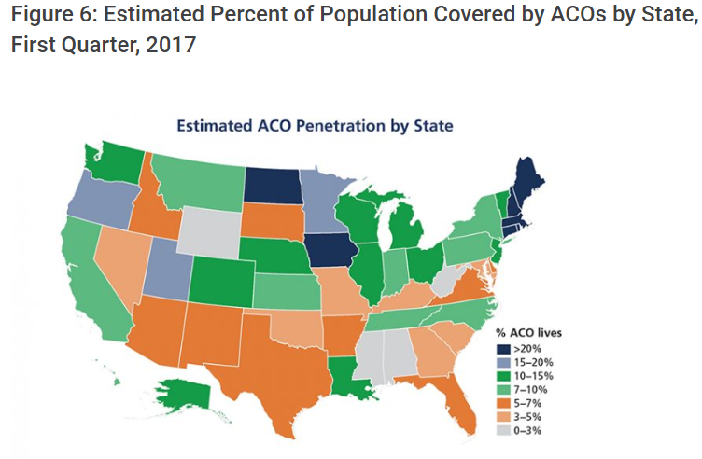
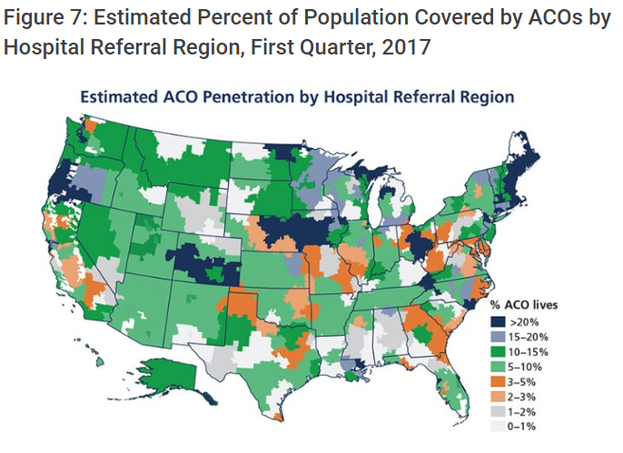
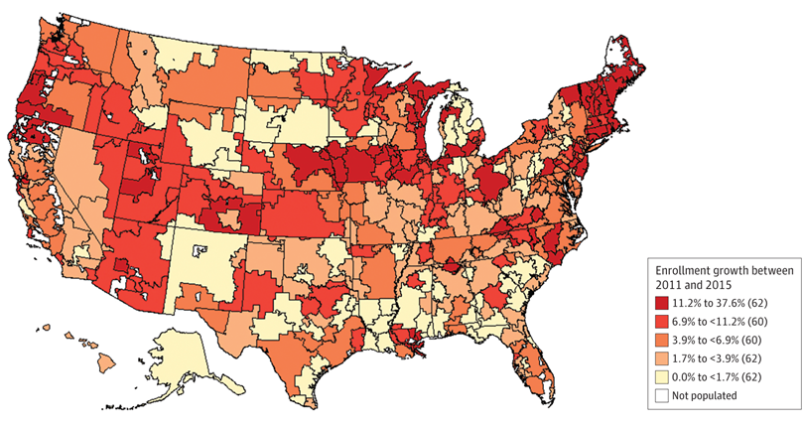
Growth in ACOs
Regional patterns:
ACOs strong in New England, Northern Prairie States, Western Great Lake States
Growing fast in the West
Lagging in the South

Slide 12
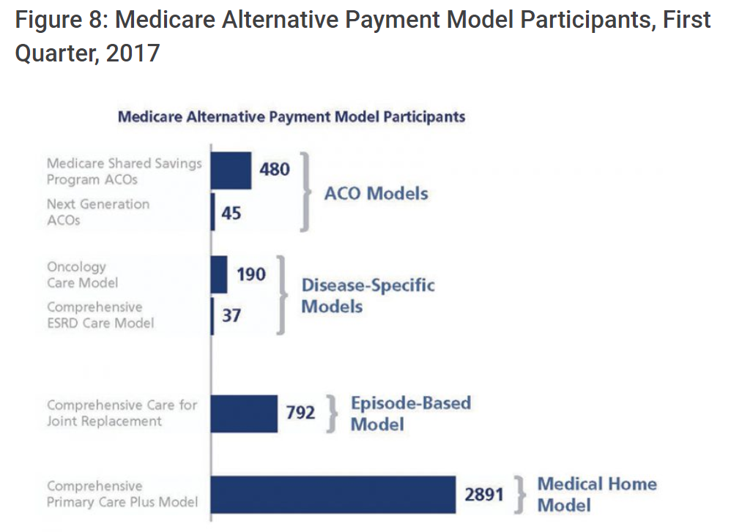
ACOs and APM
Majority of Medicare’s ACOs (561 of all 649 Medicare ACOs in 2018) are in the Medicare Shared Savings Program (MSSP)
Other ACO initiatives:
Next Generation ACO Model and Comprehensive ESRD Care Model

Slide 13
Extended Hospital Medical Staff
Most physicians are affiliated in some way with a local acute care hospital
Outpatient Care
Primary Care
Acute Care
Home Care
Inpatient Care
Pharmacy
Pros
Allow for definition of performance in P4P schemes
Allows for local organizational accountability
Centralizes and organizes efforts at quality improvement and cost containment
Cons
Alternative payment schemes reward high-tech and high volume services – leading to segregation in the market
Physicians prefer high degree of autonomy
Level of autonomy varies
Cost and revenue sharing legally and logistically difficult

Slide 14
Upside-Only Versus Two-Sided ACOs
The majority of Medicare’s ACOs – 460 of the 561 or 82% in 2018 – are in the upside-only “Track 1” of the Shared Savings Program.
Currently, ACOs are allowed to remain in the one-sided track for up to six years.
Notes:
Data from 2016

Slide 15
Upside-Only Versus Two-Sided ACOs
Savings has been less than 0.01% for upside-only ACOs and less than 0.1% for all ACOs.
Notes:
Data from 2016

Slide 16
Meta-analysis and systematic review
Estimate a weighted average from the results of the individual studies
Results can be generalized to a larger population
The precision and accuracy of estimates can be improved as more data is used.
May increase the statistical power to detect an effect
Inconsistency of results across studies can be quantified and analyzed
does inconsistency arise from sampling error, or are study results (partially) influenced by between-study heterogeneity
Hypothesis testing can be applied on summary estimates
Moderators can be included to explain variation between studies
The presence of publication bias can be investigated
Kaufman, Brystana G., B. Steven Spivack, Sally C. Stearns, Paula H. Song, and Emily C. O’Brien. "Impact of accountable care organizations on utilization, care, and outcomes: a systematic review." Medical Care Research and Review(2017): 1077558717745916.

Slide 17
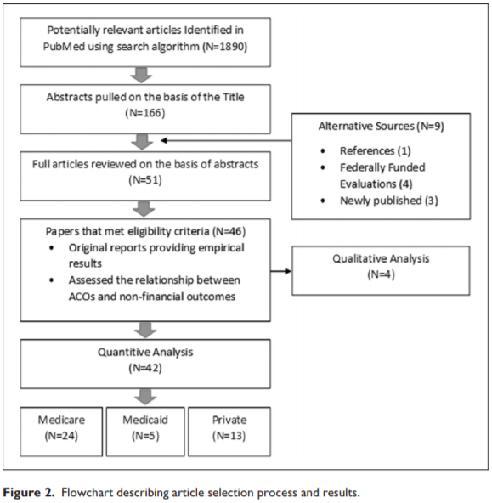
Meta-analysis and systematic review
Selection of studies
Selection/eligibility criteria
Search
N – sample size
Analysis
Qualitative
Quantitative

Slide 18
Quality research
Meta-analysis is only as good as the analysis it is based on (GIGO)
Quality research is based on three principles:
“The selection of the study groups”
Random vs observational
Large sample vs small
Sample representativeness and adaquacy
“The comparability of the groups”
Controls included in data or selection procedure
“The ascertainment of either the exposure or outcome of interest for case-control or cohort studies respectively”
Blind or not blind
Secure, detailed records
Non-response
Similarity of conditions for treatment and control
Length of follow-up

Slide 19
Sample of ACO Programs Evaluated
Read Table 2 as a group
MSSP
Shared Savings

Slide 20
Results
Utilization
Utilization decreased among ACO patients
Especially Inpatient and ED visits
Processes
Quality indicators generally saw improvement in some studies
Changes not large
Outcomes
Possible long-term improvements
Increased patient communication

Slide 21
Medicaid Managed Care
Over 70 percent of Medicaid recipients were receiving their care via private health plans
Managed care plans can do things that state Medicaid agencies cannot:
Use sophisticated network contracting, information technology, and utilization management systems to squeeze out low-value care and improve the health of beneficiaries.
States with Medicaid MCOs often have to administer Medicaid in geographic areas the MCOs don't operate
So while MCOs reduce state administrative overhead, this can be limited
States seeking budget predictability may set per-member-per-month before MCO contracts are created
CMS requirement that rates be "actuarially sound" provides limited protection
Managed care can reduce utilization
but state Medicaid single payer pays lower per-unit costs
Notes:
https://www.healthaffairs.org/do/10.1377/hblog20180430.387981/full/
https://www.healthaffairs.org/do/10.1377/hblog20180430.510086/full/

Slide 22
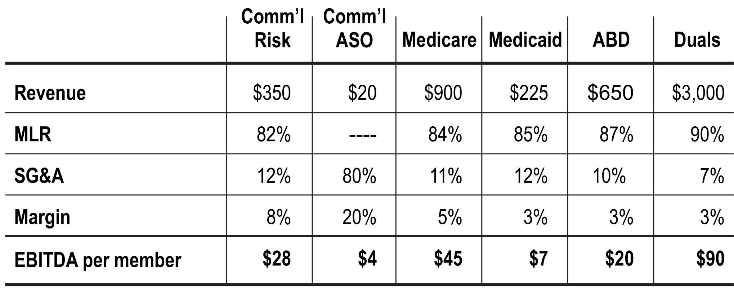
Profits
Private profits over can be significant - questions about value to states
Profits especially high for older patients, particularly dual eligibles (eligible for Medicaid and Medicare)
MLR 85%, 90% for duals, but payments for older and sicker populations are higher

Slide 23
Pros and cons
Difficulty switching back from MCO to state-run programs

Slide 24
Readings and sources:
Kaufman, Brystana G., B. Steven Spivack, Sally C. Stearns, Paula H. Song, and Emily C. O’Brien. "Impact of accountable care organizations on utilization, care, and outcomes: a systematic review." Medical Care Research and Review(2017): 1077558717745916.
Muhlestein, David, Robert Saunders, and Mark McClellan. "Growth of ACOs and alternative payment models in 2017." Health Affairs Blog. https://www. healthaffairs. org/do/10.1377/hblog20170628 60719 (2017).
Verma, Seema. “Pathways To Success: A New Start For Medicare’s Accountable Care Organizations.” Health Affairs Blog. https://www.healthaffairs.org/do/10.1377/hblog20180809.12285/full/
“Medicaid Managed Care: Lots Of Unanswered Questions (Part 1), " Health Affairs Blog, May 3, 2018. https://www.healthaffairs.org/do/10.1377/hblog20180430.387981/full/
“Medicaid Managed Care: Lots Of Unanswered Questions (Part 2), " Health Affairs Blog, May 4, 2018. https://www.healthaffairs.org/do/10.1377/hblog20180430.510086/full/

