Slide 1
HCMI 4225: Payments
Online
Shane Murphy – shane@uconn.edu

Slide 2
Incentives Matter
Incentives – things that motivate people to take certain actions
  Extrinsic – the motivation is some outside demand or reward
    i.e. a reward or monetary payment, avoiding a penalty/fine, etc.
  Intrinsic – the motivation is internal, or for its own sake
    i.e. feelings of personal fulfillment or personal satisfaction
What role do incentives play in understanding how health insurance affects people’s behaviors?
Notes:
Key idea in economics – incentives matter

Slide 3
Traditional Methods of Payment
(Health Provider Reimbursement Models)
Per Diem
  The hospital is paid for all services delivered to a patient during 1 day (private insurance, PPOs/HMOs).
Fee-For-Service
  The physician or hospital is paid a fee for each service (for example, medication, IV fluids, ECG, surgical procedure) provided (uninsured, some private insurance).
Capitation
  One payment is made for each patient’s treatment during a month or year (has now virtually disappeared; previously, largely HMOs).
Diagnosis-Related Groups (DRGs)
  Physician or hospital is paid one sum for all services delivered during one illness; there is a different set case-price for each of approximately 750 distinct DRGs (Medicare).

Slide 4
Traditional models of Health insurance
Also called “Fee for Service” (FFS) models of health insurance
Most common type of health insurance before the 1980’s
  Physicians operated in solo practices rather than network of providers
Premiums determined by a community rating
Relatively low or no deductible and copayment amounts, indemnity
Typically consumers have free choice of healthcare provider
Main function of insurer: Manage financial risk associated with medical care
Insurer pays the lowest of the Usual, Customary, or Reasonable (UCR) charge for any medical services given by physicians
Argument against FFS models: Physicians have an incentive to “overutilize” medical services
Notes:
Pre 1980’s – HI easy to define b/c consumer, insurer, health care provider relationships were easier to define.
Community rating – premium based on risk characteristics of the entire membership.
Experience rating – individuals/groups into different risk categories (risk pools) based on identifiable characteristics (age, gender, industry, prior illness)
UCR – lowest of: Usual = actual charge of the Dr. – Customary charge of the Dr. – or the Prevailing charge in the local area.
Traditional fee-for-service gives physicians incentive to “overutilize” medical services.

Slide 5
Managed Care model of health insurance
New in the 1970’s: Managed Care Organization (MCO) were developed with the goal to control the utilization and costs of medical care
Premiums determined by an experience rating
Relatively higher deductible and copayment amounts than traditional
Emphasize cost-effective methods of providing comprehensive services
Main functions of insurer: Integrate financing and delivery of health care
  Maintaining networks of providers
  Utilization review
  Quality control
  Alternative compensation schemes
Notes:
The original goals of MCO’s were to eliminate the high-cost, low-benefit medicine associated with traditional fee-for-service indemnity insurance (the moral hazard problem). Proponents thought MCO’s would reduce the need for more expensive specialty and inpatient care.
Experience rating – individuals/groups into different risk categories (risk pools) based on identifiable characteristics (age, gender, industry, prior illness)
delivery of health care – this includes Maintaining networks of providers and reviewing providers
Traditional fee-for-service gives physicians incentive to “overutilize” medical services.

Slide 6
Managed Care and Physician Incentives
Health Maintenance Organization (HMO)
  A Primary care provider (PCP) acts as a gatekeeper
  Four distinct types of HMO:
    Staff model: Physicians employed by HMO on a salary basis
    → no incentive to over-provide care
    Group model: HMO contracts with one group practice, paid by capitation
    → Physicians incentivized to limit services/use of medical services
    Network model: HMO contracts with multiple group practices, paid by capitation
    Individual Practice Association (IPA) model: HMO contracts with multiple doctors in various practices, paid by a discounted fee-for-service
    → Some incentive to overutilize exists
Notes:
Capitation pays a set amount for each enrolled person assigned to them, per period of time, whether or not that person seeks care. The amount of remuneration is based on the average expected health care utilization of that patient, with payment for patients generally varying by age and health status.
Under capitation there is an incentive to consider the cost of treatment. Pure capitation pays a set fee per patient, regardless of their degree of infirmity, giving physicians an incentive to avoid the most costly patients
Providers who work under such plans focus on preventive health care, as there is a greater financial reward in the prevention of illness than in the treatment of the ill. Such plans divert providers from the use of expensive treatment options.

Slide 7
What is Capitation?
Insurer pays provider a set dollar amount for each enrolled person
Payment made whether or not that person seeks care
Payment is based on the average expected health care utilization
Physician incentive to consider the cost of treatment:
  How might this affect use of medical services? Quality of Care?
  Avoid the most costly patients
  Focus on preventive healthcare – it’s cheaper to prevent an illness than to treat it
  Focus on more cost-effective treatment options
Any pitfalls to consider with this type of structure?
  Physicians essentially become the insurer (they take on the risk of healthcare costs), but don’t usually hire actuaries to estimate risks or have underwriters or purchase reinsurance to mitigate risks.
  Law of large numbers and insurance – so how does that affect providers?
Notes:
Capitation pays a set amount for each enrolled person assigned to them, per period of time, whether or not that person seeks care. The amount of remuneration is based on the average expected health care utilization of that patient, with payment for patients generally varying by age and health status.
Under capitation there is an incentive to consider the cost of treatment. Pure capitation pays a set fee per patient, regardless of their degree of infirmity, giving physicians an incentive to avoid the most costly patients
Providers who work under such plans focus on preventive health care, as there is a greater financial reward in the prevention of illness than in the treatment of the ill. Such plans divert providers from the use of expensive treatment options.
Because their risks are a function of portfolio size, providers can reduce their risks only by increasing the numbers of patients they carry on their rosters, but their inefficiency relative to that of the insurers' is far greater than can be mitigated by these increases.

Slide 8
Managed Care and Physician Incentives, ctd.
Preferred Provider Organization (PPO)
  Insurer contracts w/ multiple physicians, pays by discounted FFS
  Some incentive for over-utilization exists
  Enrollees pay higher deductible or copay to see physicians outside of network
Point-of-Service (POS) plans
  Like a PPO: Insurer contracts w/ multiple physicians & Enrollees pay higher deductible or copay to see physicians outside of network
  Like an HMO: Enrollees also assigned a primary caregiver to act as gatekeeper for specialists and inpatient care.
Note: Some of these distinctions have become blurred in practice/over time
Notes:
Note: Some of these distinctions have become blurred in practice/over time; for example:
-- Now conventional insurance plans usually involve some type of utilization review program
--
Note: Now we have a few more types of plans –
-- Exclusive provider organizations (EPOs) – no coverage at all for out-of-network providers
Consumer-driven healthcare plans (CDHPs) – in contrast with patient-driven healthcare of the traditional models and payer-driven healthcare of the HMO’s
-- Catastrophic coverage plans – eligible if under age 30 – lower premium but very high deductibles, 1st 3 primary care visits do not count towards deductible
-- High-deductible health plans (HDHPs), which may be linked to health savings accounts (HSAs) -- lower premium but much higher deductibles and out of pocket costs
Note: Following the ACA, we also classify plans based on levels of coverage – Bronze, Silver, Gold, Platinum (this is a separate classification from the plan types/structures we are talking about here).

Slide 9
DRGs
Diagnosis Related Group; MSDRG (MS = Medicare Severity; designed for elderly)
A complex system that essentially classifies all hospital inpatient cases into 1 of approx. 750 DRGs
DRGs are assigned by a grouper program based on International Classification of Diseases (ICD) diagnoses, procedures, age, sex, and the presence of complications and comorbidities
DRGs have been used since 1983 to determine how much Medicare pays a hospital, since patients within each category are similar clinically and are expected to use the same level of hospital resources
For MS-DRGs, Medicare (CMS) assigned one of three severity levels to each diagnosis code.
  MCC – major complications or comorbidities
  CC – complications or comorbidities
  Non-CC – non complications or comorbidities
A hospital is only reimbursed one DRG per admission regardless of the number of diagnosis treated. In some cases, the patient’s charges are greater than the DRG payment and the hospital must absorb the loss. The patient cannot be billed for the difference. If, on the other hand, the DRG payment is greater than the patient’s charges, the hospital is allowed to keep the difference.
Outpatient uses a similar system as of year 2000 only DRGs are replaced by APC “ambulatory payment classification”

Slide 10
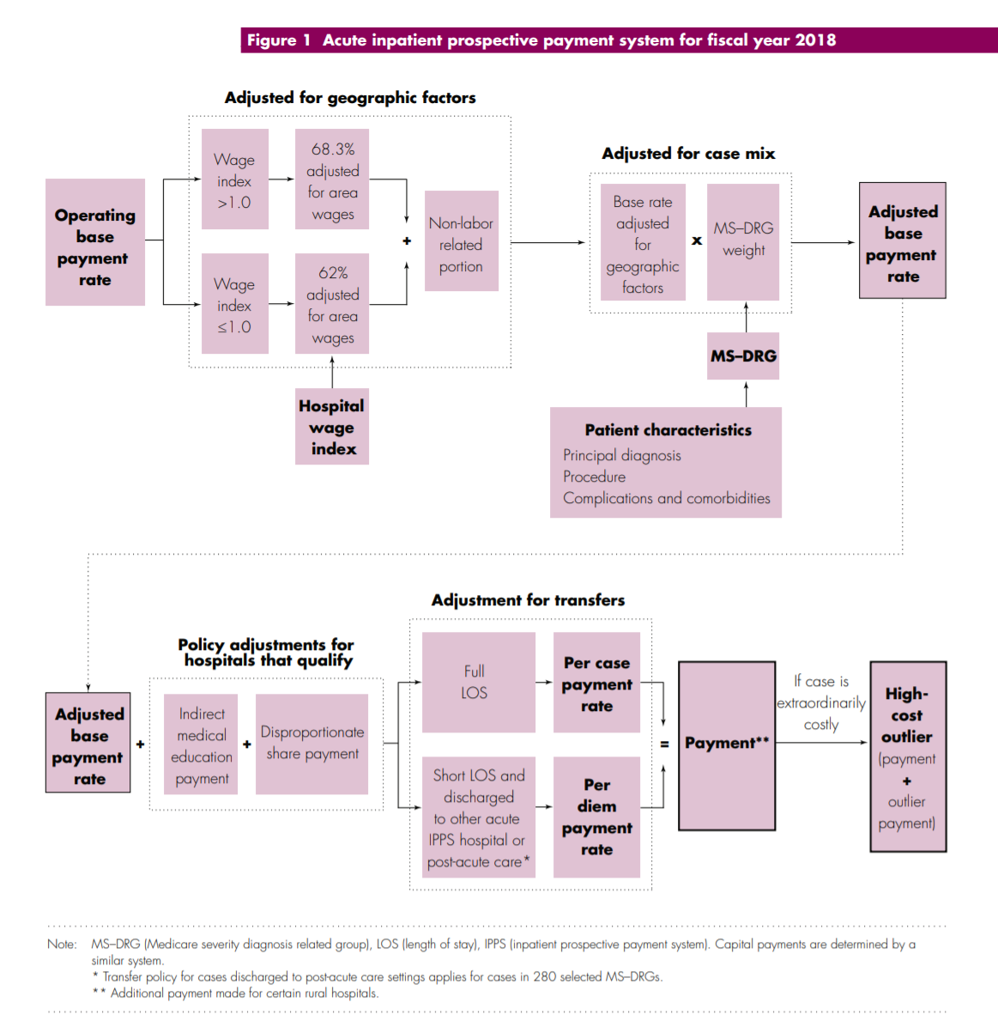

Slide 11
Bundled Payments and ACOs
Bundled payment
  An accountable provider is established for each episode of care
  A price is established which should account for all payments involved in the episode
  Providers, including the accountable provider and other possible providers such as clinics, therapists, etc. are reimbursed during the episode.
  The total cost of the episode of care is compared to the established price
    If the total cost is greater than the price, the accountable provider reimburses the insurance company/Medicare
    If the total cost is less than the price, the accountable provider receives the difference
      The accountable provider may reimburse other providers involved in care a share of the total savings
Notes:
https://catalyst.nejm.org/aco-bundled-payment-coexist/

Slide 12
Bundled Payments and ACOs
Accountable Care Organizations
  “An organization of health care practitioners that agrees to be accountable for the quality, cost, and overall care of Medicare beneficiaries who are enrolled in the traditional fee-for-service program who are assigned to it“ –CMS definition
  Similar to an HMO but provider led rather than payer led
  ACOs are composed mostly of hospitals, physicians and other healthcare professionals, but may include health departments, social security departments, safety net clinics and home care services
Notes:
https://catalyst.nejm.org/aco-bundled-payment-coexist/

Slide 13
Bundled Payments and ACOs
Coexistence is based on separate lanes for the two models
ACO to enhance primary care
  Grown from 27 in 2012 to more than 550 in 2018
Bundled payment model to improve specialty care.
  Bundled payments currently mostly used for joint replacement care
The Affordable Care Act includes provisions that encourage bundled payments and ACOs
  Some concern this will catalyze mergers and vertical integration
  Mixed evidence for reduced cost and improved quality so far
Notes:
https://catalyst.nejm.org/aco-bundled-payment-coexist/

Slide 14
Theoretical Pros & Cons of VI
Pros – consolidation and VI could increase efficiency
Economies of scale
Ease of access to capital
Decreased management/regulatory duties for physicians
Eliminate duplicative services – through electronic medical records (EMR)
Improved coordination of care – all caregivers are under one roof, EMRs
Physicians receiving salary do not face the lower cost paid by Medicare/Medicaid patients – this could increase patient access to physicians
Increased financial stability and work-life balance, reduced risk for physicians
Cons – consolidation and VI could also decrease efficiency
Reduced organizational flexibility
Loss of focus on the core business
Diffusion of expertise
More complex management challenges
Adverse effects of reduced compensation
Notes:
For physicians, VI means there is often a tradeoff between physician autonomy and support from a healthcare system.

Slide 15
VI vs Horizontal mergers: Market power and the HHI
Herfindahl-Hirschman Index (HHI), a measure used by the DOJ and Federal Trade Commission (FTC) as an indicator of market competition.
HHI is the sum of the squared market shares of all firms in a market.
  So, if a market has four companies and each has a 25 percent market share, the HHI would be 2,500 or 252 + 252 + 252 + 252.
  If a market has four companies and 3 have 10 percent market share and the forth has 70, the HHI would be 5,200 or 100 + 100 + 100 + 4900.
  Smaller numbers indicate greater competition.
  A monopoly market with one firm has an HHI of 10,000
What will happen to the HHI after a horizontal merger?
  HHI will increase – change in HHI is a good measure of the effect of a horizontal merger on market competitiveness
What will happen to the HHI after a vertical integration?
  HHI may not change – HHI is less useful to understand the effect of vertical integration on market competitiveness

Slide 16
Hospital and Physician Vertical Integration (VI)
Mid-1990’s Clinton Healthcare Reforms
HMO & MCO growth in 1990’s incentivized hospitals to purchase PCP’s to build a referral base -- “captured lives”
Early evidence of reductions in hospital revenues led to decline in VI in early 2000’s
  Evidence that salaried physicians worked less hard than those who owned their practices
Another push towards VI in the 2010’s following the ACA
  Accountable Care Organizations incentivize VI.
Notes:
Berenson, Robert A. “A Physician's Perspective On Vertical Integration.” Health Affairs. Vol. 36, Iss. 9, (Sep 2017): 1585-1590.

Slide 17
Examples of Hospitals and Physician VI
Kaiser Permanente and Sutter Health, both in California
University of Pittsburgh Medical Center
Partners Healthcare Massachusetts
Closer to home:
Vertical Integration
  Connecticut Children’s Medical Center to purchase HeadZone, a concussion center in Shelton serving ages up to 22
  Aetna-CVS-Caremark-MinuteClinics
Horizontal mergers also common
  Yale New Haven Hospital acquired the assets of the Hospital of Saint Raphael in 2012
  Western CT Health system and Hudson Valley Hospital System merged in 2018
Notes:
https://www.courant.com/business/hc-biz-danbury-hospital-network-merger-20180328-story.html
http://www.hartfordbusiness.com/article/20180802/NEWS01/180809973/ct-childrens-med-center-to-purchase-shelton-concussion-clinic

Slide 18
Financial Incentives and Management Strategies Aimed at Consumers/Patients
Indirect financial incentives:
Some plans have higher Deductibles & Coinsurance
  Traditional view: Consumer out-of-pocket prices are inversely related to the quantity of healthcare a consumer demands
Some plans set premiums based on experience ratings
  Incentivizes consumers to adopt healthier lifestyles
Management Strategies:
  Require prior medical screening to avoid high-risk patients
  Provider networks limit choice of providers
  Require primary care gatekeeper to determine whether specialized care is necessary
  Pre-authorization of care

Slide 19
Financial Incentives and Management Strategies Aimed at Healthcare Providers
Indirect financial incentives:
Reduced Fee-for-Service
Capitation
Bonuses and/or withholds – also called pay-for-performance (PFP)
  Reimbursements are withheld until use of medical care has been evaluated – inappropriate use results in physicians not receiving withheld money
Notes:
How would each of these affect providers use of medical services? Quality of care?
Reduced FFS – little incentive to reduce utilization of medical services – QoC unclear
Capitation – strong incentive to reduce costs, but unclear how it would affect QoC, possibly adversely
PFP – strong incentive to reduce costs, especially for inappropriate/excessive use of services, but unclear how QoC would be affected

Slide 20
Healthcare Provider Management Strategies
Selective contracting.
  MCOs contract with an exclusive set of providers
  Based on quality or cost-effective practice patterns
Physician profiling.
  MCOs monitor physicians’ track record regarding referrals, quality, patient satisfaction.
Utilization review
  “seek to determine whether specific services are medically necessary and whether they are delivered at an appropriate level of intensity and cost.
Practice guidelines
  Inform providers of the appropriate medical practice in certain situations.
Formularies
  restricted list of drugs physicians may prescribe.
Notes:
All of these management strategies are designed to directly affect how a physician behaves in a specific clinical circumstance.
A health insurance plan or product varies on the type of consumer and provider financial incentives and management strategies. Following the ACA, plans available through government marketplaces (nongroup plans) also vary based on levels of coverage – these are defined by the 4 different metals: bronze, silver, gold, and platinum.
It is important to note that individual insurance companies offer many different variations of plans – and they are all priced differently to reflect the degree of risk the insurer takes on.
Additionally, any one healthcare provider might accept a variety of different health insurance products.

Slide 21
So, Are MCO’s “good” or not?
Ideally, MCOs should encourage preventive and coordinated primary care, which reduces the need for more expensive specialty/inpatient care.
But often most MCOs are concerned with short-term profitability.
  Why pay for cholesterol-lowering pills when the enrollee is likely to leave your HMO years before he has a heart attack?
In general, studies show that HMOs provide medical cost savings of 15-20%, mostly through reduced hospital care.
The impact of HMOs on quality of care is less definite.
  Health care providers treat patients belonging to a variety of plans.
Notes:
MCO’s were designed with the problem of moral hazard in mind, and focused in changing patient and provider incentives to reduce wasteful/unnecessary medical care. However if we think about what incentives MCO’s are facing -- Perhaps there is moral hazard involved there as well?
We have been debating the effect of MCOs on the cost and quality of medical care for some time now.

Slide 22
New Methods: Pay for Performance
A pay-for-performance (P4P) model provides a financial incentive to providers who meet defined performance goals
  Often used as a first step in transitioning toward more value-based care; easily combines with current fee-for-service methodology
  Traditionally has been implemented as an “upside only” (bonus) approach to promote increased quality; more recently, the developing trend is to add a downside (penalty) component for poor performance on defined measures
Value-based purchasing ties payment to quality
Focus on specific conditions
  Acute Myocardial Infarction (AMI), Heart Failure, Pneumonia
  Coronary Artery Bypass Graft (CABG), Total Hip and Knee Replacement (THKR), Chronic Obstructive Pulmonary Disease (COPD)
  Surgeries (as measured by SCIP), Healthcare-associated infections

Slide 23
New Methods: Pay for Performance
Literature reflects potential ethical “pitfalls” and unintended consequences of this approach. For example, this model:
  Creates a potential incentive to deselect patients who are difficult to treat and would make meeting the performance goals more difficult
  Creates a potential incentive to provide unnecessary care—care unnecessary for appropriate patient care but helpful to meet the performance goal

Slide 24
Pay for Performance: HACs
In 2008, Medicare reduced payments to hospitals for hospital-acquired conditions
  Cuts between 0% and 1% of payments (penalty only)
In the short term, there were hospital-level decreases in numbers of hospital-acquired infections, but these were difficult to sustain
In 2012, there was no measurable effect on rates of central line–associated infections or catheter-associated urinary tract infections nationally

Slide 25
Pay for Performance: excess readmissions and mortality
In 2008, Medicare reduced payments to hospitals for excess readmissions (HRRP) and excess mortality
  Excess was measured based on comparing the hospital’s expected rates given their patient risk to their actual rates
  6 conditions were included: Pneumonia, AMI, COPD, THKR, CABG, Heart failure.
  Revenue neutral for Medicare – winners and losers
  Effects up to 3% of costs
Mixed evidence for success, but overall reduction in excess readmission has been seen

Slide 26
New Methods: Merit Based Incentive Payment System
Medicare Access & CHIP Reauthorization Act (MACRA) of 2015
  Repeals Sustainable Growth Rate(SGR) Formula
  Introduced Merit Based Incentive Payment System (MIPS) for clinicians
  Provides bonus payments for participation in eligible alternative payment models to encourage participation
Current quality and value programs for physicians and practitioners will be streamlined into MIPS
Annual update to physician fee schedule
    FY2016 through 2018 =.5% increase
    FY2019 = +/- 4% based on MIPS performance score
    FY2020 = +/- 5% based on MIPS performance score
    FY2021 = +/- 7% based on MIPS performance score
    FY2022 onward = +/- 9% based on MIPS performance score

Slide 27
Incentive discussion
When do incentives fail?
  Incentives to doctors to reduce LDL (Asch et al 2015)
  “Hard work pays off in the future, but laziness pays off right now.”
  ACO incentivize dishonest measurement (Enthoven 2009, Change et al 2012)
  Value based purchasing?
  Downsides of US tax deductions for health insurance

Slide 28
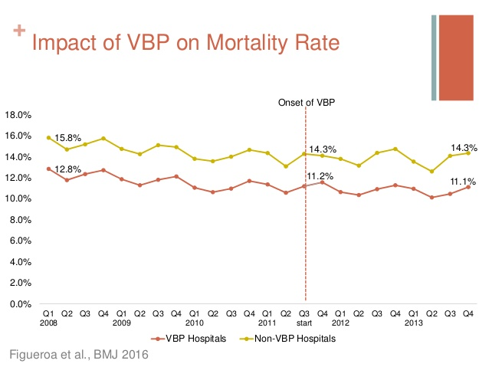

Slide 29
Incentive discussion
When do incentives work?
  Smoking cessation incentives in the workplace (Volpp 2009, Halpern et al 2015)
  Automated hovering? (https://www.youtube.com/watch?v=p_c-Fu5-Rus)
  Upsides of US tax deductions for health insurance
“Doctors are incentivized to make us sick, insurance companies to keep us well”

Slide 30
Readings and sources:
Mendelson, Aaron, Karli Kondo, Cheryl Damberg, Allison Low, Makalapua Motúapuaka, Michele Freeman, Maya O'neil, Rose Relevo, and Devan Kansagara. "The effects of pay-for-performance programs on health, health care use, and processes of care: a systematic review." Annals of internal medicine 166, no. 5 (2017): 341-353.

Slide 31
ACA Marketplaces
Open enrollment: Nov 1 – Dec 2020
Increase in competition
  In Plan Year 2021 (PY21) there are 181 Qualified Health Plan issuers participating in HealthCare.gov state Exchanges, an increase of 6 issuers from PY20.
  ACA marketplaces are notably profitable with insurers consistently making well over the cost of capital in profits over the past few years. The ACA marketplaces are policy stable. The ACA marketplaces are politically stable.
What will an increase in competition will do to prices?
  Lower unsubsidized price
  Lower spread between benchmark and cheapest silver plan – lowering subsidy on cheapest silver plan
    Potentially increasing subsidized cost of insurance!

Slide 32
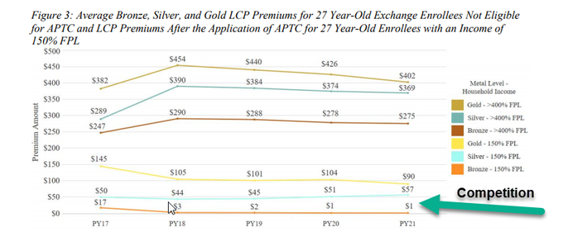

Slide 33
Bonus – optional readings
https://www.cms.gov/CCIIO/Resources/Data-Resources/Downloads/2021QHPPremiumsChoiceReport.pdf
https://www.balloon-juice.com/category/anderson-on-insurance/

