Slide 1
HCMI 4225: Title X
Online: Mon/Wed 12:30 PM – 1:45 PM
Shane Murphy – shane@uconn.edu

Slide 2
War on Poverty (LBJ 1964)
Unintended childbearing and poverty
Adverse maternal and child health outcomes
Low income women were more than twice as likely as high income women to have an unintended pregnancy
Title X Established in 1970
Public Law 91-572 or "Population Research and Voluntary Family Planning Programs“
Subject to frequent modification
Hyde Amendment (1976) restricted the funding for abortions for Medicaid recipients.
Next slide is a timeline discussing trends in legislation related to the law

Slide 3
Extending Title X for future years and establishing global and national institutes (Nixon administration, 92nd–93rd Congress, January 20, 1969–August 9, 1974).
Stipulating that a broad array of family planning methods be offered and ensuring that economic status is not a deterrent to participation. Also, bills regarding abortion began to emerge (Ford administration, 94th Congress, August 9, 1974–January 20, 1977).
Implementing demonstration projects for infertility services, providing specific guidelines regarding the content of pregnancy information delivered, and stipulating that information and education be developed and disseminated through the community (Carter administration, 95th–96th Congress, January 20, 1977–January 20, 1981).
Stipulating that programs providing abortion referrals and services are not eligible for a Title X grant even if they provide these services with other funds (non–Title X funds) and that personnel cannot be terminated if they do not advise or provide specific methods of contraception. Proposals for repeals of Title X also appeared (Reagan administration, 97th–100th Congress, January 20, 1981–January 20, 1989).
Providing HIV counseling and testing, applying Title X restrictions to global family planning funding, and adhering to state parental notification laws (George H. W. Bush administration, 101st Congress, January 20, 1989–January 20, 1993).
Encouraging family participation among minors, stipulating that directing clinic staff be sensitive to a community's culture, and prohibiting funds supporting or opposing legislative proposals or candidates (Clinton administration, 103rd–106th Congress, January 20, 1993–January 20, 2001).
Reiterating that funds are prohibited from being used for abortion services and requiring counseling for minors on how to resist sexual activities, including sexual coercion (the combination of this language was found to be continually proposed in appropriation bills during this administration) (George W. Bush administration, 106th–110th Congress, January 20, 2001–January 20, 2009).

Slide 4
Title X
Administered by US Department of Health and Human Services (10 regional offices)
Award grants to health departments, university and community centers, Planned Parenthood clinics, and other public and nonprofit agencies.
Any public or nonprofit entity (located in a designated state) that offers a broad range of acceptable family planning methods and services is eligible to apply.
In 2008, there were 4522 Title X clinics serving more than 5 million individuals.

Slide 5
Services
Among female family planning users in 2008
44% received cervical cancer screening (Papanicolau tests)
46% received breast cancer screening (clinical breast examinations)
49% received chlamydia testing; 57% of male family planning users received chlamydia testing
Among every 10 family planning users, on average 4.7, 1.4, and 1.6 gonorrhea, syphilis, and HIV tests were provided, respectively.
90% of spending is on clinical family planning services
Commonly, Title X is their avenue of entry into the health care system

Slide 6
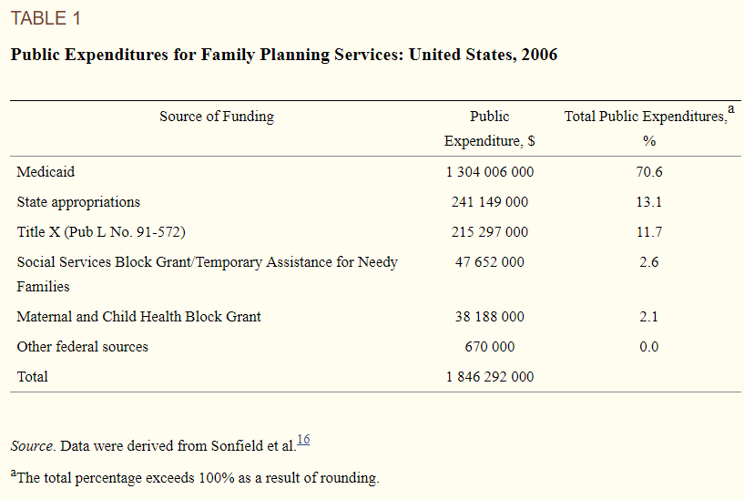

Slide 7
Restrictions
Federal regulations initiated in 1987 prohibiting clinics receiving Title X funding from disseminating abortion information or referrals (i.e., the “gag rule”). This legislation, although further supported by the Supreme Court as being constitutional in 1991, was later banned in 1993 by President Clinton.⁹
An attempt by the Reagan administration in 1982 to require minors to obtain written parental consent before receiving services (i.e., the “squeal rule”).This legislation was later reintroduced as the Parental Notification Act of 1998.
Legislation enacted in 1998 emphasizing abstinence-only education and ignoring the teaching of medically accurate and age-appropriate sexual information stressing health promotion and disease prevention.
Legislative proposals to repeal sections of Title X or the policy in its entirety.

Slide 8
Criticisms
"Title X is welfare for affluent teenagers “
Most (~80%) recipients are poor or near poor, 1/3 are teenagers, 1/6 under 18, few under 16.
"The existence of [Title XI puts the United States government on record declaring that it is appropriate for government to decide who has children.”
Title X statute stipulates that "the acceptance by any individual of family planning services or family planning or population growth information . . . shall be voluntary and shall not be a prerequisite to eligibility for or receipt of any other service or assistance

Slide 9
Criticisms
"Planned Parenthood and its affiliates . . . constitute most of the Title X network. “
About ¼ Title X funds go to PP providers
". . . no one can deny the fact that Title X does indeed subsidize teenage sexual activity. “
The rise and recent decline in teenage sexual activity is unlikely to have much to do with politics and public policy at this level.

Slide 10
Criticisms
“[In 1981, it was] demonstrated that the programs providing these teenage birth control services were not only totally ineffective in achieving their professed goals of reducing premarital pregnancy, illegitimate births, and abortion among teenagers, but had actually contributed significantly toward making these problems worse”
"Most Title X funds go to organizations which engage in abortion, pro- mote abortion, lobby for abortion, litigate about abortion. If the advocates of Title X want it to continue ... I need their support for legislation that will prohibit the use of Title X funds by any organization which in any way engages in abortion, abortion referral, abortion counseling, abortion lobbying, abortion advertising.“
"[Title X] was begun as family planning assistance for low-income families. It sounded commendable. Its stated purpose was to assist poor couples to plan their families. As with many other programs with humanitarian intent, Congress established Title X and left it in the hands of the federal bureaucracy. That is when things went haywire.”

Slide 11
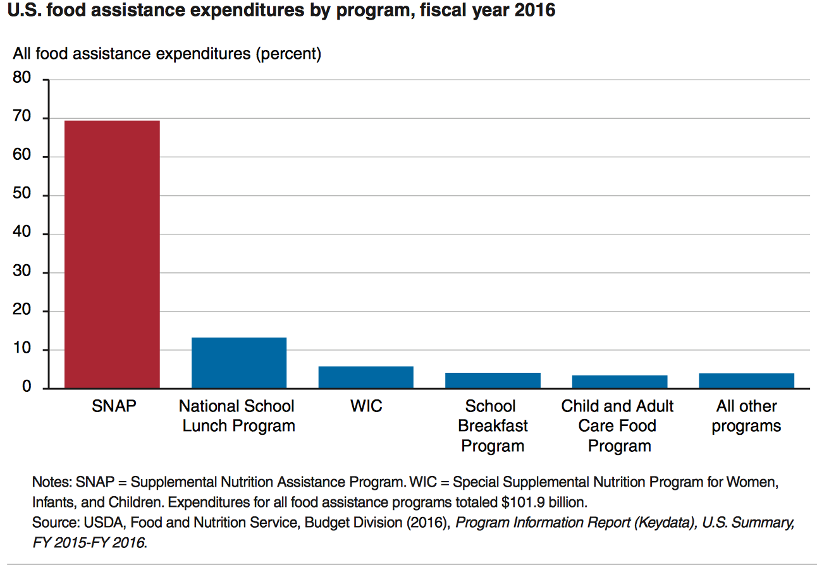
State Grants: Food Assistance Programs

Slide 12
SNAP
SNAP
central goal is to alleviate food insecurity and it succeeds
also improves well-being over other dimensions
High benefits for families
maximum of almost $700 per month for a family of 4
average benefit of about $250 per month for a family of 4
Has a profound effect on the family food economy

Slide 13
History of private health care and reform proposals in the 1990s
BUSN 202: Mon/Wed 9:30 AM – 10:45AM
Shane Murphy – shane@uconn.edu
Office Hours: Mon/Wed 11:00 AM – 12:30PM

Slide 14
Video: How did Makeup, WWII & Communism Create U.S. Healthcare?
https://www.youtube.com/watch?v=JKQif8qBRVg

Slide 15
Blue Cross
In 1929, a group of Dallas school teachers contracted with Baylor University Hospital to receive up to 21 days of inpatient care a year for regular monthly payments of 50 cents.
By 1937, there were 26 such plans with more than 600,000 members total.
These combined under the auspices of the American Hospital Association (AHA) to form the Blue Cross network of plans

Slide 16
Blue Shield
In the 1930s, physicians became concerned about proposals for compulsory national health insurance and the threat of insurance competition from Blue Cross.
Specifically, doctors worried that third-party payers would lower their incomes by restricting their ability to set their own fees. In response, physicians established a network of their own insurance plans covering physician services.
These plans, known as Blue Shield, preempted the hospital-oriented Blue Cross plans from entering into the primary care sector.

Slide 17
WWII and the 1950s
During World War II wage and price controls prevented employers from using higher salaries to attract workers.
They were, however, allowed to offer fringe benefits like health insurance for up to 5 percent of a worker's wages.
In addition, the National Labor Relations Board ruled that health insurance benefits were a legitimate subject of labor-management negotiations.
Lastly, the IRS and the National War Labor Board determined that employers could deduct the cost of employee health benefits from taxable business income, and employees did not have to include the value of those benefits in calculating their taxable income.
As a result the market for health insurance of all kinds increased dramatically during the 1940s, from a total enrollment of 20,662,000 in 1940 to 142,334,000 in 1950.

Slide 18
HMOs
In 1970, Paul Elwood coined the phrase "health maintenance organization" to emphasize the clinical prevention role of plans like Kaiser's formed in 1945 and the 1929 Ross-Loos Medical Group plan for LA city and county employees.
HMOs were able to reduce resource utilization rates, particularly hospital admissions and lengths of stay.
The Health Maintenance Organization Act of 1973 was passed to encourage HMO growth in the marketplace.
This law provided grants and loans to start or expand HMOs, removed state restrictions on federally certified HMOs, and required employers of 25 or more employees to offer this type of plan as a benefit option.
In the 1970s there were 26 plans with about 3 million subscribers nationwide; by 1991 the numbers had grown to 556 plans with 35 million enrollees.

Slide 19
Consolidated Omnibus Budget Reconciliation Act of 1985
Insurance program which gives some employees the ability to continue health insurance coverage after leaving employment
Created COBRA plans
Title X amends the Internal Revenue Code and the Public Health Service Act to deny income tax deductions to employers (generally those with 20 or more full-time equivalent employees) for contributions to a group health plan unless such plan meets certain continuing coverage requirements.
Later changed to an excise tax penalty

Slide 20
Universal health care
Video: CSPAN: Harry and Louise Ads, 1993
https://www.youtube.com/watch?v=CwOX2P4s-Iw

Slide 21
Hillarycare: the Health Security Act of 1993
Universal coverage
Most people would get insurance plans from their employers because all employers were required to provide health insurance coverage to every employee.
People without jobs could purchase health insurance on their own from the regional health alliances.
The Federal government would subsidize the costs for low-income people.

Slide 22
Hillarycare: the Health Security Act of 1993
Regional health alliances
Regional Health Alliances were state-based health insurance purchasing groups.
The alliances would control costs by setting the prices for health care providers based on a fee-per-service.
Companies with more than 5,000 full-time employees could provide their own insurance outside the alliances.

Slide 23
Hillarycare: the Health Security Act of 1993
National health board
The National Health Board was a new federal agency.\It set a cap on total health care spending for the nation.
That meant it regulated health insurance premiums. For individuals, it set limits on maximum annual out-of-pocket costs.
It also determined minimum coverage requirements.

Slide 24
Defeat
Association of American Physicians and Surgeons opposition
Doctors opposed losing control over pricing, care and treatment
Congressional concern over the deficit
1990-1991 Recession was over and workers felt confident about future employer-based insurance prospects
Labor unions didn’t support the initiative.
They were angry at the President for signing NAFTA.

Slide 25
Comparing Hillarycare and Obamacare
Feature | Hillarycare | Obamacare
Universal coverage | All employers | Most employers
Pre-existing conditions covered | Yes | Yes
Non-employer coverage | Regional health alliances | Health insurance exchanges
Reliance on insurance | Yes | Yes
Universal mandate | Yes | Yes
Required coverage | Yes | 10 essential health benefits
Low-income subsidies | Provided by federal government | Expanded Medicaid
Tax on high-end insurance | Income tax | Cadillac tax on businesses
Focus on Preventive Care | Yes | Yes
Funded by | Deficit spending | Obamacare taxes
Doctors paid on | Fee-for-service | Patient wellness
Medicare | "Doughnut hole" did not exist | Eliminate "doughnut hole"

Slide 26
HIPAA: Health Insurance Portability and Accountability Act of 1996
Title I of HIPAA protects health insurance coverage for workers and their families when they change or lose their jobs.
Title II of HIPAA, known as the Administrative Simplification (AS) provisions, requires the establishment of national standards for electronic health care transactions and national identifiers for providers, health insurance plans, and employers.
Title III sets guidelines for pre-tax medical spending accounts.
Title IV sets guidelines for group health plans.
Title V governs company-owned life insurance policies.

Slide 27
Readings:
Moseley III, George B. "The US Health Care Non-System, 1908-2008." AMA Journal of Ethics 10, no. 5 (2008): 324-331.
Amadeo, Kimberly. Hillarycare, the Health Security Act of 1993 The Balance, March 13, 2019
Mertens, Maggie. Chart: Comparing Health Reform Bills: Democrats and Republicans 2009, Republicans 1993. Kaiser Health News, February 24, 2010

