Slide 1
HCMI 4225: Health and Social Insurance
Online: Mon/Wed 9:30 AM – 10:45 AM
Shane Murphy – shane@uconn.edu
Office Hours: ?

Slide 2
Welcome to class!
What is your name, major, and where are you right now?
What is one, two, or three pieces of content (tv show, movie, book, podcast) that are especially meaningful to you?
What is your favorite animal (optional)?

Slide 3
Health and Social Insurance Course Topics
What is it and why does social insurance exist?
  Justifications
  History
What is the current state of health and social insurance in the US?
  Particular focus on the ACA
What is the future of health and social insurance?
  Trends in insurance products
  Reform proposals
  International comparisons

Slide 4
Health Landscape and Health Costs
Key points:
  Expenditure is growing
  The United States is different
  Measurement of mortality and morbidity
    Importance of direct discussion of mortality and morbidity for health professionals
  Causes of mortality and morbidity vary
    By age, sex, and disease
  Entry points into the healthcare system vary
    By age, sex, and disease
  Drivers of health care expenditure vary
    By age, sex, and disease

Slide 5
Contemplation Question
Health expenditure and GDP in the United States are rising. Is Health Expenditure as a share of GDP also rising? Should it be?

Slide 6
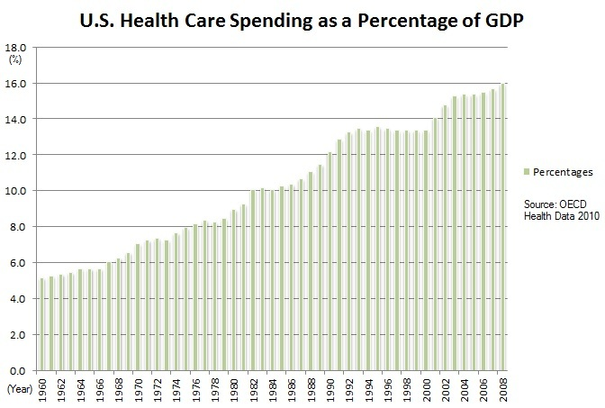
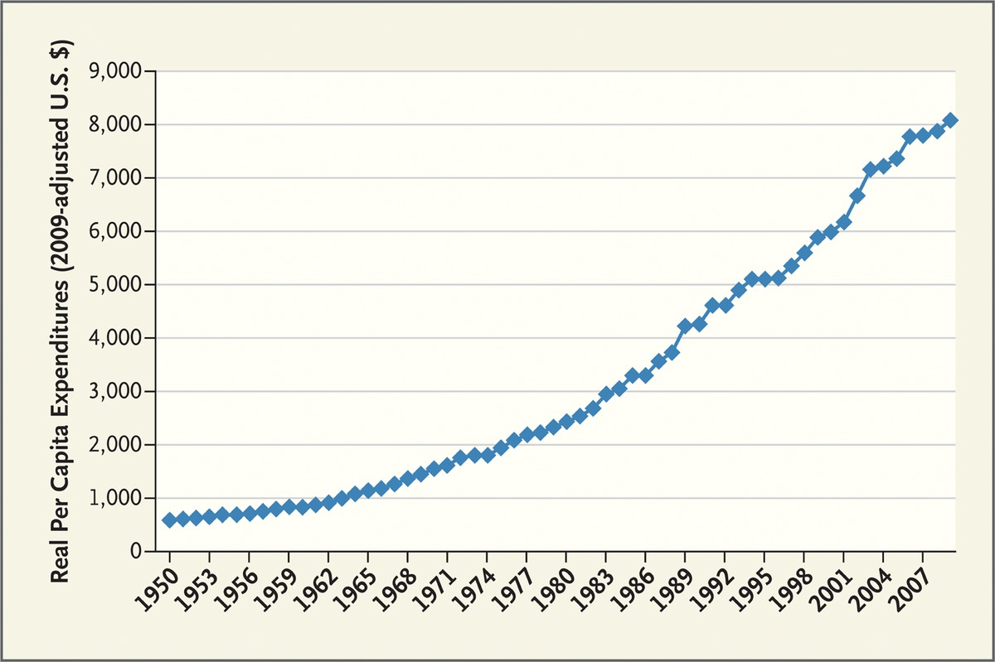
US Health Expenditure
Expenditure are increasing both in real terms and as a percentage of GDP
Fuchs 2012

Slide 7
Contemplation Question
Is the United States and outlier?
How could we tell?

Slide 8
Comparing National Health Expenditures

Slide 9
Comparing National Health Expenditures

Slide 10
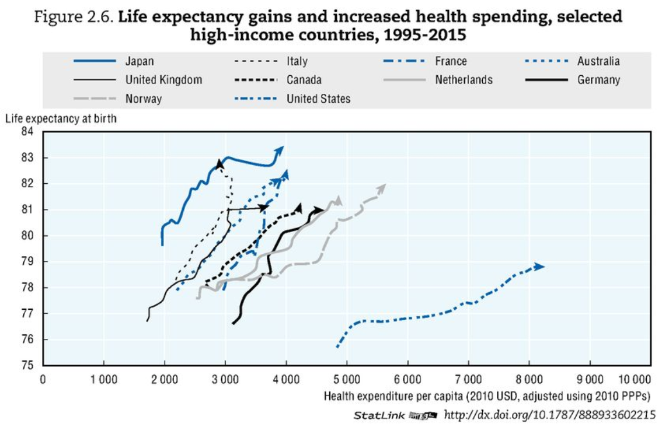
Comparing National Health Expenditures
OECD Health Data 2017

Slide 11
Unresolved Question
Is it bad that the United States is an outlier?
Is the United States wildly abnormal?
Is the income diversity (or other diversity) in the United States driving its outlier status?
Does Health Expenditure have a different meaning in the United States than elsewhere?

Slide 12
Measures of health
Mortality Rate: deaths per year per 100,000 people
Morbidity
YLL: years of life lost to a disease
DALY/QALY: sum of YLL and years of life lived with a disability

Slide 13
Disease Groups
Communicable Diseases
Neoplasms
Cardiovascular Diseases
Chronic Respiratory Diseases
Cirrhosis
Digestive Diseases
Neurological Diseases
Mental and Substance Abuse Diseases
DUBE
Musculoskeletal Disorders
Non-communicable Diseases
Injuries
Well Care
Risk Factors

Slide 14
Visualizing US Health and Health Expenditure
Health:
  https://vizhub.healthdata.org/gbd-compare/
Health Expenditure:
  https://vizhub.healthdata.org/dex/

Slide 15
Discussion Question
What causes the most disability?

Slide 16
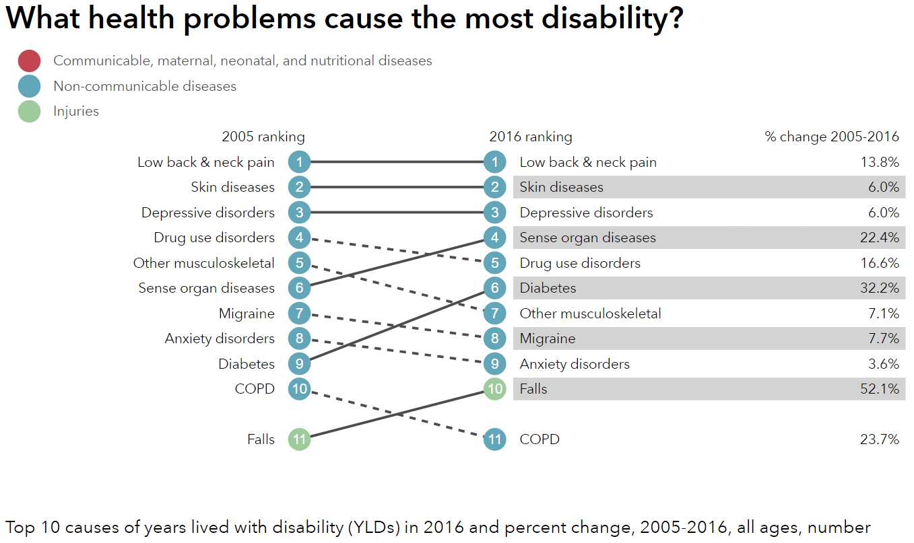
http://healthdata.org/us-health

Slide 17
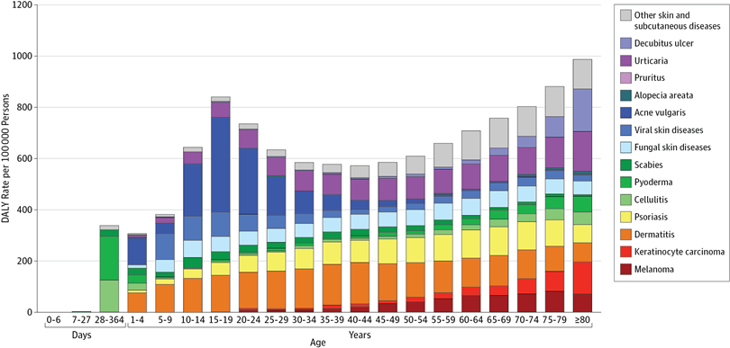
Unpacking DALY cost of skin diseases by age
Karimkhani et al 2017

Slide 18
Discussion Question
What causes the most deaths?

Slide 19
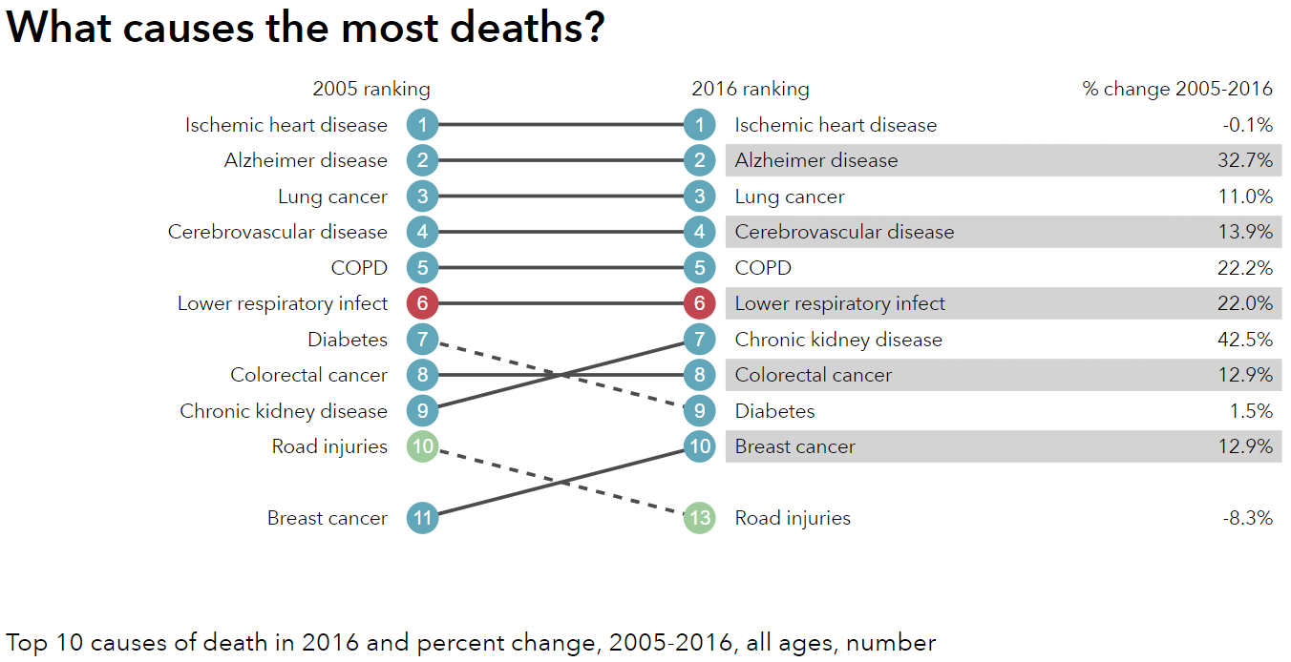
http://healthdata.org/us-health

Slide 20
Visualizing US Health and Health Expenditure
Health:
  https://vizhub.healthdata.org/gbd-compare/
Health Expenditure:
  https://vizhub.healthdata.org/dex/

Slide 21
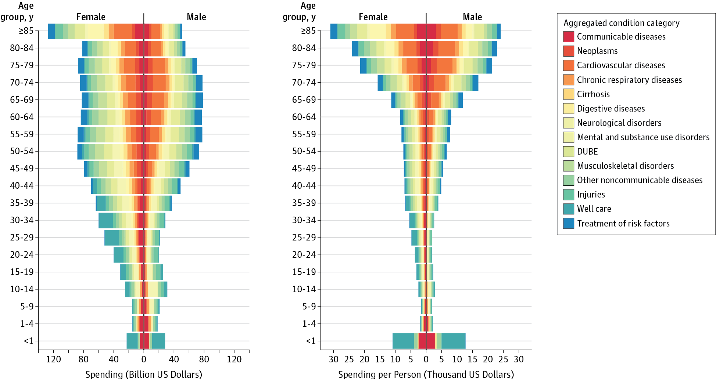
Health Care Costs by Age, Sex, and Disease
Dielman et al 2016

Slide 22
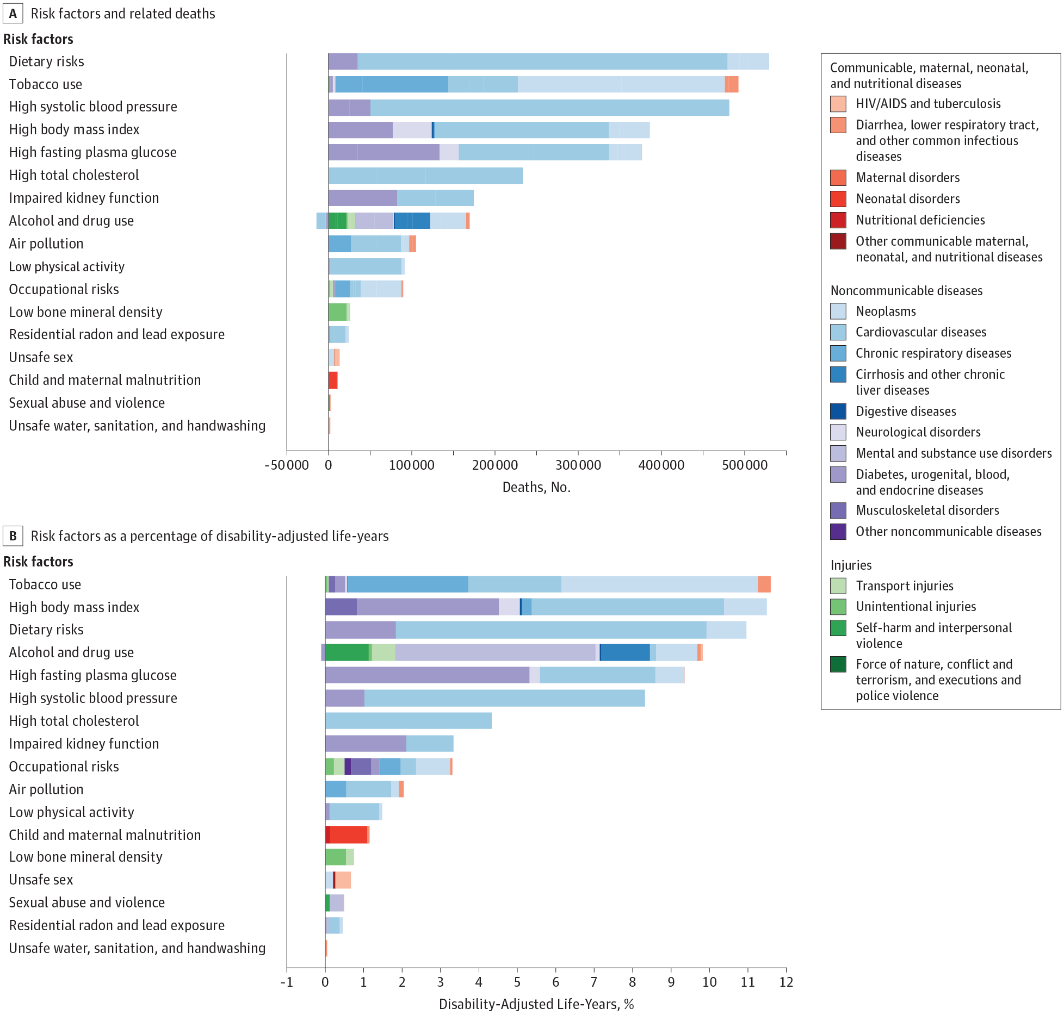
Risk Factors

Slide 23
Risk Factors

Slide 24
Unresolved Question?
Is the problem Big Pharma? Is it too many hospital administrators? Is it predatory nursing facilities?
In a broad sense, who is driving health care costs?
How should insurance premiums be structured given the distribution of costs across age and sex?
Does Medicare cause Health Care Costs to grow among people aged 65 and up or does increasing illness cause Health Care Costs to grow in this population?

Slide 25
Discussion question
Why do some say that health care in the united states is the best in the world?

Slide 26
Discussion question
Why do some say that health care in the united states is the best in the world?
  For those who can afford care, quality is often very high
  US is leader in innovation and development
  Inequality in disease risk is higher in US than other wealthy countries
  US leads in some statistics such as cancer survival rates
  About 40 percent of the world’s medical travelers—people who go abroad to obtain acute elective care—come to the United States

Slide 27
Hospital care in the US is (mostly) excellent
Five-Year Survival Rates for Patients Diagnosed with Five Common Cancers in Seven Countries, 2005–2009
Country | Female Breast | Colon | Lung | Prostate | Childhood Leukemia
Canada* | 85.8 | 62.8 | 17.3 | 91.7 | 90.6
France** | 86.9 | 59.8 | 13.6 | 90.5 | 89.2
Germany | 85.3 | 64.6 | 16.2 | 91.2 | 91.8
Italy | 86.2 | 63.2 | 14.7 | 89.7 | 87.7
Japan | 84.7 | 64.4 | 30.1 | 86.8 | 81.1
United Kingdom* | 81.1 | 53.8 | 9.6 | 83.2 | 89.1
United States | 88.6 | 64.7 | 18.7 | 97.2 | 87.7

Slide 28
Readings:
Fuchs, Victor R. "Major trends in the US health economy since 1950." New England Journal of Medicine 366, no. 11 (2012): 973-977.
Dieleman, Joseph L., et al. "US spending on personal health care and public health, 1996-2013." Jama 316.24 (2016): 2627-2646.
Bonus:
IHME Data Visualizations: https://vizhub.healthdata.org

Slide 29
Other Sources
Indicators, O. E. C. D. "Health at a Glance 2017." OECD Indicators, OECD Publishing, Paris. https://read.oecd-ilibrary.org/social-issues-migration-health/health-at-a-glance-2017_health_glance-2017-en#page1
Karimkhani, Chante, Robert P. Dellavalle, Luc E. Coffeng, Carsten Flohr, Roderick J. Hay, Sinéad M. Langan, Elaine O. Nsoesie et al. "Global skin disease morbidity and mortality: an update from the global burden of disease study 2013." JAMA dermatology 153, no. 5 (2017): 406-412.

Slide 30
Next Time
Health care as a right and as a public good
Reading:
*Gawande, Atul. “Is health care a right?” New Yorker, October 2, 2017
* Section I (pages 5-10) of Ruger, Jennifer Prah. "Toward a theory of a right to health: capability and incompletely theorized agreements." Yale Journal of Law & the Humanities 18, no. 2 (2006): 3.
Optional Readings:
Hamel, Mary Beth, Jennifer Prah Ruger, Theodore W. Ruger, and George J. Annas. "The elusive right to health care under US Law." N Engl J Med 372, no. 26 (2015): 2558-63.
Ruger, Jennifer P. "The moral foundations of health insurance." Journal of the Association of Physicians 100, no. 1 (2007): 53-57.

