Slide 1
HCMI 4225: Public Goods and Health
Mon/Wed 9:30 AM – 10:45 AM
Shane Murphy – shane@uconn.edu
Office Hours:

Slide 2
Overview
Discuss paper
Discuss next week’s discussion
What is a public good?
Is health a public good?
Importance of public goods for health
Case study: Mental health

Slide 3
Public goods
Goods which the market will not provide as:
non-excludable (non-exclusive)
  benefits of good freely available to all or prohibitively costly to provide good only to people who pay for it and prevent or exclude other people from obtaining it
non-rival in consumption (inexhaustible)
  quantity available for other people does not fall when someone consumes it, such that the total cost of production does not increase as the number of consumers increases (MC of additional user = $0)
Public goods are NOT necessarilly goods provided by the state (e.g. NOT public health systems!)

Slide 4
Examples
Defence
  Given size of armed forces may protect population of 10, 20, 50 or 100 million people
Law & order
  Foreign visitor benefits from crime-free streets as much as local residents
Information
  Discovery of food additive that causes cancer – cost borne once, then cost of dissemination so that all can benefit is (virtually) zero
  Infectious disease surveillance (prevent epidemics)

Slide 5
Is health a publics good
Health does NOT fit the definition of a public good:
  one person’s health status primarily benefits them
  goods and services necessary to provide and sustain health are predominantly rival and excludable
BUT: are aspects that have PG aspects (e.g. communicable disease control – Public Health Campaigns)

Slide 6
Quasi-public goods
Public goods are rarely ‘pure’ – often:
non-excludable but rival – ‘common pool goods’
  Beach on a holiday
non-rival but excludable – ‘club goods’
  Satellite television signals, polio vaccination
Technology & geography determine the degree of publicness (e.g. television & radio signals, street lights)

Slide 7
Public-private spectrum
Club
goods
Public
goods
Rivalry
High Low
Private
goods
Common
pool goods
High Low
Excludability

Slide 8
Access goods
Private goods are often required to access public goods (e.g. computer to access internet)
This restricts scope of the benefits from public goods and may lead to perverse targeting
To secure provision of some public goods required access goods may thus be considered as if they were public goods
  Health infrastructure possibly including health insurance

Slide 9
Importance of public goods
Free markets under-supply public goods because:
  non-excludability leads to ‘free-riding’
  non-rivalry leads to lower than socially optimal consumption

Slide 10
Non-excludability & ‘free-riding’
A free-rider is someone willing (hoping) to let others pay for a public good they will consume (e.g. cure for cancer)
If everyone tries to be a free-rider, no one pays for the good to be produced
Leads to societal loss of welfare – everyone worse off = ‘prisoner’s dilemma’

Slide 11
Non-rivalry
Private good – rivalry means each unit only consumed by 1 consumer (↑ demand = ↑ quantity)
  Market demand = horizontal sum of demand curves (sum of all quantities demanded at given price)
Public good – nonrivalry means each unit is consumed by all consumers (↑demand = ↔quantity)
  Market demand = vertical sum of demand curves (sum of price each consumer WTP for single unit)

Slide 12
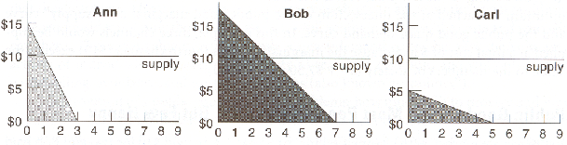
Private individual demand curve

Slide 13
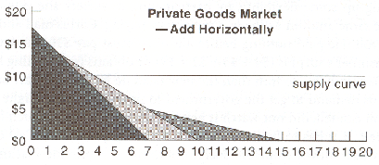
Private market demand curve

Slide 14
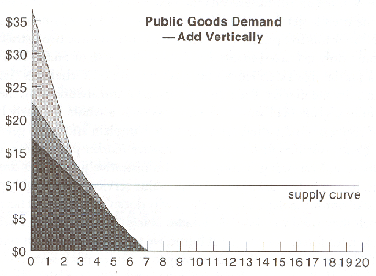
Public quasi-demand curve

Slide 15
Example PG in Health: medical research
Discovery of bacteria in 1850s and 1860s by Louis Pasteur began revolution in treatment of disease, saved wool industry from anthrax, improved brewing and dairy products
No single beneficiary (firm or consumer) obtains benefits sufficient to cover costs
Cost of research supported by (French) government
Underinvestment if beneficiaries do not pay

Slide 16
Related Issue: Social Benefit
The marginal social benefit may be above the marginal benefit, and the marginal social benefit may increase as the number of insured increases, further suggesting under-provision of the free market

Slide 17
Central problem
Core policy issue is therefore one of ensuring collective action to facilitate production of, and access to, goods which are largely non-excludable and non-rival in consumption
Role usually assigned to government (although not exclusively - peer pressure, social responsibility, community, fairness)

Slide 18
Role for government
Public good aspects are often a rationale for government finance through:
Fees (e.g. prescription, dental). Still loss welfare as leads to inefficient exclusion where people excluded even though benefit>cost
‘Privatizing’ (excluding) a public good through establishing property rights - patent system
Direct finance, funded through general taxation
Other financial incentives/compensation - permits

Slide 19
Role for government
There are drawbacks associated with governmentally provided public goods
  There may still be welfare loss from ’free’ goods (depending on actual cost)
  Level of provision may be hard to determine - problems in obtaining ‘social value’ (incentive to over/under state value – CBA replaces market pricing)
  Government programs may reflect political pressure to benefit special-interest groups

Slide 20
Readings:
Health care as a public good
*Karsten, Siegfried G. "Health care: private good vs. public good." American Journal of Economics and Sociology 54, no. 2 (1995): 129-144.
*Galea, Sandro. “Public health as a public good.” Boston University School of Public Health, January 10, 2016, https://www.bu.edu/sph/2016/01/10/public-health-as-a-public-good

Slide 21
Mental Health up to the 1950s
Dorothea Dix’s national crusade for moral treatment for the mentally ill in the 1840s
Clifford Beers mental hygiene movement of the 1910s and 1920s
Hospitals run by states, but with increasing levels of federal financial support
  Block grants as a part of FDRs New Deal in the 1930s
Truman’s National Mental Health Act of 1946 creating the NIMH
In 1955, the first antipsychotic, Chlorpromazine (Thorazine), came on the market and was quickly heavily prescribed
  Gave hope for an end to mental health illness
Dire conditions in mental health facilities was growing in the national consciousness
  One Flew Over the Cuckoo’s Nest – Ken Kesey (1962)

Slide 22
Mental Health: Willowbrook Wars
“The Willowbrook State School, located in Staten Island, New York City, was a squalid dumping ground for 5,400 profoundly mentally retarded children and adults. . .Naked bodies could be found sprawling on concrete floors; some residents seemed to live in soiled clothing; toilets didn't work, feces were everywhere, and the stench was unbearable. The physical plant was dilapidated, the interior filthy beyond imagination. Disease-especially hepatitis and shigella-was rampant. Medical care was inadequate, therapy largely nonexistent.”

Slide 23
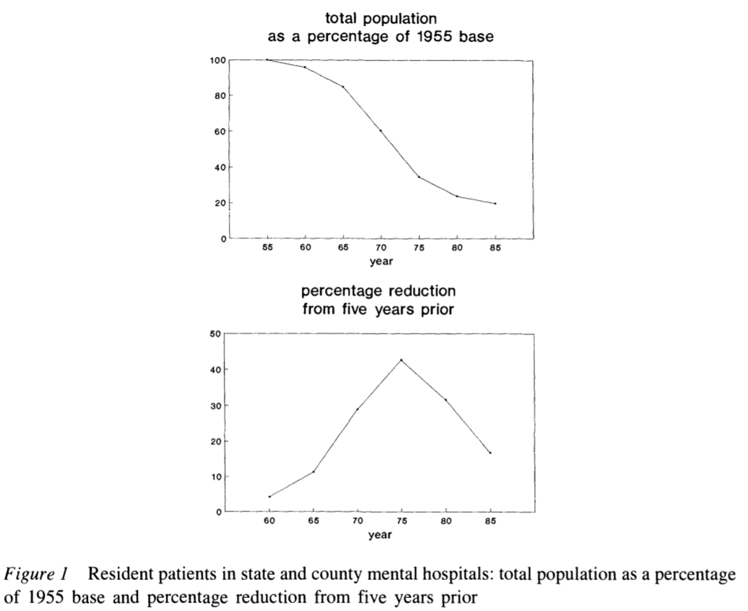
Deinstitutionalization
The peak institutionalized population was in 1955-- approximately 550,000 patients in mental institutional around the US, at a time when the US population was 165 million, roughly one in every 300 Americans.
In 2019, with a population twice the size of 1955, we have roughly 110,000 patients institutionalized -- roughly a %90 reduction in the percentage of the population institutionalized.

Slide 24
Kennedy’s Community Mental Health Act of 1963
US government decided for the first time since President Pierce vetoed the National Mental Health Act of 1854 that it had a role in the direct delivery of mental health services
  At the time, there were 30,000 psychiatrists in the US
  This has increased 10 fold, 20 fold if psychiatric nurses are included
However, Congress did not authorize adequate funding
  Kennedy was assassinated the next month, in November 1963
  funding amendments passed in 1965 (along with the creation of Medicare and Medicaid)

Slide 25
Role of Insurance and Community Hospitals
Insurance began to cover mental health benefits
Including Medicaid, which was created in 1965
  Created federally designated mental health catchment areas which were eligible to apply for federal grants to fund care
Supplementary Security Income (created in a 1972 law) provided additional assistance for people whose mental illness constituted a recognized disability
Hospitals developed specialized psychiatric units
Mental health episodes became characterized by short lengths of stay
  But little community follow up
Functions previously associated with mental health hospitals now distributed across various groups/agencies

Slide 26
Carter's Mental Health Systems Act of 1980 &
Civil Rights of Institutionalized Persons Act of 1980
Through the 1970s, Governors including Reagan in California and Carter in Georgia passed progressive mental health care laws
Ford opposed extending funding of mental health care but Johnson era law was kept in place using continuing resolutions until the election of Carter in 1976
Reagan’s (elected to president in 1980) cut funding to community health centers (sunsetting the funds, cutting 25% per year for 4 years)
  SSI, Medicaid, and patient fees made up some of the difference
MHSA was repealed in Reagan’s Consolidated Omnibus Budget Reconciliation Act (COBRA) of 1985
  Depriving the community based health organizations of the funding they needed to support the deinstitutionalized.

Slide 27
Managed Care era
Health Maintenance Organizations became a federally supported preferred method of insurance with the HMO act of 1973
Since then, and growing in importance starting in the 1990s there has been increased emphasis on managed care as a method of price control
  This system incentivizes patients to use in-network providers for care
  Reduction in fee-for-service reimbursement and growth of network requirements further defunded mental health care providers

Slide 28
Sources
Cutler, David L., Joseph Bevilacqua, and Bentson H. McFarland. "Four decades of community mental health: A symphony in four movements." Community Mental Health Journal 39, no. 5 (2003): 381-398.
Mechanic, David, and David A. Rochefort. "Deinstitutionalization: An appraisal of reform." Annual Review of Sociology 16, no. 1 (1990): 301-327.

