Slide 1
HCMI 4225: The Right to Health and to Health Care
Online: Mon/Wed 9:30 AM – 10:45 AM
Shane Murphy – shane@uconn.edu

Slide 2
Arnold Kling’s Three Languages of Politics
Progressives: The Oppressed vs. Oppression
Conservatives: Civilization vs. Barbarism
Libertarian: Freedom vs. Coercion
I might add the academics/beurocrats view:
The Expert vs. ignorance

Slide 3
Discussion Questions:
What is a right? What is a human right?
Is health care a human right?
Should the government ensure provision of basic health needs to the entire population?
Should the government ensure provision of premium health care to the entire population?

Slide 4
Rights in moral philosophy: Utilitarianism
Associated with founders of economics (Jeremy Bentham)
Policies should maximize net social utility
Aggregate welfare
Effective altruism (Singer)
Disease Control Priorities Project

Slide 5
Rights in moral philosophy: John Rawls’ Theory of Justice
Veil of ignorance
Under such a veil, what principles of justice would people choose for society
Maximin
Means rather than ends approach

Slide 6
Rights in moral philosophy: Communitarianism
Reaction to Rawls by Michael Sandel, Charles Taylor and Michael Walzer
Opposes universalist point of view
Distinct societies create distinct “spheres of justice”
Each society creates fundamental principles which are valued
Single community view called “Cosmopolitanism” (related to globalism or internationalism)

Slide 7
Rights in moral philosophy: Cosmopolitanism
Single community alternative to Communitarianism
Related to globalism or internationalism
Associated with Kant, Derrida, and Appiah
Moral universalism and belief of crimes against humanity

Slide 8
Rights in moral philosophy: Libertarian
Personal freedom
Individual choice and limited state influence
Anarchy, State, and Utopia (Nozick)
Endorse negative rights but not positive rights

Slide 9
Rights in moral philosophy: Capabilities approach
Focus on what individuals are able to do (Sen, Nussbaum)
Emphasizes functional capabilities, "substantive freedoms“
the ability to live to old age
engage in economic transactions
participate in political activities

Slide 10
Rights in moral philosophy: Older views
Daoism
Focus on personal morality over community
Confucianism
Mutual obligation
Aristotelian ethics
Cardinal virtues and human flourishing – limited place for “rights”
Abrahamic traditions (justice)
Moses’ laws, Isaiah’s covenant, Jesus’ Beatitudes, Muhammad’s Al-Israa, Augustine’s City of God
Medieval philosophers
Influenced by Aristotle: Avicenna, Averroes, Maimonides, Aquinas

Slide 11
Rights and Human Rights
https://www.youtube.com/watch?v=ew993Wdc0zo

Slide 12
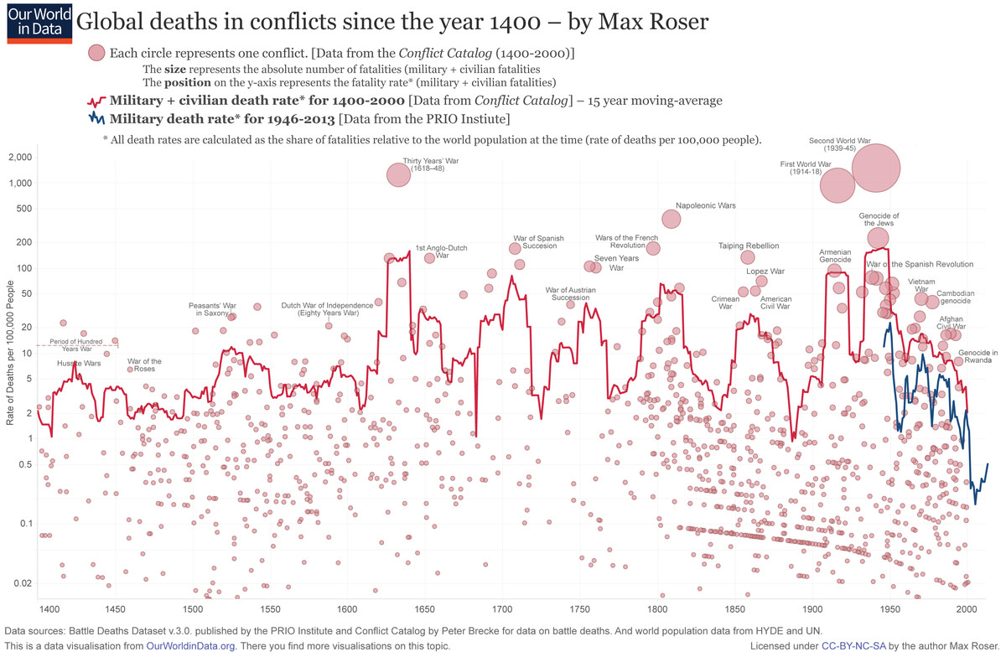
Modern Politics
Machiavelli
Ruler has right to rule
Citizen rights derive from the need for stability
Hobbes
Citizen rights derive from social contract
War, violence, and world wars
WWI (1914-1918)
WWII (1939-1945)
Notes:
https://www.vox.com/2015/6/23/8832311/war-casualties-600-years

Slide 13
Rights and Human Rights
1948 Universal Declaration of Human Rights
The preamble sets out the historical and social causes that led to the necessity of drafting the Declaration.
Articles 1–2 established the basic concepts of dignity, liberty, equality, and brotherhood.
Articles 3–5 established other individual rights, such as the right to life and the prohibition of slavery and torture.
Articles 6–11 refer to the fundamental legality of human rights with specific remedies cited for their defence when violated.
Articles 12–17 established the rights of the individual towards the community (including such things as freedom of movement).
Articles 18–21 sanctioned the so-called "constitutional liberties", and with spiritual, public, and political freedoms, such as freedom of thought, opinion, religion and conscience, word, and peaceful association of the individual.
Articles 22–27 sanctioned an individual's economic, social and cultural rights, including healthcare. Article 25 states: "Everyone has the right to a standard of living adequate for the health and well-being of himself and of his family, including food, clothing, housing and medical care and necessary social services." It also makes additional accommodations for security in case of physical debilitation or disability, and makes special mention of care given to those in motherhood or childhood.
Articles 28–30 established the general ways of using these rights, the areas in which these rights of the individual can not be applied, and that they can not be overcome against the individual.

Slide 14
Positive and Negative Rights (Isaiah Berlin)
Negative Rights (first generation) are things which cannot be done to a person
Civil and political rights (including speech, religion, unlawful imprisonment)
Positive rights (second generation) are things which must be provided to a person
Include police protection, legal council, economic, social and cultural rights

Slide 15
Legal and natural rights
Natural rights are “universal” and “inalienable” (Locke, Paine, Hobbes(?)0)
Legal rights can be modified or repealed

Slide 16
Discussion Questions:
What is a right? What is a human right?
Is health care a human right?
Should the government ensure provision of basic health needs to the entire population?
Should the government ensure provision of premium health care to the entire population?

Slide 17
Federal Laws

Slide 18
US State Constitutions
As of April 2014, 15 state constitutions specifically mention health and health care—either in the form of a programmatic statement, public concern, individual right, or government duty.

Slide 19
Readings:
Health care as a public good
*Karsten, Siegfried G. "Health care: private good vs. public good." American Journal of Economics and Sociology 54, no. 2 (1995): 129-144.
*Galea, Sandro. “Public health as a public good.” Boston University School of Public Health, January 10, 2016, https://www.bu.edu/sph/2016/01/10/public-health-as-a-public-good/
Is health care a right? Is health insurance a right?
*Gawande, Atul. “Is health care a right?” New Yorker, October 2, 2017
*Section I (pages 5-10) of Ruger, Jennifer Prah. “Toward a theory of a right to health: capability and incompletely theorized agreements.” Yale Journal of Law & the Humanities 18, no. 2 (2006): 3.
*Hamel, Mary Beth, Jennifer Prah Ruger, Theodore W. Ruger, and George J. Annas. “The elusive right to health care under US Law.” N Engl J Med 372, no. 26 (2015): 2558-63.
*Ruger, Jennifer P. “The moral foundations of health insurance.” Journal of the Association of Physicians 100, no. 1 (2007): 53-57.

