Slide 1
HCMI 4225: History of Public Health Insurance in the US
Online: Mon/Wed 9:30 AM – 10:45 AM
Shane Murphy – shane@uconn.edu

Slide 2
Video last today
Video is about 46 minutes
Includes a couple embedded youtube clips
So we’ll stop by 9:55
First, a discussion
In small groups, discuss:
What is the most unexpected/interesting thing you’ve learned about the history of social insurance in the US?
Is there anything you wish more people knew?
Is there anything we should have gone into more detail on?

Slide 3
Key Legislation
1915: AALL bills (failed)
1921: Sheppard-Towner Act (expired in 1929)
1935: Social Security Act (health insurance was omitted from the final draft)
1942: Stabilization Act
1944: Economic Bill of Rights proposal (FDR died a year later)
1946: Wagner-Murray-Dingell and Taft-Smith-Ball bills (no action)
1950: Social Security Amendments of 1950
1956: Social Security Amendments of 1956
1965: Social Security Amendments of 1965 (Medicare and Medicaid)
1972: Social Security Amendments of 1972
1974: Employee Retirement Income Security Act (ERISA)
1985: Consolidated Omnibus Budget Reconciliation Act (COBRA)
1996: The Health Insurance Portability and Accountability Act (HIPAA)

Slide 4
1915: AALL bills (failed)
State level campaign led by labor organization - American Association of Labor Legislation
Cover working class and low income individuals
Cover the services of physicians, nurses, and hospitals
Also cover as was sick pay, maternity benefits, and a death benefit for funeral expenses
Initially supported by the AMA, but opposed by many state societies
Opposed by the American Federation of Labor (AFL)
Grew in support by 1917, but faltered thereafter and was dead by 1920
Never enacted in any state

Slide 5
1921: Sheppard-Towner Act (expired in 1929)
Federal subsidies for state-run child and maternal health
Massachusetts, Connecticut nd 4 other states didn’t participate
Opposed by the AMA
Although supported by the Pediatric Section of the AMA
Led to the formation of the American Academy of Pediatrics
Renewed in 1926 but opposition grew and funding lapsed in 1929

Slide 6
1942: Stabilization Act
During WWII, increased government spending was leading to inflation
Increased demand for war-time goods and increased demand for workers due to increased military spending led to labor shortages
Bill meant to combat inflation and labor shortages
Limit employer’s ability to raise wages
Employer response was to increase benefits
Health benefits became part of employment packages

Slide 7
1944: Economic Bill of Rights proposal (FDR died a year later)
Part of FDR’s inaugural address
Also called the second bill of rights
The right to a useful and remunerative job in the industries or shops or farms or mines of the nation;
The right to earn enough to provide adequate food and clothing and recreation;
The right of every farmer to raise and sell his products at a return which will give him and his family a decent living;
The right of every businessman, large and small, to trade in an atmosphere of freedom from unfair competition and domination by monopolies at home or abroad;
The right of every family to a decent home;
The right to adequate medical care and the opportunity to achieve and enjoy good health;
The right to adequate protection from the economic fears of old age, sickness, accident, and unemployment;
The right to a good education.
FDR was elected to his fourth term in November 1944 but died in April 1945

Slide 8
Key Legislation
1946: Wagner-Murray-Dingell and Taft-Smith-Ball bills (no action)
Bills were in part in opposition to each other, but both sought to provide health payments to low income workers
Neither bill made it to the floor

Slide 9
UN Declaration of Human Rights
Proclaimed by the United Nations General Assembly in Paris on 10 December 1948
https://www.youtube.com/watch?v=Lp-3CQ6ZD4k
Article 25.
(1) Everyone has the right to a standard of living adequate for the health and well-being of himself and of his family, including food, clothing, housing and medical care and necessary social services, and the right to security in the event of unemployment, sickness, disability, widowhood, old age or other lack of livelihood in circumstances beyond his control.
(2) Motherhood and childhood are entitled to special care and assistance. All children, whether born in or out of wedlock, shall enjoy the same social protection.

Slide 10
1950s: Social Security Amendments of 1950 and 1956
Payments to health care providers for welfare recipients established in 1950 and expanded in 1956

Slide 11
LBJ and the Great Society
Civil Rights
Civil Rights Act of 1964 outlawed discrimination based on race, color, religion, sex, or national origin
Voting Rights Act of 1965
Section 5 largely struck down by Shelby County v. Holder (2013)
War on Poverty
1964 creation of the Office of Economic Opportunity
Job corps and work training programs
Head Start
1965 Elementary and Secondary Education Act
Housing and Urban Development Act of 1965
National Endowment for the Humanities and the National Endowment for the Arts
1965 National Foundation on the Arts and Humanities Act
Environmental legislation
Pro-immigration legislation
https://youtu.be/nXVAOcs5oVA?t=24

Slide 12
1965: Social Security Amendments of 1965 (Medicare and Medicaid)
Major issue in 1962 Kennedy Campaign (Kennedy was assassinated in 1963)
Johnson strongly supported legislation
Initial proposal failed in 1964
Supported by the AFL-CIO, both parties

Slide 13
1970: Title X
Provides federal support for comprehensive family planning and related preventive health services
prioritize the needs of low-income families or uninsured people (including those who are not eligible for Medicaid)
These services are provided to low-income and uninsured individuals at reduced or no cost.
Created in 1970
FDA approved the Pill in 1960
Planned Parenthood formed in 1916, changed name to Planned Parenthood in 1942, large advocate for Title X

Slide 14
Title X
Administered by US Department of Health and Human Services (10 regional offices)
Award grants to health departments, university and community centers, Planned Parenthood clinics, and other public and nonprofit agencies.
Any public or nonprofit entity (located in a designated state) that offers a broad range of acceptable family planning methods and services is eligible to apply.
In 2008, there were 4522 Title X clinics serving more than 5 million individuals.

Slide 15
Services
Among female family planning users in 2008
44% received cervical cancer screening (Papanicolau tests)
46% received breast cancer screening (clinical breast examinations)
49% received chlamydia testing; 57% of male family planning users received chlamydia testing
Among every 10 family planning users, on average 4.7, 1.4, and 1.6 gonorrhea, syphilis, and HIV tests were provided, respectively.
90% of spending is on clinical family planning services
Commonly, Title X is their avenue of entry into the health care system

Slide 16
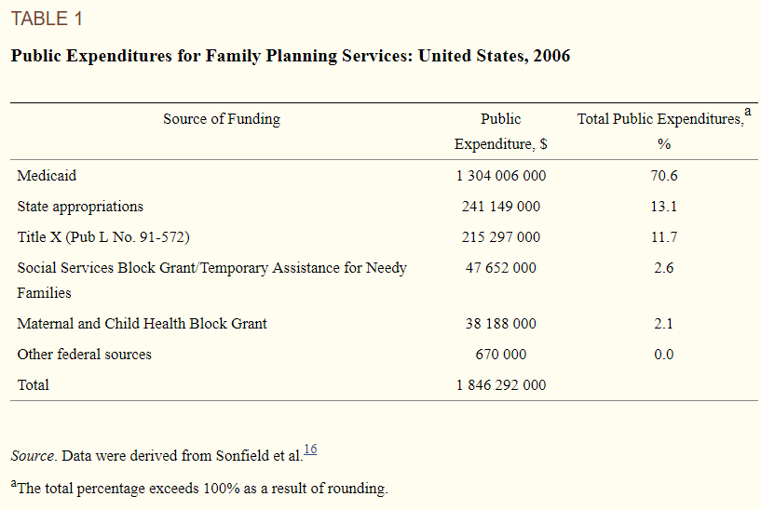

Slide 17
Restrictions
Federal regulations initiated in 1987 prohibiting clinics receiving Title X funding from disseminating abortion information or referrals (i.e., the “gag rule”). This legislation, although further supported by the Supreme Court as being constitutional in 1991, was later banned in 1993 by President Clinton.⁹
An attempt by the Reagan administration in 1982 to require minors to obtain written parental consent before receiving services (i.e., the “squeal rule”).This legislation was later reintroduced as the Parental Notification Act of 1998.
Legislation enacted in 1998 emphasizing abstinence-only education and ignoring the teaching of medically accurate and age-appropriate sexual information stressing health promotion and disease prevention.
Legislative proposals to repeal sections of Title X or the policy in its entirety.

Slide 18
Criticisms
"Title X is welfare for affluent teenagers “
Most (~80%) recipients are poor or near poor, 1/3 are teenagers, 1/6 under 18, few under 16.
"The existence of [Title XI puts the United States government on record declaring that it is appropriate for government to decide who has children.”
Title X statute stipulates that "the acceptance by any individual of family planning services or family planning or population growth information . . . shall be voluntary and shall not be a prerequisite to eligibility for or receipt of any other service or assistance

Slide 19
Criticisms
"Planned Parenthood and its affiliates . . . constitute most of the Title X network. “
About ¼ Title X funds go to PP providers
". . . no one can deny the fact that Title X does indeed subsidize teenage sexual activity. “
The rise and recent decline in teenage sexual activity is unlikely to have much to do with politics and public policy at this level.

Slide 20
Criticisms
“[In 1981, it was] demonstrated that the programs providing these teenage birth control services were not only totally ineffective in achieving their professed goals of reducing premarital pregnancy, illegitimate births, and abortion among teenagers, but had actually contributed significantly toward making these problems worse”
"Most Title X funds go to organizations which engage in abortion, pro- mote abortion, lobby for abortion, litigate about abortion. If the advocates of Title X want it to continue ... I need their support for legislation that will prohibit the use of Title X funds by any organization which in any way engages in abortion, abortion referral, abortion counseling, abortion lobbying, abortion advertising.“
"[Title X] was begun as family planning assistance for low-income families. It sounded commendable. Its stated purpose was to assist poor couples to plan their families. As with many other programs with humanitarian intent, Congress established Title X and left it in the hands of the federal bureaucracy. That is when things went haywire.”

Slide 21
1972: Social Security Amendments of 1972
Extended Medicare to disabled
Increased payroll taxes to finance

Slide 22
1973: Health Maintenance Organization Act
Provided money and federal protection to HMOs
Some state laws restricted health insurers, federally qualified HMOs could avoid such restrictions
Dual choice mandate (expired in 1995, never enforced)
Employers with 25+ employees that offered coverage should offer at least one group model and one HMO

Slide 23
1974: Employee Retirement Income Security Act (ERISA)
Established minimum standards for private pensions and health benefits plains
Two key amendments:
The Consolidated Omnibus Budget Reconciliation Act of 1985 (COBRA)
Provides some employees the right to continue coverage after termination of employment for a limited time
The Health Insurance Portability and Accountability Act of 1996 (HIPAA)
Ensures coverage of some pre-existing medical conditions
Bars some forms of discrimination

Slide 24
Failed Proposals: Nixon, Ford Carter, and Clinton
https://www.youtube.com/watch?v=_A0O7IVsVhY
Nixon:
Nixon Comprehensive Health Insurance Plan of 1974
National Health Insurance Partnership
An employer mandate
Replace Medicaid with fully financed federally run plan that covers families with children with low income head of household

Slide 25
Failed Proposals: Nixon, Ford Carter, and Clinton
Nixon:
Nixon Comprehensive Health Insurance Plan of 1974
National Health Insurance Partnership
An employer mandate
Replace Medicaid with fully financed federally run plan that covers families with children with low income head of household

Slide 26
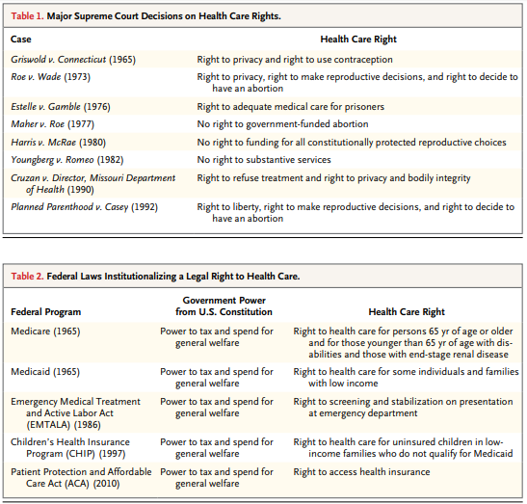
Federal Laws

Slide 27
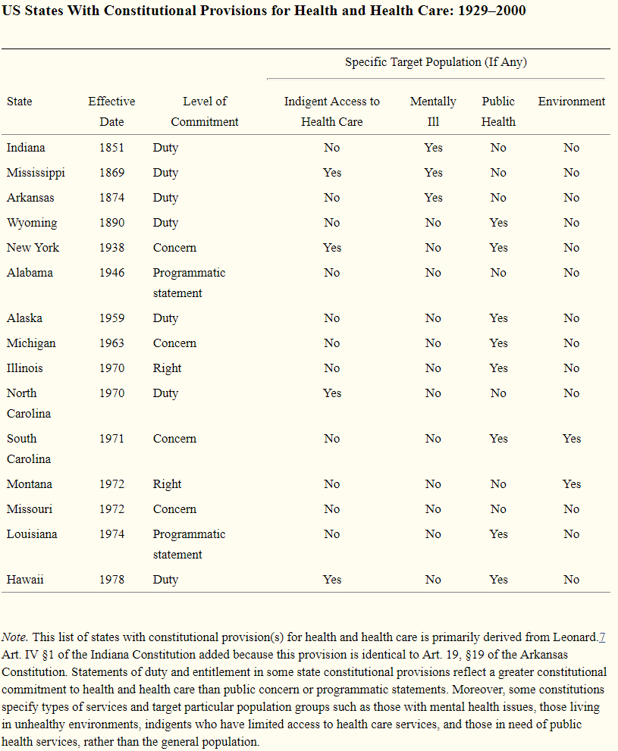
US State Constitutions
As of April 2014, 15 state constitutions specifically mention health and health care—either in the form of a programmatic statement, public concern, individual right, or government duty.

Slide 28
Universal health care
Video: CSPAN: Harry and Louise Ads, 1993
https://www.youtube.com/watch?v=CwOX2P4s-Iw

Slide 29
Hillarycare: the Health Security Act of 1993
Universal coverage
Most people would get insurance plans from their employers because all employers were required to provide health insurance coverage to every employee.
People without jobs could purchase health insurance on their own from the regional health alliances.
The Federal government would subsidize the costs for low-income people.

Slide 30
Hillarycare: the Health Security Act of 1993
Regional health alliances
Regional Health Alliances were state-based health insurance purchasing groups.
The alliances would control costs by setting the prices for health care providers based on a fee-per-service.
Companies with more than 5,000 full-time employees could provide their own insurance outside the alliances.

Slide 31
Hillarycare: the Health Security Act of 1993
National health board
The National Health Board was a new federal agency.\It set a cap on total health care spending for the nation.
That meant it regulated health insurance premiums. For individuals, it set limits on maximum annual out-of-pocket costs.
It also determined minimum coverage requirements.

Slide 32
Defeat
Association of American Physicians and Surgeons opposition
Doctors opposed losing control over pricing, care and treatment
Congressional concern over the deficit
1990-1991 Recession was over and workers felt confident about future employer-based insurance prospects
Labor unions didn’t support the initiative.
They were angry at the President for signing NAFTA.

Slide 33
Readings:
Quadagno, Jill. "Why the United States has no national health insurance: Stakeholder mobilization against the welfare state, 1945-1996." Journal of Health and Social Behavior (2004): 25-44.
Blendon, Robert J., and John M. Benson. "Americans’ views on health policy: a fifty-year historical perspective." Health Affairs 20, no. 2 (2001): 33-46.
Freed, Gary L., and Anup Das. "Nixon or Obama: Who Is the Real Radical Liberal on Health Care?." Pediatrics 136, no. 2 (2015): 211-214.

