Slide 1
HCMI 5243: Economics of Insurance
Shane Murphy – shane@uconn.edu

Slide 2
Utility
y=U(x)
Utility is generally increasing in x
  (So U’(x)>0)

Slide 3
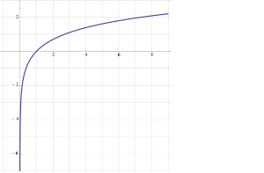
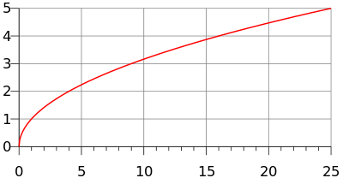
Diminishing Marginal Returns
Utility is generally concave
  U(E(x))>E(U(x))
  (also U’’(x)<0)
Examples
  y=ln(x)
  y=√x

Slide 4
Expected Value and Expected Utility
In a situation where there a multiple outcomes like a coin toss or a lottery, expected value is a weighted average of the outcomes where the weights are the probabilities of each outcome occuring

Slide 5
Expected value theory is based on gambling
In a lottery that has two possible outcomes, the expected value of the lottery is:
  E(lottery) = probability of outcome 1 * payoff for outcome 1 +
  probability of outcome 2 * payoff for outcome 2
This also works if there are more than two outcomes:
  E(lottery) = probability of outcome 1 * payoff for outcome 1 +
  probability of outcome 2 * payoff for outcome 2 +
  probability of outcome 3 * payoff for outcome 3

Slide 6
Examples
What is the expected value of a lottery that pays $1,000 with probability 1% and $0 with probability 99%?
What is the expected value of a lottery that pays $1,000 with probability 25% and $100 with probability 75%?
What is the expected value of a lottery that pays $1,000 with probability 75% and -$1000 with probability 25%?

Slide 7
Expected Value and Expected Utility
Given multiple possible outcomes with associated probabilities the expected value of a lottery is the sum of the products of the outcomes and their associated probabilities
  So if a lottery is called x and gives you A with probability p and B with probability Q, the expected value is E(x) = A*p + B*q
Given multiple possible outcomes with associated probabilities the expected utility of a lottery is the sum of the products of the utility of the outcomes and their associated probabilities
  So if a lottery is called x and gives you A with probability p and B with probability Q, the expected value is E(U(x)) = u(A)*p + u(B)*q

Slide 8
Utility of expected value vs expected utility
The utility of the expected value is different from expected utility, how?
E(U(x)) is not equal to U(E(x))
  What does this mean?
U(E(X)) is the utility of a risk free payoff of the expected value of the lottery
E(U(X)) is the utility of the lottery which includes any utility or isutility from playing the lottery
  Would you rather play a lottery or be guaranteed the payoff of the lottery?
  Would you rather invest in a risky asset or receive the expected return of that investment with no risk?

Slide 9
Expected Value and Expected Utility
What if the utility function is natural log
There are two events, it is equally likely that either will occur
The payoff of one event is 30 and the other is 10
Set up this problem for solving the expected value and expected utility

Slide 10
Expected Value and Expected Utility
Assume U(x) = ln (x), A = 30, p=1/2, B = 10, q=1/2
So E(x) = 30*1/2 + 10*1/2
= 15 + 5
= 20

Slide 11
Expected Value and Expected Utility
Assume U(x) = ln (x), A = 30, p=1/2, B = 10, q=1/2
So U(E(x)) = U(30*1/2 + 10*1/2)
= U(15 + 5)
= U(20)
= ln(20)
= 3

Slide 12
Expected Value and Expected Utility
Assume for Fred, U(x) = ln (x), A = 30, p=1/2, B = 10, q=1/2
So U(A) = ln (A)
= ln (30)
= 3.4
So U(b) = ln (b)
= ln (10)
= 2.3

Slide 13
Expected Value and Expected Utility
Assume U(x) = ln (x), A = 30, p=1/2, B = 10, q=1/2
So E(U(x)) = 3.4*1/2 + 2.3*1/2
= 1.7 + 1.15
= 2.85
  Note: U(E(x)) > E(U(x))
  3 > 2.85

Slide 14
Diminishing marginal utility
Utility functions generally show diminishing marginal returns
  A millionaire gets less utility from an additional $100 than a poor person.
Graphical representation:
Most common functional forms:
  U(x) = ln(x)
  U(x) = $√x$

Slide 15
Risk Premium
Risk Premium is the maximum amount of money a risk-averse person would pay to avoid taking a risk
Risk Premium is the difference between the expected value of a gamble and the value of a sure outcome such that the utility of that outcome equals the expected utility of the gamble
  In our previous problem,

Slide 16
Risk Premium
Risk Premium is the difference between the expected value of a gamble and the value of a sure outcome such that the utility of that outcome equals the expected utility of the gamble
  Taking a risk means getting an expected utility of E(U(x))
  What would Z need to be such that: U(Z) = E(U(X))?
  Solve for Z in U(Z) = E(U(X))
  Z = inverse U(E(U(X))
  So in our previous problem, E(U(X)) = 2.85
  so, Z = invers ln (2.85)
  Z = e^(2.85)
  Z = 17.3
  Z is called the Certainty Equivalent

Slide 17
Risk Premium
Risk Premium is the difference between the expected value of a gamble and the value of a sure outcome such that the utility of that outcome equals the expected utility of the gamble
  So the risk premium = E(U(x)) - inverse U(E(U(X))
  = 20 – 17.3
  = 2.7
So Fred would be willing to pay 2.7 in order to get 20 (that is, to get E(X)) with 100% certainty rather than be uncertain between 10 and 30.

Slide 18
Let’s do a problem:
40% chance of earning $2500/month
60% change of $1600/month
U(Y) = √Y
  Expected utility: E(U(Y)) = P1*U(Y1) + P2*U(Y2)?
  E(U(Y)) = 0.4(2500)0.5 + 0.6(1600)0.5 = 0.4(50) + 0.6(40) = 44
  E(Y)?
  E(Y) = 0.4(2500) + 0.6(1600) = 1960
  Certainty Equivalent = inverse U(E(U(Y))?
  44^2 = 1936
  Risk Premium = E(U(Y)) - inverse U(E(U(Y))?
  1960-44^2=1960-1936=24
  Interpretation?

Slide 19
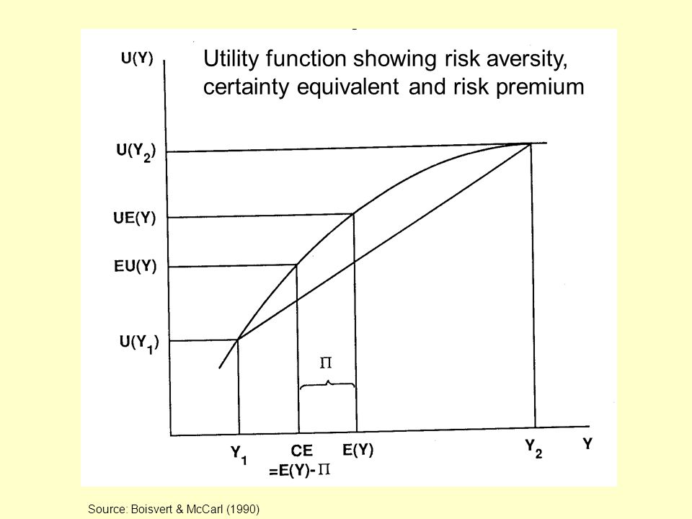
Graphical Representation

Slide 20
Another problem
Suppose have $200,000 home (wealth).
Small chance that a fire will damage you house. If does, will generate $75,000 in loss (L)
U(W) = ln(W)
Prob of a loss is 0.02 or 2%
Wealth in “good” state = W
Wealth in bad state = W-L
Fist Calculate E(Y) and E(U(Y))

Slide 21
E(Y) = (1-P)W + P(W-L)
E(Y) = 0.98(200,000) + 0.02(125,000) = $198,500
E(U(Y)) = (1-P) ln(W) + P ln(W-L)
E(U(Y)) = 0.98 ln(200K) + 0.02 ln(200K-75K) = 12.197

Slide 22
Continuing
Suppose you can add a fire detection/prevention system to your house.
This would reduce the chance of a bad event to 0 but it would cost you $C to install
What is the most you are willing to pay for the security system?
E(U(Y)) in the current situation is 12.197
Utility with the security system is U(W-C)
Set U(W-C) equal to 12.197 and solve for C

Slide 23
ln(W-C) =12.197
Recall that e^ln(x) = x
Raise both sides to the e
E^ln(W-C) = W-C = e^12.197 = 198,128
198,500 – 198,128 = $372
Expected loss is $1500
Would be willing to pay $372 to avoid that loss
Graph the situation

Slide 24
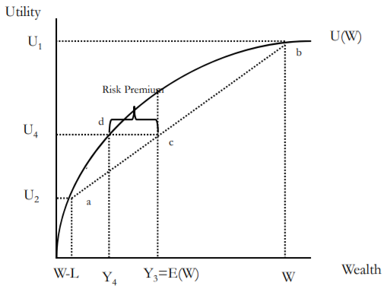
Will earn Y1 with probability p1 – Generates utility U1
Will earn Y2 with probability p2=1-p1 – Generates utility U2
E(I) =p1Y1 + (1-p1)Y2 = Y3
Line (ab) is a weighted average of U1 and U2
Note that expected utility is also a weighted average
A line from E(Y) to the line (ab) give E(U) for given E(Y)Take the expected income, E(Y). Draw a line to (ab). The height of this line is E(U).
E(U) at E(Y) is U4
Suppose income is know with certainty at I3. Notice that utility would be U3, which is greater that U4
Look at Y4. Note that the Y4
The line segment (cd) is the “Risk Premium.” It is the amount a person is willing to pay to avoid the risky situation.
If you offered a person the gamble of Y3 or income Y4, they would be indifferent.
Therefore, people are willing to sacrifice cash to ‘shed’ risk.

Slide 25
Can you spot the mistake?

Slide 26
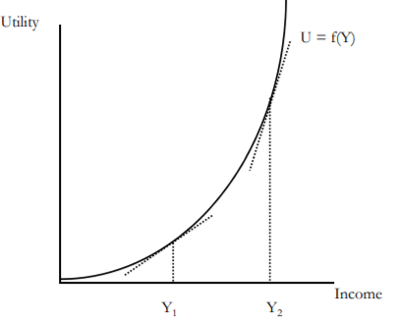
Risk averse vs Risk loving vs Risk neutral
What in the graph expresses an individual is risk averse?
If an individual is risk loving, their utility function is convex (like u(X)=x^2
What about Risk neutral?

Slide 27
Role of Insurance
Consider our Previous problem:
  E(W) = $198,500
  L = 75,000 with P=2%
  E(U(W)) = 12.197
  C = 198,128
  Expected loss is $1500
  Would be willing to pay (risk premium) $372 to avoid that loss
Another firm can capitalize on the risk aversion by providing insurance.

Slide 28
Role of Insurance
Consider our Previous problem:
  E(W) = $198,500
  L = 75,000 with P=2%
  E(U(W)) = 12.197
  C = 198,128
  Expected loss is $1500
  Would be willing to pay (risk premium) $372 to avoid that loss
How much can the firm charge?
What is the firms expected profit?
If the firm is required to keep capital on hand equal to the possible loss, if the insurance premium is paid each year, what is the firms return to capital on hand?

Slide 29
Role of Insurance
How much can the firm charge?
$1500 + $372 = $1872
What is the firms expected profit from this person if they charge this amount?
$372
If the firm is required to keep capital on hand equal to the possible loss, if the insurance premium is paid each year, what is the firms return to capital on hand?
Capital requirement is $75,000, so return is $372/$75,000 = .00496
If the firm is required to keep capital on hand equal to the 10% of the possible loss, if the insurance premium is paid each year, what is the firms return to capital on hand?
Capital requirement is $7,500, so return is $372/$7,500 = .0496

Slide 30
Role of Insurance
Suppose you can buy insurance that costs you PREM. The insurance pay you to compensate for the loss L.
In good state, income is
Y-Prem
In bad state; you paid PREM, lose L, and receive PAYMENT, therefore, income is
Y-Prem-L+PAYMENT
If PAYMENT=L, income in the bad state is
Y-Prem

Slide 31
Role of Insurance
Notice that insurance has made income certain. You will always have income of Y-PREM
What is the most this person will pay for insurance?
  The expected loss is p*L
  Expected income is E(Y)
  The expected utility is U2
People would always be willing to pay a premium that equaled the expected loss
But they are also willing to pay a premium to shed risk (line cd)
The maximum amount they are willing to pay is expected loss + risk premium
  Note: Y4 is the certainty equivalence

Slide 32
One final example
Suppose income is $50K, and there is a 5% chance of having a car accident that will generate $15,000 in loss
Expected loss is .05(15K) = $750
U = ln(y)
What is E(U)?
E(U)=10.8

Slide 33
One final example
What is the most someone will pay for insurance?
People would purchase insurance so long as utility with certainty is at least 10.8 (expected utility without insurance)
U* =U(Y – Prem) ≥ 10.8
Solve for Prem, CE, risk premium
979 ≥ PREM
CE = 49,021
Risk premium = E(Y) – CE = 49,250 – 49,021 = 229

Slide 34
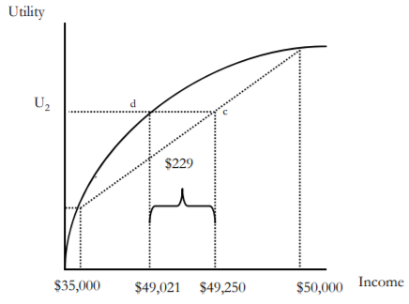
One final example
Recall that the expected loss is $750 but this person is willing to pay more than the expected loss to avoid the risk
Pay $750 (expected loss), plus the risk premium ($979- $750) = 229

Slide 35
Theory of the firm
What is the firms expected profit if the full risk premium is charged?
$229
If the firm must keep 100% of capital on hand, what is the return to this capital?
$229/$15,000 = 1.5%
If the market is perfectly competitive, profits will shrink – theoretically shrinking to zero. What would the premium be if markets were perfectly competitive?
E(Loss) = $750

Slide 36
Diversification and Pooling and the Role of the Standard Deviation
In a sense, Insurance is a mechanism by which the cost of risks are mediated through pooling
  The insured are willing to pay a risk premium to cover administrative and transaction costs of the pool in return for the reduction in risk
  Members of a pool do not necessarily make equal contributions
    Contributions may be increasing in level of risk and exposure

Slide 37
Diversification and Pooling and the Role of the Standard Deviation
Risky Situation | No Risk Situation
E(Y)=49,250 SD(Y)=3.3 | E(Y)=49,021 SD(Y)=0
U(E(Y))=10.8 | U(E(Y))=10.8

Slide 38
Diversification and Pooling and the Role of the Standard Deviation
Why are there very few private flood insurance plans?

Slide 39
Law of Large Numbers
Given a fair experiment, the average or mean value of the results obtained from a large number of trials should be close to the expected value. As more trials are performed, the mean will tend to become closer to the expected value.

Slide 40
Pooling in Insurance
Efficiency (maximized social welfare) vs Equity (“fairness”)
How do you think Efficiency and Equity could be managed in designing an insurance program?
Pooling equilibrium – all risk types buy the same policy
  High risk individuals pay lower rate, low risk individuals pay higher rate
  Low risk individuals less likely to buy insurance
  High risk individuals more likely to buy insurance
Separating equilibrium – Risk types buy different insurance policies
  Low risk individuals pay lower rate, become more likely to buy policy
  High risk individuals pay higher rate, become less likely to buy policy

Slide 41
Moral Hazard
Moral hazard can be reduced by a number of policies – and fear of moral hazard has lead to many such policies being widespread
  Higher deductibles and coinsurance
  Care management
  Prepayment
  Gatekeeping
  Utilization review
  Voluntary and mandatory second opinions
  Chronic disease management

Slide 42
Moral Hazard
Any change in behavior due to becoming insured
An insured person may take fewer precautions to avoid illness
Reduced prices increase consumption of health care
  Consuming health care that costs more than it is worth to the consumer
Pauly later (1983) clarified – his argument was intended to apply only or primarily to relatively inexpensive and predictable elements of medical care
  Routine visits, dental care, eye care, pharmaceuticals
Moral Hazard in the case of serious illness is a possible hole in this analysis to this day

Slide 43
Can you find and explain the deadweight loss in this graph?

Slide 44
Demand for insurance: Risk avoidance vs access
In the late 1990s, John Nyman made an argument against excessive concern for moral hazard
His argument is that risk avoidance and the demand for certainty is not the reason people buy insurance, especially health insurance
Instead, people demand health insurance in order to increase their access to health care in time of need (the access motive)

Slide 45
Demand for Insurance: Access effect
More importantly, consider an example:
  Elizabeth purchases an insurance policy (for $4,000) that directly writes a check for $40,000 upon a diagnosis with breast cancer
  Without the insurance, she would purchase a $20,000 mastectomy
  With the insurance, she also buys a $20,000 breast reconstruction procedure
Now consider a separate example:
  Elizabeth purchases an insurance policy (for $4,000) that pays up to $40,000 upon a diagnosis with breast cancer
  In this case, what would Elizabeth buy?
  What if the policy pays up to $80,000?

Slide 46
Demand for Insurance: Access effect
In the first example, Elizabeth’s purchases represent her demand for care when sick and provided with $40,000.
  Her spending represents the purchase which provides her with the most welfare
  So the moral hazard is, in a sense, efficient.
In the second and third cases, we don’t know how much of her purchases represent what she would do if she had a check or $40,000 and how much of her purchases represent the fact that medical care has an effective price of $0 for the first $40,000 of spending.

Slide 47
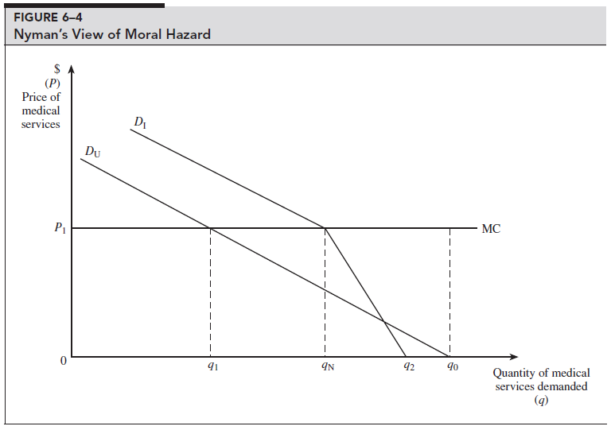
In fact, the uninsured may have less price elasticity for medical care than the insured
The uninsured
  Have higher rates of preventable and/or untreated illness
  Are less likely to receive care that they feel they need
  Have more preventable hospitalizations
  Have shorter hospital stays for the same conditions
  Are hospitalized sicker and have poorer health outcomes (including death)…
Can you find and explain the deadweight loss in this graph?

Slide 48
In fact, the uninsured may have less price elasticity for medical care than the insured
The uninsured
  Have higher rates of preventable and/or untreated illness
  Are less likely to receive care that they feel they need
  Have more preventable hospitalizations
  Have shorter hospital stays for the same conditions
  Are hospitalized sicker and have poorer health outcomes (including death)…

Slide 49
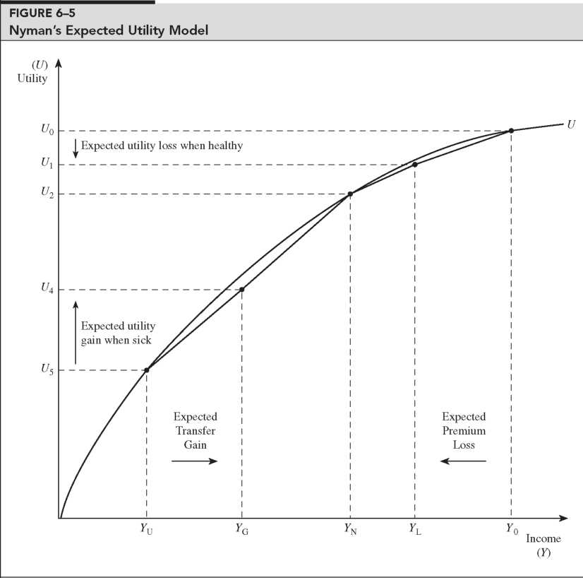
Transfer of wealth from the healthy to the sick has a different utility interpretation than a simple gamble

Slide 50
Implication for cost sharing
Remember our methods of mitigation moral hazard:
  Higher deductibles and coinsurance, Care management, Prepayment, Gatekeeping, Utilization review, Voluntary and mandatory second opinions, Chronic disease management
If the negative cost of moral hazard is overestimated, then mitigation will be overzealous
  “Cost sharing policies are directed at problems that largely do not exist”
  Insurance subsidies are socially optimal (providing access value to those who couldn’t afford it)

Slide 51
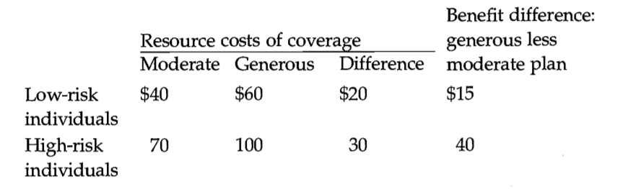
Adverse selection example
High risks are more expensive than low risks, and spending is greater under the generous plan for each risk type.
The last column shows the posited gain in benefits the different types of individuals receive from the generous as opposed to the moderate plan.
The efficient outcome in this example is for high-risk people to be in the more generous plan and low risk people to be in the moderate plan.
High risks should be in the generous plan because the incremental value of that plan to them ($40) is greater than its additional cost ($30).
For low risks, the opposite is true ($15 <$20).

Slide 52
Adverse selection example
We suppose that insurers charge the same premium for everyone enrolled in the plan
  possibly because individuals are indistinguishable to the insurer, equal premiums are required by law, or employers adopt this policy to help spread risks.
Starting at the efficient equilibrium, the premiums that would cover costs in this case are $40 for the moderate plan and $100 for the generous plan.
If these premiums were offered, however, all of the high-risk people would switch to the low-risk plan:
  the additional cost to high risks of the more generous plan ($60) is not worth the additional benefit ($40).
Thus, everyone would wind up in the moderate plan. The reason is simple: A person who switches from the generous to moderate plan benefits by mixing in with lower-risk individuals, and since premiums reflect risk mixes, this distorts choices towards the moderate plan.
This leads to higher costs for the low risk individuals or higher losses for the insurance provider

Slide 53
Adverse Selection
Adverse selection occurs when market participation is affected by asymmetric information
Adverse selection occurs when high-risk individuals are more likely to purchase insurance than low-risk individuals

Slide 54
Mitigating Adverse Selection
Individual Mandate in the ACA
Waiting Period before Coverage Takes Effect
Premiums Tied to Risk

Slide 55
Adverse Selection
Adverse selection occurs when market participation is affected by asymmetric information
Adverse selection occurs when high-risk individuals are more likely to purchase insurance than low-risk individuals

Slide 56
Mitigating Adverse Selection
Individual Mandate in the ACA
Waiting Period before Coverage Takes Effect
Premiums Tied to Risk

Slide 57
Moral Hazard
When there is a lack of incentive to guard against risks because an individual is protected from the consequences of those risks

Slide 58
Mitigating Moral Hazard
Co-payments and Deductibles

Slide 59
Demand for Insurance
Factors of Demand:
  Risk Aversion
  Perception of Risk
  Peer Behavior
  Wealth and Income
  Ability to Externalize Risk
    Moral Hazard

Slide 60
How much do insurance companies make?
An average of 79.7 cents per premium dollar is spent by insurers on health care proper and 17.8 cents on the insurers’ operating costs, leaving only 2.7 cents per premium dollar as profits.
  Medical loss ratio (MLR) – the portion of premiums collected health insurers “lose” to physicians, hospitals, and other entities who offer health care
Affordable Care Act (ACA) mandated an MLR of at least 85% for large insurance companies and of at least 80% for smaller carriers.
Pre-ACA MLRs were about 55%-65%
Profit margins for the larger US health insurers, for example, actually were much higher than just 3% in recent years, with 4.7% for Aetna, 7.0% for Cigna, and 4.6% for United Health Group in 2015 and 3.5% for Anthem in 2014.
  These numbers include the Medicare Advantage program

Slide 61
Insurance Market Structure
Consumers vs Insurance companies
  There is some evidence that individual market would be more efficient than group plans, and that this increase in efficiency may outweigh the benefit of risk pooling from group plans
  However, when given choices, consumers don’t often use the information at hand rationally
    When offered a better plan, few consumers switch
      Perhaps consumers don’t even notice the better option?
    Consumers generally care more about premiums than co-pays and other costs of different plans

Slide 62
Operating costs
18%
  Include cost of marketing, determining eligibility, utilization controls (eg, prior authorization of particular procedures), claims processing, and negotiating fees with each and every physician, hospital, and other health care workers and facilities.
Twice as high as costs in other OECD countries with simpler systems
  One study estimates this accounts for 39% of the difference in the cost of spending in Canada vs the US
    31% is due to incomes, 14% due to spending intensity
  For example, the Duke University's hospital system (with 3 hospitals) has 957 beds and about 1600 billing clerks.

Slide 63
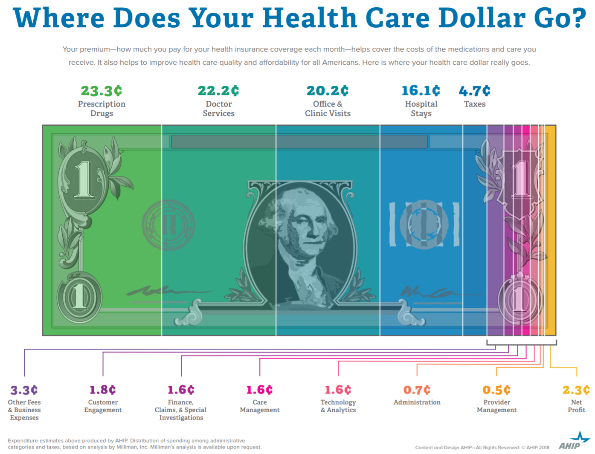
Notes:
https://www.ahip.org/wp-content/uploads/2017/03/HealthCareDollar_FINAL.pdf

Slide 64
Notes:
https://www.ahip.org/wp-content/uploads/2017/03/HealthCareDollar_FINAL.pdf

Slide 65
Notes:
https://www.ahip.org/wp-content/uploads/2017/03/HealthCareDollar_FINAL.pdf

Slide 66
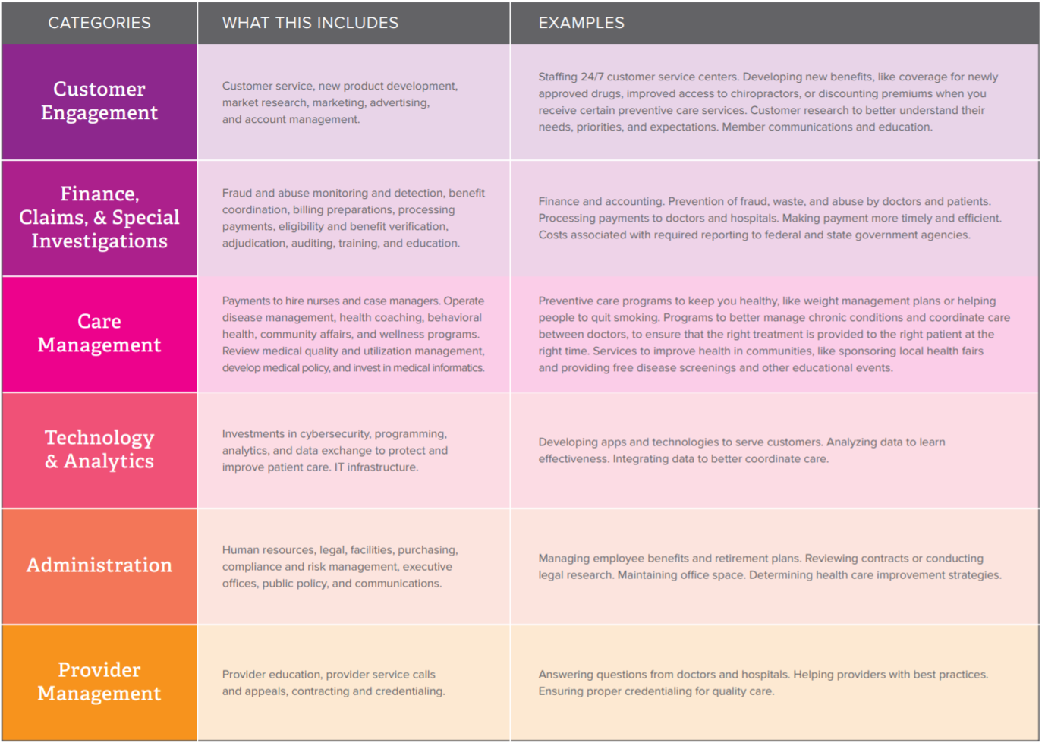
Notes:
https://www.ahip.org/wp-content/uploads/2017/03/HealthCareDollar_FINAL.pdf

Slide 67
Readings:
Klein, Robert (2014) A Primer on The Economics of Insurance (https://www.researchgate.net/publication/270500085_A_Primer_on_The_Economics_of_Insurance)
Reinhardt, Uwe. “Where does the health insurance premium dollar go?.” Jama 317, no. 22 (2017): 2269-2270.
America’s Health Insurance Plans (AHIP), Where does the health insurance premium dollar go?.pdf May 22, 2018
Rosenthal, Elisabeth. “Those indecipherable medical bills? They’re one reason health care costs so much hospitals have learned to manipulate medical codes—Often resulting in mind-boggling bills.” New York Times Magazine (2017).

Slide 68
Arnold Kling’s Three Languages of Politics
Progressives: The Oppressed vs. Oppression
Conservatives: Civilization vs. Barbarism
Libertarian: Freedom vs. Coercion
I might add the academics/beurocrats view:
The Expert vs. ignorance

Slide 69
Rights in moral philosophy: Utilitarianism
Associated with founders of economics (Jeremy Bentham)
Policies should maximize net social utility
  Aggregate welfare
  Effective altruism (Singer)
Disease Control Priorities Project

Slide 70
Rights in moral philosophy: John Rawls’ Theory of Justice
Veil of ignorance
  Under such a veil, what principles of justice would people choose for society
Maximin
Means rather than ends approach

Slide 71
Rights in moral philosophy: Communitarianism
Reaction to Rawls by Michael Sandel, Charles Taylor and Michael Walzer
Opposes universalist point of view
Distinct societies create distinct “spheres of justice”
Each society creates fundamental principles which are valued
Single community view called “Cosmopolitanism” (related to globalism or internationalism)

Slide 72
Rights in moral philosophy: Cosmopolitanism
Single community alternative to Communitarianism
  Related to globalism or internationalism
  Associated with Kant, Derrida, and Appiah
Moral universalism and belief of crimes against humanity

Slide 73
Rights in moral philosophy: Libertarian
Personal freedom
Individual choice and limited state influence
  Anarchy, State, and Utopia (Nozick)
Endorse negative rights but not positive rights

Slide 74
Rights in moral philosophy: Capabilities approach
Focus on what individuals are able to do (Sen, Nussbaum)
Emphasizes functional capabilities, "substantive freedoms“
  the ability to live to old age
  engage in economic transactions
  participate in political activities

Slide 75
Rights in moral philosophy: Older views
Daoism
  Focus on personal morality over community
Confucianism
  Mutual obligation
Aristotelian ethics
  Cardinal virtues and human flourishing – limited place for “rights”
Abrahamic traditions
  Moses’ laws, Isaiah’s covenant, Jesus’ Beatitudes, Muhammad’s Al-Israa, Augustine’s City of God
Medieval philosophers
  Influenced by Aristotle: Avicenna, Averroes, Maimonides, Aquinas,

Slide 76
Rights and Human Rights
https://www.youtube.com/watch?v=ew993Wdc0zo

Slide 77
Rights and Human Rights
1948 Universal Declaration of Human Rights
The preamble sets out the historical and social causes that led to the necessity of drafting the Declaration.
Articles 1–2 established the basic concepts of dignity, liberty, equality, and brotherhood.
Articles 3–5 established other individual rights, such as the right to life and the prohibition of slavery and torture.
Articles 6–11 refer to the fundamental legality of human rights with specific remedies cited for their defence when violated.
Articles 12–17 established the rights of the individual towards the community (including such things as freedom of movement).
Articles 18–21 sanctioned the so-called "constitutional liberties", and with spiritual, public, and political freedoms, such as freedom of thought, opinion, religion and conscience, word, and peaceful association of the individual.
Articles 22–27 sanctioned an individual's economic, social and cultural rights, including healthcare. Article 25 states: "Everyone has the right to a standard of living adequate for the health and well-being of himself and of his family, including food, clothing, housing and medical care and necessary social services." It also makes additional accommodations for security in case of physical debilitation or disability, and makes special mention of care given to those in motherhood or childhood.
Articles 28–30 established the general ways of using these rights, the areas in which these rights of the individual can not be applied, and that they can not be overcome against the individual.

Slide 78
Positive and Negative Rights
Negative Rights (first generation) are things which cannot be done to a person
  Civil and political rights (including speech, religion, unlawful imprisonment)
Positive rights (second generation) are things which must be provided to a person
  Include police protection, legal council, economic, social and cultural rights

Slide 79
Legal and natural rights
Natural rights are “universal” and “inalienable” (Locke, Paine, Hobbes)
Legal rights can be modified or repealed

Slide 80
Discussion Questions:
What is a right? What is a human right?
Is health care a human right?
Should the government ensure provision of basic health needs to the entire population?
Should the government ensure provision of premium health care to the entire population?

Slide 81
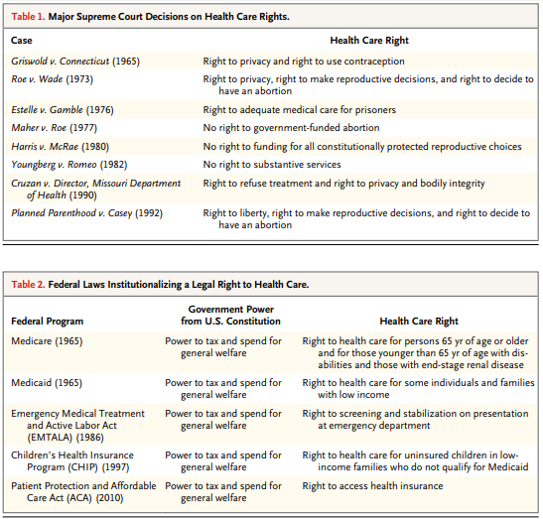
Federal Laws

Slide 82
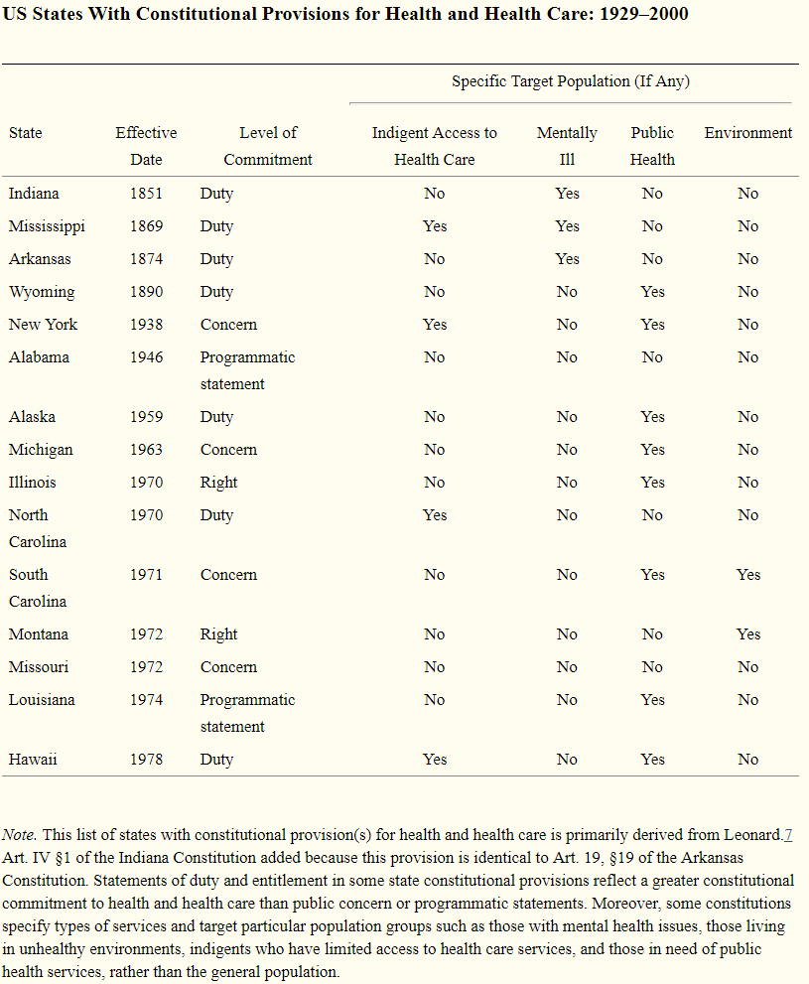
US State Constitutions
As of April 2014, 15 state constitutions specifically mention health and health care—either in the form of a programmatic statement, public concern, individual right, or government duty.

Slide 83
Readings:
Health care as a public good
*Karsten, Siegfried G. "Health care: private good vs. public good." American Journal of Economics and Sociology 54, no. 2 (1995): 129-144.
*Galea, Sandro. “Public health as a public good.” Boston University School of Public Health, January 10, 2016, https://www.bu.edu/sph/2016/01/10/public-health-as-a-public-good/
Is health care a right? Is health insurance a right?
*Gawande, Atul. “Is health care a right?” New Yorker, October 2, 2017
*Section I (pages 5-10) of Ruger, Jennifer Prah. “Toward a theory of a right to health: capability and incompletely theorized agreements.” Yale Journal of Law & the Humanities 18, no. 2 (2006): 3.
*Hamel, Mary Beth, Jennifer Prah Ruger, Theodore W. Ruger, and George J. Annas. “The elusive right to health care under US Law.” N Engl J Med 372, no. 26 (2015): 2558-63.
*Ruger, Jennifer P. “The moral foundations of health insurance.” Journal of the Association of Physicians 100, no. 1 (2007): 53-57.

