Slide 1
HCMI 5243: Experiments in Health Insurance
Shane Murphy – shane@uconn.edu

Slide 2
Experiment design: randomization
Randomized evaluations can provide clear answers
Without knowing why two groups differ, hard to know what to attribute the differences to
Can get perverse “findings” (e.g. health insurance makes you sicker)
Randomly assign individuals to different treatments (programs) or control (status quo continues)
By construction, the treatment group and the control group will have the same characteristics, on average
Observable: age, income, measured health…
Unobservable: motivation, social networks, unmeasured health…

Slide 3
Experiments in Health Insurance
RAND Health Insurance Experiment
Ran from 1971-1982
Oregon Health Study

Slide 4
Rand Health Insurance Experiment (HEI)
Research questions:
How does cost sharing affect demand for personal health care services?
How does cost sharing affect demand for particular services, e.g., hospital care, dental services?
Does use of personal health care services improve health?
How does a change from fee-for-service payment to capitation affect demand for personal health care services?

Slide 5
Study design
Enrolled 2,750 non-elderly (<=61) families, 7,700 individuals for from 3-5 years across 6 sites throughout the US
Families randomly assigned to 1 of 14 insurance plans differing in cost sharing rates and in maximum dollar expenditures per year (MDE or stop loss)
Five basic types:
Free care, 25% cost sharing, 75% cost sharing, and 95% cost sharing, HMO-style
Income adjusted for poor families
OOP capped at $1,000 ($3,000 at 2005 US$)
At enrollment, families exchanged their existing health insurance policy for HIE plan—held harmless for medical expenditure higher than they would have experienced if they had not enrolled in HIE
Some participants randomly assigned to capitation plan
Participation in HIE voluntary for families
Ran from 1971-1982

Slide 6
Results
More cost sharing -> less utilization and les cost

Slide 7
Results
Utilization rates decreased for cost sharing individuals across illness type

Slide 8
Health Outcomes
The poorest and sickest 6 percent of the sample at the start of the experiment had better outcomes under the free plan for 4 of the 30 conditions measured.
Serious symptoms were less prevalent for poorer people on the free plan.
Free care improved the control of hypertension.
Free care marginally improved vision for the poorest patients.
Free care also increased the likelihood among the poorest patients of receiving needed dental care.
Cost sharing also had some beneficial effects. Participants in cost sharing plans worried less about their health and had fewer restricted-activity days (including time spent in seeking medical care).

Slide 9
Key Result
For 94 percent of persons in HIE, not with low income and not in poor health at baseline, having health insurance coverage had no effect on health.
In a large-scale, multiyear experiment, participants who paid for a share of their health care used fewer health services than a comparison group given free care.
Cost sharing reduced the use of both highly effective and less effective services in roughly equal proportions. Cost sharing did not significantly affect the quality of care received by participants.
Cost sharing in general had no adverse effects on participant health, but there were exceptions: free care led to improvements in hypertension, dental health, vision, and selected serious symptoms. These improvements were concentrated among the sickest and poorest patients.

Slide 10
Oregon Medical Experiment
Research Question: What are the effects of expanding access to public health insurance for low income adults?
Oregon’s Medicaid expansion program covers those financially but not categorically eligible for Medicaid
Low-income (below 100% of federal poverty line), uninsured, able-bodied adults
Covers doctors, hospitals, drugs, mental health, etc. with no consumer cost sharing and low or no premiums
In 2008: Oregon had money to cover some but not all of those eligible… so chose to run a lottery for fairness
Asked interested individuals to sign up
Randomly assigned ~30,000 out of 75,000 ability to apply for Medicaid
After about 2 years, find money to offer the remainder coverage.

Slide 12
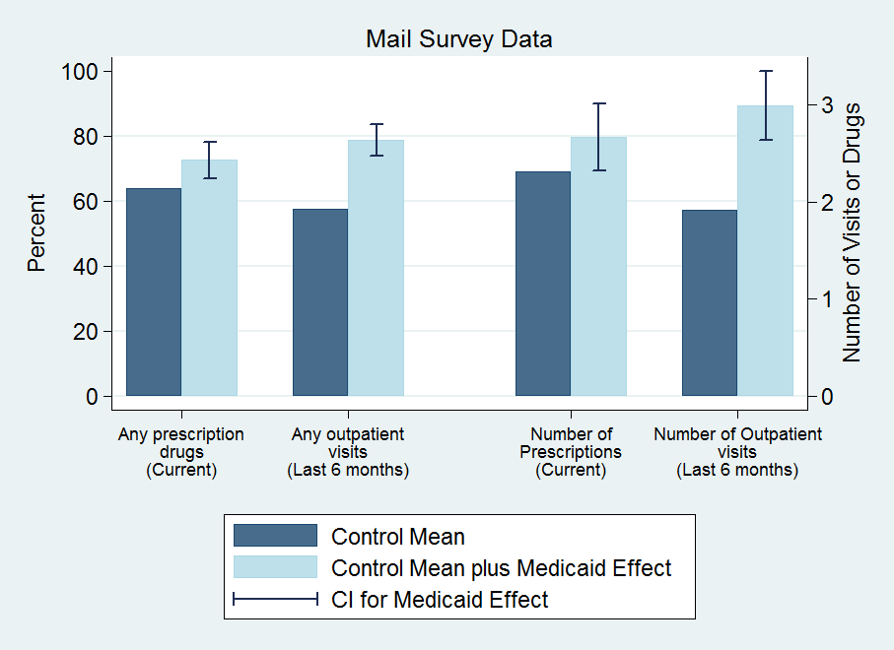
Results: Utilization

Slide 13
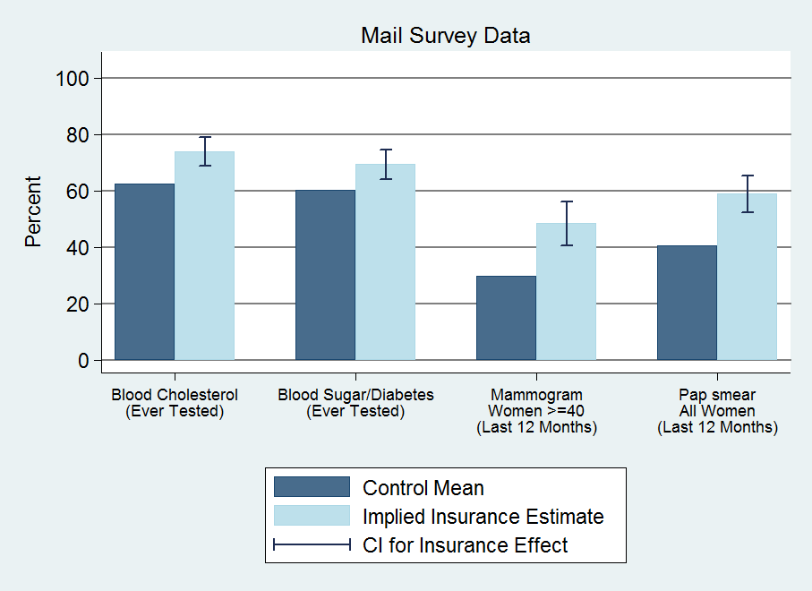
Results: Preventive Care

Slide 14
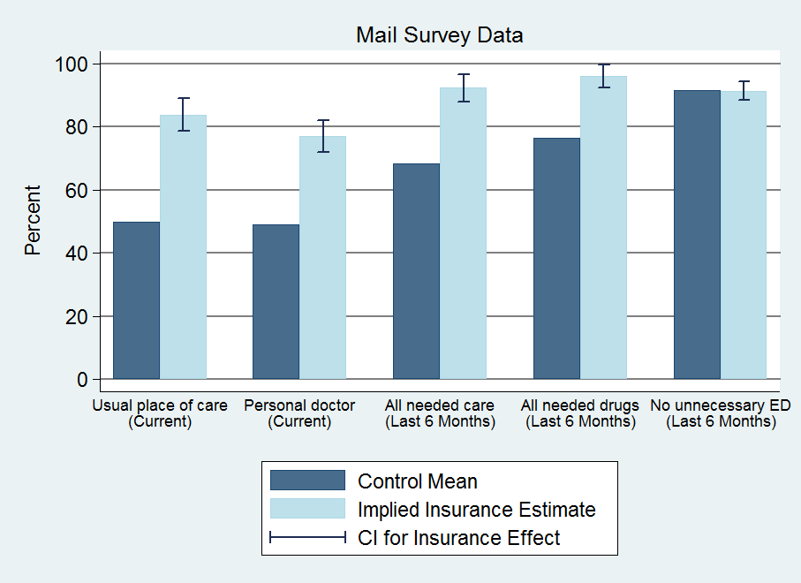
Results: Access

Slide 15
Hospitalizations (discharge data)
30%↑probability of hospital admission
40% ↑number of ER visits
Substantial (but imprecise) increase in total resource use
By condition: increase in heart disease use (not shown)
No change in mix of private/public use; no power to detect change in quality of hospitals used
Other use (self-reports)
35% ↑ probability of outpatient visit
15% ↑ probability of taking prescription drugs
0.3 standard dev ↑ in compliance with recommended preventive care
No discernable change in ER use (imprecise)
Implied $777 increase in spending for insured
25% increase

Slide 16
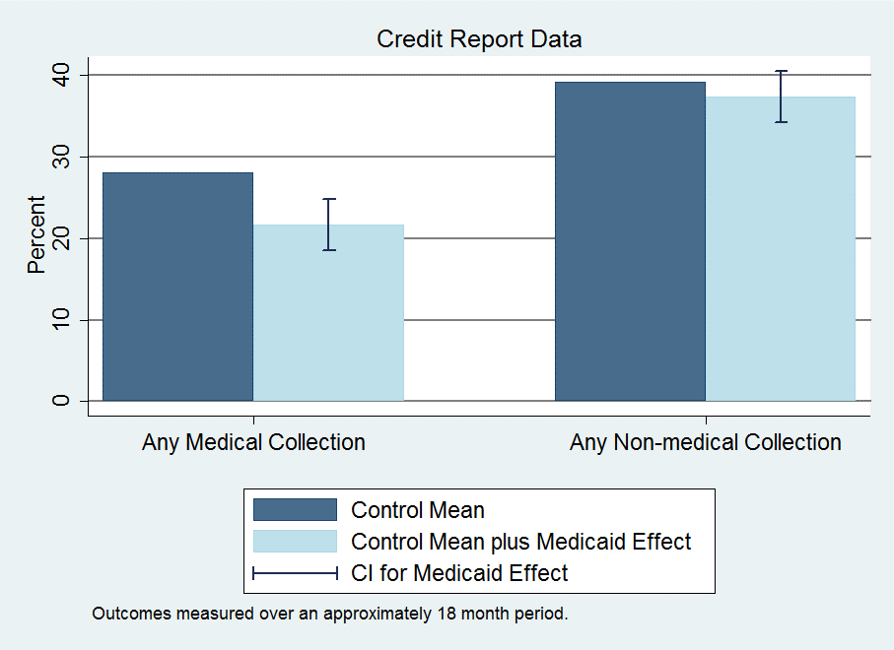
Results: Financial

Slide 17
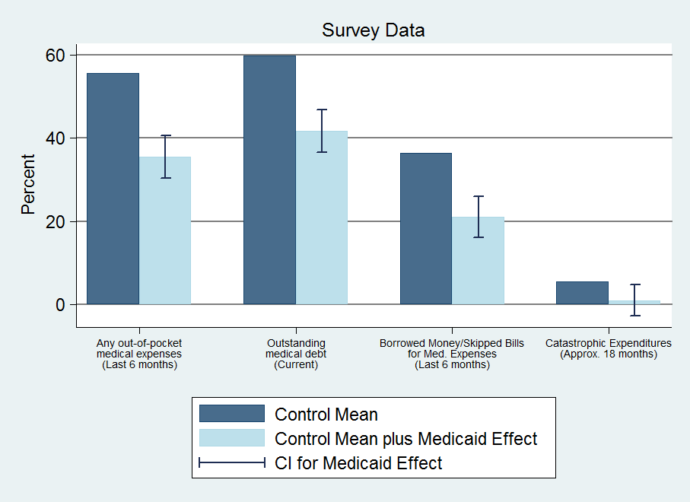
Results: Financial

Slide 18
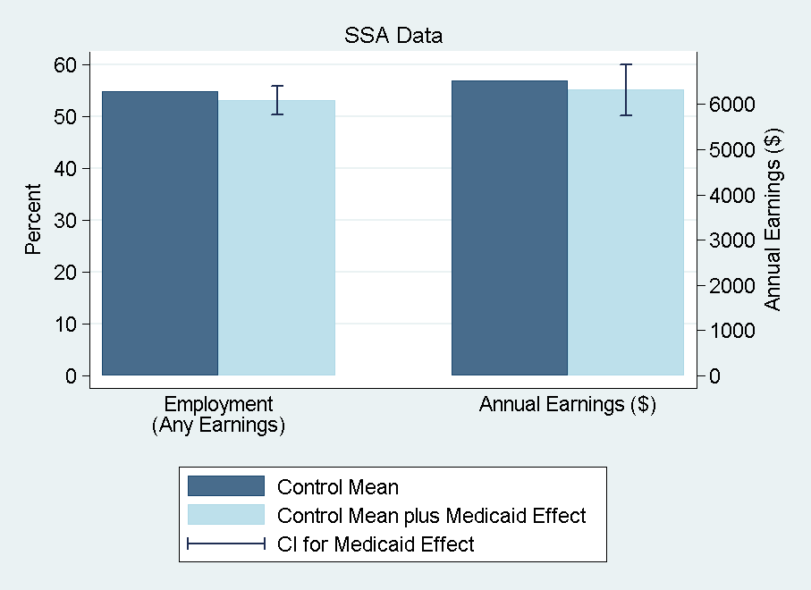
Results: Financial

Slide 19
Results: Financial
Reduction in collections (credit reports)
25% ↓ probability of unpaid medical bills sent to collection
No observed effects on other measures
Limitations: time lags, extreme events, lack of data on informal channels (more heavily used by poor)
Reduction in strain, OOP, money owed (self-reports)
Substantial reduction across measures
Captures additional channels
Implications for distribution of burden/benefits
Some borne by patients, some by providers (or those to whom passed through) – only 2% of bills sent to collection ever paid

Slide 20
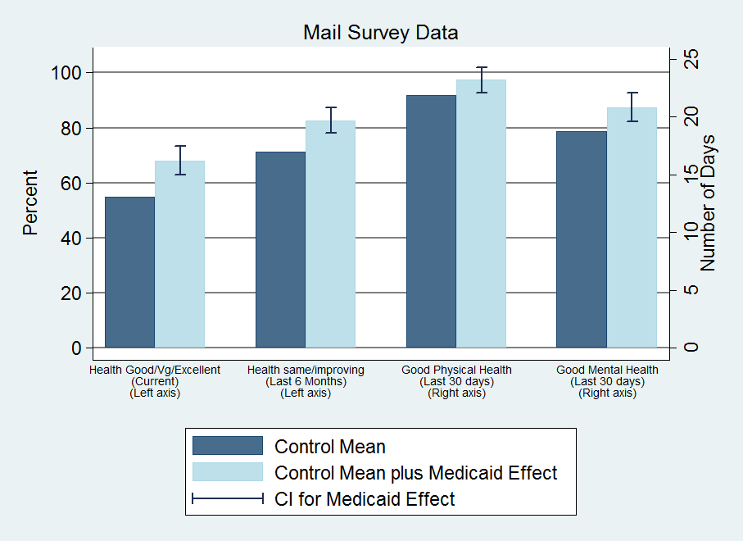
Results: Health

Slide 21
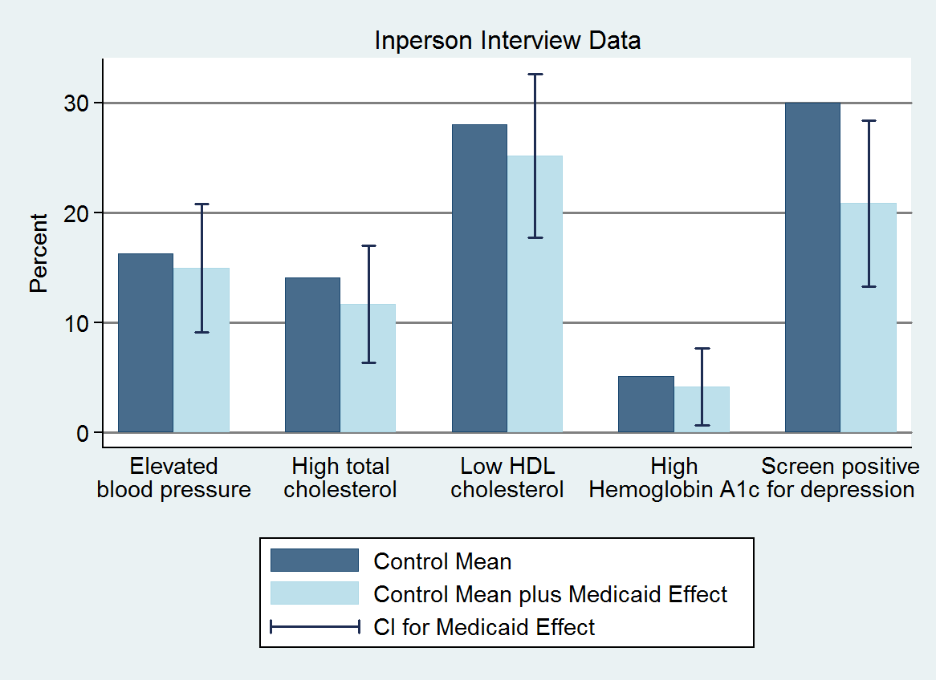
Results: Health

Slide 22
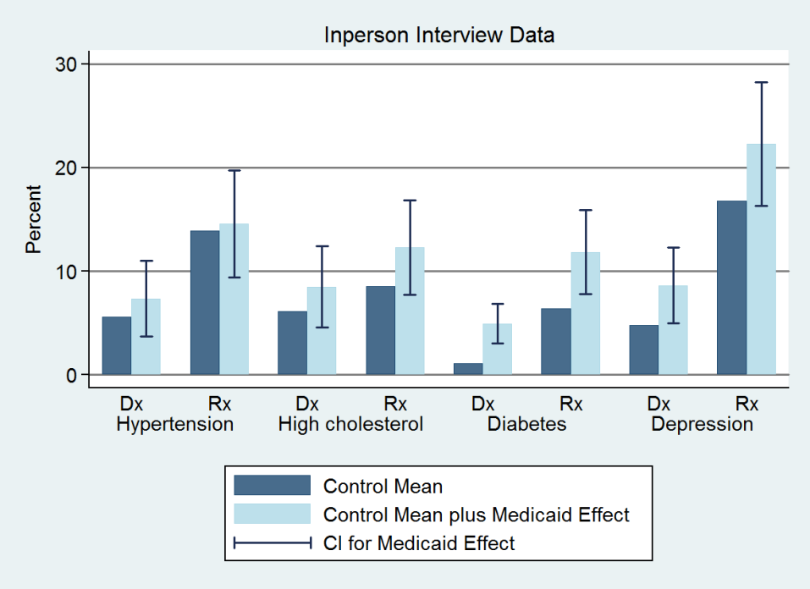
Results: Health

Slide 23
Results: Health
Health benefits from Medicaid
Improves self-reported health
Reduces depression (by ~9 pctg pts or 30%)
No detectable impact on blood pressure, cholesterol, or blood sugar
Chosen because they are important, measurable health problems in this population and have been shown in clinical trials to be modifiable with effective treatment within our time frame
Cannot reject decline in blood sugar predicted by the effect we see on diabetes medication + clinical trials of effects of such medication
Can reject declines in blood pressure found in quasi-experimental Medicaid studies

Slide 24
Large improvements in self-reported physical and mental health
Mental health indices correlate well with clinical diagnoses
Reduces depression (by ~9 pctg pts or 30%)
Physical health measures open to several interpretations
Improvements consistent with increased utilization
Also see reports of improved quality and access
Usual place of care; reported quality of care
But these results appear shortly after insurance coverage
~2/3 magnitude, in advance of changes in utilization
Although lottery selection “glow” may be stronger earlier
Suggestive of increase in perceived overall well-being
Also substantial improvements in reported happiness
Possible decline in blood sugar for individuals with diabetes
Unlikely that it had an effect on blood pressure for people with hypertension

Slide 25
Results: Summary
Increased health care use across the board
Hosp, ER, primary care, drugs, preventive care
~25% ↑ total, annual spending (hospital, outpatient, drugs)
Reduced out-of-pocket costs and financial strain
Virtually eliminated “catastrophic” out-of-pocket spending
No detectable effect on earnings and employment
Health
Improved self-reported health
Reduced depression
No/Limited detectable effects on measured physical health

Slide 26
Myth vs reality
“Insurance/Medicaid is worthless or worse than no insurance”
Not true: Increases in utilization, perceived access and quality, reductions in financial strain, and improvement in self-reported health
“Covering the uninsured will get them out of the Emergency Room”
Not true: Medicaid increases use of ER (overall and for a broad range of visit types)
“Health insurance expansion saves money”
Not true in short run: increases in health care use
In long run, remains to be seen: increases in preventive care and improvements in self-reported health

Slide 27
Readings:
Brook, Robert H., Emmett B. Keeler, Kathleen N. Lohr, Joseph P. Newhouse, John E. Ware, William H. Rogers, A. Ross Davies et al. "The health insurance experiment: A classic RAND study speaks to the current health care reform debate." Santa Monica. RAND Corporation (2006). (https://www.rand.org/content/dam/rand/pubs/research_briefs/2006/RAND_RB9174.pdf)
“The Oregon Health Insurance Experiment, " Health Affairs Health Policy Brief, July 16, 2015. (https://www.healthaffairs.org/do/10.1377/hpb20150716.236899/full/)

