Slide 1
HCMI 4225: Recession Ready
Online
Shane Murphy – shane@uconn.edu

Slide 2
Recession Ready - Hamilton Project of Brookings and Equitable Growth
Every chapter was on a different automatic stabilizer
Currently existing
unemployment insurance
extended benefits
New proposals
Infrastructure
Direct payments to individuals

Slide 3
Direct payments to individuals
Common - small
2001 – Tech bubble crash
Tax rebate - $500
2008 – Housing bubble crash
Economic stimulus payment - $1,000
2019 – Covid-19 crisis
CARES check - $1,200
2021 – American Recovery Act
Child Tax Credit - $3,600 per child

Slide 4
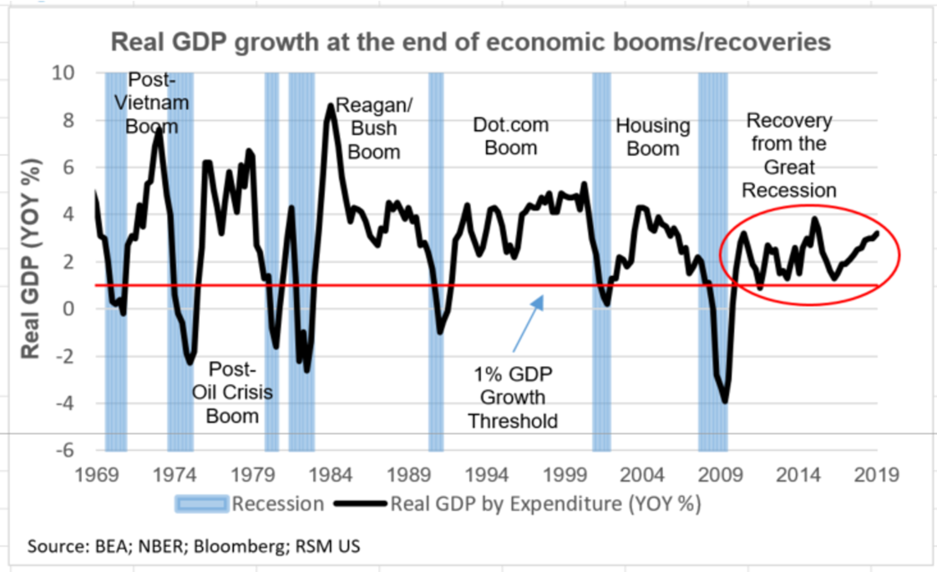
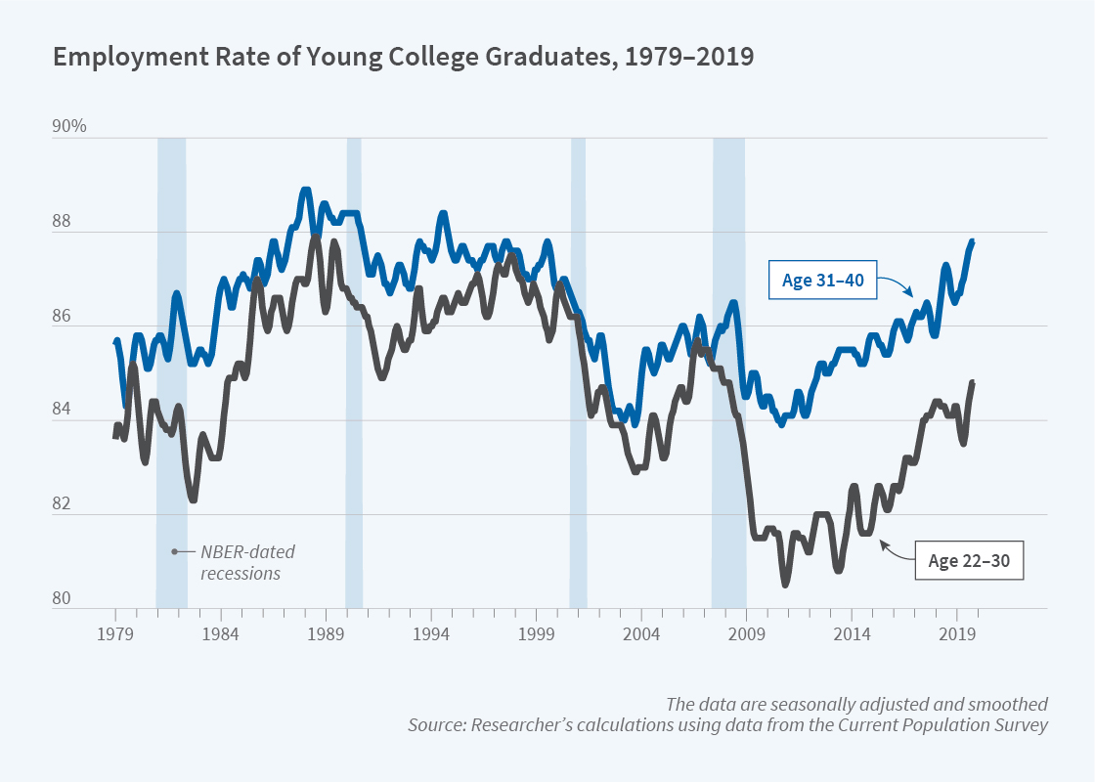
Recessions – GDP and Employment
Economists define as fall in GDP over two quarters
GDP is measured by NBER, an independent, Boston-based economics research group
Measures come out with about six months delay
NBER recession announcement is more complicated
Comes out with 12 month delay

Slide 5
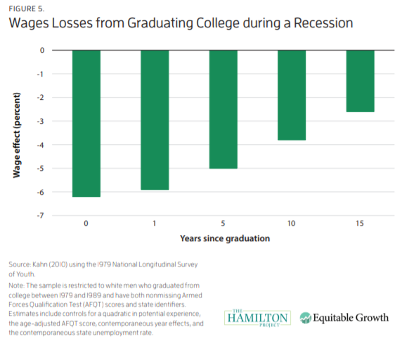
Cost not born equally across components of the economy

Slide 6
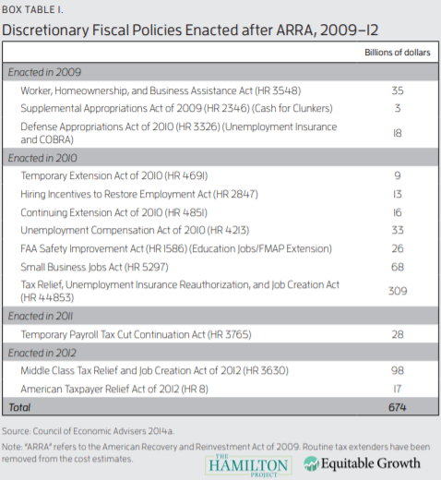
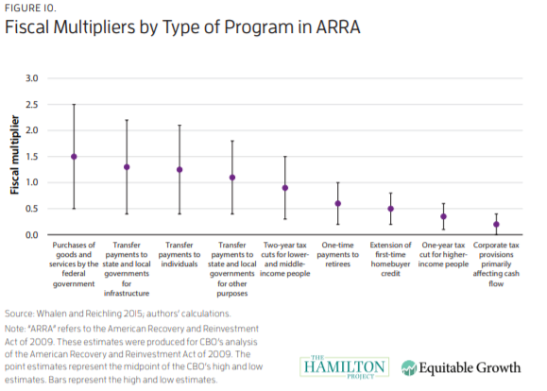
Fiscal Policy

Slide 7
Claudia Sahm
Macroeconomist focusing on weaknesses in the economy
Worked at the Federal Reserve Bank from 2007-2019
Currently at think tank – Washington Center for Economic Growth

Slide 8
Sahm Index/Sahm Rule
Three-month average of monthly unemployment rate
current rate and the two prior.
monthly data's noisy, so you don't want to overreact to little ups and downs
Compare current month to prior 12 months.
If the difference is half a percentage point or more, we're in a recession

Slide 9
Coronavirus recession
¾ of US spending is consumer spending
Retail spending collapsed
Fed already in March set interest rates to zero
Fed represents opinion of top US macroeconomists
Made many more efforts to prop up economy
Lending expansion helped wall street – also expanded loan access to smaller businesses
But individuals and small businesses need money more than loans

Slide 10
A note on Modern Monetary Theory
Related to Keynesian principle that the limit to the economy shouldn’t be money, it should be capacity
Basically, print money to finance increasing spending until unemployment is as low as possible
Money supply is not fixed by the amount of gold in the world
Key figures:
Stephanie Kelton (Bernie Sanders advisor), L. Randall Wray, Bill Mitchell, Warren Mosler
Widely criticized by most economists
MMT are unconvincing about policy effects on interest rates, investment environment, and open economy macro/international trade

Slide 11
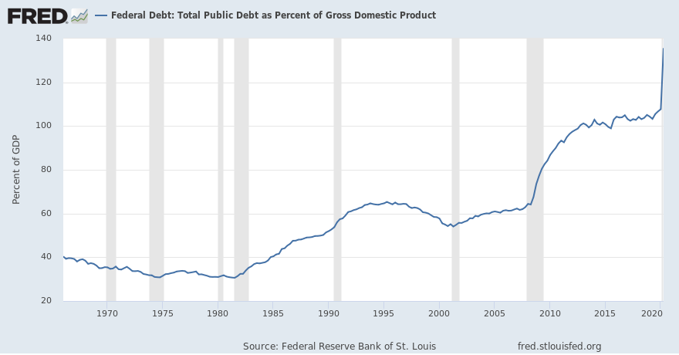
In the meantime: Debt financing
Debt represents future taxes
Who holds out debt?
17% of US debt is held by investors, much of it is held by Americans expecting to retire on its returns
23% of US debt is held by other branches of the government
25% of US debt is held by foreign governments
Japan and China together hold a little over half of foreign owned debt, under 10% of US Debt
Holding US debt helps strengthen foreign currency, lowering prices of foreign exports purchased in the US
What’s going to happen?
Nothing much! The worst case scenario is really bad though!

