Slide 1
HCMI 4225: Issues in Medicaid
Online
Shane Murphy – shane@uconn.edu

Slide 2
Work Requirement tradeoff
Lowering poverty vs increasing self-sufficiency
Cross-sectional evidence:
6.3% of working people are in poverty
32% of non-working people are in poverty
Causal evidence is less clear

Slide 3
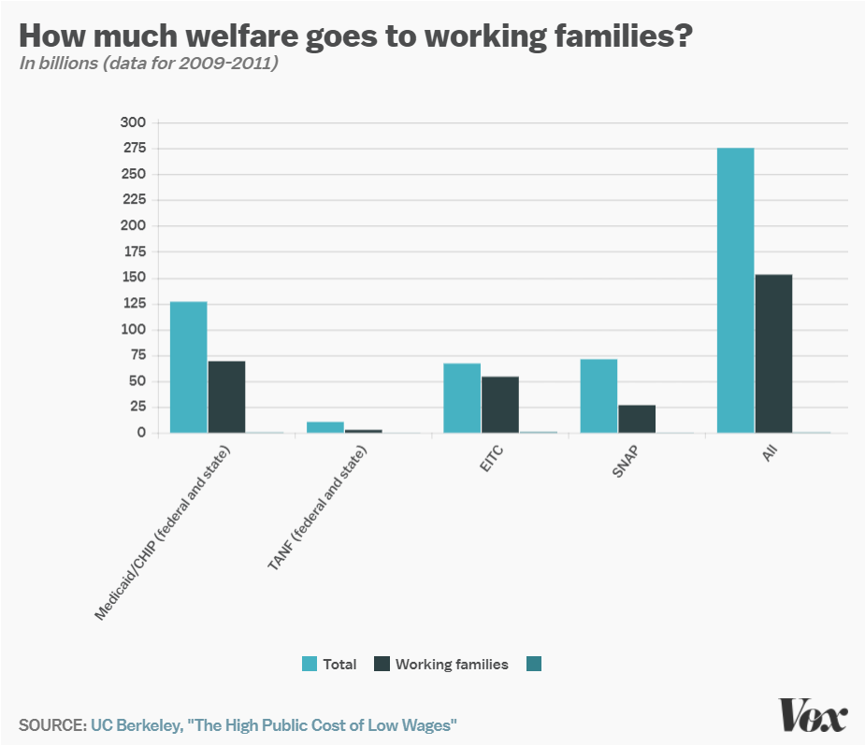
Work requirements
Federal: SNAP (food stamps)
Requires able-bodied recipients without dependents to work 80 hours a month
Part of 1996 Welfare Reform
State: TANF (Kansas and elsewhere)
Limited improvements on unemployment and poverty
State: Medicaid
Earned Income Tax Credit!
Notes:
http://laborcenter.berkeley.edu/the-high-public-cost-of-low-wages/

Slide 4
EITC – Earned Income Tax Credit
Low income individuals get a cash subsidy based on how much they work, up to $5610 dollars for someone earning $14,000 (40% raise)
Always incentivizes work
Administered by IRS
Popular and effective

Slide 5
1996 Welfare reform
Changed Aid to Families with Dependent Children (AFDC) to TANF
States had more leeway to who gets benefits
Block Grants to states
Assistance cut to recent immigrants
Work requirements

Slide 6
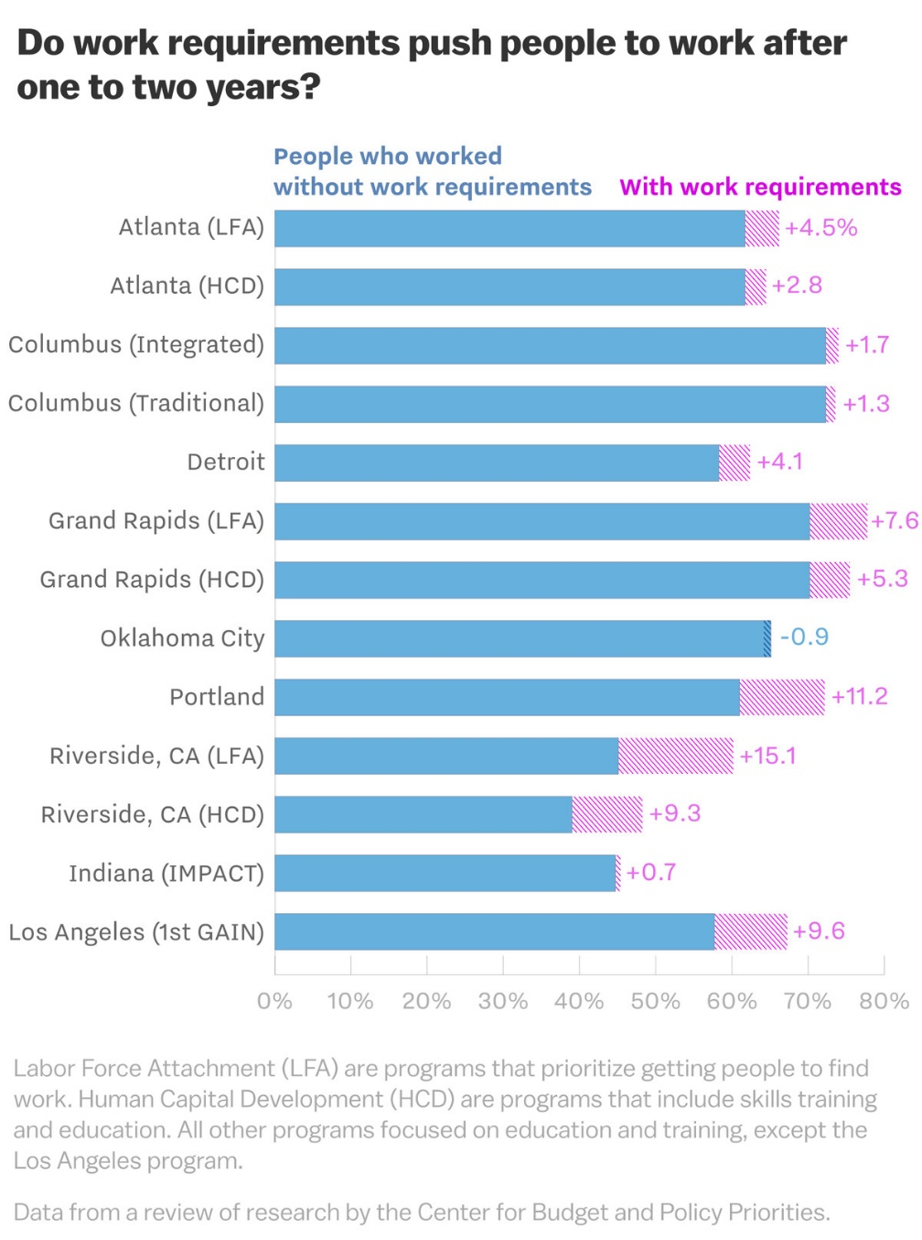
Effect of 1996 work requirements on TANF
13 cities participated in an experiment before requirement was implemented
The proportion of TANF recipients who worked without requirements was about 60% before the experiment
Increased by about 4% on average in the following years
Gains disappeared by 5 years
Stable work saw small increase by 5 years
Small effect on poverty – on average increasing poverty
Decrease the ability to attend training programs, deal with health issues
Targets foreign born and ESL

Slide 7
Pros and Cons of TANF work requirements
Pro
Work requirement increases amount people work
Con
Work requirement increases poverty

Slide 8
Medicaid work requirements
During Trump administration, states were allowed to implement work requirements
Non-elderly, non-pregnant, non-disabled
In June 2018, Arkansas became the first state to implement work requirements in Medicaid
Work requirement could also be satisfied by “community engagement”
Most (95%) Medicaid beneficiaries already satisfy work requirements in one way or another
Led to loss in coverage but no change in employment

Slide 9
People receiving social insurance are already working
80% of adults on Medicaid are in working families
60% work themselves
Of those that don’t:
35% are unable to due to disability
28% are caretakers for family members
18% are students
8% are actively looking for work
8% are retired
Leaving 3% of nonworking adult Medicaid population who could work but don’t
Notes:
JAMA Dec 2017

Slide 10
Barriers to employment
Low income individuals facing Medicaid work requirements struggle to find work
20% have less than a high school degree
25% have multiple chronic conditions
More likely to live in areas with high unemployment and poverty
Notes:
Urban Institute 2019

Slide 11
Videos
2018 PBS report - https://www.youtube.com/watch?v=X02BSr0W5rU
2018 Pro-work requirement ad - https://www.youtube.com/watch?v=OSRgjG2R2U8

Slide 12
Welcome to class
Short video today ~15 minutes
So we’ll convene here at 9:45
In the meantime, I’m here to chat/answer questions

