Slide 1
HCMI 4225: Comparing Health Systems
Shane Murphy – shane@uconn.edu

Slide 2
Canada
Federal single payer system – health under provincial jurisdiction
Public administration, private provision
  Providers required to be non-profit
Comprehensive coverage, Universal, Portable, Accessible

Slide 3
Canada: Issues
Financing crisis since the 1980s
Lead to cost controls – cost of care lower in 1997 than 1989
Some support for overhaul
  Move to a privatized single payer system?

Slide 4
United Kingdom
National Health Services
Health care should be “free at the point of service,” a founding principle of the NHS.
Funded through income taxes
Focus on:
  Primary care
  Reducing inequalities
  Incentivizing prevention
  Uniform salary scale across subspecialists
  Cost control, especially for drugs

Slide 5
UK: Managed Competition
Under Thatcher, the UK experimented with reducing regulations and cost controls, allowing providers to control funds, especially for elective services
Experiment failed, largely because providers did not build up the administrative structure to successfully bargaining between providers and provider groups called GP fundholers.
Ended in 1997

Slide 6
France
Fee-for-service private provision reimbursed by the NHI (liberalism)
Famously #1 in 2000 WHO ranking
Slightly over half funded by payroll taxes
Funding system is complex
  Some care is paid out of pocket and then reimbursed
  Some is fee-for-service
  Some is based on estimated annual budgets

Slide 7
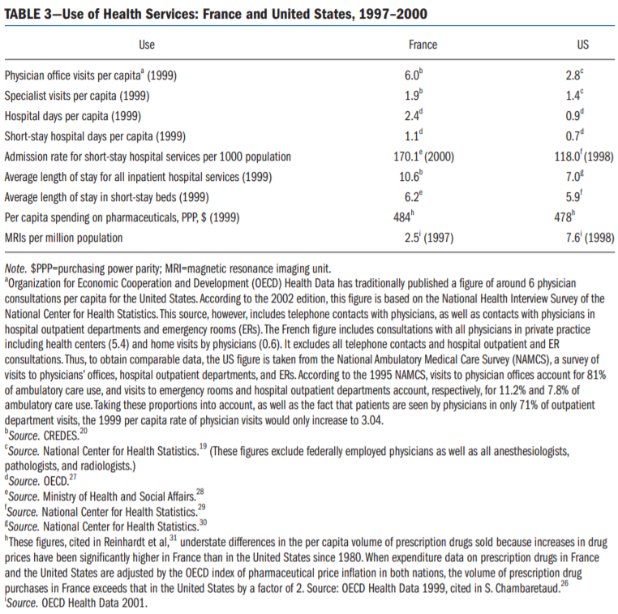

Slide 8
France: Issues
Significant inequalities of resources, outcomes, and quality
Relatively high spending

Slide 9
Germany
Statutory Health Insurance – 92% coverage, rest private or wealthy
Professional autonomy for providers with self-governing bodies
Financed with payroll taxes and regional or occupation based funds

Slide 10
Canada – Medicaid for all
  ACA on steroids
UK – Socialized Medicine
France – Medicare for all
Germany – Fully funded private insurance for all
  ARP on steroids

Slide 11
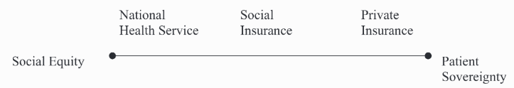
Types of health care systems by provision and funding

Slide 12
Governance issues
Governance of Consumption
  Extent of public access to care
  Extent of public control of costs
Governance of provision
  Extent of control of hospitals
  Extent of constraints on private interests and doctors
Governance of Production
  Extent of public constraints on medical innovation

Slide 13
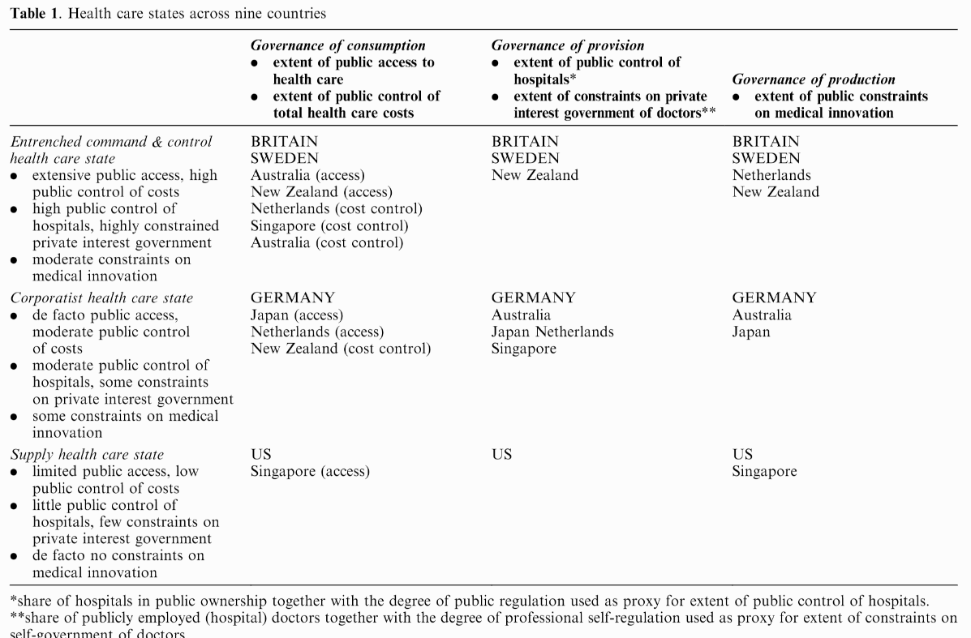

Slide 14
Problems facing any health care system
1. How does one reconcile the need for regional or national coordination with the ability to respond to local needs?
2. How does one reconcile urban with rural needs and the problems of maldistribution?
3. How does one devise a national health care system and yet honor and foster the energies, creativity, and resources of the voluntary sector?
4. How does one reconcile public accountability with professional autonomy and expertise?
5. How shall primary care be integrated with specialty and hospital care?
6. How shall individualistic principles and patterns of practice be reconciled with national standards and a national system?
7. How is a system to reconcile a focus on the patient with a focus on community and population health?

Slide 15
All payer-systems
AKA State Hospital Rate Setting
Goal (same as single payer):
  Increase efficiency and reduce insurer overhead in the health care system.
Sets one price that every health insurer pays for any given medical procedure.
  Removes job of billing clerk, among others
Currently, bigger plans tend to negotiate deeper discounts.
  Private insurance plans pay the most, Medicare pays slightly less, and Medicaid pays the lowest rates.
Con: may lower incentive for innovation and lower provider profits which could be used for experiments.

Slide 16
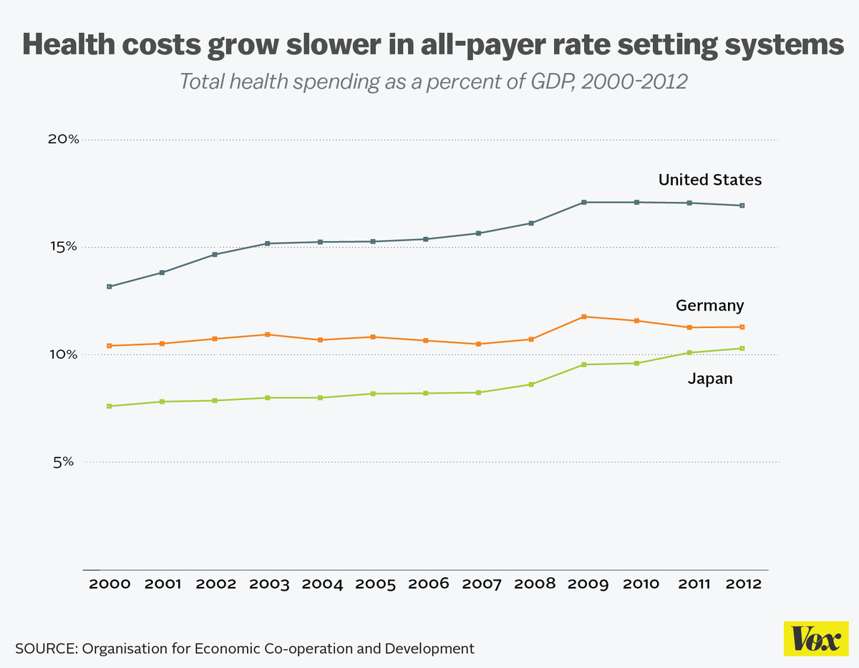
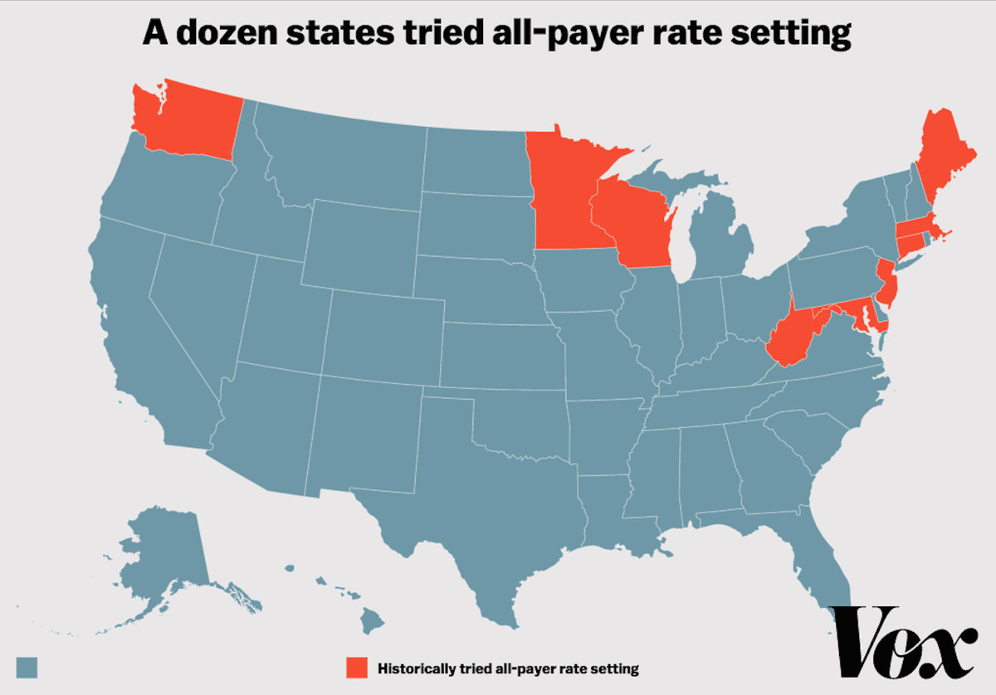
All payer-systems
France, Germany, Japan, the Netherlands, and Switzerland
12 States in the 1970s and 1980s
  Killed by HMOs
  Only Maryland still uses all-payer
Maryland
  Not success story (but not a failure)
  Prices have come down substantially
  But utilization has increased
  Added spending cap in 2014

Slide 17
Welcome to class
Today’s video is 35 minutes
  So we’ll convene at 10:10
  In the meantime, I’m here to chat or answer questions

Slide 18
Readings and Sources
January 2003 edition of the American Journal of Public Health
Burau, Viola, and Robert H. Blank. "Comparing health policy: an assessment of typologies of health systems." Journal of comparative policy analysis 8, no. 01 (2006): 63-76.
McDonough, John E. "Tracking the demise of state hospital rate setting." Health Affairs 16, no. 1 (1997): 142-149.
Pauly, Mark, and Robert Town. "Maryland exceptionalism? All-payers regulation and health care system efficiency." Journal of health politics, policy and law 37, no. 4 (2012): 697-707.

