Slide 1
HCMI 4225: Costs of Health Care
Shane Murphy – shane@uconn.edu

Slide 2
Chandra, C., et al(2011). Hospital cost structure in the USA: what's behind the costs? A business case.
Significant waste exists across the entire medical supply process that needs to be eliminated.
Uses simulation to estimate the effect of streamlining administrative processes

Slide 3
Fuchs, V. R. (2013). How and why US health care differs from that in other OECD countries.
Because funding in most OECD countries is usually through a tax-supported system, administrative costs are usually much lower than in the United States, with its fragmented sources of funding and payment.
OECD countries use the concentration of funding to negotiate aggressively with drug companies and physicians and to control investment in hospitals and equipment.
For Medicare in the US, legislation and political pressure prevent such an approach.
OECD countries provide more physicians and more acute care hospital beds, whereas the United States provides much more high-tech services, such as magnetic resonance imaging (MRI) scans and mammograms, proportionately more specialists, more amenities (privacy and space in hospitals), and more standby capacity as evident in a higher ratio of MRI scanners available to MRI scans performed.

Slide 4
Dieleman, J. L., et a;. (2017). Factors associated with increases in US health care spending, 1996-2013.
Annual health care spending on inpatient, ambulatory, retail pharmaceutical, nursing facility, emergency department, and dental care increased by $933.5 billion between 1996 and 2013, from $1.2 trillion to $2.1 trillion.
5 factors in order of importance:
Changes in service price and intensity were associated with a 50.0% (UI, 45.0%-55.0%), or $583.5 (UI, $525.2-$641.4) billion, spending increase.
Increases in US population size were associated with a 23.1% (uncertainty interval [UI], 23.1%-23.1%), or $269.5 (UI, $269.0-$270.0) billion, spending increase
aging of the population was associated with an 11.6% (UI, 11.4%-11.8%), or $135.7 (UI, $133.3-$137.7) billion, spending increase
Changes in disease prevalence or incidence were associated with spending reductions of 2.4% (UI, 0.9%-3.8%), or $28.2 (UI, $10.5-$44.4) billion
Changes in service utilization were not associated with a statistically significant change in spending

Slide 5
Woolhandler, S., et al (2003). Costs of health care administration in the United States and Canada.
Administration accounted for 31.0 percent of health care expenditures in the United States and 16.7 percent of health care expenditures in Canada.
Between 1969 and 1999, the share of the U.S. health care labor force accounted for by administrative workers grew from 18.2 percent to 27.3 percent. In Canada, it grew from 16.0 percent in 1971 to 19.1 percent in 1996.

Slide 6
Papanicolas, I., at al. (2018). Health care spending in the United States and other high-income countries.
The United States spent approximately twice as much as other high-income countries on medical care, yet utilization rates in the United States were largely similar to those in other nations.
Prices of labor and goods, including pharmaceuticals, and administrative costs appeared to be the major drivers of the difference in overall cost between the United States and other high-income countries.

Slide 7
Anderson, G. F., et al. (2019). It’s Still The Prices, Stupid: Why The US Spends So Much On Health Care
On key measures of health care resources per capita (hospital beds, physicians, and nurses), the US still provides significantly fewer resources compared to the OECD median country.
In 2016, the US had 26 percent fewer hospital beds per capita, 20 percent fewer practicing nurses, and 19 percent fewer practicing physicians per capita, compared to the OECD median country.
Since the US is not consuming greater resources than other countries, the most logical factor is the higher prices paid in the US.

Slide 8
Lorenzoni, L., et al. (2014). Health-care expenditure and health policy in the USA versus other high-spending OECD countries.
Health price levels contribute the most to explaining the higher spending in the USA, and recent price dynamics largely explain declines in health expenditure growth
High and increasing rates of generic drug use, an important shift from inpatient to outpatient hospital care, along with some effective price control measures on plans and providers by Medicare and Medicaid, were some of the key factors responsible for the slowdown in health-care expenditure growth in the USA

Slide 9
Anderson, G. F., et al. (2003). It’s the prices, stupid: why the United States is so different from other countries.
The data show that the United States spends more on health care than any other country.
However, on most measures of health services use, the United States is below the OECD median.

Slide 10
Kantarjian, H., & Rajkumar, S. V. (2015). Why are cancer drugs so expensive in the United States, and what are the solutions?.
The health care industry in the United States is for-profit (unlike in European and other advanced nations), which appears to result in ill consequences driven by the demands for high profits: high drug prices (including cancer drugs) and high health care costs (18% of our gross domestic product vs 5%-9% in Europe).

Slide 11
Kesselheim, A. S., Aet al. (2016). The high cost of prescription drugs in the United States: origins and prospects for reform.
High drug prices are the result of the approach the United States has taken to granting government-protected monopolies to drug manufacturers, combined with coverage requirements imposed on government-funded drug benefits.
Per capita prescription drug spending in the United States exceeds that in all other countries, largely driven by brand-name drug prices that have been increasing in recent years at rates far beyond the consumer price index.
In 2013, per capita spending on prescription drugs was $858 compared with an average of $400 for 19 other industrialized nations.

Slide 12
Siddiqui, M., & Rajkumar, S. V. (2012). The high cost of cancer drugs and what we can do about it.
It is very expensive to move findings from bench to bedside and to perform all the regulatory studies (including phase 1, 2, and 3 clinical trials) to gain approval.
Because most cancers are incurable, patients are treated with each approved agent (sequentially or in combination), creating a virtual monopoly because the use of one drug does not automatically mean that the others are no longer needed.
Even when the monopoly is broken with the arrival of “new and improved” versions of an approved drug, the older (and by now generic) drug tends to be viewed as substandard treatment, thereby perpetuating the situation.
Cancer, and the seriousness of the diagnosis, plays a role in that patients and physicians are often willing to pay the high price of treatment even for marginal improvements in outcome.
Our systems provide an incentive to administer more chemotherapy, and there are legal barriers that prevent agencies such as the FDA from taking economic and cost-effectiveness considerations into account when approving new drugs

Slide 13
Squires, D., & Anderson, C. (2015). US health care from a global perspective: spending, use of services, prices, and health in 13 countries.
Higher spending appeared to be largely driven by greater use of medical technology and higher health care prices, rather than more frequent doctor visits or hospital admissions.

Slide 14
Cutler, D. (2013). Why does health care cost so much in America? Ask Harvard’s David Cutler.
Administrative costs
Duke University Hospital has 900 hospital beds and 1,300 billing clerks.
U.S. spends more than other countries do on many of the same things.
Drugs, physician salaries, medical equipment
Utilization of high cost procedures
If a person has a heart attack in the United States, they’re much more likely to get open heart surgery than they are in most other countries.
In all of Ontario there are 11 hospitals that can do open heart surgery. Pennsylvania has roughly the population of Ontario and it has a bit over 60 hospitals that can do open heart surgery.

Slide 15
Gawande, A. (2009). The cost conundrum.
More frequent tests and procedures, more visits with specialists, and more frequent admission to hospitals.
Patients in high-cost areas were actually less likely to receive low-cost preventive services
Accountability is limited, doctors don’t know if they are improving overall community health, only if they are following best practice for the patients they see.

Slide 16
Aaron, H. J., & Ginsburg, P. B. (2009). Is health spending excessive? If so, what can we do about it?.
Most studies attribute one-half to two-thirds of the gap to the advance of medical technology, which lengthens the menu of beneficial interventions or improves their quality.
Excessive use resulting from insurance
Fee-for-service payment rewards providers for supplying particular services rather than for producing favorable outcomes or efficiently treating an episode of illness.
Inefficient organization of health care delivery needlessly boosts U.S. health spending.
Prices of drugs in the United States are higher than in other countries
Also discusses alternative reasons which may not be a good explination

Slide 17
Reinhardt, U. E., et al. (2004). US health care spending in an international context.
GDP per capita
Higher prices
Limited supply of providers (low physicians and nurses per capita)
Highly complex and fragmented payment system that weakens the demand side of the health sector and entails high administrative costs
Unwillingness to ration care

Slide 18
Bodenheimer, T. (2005). High and rising health care costs. Part 1: seeking an explanation.
the weakness of a competitive free market within the health system, by the rapid diffusion of new technologies
excessive costs of administering the health system
absence of strong cost-containment measures
undue market power of health care providers

Slide 19
Shrank, William H., Teresa L. Rogstad, and Natasha Parekh. "Waste in the US health care system: estimated costs and potential for savings." Jama 322, no. 15 (2019): 1501-1509.
Cost of waste, $760 billion to $935 (25% of total spending):
Failure of care delivery, $102.4 billion to $165.7 billion;
Failure of care coordination, $27.2 billion to $78.2 billion;
Overtreatment or low-value care, $75.7 billion to $101.2 billion;
Pricing failure, $230.7 billion to $240.5 billion;
Fraud and abuse, $58.5 billion to $83.9 billion;
Administrative complexity, $265.6 billion.
Estimated annual savings from measures to eliminate waste:
Failure of care delivery, $44.4 billion to $97.3 billion;
Failure of care coordination, $29.6 billion to $38.2 billion;
Overtreatment or low-value care, $12.8 billion to $28.6 billion;
Pricing failure, $81.4 billion to $91.2 billion;
Fraud and abuse, $22.8 billion to $30.8 billion.
Administrative complexity, ?

Slide 20
Chernew, Michael E., and Jermaine Heath. "How Different Payment Models Support (or Undermine) a Sustainable Health Care System: Rating the Underlying Incentives and Building a Better Model." NEJM Catalyst Innovations in Care Delivery 1, no. 1 (2019).
Article unavailable, sorry

Slide 21
Primary factors
Technology
Administrative costs
Pharmaceutical prices
Service intensity and utilization
Insurance market fragmentation
Stakeholder disagreement in government
Waste

Slide 22
Welcome to class
Discussion
In groups:
What were the factors your paper considered that cause healthcare in the US to be so high? (Scott, Marie, Taylor, Jennie)
What do you think are concrete steps that could be carried out to address this issue?
What more needs to be studied to better answer these questions.

Slide 23
Price Controls
Prices offered might be too low

Slide 24
Welcome to class
Discussion
In groups:
What were the factors your paper considered that cause healthcare in the US to be so high? (Scott, Marie, Taylor, Jennie)
What do you think are concrete steps that could be carried out to address this issue?
What more needs to be studied to better answer these questions.

Slide 25
Welcome to class
Discussion
In groups:
What were the factors your paper considered that cause healthcare in the US to be so high? (Scott, Marie, Taylor, Jennie)
What do you think are concrete steps that could be carried out to address this issue?
What more needs to be studied to better answer these questions.

Slide 26
Welcome to class
Discussion
In groups:
What were the factors your paper considered that cause healthcare in the US to be so high? (Scott, Marie, Taylor, Jennie)
What do you think are concrete steps that could be carried out to address this issue?
What more needs to be studied to better answer these questions.

Slide 27
Welcome to class
Discussion
In groups:
What were the factors your paper considered that cause healthcare in the US to be so high? (Scott, Marie, Taylor, Jennie)
What do you think are concrete steps that could be carried out to address this issue?
What more needs to be studied to better answer these questions.

Slide 28
Welcome to class
Discussion
In groups:
What were the factors your paper considered that cause healthcare in the US to be so high? (Scott, Marie, Taylor, Jennie)
What do you think are concrete steps that could be carried out to address this issue?
What more needs to be studied to better answer these questions.

Slide 29
Welcome to class
Discussion
In groups:
What were the factors your paper considered that cause healthcare in the US to be so high? (Scott, Marie, Taylor, Jennie)
What do you think are concrete steps that could be carried out to address this issue?
What more needs to be studied to better answer these questions.

Slide 30
Welcome to class
Discussion
In groups:
What were the factors your paper considered that cause healthcare in the US to be so high? (Scott, Marie, Taylor, Jennie)
What do you think are concrete steps that could be carried out to address this issue?
What more needs to be studied to better answer these questions.

Slide 31
Welcome to class
Discussion
In groups:
What were the factors your paper considered that cause healthcare in the US to be so high? (Scott, Marie, Taylor, Jennie)
What do you think are concrete steps that could be carried out to address this issue?
What more needs to be studied to better answer these questions.

Slide 32
Welcome to class
Discussion
In groups:
What were the factors your paper considered that cause healthcare in the US to be so high? (Scott, Marie, Taylor, Jennie)
What do you think are concrete steps that could be carried out to address this issue?
What more needs to be studied to better answer these questions.

Slide 33
Welcome to class
Discussion
In groups:
What were the factors your paper considered that cause healthcare in the US to be so high? (Scott, Marie, Taylor, Jennie)
What do you think are concrete steps that could be carried out to address this issue?
What more needs to be studied to better answer these questions.

Slide 34
Welcome to class
Discussion
In groups:
What were the factors your paper considered that cause healthcare in the US to be so high? (Scott, Marie, Taylor, Jennie)
What do you think are concrete steps that could be carried out to address this issue?
What more needs to be studied to better answer these questions.

Slide 35
Welcome to class
Discussion
In groups:
What were the factors your paper considered that cause healthcare in the US to be so high? (Scott, Marie, Taylor, Jennie)
What do you think are concrete steps that could be carried out to address this issue?
What more needs to be studied to better answer these questions.

Slide 36
Welcome to class
Discussion
In groups:
What were the factors your paper considered that cause healthcare in the US to be so high? (Scott, Marie, Taylor, Jennie)
What do you think are concrete steps that could be carried out to address this issue?
What more needs to be studied to better answer these questions.

Slide 37
Percentile of population ranked by spending and amount spent during the year
Lower Threshold | Upper Threshold | Lower Spending | Upper Spending
99% | 100% | $72,212 | a lot
95% | 99% | $26,355 | $72,212
90% | 95% | $14,651 | $26,355
70% | 90% | $3,776 | $14,651
0 | 50% | 0 | $1,317

Slide 38
Low spenders (bottom 50%)
In any given year, half the non-institutionalized population is barely touching the medical system.
Benefit design indifferent as either they are not using any services so no theoretical cost sharing applies
the few services that they do use are already exempted from cost-sharing (flu shots)
the plans that they are offered have high enough cost-sharing that there is no difference to them between a $500 deductible and a $5000 deductible

Slide 39
High spenders (top 10%)
Someone who knows that they have a $75,000 per year condition will not be influenced directly by cost sharing tweaks for one plan that is a little heavier on deductible while another plan is heavier on coinsurance.
In either plan, they are extremely likely to hit out of pocket maximums and the difference in benefit design will only be on cash flow and cognitive complexity.

Slide 40
Medium high spenders (50% to 90%)
Cost-sharing is probably relevant retrospectively for individuals who are in the 50th to the 90%th percentile of spending.
This group has ~32% of all medical spending in the country.
If we think that optimal cost-sharing design can do something to healthcare expenditures, this is where the squeeze will be.

Slide 41
How insurance subsidies benefit consumers
Consider two types of subsidy: Cost sharing reductions and premium reductions
People in the bottom 50% of the spending will more strongly benefit from a dollar in premium reducing subsidies than cost-sharing reductions.
People at the very top of the spending distribution are indifferent as to the form of assistance as they will get the full benefit either way
It is the people in between where a dollar spent in reducing maximum allowable deductibles instead of reducing premiums are in a complex situation.
Someone who has $5,000 in deductible eligible claims will be better off if maximum deductible is reduced from $5,200 to $4,500. They are no better off if maximum allowed deductible is reduced from $8,850 to $7,500.

Slide 42
Source:
https://meps.ahrq.gov/data_files/publications/st533/stat533.shtml

Slide 43
Relationship between cost and quality
Healthcare spending buys a certain set of healthcare goods
Beds per capita
Physicians/nurses/midwives per capita
Insurance/financial coverage
Universal support for basic health needs
UHC tracer index of 11 interventions: Coverage of four childhood vaccinations (BCG, measles, three doses of diphtheria-pertussis-tetanus, and three doses of polio vaccines); skilled birth attendance; coverage of at least one and four antenatal care visits; met need for family planning with modern contraception; tuberculosis case detection rates; insecticide-treated net coverage; and antiretroviral therapy coverage for populations living with HIV
WB coverage index of three basic primary care interventions: three doses of diphtheria-pertussis-tetanus vaccine; at least four antenatal care visits; and children with diarrhoea receiving appropriate treatment

Slide 44
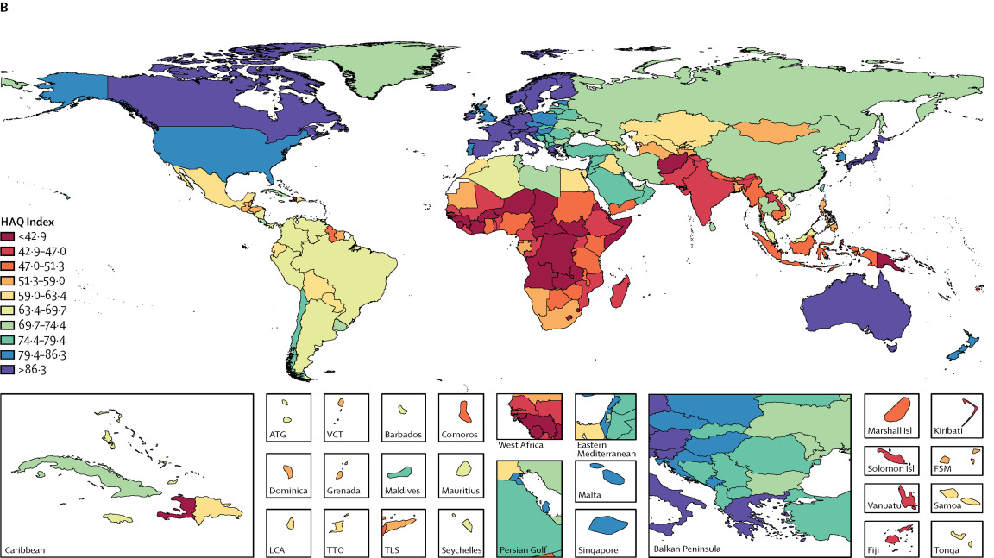
Hospital Access and Quality index

Slide 45
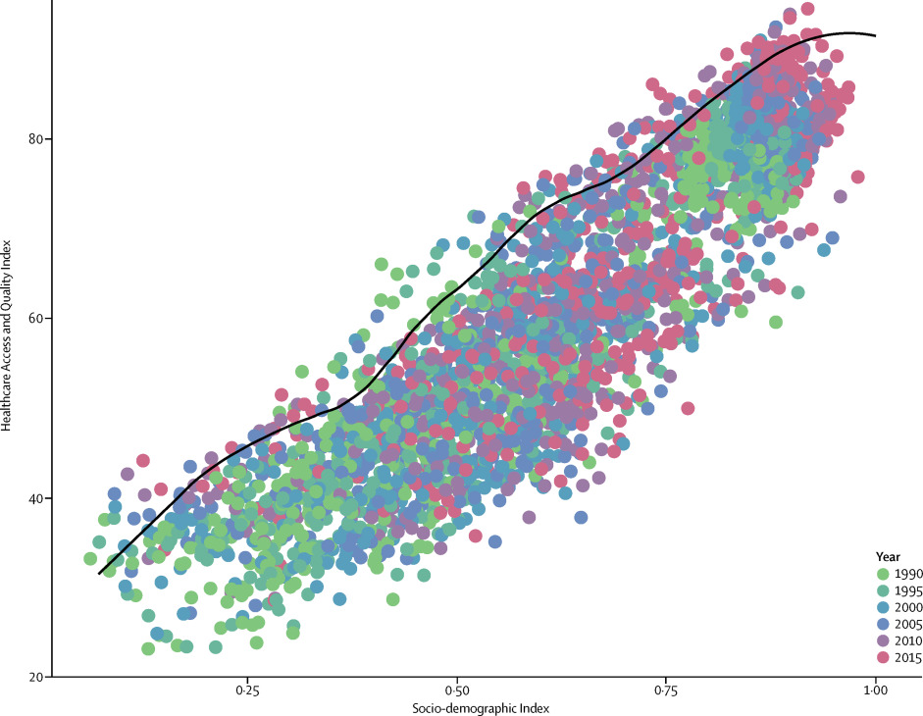
Comparing HAQ to expected HAQ
Absolute performance vs relative performance

Slide 46
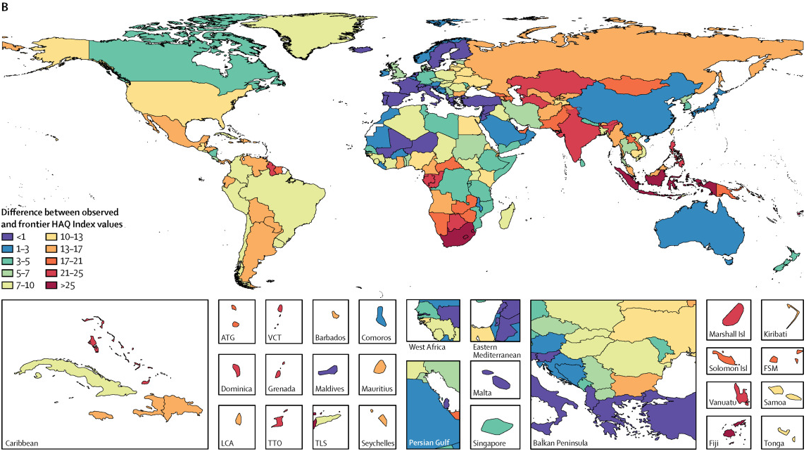
Comparing HAQ to expected HAQ

Slide 47
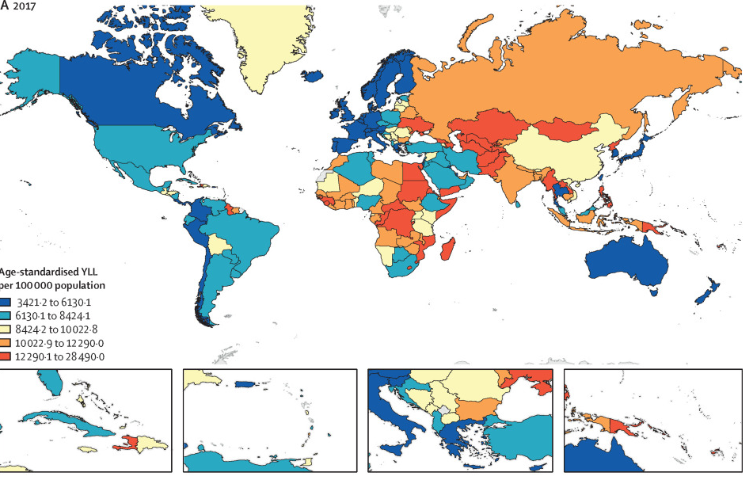
Amenable Mortality/Premature Mortality
Deaths from causes amenable to changes in health behavior or to changes in health care access and quality
NCDs

Slide 48
Amenable Mortality/Premature Mortality
Deaths from causes amenable to changes in health behavior or to changes in health care access and quality
NCDs

Slide 49
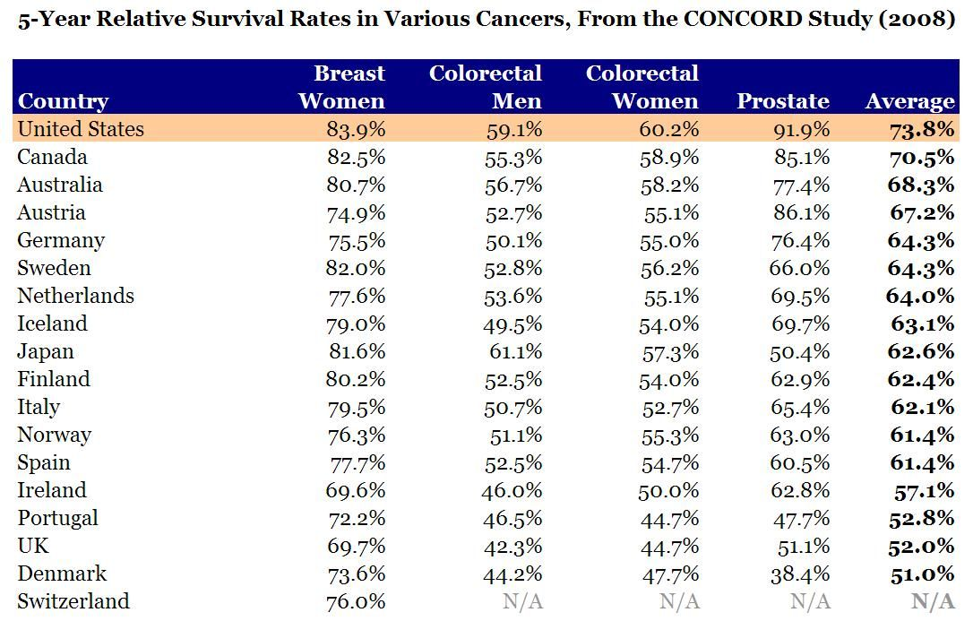
Cancer

Slide 50
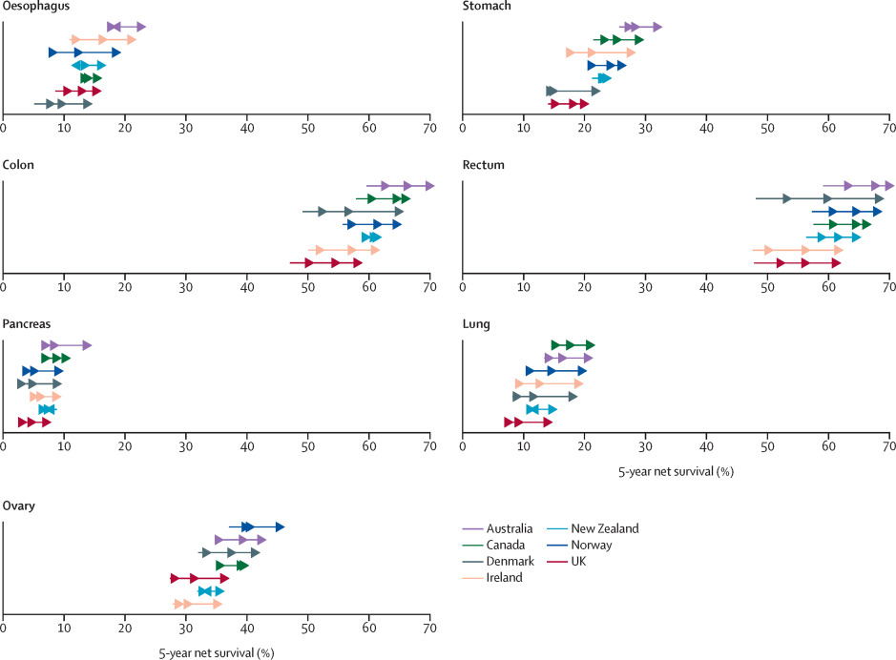
Cancer

Slide 51
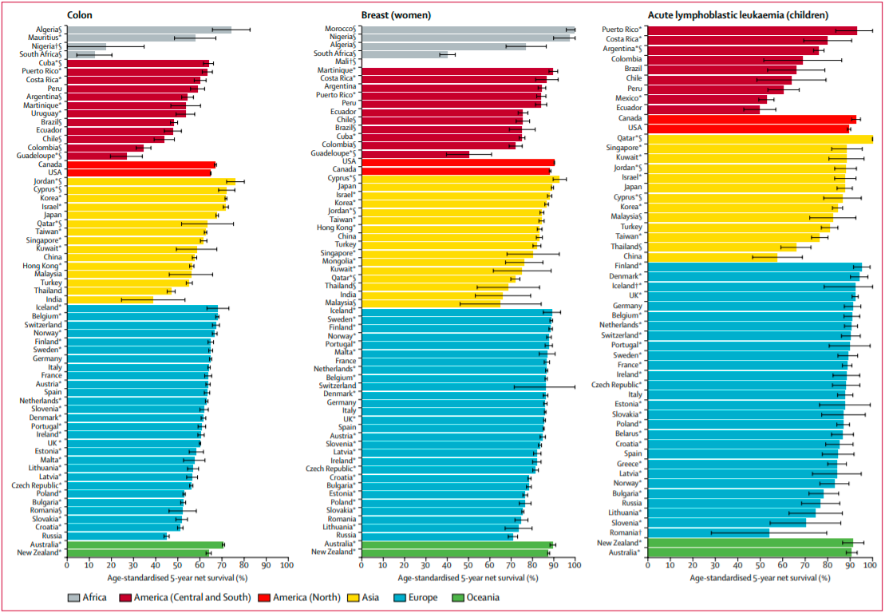

Slide 52
Sources
Martinez, Ramon, Peter Lloyd-Sherlock, Patricia Soliz, Shah Ebrahim, Enrique Vega, Pedro Ordunez, and Martin McKee. "Trends in premature avertable mortality from non-communicable diseases for 195 countries and territories, 1990–2017: a population-based study." The Lancet Global Health 8, no. 4 (2020): e511-e523.
Arnold, Melina, Mark J. Rutherford, Aude Bardot, Jacques Ferlay, Therese ML Andersson, Tor Åge Myklebust, Hanna Tervonen et al. "Progress in cancer survival, mortality, and incidence in seven high-income countries 1995–2014 (ICBP SURVMARK-2): a population-based study." The Lancet Oncology 20, no. 11 (2019): 1493-1505.
Barber, Ryan M., Nancy Fullman, Reed JD Sorensen, Thomas Bollyky, Martin McKee, Ellen Nolte, Amanuel Alemu Abajobir et al. "Healthcare Access and Quality Index based on mortality from causes amenable to personal health care in 195 countries and territories, 1990–2015: a novel analysis from the Global Burden of Disease Study 2015." The Lancet 390, no. 10091 (2017): 231-266.
Allemani, Claudia, Tomohiro Matsuda, Veronica Di Carlo, Rhea Harewood, Melissa Matz, Maja Nikšić, Audrey Bonaventure et al. "Global surveillance of trends in cancer survival 2000–14 (CONCORD-3): analysis of individual records for 37 513 025 patients diagnosed with one of 18 cancers from 322 population-based registries in 71 countries." The Lancet 391, no. 10125 (2018): 1023-1075.
Coleman, Michel P., Manuela Quaresma, Franco Berrino, Jean-Michel Lutz, Roberta De Angelis, Riccardo Capocaccia, Paolo Baili et al. "Cancer survival in five continents: a worldwide population-based study (CONCORD)." The lancet oncology 9, no. 8 (2008): 730-756.

