Slide 1
HCMI 5243: Worms!
Online: 6:00 PM – 9:00 PM
Shane Murphy – shane@uconn.edu

Slide 2
Randomized Control Trials
RCTs are the gold standard for estimating causality
Alternatives for estimating causality:
Natural experiments – Instrumental variables, difference in difference (DID)
Correlation/regression
Discontinuity
Difference in means between treated and untreated
Big issues:
Multiple comparisons and p-hacking
Solutions:
Pre-registration, publishing null results, replication

Slide 3
Background: Worms
Soil-transmitted helminth (STH) and schistosomiasis infections affect more than 1 billion people
Mainly in low- and middle-income countries
Mainly school-age children
Light infections can be fairly asymptomatic
Severe infections can have significant health effects
Malnutrition
Listlessness
Organ damage
Internal bleeding

Slide 4
Background: Transmition
Soil Transmitted helminth include hookworm, roundworm, and whipworm
Transmitted via eggs in feces deposited in the local environment
Typically through open defecation or lack of proper hygiene after defecating
Schistosomiasis is spread through contact with infected fresh water

Slide 5
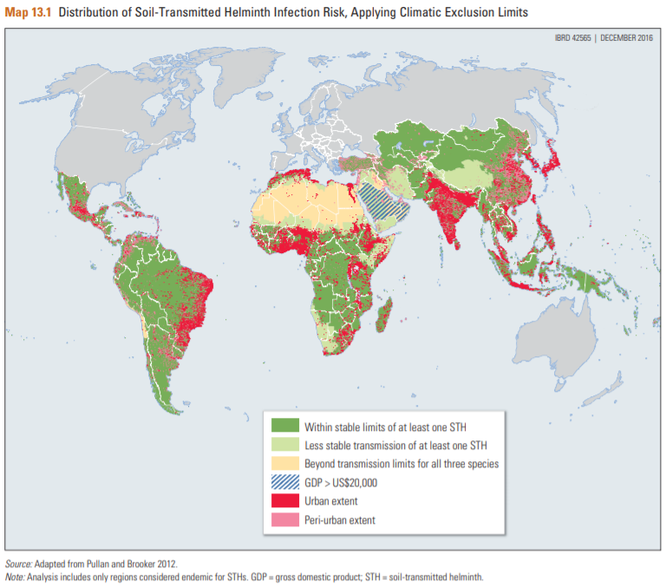

Slide 6
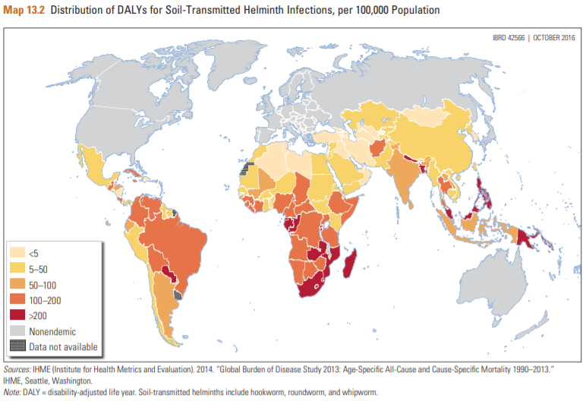

Slide 7
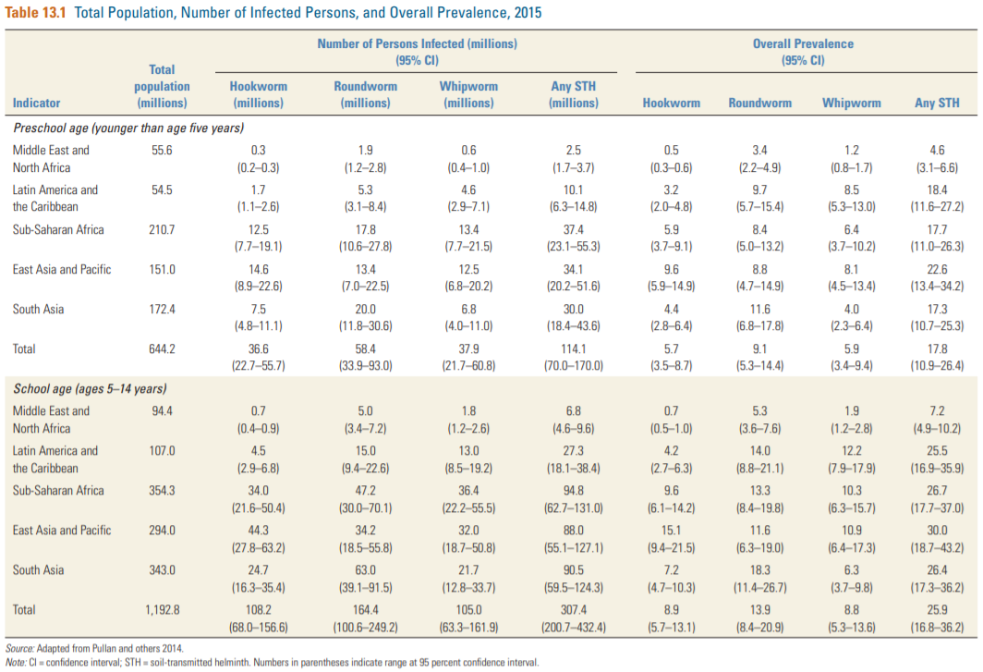

Slide 8
Illness
In 1990:
11.5 million children were at risk of clinically overt acute illness
200,000 children developed serious complications such as intestinal obstruction, biliary or pancreatic disease, appendicitis, and peritonitis
About 10,000 deaths (de Silva, Chan, and Bundy 1997)
Dysentery, diarrhea, and colitis in children with Trichuris infection
Heavily infected children more frequently presented with the more severe symptom of rectal prolapse (Cooper and Bundy 1988)

Slide 9
Illness
Heavy infection can lead to a well-described Trichuris dysentery syndrome, characterized by dysentery, anemia, growth retardation, finger clubbing, rectal prolapse, and a specific trichuriasis colitis (Cooper and Bundy 1988).
Curative treatment for parasite infection leads to rapid alleviation of these symptoms (Cooper and Bundy 1988; Jung and Beaver 1951).
Studies have recorded significant catch-up growth in middle childhood—especially ages four to eight years— following curative treatment, with significant increases in height and weight as well as improvements in cognition (Callender and others 1998; Cooper and others 1990; Cooper and others 1995; Nokes and others 1992)
Anemia is associated with trichuriasis colitis and eliminating hookworm infections from one study population could lead to a reduction in anemia of 25 percent and severe anemia by as much as 73 percent (Stoltzfus et al 1997)
Note that trials leading to these results would no longer be conducted as refusing treatment to known infected individuals would be unethical.

Slide 10
Treatment
Low-cost drugs are available and are the standard of medical care for diagnosed infections.
The most commonly used deworming drugs are albendazole, mebendazole, and praziquantel
Efficacious against a variety of worm infections with minimal side effects (Bundy, Appleby, and others 2017)
About 1 billion people were treated in 2015 (WHO 2015)
About 45% of all at-risk school age children
Diagnosis is relatively expensive
Treatment is inexpensive and safe
World Health Organization recommends periodic mass treatments in areas where worm infections are greater than certain thresholds
However, mass drug administration is not universally accepted

Slide 11
Health benefits
A Cochrane Review (Taylor-Robinson et al 2015) found that MDA did not improve average nutritional status, hemoglobin, cognition, school performance, or survival and only found evidence of weight gain from targeted programs
A Croke et al 2016 study of the same data augmented with additional data found a 0.111 kilogram weight gain (p < 0.001) from deworming in a fixed-effects model and a 0.134 kilogram weight gain (p = 0.01) in a random-effects model from MDA
Resolving this debate requires exploring the distribution of individual morbidity and infection intensity.

Slide 12
Recent field trials
MDA is more effective than targeted treatment at reducing population-level prevalence (Asaolu, Holland, and Crompton 1991);
MDA is more cost-effective than selective treatment (Holland and others 1996);
School-based deworming is a highly cost-effective way to reduce anemia (Brooker and others 2008; Guyatt and others 2001)
MDA in children reduces in prevalence of infection in untreated adults (Asaolu, Holland, and Crompton 1991; Bundy et al 1990)

Slide 13
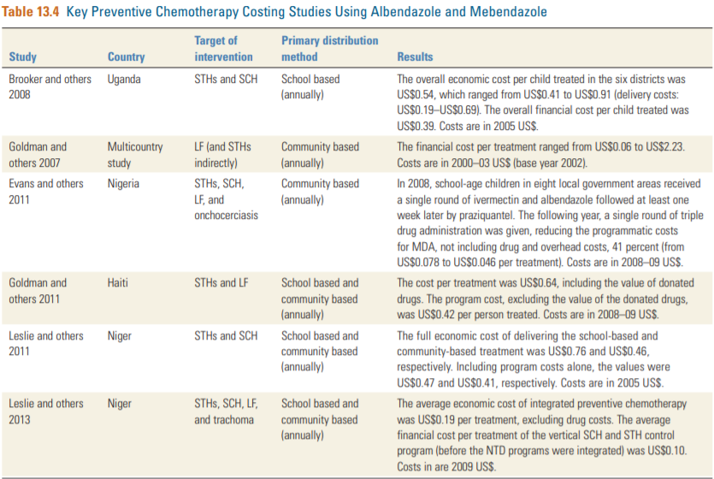

Slide 14
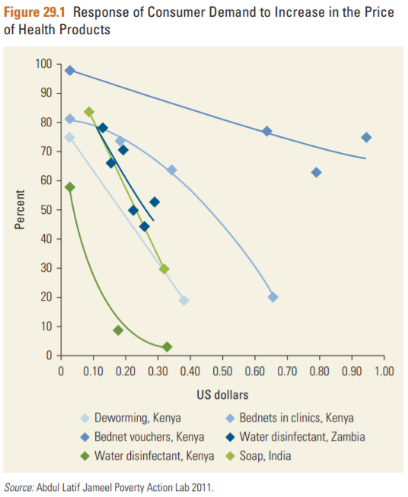
Elasticity of treatment
Increasing price from $0 to $0.30 reduced take-up of deworming drugs from 75% to 19% (an 80% decrease) (Kremer and Miguel 2007)
Infected students were not more likely to pay for medicine (elasticity was not responsive to being ill)

Slide 15
Non Health benefits
The benefits of government deworming programs include:
Health spillovers when programs lower the spread of other infectious diseases
Fiscal spillovers when treatment increases future wages and tax receipts
Other considerations include
Cost-effectiveness of the intervention
Including health and non-health benefits
Demand and price elasticity of deworming
If people would buy the intervention either way, then government programs may be unnecessary

Slide 16
Effectiveness of Treatment Programs: Health
Mass drug administration (MDA) in Montserrat, West Indies for children age 2-15 showed substantial reductions in infection and positive epidemiological externalities (Bundy et al 1990)
School-randomized control trial using MDA in rural western Kenya found substantial reductions in infection and strong spillovers for the health of treated classmates and other students living nearby (Miguel and Kremer 2004)
Spillovers included improving outcomes for younger children not in schools during the trial but whose environment was healthier due to the treatments (Ozier 2014)
Smaller externalities are found in areas with lower prevalence, such as India (Bobonis, Miguel, and Puri-Sharma 2006)

Slide 17
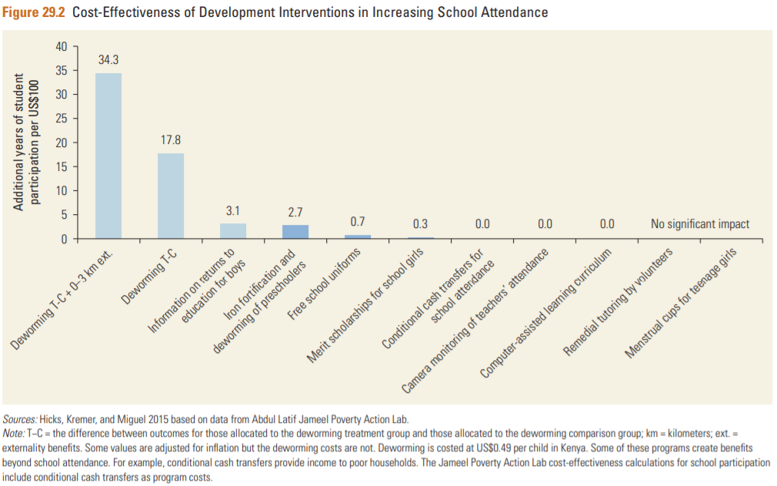
Effectiveness of Treatment Programs: Education
MDA increased school participation for treated students and had positive spillovers for untreated students at the same school (Miguel and Kremer 2004)
Davey et al 2015 questioned these results
Limited short-term effect on student test scores (Miguel and Kremer 2004) but possible long-term effect
Increasing high school final exam passing rate for girls in Kenya from 41% to 50% - a 25% increase (Baird et al 2016)
Increased long-term English literacy, numeracy, and combined test scores in Uganda (Croke 2014)

Slide 18
Effectiveness of Treatment Programs: US
Rockefeller Sanitary Commission (RSC) in 1910 to eradicate hookworm infections in the U.S. South.
Baseline hookworm infection rates at 40 percent among schoolage children
Traveling dispensaries administered treatment to infected individuals in endemic areas and educated local physicians and the public about prevention
The RSC reported a 30 percentage point decrease in infection rates across affected areas 10 or more years after launch of the program (Bleakley 2007)
By 1940 census, adults exposed to the campaign as children saw 43% increase in wages (Bleakley 2010)

Slide 19
Effectiveness of Treatment Programs: Weight
MDA increases child weight by an average of 0.13 kilograms, with somewhat larger point estimates among populations with higher prevalence
Given a cost of $0.60 for two treatments, this implies cost of deworming MDA per kilogram of weight gain is US$4.48
40.62 times the benefit of school feeding programs

Slide 20
Effectiveness of Treatment Programs: Wages
Net present value of the long-term educational and economic benefits in Kenya more than 100 times the cost (Baird et al 2016)
They found that Kenyan women who received more deworming treatment are more likely to grow cash crops and reallocate labor time from agriculture to nonagricultural self-employment.
Treated men work 17 percent more hours per week, spend more time in entrepreneurial activities, and are more likely to work in higher-wage manufacturing jobs
Annualized internal rate of return to deworming of 32 percent to 51 percent, depending on whether health spillovers are included

Slide 21
MDA vs screened treatment
School-based mass treatment costs approximately US$0.30 per child per treatment, including delivery costs.
The Kato-Katz test, the most widely used field test for worm infections, is US$1.88.
Not including lab set up and screening follow up for those testing positive
Total cost of screened treatment over US$13
Also, Kato-Katz test has high error rate, leading to failure to treat significant number of infected persons
Where infection rate is above 1 per $13/$.3 = 43, MDA is cheaper

Slide 22
Controversy over MDA
Research risks two types of errors:
identifying an impact that does not exist (type 1 error)
missing an impact that does exist (type 2)
Cochrane Review decision rule:
Risk of a type 1 error is less than 5 percent.
Cochrane Collaboration (Taylor-Robinson et al 2015) and Campbell Collaboration (Welch et al 2016) argue against MDA
Cost-benefit approach:
Expected total benefit is greater than the cost
if the policy maker believes there is a 10 percent chance of an impact of the magnitude estimated by Miguel and Kremer (2004), and a 90 percent chance of zero impact, it would still be among the most highly cost-effective ways of boosting school participation (Ahuja and others 2015).
If the impact on weight is even 3 percent of that estimated by Croke and others (2016), then deworming is cost- effective relative to school feeding in increasing weight.
If the labor market impact were even 1 percent of that found by Baird and others (2016), then the financial benefits of deworming would exceed the cost.
Labor market effects half as large as those estimated in Baird and others (2016) would be sufficient for deworming to generate enough tax revenue to fully cover its costs.
Ahuja, Baird, Hicks, Kremer, and Miguel 2017 argue forcefully against the Cochran Review conclusions

Slide 23
Worm Wars
Ted Miguel (Berkeley) and Michael Kremer (Harvard) showed big effects of the medicine on school attendance in Kenya starting with the 2004 publication in Econometrica
That study ignited the impact evaluation movement in international development, especially through their students
It also ignited a movement to deworm the world.
Calum Davey led the team who did a replication
Most scientific studies don’t stand up to scrutiny very well. Most are utterly wrong.
Miguel and Kremer made all of their data public and wrote replies to Davey et al
The dispute led to a large amount of writing in 2015
https://blogs.worldbank.org/impactevaluations/worm-wars-anthology

Slide 24
Davey et al
Many of the results were not robust to a particular check they made:
The medicine was phased in over time. Some people received medicine in year 1 and some in year two year 2. If you split years 1 and 2 into two separate experiments, the precision goes down.
This is the most important difference in terms of changing the result
The replication ignores spillovers to untreated individuals
The medicine has a bigger effect in bigger schools, probably because the medicine stops the disease from spreading. If you ignore this, and take school averages, as Davey does, rather than pupil averages, you will get a lower estimate of how well the medicine works.
There was a significant error in Miguel and Kremer’s estimate of spillovers for schools greater than 3km away
There were a number of small errors and rounding errors

Slide 25
Discussion Questions regarding the policy dispute
MDA for STHs is overwhelmingly worthwhile, so what gives?
Cochrane Reviews only include studies with clear treatment and control groups
Cochrane Reviews focus on Soil-transmitted helminth (STH) and schistosomiasis interventions separately, combined interventions are not included
And Schistosomiasis interventions are recommended by Cochrane
Should policy makers focus only on interventions where the effectiveness has been shown by RCTs?
Where the degree of confidence is shown to be high?
What if the effect size is large, but confidence is low (so the p-value is above 0.05)?

Slide 26
Worm Wars discussion questions
Miguel and Kremer have been praised for their openness in the process. Without going over everything that happened, what are the responsibilities of economists regarding openness?
When is it ok for economists to be less open?
What are the costs and benefits of changing spending policy on the basis of one paper? On the basis of flawed papers?
Cochrane has a set of procedures for writing their meta-analyses and systematic reviews. These procedures ensure comparability of their conclusions across studies. But exactly these procedures led to this dispute.
How can policy makers deal with disputes of this nature?
Non-health benefits of health interventions are hard to measure. What are some easy places to look for possible non-health benefits of health interventions? What sorts of interventions and contexts would you want to look?
What are some places to look for possible non-health benefits of health interventions in the US?

Slide 27
HCMI 5243: Comparing Health Systems
Shane Murphy – shane@uconn.edu

Slide 28
Canada
Federal single payer system – health under provincial jurisdiction
Public administration, private provision
Providers required to be non-profit
Comprehensive coverage, Universal, Portable, Accessible

Slide 29
Canada: Issues
Financing crisis since the 1980s
Lead to cost controls – cost of care lower in 1997 than 1989
Some support for overhaul
Move to a privatized single payer system?

Slide 30
United Kingdom
National Health Services
Health care should be “free at the point of service,” a founding principle of the NHS.
Funded through income taxes
Focus on:
Primary care
Reducing inequalities
Incentivizing prevention
Uniform salary scale across subspecialists
Cost control, especially for drugs

Slide 31
UK: Managed Competition
Under Thatcher, the UK experimented with reducing regulations and cost controls, allowing providers to control funds, especially for elective services
Experiment failed, largely because providers did not build up the administrative structure to successfully bargaining between providers and provider groups called GP fundholers.
Ended in 1997

Slide 32
France
Fee-for-service private provision reimbursed by the NHI (liberalism)
Famously #1 in 2000 WHO ranking
Slightly over half funded by payroll taxes
Funding system is complex
Some care is paid out of pocket and then reimbursed
Some is fee-for-service
Some is based on estimated annual budgets

Slide 33
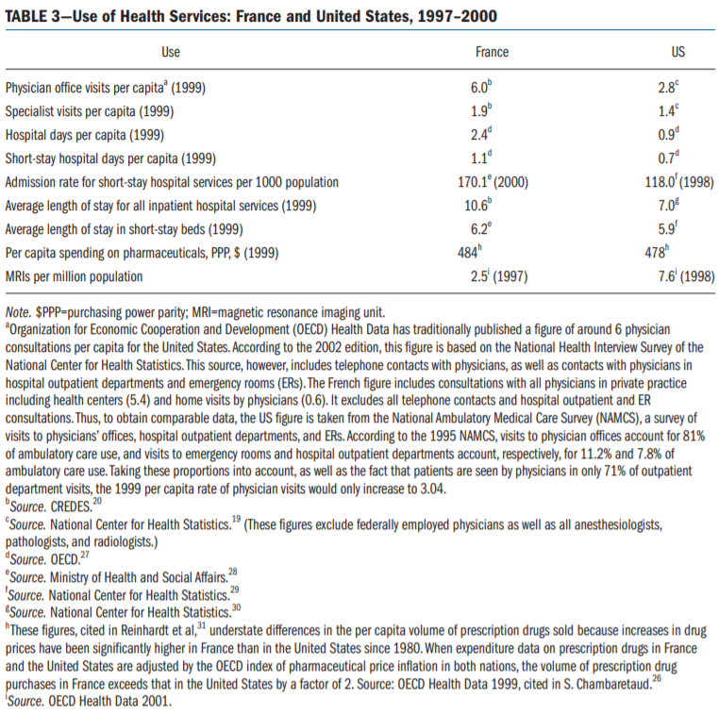

Slide 34
France: Issues
Significant inequalities of resources, outcomes, and quality
Relatively high spending

Slide 35
Germany
Statutory Health Insurance – 92% coverage, rest private or wealthy
Professional autonomy for providers with self-governing bodies
Financed with payroll taxes and regional or occupation based funds

Slide 36
Canada – Medicaid for all
ACA on steroids
UK – Socialized Medicine
France – Medicare for all
Germany – Fully funded private insurance for all
ARP on steroids
Discussion:
Rank these in easiest to hardest to implement in the US. Why?

Slide 37
Types of health care systems by provision and funding

Slide 38
Governance issues
Governance of Consumption
Extent of public access to care
Extent of public control of costs
Governance of provision
Extent of control of hospitals
Extent of constraints on private interests and doctors
Governance of Production
Extent of public constraints on medical innovation

Slide 39
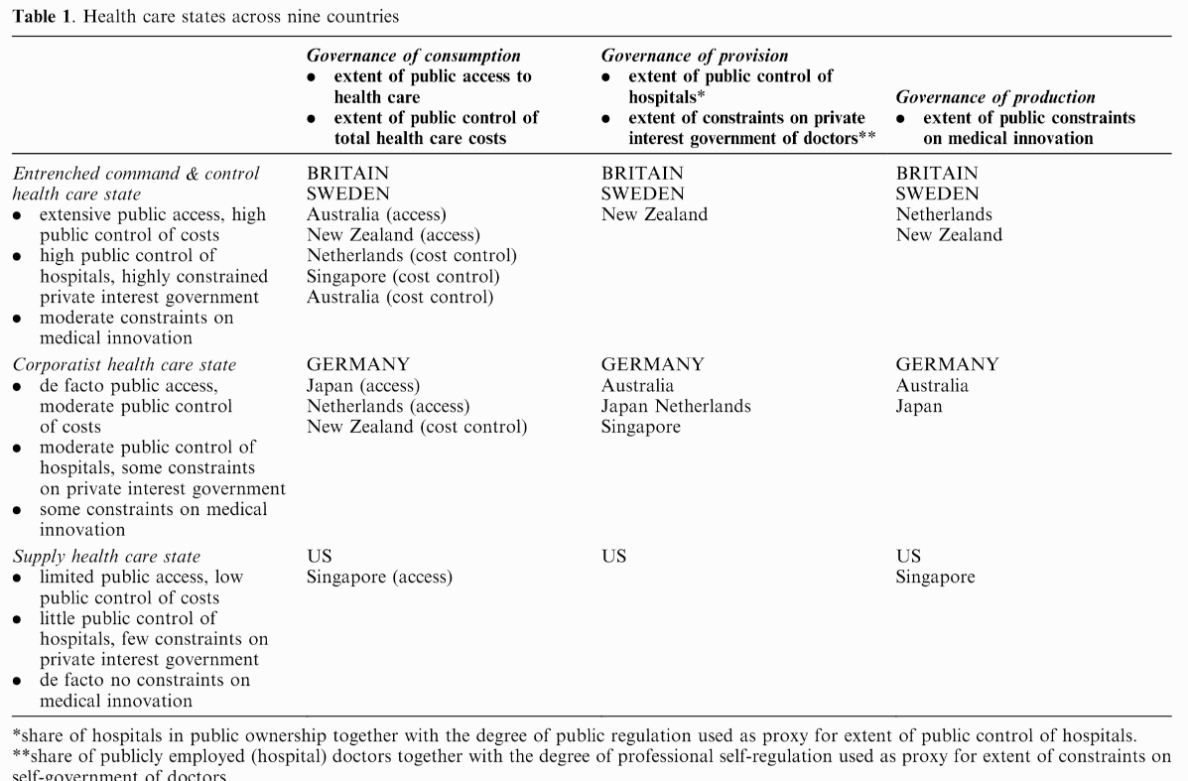

Slide 40
Problems facing any health care system
1. How does one reconcile the need for regional or national coordination with the ability to respond to local needs?
2. How does one reconcile urban with rural needs and the problems of maldistribution?
3. How does one devise a national health care system and yet honor and foster the energies, creativity, and resources of the voluntary sector?
4. How does one reconcile public accountability with professional autonomy and expertise?
5. How shall primary care be integrated with specialty and hospital care?
6. How shall individualistic principles and patterns of practice be reconciled with national standards and a national system?
7. How is a system to reconcile a focus on the patient with a focus on community and population health?

Slide 41
All payer-systems
AKA State Hospital Rate Setting
Goal (same as single payer):
Increase efficiency and reduce insurer overhead in the health care system.
Sets one price that every health insurer pays for any given medical procedure.
Removes job of billing clerk, among others
Currently, bigger plans tend to negotiate deeper discounts.
Private insurance plans pay the most, Medicare pays slightly less, and Medicaid pays the lowest rates.
Con: may lower incentive for innovation and lower provider profits which could be used for experiments.

Slide 42
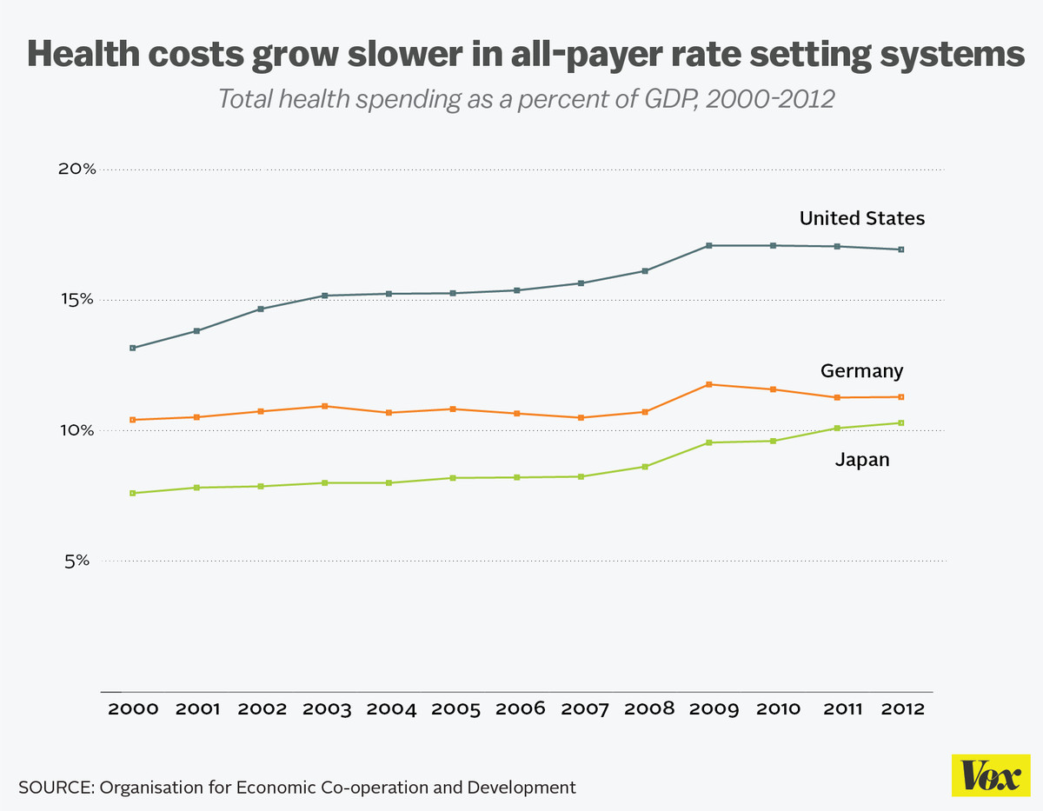
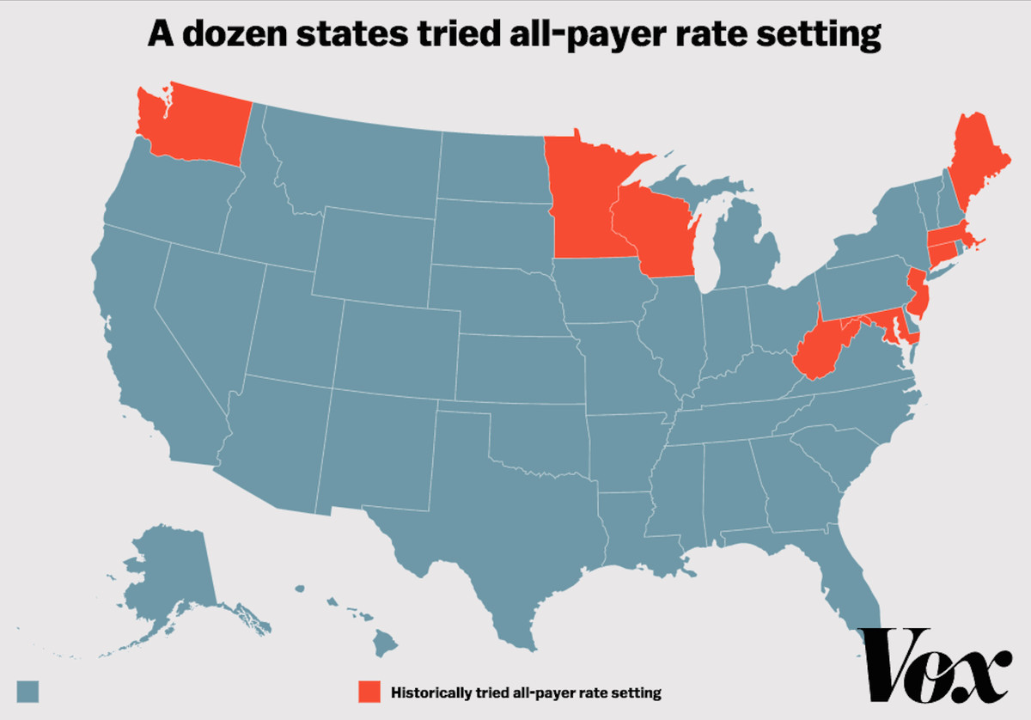
All payer-systems
France, Germany, Japan, the Netherlands, and Switzerland
12 States in the 1970s and 1980s
Killed by HMOs
Only Maryland still uses all-payer
Maryland
Not success story (but not a failure)
Prices have come down substantially
But utilization has increased
Added spending cap in 2014

Slide 43
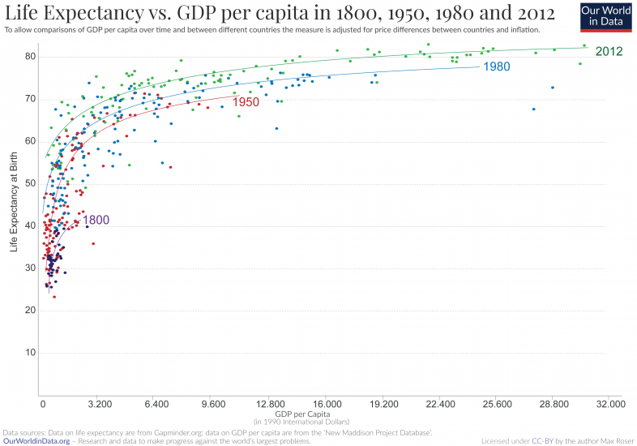

Slide 44
Welcome to class
Today’s video is 55 minutes
So we’ll convene at 7:00
In the meantime, I’m here to chat or answer questions
(I just uploaded the slides as well, sorry for being late)

Slide 45
Readings and Sources
January 2003 edition of the American Journal of Public Health
Burau, Viola, and Robert H. Blank. "Comparing health policy: an assessment of typologies of health systems." Journal of comparative policy analysis 8, no. 01 (2006): 63-76.
McDonough, John E. "Tracking the demise of state hospital rate setting." Health Affairs 16, no. 1 (1997): 142-149.
Pauly, Mark, and Robert Town. "Maryland exceptionalism? All-payers regulation and health care system efficiency." Journal of health politics, policy and law 37, no. 4 (2012): 697-707.

