Slide 1
Pandemics and Covid-19
Shane Murphy – shane@uconn.edu

Slide 2
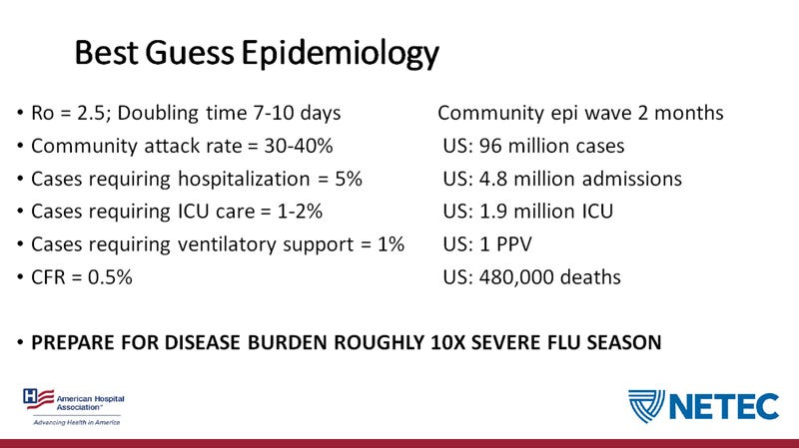
American Hospital Association leaked slide from March 2020

Slide 3
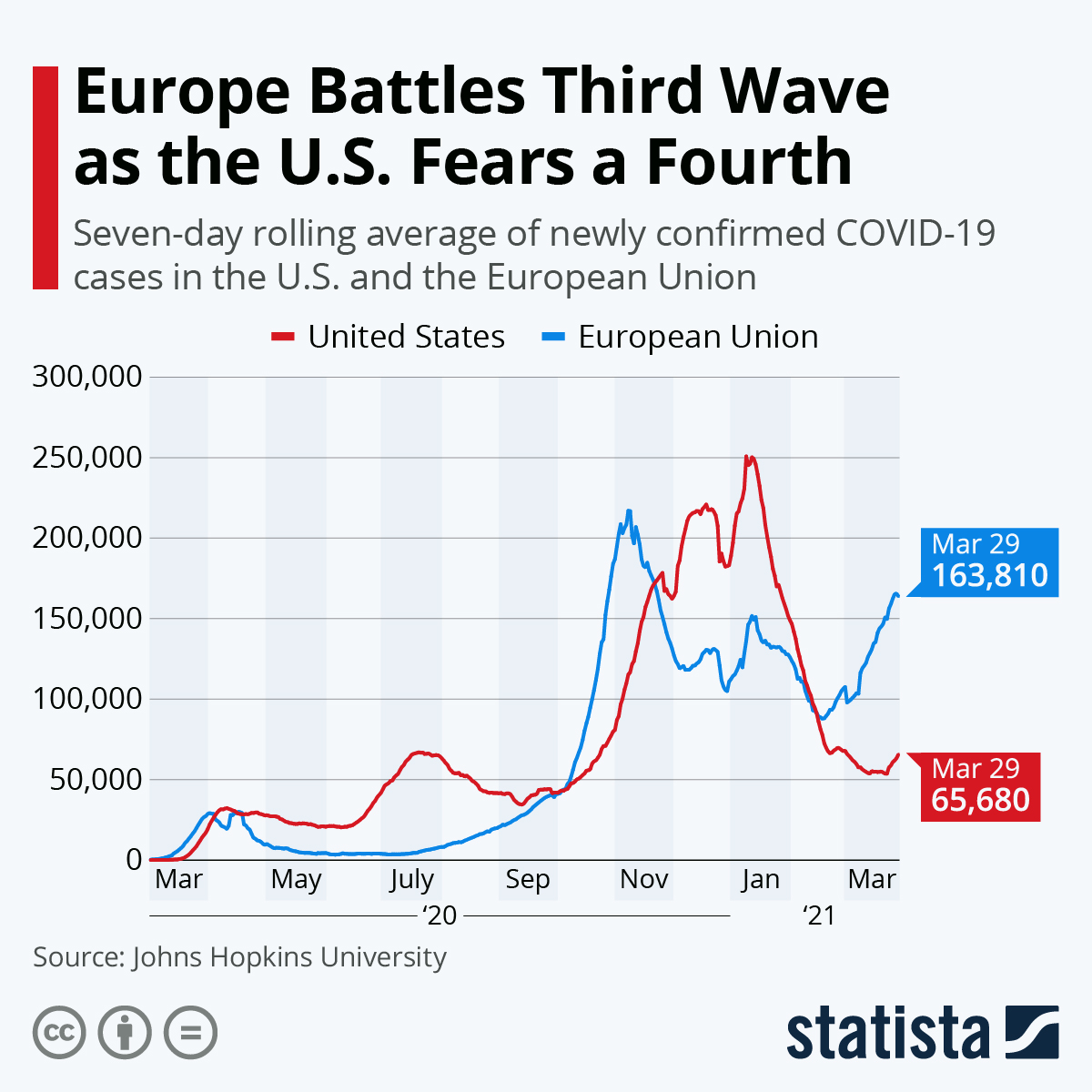
Current picture
US (pop 333M)
  32.8M Cases
  586K Deaths
Europe (pop 741M)
  43.9M Cases
  998K Deaths
Worldwide (pop 7.59B)
  147.3M Cases
  3.12M Deaths

Slide 4
Emergency management
US Preventive Services Task Force
FEMA
WHO Public Health Emergency of International Concern
  Facilitates WHO money to affected countries
  Gives political cover for refusing travel from affected countries
  In the case of Covid-19, delays in declaring PHEIC may have led to countries taking unilateral actions which are outside of WHO recommendations
    Reducing WHO legitimacy

Slide 5
Health Agencies
Centers for Disease Control and Prevention (CDC)
  Surveillance and public health coordination with state/local/tribal/territory public health departments
  National Center for Immunization and Respiratory Diseases (NCIRD)
Food and Drug Administration (FDA)
  Approves tests and medications
HHS
  Runs Medicare/Medicaid
  ACA regulations
National Institute of Health (NIH)
  National Institute of Allergy and Infectious Diseases
  Conducts and supports basic and applied research

Slide 6
Connecticut Department of Public Health
Epidemiology program
Connecticut Epidemiologist newsletter
  https://portal.ct.gov/DPH/Epidemiology-and-Emerging-Infections/Connecticut-Epidemiologist-Newsletter-Archive

Slide 7
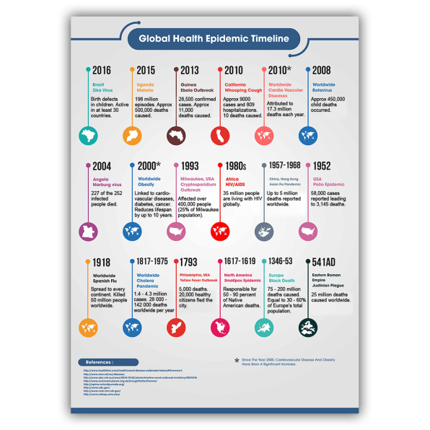

Slide 8
Past Epidemics
2002-2004 South Asian Respiratory Syndrome (SARS)
2009 H1N1 (or swine flu) pandemic
2012 Middle Eastern Respiratory Syndrome (MERS).
2014 polio outbreak
2014 outbreak of Ebola in Western Africa
2015–16 Zika virus epidemic
2018–20 Kivu Ebola epidemic
2019–20 novel coronavirus outbreak (Covid-19)

Slide 9
Employee Retirement Income Security Act of 1974 (ERISA)
Sets minimum standards for most voluntarily established retirement and health plans in private industry to provide protection for individuals in these plans.
  ERISA focuses on pension plans not health insurance
    Many employers had underfunded, hurting retired employees.
    ERISA offer protections for employees - In exchange, Congress preempted any state laws that “relate to” employee benefit plans except insurance.
  So under ERISA, states can still regulate insurance.
  But lots of firms don’t actually buy insurance for their employees. Instead, larger firms usually “self-insure,” meaning that they pay for their employees’ health expenses themselves. And ERISA clarifies that employers, when they self-insure, aren’t to be treated as insurers.
    61% of people with employer-sponsored coverage are covered by self-insurers
    100 million people nationwide who receive coverage through self-insured employers

Slide 10
3 groupings of regulatory authorities
Federal government programs in CMS and Department of Veterans Affairs
  Medicare
  VA
  Some Medicaid
State regulators
  Some Medicaid
  Fully insured plans where the insurance company takes on the risk of bad claims and profits from low claims
    ACA individual market
    Big chunks of small group employer market
    Small elements of large group employer markets
ERISA rules them all
  Group plans in Administrative Services Contracts

Slide 11
Relevant regulations
Emergency directives require insurers to cover COVID-19 testing without cost-sharing.
  High deductibles and other out-of-pocket payments discourage people from getting tested, which in turn threatens public health.
Essential health benefits under the ACA
  Ambulatory patient services (outpatient services); Emergency services; Hospitalization Maternity and newborn care; Mental health and substance use disorder services, including behavioral health treatment; Prescription drugs; Rehabilitative and habilitative services (those that help patients acquire, maintain, or improve skills necessary for daily functioning) and devices; Laboratory services; Preventive and wellness services and chronic disease management; Pediatric services, including oral and vision care
  Includes inpatient hospitalization, rehab, prescription drugs and for COVID-19 purposes, lab and diagnostic services.
  If there is a COVID-19 test or subsequent treatment of an individual who tests positive, their testing and treatment is covered as an EHB.
  Allowable benefits do not imply zero cost-sharing
EHBs for preventive services and screenings are no cost sharing.
  Preventive services include vaccines, a lot of developmental screenings for kids, colon cancer checks and now PrEP for individuals at high risk of being infected by HIV
  Requires rating by US Preventive Services Task Force and one year waiting period

Slide 12
Self-funded health care - Administrative Services Only (ASO)
While some large employers self-administer their self funded group health plan, most find it necessary to contract with a third party for assistance in claims adjudication and payment.
Third party administrators (TPA's) provide these and other services, such as access to preferred provider networks, prescription drug card programs, utilization review and the stop loss insurance market.
Insurance companies offer similar services under what is frequently described as "administrative services only" or "ASO" contracts.
  In these arrangements the insurance company provides the typical third party administration services but assume no risk for claims payment.
  ASOs often are EPOs, incorporate HSAs and/or HRAs
Self-funded plans must comply with most of the provisions in the ACA including dependent coverage until 26, prohibition on rescission, and prohibition annual or lifetime limits.
However, while the ACA required coverage of essential health benefits for fully insured plans, self-funded plans are notably exempt from this requirement.

Slide 13
Regulatory laws
Mental Health Parity and Addictions Equity Act (2010) prevented insurers from placing greater restrictions on mental health and substance abuse disorder treatment

Slide 14
Quarantine
From the Italian “quaranta giorni,” meaning 40 days— were first developed in Venice in 1370, to keep the bubonic plague at bay by banning any ships and goods for the time it seemed to take most epidemics to burn themselves out.
Quarantine power a part of police power of the state
  No right to break a quarantine
  Can be a misdemeanor
  No right to keep job or be paid if quarantined (exceptions exist in Maine, Maryland, New Jersey, New Mexico, South Carolina, and Texas)
Quarantines and travel bans often last longer than necessary
  Leading to excess economic costs
  Also may drive undocumented movement and dishonesty about symptoms
Hourly wage workers particularly harmed

Slide 15
Federal Disaster Assistance
FEMA focuses on disaster relief
  Activated by state/tribe/territory or federal declaration of emergency
  FEMA is not to duplicate other efforts, including efforts provided by private insurance
  Does not fund patient care in most cases
Disaster Unemployment Assistance (DUA)
  Overseen by the Department of Labor, funded by FEMA
Federal-State Unemployment Insurance is available from states
  FUTA
Local United Way

Slide 16
Surveillance
Future Covid-19 surveillance in CT likely to follow SARS recommendations:
  Individuals admitted to the hospital with pneumonia with radiographic changes acute respiratory distress syndrome of likely infectious origin; AND at least one a number of risk factors for SARS-CoV infection related to association with endemic areas should be reported to the CT Dept of Public Health Epidemiology Program
  The state laboratory pays for free testing for SARS-CoV
Insurance company role
  Insurance providers often provide clinicians and hospitals with reports that track clinicians’ prescribing habits, addressing adherence to CDC recommendations

Slide 17
Managed Care
MCOs could use their provider networks, contractual relationships, and client-tracking technologies to improve coordination, promote continuity of patient care, and improve its quality.
MCOs have incentives to adopt and implement best practices because by reducing infectious diseases, they could control their costs and fulfill state contracts more effectively.
Provider autonomy is one source of pushback against MCO pressure
Standing order programs (SOPs) allow clinicians to administer influenza and pneumonia vaccinations according to a protocol approved by a physician or health system without an individual physician order or examination.

Slide 18
Long shadow of epidemics
Economic studies of
  Late 19th century Yellow Fever exposure in utero (Saavedra 2017)
  1918 Influenza pandemic (Almond 2006, Karlsson et al 2014)
In utero exposure reduced high school graduation rates by 2%, reduced professional employment rates years later by 1%, reduced wages/income years later
Mortality shock decreases savings and increases poverty rate for next decade

Slide 19
Risk of infection to health professionals
Viruses can survive outside the body for long periods of time
  SARS was found to survive for days
Complacency in following procedures was key issue
Procedures should be put in place in advance
  Understand different causes of spread are in play for different diseases

Slide 20

Event Insurance
Possible to insure anything
Zurich Insurance and Lloyds of London
Policies cover cancelation under particular circumstances
Purchases always jump after epidemics

Slide 21
Legitimacy
Moral justification concerns what it is that makes a decision morally right or wrong, whereas deliberating about moral legitimacy is a task subsequent to the question of justification. Moral legitimacy ‘depends on whether a justified act under consideration is performed in a morally acceptable manner’
Who holds sufficient expertise to make allocative decisions
  Courts; Legislators; Government Bureaucrats; Insurance companies; Patients; Doctors
Community Health Centers and Community Access Programs

Slide 22
Distribution of Vaccine – CDC report
Maximize benefits and minimize harms
  The ability of essential workers, including health care workers and non–health care workers, to remain healthy has a multiplier effect
Promote Justice
  Commitment to removing unfair, unjust, and avoidable barriers to vaccination that disproportionately affect groups that have been economically or socially marginalized, as well as a fair and consistent implementation process
Mitigate Health Inequalities
  Disparities in the severity of COVID-19 and COVID-19–related death, as well as inequities in social determinants of health that are linked to COVID-19 risk, such as income or health care access and utilization
Promote Transparency
  The underlying principles, decision-making processes, and plans for COVID-19 vaccine allocation must be evidence-based, clear, understandable, and publicly available. To the extent possible, considering the urgency of the COVID-19 response, public participation in the creation and review of the decision-making process should be facilitated. In addition, when feasible, tracking administration of vaccine to the groups recommended for initial vaccine allocation can contribute to transparency and trust in the process. In an ongoing public health response, the situation continually evolves as new information becomes available. Transparency includes being clear about the level of certainty in the available evidence and communicating new information that might change recommendations in a timely fashion.
Notes:
https://www.cdc.gov/mmwr/volumes/69/wr/mm6947e3.htm

Slide 23
Economic effects of Covid 19
Supply
  result from the loss of working hours, and the decline in aggregate demand results from the decline in income due to unemployment associated with lockdowns.
Demand
  First, reduction in employment leads to lower demand for capital, thereby resulting in output loss.
  Second, the rising costs of imports and exports for goods and services result in trade reduction and productivity loss.
  Third, the sharp decline in international tourism generates less revenue, thereby leading to production loss.
  Finally, the decline in demand by households, who purchase fewer services than before, considerably decreases the consumption of goods and services.
In addition, the contraction in foreign direct investment, real effects of financial shocks, and falling oil prices widen the economic costs associated with the COVID-19.

Slide 24
A few headline numbers
Global GDP declined by more than 4.9% in the second quarter of 2020 due to economic disruption.
The world lost nearly 300 million full-time jobs in the second quarter of 2020 from 130 full-time job losses in the first quarter of 2020.
The World Travel and Tourism Council (WTTC) estimated a 25% decline in global travel in 2020 due to the COVID-19 pandemic.
During the COVID-19 period, Russia–Saudi Arabia oil war reduced the value of oil prices from $ 31.05 per barrel on March 8, 2020, to $ 19.23 per barrel on April 30, 2020.
Wall Street witnessed a large single-day drop in the stock price in the second week of March 2020 due to a lack of investor confidence after the US’s travel ban declaration and unchanged interest rate by the European central bank.
  Transportation, mining, electricity, heating and environment more affected Manufacturing, IT, Education and Health Care remains less affected
  Smaller firms more affected

Slide 25
Effect on monetary policy and macroeconomics
COVID-19 recession is associated with lower inflation in advanced economies
  Expansionary monetary policy could facilitate higher economic growth and higher investment in the productive sector.
  This shifts investment away from emerging market economies, exasperating recessions there.

Slide 26
Results that slipped through the cracks
Much of the research focuses on financial effects
  Increased volatility
Dozens of additional papers already published
  Reduced energy sector performance
  Increased stock market bubbles
  Decreased remittances from affected countries (like the US)
  Reduced political partisanship in the US

Slide 27
Padhan, Rakesh, and K. P. Prabheesh. "The economics of COVID-19 pandemic: A survey." Economic Analysis and Policy 70 (2021): 220-237.

