Slide 1
HCMI 5243: Public Health Reform
Shane Murphy – shane@uconn.edu

Slide 2
Welcome to class
Video is uploaded (sorry about the music in the first 30 seconds)
Video is ~40 minutes, so we’ll convene at 6:40
In the meantime, I’m here to chat/answer questions

Slide 3
Discussion
List 3 arguments for universal, single payer health insurance in the US.
What are counterarguments for these?
List 3 arguments against.
What are counterarguments for these?
Most arguments revolve around who is helped and who is hurt. In each case, think about who are the stakeholders affected and how are they affected.

Slide 4
Arguments for single payer health insurance in the US
For 1. Universal coverage is good in and of itself – it gives access to care for all – could improve overall health and productivity
Counter 1.1. Increases the cost base for the public health payer and raise taxes
Counter 1.2. People don’t want to lose their current plan
Counter 1.3. Insurance may not always improve health
For 2. Eliminates the need to navigate insurance marketplaces
Counter 2.1. Government system may itself be complicated
Counter 2.2. Less choice isn’t in itself a good thing
Counter-counter 2.2.1. Choice may not add value to the insurance system
For 3. Reduces administrative costs and eliminate duplication of services
Counter 3.1. Evidence is not clear that this is true
Counter 3.2. Locking people into one product reduces incentive to improve product
Counter 3.3. Increase the cost of auditing system
For 4. Reduces stress for entrepreneurs and people seeking work where employer based insurance is not available
Counter 4.1. If funded using payroll taxes, this would increase the tax burden for small businesses
For 5. Reduces financial stress
Counter 5.1. Depends on the structure of financing – tax increase could lead to new sorts of stresses
For 6. Could equalize standard of care
Counter 6.1. This means lower standards for some, higher for others, not clear if there is an overall winner
Counter-counter 6.1.1. Increased government role in decision making would require more utilization of CEA, etc.
Counter 6.2. Geographic and other disparities will persist

Slide 5
Arguments against single payer health insurance in the US
Against 1. Could reduce provider salaries and decrease the supply of physicians
Counter 1.1. This would reduce cost of care overall
Counter-counter 1.1.1. Would reduce quality of doctors
Counter 1.2. Government could play a larger role in funding medical education
Counter 1.3. Could make up cut in payments by increased efficiency, leading to a minimal haircut
Against 2. Increased wait times and rationing
Counter 2.1. Reduces wait times from infinity to X for people who were otherwise uninsured
Counter 2.2. Wait time increases cost for mild conditions
Counter-counter 2.2.1. moral hazard is equally effective in low and high severity illnesses
Against 3. Government is inefficient
Counter 3.1. Current system is inefficient
Counter-Counter 3.1.1. Current inefficiencies may be due to government regulations and influences
Counter 3.2. Government inefficiency is over-estimated
Against 4. Creating a new program from scratch will be expensive and buggy
Counter 4.1. Can avoid problems with current model
Counter 4.2. Can build on current CMS system
Against 5. Vertical integration of the health system removes checks and balances and independent consumer protection
Counter 5.1. VI could increase efficiency
Counter 5.2. Could move people from billing to auditing
Against 6. Could remove incentives for innovation
Counter 6.1. Not necessarily, depends on the real motivation for innovation
Counter 6.2. New models of incentivizing innovation could be created (prizes, etc)
Against 7. Increase political involvement may lead to swings in the nature of the system as political winds change
Counter 7.1. Most of Medicare stays fairly consistent across political regimes

Slide 6
Great unknowns if single payer health insurance is implemented in the US
How would interest group involvement change

Slide 7
The problem in two graphs
Costs are growing, particularly administrative costs, prices, and overutilization
I prefer to focus on administrative costs
Health isn’t improving and for many it is getting worse
This may not be the fault of the medical health system, but rather the behavioral health system

Slide 8
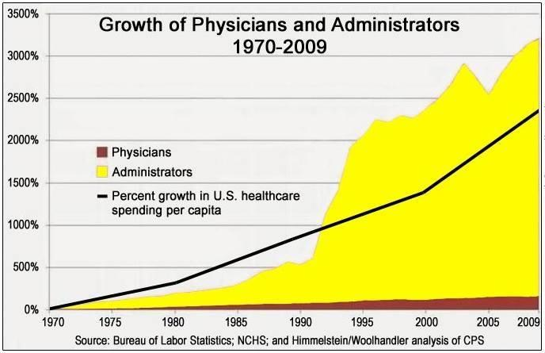

Slide 9
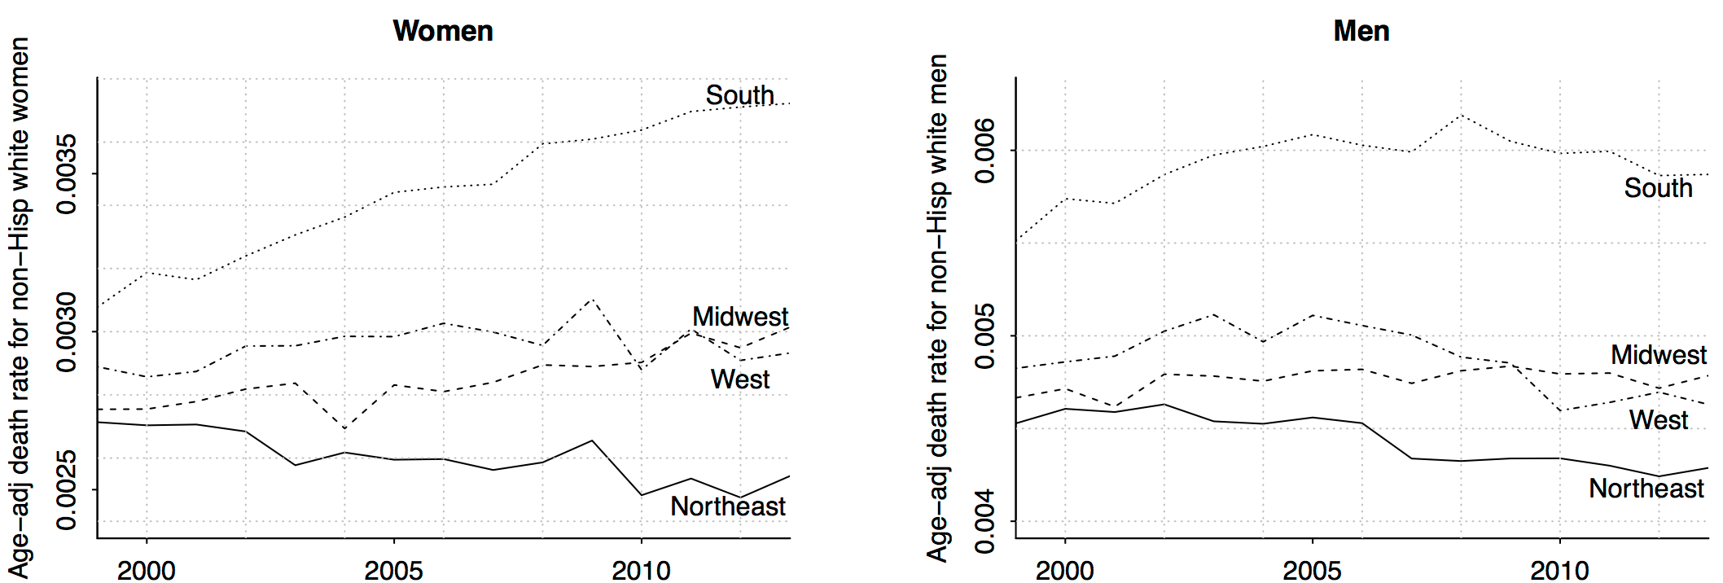
Deaton and Case 2015 (corrected by Gelman 2016)

Slide 10
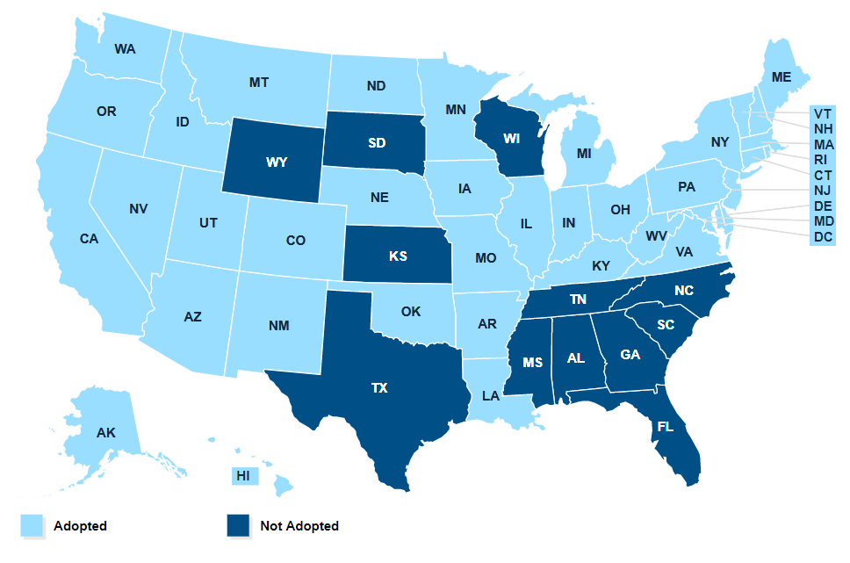
State of Medicaid Expansion

Slide 11
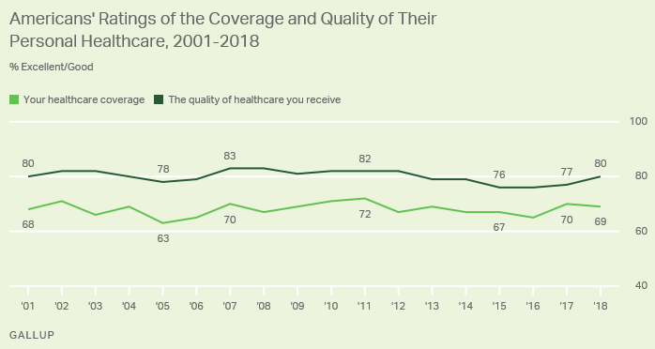
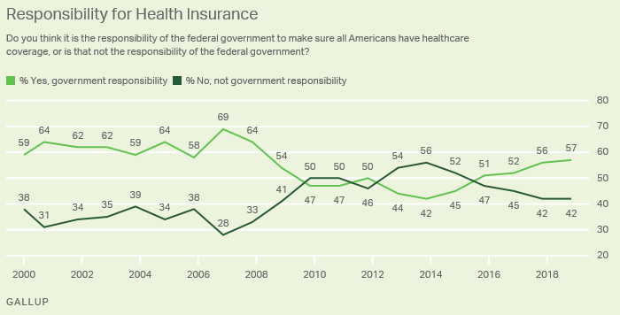
Some Polls
People like their insurance
But not as much as they like their coverage
And they don’t like the healthcare industry
People think the government should play a role
But aren’t sure what that role should be
Notes:
https://news.gallup.com/poll/4708/healthcare-system.aspx
https://news.gallup.com/poll/245195/americans-rate-healthcare-quite-positively.aspx

Slide 12
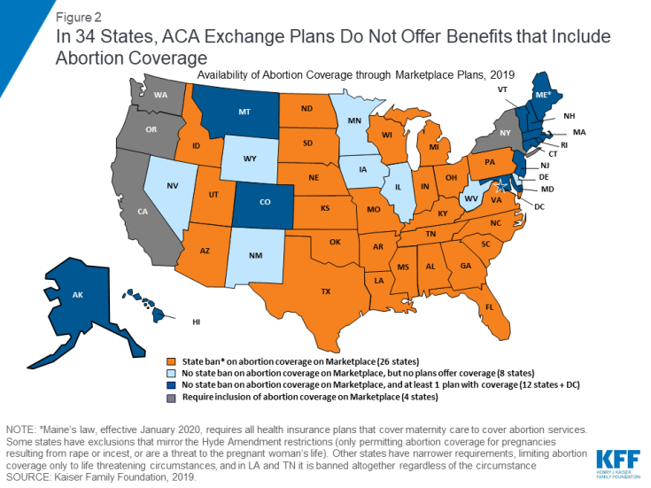
Abortion Coverage Regulations
Hyde Amendment
Applies to subsidies for plans bought on exchange
Does not apply to abortions in cases of rape, incest, or endangerment of life of woman
States may fund abortion care for Medicaid recipients

Slide 13
H.R. 3, the Lower Drug Costs Now Act of 2019
It will become legal and required for the Centers for Medicare & Medicaid Services to negotiate prices for between 25 and 250 drugs meeting specific criteria and including insulin. The negotiated prices must be offered under Medicare and Medicare Advantage. Private insurers may also be offered the negotiated price.
The negotiated maximum price may not be higher than 120% of the average price in specific other industrialized companies. Drug companies failing to comply will face civil and tax penalties.
The bill also includes rebates from drug manufacturers to CMS for covered drugs that have prices that rise more rapidly than the increase in inflation and reduces the annual out-of-pocket spending threshold.

Slide 15
Democratic proposals focus on:
Coverage for all
The ACA cut uninsured rates in half, but no further
And purchase of bronze plans and interest in high deductible plans suggests markets are going to lead to less complete coverage
Most democratic plans propose a single payer without copayments or deductible available for everyone
Notes:
Based on the Kip Sullivan plan

Slide 16
Democratic proposals focus on:
Costs
ACA cost control measures have little or no evidence behind them
HMOs create possibly only short term cost improvements
Gaming the system has increased
Gaming measurement
Gaming caase-mix
Gaming costs
Single payer would shrink administrative costs and reduce corruption/gaming
Single payer would negotiate with pharmaceutical companies

Slide 17
Democratic proposals focus on:
Payment
Less emphasis or detail on payment, similar proposals to Medicare Part A and B
Physicians: FFS
Hospitals: Capitation
Choice
Removal of networks used by HMOs/PPOs/POSs

Slide 18
Republican criticisms of Democratic plans
Complexity
The ACA was 2,300 pages long and now entails 16,000 pages of regulations
Cost
Government organizations are known for waste
Physician incentives
Physician pay will have to go down
Insuree choice
People prefer the public option, so that they could keep their current plan

Slide 19
Republican proposals focus on
Liberalize Health Savings Accounts
Increase tax deductible contribution maximums
Permit broader usage
Allow tax-free rollover to survivors
Notes:
Based on the Scott Atlas plan

Slide 20
Republican proposals focus on
Tax Treatment and Incentives
Either remove tax deduction for employer sponsored care or allow deduction for non-employer sponsored care
Remove tax deductions for non-high deductible plans
Ie treat most plans as Cadillac plans

Slide 21
Republican proposals focus on
Reduce regulations on insurance
Allow high-deductible plans with fewer coverage mandates
Reduce or remove use of employer sponsored health insurance
Permit insurers to adjust premiums for obesity and other health risks and pre-existing conditions

Slide 22
Republican proposals focus on
Increase Medicare privatization
Add private options for Medicare enrollees
Include drug benefits in plans
Regulate private plans to ensure out-of-pocket limits
Combine A, B, and D into one, simplified Medicare public option
Promote HSAs for Medicare recipients
Increase eligibility age

Slide 23
Republican proposals focus on
Increase Medicaid privatization
Allow high-deductible private Medicaid plans
Seed fund HSAs for Medicaid recipients
Use federal funds incentives to push states to encourage enrollees onto high-deductible plans

Slide 24
Republican proposals focus on
Reduce regulatory burden
Allow nurse practitioners and physician assistants to take a higher role
Reduce the power of medical specialty societies restricting supply of doctors
Repeal taxes on medical devices and brand-name drugs
Reduce bureaucracy in the FDA for device and drug approvals

Slide 25
Texas v Azar -> Texas v US
Notes:
https://www.kff.org/health-reform/fact-sheet/potential-impact-of-texas-v-u-s-decision-on-key-provisions-of-the-affordable-care-act/?utm_source=hs_email&utm_medium=email&utm_content=2&_hsenc=p2ANqtz-_037l8tBxCjsxUijA0INwupseSA0XA0fYwXLCVUgAn08z0nBGg2egu9vDkAhM8FxmmRzkRaJKdRDb5v-4XisZ7tNXt_g

Slide 26
Democratic criticism of Republican plans
Introducing low cost high deductible plans won’t lead to universal coverage and will reduce necessary utilization
Health Savings Accounts, depending on implementation, will be a regressive tax break
Regulations improve care and are necessary
Privatizing Medicare and Medicaid is unpopular and may not lead to improvements

Slide 27
Proposals with broad appeal include:
Limited Medicaid expansion
To 100% FPL rather than 138%
People eligible for no-cost Medicaid or ACA no-cost plans should be automatically enrolled
Encourage state reinsurance risk pools to expand the size of pools
Increase transparency in prices
Limit monopoly power, including patent-based monopoly
Notes:
http://www.aei.org/publication/the-health-reforms-the-g-o-p-should-embrace-but-probably-wont/

Slide 28
Proposals with broad appeal include:
Limit the tax exclusion of employer-sponsored insurance
Ensure effective anti-trust enforcement
Encourage all-payer claims databases – reversing Gobeille v. Liberty Mutual and ERISA rules against these
Expand site-neutral payments where clinically feasible – hospital outpatient departments shouldn’t receive higher payments than stand-alone clinics
Balancing incentives in Medicare Physician Fee Schedule to incentivize med students to become PCPs
Notes:
http://www.aei.org/publication/cost-reducing-health-policies/

Slide 29
Proposals with broad appeal include:
Limit the tax exclusion of employer-sponsored insurance
Ensure effective anti-trust enforcement
Encourage all-payer claims databases – reversing Gobeille v. Liberty Mutual and ERISA rules against these
Expand site-neutral payments where clinically feasible – hospital outpatient departments shouldn’t receive higher payments than stand-alone clinics
Balancing incentives in Medicare Physician Fee Schedule to incentivize med students to become PCPs
Reforming Medigap cost sharing and Medicare benefit design
Reforming protected classes in Medicare Part D
Remove incentive to prescribe higher cost drugs in Medicare Part B
Remove regulations that restrict generic drugs
Notes:
http://www.aei.org/publication/cost-reducing-health-policies/

Slide 30
Other proposals
Repeal any willing provider laws – insurance plans don’t need to offer so generous out-of-network coverage

Slide 31
4 more classes
Three topics from the following:
Covid, various aspects of Medicare/mediciad, Crises, retirement/social security/private retirement financing, ….
Apr 19: ??? - Financing of Medicare and Medicaid
Apr 21: ??? – Biden, O’Connor, and the next 5 years
Apr 26: ? – Covid
Apr 28: Review/wrap up

Slide 32
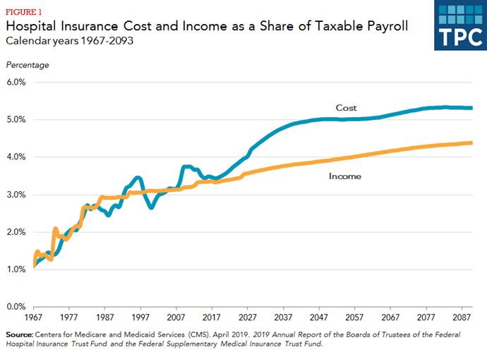
Medicare solvency

Slide 33
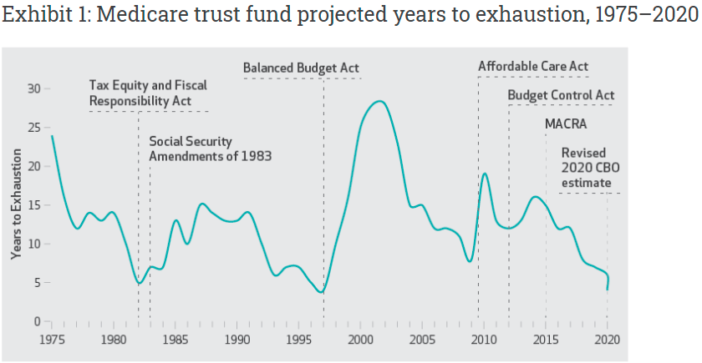
Never the first time, not the last(?)

Slide 34
Timeline
Recessions reduce payroll tax revenue: Nov 1973–Mar 1975 Oil Crisis, Jan 1980–July 1980 double dip, July 1981–Nov 1982 Iran revolution, July 1990–Mar 1991 ending Bush’s presidency, Mar 2001–Nov 2001 dot-com bubble, Dec 2007–June 2009 great recession, Feb 2020–June 2020 Covid recession
The Tax Equity and Fiscal Responsibility Act of 1982: The prospective payment system required Medicare to pay for most inpatient care using diagnosis-related groups. This significantly reduced federal outlays, quickly leading to an increase in the life span of the trust fund, which remained relatively stable through the end of the 1980s.
Balanced Budget Act of 1997: various measures including reductions in the growth of payments to providers, expansion of prospective payments to post acute care facilities, and increased cost sharing for beneficiaries.
Reduced revenues from the dot-com bubble triggered the Sustainable Growth Rate (SGR) provisions of the 1997 Balanced Budget Act, requiring a significant cut in Medicare payments. These cuts were canceled by legislation, leading to continued reduction in Trust Fund balance.
Expected revenue generators such as the “Cadillac Tax,” medical device tax, and other parts of the ACA did not end up becoming reality. A year after the ACA went into effect, a fiscal crisis led to the Budget Control Act of 2011, which cut Medicare payments by 2 percent.
The Medicare Access and CHIP Reauthorization Act of 2015 permanently repealed the SGR and provided temporary increases in payments for a variety of providers, including ambulance services and home health services in rural areas. The effect has been a depletion of the trust fund at faster than expected rates. Over the past five years, the expected year of exhaustion shortened from 2030 to 2026.

Slide 35
Future
Current Law if Fund runs out
Payments may be delayed
Or reduced
New legislation likely
Revenue enhancing
Cost cutting
Radical changes
Medicare buy-in with ACA subsidies
Push generics
Increase payroll tax
Cost cutting legislation
Policy Option | Potential Savings
Expand Bundled Payments and Promote New Payment Models | $5 to $50 billion
Reduce Preventable Readmissions and Unnecessary Complications | Up to $10 billion
Reduce Payments to Post-Acute Providers | $25 to $50 billion
Reform and Reduce Payments for Graduate Medical Education | $15 to $40 billion
Reduce Medicare's Coverage of Bad Debts | $15 to $50 billion
Expand Medicare and Medicaid Drug Rebates | $50 to $150 billion
Reduce the Price and Use of High-Cost Drugs | Up to $30 billion
Adopt Competitive Bidding for Medicare Advantage | $25 to $75 billion
Limit Medicare Cost-Sharing Rules | Up to $20 billion
Restrict Supplemental Coverage | $50 to $125 billion
Limit Medical Malpractice Claims | $50 to $70 billion

Slide 36
Discussion
Consider three possibilities, each group will focus on one outcome:
1) Democratic proposals
2) Republican proposals
3) Status quo/centrist
Three groups, in your group, consider some of the proposals (5-10) you read about.
Who are the stakeholders that advocate for your outcome? Why?
Take the position assigned to your group, what would someone advocating for that position say about this proposal?
Imaging the country decides to pursue a grand compromise. Would a version of this proposal be something your group would be willing to accept in such a compromise?

Slide 37
Discussion
Who are the stakeholders that advocate for your outcome? Why?
Low-income families (rural/urban), private insurance companies (large/small), middle/high income families (rural/suburban/urban), employers (large/small)
Take the position assigned to your group, what would someone advocating for that position say about this proposal?
Imaging the country decides to pursue a grand compromise. Would a version of this proposal be something your group would be willing to accept in such a compromise?

Slide 38
Discussion - proposals
Independent Payment Advisory Board (IPAB) – Control costs for Medicare (and maybe Medicaid) by limiting reimbursement for high cost-low effectiveness treatments
Democratic response – In favor of limited cuts, but afraid this would shift more burden to the sick
Republican response – In favor of cutting spending, proposed caps are often state-administered
Which stakeholders are less concerned that this would shift more burden to the sick?
Higher income individuals (generally older), less sick individuals (generally younger)
What about providers?
Could limit ability to provide high cost (and high margin) care. Don’t want their autonomy reduced
What about private insurance companies?
Could result in shift of high-cost care from medicare to private insurer, could also justify private insurers not covering high cost care

Slide 39
Discussion - proposals
More limited Medicaid expansion (to 100% FPL)
Republican response – spending on Medicaid is already to high, but more limited is better than a larger
Democratic response – spending on Medicaid is already to limited, but more expansion is better than none

Slide 40
Muhlestein, David. "The Coming Crisis For The Medicare Trust Fund" Health Affairs Blog, December 15, 2020

