Slide 1
HCMI 4225: The Right to Health and to Health Care
BUSN 202: Mon/Wed 12:30 AM – 1:45 PM
Shane Murphy – shane@uconn.edu

Slide 2
Music
19th Century European Freedom Movements:
Beehthoven – Fedelio: https://www.youtube.com/watch?v=kdB0roPqg7Q
Verdi – Nabucco: https://www.youtube.com/watch?v=2VejTwFjwVI
Late-20th Century Emancipation
The Clash – Know Your Rights: https://www.youtube.com/watch?v=5lfInFVPkQs

Slide 3
Arnold Kling’s Three Languages of Politics
Progressives: The Oppressed vs. Oppression
Conservatives: Civilization vs. Barbarism
Libertarian: Freedom vs. Coercion
I might add the academics/bureaucrats view:
The Expert vs. ignorance

Slide 4
Rights in moral philosophy: Utilitarianism
Associated with founders of economics (Jeremy Bentham)
Policies should maximize net social utility
Aggregate welfare
Effective altruism (Singer)
Disease Control Priorities Project

Slide 5
Rights in moral philosophy: John Rawls’ Theory of Justice
Veil of ignorance
Under such a veil, what principles of justice would people choose for society
Maximin
Means rather than ends approach

Slide 6
Rights in moral philosophy: Communitarianism
Reaction to Rawls by Michael Sandel, Charles Taylor and Michael Walzer
Opposes universalist point of view
Distinct societies create distinct “spheres of justice”
Each society creates fundamental principles which are valued
Single community view called “Cosmopolitanism” (related to globalism or internationalism)

Slide 7
Rights in moral philosophy: Cosmopolitanism
Single community alternative to Communitarianism
Related to globalism or internationalism
Associated with Kant, Derrida, and Appiah
Moral universalism and belief of crimes against humanity

Slide 8
Rights in moral philosophy: Libertarian
Personal freedom
Individual choice and limited state influence
Anarchy, State, and Utopia (Nozick)
Endorse negative rights but not positive rights

Slide 9
Rights in moral philosophy: Capabilities approach
Focus on what individuals are able to do (Sen, Nussbaum)
Emphasizes functional capabilities, "substantive freedoms“
the ability to live to old age
engage in economic transactions
participate in political activities

Slide 10
Rights in moral philosophy: Older views
Daoism
Focus on personal morality over community
Confucianism
Mutual obligation
Aristotelian ethics
Cardinal virtues and human flourishing – limited place for “rights”
Abrahamic traditions (justice)
Moses’ laws, Isaiah’s covenant, Jesus’ Beatitudes, Muhammad’s Al-Israa, Augustine’s City of God
Medieval philosophers
Influenced by Aristotle: Avicenna, Averroes, Maimonides, Aquinas

Slide 11
Rights and Human Rights
https://www.youtube.com/watch?v=ew993Wdc0zo

Slide 12
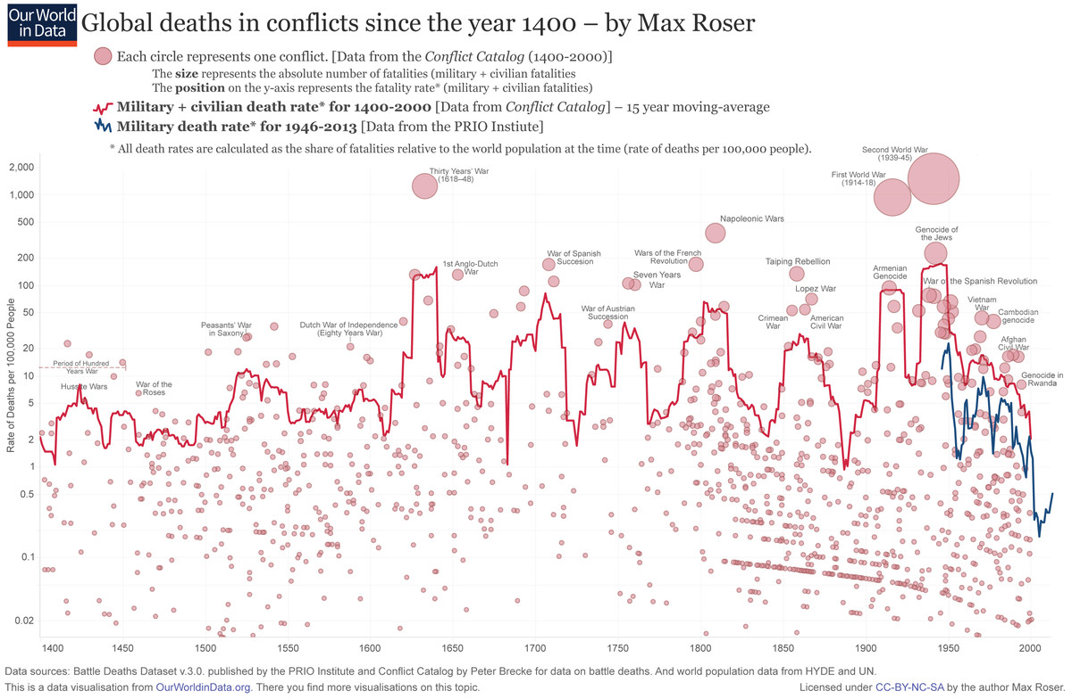
Modern Politics
Machiavelli
Ruler has right to rule
Citizen rights derive from the need for stability
Hobbes
Citizen rights derive from social contract
War, violence, and world wars
WWI (1914-1918)
WWII (1939-1945)
Notes:
https://www.vox.com/2015/6/23/8832311/war-casualties-600-years

Slide 13
Rights and Human Rights
1948 Universal Declaration of Human Rights
The preamble sets out the historical and social causes that led to the necessity of drafting the Declaration.
Articles 1–2 established the basic concepts of dignity, liberty, equality, and brotherhood.
Articles 3–5 established other individual rights, such as the right to life and the prohibition of slavery and torture.
Articles 6–11 refer to the fundamental legality of human rights with specific remedies cited for their defence when violated.
Articles 12–17 established the rights of the individual towards the community (including such things as freedom of movement).
Articles 18–21 sanctioned the so-called "constitutional liberties", and with spiritual, public, and political freedoms, such as freedom of thought, opinion, religion and conscience, word, and peaceful association of the individual.
Articles 22–27 sanctioned an individual's economic, social and cultural rights, including healthcare. Article 25 states: "Everyone has the right to a standard of living adequate for the health and well-being of himself and of his family, including food, clothing, housing and medical care and necessary social services." It also makes additional accommodations for security in case of physical debilitation or disability, and makes special mention of care given to those in motherhood or childhood.
Articles 28–30 established the general ways of using these rights, the areas in which these rights of the individual can not be applied, and that they can not be overcome against the individual.

Slide 14
Positive and Negative Rights (Isaiah Berlin)
Negative Rights (first generation) are things which cannot be done to a person
Civil and political rights (including speech, religion, unlawful imprisonment)
Positive rights (second generation) are things which must be provided to a person
Include police protection, legal council, economic, social and cultural rights

Slide 15
Ancient vs Modern (Benjamn Constant)
Ancient Rights were collective
Depended on society being self determining and individuals participating actively and constantly in collective power.
Individual was subjected to the authority of the whole.
Modern Rights protect the private sphere
Security in private pleasures
Synthesis requires individuals to sometimes put aside private pleasures and take part in the collective through political engangement.

Slide 16
Legal and natural rights
Natural rights are “universal” and “inalienable” (Locke, Paine, Hobbes(?)0)
Legal rights can be modified or repealed

Slide 17
Discussion Questions:
What is a right? What is a human right?
Is health care a human right?
Should the government ensure provision of basic health needs to the entire population?
Should the government ensure provision of premium health care to the entire population?

Slide 18
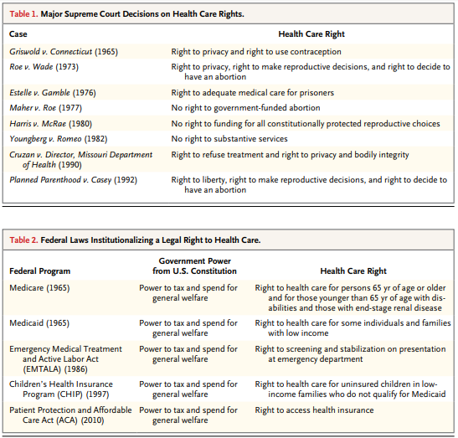
Federal Laws

Slide 19
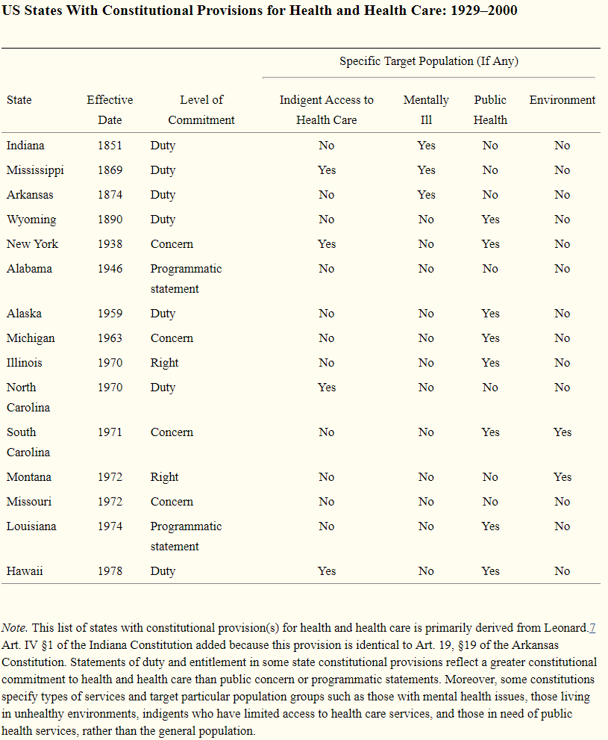
US State Constitutions
As of April 2014, 15 state constitutions specifically mention health and health care—either in the form of a programmatic statement, public concern, individual right, or government duty.

Slide 20
Discussion Questions:
Consider, “The right not to be vaccinated”
What kind of right is this according to the different positions we’ve heard?
Is this right context dependent? In what contexts is it more or less justified?
What rights does it depend on?
What rights does it violate?
Could you reword this principle in a way that does not use the word right. Does that rewording sound better or worse?

Slide 21
Discussion Questions Next Time:
What is a right? What is a human right?
Is health care a human right?
Should the government ensure provision of basic health needs to the entire population?
Should the government ensure provision of premium health care to the entire population?

Slide 22
Philosophers on list of podcasts
John Rawls - Liberal equality
Robert Nozik – Libertarianism
Friederich Hayek - Libertarianism
Martha Nussbaum - Capabilities approach
Kwame Appiah - Cosmopolitanism
Peter Singer - Utilitarianism/Effective altruism
Amartiya Sen - Social welfare
Carl Schmitt - Authoritarianism
John Locke - Natural rights
John Dewey - 20th Century Pragmatism
Richard Rorty - Post-Modern Pragmatism
Catherine MacKinnon - Radical Feminism
Joseph Schumpeter - Corporatism/Elitism/Meritocracyism?
Judith Shklar - Progressive Liberalism

Slide 23
Arnold Kling’s Three Languages of Politics
Progressives: The Oppressed vs. Oppression
Conservatives: Civilization vs. Barbarism
Libertarian: Freedom vs. Coercion
I might add the academics/bureaucrats view:
The Expert vs. ignorance

Slide 24
Philosophers we skipped
Hobbes
Government = Leviathan
Kant and Locke
Categorical Imperative (Act only according to that maxim by which you can at the same time will that it should become a universal law.)
Universals (Reason and God)
Rousseau
Locke - property rights arise prior to the state as an element of natural law.
Rousseau - a social contract is a necessary precondition for the creation and legitimacy of property rights.
Marx
Materialism (the world and what is in it should be the focus of our philosophy and politics), Property Rights, and Hierarchy
Reinhold Niebuhr
Inherent fallibility of humans
Social Justice and Democracy were moral goods under the law of love
Pragmatic incrementalism in the face of Moral Idealism vs Legal Realism/Constitutional Idealism

Slide 25
Idealism vs Pragmatism
Pragmatism in philosophy is the idea that ideas should be considered in terms of their practical effects and consequences.
The truth of beliefs are to be judged by the success of actions of the believer in securing the believer’s goals.
Idealism
Ideology guides actions and choices
Ideology shapes understanding
Note: Idealism could also refer to a type of Phenomenology, but that is not what I’m referring to.

Slide 26
3 Pragmatists(?): John Dewey, Carl Schmitt, and Richard Rorty
Dewey:
Debated Walter Lippman
Lippman was skeptical of public opinion (and thereby Democracy), that it was based on stereotypes and media.
Dewey saw Democracy as an ethical ideal, not just a form of government.
Participation engages individuals in society so that societal stability is greater and more healthy in a democracy.
True Democracy allows every citizen to live to their full potential - which in turn helps society.
The relationship between societal stability and equality is reinforced through providing social services.

Slide 27
3 Pragmatists(?): John Dewey, Carl Schmitt, and Richard Rorty
Schmitt:
Liberalism is a utopian fantasy - during normal times a dictator behaves the same way as a democracy and during emergency a democracy behaves the same way as a dictator.
Liberalism in his view has asked people to give up their political, religious and national identities and replace them instead with the Liberal identity of multicultural globalism, producing weak societies.

Slide 28
3 Pragmatists(?): John Dewey, Carl Schmitt, and Richard Rorty
Rorty:
Values determined by culture
“The emergence of the human rights culture seems to owe nothing to increased moral knowledge, and everything to hearing sad and sentimental stories.”

Slide 29
Critical Theory
Critiques (Horkheimer) of human rights explore how justice systems create a social frame which empowers values held by those who create the system (ought vs is)
Should rights defend markets? Powerful individuals? Western values?
Under this theory, rights privilege the individual over community and freedom over harmony
Human Rights structures are managerial and imperialistic rather than emancipatory
But Critical Theorists (Adorno, Habermas, Benhabib) do support the norms of a constitutionalized democracy for protecting civil and human rights and dignity.

Slide 30
Other philosophical movements
In Ethics (How should I behave?) and Politics
Existentialism
Post-Modernism
Structuralism
Post-Structuralism
Critical Theory
Frankfurt School
Other branches of philosophy
Metaphysics (What is existence?), Epistemology (What is knowledge?), Logic (What is good reasoning?)

Slide 31
Readings:
Health care as a public good
*Karsten, Siegfried G. "Health care: private good vs. public good." American Journal of Economics and Sociology 54, no. 2 (1995): 129-144.
*Galea, Sandro. “Public health as a public good.” Boston University School of Public Health, January 10, 2016, https://www.bu.edu/sph/2016/01/10/public-health-as-a-public-good/
Is health care a right? Is health insurance a right?
*Gawande, Atul. “Is health care a right?” New Yorker, October 2, 2017
*Section I (pages 5-10) of Ruger, Jennifer Prah. “Toward a theory of a right to health: capability and incompletely theorized agreements.” Yale Journal of Law & the Humanities 18, no. 2 (2006): 3.
*Hamel, Mary Beth, Jennifer Prah Ruger, Theodore W. Ruger, and George J. Annas. “The elusive right to health care under US Law.” N Engl J Med 372, no. 26 (2015): 2558-63.
*Ruger, Jennifer P. “The moral foundations of health insurance.” Journal of the Association of Physicians 100, no. 1 (2007): 53-57.

