Slide 1
HCMI 4225: History of Insurance
BUSN 202: Mon/Wed 12:30-1:45
Shane Murphy – shane@uconn.edu

Slide 2
Contents
Federal expenditure before 1900
Civil War
Freedmen’s Bureau
Pensions
Mutual Aid organizations
Early Welfare States
Song of the day – Henry Worrell’s 1856 classic, Sebastopol performed by Elizabeth Cotton: https://www.youtube.com/watch?v=S4EA8DNjxx4

Slide 3
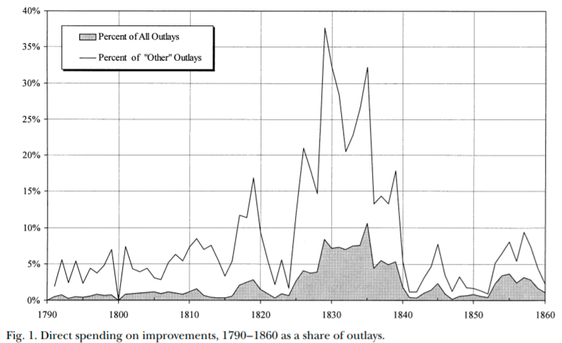
Federal expenditure before the Civil War (1861-1865)
Internal improvements, war, veterans pensions
Defense (including pensions) made up about half of expenditure most years
Congressional structure made federal spending particularly hard
Before 1820, non-defense spending was largely government employee salaries
Ways and means controlled budget; Finance committee (1816), Appropriations committee (1867) came later
Increased Westward expansion and industrialization
1820s until 1920s were an era of appropriations

Slide 4
Internal improvements
Building roads, canals, and railroads, river and harbor projects, and erecting lighthouses and other aids to navigation
Henry Clay and John Quincy Adam’s “American System”
Seven Points of 1815
Era of internal improvements was 1825-1838
Opposed by President Andrew Jackson (1829-1837)
Ends with Panic of 1837
Land grants – distribution of land sale revenues to states – expanded greatly after 1841
Westward expansion and railroads
Organization of Nebraska territory
Slavery question
Transcontinental railroad (1863-1869)

Slide 5
Civil war and emancipation
Secession starts in 1860 after Lincoln elected, before inauguration, war begins April 12, 1861
First Confiscation Act (August 6, 1861) legalizes giving escaped slaves right to remain across Union lines – called contraband
Emancipation proclamation (September 22, 1862)
Went into effect on January 1, 1863
Reconstruction
Bureau of Refugees, Freedmen and Abandoned Lands (March 3, 1865)

Slide 6
Freedmen’s Bureau
Impose a “free labor system” – northern labor ideology onto the South
Give labor rights to workers, largely black
Less than 1000 agents, budget under $6 million per year
Headed by Oliver O. Howard
Opposed by President Johnson, financing stripped in 1869, fully closed in 1872
Black Codes (1865-1866)
Federal troop occupation of the south continued until 1877 – reconstruction era is 1865-1877
Set up schools, hospitals, banks, orphanages, old-age homes, distribute food and clothes
By September 1867, ran 45 hospitals, with 5,292 beds, budget about $250,000 per year (budget supplemented by donations and by exchange with garrisons)
Pressure to move fiscal responsibility to local officials led to closures of most hospitals in 1869.

Slide 7
Civil War pensions
Competitive, patronage oriented political parties
Republican coalition was complex and cut across class and region civil war pensions funded by precisely targeted tariffs could further electoral goals of the party
Administered by the US Bureau of Pensions (merged into the VA in 1930)
Pensions were advocated by the Grand Army of the Republic (GAR), a social group for veterans
GAR became an important political group
Disabled and elderly Veterans and their dependents were more generously aided than in fledgling welfare states of the day

Slide 8
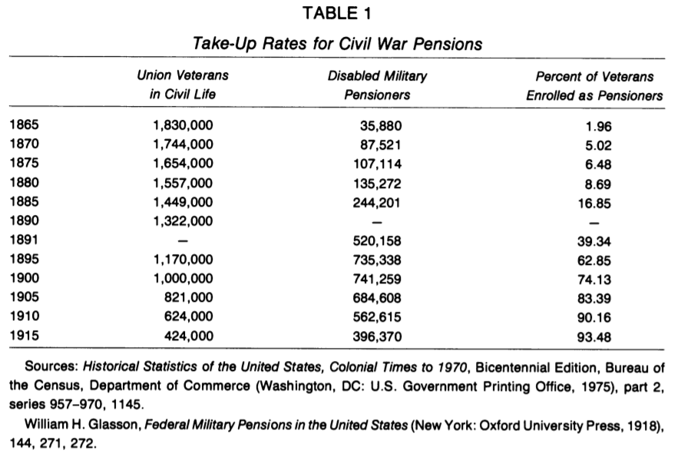
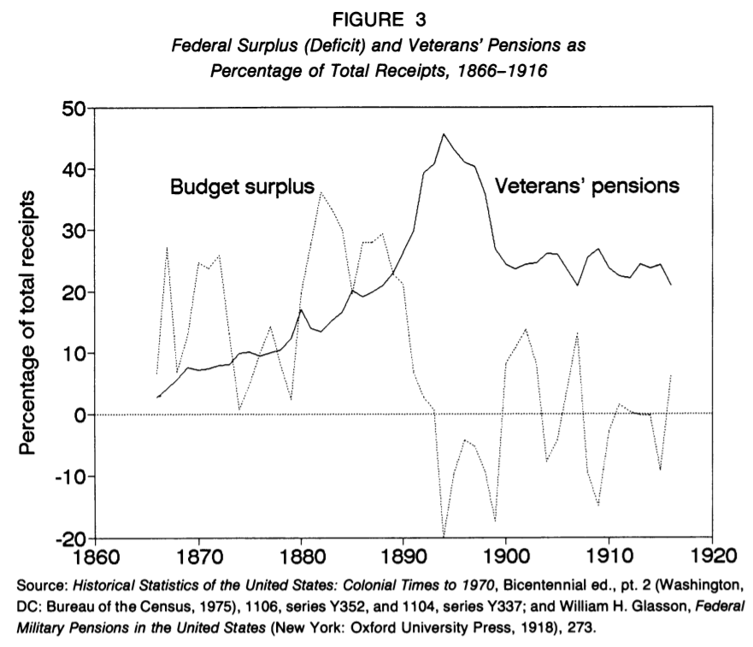
Civil War pensions

Slide 9
Extending benefits beyond veterans
Proposals to extend Civil War benefits used the language of "army of labor" to generalize from the Union Army
Proposals had some limited support from trade unions
Early 1900s proposals for old-age pensions, health and unemployment insurance, and labor regulations were rebuffed by the state
Popular support for these early programs floundered due to negative reactions to being seen as unfounded charity
Future programs would deal with this by becoming contributory
Failures at the federal level led to state level attempts state level attempts had limited long-term success, but did develop ideas and expertise that would later be incorporated into the New Deal. Wisconsin - social insurance rather than tax financed welfare

Slide 10
Maternalist movement
However, maternalist welfare state did begin to form
In the early 1900s, women's organizations grew in strength, pushing for women's rights as well as increased social protection for women
Both of these issues were cross-cutting, middle class women were aware of the possibility of destitution
Maternalist social organization was advocated especially by groups such as:
National Child Labor Committee, National Consumers League, the General Federation of Women's Clubs, the National Congress of Mothers, and the Daughters of the American Revolution.

Slide 11
Comparing maternalist and fraternal social organization
Male dominated social groups cut across class and region
But middle class female dominated groups formed with religious, charitable, and welfare purposes
Task of shaping public opinion was key both in influencing legislatures to act and influencing courts to accept
This was in contrast with courts striking down laws intended to shield unions, regulate working conditions, and regulate the market

Slide 12
Detour: Local medical systems
Poorhouses/workhouses/pesthouses
Urban public hospitals systems
Funded by cities
Staffing supplemented by medical students
Limited willingness of counties and states to subsidize local systems before the Progressive Era (1890s-1916)

Slide 13
Children’s Bureau (1912)
The Children's Bureau was a key federal program that resulted from this effort
Educational campaigns – pamphlets had wide reach (1/2 of births by 1929)
Birth registration and surveillance
Promoting legislation
Keating-Owen (1917), Sheppard-Towner (1921), New Deal Programs (1932-1939)
Key leaders
Julia Lothrop (social worker training, supported AALL push for greater public health insurance, Juvenile courts, first head of the Children's Bureau)
Lillian Ward (Nurse, worked at juvenile wards, mental health advocate, co-founder of NAACP)
Florence Kelley (labor advocate, cofounder NAACP, congressional advocate), and
Jane Addams (First US female Peace Prize winner, cofounder of ACLU, city-level activist, Hull settlement house),

Slide 14
Key federal programs
Children's Bureau:
Birth registration Infant health campaigns commissioned studies Advocated for child labor protection - Keating Owen Act (1917-1918) Sheppard-Towner Act (1921-1929) New Deal
Sheppard-Towner Act
Midwife training programs, licensing, and enforcement Parent education through traveling health demonstrations, health centers, home visits, correspondence courses, and classes Establishment of standards and licensing procedures for maternity homes Data collection on maternal and infant mortality
Lacked elite support: Keating Owen Act (1917-1918) - Killed by the Supreme Court Sheppard-Towner Act (1921-1929) - Sunsetted/failed to be renewed
Opposed by AMA general congress – supported by Pedriatic section

Slide 15
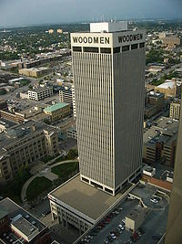
19th Century US Life Insurance
Life Insurance:
Legal Reserve Insurance
Stock companies
Owned by Investors
Mutual companies
Owned by policy holders
Fraternal orders
Notes:
https://www.youtube.com/watch?v=f7odiGPRBqc

Slide 16
Legal Reserve Insurance
Collects premiums in advance
Establishes reserves and holds assets
US regulation began in 1849 in New York
State regulation of insurance

Slide 17
Mutual Aid and Fraternal Insurance
Ancient Order of United Workmen (AOUW) formed in 1868
3 years after the end of the Civil War
Fraternal insurers grew from beginnings in 1860s to controlling half the market in the 1890s
Regulated after 1900
Generally required solvency
Disappeared thereafter, shrinking to 8% of the market by 1930s

Slide 18
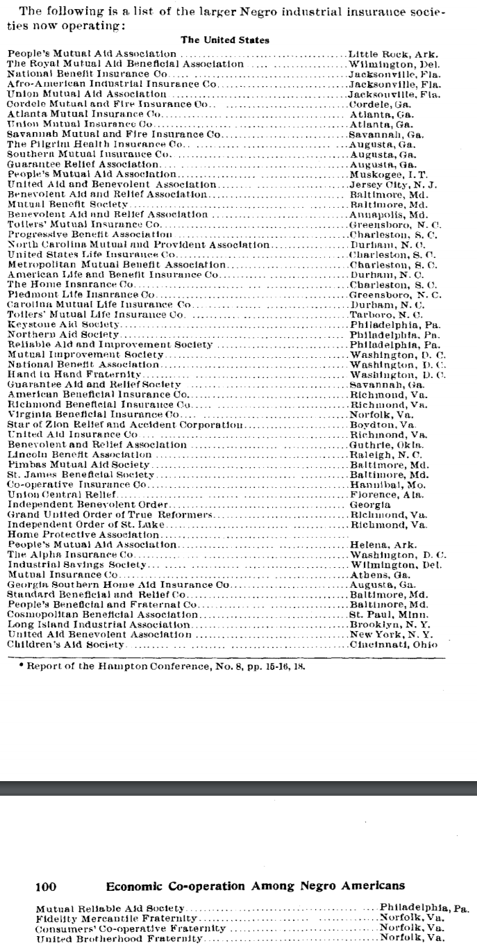
African American Insurance Societies
Mutual Aid Societies also played multiple important roles in African American Society
Insurance and social organization

Slide 19
Products of Fraternal Societies
Life Insurance
Sickness Insurance
Accident Insurance
Fixed-Fee Medical Care Provision
Other Charity
Social Organization

Slide 20
Causes of decline of Fraternal Insurance
Regulation
No regulation until 1888
Federal regulation began in 1893
Reserve requirement
Self regulating Mobile Bill of 1910
Growth of group insurance
Financial strain and dissolution
Workers compensation laws and assistance

Slide 21
HCMI 4225: History of Insurance
Online: Mon/Wed 9:30-10:45
Shane Murphy – shane@uconn.edu

Slide 22
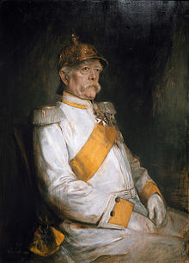
Otto van Bismarck
Minister President of Prussia from 1862-1890
Oversaw Prussian Military victories from 1863-1871
Oversaw Prussian led unified Germany in 1871
Then appointed Imperial Chancellor, serving from 1871-1890
“First” social insurance scheme in 1881, 1883, & 1884
Employer based: employers paying 2/3, employees 1/3
Responding to rising social movements and combat socialism

Slide 23
Why Germany?
Germany saw greatest level of industrial growth in late 1800s
German political philosophers (such as J G Fichte, Richard Wagner, and even Albert Schaeffle) were less libertarian than Anglo counterparts (Adam Smith, J S Mill, Ben Franklin)
Note that in many ways, Marx was more pro-state than French Socialists
Well developed labor movement
1848 revolutions
Goals: Democracy (anti-monarchy and pro working class), social justice, and, in the case of Germany, unification
Bismarck worked with German Socialists from 1848 revolutions such as Ferdinand Lasalle

Slide 24
Initial forms
First: Accident and sickness insurance
Sickness in 1883, accident in 1884
Base on no-fault principle, industrial accidents a fact of life
Later: Old age and invalidity
Even later:
Insurance for survivors of industrial accidents (widows and orphans)
Maternity insurance (First program created in 1911 in Italy)
Four Social Risks: injury, sickness, old age, and unemployment

Slide 25
Spread of accident insurance
Social insurance programs were initially slow to spread, with only Germany, Austria, and Hungary having programs by 1894
But by 1904, most of Western, Central, and Northern Europe had programs
United States was late, creating a program for federal employees only in 1908
Two years after the creation of a program in Mexico (particularly in state of Nuevo Leon)
Canadian provinces largely created programs between 1908-1910
Sickness insurance did not spread as quickly

Slide 26
Sick, old-age, and unemployment insurance
Spread was slower
Initial programs were largely subsidy based and voluntary
Unemployment insurance programs were more popular at local levels

Slide 27
Federal and State programs in the US
First state social insurance law was in Maryland in 1902
Accident insurance
For workers in mines, quarries, and steam and electric railroads
Granted $1,000 in case of fatal accident
Based on equal employee and employer contributions
Declared unconstitutional in 1904
Grounds that it deprived both parties right of trial by jury

Slide 28
Other early programs
Voluntary, equal contribution accident programs were set up in Massachusetts and Illinois in 1905 and 1908, but these were not popular among workers and unions
Connecticut state legislature investigation in 1907 found such programs would be good, but could not find a solution out of fear of interstate competition
However, Theodore Roosevelt succeeded in passing an accident insurance bill for US employees in 1908
He had supported a similar bill when he was governor of NY in the 1890s

Slide 29
State programs
Early programs by Maryland (1904), Montana (1910) and New York (1910) were later declared unconstitutional
Other 1910 programs by Massachusetts, Maryland, and New York were voluntary and failed
Starting in 1911, States began enacting effective programs

Slide 30
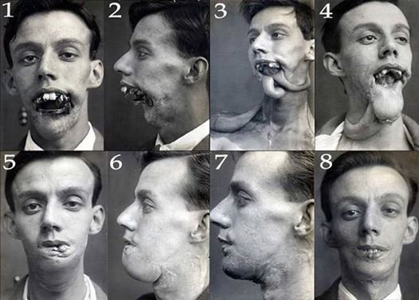
Phossy Jaw and the AALL
American Association for Labor
Legislation sough federal regulation
of yellow phosphorus used in match
manufacturing
Substitutes existed, the substance was banned in Europe, and it led to a painful, debilitating and sometimes deadly condition
Phosphorus necrosis
AALLs first movement was successful, and regulation began in 1912

Slide 31
Characteristics of initial state programs
Limited scope
Limited forms of industries
Iron and steel building erection, elevator operation, work on scaffolding, electricians, work with/near explosives, railworkers, construction of tunnels and subways, and compressed air work.
Dangerous operation with little interstate competition
Constitutional legality based on police power of state
Elective programs included changes to liability law
Non-electing companies no longer as able to waive liabilities
Electing employees reduced in ability to extract unlimited damages
But such progras generally were unsuccessful

Slide 32
Nudges
In most states, most employers did not elect to join scheme
Laborers were not in a strong position and were not generally able to take advantage of increased legal rights
Voluntary program in New Jersey was exception
In NJ, employers were assumed to have elected to join scheme unless they made a specific statement not to join
Many employers were uninterested or uninformed and joined by default
Voluntary program in Illinois was another exception
In both NJ and Illinois, insurance rates were lower so compensation was cheaper than liability

Slide 33
Workers compensation
State Employer Liability Acts passed between 1855 and 1907 allowed workers to sue for injury caused by employer negligence
Starting with Wisconsin in 1911, 36 states created workers’ compensation laws in the 1910s.
Mississippi was the last state to pass such legislation in 1948

Slide 34
Response of US labor
Organized labor initially fought against early programs
In 1909, the American Federation of Labor began to support social insurance
Private programs were created as well
US Steel and International Harvester
Values were placed on injuries
As the idea of public social insurance grew in popularity, state and federal jurists became less likely to make constitutional arguments against it

Slide 35
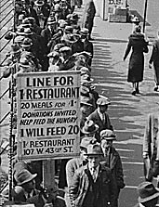
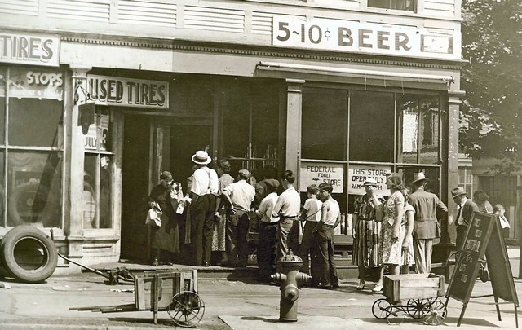
Great Depression (1929-1939)
Notes:
https://www.youtube.com/watch?v=IzjWk1DD6gE
https://www.youtube.com/watch?v=l4zfEkKs2ZM

Slide 36
1935 Social Security Act and the Welfare State in the US
Federal Old Age, Survivors, Disability and Hospital Insurance Program
Originally entitled the Federal Old Age Benefits (I) program
Program now also encompasses Medicare and is funded through FICA
Federal-state unemployment compensation program
FUTA (1954)
9 other programs including aid to states for programs for the blind (X), needy dependent children (IV)
Avoided using the word “insurance” to provide some protection from conservative SC justices – but programs were called social insurance after SC ruling in support in 1939
American Medical Association opposed early efforts for state or national health insurance

Slide 37
Health Insurance programs in the Social Security Act
Four key programs
Maternal and Child Health
Crippled Children Services
Vocational rehabilitation
Public Health
Created as grants to states for state run programs
Initial plans included national health insurance, which AMA opposed and FDR thought was politically too risky, eventual AMA support of Act was reluctant

Slide 38
New Deal
First New Deal included banking reform, the National Recovery Administration, and the Civil Works Administration
Second New Deal included labor union protections, establishment of the Works Progress Administration, the creation of the US Housing Authority, the Fair Labor and Standards Act of 1938, and the Social Security Act
FDR (a New York Democrat) vs the conservative coalition of Republicans and Southern Democrats
Harry F. Byrd Sr was a noted leader of the conservative coalition
Opposed Federal control over standards for old age assistance and other programs

Slide 39
Rise of Fascism, American Fascism, and the New Deal
Mussolini, not Hitler, was the superstar of Fascist politics in the early 1930s
Fritz Julius Kuhn’s German-American Bund, founded in 1936
William Dudley Pelley’s Silver Legion, founded in 1933
Business Plot of 1933
William Joseph Simmons’s 2nd KKK, founded in 1915
William Shepard and Virgil Effinger’s Black Legion, founded in 1920s, Effinger took control in 1931
National Industrial Recovery Act of 1933 - authorized the President to regulate industry for fair wages and prices
Supported by Huey Long and Father Charles Coughlin
Recognized as being modelled on Italian cooperative state
However, Italian statism, liberals argued, was in the service of the state
The NRA sought to protect the interests of the people
German and Italian Fascism came to be identified with business interests
New Deal philosophy more closely resembled the British Labor Party or Social Corporatism/Social Democracy (1930s Norway and Sweden)
Division grew and by 1939, the New Deal was called the Jew Deal by Kuhn

Slide 40
Judicial Procedures Reform Bill of 1937
National Industrial Recovery Act of 1933 found unconstitutional in Schechter Poultry Corp. v. United States (1935)
Judicial review
Created by Chief Justice John Marshall in case called Marbury v Madison (1803)
Granted the president power to appoint an additional justice to the Supreme Court for every member of the court over the age of 70 years and 6 months.
Up to a maximum of six
Proposed in February 1937
In March, anti-new deal justice made pro-new deal decision
"the switch in time that saved nine“
Bill was wildly unpopular

Slide 41
Year | Size | Enacting Legislation | Comments
1789 | 6 | Judiciary Act of 1789 | Original court with Chief Justice & five associate justices; two justices for each of the three circuit courts. (1 Stat. 73)
1801 | 5 | Judiciary Act of 1801 | Lameduck Federalists, at end of President John Adams's administration, greatly expand federal courts, but reduce the number of associate justices¹ to four in order to dominate the judiciary and hinder judicial appointments by incoming President Thomas Jefferson. (2 Stat. 89)
1802 | 6 | Judiciary Act of 1802 | Democratic-Republicans repeal the Judiciary Act of 1801. As no vacancy had occurred in the interim, no seat on the court was ever actually abolished. (2 Stat. 132)
1807 | 7 | Seventh Circuit Act | Created a new circuit court for OH, KY, & TN; Jefferson appoints the new associate justice. (2 Stat. 420)
1837 | 9 | Eighth & Ninth Circuits Act | Signed by President Andrew Jackson on his last full day in office; Jackson nominates two associate justices, both confirmed; one declines appointment. New President Martin Van Buren then appoints the second. (5 Stat. 176)
1863 | 10 | Tenth Circuit Act | Created Tenth Circuit to serve CA and OR; added associate justice to serve it. (12 Stat. 794)
1866 | 7 | Judicial Circuits Act | Chief Justice Salmon P. Chase lobbied for this reduction.¹ The Radical Republican Congress took the occasion to overhaul the courts to reduce the influence of former Confederate States. (14 Stat. 209)
1869 | 9 | Judiciary Act of 1869 | Set Court at current size, reduced burden of riding circuit by introducing intermediary circuit court justices. (16 Stat. 44)
Notes
1. Because federal justices serve during "good behavior", reductions in a federal court's size are accomplished only through either abolishing the court or attrition—i.e., a seat is abolished only when it becomes vacant. However, the Supreme Court cannot be abolished by ordinary legislation. As such, the actual size of the Supreme Court during a contraction may remain larger than the law provides until well after that law's enactment.

Slide 42
World Wars
World War I (1914-1918) and World War II (1939-1945)
WWI: Allied Powers (France, Britain, Russia, Serbia, Belgium, Japan, Italy, US, Romania, Portugal, US, China, and others) vs Central Powers (Germany, Austria-Hungary, Ottoman Empire (Turkey), Bulgaria)
WWII: Allies (Russia [1941], US [1941], UK, China) vs Axis (Germany, Japan, Italy)
In 1919, as a part of the Treaty of Versailles, the International Labor Organization was created (now a part of the UN)
In 1927, the International Social Security Association was established affiliated with the ILO
In 1945, the UN was established

Slide 43
Communist programs
Leninist social insurance programs based on two 1912 principles
Cost solely responsibility of employers
Administration by employees
Program evolved greatly in 1930s
Centralized in 1931, expanded to include health care in 1936
Adopted by China in 1930s and other socialist countries after WWII

Slide 44
Spread of the German Model
Old age and sickness insurance in the German model spread through non-Communist states more quickly after 1919
US adopted old-age and unemployment insurance in 1935

Slide 45
1941, Roosevelt, and WWII
Four Freedoms - https://www.youtube.com/watch?v=qrNDwyj4u1w – Jan 6
Freedom of speech, Freedom of worship, Freedom from want, Freedom from fear
The third is freedom from want—which, translated into world terms, means economic understandings which will secure to every nation a healthy peacetime life for its inhabitants—everywhere in the world.
Atlantic Charter - https://www.youtube.com/watch?v=-msKSTzmQxk – Aug 14
Set ideological goals of Anglo-American alliance
WWII was not just to be a military war against Germany and the axis, but also an ideological war against Naziism and Fascism
5. The desire to bring about the fullest collaborations between all nations in the economic field with the object of scoring, for all, improved labor standards, economic advancement and social security.
Pearl Harbor bombed – Dec 7

Slide 46
Social Security development during WWII
1941 UK: Beveridge Plan
Led to the creation of social programs in the UK forming the Welfare State
Family Allowances Act 1945, National Insurance (Industrial Injuries) Act 1946, National Insurance Act 1946, National Health Service Act 1946, Pensions (Increase) Act 1947, Landlord and Tenant (Rent Control) Act 1949, National Insurance (Industrial Injuries) Act 1948, National Insurance Act 1949
1943 US: Wagner-Murray-Dingell Bill
Failed law for national medical and hospitalization coverage
1943 Canada: Marsh Plan
1944 India: India Beveridge Plan
1945 China, etc
By the 1950s, most industrial capitalist countries had comprehensive systems for all of the four social risks

Slide 47
Age of privatization
Neo-liberal ideology grew in influence since around 1980
Chicago Boys, Led by University of Chicago economists such as Milton Friedman
1981 privatization of the Chilean pension system
Under the Pinochet regime
Replace public pension with fully funded individual accounts system with contributions by individuals and administered privately
During debt crises in the 1980s (and carrying into the 1990s) in low and middle income countries (especially in Latin America) the World Bank and IMF pushed other countries with to privatize

Slide 48
Readings:
Cutler, David M., and Richard Johnson. "The birth and growth of the social insurance state: Explaining old age and medical insurance across countries." Public Choice 120, no. 1-2 (2004): 87-121.
Zanjani, George. "The Rise and Fall of the Fraternal Life Insurer: Law and Finance in US Life Insurance, 1870-1920." (2003).
Du Bois, William Edward Burghardt. "Economic co-operation among Negro Americans." In Conference for the Study of the Negro Problems 1907: Atlanta, Ga.). The Atlanta University Press, 1907. Section 11 p92-109
Rubinow, Isaac Max. Social insurance: With special reference to American conditions. H. Holt, 1913. (https://archive.org/details/socialinsurancew00rubiiala) Chapters 2, 10, 11, 12
Guyton, Gregory P. "A brief history of workers' compensation." The Iowa orthopaedic journal 19 (1999): 106.
Hu, Aiqun, and Patrick Manning. "The global social insurance movement since the 1880s." Journal of Global History 5, no. 1 (2010): 125-148.

