Slide 1
HCMI 4225: Welfare in the US
BUSN 202: Mon/Wed 12:30 AM – 1:45 PM
Shane Murphy – shane@uconn.edu
Notes:
https://www.youtube.com/watch?v=TmwOWmd7c98&ab_channel=KoolKlipsFromDeke
https://www.youtube.com/watch?v=NRWUs0KtB-I&ab_channel=2PacVEVO

Slide 2
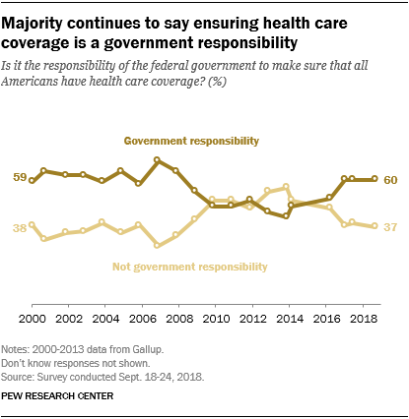
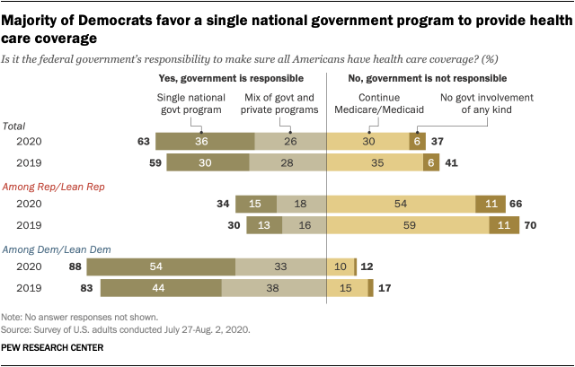
Opinion Polling
Pew and Kaiser are main health policy opinion pollsters
March 2017, ¼ of people thought ACA was repealed (Pew)
September 2017, ½ of people thought ACA marketplaces collapsing (Kaiser)

Slide 3
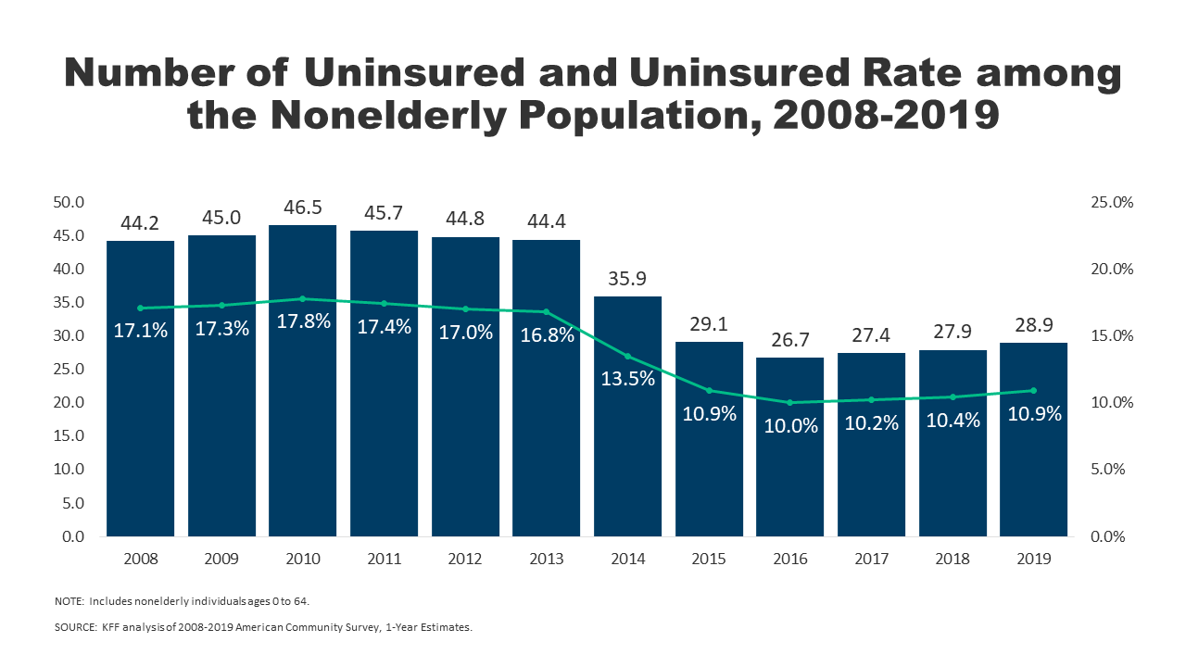
Effects ACA on health and coverage
Largest effect on coverage was due to Medicaid expansion, not the exchanges
Largest effect on health comes from self-perceived health, mental health, financial stability
These three factors are all closely interrelated
Benefits of wellness visits are difficult to measure
Health benefits for chronic conditions require large samples sizes, studies are hard to perform

Slide 4
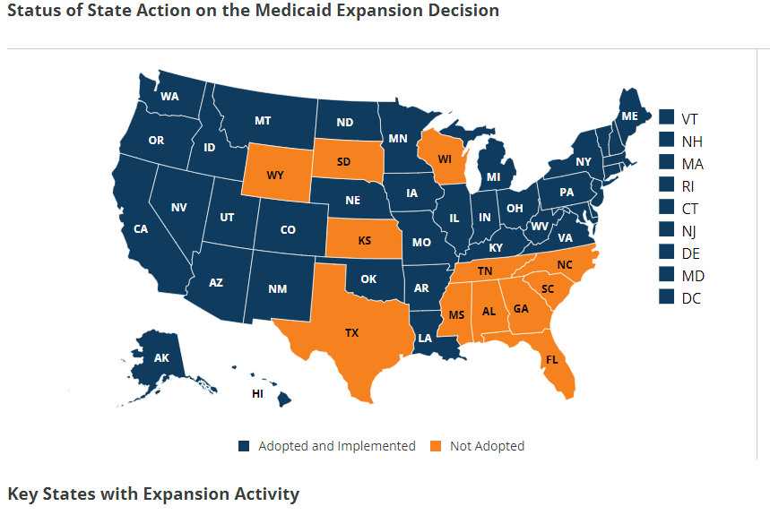
Coverage: Medicaid expansion
All US citizens and legal residents with income up to 138% FPL qualify for coverage in participating states
Led to large growth in enrollment in participating states, smaller growth in non-participating states
Reduction in uninsured rates, especially among low-income individuals
Partial Woodwork effect/welcome mat effect
Growth among individuals who were previously eligible

Slide 5
Coverage: Medicaid expansion: criticism
Crowding out of private insurance
Mixed results, although there has been some decline in private coverage in participating states

Slide 6
Coverage: Medicaid expansion: subgroups
Coverage gains in expansion versus non-expansion states for specific vulnerable populations:
young adults, prescription drug users, people with HIV, veterans, parents, mothers, women of reproductive age (with and without children), children, lesbian, gay, and bisexual adults, newly diagnosed cancer patients, women diagnosed with a gynecologic malignancy, low-income workers, low-educated adults, early retirees, and childless adults with incomes under 100% FPL
Disproportionately positive impact in rural areas in expansion states
Gains can be found across racial/ethnic categories
Reduced disparities by income and age
Possibly reducing disparities by race/ethnicity

Slide 7
Additional effects of the ACA
There has been a lot of research on the health and coverage outcomes of the Affordable Care Act
KFF summary for Medicaid expansion (Antonisse as lead author) - https://www.kff.org/medicaid/report/the-effects-of-medicaid-expansion-under-the-aca-updated-findings-from-a-literature-review/
Mazurenko, Olena, Casey P. Balio, Rajender Agarwal, Aaron E. Carroll, and Nir Menachemi. "The effects of Medicaid expansion under the ACA: a systematic review." Health Affairs 37, no. 6 (2018): 944-950.
Courtemanche, Charles, James Marton, Benjamin Ukert, Aaron Yelowitz, Daniela Zapata, and Ishtiaque Fazlul. "The three‐year impact of the Affordable Care Act on disparities in insurance coverage." Health services research 54 (2019): 307-316.
Soni, Aparna, Laura R. Wherry, and Kosali I. Simon. "How Have ACA Insurance Expansions Affected Health Outcomes? Findings From The Literature: A literature review of the Affordable Care Act's effects on health outcomes for non-elderly adults." Health Affairs 39, no. 3 (2020): 371-378.
Courtemanche, Charles, James Marton, Benjamin Ukert, Aaron Yelowitz, and Daniela Zapata. "Early effects of the Affordable Care Act on health care access, risky health behaviors, and self‐assessed health." Southern Economic Journal 84, no. 3 (2018): 660-691.
…

Slide 8
Coverage: Medicaid expansion: Alternative approaches
Section 1115 gave states the option of expanding Medicaid in alternative ways
These states (especially Arkansas, Michigan, and Indiana) have shown similar gains in coverage rates
Indiana instituted monthly contributions which have created enrollment and continuing coverage issues

Slide 9
Access, Utilization
Many studies find improvements in access to care
Increases in cancer diagnosis rates (especially early stage)
Earlier presentation for common surgical conditions – lowering complications
Increase listing for heart transplants among African Americans
Increased access for treatment of behavioral and mental health conditions
Increase in prescriptions for opioid use disorder and overdose
Increase in prescriptions for smoking cessation drugs

Slide 10
Access, Utilization
Many studies find improvements in access to care
Reduction in disparities by race, income, education, and employment status in access and affordability
Increased rates of optimal care for patients with common surgical conditions
Improved quality of care for common community health care treated conditions:
Asthma, Pap testing, BMI assessment, hypertension control
Declines in uninsured ED visits, but mixed evidence and no significant change in total ED volume
Reduced LOS for Medicaid patients
Improvements in care and quality in areas with primary care shortages

Slide 11
Access, Utilization: Criticism
Confusion in non-waiver states
Failures to follow up with new patients
Longer wait times

Slide 12
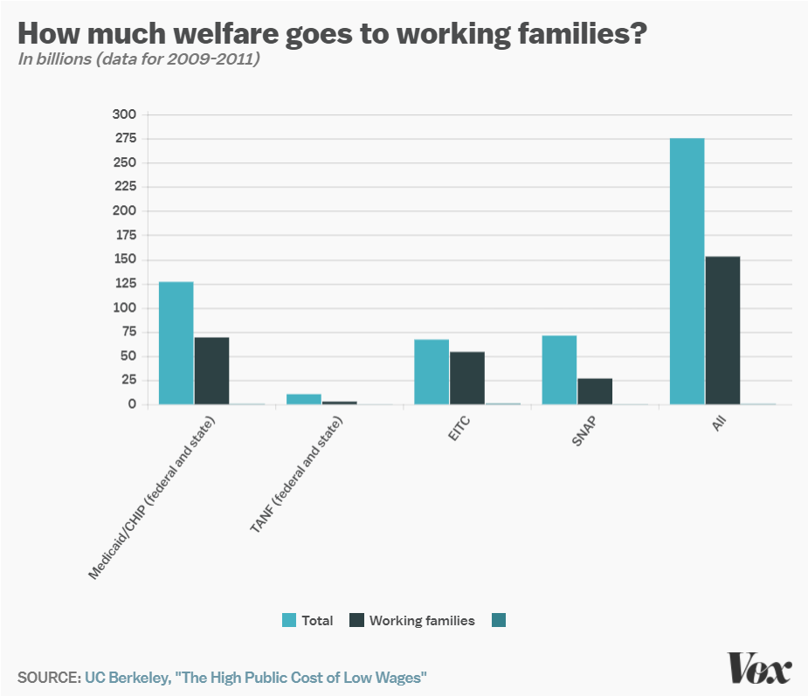
Work requirements
Federal: SNAP (food stamps)
Requires able-bodied recipients without dependents to work 80 hours a month
Part of 1996 Welfare Reform
State: TANF (Kansas and elsewhere)
Limited improvements on unemployment and poverty
State: Medicaid
Earned Income Tax Credit!
Notes:
http://laborcenter.berkeley.edu/the-high-public-cost-of-low-wages/

Slide 13
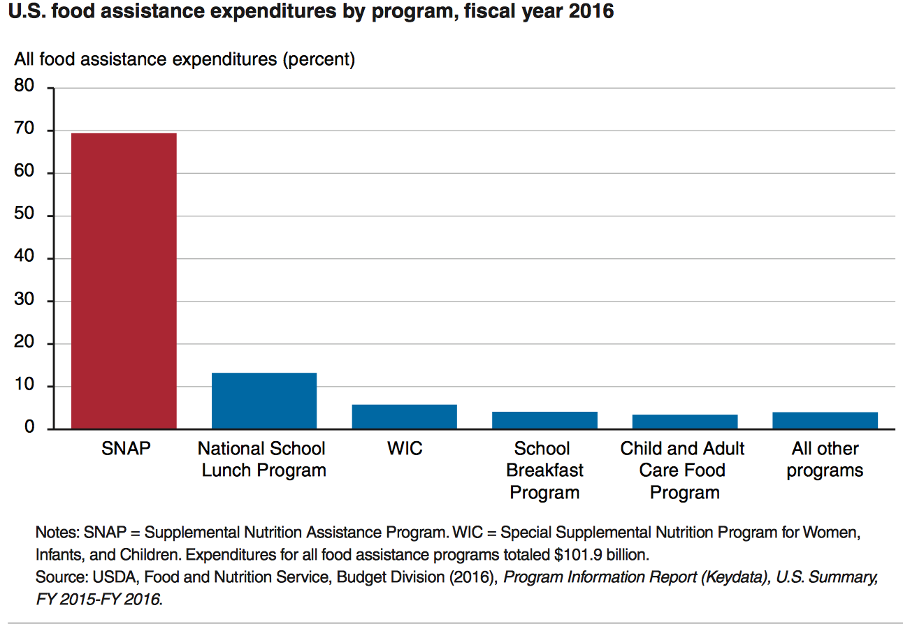
State Grants: Food Assistance Programs

Slide 14
SNAP
SNAP
central goal is to alleviate food insecurity and it succeeds
also improves well-being over other dimensions
High benefits for families
maximum of almost $700 per month for a family of 4
average benefit of about $250 per month for a family of 4
Has a profound effect on the family food economy

Slide 15
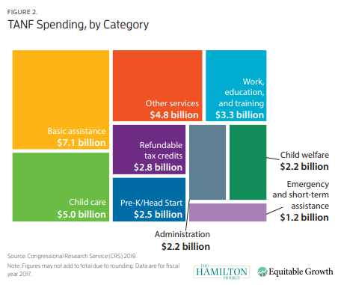
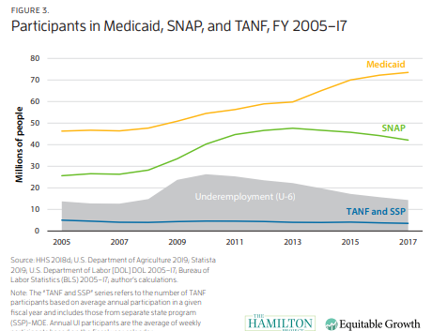
Temporary Assistance for Needy Families (TANF)
Block grants to states
Downsides of block grants
Under pre-existing Aid to Families with Dependent Children, states had access to unlimited matched federal funds for eligible families
Under 25% of families in poverty receive TANF
Maximum benefit between $170 and $923 /month

Slide 16
EITC – Earned Income Tax Credit
Low income individuals get a cash subsidy based on how much they work, up to $5610 dollars for someone earning $14,000 (40% raise)
Always incentivizes work
Administered by IRS
Popular and effective

Slide 17
1996 Welfare reform
Changed Aid to Families with Dependent Children (AFDC) to TANF
States had more leeway to who gets benefits
Block Grants to states
Assistance cut to recent immigrants
Work requirements

Slide 18
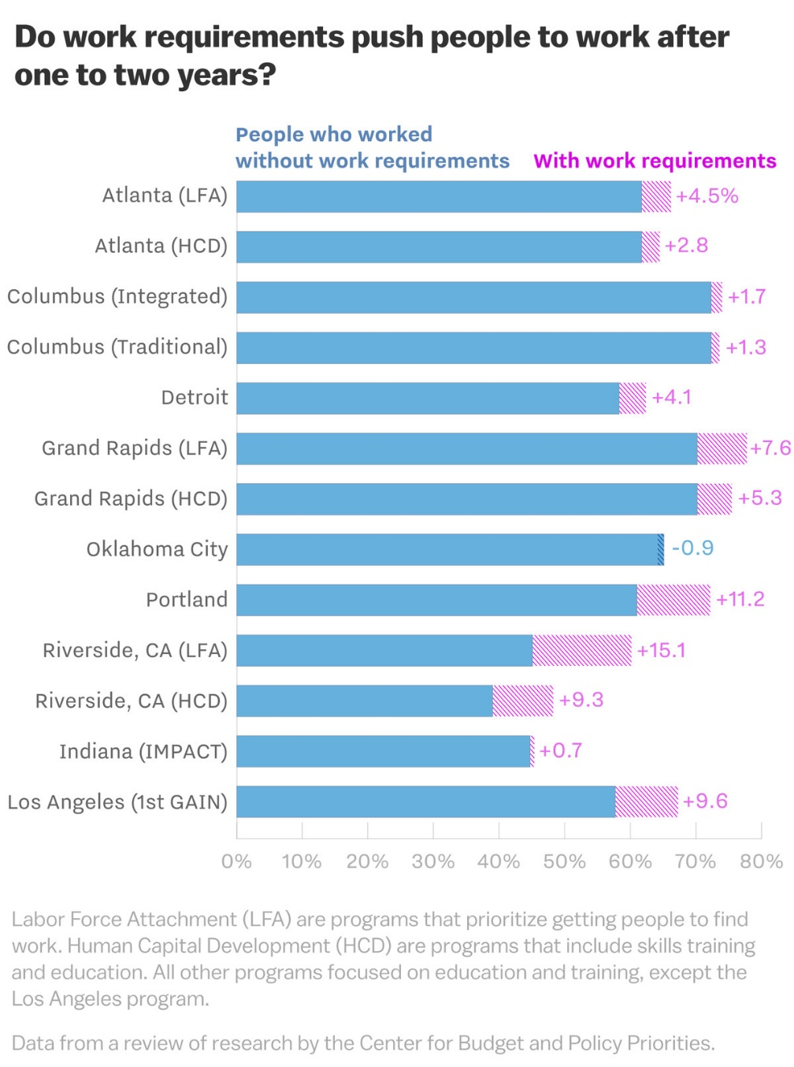
Effect of 1996 work requirements on TANF
13 cities participated in an experiment before requirement was implemented
The proportion of TANF recipients who worked without requirements was about 60% before the experiment
Increased by about 4% on average in the following years
Gains disappeared by 5 years
Stable work saw small increase by 5 years
Small effect on poverty – on average increasing poverty
Decrease the ability to attend training programs, deal with health issues
Targets foreign born and ESL

Slide 19
Pros and Cons of TANF work requirements
Pro
Work requirement increases amount people work
Con
Work requirement increases poverty

Slide 20
However
80% of adults on Medicaid are in working families
60% work themselves
Of those that don’t:
35% are unable to due to disability
28% are caretakers for family members
18% are students
8% are actively looking for work
8% are retired
Leaving 3% of nonworking adult Medicaid population who could work but don’t
Notes:
JAMA Dec 2017

Slide 21
Barriers to employment
Low income individuals facing Medicaid work requirements struggle to find work
20% have less than a high school degree
25% have multiple chronic conditions
More likely to live in areas with high unemployment and poverty
Notes:
Urban Institute 2019

Slide 22
Labor Market Effects
Increased jobs
Did not reduce employment for low-income workers
Enrollees looking for work reported Medicaid enrollment made it easier to seek employment, those employed reported it made it easier to continue working
Increase volunteering

Slide 23
Additional Social Support/Welfare Programs
Programs we’ve discussed
TANF
Social Security
Unemployment
SNAP/WIC
Others:
Section 8 of the Housing Act of 1937
Rental assistance for low income households
Supplemental Security Income
Replace Aid to the Blind, Aid to the Permanently and Totally Disabled, and Aid to the Elderly from 1935 SSA
Once an individual qualifies for Supplemental Security Income they automatically become eligible for several other assistance programs (Medicaid, SNAP, Sectuon 8, others)
Head Start
1965 program – Early Childhood Education
High Ed programs
Pell, SMART, FSEOG, and subsidized loans
Other…

Slide 24
Reading
Grogan, Colleen M. "How the ACA addressed health equity and what repeal would mean." Journal of Health Politics, Policy and Law 42, no. 5 (2017): 985-993.
Levy, Helen, Andrew Ying, and Nicholas Bagley. "What’s Left of the Affordable Care Act? A Progress Report." RSF: The Russell Sage Foundation Journal of the Social Sciences 6, no. 2 (2020): 42-66.
Rosenbaum, Sara, and Sara Schmucker. "Viewing Health Equity through a Legal Lens: Title VI of the 1964 Civil Rights Act." Journal of Health Politics, Policy and Law 42, no. 5 (2017): 771-788.
Boushey, Heather, Ryan Nunn, and Jay Shambaugh. Recession ready: Fiscal policies to stabilize the American economy. Washington, DC: Brookings, 2019.

Slide 25
HCMI 4225: More on the ACA
BUSN 202: Mon/Wed 12:30 AM – 1:45 PM
Shane Murphy – shane@uconn.edu

Slide 26
Affordability and Financial Security
Possible reduced patients with unmet medical need because of cost
Reduction in OOP
Average reduction in 2014 of about $205
Greater reductions among Medicaid expansion covered individuals than subsidized marketplace coverage individuals
Declines in unpaid bills and financial stress over future bills
In Ohio, percentage of expansion enrollees with medical debt fell by nearly half since enrolling in Medicaid (55.8% had debt prior to enrollment, 30.8% had debt at the time of the study)

Slide 27
Health Outcomes
Possible improvements in self-reported health
Improved outcomes for cardiac patients
Infant Mortality Rate Reductions for expansion states between 2014 and 2016, a period where the rate rose slightly for non-expansion states
Effect largest among African Americans
Limited of no effect on drug overdoses or alcohol poisonings

Slide 28
Economic effects
Federal matching for expansion population provided large spending savings for expansion states
No significant increase in state spending on Medicaid, including savings in some states
Possible reduction in overall spending due to spillovers
State costs related to behavioral health services, crime and the criminal justice system, and Supplemental Security Income program costs.
Lower Medicaid spending per enrollee
New enrollees generally less expensive than existing enrollees
First year of enrollment generally more expensive than subsequent years
Medicaid expansion lowers marketplace premiums
Marketplace enrollees younger and healthier in expansion states

Slide 29
Impacts on providers
Reduction in uninsured visits and uncompensated care costs
Decline in uninsured ED visits and increase in Medicaid-covered ED visits
Increase in Medicaid-covered substance use disorder treatment facility visits
Reduced disparity in uninsured visits between hospitals that treat a disproportionate share of low-income patients (DSH hospitals/safety net hospitals) and those that do not
Improved overall hospital financial performance, reduced probability of closure
Especially in rural areas

Slide 30
Labor Market Effects
Increased jobs
Did not reduce employment for low-income workers
Enrollees looking for work reported Medicaid enrollment made it easier to seek employment, those employed reported it made it easier to continue working
Increase volunteering

Slide 31
Cost Sharing Reductions (CSR)
Another provision of the ACA is that consumers with incomes below 250% FPL are entitled to CSRs
Lower deductibles, copays, and other cost-sharing for low-income consumers
Increases the actuarial value of the plan
HHS was then required to reimburse insurance companies for the CSRs
Reimbursement was opposed by the conservative-majority House of Representatives
House v Burwell -> House v Azar
CSR reimbursement payments stopped
Drove up premiums on the marketplace

Slide 32
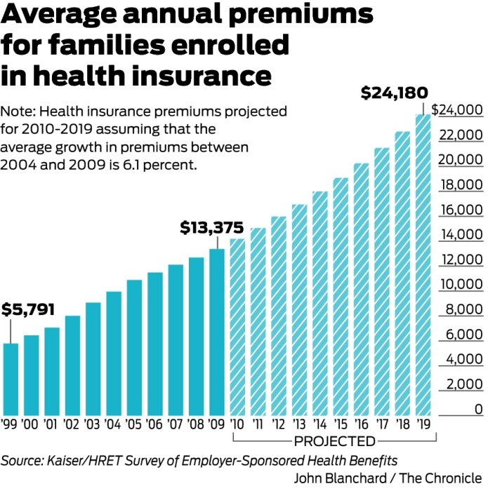
Health Insurance Premiums: Skyrocketing?
Premiums grew by over 6% between 2004 and 2009
If such growth continued, the cost for a family would grow to:
2010 | 14190.88
2011 | 15056.52
2012 | 15974.97
2013 | 16949.44
2014 | 17983.35
2015 | 19080.34
2016 | 20244.24
2017 | 21479.14
2018 | 22789.37
2019 | 24179.52

Slide 33
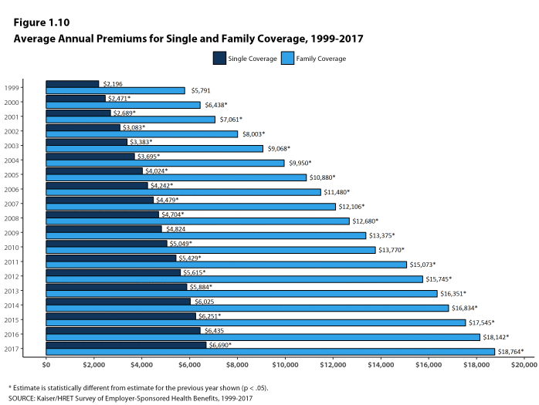
Health Insurance Premiums: Skyrocketing?
Actual growth rate has ben about 4.3%

Slide 34
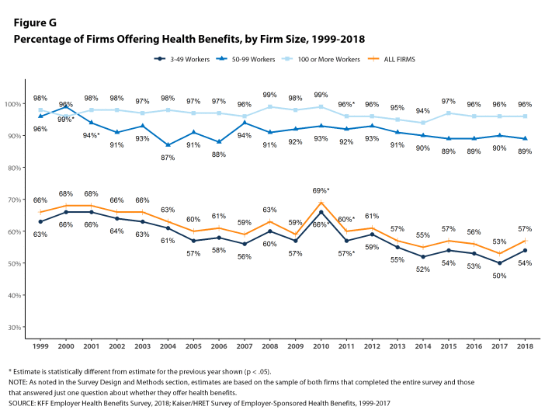

Slide 35
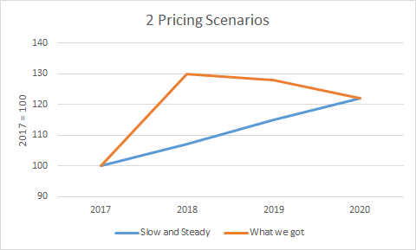
MLR and premiums
Increases in premiums will be tied to increases in healthcare spending by MLR regulations

Slide 36
Title 1: Quality, Affordable Health Care for All Americans.
The largest title of the ACA, measured in number of key provisions or in total spending and revenue
Title I focuses on the private health insurance sector.
Forty-nine provisions,
$509 billion in spending, $81 billion in revenue,
88 percent implemented.
High-profile provisions such as the creation of health insurance marketplaces, premium tax credits, employer and individual mandates, community rating requirements, and the ban on lifetime caps on coverage, among others.
As of 2019, 11.4 million Americans are covered by marketplace health insurance plans, down slightly from the peak of 12.7 million in 2016 (Kaiser Family Foundation 2019).

Slide 37
Title II: The Role of Public Programs
Medicaid expansion
Seventeen provisions, $459 billion in spending, $53 billion in revenue,
78 percent implemented
Meant to cover all adults ages nineteen through sixty-four living in families with income below 138 percent of the federal poverty level on January 1, 2014.
Instead, a Supreme Court ruling rendered this expansion effectively optional for states.
Twenty-four states plus the District of Columbia chose to expand Medicaid on or before January 2014;
about half of the target population of low-income nonelderly adults.
As of 2019, 64 percent of the adults in the expansion population live in states in which Medicaid expansion has been implemented or in which implementation is pending.

Slide 38
Title III: Improving the Quality and Efficiency of Health Care
Thirty-five key provisions, $54 billion in spending, $450 billion in revenue,
96 percent implemented.
Intended to improve the quality of care (or at least not degrade it) while reducing federal payments,
Aka delivery-system reform.
Cuts in Medicare payments to Medicare Advantage plans and to hospitals; together, CBO scored these cuts as achieving $290 billion in savings over the 2010 to 2019 scoring window.
Expanded quality measurement and value-based purchasing initiatives, and also created the Center for Medicare and Medicaid Innovation to facilitate the development and diffusion of innovations in Medicare policy
Introduced innovative payment models for Medicare such as the Shared Savings Program
spurred the growth of accountable care organizations, and expanded pilot projects of bundled payments.
Created (but not implemented) the Independent Payment Advisory Board

Slide 39
Title IV: Prevention of Chronic Disease and Improving Public Health.
$18 billion in spending and $1 billion in revenue, 19 provisions
85 percent implemented.
Creation of the Prevention and Public Health Fund.
Regulation expansions
Nutrition labeling for restaurant menus
Large firms provide break time and lactation space for employees who are nursing mothers

Slide 40
Title V: Health Care Workforce.
$18 billion in spending and zero revenue,
Eight of its nine key provisions— 94 percent—were implemented.
Grant programs and residency regulation
Unimplemented provision established a National Health Care Workforce Commission, and members were appointed in September 2010. Congress, however, never appropriated the money for the commission, which has therefore never met

Slide 41
Title VI: Transparency and Program Integrity.
$3 billion spending and $7 billion in revenue,
90 percent implemented
43 provisions
prevent fraud, including the creation of provider data banks for Medicare and Medicaid
Elder Justice Act, intended to prevent abuse, neglect, and exploitation of older Americans;
Physician Payments Sunshine Act, which requires pharmaceutical companies and drug manufacturers to report payments to physicians;
Creation of the Patient-Centered Outcomes Research Institute.
Could have been implemented separately, but included in part to provide revenue

Slide 42
Title VII: Improving Access to Innovative Medical Therapies.
zero spending and $7 billion in revenue
Seven key provisions, fully implemented
Adopted the Biologics Price Competition and Innovation Act of 2009 (BPCI Act), intended to create a simplified path for the approval of “biosimilar” therapies—essentially, generic versions of biological products approved by the Food and Drug Administration (FDA).
Only limited success
Expanded the 340B Drug Pricing Program in Medicaid, effectively increasing the number of hospitals that receive drug rebates from manufacturers.

Slide 43
Title VIII: Community Living Assistance Services and Supports.
The CLASS Act
zero spending and a stated $70 billion in forecast revenue
One provision, not implemented.
Intended to create an insurance-like program that would cover expenses for services required to help disabled individuals remain living in the community rather than having to move to a nursing home.

Slide 44
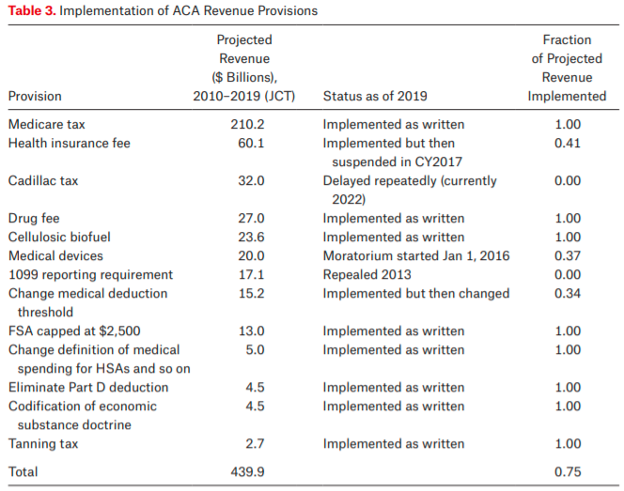
Title IX: Revenue Provisions.
Projected to raise $438 billion between 2010 and 2019, 19 provisions, 79% implemented
Medicare tax on high income individuals and on unearned income
property income, inheritance, pensions, and payments received from public welfare

Slide 45
Legal challenges
Medicaid expansion
National Federation of Independent Business v. Sebelius
Cost-sharing reductions
House v. Burwell
Payments meant to reimburse insurers for adhering to ACA rules that require them to limit the out-of-pocket costs of their low-income enrollees
Money never appropriated
Trump scrapped attempts to appropriate money
Lead to “silver loading”
Contraceptive coverage
Burwell v. Hobby Lobby

Slide 46
Born to fail
1099 reporting provision
Repealed by congress in April 2011
Community Living Assistance Services and Supports (CLASS) Act
Required to be self-sustaining
Capped premiums for low income and student enrollees
Premiums go into 10-year CBO window, outlays come later
Co-ops
Proposed loans to co-op insurance plans
23 programs initially took part, political failure to support and difficult market led to failure

Slide 47
Interest group pressure
Cadillac tax
Medical device tax
IPAB
DSH cuts
Free Choice vouchers
Allow low income employees to buy subsidized marketplace insurance rather than get employer based insurance
Menu labeling

Slide 48
Failure to thrive
Multistate compacts and multistate plans
Allows plans to be sold across state lines – no state has legalized such actions
Biosimilars
the generic drug industry works as well as it does because small-molecule compounds are easy to copy and cheap to manufacture. Biologics, in contrast, are large-molecule, protein based drugs that are much harder to copy
Antidiscrimination rules
Section 1557 of the ACA prohibits discrimination in “any health program or activity” that receives federal funds on the grounds of race, color, national origin, sex, age, or disability (see Grogan 2017, Rosenbaum and Schmucker 2017).
Ruled against by Reed O’Connor
Prevention and Public Health Fund
Funds chronically redirected by congress

Slide 49
Executive branch sabotage
Zeroing out the individual mandate
Back to Texas v Azar (aka Texs v US aka Texas v California)
Medicaid work requirements
Currently in courts
Short-term, limited duration insurance
Create 364 day plans to allow for a separating equilibrium
Increases chance that marketplace fails via death spiral
In courts
Association health plans
Also meant to divide pool
In courts

Slide 50
Work Requirement tradeoff
Lowering poverty vs increasing self-sufficiency
Cross-sectional evidence:
6.3% of working people are in poverty
32% of non-working people are in poverty
Causal evidence is less clear

