Slide 1
HCMI 4225: Health and Social Insurance
BUSN 202: Mon/Wed
Shane Murphy – shane@uconn.edu
Office Hours: Mon/Wed 12:30 AM – 1:45PM

Slide 2
*
Roughly how many people in the US have died of HIV/AIDS?
  A) 100,000
  B) 500,000
  C) 700,000
  D) 1,200,000

Slide 3
*
Roughly how many people in the US have died of Covid-19?
  A) 100,000
  B) 500,000
  C) 700,000
  D) 1,200,000

Slide 4
What does YLL stand for?
  A)Years of Life Lost
  B)Years of Life Lived
  C)You only Live Life
  D)Youth Longevity and Likelihoods

Slide 5
What does DALY stand for?
  A)Disability and Loss in Youth
  B)Devastation and Loss in Youth
  C)Devastation adjusted Life Years
  D)Disability Adjusted Life Years

Slide 6
Which category causes the most disability in the US?
  A)Communicable diseases
  B)Non-communicable diseases
  C)Injuries
  D)Maternal and neonatal diseases

Slide 7
Public goods are defined as goods which are:
  A) Rival and excludable
  B) Non-rival and excludable
  C) Non-rival and non-excludable
  D) Rival and non-excludable

Slide 8
A free rider is someone who:
  A) Is willing (hoping) to let others pay for a public good they will consume
  B) Consumes more of a good than they pay for
  C) Borrows without ever lending
  D) Owns public space and is not required to pay rent

Slide 9
Which aspect of health care is a public good?
  A) Medical research
  B) Hospitals
  C) Insurance
  D) the Center for Disease Control

Slide 10
*
When was the germ theory of disease developed?
  A) 1770s
  B) 1820s
  C) 1860s
  D) 1910s

Slide 11
If the utility function is sqrt, what is the expected value of a lottery which pays 4 with probability 50% and 16 with probability 50%?
  A) 3
  B) 6
  C) 10
  D)14

Slide 12
If the utility function is sqrt, what is the utility of a payoff of 4? Of 16?
  A) 2, 8
  B) 2, 4
  C) 4, 16
  D) 16, 256

Slide 13
If the utility function is sqrt, what is the expected utility of a lottery which pays 4 (giving utility 2) with probability 50% and 16 (giving utility 4) with probability 50%?
  A) 3
  B) 6
  C) 10
  D)14

Slide 14
What is true about the Risk Premium
  A) Risk premium is the mathematically efficient premium charged to consumers for insurance
  B) In the model, profit for the insurance company is risk premium plus expected loss
  C) The risk premium is positive for risk seeking, risk averse, and risk neutral consumers
  D) Maximum amount of money a risk-averse person would pay to avoid taking a risk

Slide 15
Given a fair experiment, the average or mean value of the results obtained from a large number of trials should be close to the expected value. As more trials are performed, the mean will tend to become closer to the expected value. This is the definition of:
  A) Law of Large Numbers
  B) Fundamental law of statistics
  C) Central limit theorem
  D) Arrow’s theorem

Slide 16
Pooling equilibrium maximize ______, while separating equilibrium maximize ______.
  A) Efficiency, Equity
  B) Equity, Efficiency
  C) Profits, Consumer welfare
  D) Pragmatism, Idealism

Slide 17
Which of the following is not a way to mitigate Adverse Selection
  A) Individual Mandate in the ACA
  B) Waiting Period before Coverage Takes Effect
  C) Premiums Tied to Risk
  D) Co-payments and deductibles

Slide 18
What is it called when there is a lack of incentive to guard against risks because an individual is protected from the consequences of those risks.
  A) Moral Hazard
  B) Adverse Selection
  C) Risk neutrality
  D) Certainty Equivalent

Slide 19
Which philosophy focuses on ends rather than means and on substantive freedoms
  A) Libertarianism
  B) Utilitarianism
  C) Capabilities approach
  D) Cosmopolitanism

Slide 20
Which philosophy suggests that moral values should apply across national borders?
  A) Libertarianism
  B) Utilitarianism
  C) Capabilities approach
  D) Cosmopolitanism

Slide 21
Which philosophy emphasizes personal freedom and individual choice
  A) Libertarianism
  B) Utilitarianism
  C) Capabilities approach
  D) Cosmopolitanism

Slide 22
Which philosophy suggests policy should maximize net social benefit, “the most good to the most people”
  A) Libertarianism
  B) Utilitarianism
  C) Capabilities approach
  D) Cosmopolitanism

Slide 23
The United Nations’ Universal Declaration of Human Rights was signed in which year?
  A) 1935
  B) 1941
  C) 1948
  D) 1965

Slide 24
The Universal Declaration of Human Rights was associated with which figure?
  A) Florence Nightingale
  B) Eleanor Roosevelt
  C) Otto von Bismark
  D) Ulysses S. Grant

Slide 25
Which of the following is not a Negative right?
  A) Freedom of speech
  B) Freedom of religion
  C) Freedom from unlawful imprisonment
  D) Police Protection

Slide 26
Which of the following is not a Positive right?
  A) Police Protection
  B) Employment
  C) Health Care
  D) Gun Ownership

Slide 27
Rights which are universal and inalienable are called
  A) Positive Rights
  B) Negative Rights
  C) Legal Rights
  D) Natural Rights

Slide 28
Federal programs enshrining some right to care include all of the following except:
  A) ACA
  B) Medicare
  C) CHIP
  D) HUD

Slide 29
The Bureau of Refugees, Freedmen and Abandoned Lands (Freedmen’s Bureau) was a federal agency that ran hospitals in the post-Civil War era from what years?
  A) 1858-1864
  B) 1865-1869
  C) 1866-1899
  C) 1880-1890

Slide 30
Civil War pensions cost the US government over 20% total government receipts each year between about which years?
  A) 1865-1890
  B) 1865-1920
  C) 1880-1945
  D) 1890-1920

Slide 31
Which of the following is not a social organization which advocated for more social insurance.
  A) Grand Army of the Republic
  B) National Congress of Mothers
  C) American Association of Labor Legislators
  D) The Hartford Group

Slide 32
Who was the first head of the Children’s Bureau
  A) Jane Addams
  B) Jane Jacobs
  C) Julia Lothrop
  D) Eleanor Roosevelt

Slide 33
Which were not among the tasks of the Children’s Bureau
  A) Birth registrations
  B) administrate the Sheppard-Towner Act
  C) Infant health campaigns
  D) Administrate unemployment insurance

Slide 34
Otto van Bismark is known in part for which
  A) Establishing the first public hospitals
  B) Discovering penicillin
  C) Inventing the aircraft carrier
  D) Establishing the first social insurance schemes

Slide 35
What nudge was important in early New Jersey accident insurance plans
  A) Employers were forced to opt-out rather than opt-in to the plan
  B) Employees were forced to opt-out rather than opt-in to the plan
  C) Employers were forced to pay an extra tax to cover employees at other firms
  D) No one was really covered

Slide 36
Which of the following organizations did not promote the creation of Medicare and Medicaid in 1965:
  A) The American Medical Association (AMA)
  B) The National Council of Senior Citizens (NCSC)
  C) American Federation of Labor (AFL)
  D) Congress of Industrial Organizations (CIO)

Slide 37
Communist social insurance programs were noted for being
  A) generous in coverage amounts
  B) paid for by employees but administered by employers
  C) Being adopted in western Europe
  D) paid for by employers but administered by employees

Slide 38
UK PM Winston Churchill during WWII
  A) Promoted social insurance as a part of anti-Nazi ideology
  B) Promoted privatizing social insurance to help reduce government expenditures during the war
  C) Sought to establish a global regime of free health for all
  D) Saw legislation for social insurance to be a hindrance on war efforts

Slide 39
Privatization of the Chilean pension scheme was not related to which:
  A) Neo-liberal ideologies led by U of Chicago economist Milton Friedmen
  B) The oil crises of the 1970s
  C) World Bank and IMF pressure
  D) Pinochet’s goal of Chilean expansion

Slide 40
What year was FDR’s Social Security Act Passed
  A) 1932
  B) 1935
  C) 1938
  D) 1942

Slide 41
Unemployment insurance is financed by which tax
  A) FICA
  B) FILA
  C) FUBAR
  D) FUTA

Slide 42
What does OASDI stand for?

Slide 43
What does OASDI stand for
  Old Age Survivors and Disability Insurance

Slide 44
The 1942 Stabilization Act put controls on prices and wages but allowed businesses to offer benefits like health insurance to bypass these limits and made health insurance tax free. It was in response to what:
  A) WWII inflation
  B) High mortality during the Yellow Fever epidemic
  C) The rise of Fascism in the US
  D) The rise of Communism in the US

Slide 45
Which senator is most associated with a movement for public health expansion in the 1970s and 1980s
  A) Robert Byrd
  B) Robert Taft
  C) Edward Kennedy
  D) John Kerry

Slide 46
The FDA approved the pill in year ____ and Title X passed in year ____.
  A) 1960, 1970
  B) 1965, 1977
  C) 1945, 1956
  D) 1980, 1935

Slide 47
The law which forbids Medicaid recipients from receiving federal reimbursements for abortion is called:
  A) The Kennedy Rule
  B) The Beveridge Plan
  C) War on Poverty
  D) The Hyde Amendment

Slide 48
*
Temporary assistance for needy families nudges people into the employment market by only providing coverage for how many months?
  A) 12
  B) 18
  C) 24
  D) 36

Slide 49
*
To qualify for OASDI, workers must show how many years of payment of payroll taxes:
  A) 20
  B) 5
  C) 2
  D) 10

Slide 50
The current ratio of covered workers to social security (OASDI) beneficiary is:
  A) 8
  B) 3
  C) 2
  D) 5

Slide 51
Means testing
  A) Bases payments on individual need
  B) Bases payments on individual contributions
  C) Bases payments on average present contributions
  D) Bases payments on rudeness

Slide 52
Medicare and Medicaid were created in
  A) 1935
  B) 1950
  C) 1956
  D) 1965

Slide 53
Which of these is not a labor or professional organization
  A) AFL
  B) AMA
  C) CIO
  D) COBRA

Slide 54
Which of the following are not included as stakeholders in the Quadagno paper?
  A) Insurance Companies
  B) Doctors
  C) Foreign Countries
  D) Labor Unions
  E) Politicians

Slide 55
Which of the following organizations created one of the first health insurance programs and focused on hospital care.
  A) Social Security
  B) Blue Cross
  C) Kaiser Permanente
  D) Blue Shield

Slide 56
Which of the following organizations created one of the first health insurance programs and focused on physician care.
  A) Social Security
  B) Blue Cross
  C) Kaiser Permanente
  D) Blue Shield

Slide 57
Which of the following organizations created an early example of what would later be known as an HMO in 1943
  A) Social Security
  B) Blue Cross
  C) Kaiser Permanente
  D) Blue Shield

Slide 58
What does HIPAA stand for?

Slide 59
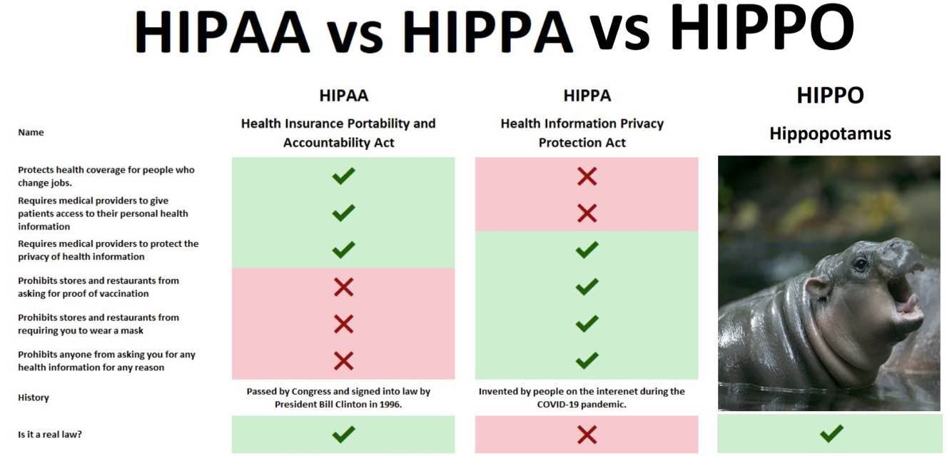
What does HIPAA stand for?
  Health Insurance Portability and Accountability Act

Slide 60
Which of the following are not a method of pooling insurees?
  A) Regional Health Alliances
  B) Social Network Alliances
  C) Group plans
  D) Health Insurance Exchanges

Slide 61
To people earning what percent of the FPL was medicaid expanded by the ACA?

Slide 62
To people earning what percent of the FPL was medicaid expanded by the ACA?
  138%

Slide 63
Which senator opposed the public option being part of the ACA
  A) Ben Nelson
  B) Evan Bayh
  C) Joe Lieberman
  D) Edward Kennedy

Slide 64
What epithet was applied to the Independent Payments Advisory Board to criticize it?
  A) Socialism
  B) Obamacare
  C) Boondogle
  D) Death Panel

Slide 65
What year was NFIB v Sebilius decided
  A) 2010
  B) 2011
  C) 2012
  D) 2013

Slide 66
Who was (and still is) the chief justice of the United States in 2012?
  A) John Marshall
  B) John Roberts
  C) Ruth Bader Ginsburg
  D) Clarence Thomas

Slide 67
Which provision of the ACA was found unconstitutional by NFIB v Sebilius?
  A) The Mandate
  B) The Exchanges
  C) The Cadillac Taxes
  D) Medicaid Expansion

Slide 68
What was the main result of Burwell v. Hobby Lobby Stores, Inc. (2014)
  A) The Risk-Corridor Program was found unconstitutional
  B) Certain types of companies were allowed religious exemption from certain coverage requirements in employer-offered health insurance
  C) ACA subsidies were unconstitutional
  D) The Tax Mandate was found unconstitutional

Slide 69
*
What was argued this summer in SCOTUS in an appeal of Texas V Azar?
  A) Whether the removal of the mandate voids the ACA
  B) Whether Trump can unilaterally veto the ACA
  C) Whether individuals can claim religious exemption from the insurance mandate
  D) Whether Trumps justice department is required to defend the ACA

Slide 70
What is an example of the woodwork effect?
  A) Previously eligible individuals unaware of their eligibility signed up for Medicaid after expansion
  B) People working in dangerous jobs like woodworking supporting more social insurance
  C) It is a disease not covered as a pre-existing condition prior to the ACA
  D) It is the collapse of support for progressive policies by woodworkers after NAFTA

Slide 71
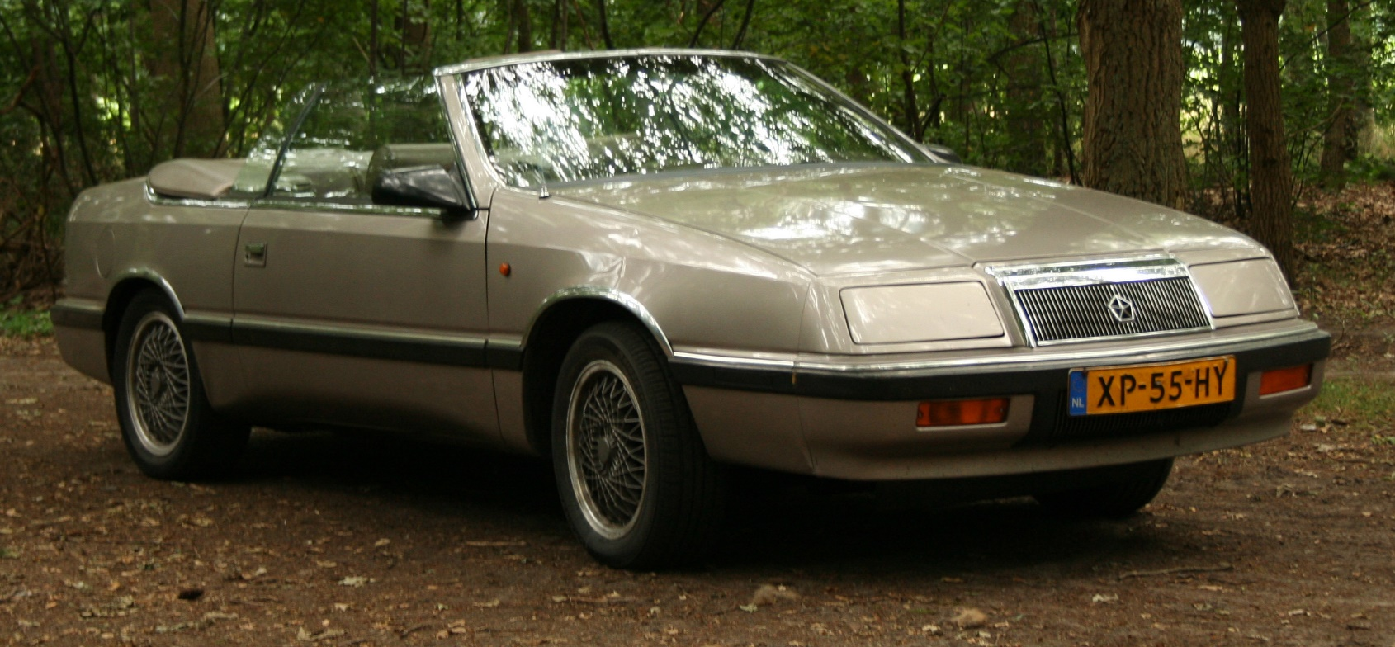
What is the name of the never enacted ACA tax on high value/generous health insurance plans
  A) Chrysler LaBaron Tax
  B) Tesla Tax
  C) Ferrari Tax
  D) Cadillac Tax

Slide 72
Which part of the ACA had the greatest effect in increasing health insurance coverage
  A) Medicaid Expansion
  B) Individual Mandate
  C) Employer Mandate
  D) Parental Coverage Extended to Age 26

Slide 73
The greatest measured positive health effect of the ACA so far is in what area?
  A) Chronic disease
  B) Infectious disease
  C) Mental health
  D) The ACA has not had a positive health effect

Slide 74
What does SNAP stand for?

Slide 75
What does SNAP stand for?
Supplemental Nutrition Assistance Program

Slide 76
Which of the following was an implemented Trump policy regarding ACA programs
  A) Require catastrophic coverage on the marketplace
  B) Allow work requirements for Medicaid
  C) Increase reimbursements to insurance companies for the cost sharing reduction program
  D) Hire incompetent bureaucrats to staff HHS and CMS

Slide 77
Which of the following was an implemented Biden policy regarding ACA programs
  A) Create a Medicare Public Option
  B) Implement the gag rule
  C) Expand marketplace subsidies
  D) Decrease taxes on medical devices

Slide 78
  A)
  B)
  C)
  D)

Slide 79
  A)
  B)
  C)
  D)

Slide 80
  A)
  B)
  C)
  D)

Slide 81
  A)
  B)
  C)
  D)

Slide 82
  A)
  B)
  C)
  D)

Slide 83
  A)
  B)
  C)
  D)

Slide 84
  A)
  B)
  C)
  D)

