Slide 1
HCMI 4225: Costs of Health Care
Shane Murphy – shane@uconn.edu
Notes:
https://vizhub.healthdata.org/dex/
https://vizhub.healthdata.org/gbd-compare/

Slide 2
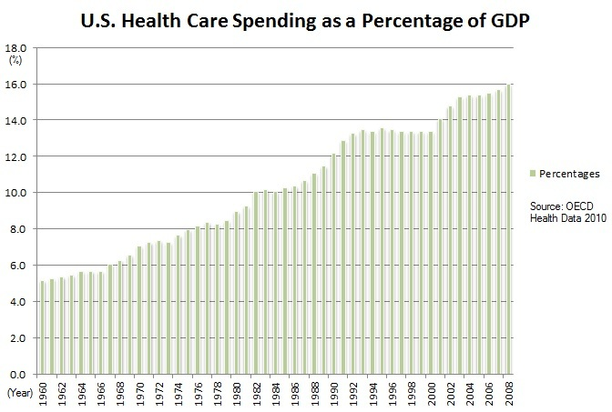
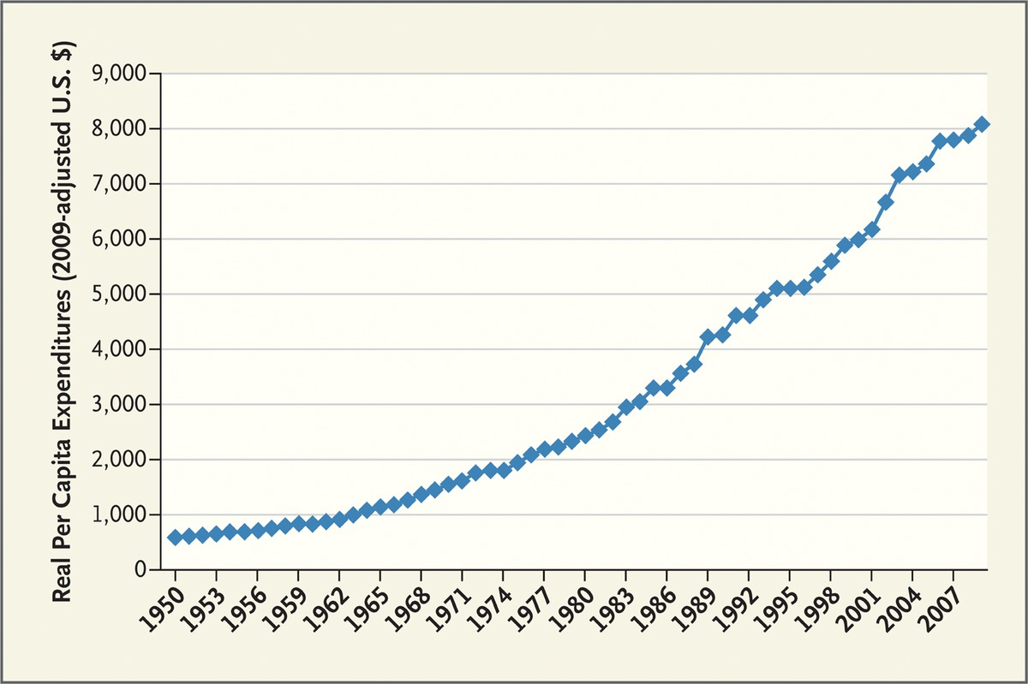
US Health Expenditure
Expenditure are increasing both in real terms and as a percentage of GDP
Fuchs 2012

Slide 3
Comparing National Health Expenditures

Slide 4
Comparing National Health Expenditures

Slide 5
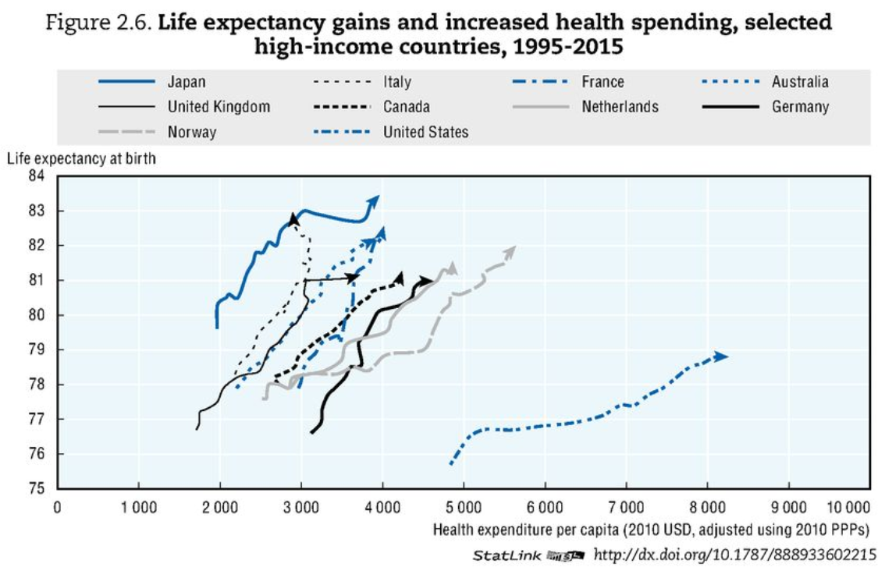
Comparing National Health Expenditures
OECD Health Data 2017

Slide 6
Discussion
As a group, come up with a list of 5 to 10 likely causes of excessively high costs in US healthcare. Rank in order of importance (ties are allowed).
Which of these do your articles think is most important?
Why?
  What theoretical reasons are there?
  What empirical reasons are there?
What reasons are not discussed or not adequately discussed in your papers?

Slide 7
Chandra, C., et al(2011). Hospital cost structure in the USA: what's behind the costs? A business case.
Significant waste exists across the entire medical supply process that needs to be eliminated.
Uses simulation to estimate the effect of streamlining administrative processes

Slide 8
Fuchs, V. R. (2013). How and why US health care differs from that in other OECD countries.
Because funding in most OECD countries is usually through a tax-supported system, administrative costs are usually much lower than in the United States, with its fragmented sources of funding and payment.
OECD countries use the concentration of funding to negotiate aggressively with drug companies and physicians and to control investment in hospitals and equipment.
  For Medicare in the US, legislation and political pressure prevent such an approach.
OECD countries provide more physicians and more acute care hospital beds, whereas the United States provides much more high-tech services, such as magnetic resonance imaging (MRI) scans and mammograms, proportionately more specialists, more amenities (privacy and space in hospitals), and more standby capacity as evident in a higher ratio of MRI scanners available to MRI scans performed.

Slide 9
Dieleman, J. L., et a;. (2017). Factors associated with increases in US health care spending, 1996-2013.
Annual health care spending on inpatient, ambulatory, retail pharmaceutical, nursing facility, emergency department, and dental care increased by $933.5 billion between 1996 and 2013, from $1.2 trillion to $2.1 trillion.
5 factors in order of importance:
  Changes in service price and intensity were associated with a 50.0% (UI, 45.0%-55.0%), or $583.5 (UI, $525.2-$641.4) billion, spending increase.
  Increases in US population size were associated with a 23.1% (uncertainty interval [UI], 23.1%-23.1%), or $269.5 (UI, $269.0-$270.0) billion, spending increase
  aging of the population was associated with an 11.6% (UI, 11.4%-11.8%), or $135.7 (UI, $133.3-$137.7) billion, spending increase
  Changes in disease prevalence or incidence were associated with spending reductions of 2.4% (UI, 0.9%-3.8%), or $28.2 (UI, $10.5-$44.4) billion
  Changes in service utilization were not associated with a statistically significant change in spending

Slide 10
Woolhandler, S., et al (2003). Costs of health care administration in the United States and Canada.
Administration accounted for 31.0 percent of health care expenditures in the United States and 16.7 percent of health care expenditures in Canada.
Between 1969 and 1999, the share of the U.S. health care labor force accounted for by administrative workers grew from 18.2 percent to 27.3 percent. In Canada, it grew from 16.0 percent in 1971 to 19.1 percent in 1996.

Slide 11
Papanicolas, I., at al. (2018). Health care spending in the United States and other high-income countries.
The United States spent approximately twice as much as other high-income countries on medical care, yet utilization rates in the United States were largely similar to those in other nations.
Prices of labor and goods, including pharmaceuticals, and administrative costs appeared to be the major drivers of the difference in overall cost between the United States and other high-income countries.

Slide 12
Anderson, G. F., et al. (2019). It’s Still The Prices, Stupid: Why The US Spends So Much On Health Care
On key measures of health care resources per capita (hospital beds, physicians, and nurses), the US still provides significantly fewer resources compared to the OECD median country.
  In 2016, the US had 26 percent fewer hospital beds per capita, 20 percent fewer practicing nurses, and 19 percent fewer practicing physicians per capita, compared to the OECD median country.
Since the US is not consuming greater resources than other countries, the most logical factor is the higher prices paid in the US.

Slide 13
Lorenzoni, L., et al. (2014). Health-care expenditure and health policy in the USA versus other high-spending OECD countries.
Health price levels contribute the most to explaining the higher spending in the USA, and recent price dynamics largely explain declines in health expenditure growth
  High and increasing rates of generic drug use, an important shift from inpatient to outpatient hospital care, along with some effective price control measures on plans and providers by Medicare and Medicaid, were some of the key factors responsible for the slowdown in health-care expenditure growth in the USA

Slide 14
Anderson, G. F., et al. (2003). It’s the prices, stupid: why the United States is so different from other countries.
The data show that the United States spends more on health care than any other country.
However, on most measures of health services use, the United States is below the OECD median.

Slide 15
Kantarjian, H., & Rajkumar, S. V. (2015). Why are cancer drugs so expensive in the United States, and what are the solutions?.
The health care industry in the United States is for-profit (unlike in European and other advanced nations), which appears to result in ill consequences driven by the demands for high profits: high drug prices (including cancer drugs) and high health care costs (18% of our gross domestic product vs 5%-9% in Europe).

Slide 16
Kesselheim, A. S., Aet al. (2016). The high cost of prescription drugs in the United States: origins and prospects for reform.
High drug prices are the result of the approach the United States has taken to granting government-protected monopolies to drug manufacturers, combined with coverage requirements imposed on government-funded drug benefits.
Per capita prescription drug spending in the United States exceeds that in all other countries, largely driven by brand-name drug prices that have been increasing in recent years at rates far beyond the consumer price index.
  In 2013, per capita spending on prescription drugs was $858 compared with an average of $400 for 19 other industrialized nations.

Slide 17
Siddiqui, M., & Rajkumar, S. V. (2012). The high cost of cancer drugs and what we can do about it.
It is very expensive to move findings from bench to bedside and to perform all the regulatory studies (including phase 1, 2, and 3 clinical trials) to gain approval.
Because most cancers are incurable, patients are treated with each approved agent (sequentially or in combination), creating a virtual monopoly because the use of one drug does not automatically mean that the others are no longer needed.
Even when the monopoly is broken with the arrival of “new and improved” versions of an approved drug, the older (and by now generic) drug tends to be viewed as substandard treatment, thereby perpetuating the situation.
Cancer, and the seriousness of the diagnosis, plays a role in that patients and physicians are often willing to pay the high price of treatment even for marginal improvements in outcome.
Our systems provide an incentive to administer more chemotherapy, and there are legal barriers that prevent agencies such as the FDA from taking economic and cost-effectiveness considerations into account when approving new drugs

Slide 18
Squires, D., & Anderson, C. (2015). US health care from a global perspective: spending, use of services, prices, and health in 13 countries.
Higher spending appeared to be largely driven by greater use of medical technology and higher health care prices, rather than more frequent doctor visits or hospital admissions.

Slide 19
Cutler, D. (2013). Why does health care cost so much in America? Ask Harvard’s David Cutler.
Administrative costs
  Duke University Hospital has 900 hospital beds and 1,300 billing clerks.
U.S. spends more than other countries do on many of the same things.
  Drugs, physician salaries, medical equipment
Utilization of high cost procedures
  If a person has a heart attack in the United States, they’re much more likely to get open heart surgery than they are in most other countries.
    In all of Ontario there are 11 hospitals that can do open heart surgery. Pennsylvania has roughly the population of Ontario and it has a bit over 60 hospitals that can do open heart surgery.

Slide 20
Gawande, A. (2009). The cost conundrum.
More frequent tests and procedures, more visits with specialists, and more frequent admission to hospitals.
Patients in high-cost areas were actually less likely to receive low-cost preventive services
Accountability is limited, doctors don’t know if they are improving overall community health, only if they are following best practice for the patients they see.

Slide 21
Aaron, H. J., & Ginsburg, P. B. (2009). Is health spending excessive? If so, what can we do about it?.
Most studies attribute one-half to two-thirds of the gap to the advance of medical technology, which lengthens the menu of beneficial interventions or improves their quality.
Excessive use resulting from insurance
Fee-for-service payment rewards providers for supplying particular services rather than for producing favorable outcomes or efficiently treating an episode of illness.
Inefficient organization of health care delivery needlessly boosts U.S. health spending.
Prices of drugs in the United States are higher than in other countries
Also discusses alternative reasons which may not be a good explination

Slide 22
Reinhardt, U. E., et al. (2004). US health care spending in an international context.
GDP per capita
Higher prices
Limited supply of providers (low physicians and nurses per capita)
Highly complex and fragmented payment system that weakens the demand side of the health sector and entails high administrative costs
Unwillingness to ration care

Slide 23
Bodenheimer, T. (2005). High and rising health care costs. Part 1: seeking an explanation.
the weakness of a competitive free market within the health system, by the rapid diffusion of new technologies
excessive costs of administering the health system
absence of strong cost-containment measures
undue market power of health care providers

Slide 24
Shrank, William H., Teresa L. Rogstad, and Natasha Parekh. "Waste in the US health care system: estimated costs and potential for savings." Jama 322, no. 15 (2019): 1501-1509.
Cost of waste, $760 billion to $935 (25% of total spending):
  Failure of care delivery, $102.4 billion to $165.7 billion;
  Failure of care coordination, $27.2 billion to $78.2 billion;
  Overtreatment or low-value care, $75.7 billion to $101.2 billion;
  Pricing failure, $230.7 billion to $240.5 billion;
  Fraud and abuse, $58.5 billion to $83.9 billion;
  Administrative complexity, $265.6 billion.
Estimated annual savings from measures to eliminate waste:
  Failure of care delivery, $44.4 billion to $97.3 billion;
  Failure of care coordination, $29.6 billion to $38.2 billion;
  Overtreatment or low-value care, $12.8 billion to $28.6 billion;
  Pricing failure, $81.4 billion to $91.2 billion;
  Fraud and abuse, $22.8 billion to $30.8 billion.
  Administrative complexity, ?

Slide 25
Chernew, Michael E., and Jermaine Heath. "How Different Payment Models Support (or Undermine) a Sustainable Health Care System: Rating the Underlying Incentives and Building a Better Model." NEJM Catalyst Innovations in Care Delivery 1, no. 1 (2019).
Article unavailable, sorry

Slide 26
Primary factors
S
A
B
C
D
Pharmaceutical prices
Administrative costs
Government regulations
Service intensity and (over)utilization
US healthcare worker salaries
Insurance market fragmentation
Defensive Medicine
Technology
Stakeholder disagreement in government
Non drug government regulations
.
US healthcare worker salaries
Technology
Administrative costs
Pharmaceutical prices
  Patents
  Market forces
  Research/Development/Approval
  Government regulations
Service intensity and (over)utilization
  Malpractice/consumer pressure/…
Insurance market fragmentation
Stakeholder disagreement in government
Waste
  Fraud/abuse
  Unused products
Defensive medicine
  Malpractice exposure
  High use of imaging tech
Non drug government regulations

