Slide 1
HCMI 4225: Effects of Health Insurance
Shane Murphy – shane@uconn.edu

Slide 2
Title 1: Quality, Affordable Health Care for All Americans.
The largest title of the ACA, measured in number of key provisions or in total spending and revenue
  Title I focuses on the private health insurance sector.
  Forty-nine provisions,
  $509 billion in spending, $81 billion in revenue,
  88 percent implemented.
High-profile provisions such as the creation of health insurance marketplaces, premium tax credits, employer and individual mandates, community rating requirements, and the ban on lifetime caps on coverage, among others.
As of 2019, 11.4 million Americans are covered by marketplace health insurance plans, down slightly from the peak of 12.7 million in 2016 (Kaiser Family Foundation 2019).

Slide 3
Title II: The Role of Public Programs
Medicaid expansion
  Seventeen provisions, $459 billion in spending, $53 billion in revenue,
  78 percent implemented
  Meant to cover all adults ages nineteen through sixty-four living in families with income below 138 percent of the federal poverty level on January 1, 2014.
  Instead, a Supreme Court ruling rendered this expansion effectively optional for states.
Twenty-four states plus the District of Columbia chose to expand Medicaid on or before January 2014;
  about half of the target population of low-income nonelderly adults.
  As of 2019, 64 percent of the adults in the expansion population live in states in which Medicaid expansion has been implemented or in which implementation is pending.

Slide 4
Title III: Improving the Quality and Efficiency of Health Care
Thirty-five key provisions, $54 billion in spending, $450 billion in revenue,
  96 percent implemented.
Intended to improve the quality of care (or at least not degrade it) while reducing federal payments,
  Aka delivery-system reform.
Cuts in Medicare payments to Medicare Advantage plans and to hospitals; together, CBO scored these cuts as achieving $290 billion in savings over the 2010 to 2019 scoring window.
Expanded quality measurement and value-based purchasing initiatives, and also created the Center for Medicare and Medicaid Innovation to facilitate the development and diffusion of innovations in Medicare policy
Introduced innovative payment models for Medicare such as the Shared Savings Program
  spurred the growth of accountable care organizations, and expanded pilot projects of bundled payments.
Created (but not implemented) the Independent Payment Advisory Board

Slide 5
Title IV: Prevention of Chronic Disease and Improving Public Health.
$18 billion in spending and $1 billion in revenue, 19 provisions
  85 percent implemented.
Creation of the Prevention and Public Health Fund.
Regulation expansions
  Nutrition labeling for restaurant menus
  Large firms provide break time and lactation space for employees who are nursing mothers

Slide 6
Title V: Health Care Workforce.
$18 billion in spending and zero revenue,
Eight of its nine key provisions— 94 percent—were implemented.
Grant programs and residency regulation
Unimplemented provision established a National Health Care Workforce Commission, and members were appointed in September 2010. Congress, however, never appropriated the money for the commission, which has therefore never met

Slide 7
Title VI: Transparency and Program Integrity.
$3 billion spending and $7 billion in revenue,
90 percent implemented
43 provisions
  prevent fraud, including the creation of provider data banks for Medicare and Medicaid
  Elder Justice Act, intended to prevent abuse, neglect, and exploitation of older Americans;
  Physician Payments Sunshine Act, which requires pharmaceutical companies and drug manufacturers to report payments to physicians;
  Creation of the Patient-Centered Outcomes Research Institute.
Could have been implemented separately, but included in part to provide revenue

Slide 8
Title VII: Improving Access to Innovative Medical Therapies.
zero spending and $7 billion in revenue
Seven key provisions, fully implemented
Adopted the Biologics Price Competition and Innovation Act of 2009 (BPCI Act), intended to create a simplified path for the approval of “biosimilar” therapies—essentially, generic versions of biological products approved by the Food and Drug Administration (FDA).
  Only limited success
Expanded the 340B Drug Pricing Program in Medicaid, effectively increasing the number of hospitals that receive drug rebates from manufacturers.

Slide 9
Title VIII: Community Living Assistance Services and Supports.
The CLASS Act
zero spending and a stated $70 billion in forecast revenue
One provision, not implemented.
Intended to create an insurance-like program that would cover expenses for services required to help disabled individuals remain living in the community rather than having to move to a nursing home.

Slide 10
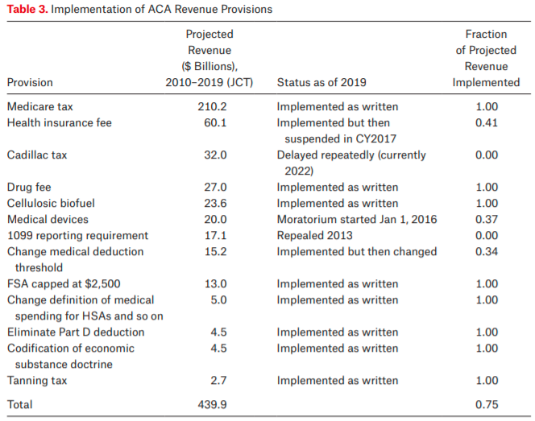
Title IX: Revenue Provisions.
Projected to raise $438 billion between 2010 and 2019, 19 provisions, 79% implemented
Medicare tax on high income individuals and on unearned income
  property income, inheritance, pensions, and payments received from public welfare

Slide 11
Legal challenges
Medicaid expansion
  National Federation of Independent Business v. Sebelius
Cost-sharing reductions
  House v. Burwell
  Payments meant to reimburse insurers for adhering to ACA rules that require them to limit the out-of-pocket costs of their low-income enrollees
  Money never appropriated
  Trump scrapped attempts to appropriate money
  Lead to “silver loading”
Contraceptive coverage
  Burwell v. Hobby Lobby

Slide 12
Born to fail – parts of law not written well
1099 reporting provision
  Repealed by congress in April 2011
Community Living Assistance Services and Supports (CLASS) Act
  Required to be self-sustaining
  Capped premiums for low income and student enrollees
  Premiums go into 10-year CBO window, outlays come later
Co-ops
  Proposed loans to co-op insurance plans
  23 programs initially took part, political failure to support and difficult market led to failure

Slide 13
Interest group pressure
Cadillac tax
Medical device tax
IPAB
DSH cuts
Free Choice vouchers
  Allow low income employees to buy subsidized marketplace insurance rather than get employer based insurance
Menu labeling

Slide 14
Experiment design: randomization
Randomized evaluations can provide clear answers
  Without knowing why two groups differ, hard to know what to attribute the differences to
    Can get perverse “findings” (e.g. health insurance makes you sicker)
  Randomly assign individuals to different treatments (programs) or control (status quo continues)
By construction, the treatment group and the control group will have the same characteristics, on average
  Observable: age, income, measured health…
  Unobservable: motivation, social networks, unmeasured health…

Slide 15
Experiments in Health Insurance
RAND Health Insurance Experiment
  Ran from 1971-1982
Oregon Health Study
Medicaid Expansion

Slide 16
Rand Health Insurance Experiment (HEI)
Research questions:
  How does cost sharing affect demand for personal health care services?
  How does cost sharing affect demand for particular services, e.g., hospital care, dental services?
  Does use of personal health care services improve health?
  How does a change from fee-for-service payment to capitation affect demand for personal health care services?

Slide 17
Study design
Enrolled 2,750 non-elderly (<=61) families, 7,700 individuals for from 3-5 years across 6 sites throughout the US
Families randomly assigned to 1 of 14 insurance plans differing in cost sharing rates and in maximum dollar expenditures per year (MDE or stop loss)
  Five basic types:
    Free care, 25% cost sharing, 75% cost sharing, and 95% cost sharing, HMO-style
    Income adjusted for poor families
    OOP capped at $1,000 ($3,000 at 2005 US$)
At enrollment, families exchanged their existing health insurance policy for HIE plan—held harmless for medical expenditure higher than they would have experienced if they had not enrolled in HIE
Some participants randomly assigned to capitation plan
Participation in HIE voluntary for families
Ran from 1971-1982

Slide 18
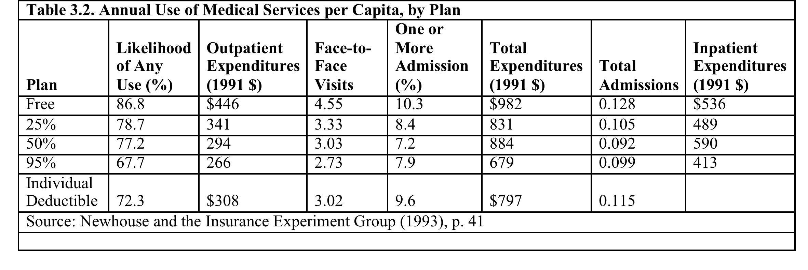
Results
More cost sharing -> less utilization and les cost

Slide 19
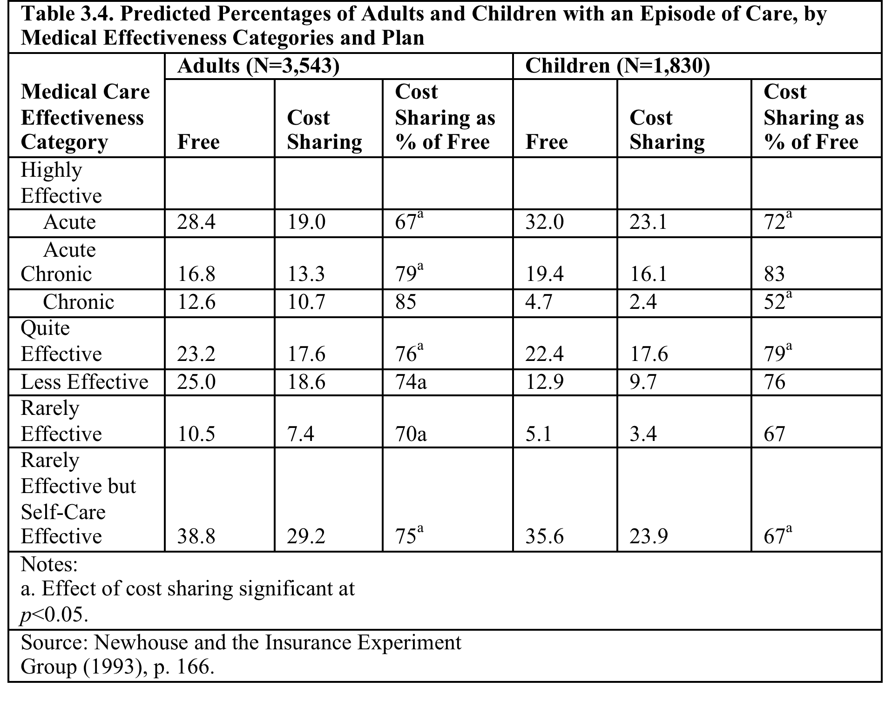
Results
Utilization rates decreased for cost sharing individuals across illness type

Slide 20
Health Outcomes
The poorest and sickest 6 percent of the sample at the start of the experiment had better outcomes under the free plan for 4 of the 30 conditions measured.
  Serious symptoms were less prevalent for poorer people on the free plan.
Free care improved the control of hypertension.
Free care marginally improved vision for the poorest patients.
Free care also increased the likelihood among the poorest patients of receiving needed dental care.
Cost sharing also had some beneficial effects. Participants in cost sharing plans worried less about their health and had fewer restricted-activity days (including time spent in seeking medical care).

Slide 21
Key Result
For 94 percent of persons in HIE, not with low income and not in poor health at baseline, having health insurance coverage had no effect on health.
In a large-scale, multiyear experiment, participants who paid for a share of their health care used fewer health services than a comparison group given free care.
Cost sharing reduced the use of both highly effective and less effective services in roughly equal proportions. Cost sharing did not significantly affect the quality of care received by participants.
Cost sharing in general had no adverse effects on participant health, but there were exceptions: free care led to improvements in hypertension, dental health, vision, and selected serious symptoms. These improvements were concentrated among the sickest and poorest patients.

Slide 22
Oregon Medical Experiment
Research Question: What are the effects of expanding access to public health insurance for low income adults?
Oregon’s Medicaid expansion program covers those financially but not categorically eligible for Medicaid
  Low-income (below 100% of federal poverty line), uninsured, able-bodied adults
Covers doctors, hospitals, drugs, mental health, etc. with no consumer cost sharing and low or no premiums
In 2008: Oregon had money to cover some but not all of those eligible… so chose to run a lottery for fairness
  Asked interested individuals to sign up
  Randomly assigned ~30,000 out of 75,000 ability to apply for Medicaid
  After about 2 years, find money to offer the remainder coverage.

Slide 24
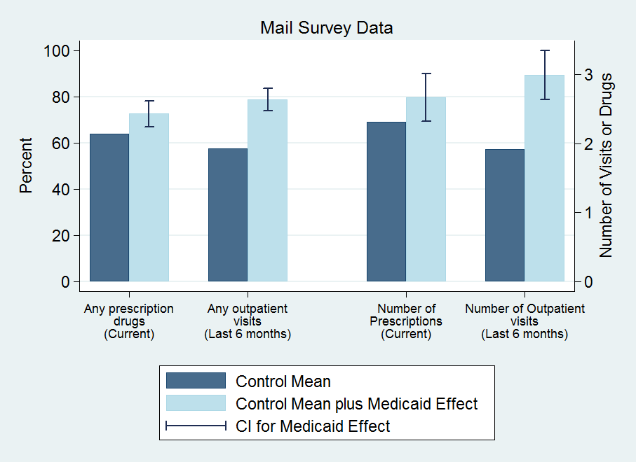
Results: Utilization

Slide 25
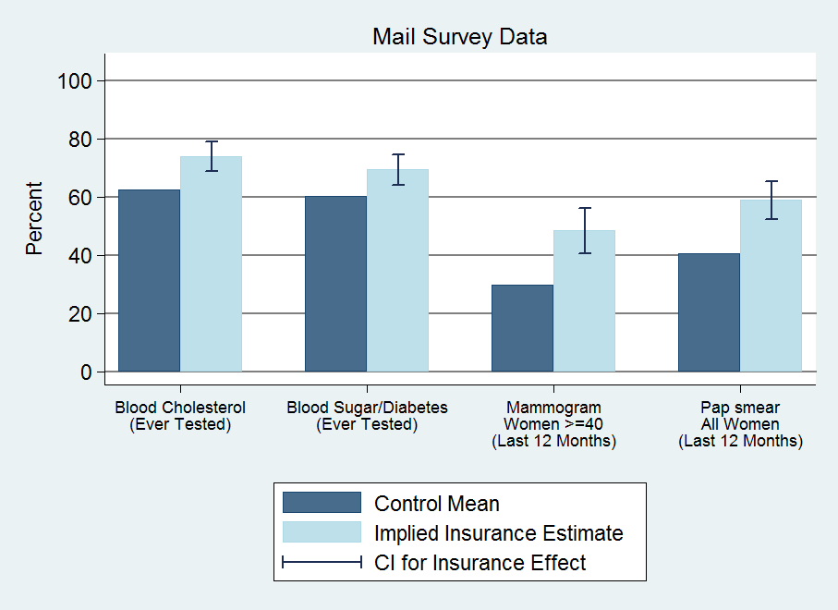
Results: Preventive Care

Slide 26
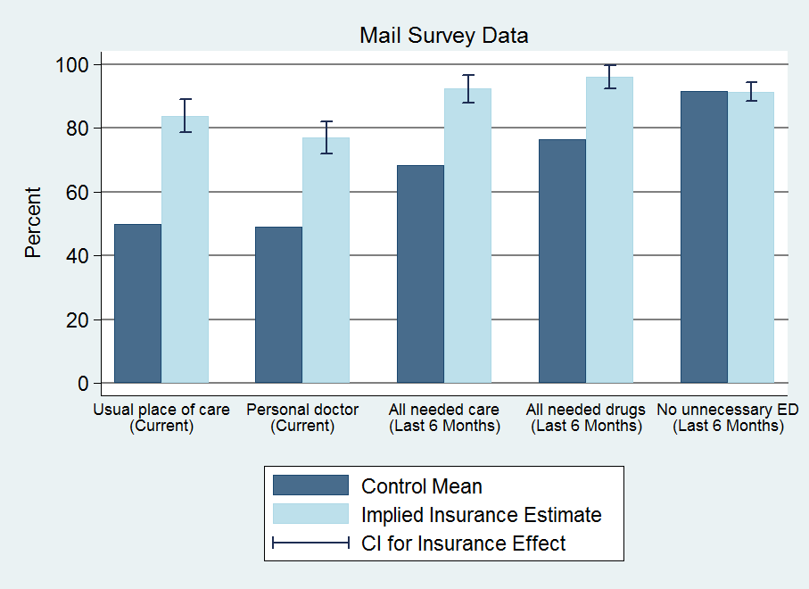
Results: Access

Slide 27
Hospitalizations (discharge data)
  30%↑probability of hospital admission
    40% ↑number of ER visits
  Substantial (but imprecise) increase in total resource use
  By condition: increase in heart disease use (not shown)
  No change in mix of private/public use; no power to detect change in quality of hospitals used
Other use (self-reports)
  35% ↑ probability of outpatient visit
  15% ↑ probability of taking prescription drugs
  0.3 standard dev ↑ in compliance with recommended preventive care
  No discernable change in ER use (imprecise)
Implied $777 increase in spending for insured
  25% increase

Slide 28
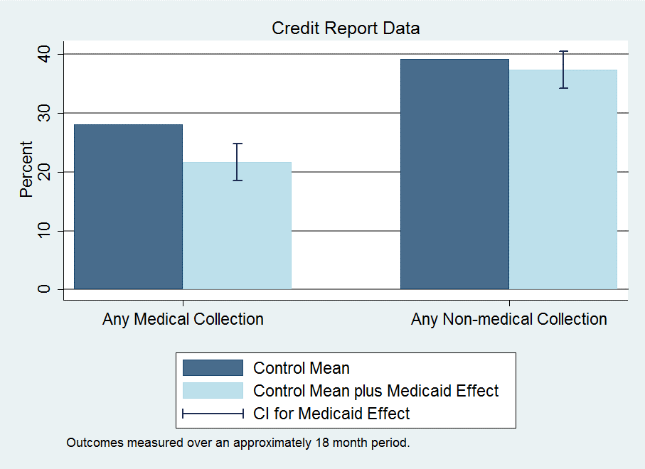
Results: Financial

Slide 29
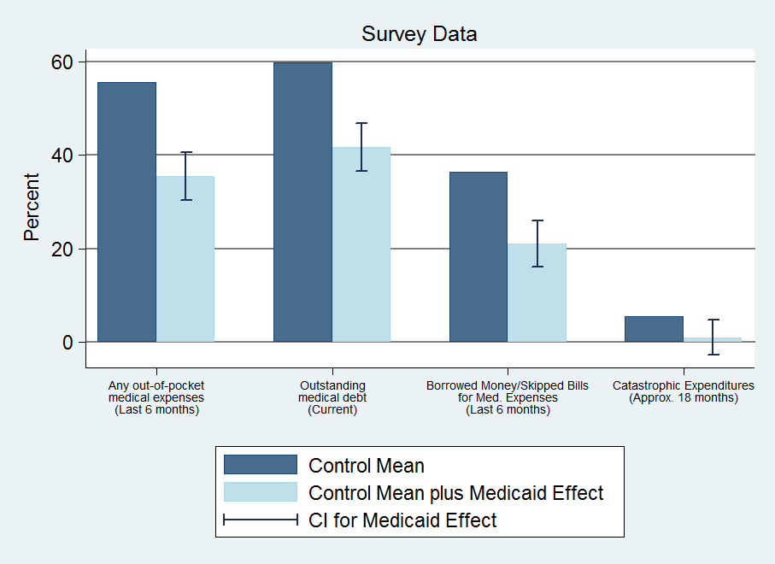
Results: Financial

Slide 30
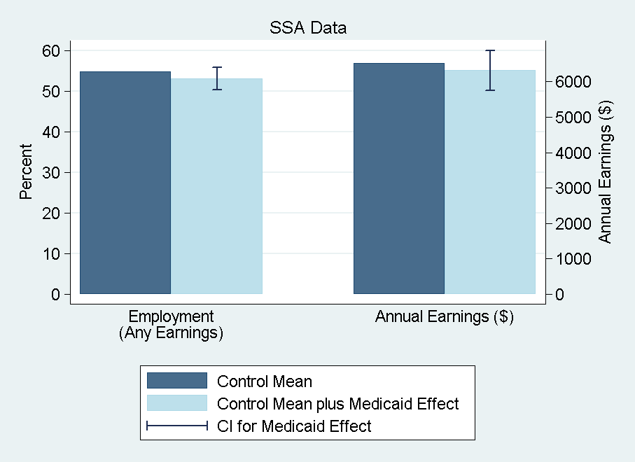
Results: Financial

Slide 31
Results: Financial
Reduction in collections (credit reports)
  25% ↓ probability of unpaid medical bills sent to collection
  No observed effects on other measures
  Limitations: time lags, extreme events, lack of data on informal channels (more heavily used by poor)
Reduction in strain, OOP, money owed (self-reports)
  Substantial reduction across measures
  Captures additional channels
Implications for distribution of burden/benefits
  Some borne by patients, some by providers (or those to whom passed through) – only 2% of bills sent to collection ever paid

Slide 32
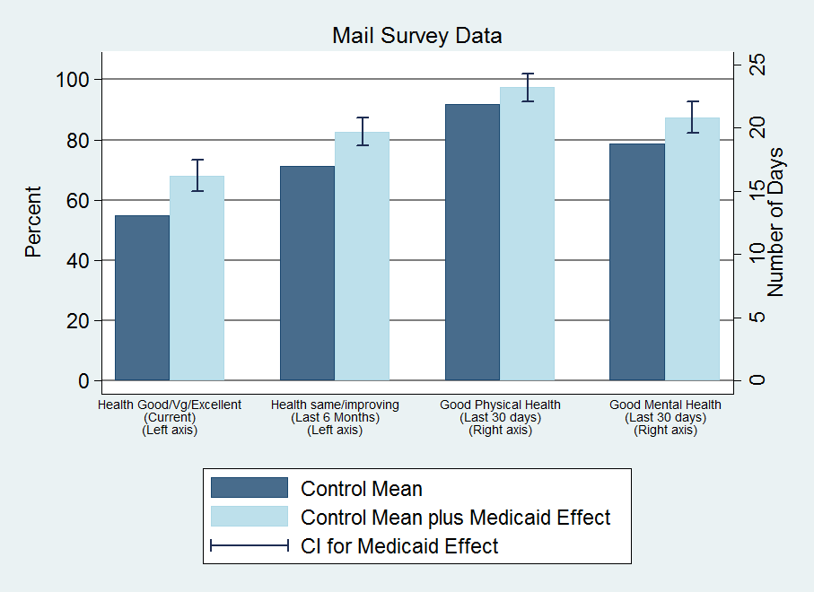
Results: Health

Slide 33
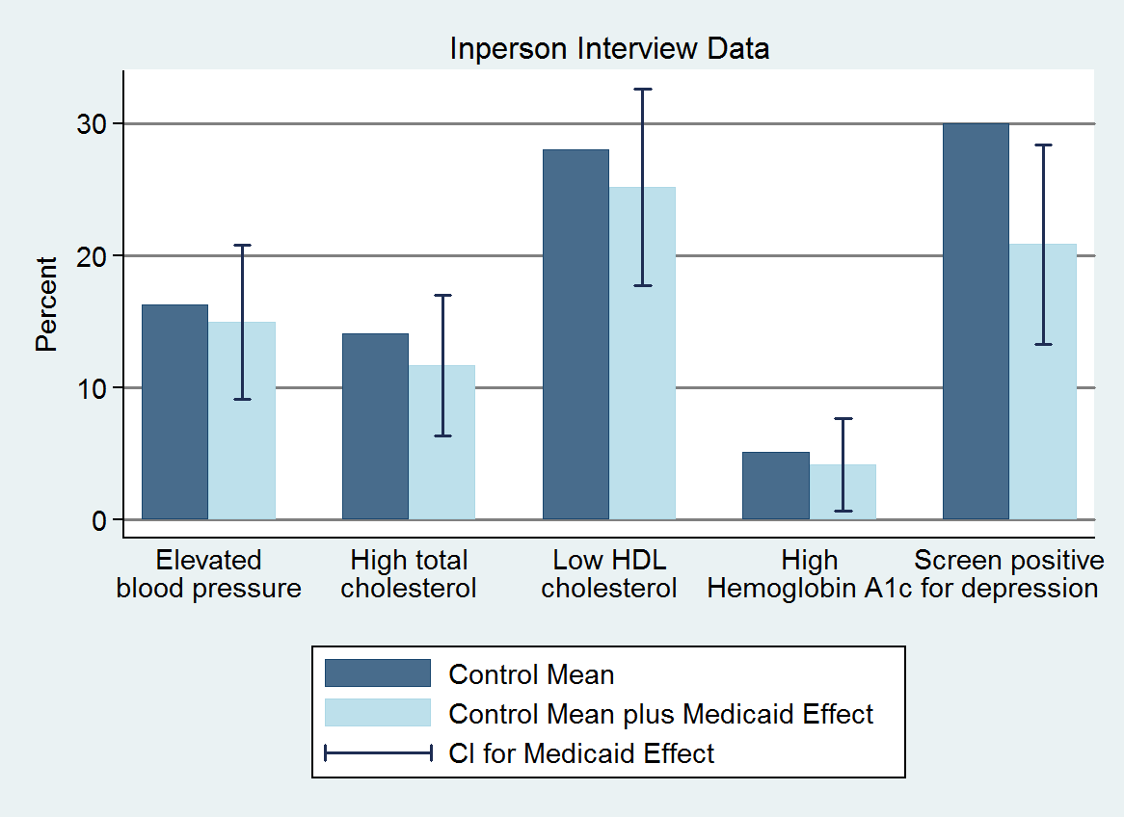
Results: Health

Slide 34
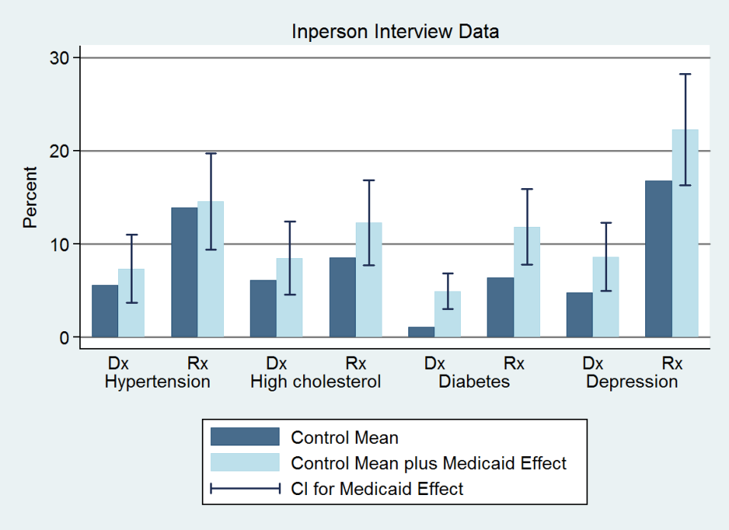
Results: Health

Slide 35
Results: Health
Health benefits from Medicaid
  Improves self-reported health
  Reduces depression (by ~9 pctg pts or 30%)
No detectable impact on blood pressure, cholesterol, or blood sugar
  Chosen because they are important, measurable health problems in this population and have been shown in clinical trials to be modifiable with effective treatment within our time frame
  Cannot reject decline in blood sugar predicted by the effect we see on diabetes medication + clinical trials of effects of such medication
  Can reject declines in blood pressure found in quasi-experimental Medicaid studies

Slide 36
Large improvements in self-reported physical and mental health
  Mental health indices correlate well with clinical diagnoses
    Reduces depression (by ~9 pctg pts or 30%)
  Physical health measures open to several interpretations
    Improvements consistent with increased utilization
    Also see reports of improved quality and access
      Usual place of care; reported quality of care
    But these results appear shortly after insurance coverage
      ~2/3 magnitude, in advance of changes in utilization
      Although lottery selection “glow” may be stronger earlier
    Suggestive of increase in perceived overall well-being
      Also substantial improvements in reported happiness
  Possible decline in blood sugar for individuals with diabetes
  Unlikely that it had an effect on blood pressure for people with hypertension

Slide 37
Results: Summary
Increased health care use across the board
  Hosp, ER, primary care, drugs, preventive care
  ~25% ↑ total, annual spending (hospital, outpatient, drugs)
Reduced out-of-pocket costs and financial strain
  Virtually eliminated “catastrophic” out-of-pocket spending
  No detectable effect on earnings and employment
Health
  Improved self-reported health
  Reduced depression
  No/Limited detectable effects on measured physical health

Slide 38
Criticism: Power and effect size in the Oregon Healthcare experiment
The Oregon study was aimed at expanding coverage for roughly half of the 75,000 newly eligible individuals for Medicaid
But 12,229 people responded to the surveys and were analyzed, about half in treatment and control
And most of the treatment group (all of whom were offered Medicaid in the experiment) didn’t even sign up for Medicaid
So the treatment group actually was about 1,500 people!!!!
  The majority of whom did not have any given chronic condition
There are claims that the Oregon Healthcare experiment was too small and therefore was underpowered
  The power of an experiment expresses whether an experiment has enough subjects to estimate with statistical significance an effect size of interest to the researchers

Slide 39
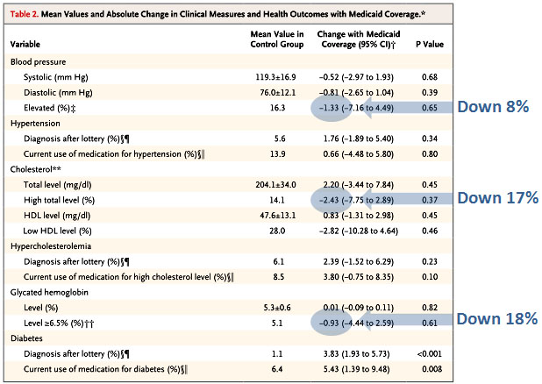
Total health effect sizes estimated by the Oregon Experiement
Notes:
https://www.motherjones.com/kevin-drum/2013/05/what-we-know-oregon-medicaid-study/

Slide 40
Power and effect size in the Oregon Healthcare experiment
5.1% of the control group had elevated glycated hemoglobin levels (common marker for diabetes)
5.1% of 1,500 is roughly 80 people
Assume the treatment group has the same numbers.
The reduction in people with elevated GH was roughly 20%, about 16 people.
Any experiment on a treatment group of 80 people that shows success in 16 (and no success in the other 64 or in the 80 people in the control group) is underpowered
  The power of an experiment expresses whether an experiment has enough subjects to estimate with statistical significance an effect size of interest to the researchers
But a 20% reduction in the number of people with elevated GH would be a great success!!
Notes:
https://www.motherjones.com/kevin-drum/2013/05/what-we-know-oregon-medicaid-study/

Slide 41
Power and effect size in the Oregon Healthcare experiment
Before randomization, there were 2225 people with hypertension. If we assume that half got randomized to each arm, and then take the 24.1 percentage point increase in coverage the study reports, that means there were only 280 people with hypertension who got Medicaid, and who could be studied for this outcome. Further, those people had a baseline average blood pressure of 130/83. That’s remarkably well controlled! So there’s not nearly the room for improvement that you might assume.
Before randomization, there were 872 patients with diabetes. Half to each group, and then the 24.1% who actually got new Medicaid, and you’ve got about 110 patients with diabetes in the Medicaid group. And again, their average baseline A1c was 6.7%, which is pretty well controlled. How much could the Medicaid do? With respect to the percentage of patients with a A1C>=6.5, there appears to be so much imprecision in the measurement that it’s in the 95% confidence interval that they got every single person in Medicaid with diabetes under control: the baseline percentage of A1C>=6.5 was 54.0, and the reduction in the Medicaid group was -27.0 (95% CI -71.91 to 17.92).
Notes:
https://theincidentaleconomist.com/wordpress/oregon-medicaid-power-problems-are-important/

Slide 42
Average health outcomes and the Oregon Experiment
“Average blood pressure was a bizarre thing to measure. You have to remember that most people who get health insurance are healthy. They’re not going to get “healthier”. The average blood pressure in the control group was 119/76. That’s normal! You would only expect that it might improve in those with a high blood pressure. So I might have looked for an effect in those patients with hypertension. 16.3% of people in the control group had a systolic over 140 or a diastolic over 90. In the Medicaid group, that dropped to 15%. If they wanted to look at average pressures, why didn’t they single out the hypertensive people?”
Notes:
https://theincidentaleconomist.com/wordpress/additional-thoughts-on-the-new-oregon-medicaid-results/

Slide 43
Myth vs reality
“Insurance/Medicaid is worthless or worse than no insurance”
  Not true: Increases in utilization, perceived access and quality, reductions in financial strain, and improvement in self-reported health
“Covering the uninsured will get them out of the Emergency Room”
  Not true: Medicaid increases use of ER (overall and for a broad range of visit types)
“Health insurance expansion saves money”
  Not true in short run: increases in health care use
  In long run, remains to be seen: increases in preventive care and improvements in self-reported health

Slide 44
Effects of the ACA
There has been a lot of research on the health and coverage outcomes of the Affordable Care Act
  KFF summary for Medicaid expansion (Antonisse as lead author) - https://www.kff.org/medicaid/report/the-effects-of-medicaid-expansion-under-the-aca-updated-findings-from-a-literature-review/
  Mazurenko, Olena, Casey P. Balio, Rajender Agarwal, Aaron E. Carroll, and Nir Menachemi. "The effects of Medicaid expansion under the ACA: a systematic review." Health Affairs 37, no. 6 (2018): 944-950.
  Courtemanche, Charles, James Marton, Benjamin Ukert, Aaron Yelowitz, Daniela Zapata, and Ishtiaque Fazlul. "The three‐year impact of the Affordable Care Act on disparities in insurance coverage." Health services research 54 (2019): 307-316.
  Soni, Aparna, Laura R. Wherry, and Kosali I. Simon. "How Have ACA Insurance Expansions Affected Health Outcomes? Findings From The Literature: A literature review of the Affordable Care Act's effects on health outcomes for non-elderly adults." Health Affairs 39, no. 3 (2020): 371-378.
  Courtemanche, Charles, James Marton, Benjamin Ukert, Aaron Yelowitz, and Daniela Zapata. "Early effects of the Affordable Care Act on health care access, risky health behaviors, and self‐assessed health." Southern Economic Journal 84, no. 3 (2018): 660-691.
  …

Slide 45
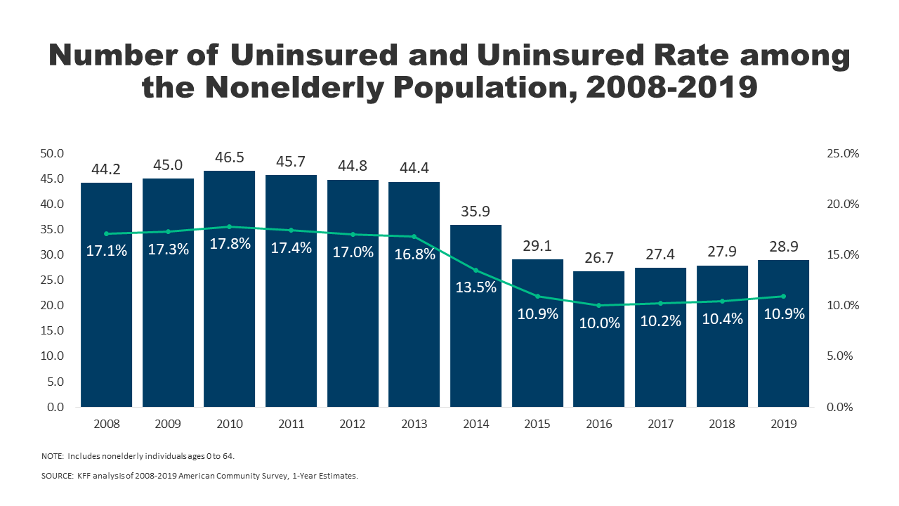
Effects on health and coverage
Largest effect on coverage was due to Medicaid expansion, not the exchanges
Largest effect on health comes from self-perceived health, mental health, financial stability
  These three factors are all closely interrelated
  Benefits of wellness visits are difficult to measure
  Health benefits for chronic conditions require large samples sizes, studies are hard to perform

Slide 46
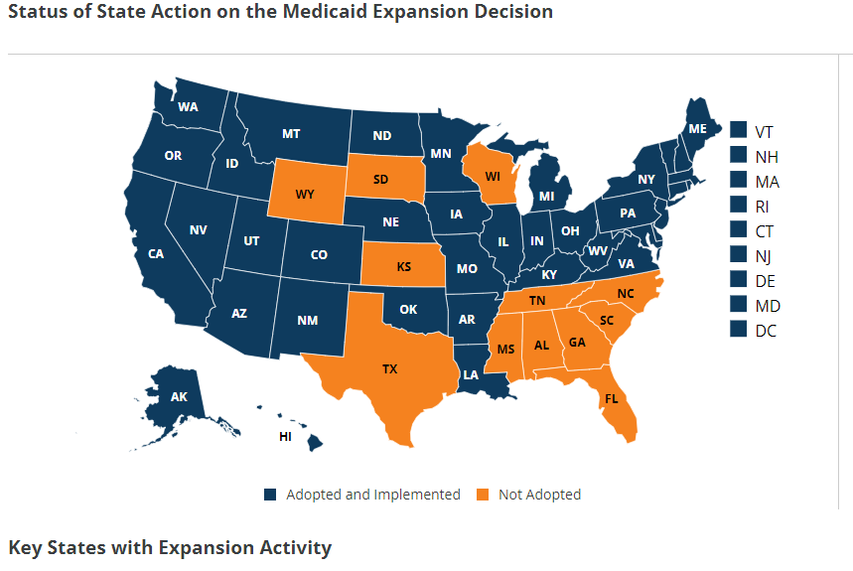
Coverage: Medicaid expansion
All US citizens and legal residents with income up to 138% FPL qualify for coverage in participating states
Led to large growth in enrollment in participating states, smaller growth in non-participating states
Reduction in uninsured rates, especially among low-income individuals
Partial Woodwork effect/welcome mat effect
  Growth among individuals who were previously eligible

Slide 47
Coverage: Medicaid expansion: subgroups
Coverage gains in expansion versus non-expansion states for specific vulnerable populations:
  young adults, prescription drug users, people with HIV, veterans, parents, mothers, women of reproductive age (with and without children), children, lesbian, gay, and bisexual adults, newly diagnosed cancer patients, women diagnosed with a gynecologic malignancy, low-income workers, low-educated adults, early retirees, and childless adults with incomes under 100% FPL
Disproportionately positive impact in rural areas in expansion states
Gains can be found across racial/ethnic categories
  Reduced disparities by income and age
  Possibly reducing disparities by race/ethnicity

Slide 48
Coverage: Medicaid expansion: Alternative approaches
Section 1115 gave states the option of expanding Medicaid in alternative ways
These states (especially Arkansas, Michigan, and Indiana) have shown similar gains in coverage rates
Indiana instituted monthly contributions which have created enrollment and continuing coverage issues

Slide 49
Coverage: Medicaid expansion: criticism
Crowding out of private insurance
  Mixed results, although there has been some decline in private coverage in participating states

Slide 50
Access, Utilization
Many studies find improvements in access to care
  Increases in cancer diagnosis rates (especially early stage)
  Earlier presentation for common surgical conditions – lowering complications
  Increase listing for heart transplants among African Americans
  Increased access for treatment of behavioral and mental health conditions
  Increase in prescriptions for opioid use disorder and overdose
  Increase in prescriptions for smoking cessation drugs

Slide 51
Access, Utilization
Many studies find improvements in access to care
  Reduction in disparities by race, income, education, and employment status in access and affordability
  Increased rates of optimal care for patients with common surgical conditions
  Improved quality of care for common community health care treated conditions:
    Asthma, Pap testing, BMI assessment, hypertension control
  Declines in uninsured ED visits, but mixed evidence and no significant change in total ED volume
  Reduced LOS for Medicaid patients
  Improvements in care and quality in areas with primary care shortages

Slide 52
Access, Utilization: Criticism
Confusion in non-waiver states
Failures to follow up with new patients
Longer wait times

Slide 53
Affordability and Financial Security
Possible reduced patients with unmet medical need because of cost
Reduction in OOP
  Average reduction in 2014 of about $205
  Greater reductions among Medicaid expansion covered individuals than subsidized marketplace coverage individuals
Declines in unpaid bills and financial stress over future bills
  In Ohio, percentage of expansion enrollees with medical debt fell by nearly half since enrolling in Medicaid (55.8% had debt prior to enrollment, 30.8% had debt at the time of the study)

Slide 54
Health Outcomes
Possible improvements in self-reported health
Improved outcomes for cardiac patients
Infant Mortality Rate Reductions for expansion states between 2014 and 2016, a period where the rate rose slightly for non-expansion states
  Effect largest among African Americans
Limited of no effect on drug overdoses or alcohol poisonings

Slide 55
Economic effects
Federal matching for expansion population provided large spending savings for expansion states
  No significant increase in state spending on Medicaid, including savings in some states
Possible reduction in overall spending due to spillovers
  State costs related to behavioral health services, crime and the criminal justice system, and Supplemental Security Income program costs.
Lower Medicaid spending per enrollee
  New enrollees generally less expensive than existing enrollees
  First year of enrollment generally more expensive than subsequent years
Medicaid expansion lowers marketplace premiums
  Marketplace enrollees younger and healthier in expansion states

Slide 56
Impacts on providers
Reduction in uninsured visits and uncompensated care costs
  Decline in uninsured ED visits and increase in Medicaid-covered ED visits
  Increase in Medicaid-covered substance use disorder treatment facility visits
  Reduced disparity in uninsured visits between hospitals that treat a disproportionate share of low-income patients (DSH hospitals/safety net hospitals) and those that do not
  Improved overall hospital financial performance, reduced probability of closure
    Especially in rural areas

Slide 57
Labor Market Effects
Increased jobs
Did not reduce employment for low-income workers
Enrollees looking for work reported Medicaid enrollment made it easier to seek employment, those employed reported it made it easier to continue working
Increase volunteering

Slide 58
Readings:
Brook, Robert H., Emmett B. Keeler, Kathleen N. Lohr, Joseph P. Newhouse, John E. Ware, William H. Rogers, A. Ross Davies et al. "The health insurance experiment: A classic RAND study speaks to the current health care reform debate." Santa Monica. RAND Corporation (2006). (https://www.rand.org/content/dam/rand/pubs/research_briefs/2006/RAND_RB9174.pdf)
“The Oregon Health Insurance Experiment, " Health Affairs Health Policy Brief, July 16, 2015. (https://www.healthaffairs.org/do/10.1377/hpb20150716.236899/full/)

Slide 59
Covid talk
Increase in Covid mortality risk is much higher among older people than younger:
  In fact 65-74 year olds are 65 times more likely to die from COVID than are 18-29 year olds
  The comparable risk increases for 75-84 year olds and people 85 and older compared to 18-29 year olds are 140 times and 340 times, respectively.
  Note that people in all age cohorts from five years old and up are equally likely to contract COVID, or at least to be recorded as having contracted it
Notes:
https://www.cdc.gov/nchs/nvss/vsrr/mortality-dashboard.htm#

Slide 60
Covid talk
All-cause mortality has increased much more than the number of estimated Covid deaths
Covid’s mortality effect by age group depends on if you estimate all-cause mortality or official Covid mortality - between the third quarter of 2019 and the second quarter of 2021:
  Among Americans between the ages of 15 and 44, official COVID deaths account for 22.6% of the increase in the all-cause mortality rate over the course of the pandemic.
  Among Americans between the ages of 45 and 64, official COVID deaths account for 63% of the increase in the all-cause mortality rate over the course of the pandemic.
  Among Americans 65 and older, official COVID deaths account for 112% of the increase in the all-cause mortality rate over the course of the pandemic.
While
  Among 15-44 year old Americans all-cause mortality has increased by 31.7% over the course of the pandemic.
  Among 45-64 year old Americans all-cause mortality has increased by 24.3% over the course of the pandemic.
  Among Americans 65 year and older all-cause mortality has increased by 15.7% over the course of the pandemic.
Notes:
https://www.cdc.gov/nchs/nvss/vsrr/mortality-dashboard.htm#

Slide 61
Covid talk
How far back in the nation’s medical history do we have to go to find the same mortality rate among people 65 or older that we saw during the first year of the pandemic? The answer is: 2006.
How far back do we have to go to find the same mortality rate among people 25 to 34 years old that we saw during the first year of the pandemic? The answer is: 1952.
Notes:
https://www.cdc.gov/nchs/nvss/vsrr/mortality-dashboard.htm#

Slide 62
Covid talk
Total burden might be estimated by life years lost – for the period from spring 2020 to spring 2021:
110,080 excess deaths among 75-84 year olds.
  1,012,737 years of life lost among 75-84 year olds.
110,670 excess deaths among 65-74 year olds.
  1,715,340 years of life lost among 65-74 year olds.
75,460 excess deaths among 55-64 year olds.
  1,754,445 years of life lost among people 55-64.
41,715 excess deaths among 45-54 year olds
  1,334,880 years of life lost among 45-54 year olds
28,006 excess deaths among 35-44 year olds.
  1,148,246 years of life lost among 35-44 year olds.
8,744 excess deaths among 15-24 year olds.
  524,610 years of life lost among 15-24 year olds.

Slide 63
Covid Talk
All-cause mortality among 25-34 year olds crept up gradually between 2003 and 2019, rising by a total of 23% over this time, before the massive leap last year
Here’s the breakdown of the official causes of the increase over the last year:
  COVID: 0 to 6.4. (15.8% of increase)
  Drug overdose: 34.8 to 47.3 (31% of the increase)
  Firearm injury: 17.9 to 23.6 (14.1% of the increase)
  Homicide: 11.4 to 16.3 (12.1% of the increase)
  Unintentional injuries: 52.7 to 71.3 (46% of the increase)

Slide 64
Other major causes of death where there was any statistical change:
  Cancer 7.9 to 7.6
  Chronic liver disease and cirrhosis: 2.4 to 4.0
  Chronic lower respiratory disease: 0.7 to 0.8
  Diabetes: 2.0 to 2.7
  Heart disease: 7.6 to 8.7
  HIV: 1.0 to 1.1
  Hypertension: 0.2 to 0.4
  Influenza and pneumonia: 1.0 to 0.7
  Kidney disease: 0.6 to 0.7
  Suicide: 17.5 to 18.3
  4.1 total increase, i.e. these account for 10.1% of the total rise in all-cause mortality.

Slide 65
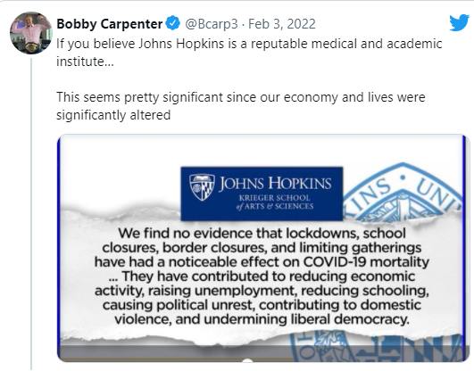
Covid Health Economics News
Cato paper (aka Johns Hopkins paper) shows masks ineffective
  Epidemiologists very upset
  Most studies show masks effective
  Key studies in paper show masks effective
  Particular choices made by authors able to find different results
Conclusion: Ugh Cato?

Slide 66
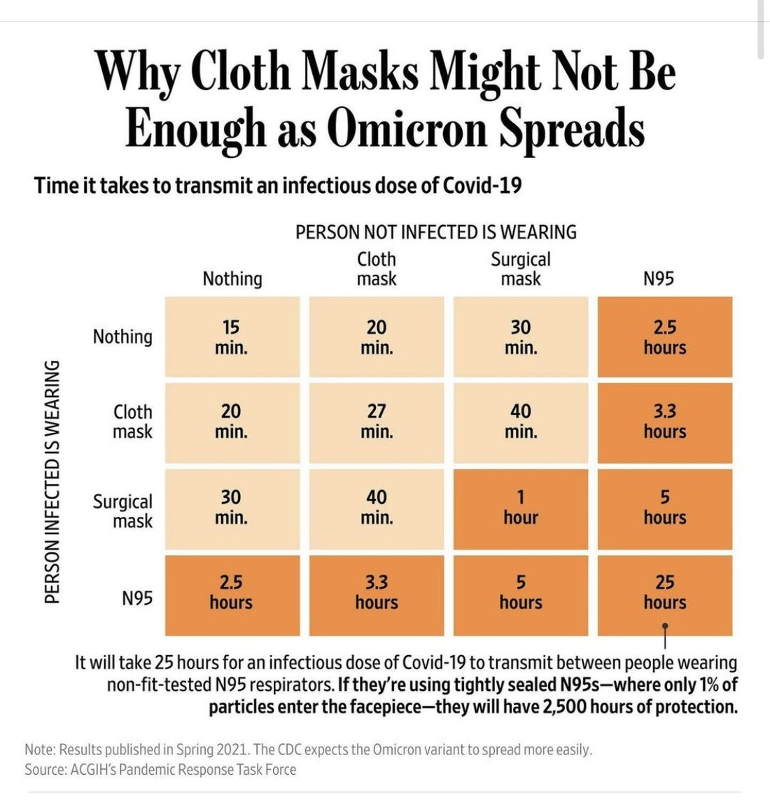
Discussion
What’s up with masks? I live in Mansfield and mask adherence is very high here. The data shows mask adherence is very low everywhere else. Are people wearing L'homme au masque de fer-style masks or what? Or am I wierd and spending too much time with eastern Connecticut’s sheep herds?

Slide 67
Non Health Economics news
Is anyone following the largest theft of all time?
Ilya Lichtenstein, 34, and his wife, Heather Morgan, 31, both of Manhattan, are due in court Tuesday afternoon. Federal prosecutors allege they conspired to launder the proceeds of 119,754 bitcoin that were stolen from Bitfinex’s platform and ended up in a digital wallet under Lichtenstein’s control.
  44,418$/bitcoin*119,754 bitcoins = current value of $5,319,233,172
  Justice Department has currently recovered $3.6 billion

