Slide 1
HCMI 4225: The Right to Health and to Health Care
Mon/Wed 9:30 AM – 10:45 AM
Shane Murphy – shane@uconn.edu

Slide 2
Arnold Kling’s Three Languages of Politics
Progressives: The Oppressed vs. Oppression
Conservatives: Civilization vs. Barbarism
Libertarian: Freedom vs. Coercion
I might add the academics/beaurocrats view:
The Expert vs. ignorance

Slide 3
Discussion Questions:
What is a right? What is a human right?
Is health care a human right?
Should the government ensure provision of basic health needs to the entire population?
Should the government ensure provision of premium health care to the entire population?

Slide 4
Rights in moral philosophy: Older views
Daoism
Focus on personal morality over community
Confucianism
Mutual obligation
Aristotelian ethics
Cardinal virtues and human flourishing – limited place for “rights”
Abrahamic traditions (justice)
Moses’ laws, Isaiah’s covenant, Jesus’ Beatitudes, Muhammad’s Al-Israa, Augustine’s City of God
Medieval philosophers
Influenced by Aristotle: Avicenna, Averroes, Maimonides, Aquinas

Slide 5
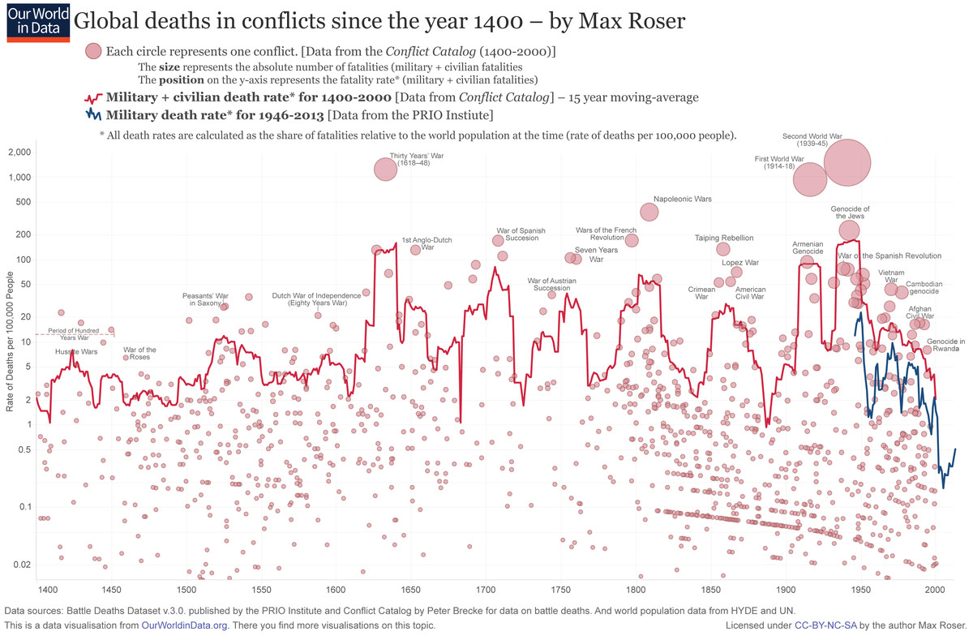
Modern Politics
Machiavelli
Ruler has right to rule
Citizen rights derive from the need for stability
Hobbes
Citizen rights derive from social contract
War, violence, and world wars
WWI (1914-1918)
WWII (1939-1945)
https://www.youtube.com/watch?v=Lp-3CQ6ZD4k
Notes:
https://www.vox.com/2015/6/23/8832311/war-casualties-600-years

Slide 6
A few more key principles philosophers
Hobbes
Government = Leviathan
Kant and Locke
Universals (Reason and God)
Rousseau
Locke - property rights arise prior to the state as an element of natural law.
Rousseau - a social contract is a necessary precondition for the creation and legitimacy of property rights.
Marx
Materialism, Property Rights, and Hierarchy
Reinhold Niebuhr
Christian fallibility
Pragmatic incrementalism in the face of Moral Idealism vs Legal Realism/Constitutional Idealism

Slide 7
Rights and Human Rights
1948 Universal Declaration of Human Rights
The preamble sets out the historical and social causes that led to the necessity of drafting the Declaration.
Articles 1–2 established the basic concepts of dignity, liberty, equality, and brotherhood.
Articles 3–5 established other individual rights, such as the right to life and the prohibition of slavery and torture.
Articles 6–11 refer to the fundamental legality of human rights with specific remedies cited for their defence when violated.
Articles 12–17 established the rights of the individual towards the community (including such things as freedom of movement).
Articles 18–21 sanctioned the so-called "constitutional liberties", and with spiritual, public, and political freedoms, such as freedom of thought, opinion, religion and conscience, word, and peaceful association of the individual.
Articles 22–27 sanctioned an individual's economic, social and cultural rights, including healthcare. Article 25 states: "Everyone has the right to a standard of living adequate for the health and well-being of himself and of his family, including food, clothing, housing and medical care and necessary social services." It also makes additional accommodations for security in case of physical debilitation or disability, and makes special mention of care given to those in motherhood or childhood.
Articles 28–30 established the general ways of using these rights, the areas in which these rights of the individual can not be applied, and that they can not be overcome against the individual.

Slide 8
Positive and Negative Rights (Isaiah Berlin)
Negative Rights (first generation) are things which cannot be done to a person
Civil and political rights (including speech, religion, unlawful imprisonment)
Positive rights (second generation) are things which must be provided to a person
Include police protection, legal council, economic, social and cultural rights

Slide 9
Legal and natural rights
Natural rights are “universal” and “inalienable” (Locke, Paine, Hobbes(?)0)
Legal rights can be modified or repealed

Slide 10
Foundationalism/Rationalist vs Sentamintalist
Foundationalist approach: Human rights answer questions like, “Why should I care about a stranger?” With answers like “Because kinship and custom are morally irrelevant, irrelevant to the obligations imposed by the recognition of membership in the same species”.
Sentamientalists give answers like: “Because this is what it is like to be in her situation – to be far from home, among strangers”, or “Because she might become your daughter-in-law”.

Slide 11
Rights in moral philosophy: Utilitarianism
Associated with founders of economics (Jeremy Bentham)
Policies should maximize net social utility
Aggregate welfare
Effective altruism (Singer)
Disease Control Priorities Project

Slide 12
Rights in moral philosophy: John Rawls’ Theory of Justice
Veil of ignorance
Under such a veil, what principles of justice would people choose for society
Maximin
Means rather than ends approach

Slide 13
Rights in moral philosophy: Communitarianism
Reaction to Rawls by Michael Sandel, Charles Taylor and Michael Walzer
Opposes universalist point of view
Distinct societies create distinct “spheres of justice”
Each society creates fundamental principles which are valued
Single community view called “Cosmopolitanism” (related to globalism or internationalism)

Slide 14
Rights in moral philosophy: Cosmopolitanism
Single community alternative to Communitarianism
Related to globalism or internationalism
Associated with Kant, Derrida, and Appiah
Moral universalism and belief of crimes against humanity

Slide 15
Rights in moral philosophy: Libertarian
Personal freedom
Individual choice and limited state influence
Anarchy, State, and Utopia (Nozick)
Endorse negative rights but not positive rights

Slide 16
Rights in moral philosophy: Capabilities approach
Focus on what individuals are able to do (Sen, Nussbaum)
Emphasizes functional capabilities, "substantive freedoms“
the ability to live to old age
engage in economic transactions
participate in political activities

Slide 17
Rights in moral philosophy: Radical Feminist approach
Focus on women (MacKinnon)
Feminist philosophies often start with another principle and consider how that principle can be applied to women.
Radical Feminism starts with the concerns of women
Reinterpret pregnancy, sex

Slide 18
Rights in moral philosophy: Pragmatist approach
Focus on history and efficient moral progress (Dewey, Rorty)
The most philosophy can hope to do is summarize our culturally influenced intuitions about the right thing to do in various situations
Summary is effected by generalizations and noncontroversial “lemmas”
“Difference Principle” or “Right to Privacy” are summarization of intuitions
Summarizing generalizations increase the predictability, power, and efficiency of intuitions
Security – conditions of life sufficiently risk-free as to make one’s difference from others inessential to one’s self-respect and sense of worth.
Sympathy – education in the stories that come out of moral failures (Aeschylus’ The Persians, Uncle Toms Cabin, videos from a genocide)
More efficient

Slide 19
Discussion Questions:
What is a right? What is a human right?
Is health care a human right?
Should the government ensure provision of basic health needs to the entire population?
Should the government ensure provision of premium health care to the entire population?

Slide 20
Federal Laws

Slide 21
US State Constitutions
As of April 2014, 15 state constitutions specifically mention health and health care—either in the form of a programmatic statement, public concern, individual right, or government duty.

Slide 22
Review
Paradigm axis
Means v ends
Rawls v Sen/Nussbaum
Universals v culture
Modern philosophers (Locke, Kant, etc) vs post-modern (Sen, Rorty, etc)
Most important in US today:
Rawls, Nozick, and Singer
Rawls – justice through setting up good institutions
Nozick – Libertarianism
Singer – Effective Alturism

Slide 23
HCMI 4225: Economics and Human Rights: The Right to Health and to Health Care
Mon/Wed 9:30 AM – 10:45 AM
Shane Murphy – shane@uconn.edu

Slide 24
Foundationalism/Rationalist vs Sentamintalist
Foundationalist approach: Human rights answer questions like, “Why should I care about a stranger?” With answers like “Because kinship and custom are morally irrelevant, irrelevant to the obligations imposed by the recognition of membership in the same species”.
Sentamientalists give answers like: “Because this is what it is like to be in her situation – to be far from home, among strangers”, or “Because she might become your daughter-in-law”.

Slide 25
Foundationalism/Rationalist vs Sentamintalist
Foundationalist approach: rights reflect that which humans are entitled by virtue of their humanity
Sentamentalists approach: rights reflect principles that most efficiently bring about social, economic, and political improvement and increase human flourishing.

Slide 26
Rational vs Empirical
Rational philosophy suggests that problems can be solved by applying logic (deduction) from basic principles upon which all can agree. Associated with Kant, Descartes, Spinoza – also with structuralists
Empirical philosophy is more materialist, in that knowledge coms from experience. Associated with Locke, Hume, Heideggar – also with pragmatists

Slide 27
Key Concepts Welfare Economics
Preferences, Ordinal Utility, Ranking – Measuring utility functions objectively on a numerical scale is methodologically impossible. Either approximations are used or utility is measured on a non-numerical scale by allowing commodity bundles to be ranked, but not giving numerical utility scores.

Slide 28
Key Concepts Welfare Economics
Pareto Improvement – A policy change is preferred if it leaves at least one person better off (more utility) and no one worse off.
Pareto Optimality – A policy of which there is no possible Pareto improvement
Nash equilibrium – A set of actions and outcomes in which no player can make a change in action to change their outcome given all other players’ choices of actions.
A policy may be one and not the other, both, neither, etc.

Slide 29
Key Concepts Welfare Economics
Welfare in economics – policies should be assessed on the resulting individual and aggregate utilities
Welfare theorems:
First - in economic equilibrium, a set of complete markets, with complete information, and in perfect competition, will be Pareto optimal
Second - any Pareto optimum can be supported as a competitive equilibrium for some initial set of endowments.
Require free, competitive, open markets, no externalities, and perfect information

Slide 30
Key Concepts Welfare Economics
Measurement – the science of estimating values for real world concepts
Often involves giving precise, flawed definitions to intuitive concepts (DALY for health, GDP for economic activity)
Tractable, estimable – a property of a problem referring to whether data and analysis can be brought to bear on the problem and whether a solution is possible.
What are some intractable problems?

Slide 31
Key Concepts Welfare Economics
Consequentialism - consequences or results of an action and associated with utilitarianism (Bentham,Mill). Mill proposed "the greatest happiness for the greatest number" as the guiding principle.
Consequentialism and Deontological theories are two of the main theories in ethics.
consequentialism focuses on judging the moral worth of the results of the actions and deontological ethics focuses on judging the actions themselves.
Deontological ethics - how actions follow certain moral rules. So, the action is judged rather than the consequences of the action (Kant). Deontological principle: moral rules should be adhered to if universalising the opposite would make an impossible world. So, "Do not steal" is a rule because if everyone stole as a rule, there would be no concept of private property.
Famously, Kant said to never lie, even if a murderer asked the location of your mother.

Slide 32
Free market justification of rights
Free markets are an economic analog to a political system of majority rule without minority rights. Like pure democracy, free markets sacrifice individuals and their rights to a 'higher' collective good. Economic and social rights, from this perspective, is a device to ensure that a minority that is disadvantaged in or deprived by markets is treated with minimum economic concern and respect.

Slide 33
Economic critiques of rights
Economic and social rights are aspirational – When a government locks someone up without a fair trial, the victim, perpetrator and remedy are pretty clear. This seldom applies to social and economic ‘rights’. What should be given to which people for how long at what cost in taxpayers’ money is a political question.

Slide 34
Competition between rights
A goal of public policy is to maintain a level of economic stability and growth across a number of goals and subject to a number of tradeoffs
Unemployment vs inflation
In some theories, inflation can occur when production lags demand – ie aggregate demand is greater than aggregate supply.
Equity vs efficiency
Efficient economic systems incentivize innovation and value creation which leads to haves and have nots
Free market vs government intervention
Political and social decision making may differ from decisions emergent from individuals on a free market

Slide 35
Double speak?
An individual economic or social right is uncomfortable for either economists or the public to embrace if the real goal of public policy is the maintenance of status quo.
It is not easy to deny the right to Health outright. The harms suffered by the untreated illness are too great to countenance an express denial of the right.
The result is a certain evasiveness in public policy discussions concerning the ultimate goal of health policy
Efforts to reduce disease burden are universally applauded, but securing the right to health is always an incremental process

