Slide 1
HCMI 4225: Welfare in the US
BUSN 203: Mon/Wed 9:30 AM – 10:45 AM
Shane Murphy – shane@uconn.edu
Notes:
https://www.youtube.com/watch?v=TmwOWmd7c98&ab_channel=KoolKlipsFromDeke
https://www.youtube.com/watch?v=NRWUs0KtB-I&ab_channel=2PacVEVO

Slide 2
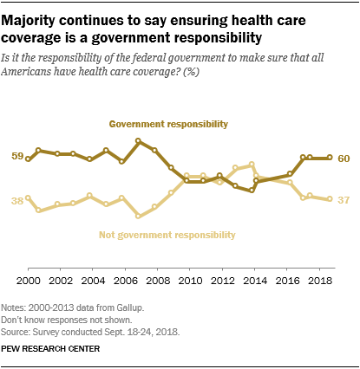
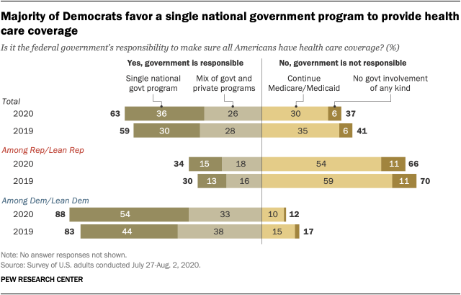
Opinion Polling
Pew and Kaiser are main health policy opinion pollsters
March 2017, ¼ of people thought ACA was repealed (Pew)
September 2017, ½ of people thought ACA marketplaces collapsing (Kaiser)

Slide 3
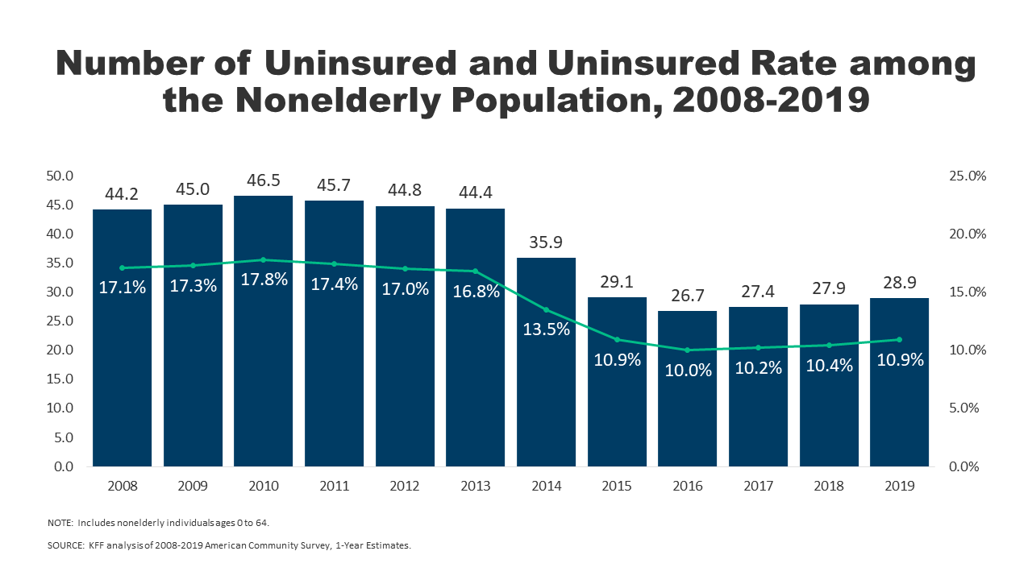
Effects ACA on health and coverage
Largest effect on coverage was due to Medicaid expansion, not the exchanges
Largest effect on health comes from self-perceived health, mental health, financial stability
These three factors are all closely interrelated
Benefits of wellness visits are difficult to measure
Health benefits for chronic conditions require large samples sizes, studies are hard to perform

Slide 4
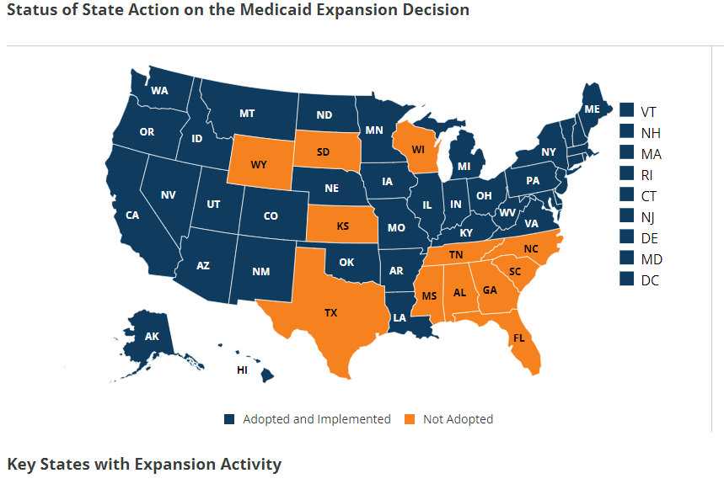
Coverage: Medicaid expansion
All US citizens and legal residents with income up to 138% FPL qualify for coverage in participating states
Led to large growth in enrollment in participating states, smaller growth in non-participating states
Reduction in uninsured rates, especially among low-income individuals
Partial Woodwork effect/welcome mat effect
Growth among individuals who were previously eligible

Slide 5
Coverage: Medicaid expansion: criticism
Crowding out of private insurance
Mixed results, although there has been some decline in private coverage in participating states

Slide 6
Coverage: Medicaid expansion: subgroups
Coverage gains in expansion versus non-expansion states for specific vulnerable populations:
young adults, prescription drug users, people with HIV, veterans, parents, mothers, women of reproductive age (with and without children), children, lesbian, gay, and bisexual adults, newly diagnosed cancer patients, women diagnosed with a gynecologic malignancy, low-income workers, low-educated adults, early retirees, and childless adults with incomes under 100% FPL
Disproportionately positive impact in rural areas in expansion states
Gains can be found across racial/ethnic categories
Reduced disparities by income and age
Possibly reducing disparities by race/ethnicity

Slide 7
Additional effects of the ACA
There has been a lot of research on the health and coverage outcomes of the Affordable Care Act
KFF summary for Medicaid expansion (Antonisse as lead author) - https://www.kff.org/medicaid/report/the-effects-of-medicaid-expansion-under-the-aca-updated-findings-from-a-literature-review/
Mazurenko, Olena, Casey P. Balio, Rajender Agarwal, Aaron E. Carroll, and Nir Menachemi. "The effects of Medicaid expansion under the ACA: a systematic review." Health Affairs 37, no. 6 (2018): 944-950.
Courtemanche, Charles, James Marton, Benjamin Ukert, Aaron Yelowitz, Daniela Zapata, and Ishtiaque Fazlul. "The three‐year impact of the Affordable Care Act on disparities in insurance coverage." Health services research 54 (2019): 307-316.
Soni, Aparna, Laura R. Wherry, and Kosali I. Simon. "How Have ACA Insurance Expansions Affected Health Outcomes? Findings From The Literature: A literature review of the Affordable Care Act's effects on health outcomes for non-elderly adults." Health Affairs 39, no. 3 (2020): 371-378.
Courtemanche, Charles, James Marton, Benjamin Ukert, Aaron Yelowitz, and Daniela Zapata. "Early effects of the Affordable Care Act on health care access, risky health behaviors, and self‐assessed health." Southern Economic Journal 84, no. 3 (2018): 660-691.
…

Slide 8
Coverage: Medicaid expansion: Alternative approaches
Section 1115 gave states the option of expanding Medicaid in alternative ways
These states (especially Arkansas, Michigan, and Indiana) have shown similar gains in coverage rates
Indiana instituted monthly contributions which have created enrollment and continuing coverage issues

Slide 9
Access, Utilization
Many studies find improvements in access to care
Increases in cancer diagnosis rates (especially early stage)
Earlier presentation for common surgical conditions – lowering complications
Increase listing for heart transplants among African Americans
Increased access for treatment of behavioral and mental health conditions
Increase in prescriptions for opioid use disorder and overdose
Increase in prescriptions for smoking cessation drugs

Slide 10
Access, Utilization
Many studies find improvements in access to care
Reduction in disparities by race, income, education, and employment status in access and affordability
Increased rates of optimal care for patients with common surgical conditions
Improved quality of care for common community health care treated conditions:
Asthma, Pap testing, BMI assessment, hypertension control
Declines in uninsured ED visits, but mixed evidence and no significant change in total ED volume
Reduced LOS for Medicaid patients
Improvements in care and quality in areas with primary care shortages

Slide 11
Access, Utilization: Criticism
Confusion in non-waiver states
Failures to follow up with new patients
Longer wait times

Slide 12
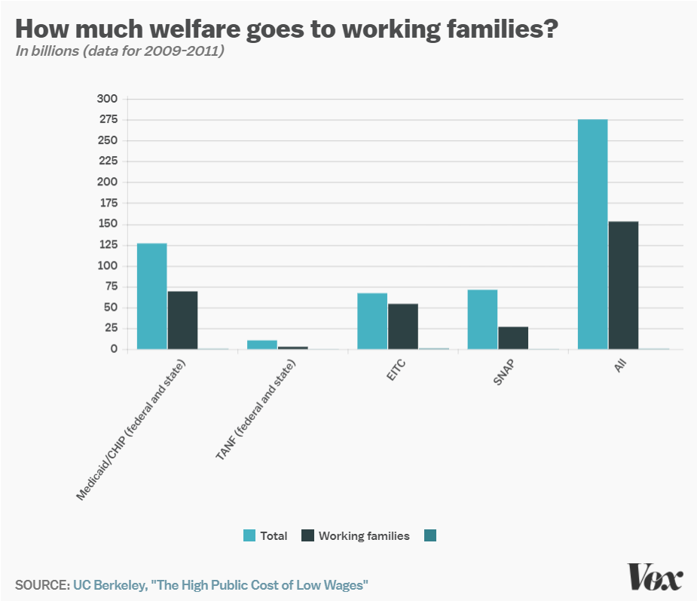
Work requirements
Federal: SNAP (food stamps)
Requires able-bodied recipients without dependents to work 80 hours a month
Part of 1996 Welfare Reform
State: TANF (welfare)
Kansas and elsewhere
Limited improvements on unemployment and poverty
State: Medicaid
Earned Income Tax Credit!
Notes:
http://laborcenter.berkeley.edu/the-high-public-cost-of-low-wages/

Slide 13
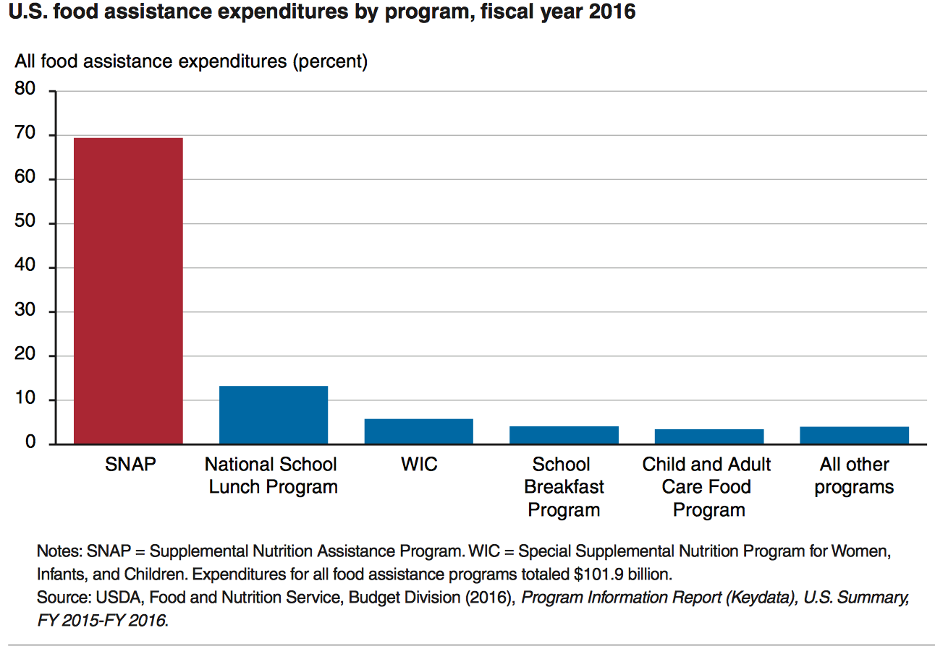
State Grants: Food Assistance Programs

Slide 14
SNAP
SNAP
central goal is to alleviate food insecurity and it succeeds
also improves well-being over other dimensions
High benefits for families
maximum of almost $700 per month for a family of 4
average benefit of about $250 per month for a family of 4
Has a profound effect on the family food economy

Slide 15
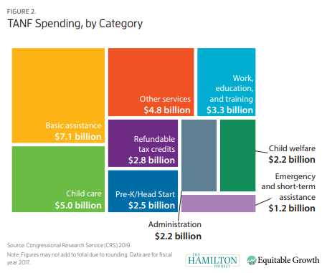
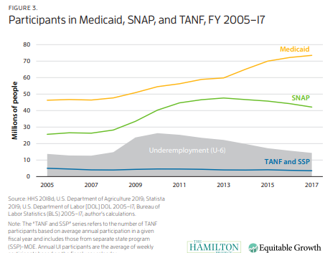
Temporary Assistance for Needy Families (TANF)
Block grants to states
Downsides of block grants
Under pre-existing Aid to Families with Dependent Children, states had access to unlimited matched federal funds for eligible families
Under 25% of families in poverty receive TANF
Maximum benefit between $170 and $923 /month

Slide 16
EITC – Earned Income Tax Credit
Low income individuals get a cash subsidy based on how much they work, up to $5610 dollars for someone earning $14,000 (40% raise)
Always incentivizes work
Administered by IRS
Popular and effective

Slide 17
1996 Welfare reform
Changed Aid to Families with Dependent Children (AFDC) to TANF
States had more leeway to who gets benefits
Block Grants to states
Assistance cut to recent immigrants
Work requirements

Slide 18
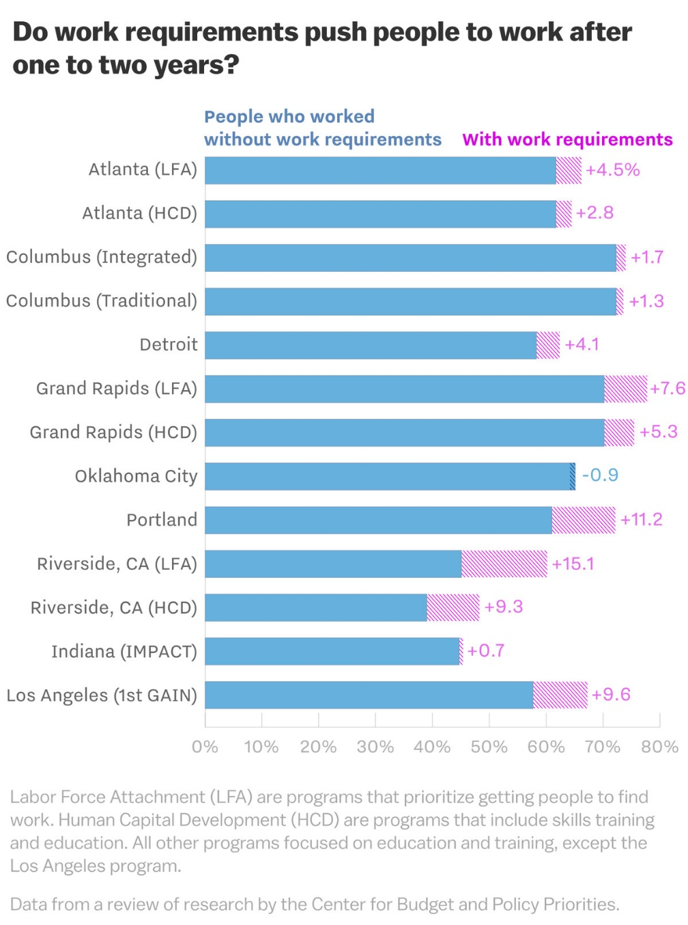
Effect of 1996 work requirements on TANF
13 cities participated in an experiment before requirement was implemented
The proportion of TANF recipients who worked without requirements was about 60% before the experiment
Increased by about 4% on average in the following years
Gains disappeared by 5 years
Stable work saw small increase by 5 years
Small effect on poverty – on average increasing poverty
Decrease the ability to attend training programs, deal with health issues
Targets foreign born and ESL

Slide 19
Pros and Cons of TANF work requirements
Pro
Work requirement increases amount people work
Con
Work requirement increases poverty

Slide 20
However
80% of adults on Medicaid are in working families
60% work themselves
Of those that don’t:
35% are unable to due to disability
28% are caretakers for family members
18% are students
8% are actively looking for work
8% are retired
Leaving 3% of nonworking adult Medicaid population who could work but don’t
Notes:
JAMA Dec 2017

Slide 21
Barriers to employment
Low income individuals facing Medicaid work requirements struggle to find work
20% have less than a high school degree
25% have multiple chronic conditions
More likely to live in areas with high unemployment and poverty
Notes:
Urban Institute 2019

Slide 22
Labor Market Effects
Increased jobs
Did not reduce employment for low-income workers
Enrollees looking for work reported Medicaid enrollment made it easier to seek employment, those employed reported it made it easier to continue working
Increase volunteering

Slide 23
Additional Social Support/Welfare Programs
Programs we’ve discussed
TANF
Social Security
Unemployment
SNAP/WIC
Others:
Section 8 of the Housing Act of 1937
Rental assistance for low income households
Supplemental Security Income
Replace Aid to the Blind, Aid to the Permanently and Totally Disabled, and Aid to the Elderly from 1935 SSA
Once an individual qualifies for Supplemental Security Income they automatically become eligible for several other assistance programs (Medicaid, SNAP, Sectuon 8, others)
Head Start
1965 program – Early Childhood Education
High Ed programs
Pell, SMART, FSEOG, and subsidized loans
Other…

Slide 24
Reading
Grogan, Colleen M. "How the ACA addressed health equity and what repeal would mean." Journal of Health Politics, Policy and Law 42, no. 5 (2017): 985-993.
Levy, Helen, Andrew Ying, and Nicholas Bagley. "What’s Left of the Affordable Care Act? A Progress Report." RSF: The Russell Sage Foundation Journal of the Social Sciences 6, no. 2 (2020): 42-66.
Rosenbaum, Sara, and Sara Schmucker. "Viewing Health Equity through a Legal Lens: Title VI of the 1964 Civil Rights Act." Journal of Health Politics, Policy and Law 42, no. 5 (2017): 771-788.
Boushey, Heather, Ryan Nunn, and Jay Shambaugh. Recession ready: Fiscal policies to stabilize the American economy. Washington, DC: Brookings, 2019.

